Slide 1

Walmart Retail Sales Performance
Baruch College Spring 2026
STA 9750 Software Tools for Data Analysis
Group 11
Notes:
Slide 1 — Title
Hi everyone, this is Group 11. Today we are presenting our analysis(əˈnaləsəs) of Walmart retail sales performance. Using data from 45 Walmart stores between 2010 and 2012.

Slide 2
Research Goal
The goal of this project is to identify which economic and seasonal factors most significantly influence weekly retail sales across 45 Walmart stores in the United States.
Using the Walmart Store Sales Dataset (Kaggle, 2010–2012), we conduct:
Association Analysis to examine the relationships between each predictor variable and Weekly_Sales
Regression Modeling to quantify the impact of significant factors and build a regression model to identify and quantify the key factors influencing weekly sales
Our aim is to determine which variables are statistically significant drivers of retail sales performance.
2
Notes:
our research question is: which economic and seasonal factors most significantly drive weekly sales? To answer this, we used association analysis(əˈnaləsəs) to explore relationships between variables, and regression modeling to quantify their impact.

Slide 3
Introduction
This project investigates which economic and seasonal factors most significantly influence weekly sales across Walmart stores in the United States, using association analysis and regression modeling.
01
Data Preparation
Missing values, outliers, variable types (Sources: Kaggle)
02
Association Analysis
5 variables, visualizations & statistical tests
03
Regression Models
3 models compared and interpreted
04
Other Techniques
Lasso, Ridge regression $+& ARIMA forecasting
Notes:
The dataset comes from Kaggle
we followed four main steps — data preparation, association analysis((əˈnaləsəs) ), regression modeling, and other techniques.

Slide 4
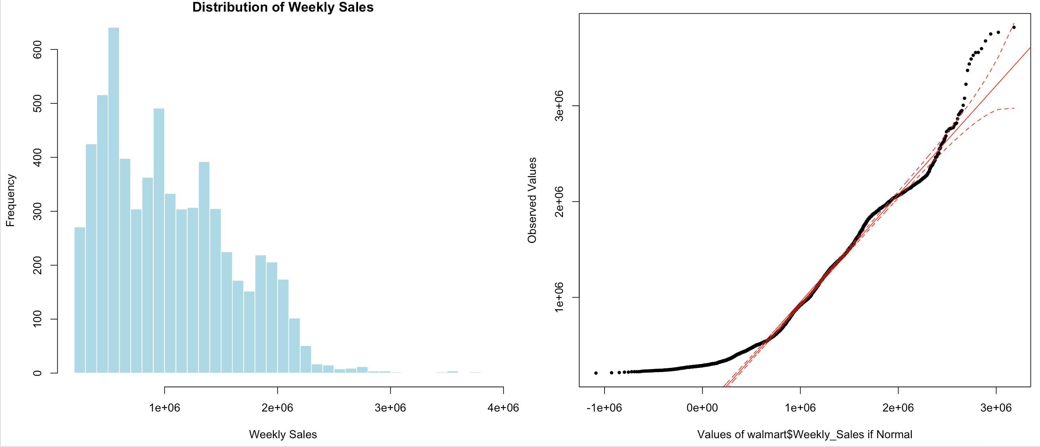
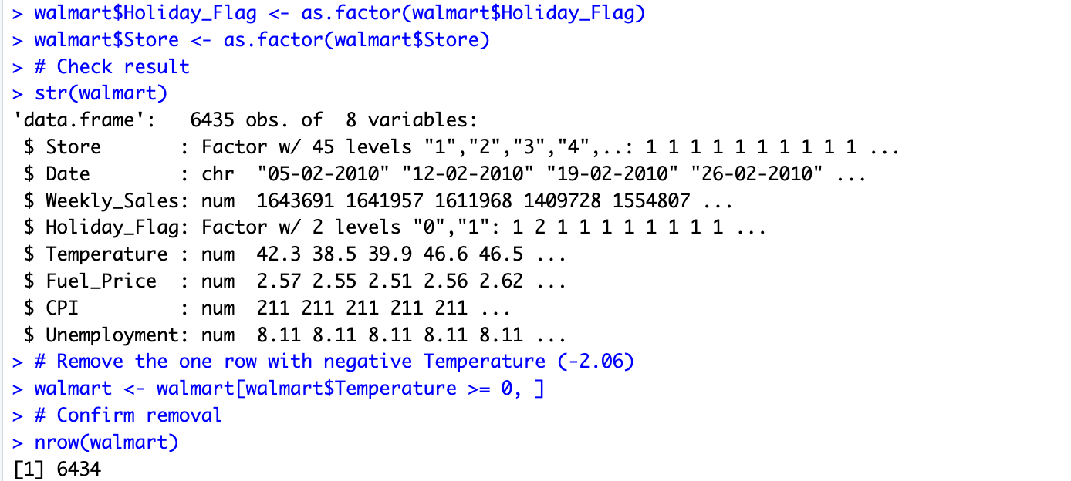
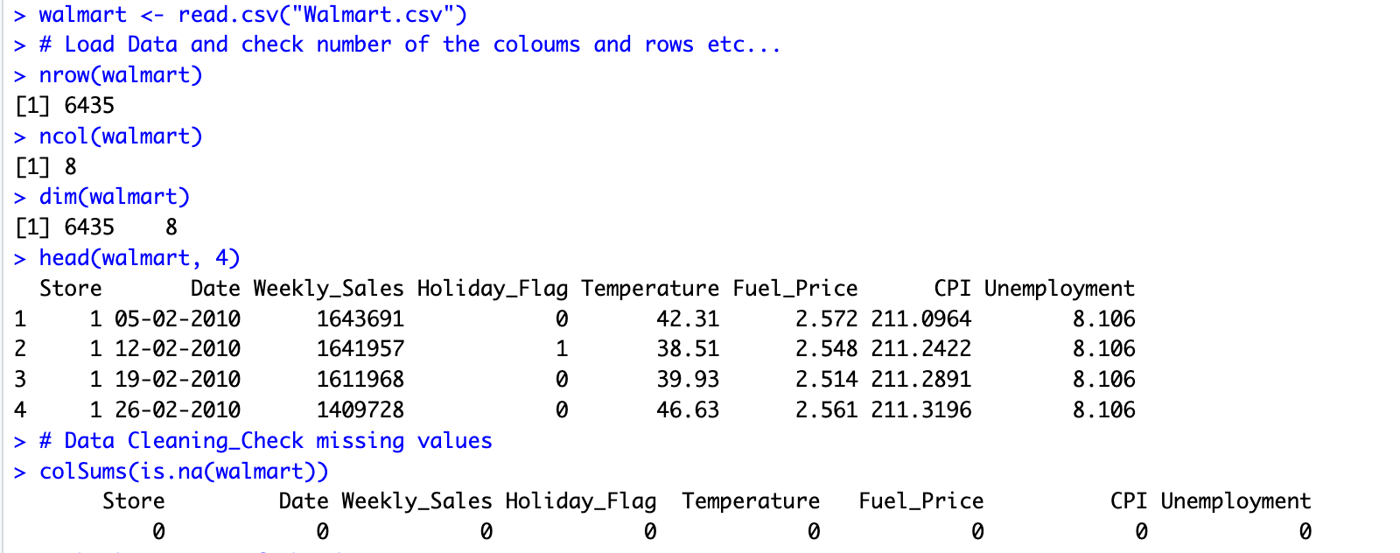
Data Overview and Cleaning
Checking missing values
Remove abnormal value (Temperature = -2.06°F)
Convert variable types (Holiday_Flag, Store → factor)
Check distribution of Weekly_Sales (histogram + QQ plot)
Final dataset: 6,434 complete observations ready for analysis
Notes:
After loading the data, we checked the total number of columns ,rows, And missing value, outliers.
点击！
We converted Holiday_Flag and Store into factor variables. The final dataset has 6,434 complete observations ready for analysis.
点击！
The histogram shows weekly sales are right-skewed(“skilled”), with most stores generating between $500K and $2 million per week.
(we removed one row with an impossible temperature of negative 2.06 degrees Fahrenheit, )

Slide 5
The Variables
Weekly_Sales
Weekly revenue per store (USD)
Response (y)
Holiday_Flag
Holiday week indicator (0/1)
Predictor (x)
Temperature
Regional temperature (°F)
Predictor (x)
Fuel_Price
Regional fuel price (USD/gallon)
Predictor (x)
CPI
Consumer Price Index
Predictor (x)
Unemployment
Regional unemployment rate (%)
Predictor (x)
Notes:
My response variable is Weekly Sales — the weekly revenue per store in US dollar. My five predictor variables are Holiday Flag, Temperature, Fuel (fill )Price, Consumer Price Index, and Unemployment Rate."

Slide 6
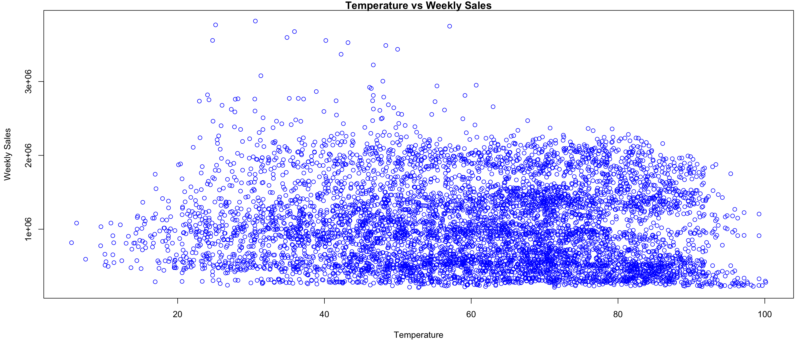
Association Analysis: Visualizations
Temperature shows a weak association with Weekly_Sales. Sales are distributed across all temperature ranges with no clear trend.
Notes:
this is the first association analysis((əˈnaləsəs) ): Looking at Temperature versus Weekly Sales, the scatter plot shows no clear trend (chaned)— sales are distributed across all temperature ranges. This suggests temperature has a weak association with sales."

Slide 7
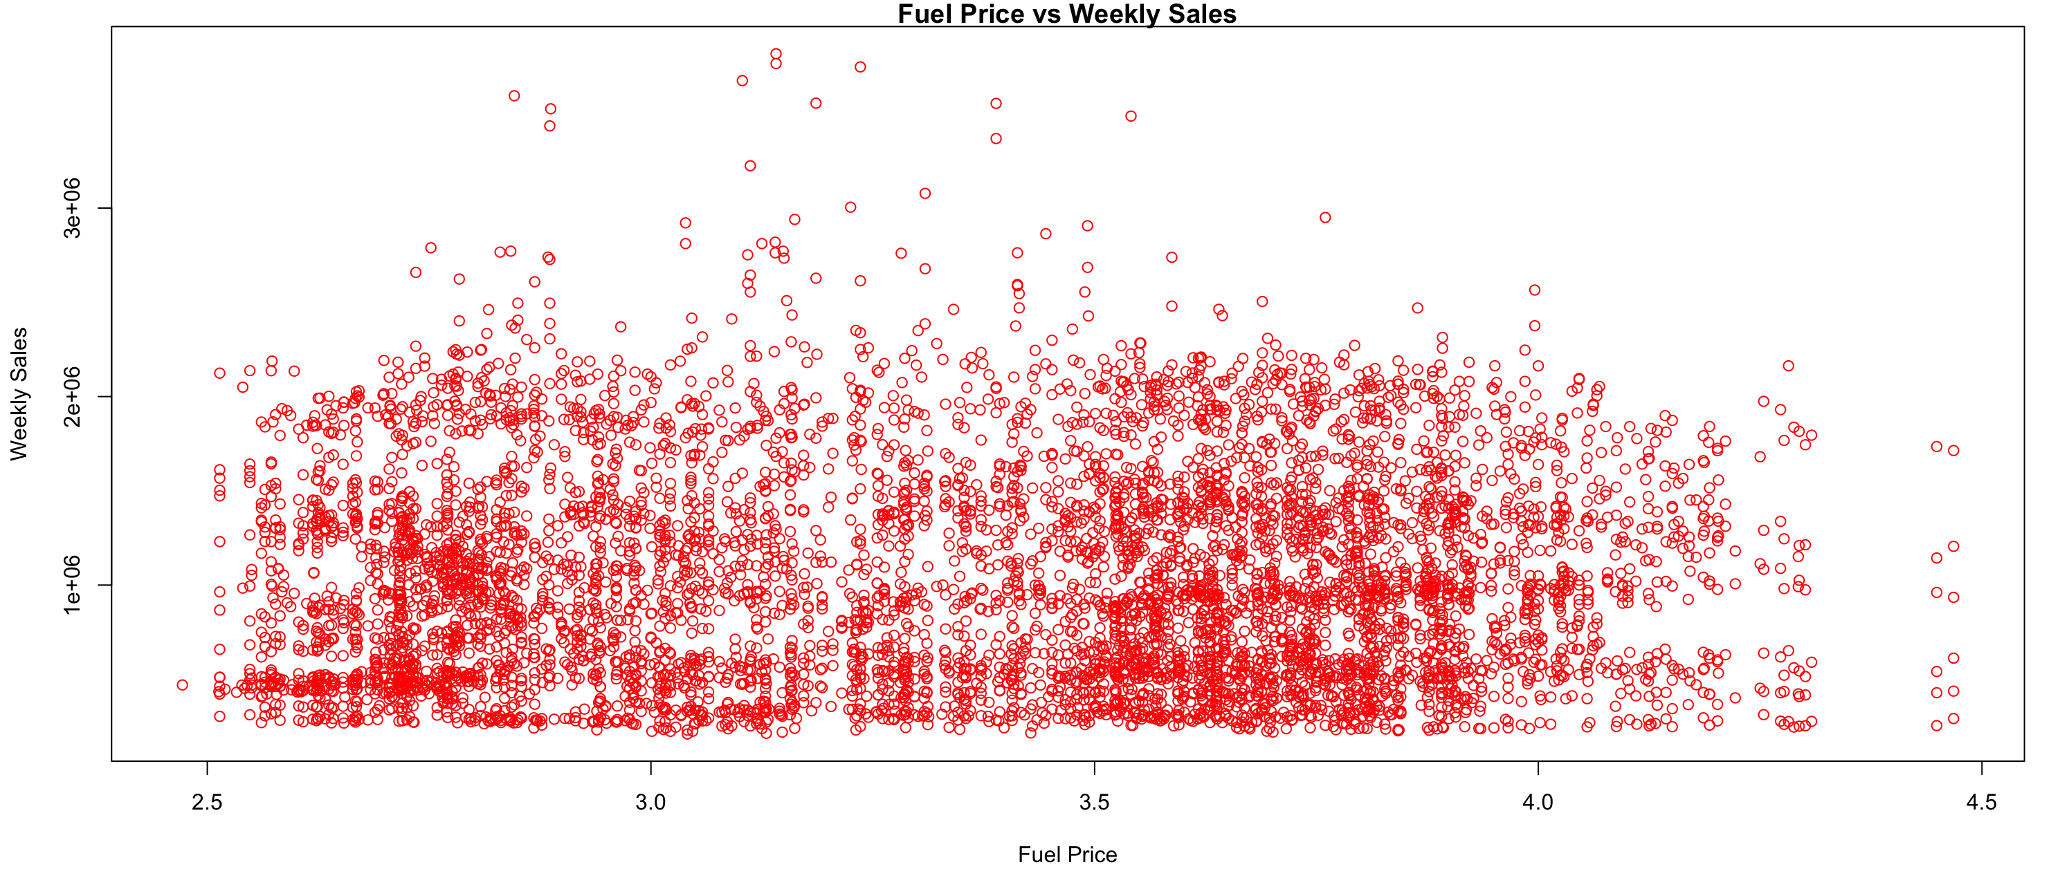
Association Analysis: Visualizations
Fuel Price shows no significant association with Weekly_Sales (p = 0.453). Sales remain consistent across all fuel price levels, making it the least useful predictor in this analysis.
Notes:
Fuel Price shows no significant association with Weekly Sales. The p-value is 0.453,
confirming it is the least useful predictor in this analysis.

Slide 8
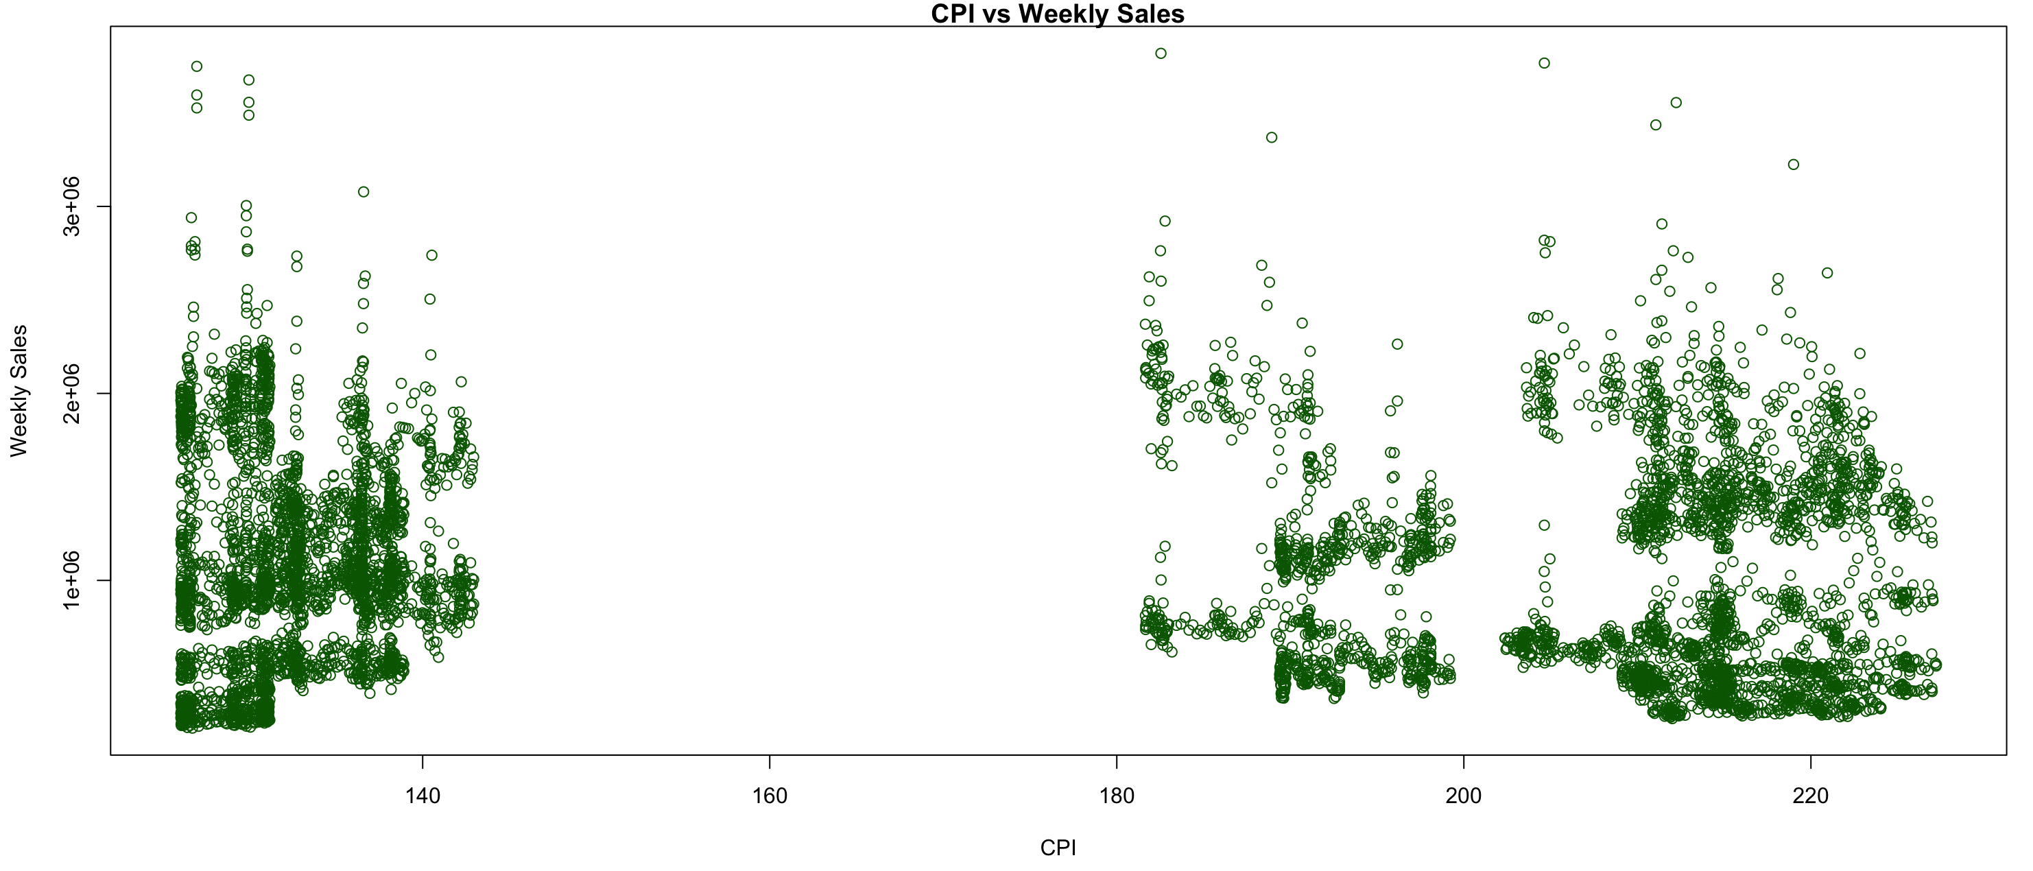
Association Analysis: Visualizations
CPI shows three store clusters by region. While statistically significant (p < 0.05), the overall relationship with weekly sales is weak.
Notes:
The CPI scatter plot shows three distinct regional clusters (clasted). While statistically significant with p less than 0.05, the overall relationship with weekly sales is weak."

Slide 9
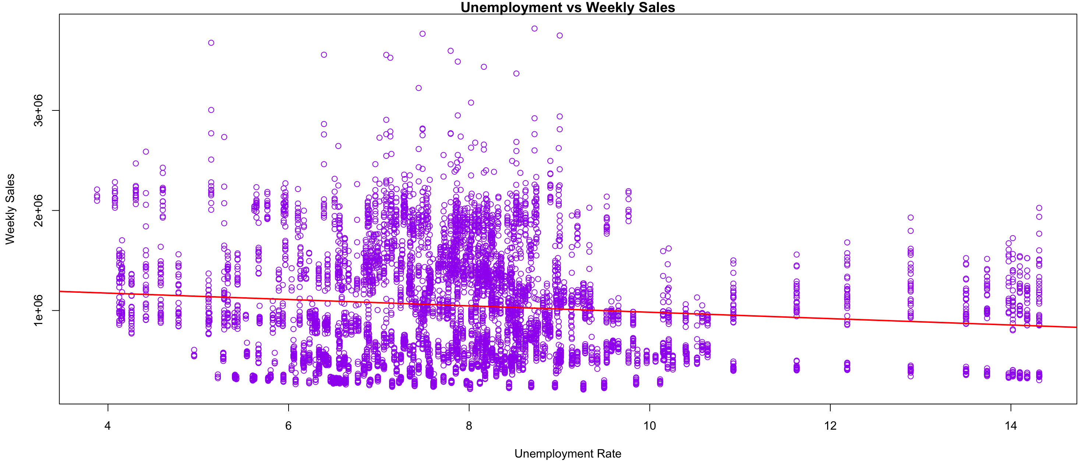
Association Analysis: Visualizations
Unemployment shows the strongest negative association (r = -0.106, p ≈ 0). A 1% rise in unemployment is associated with a $42,520 drop in weekly sales.
Notes:
"Unemployment shows the strongest negative association, with r = -0.106 and p approximately zero. A 1% rise in unemployment is associated with a $42,520 drop in weekly sales ,
the largest effect among all variables."

Slide 10
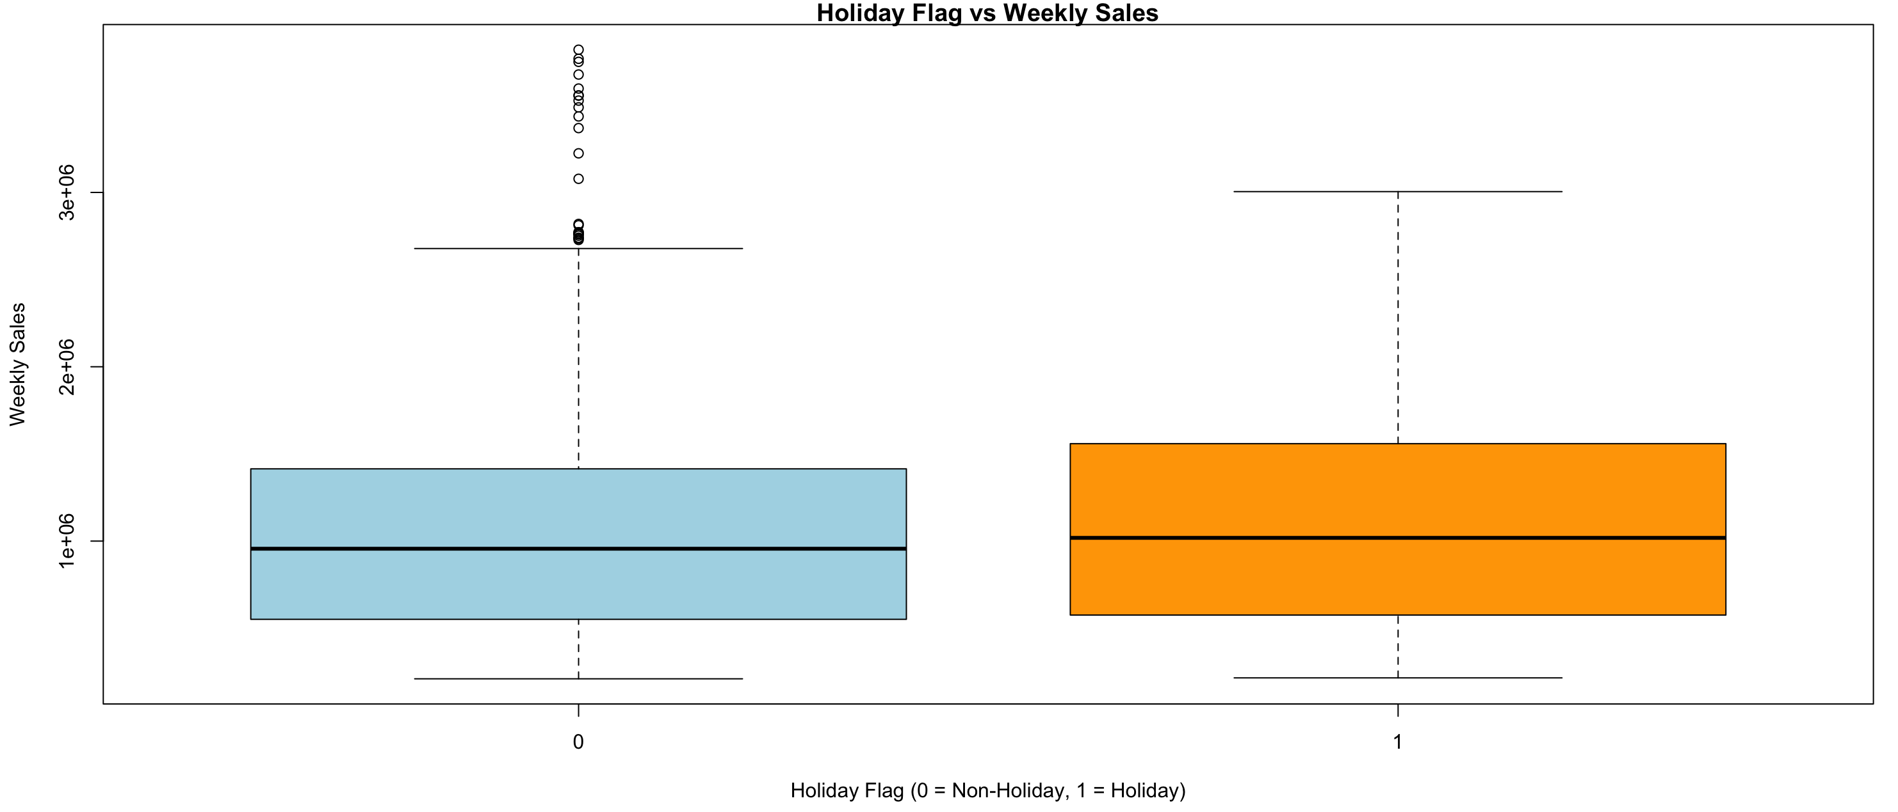
Association Analysis: Visualizations
Holiday weeks generate significantly higher sales than non-holiday weeks, with a median difference of approximately $81,551. The association is statistically significant (p = 0.003).
Notes:
"Holiday weeks generate significantly higher sales, with a median difference of about $81,551 compared to non-holiday weeks. The association is statistically significant with p = 0.003."

Slide 11
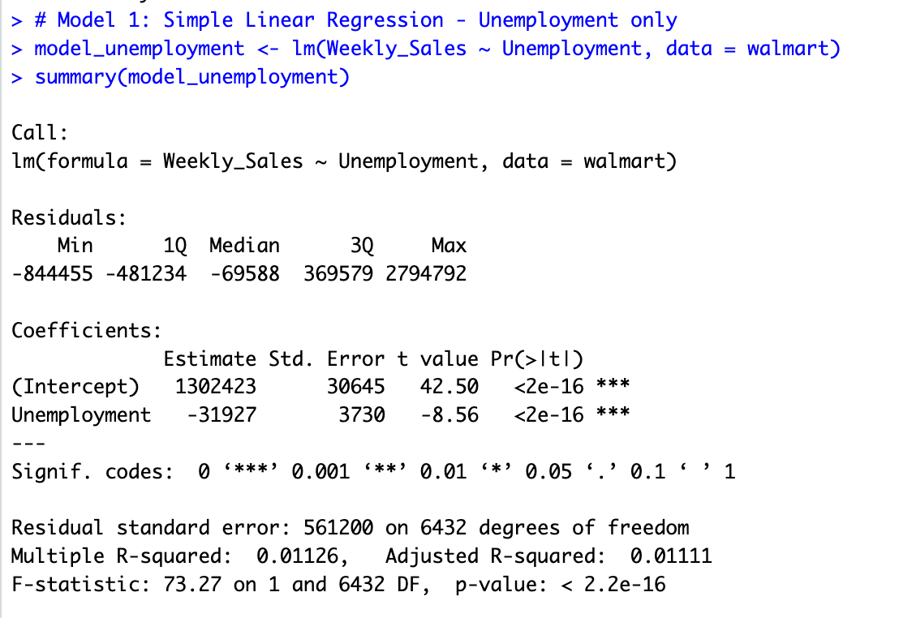
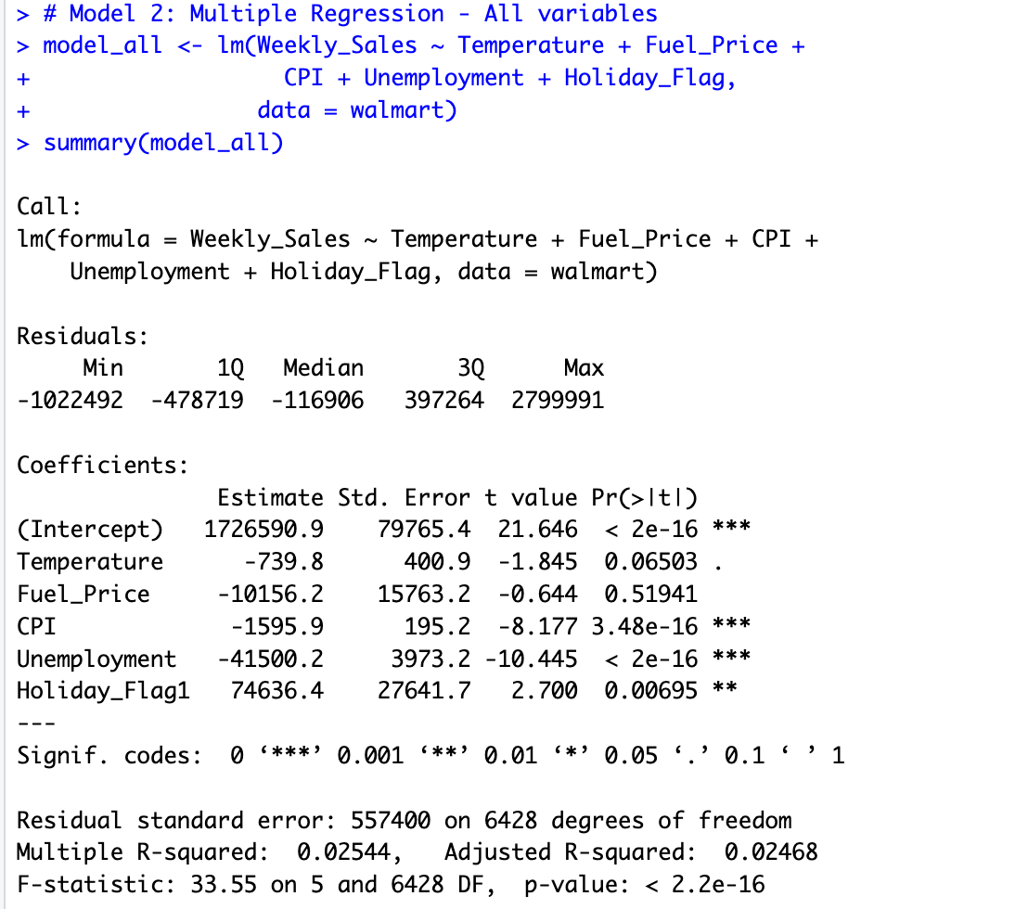
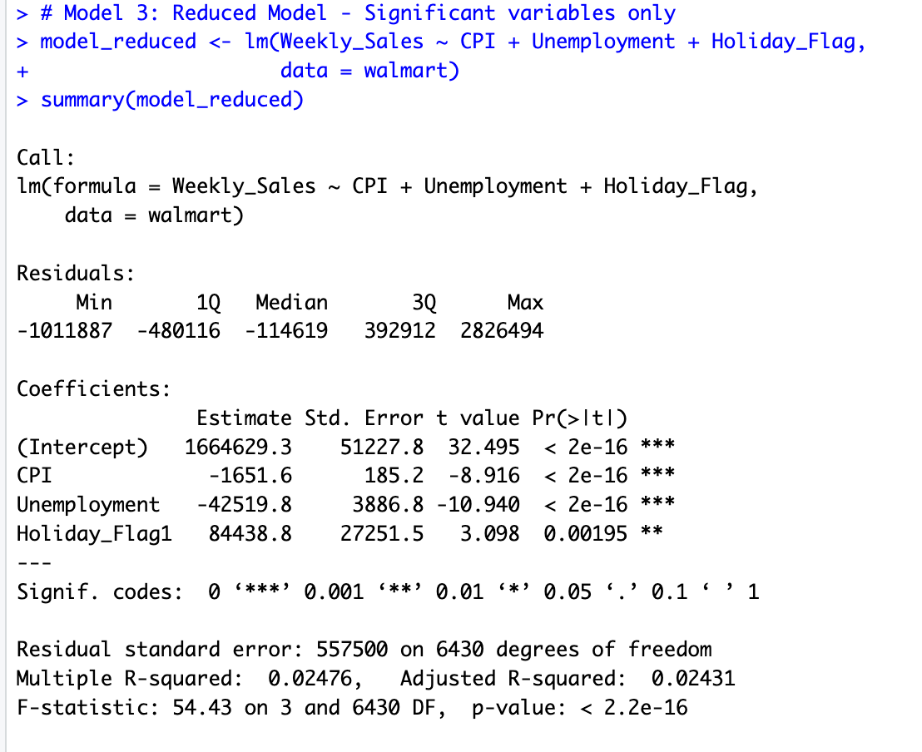
Regression Model 1 - 3
Mode | Variables | R² | RMSE | AIC
Model 1 | Unemployment only | 1.1% | $561,147 | 188,608
Model 2 | All 5 variables | 2.54% | $557,110 | 188,523
Model 3 | CPI + Unemployment + Holiday | 2.48% | $557,302 | 188,524
Model 2 and Model 3 have nearly identical R², RMSE, and AIC. Removing Temperature and Fuel Price did not hurt performance, confirming they are not meaningful predictors. Model 3 is simpler and equally accurate.
Notes:
we tested three regression models. Model 1 uses only Unemployment. Model 2 uses all 5 variables. Model 3 is the reduced model using only CPI, Unemployment, and Holiday Flag. Model 2 and Model 3 have nearly identical R², RMSE, and AIC — confirming that Temperature and Fuel Price add no value. Model 3 is the best model — simpler and equally accurate."

Slide 12
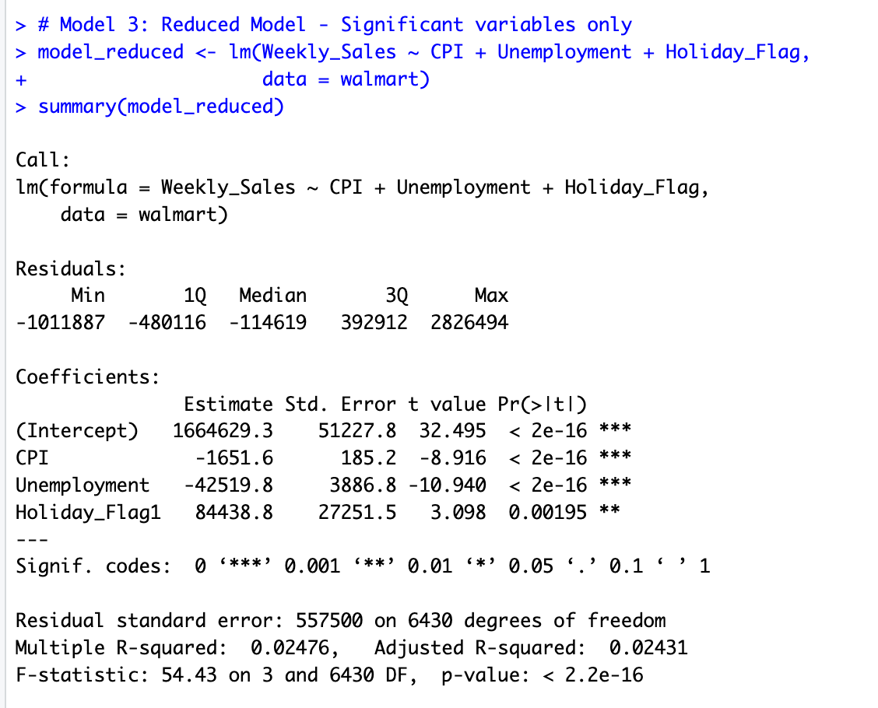
Regression Model 3
CPI → A 1-unit increase in CPI is associated with a $1,652 drop in weekly sales
Unemployment → A 1% rise in unemployment → $42,520 drop in weekly sales
Holiday Flag → Holiday weeks generate $84,438 more in sales
R² = 2.5% → Macroeconomic variables explain a limited portion of sales variation
All variables p < 0.05 → Statistically significant
Notes:
This is a detailed look at Model 3.
（ all three variables are statistically significant. ）
CPI has a negative effect — a 1-unit increase is associated with a $1,652 drop in sales.
Unemployment has the strongest effect — a 1% rise leads to a $42,520 drop.
Holiday weeks boost sales by $84,438 on average.
The R² is 2.5%, which means macroeconomic variables alone explain only a small portion of sales variation."

Slide 13
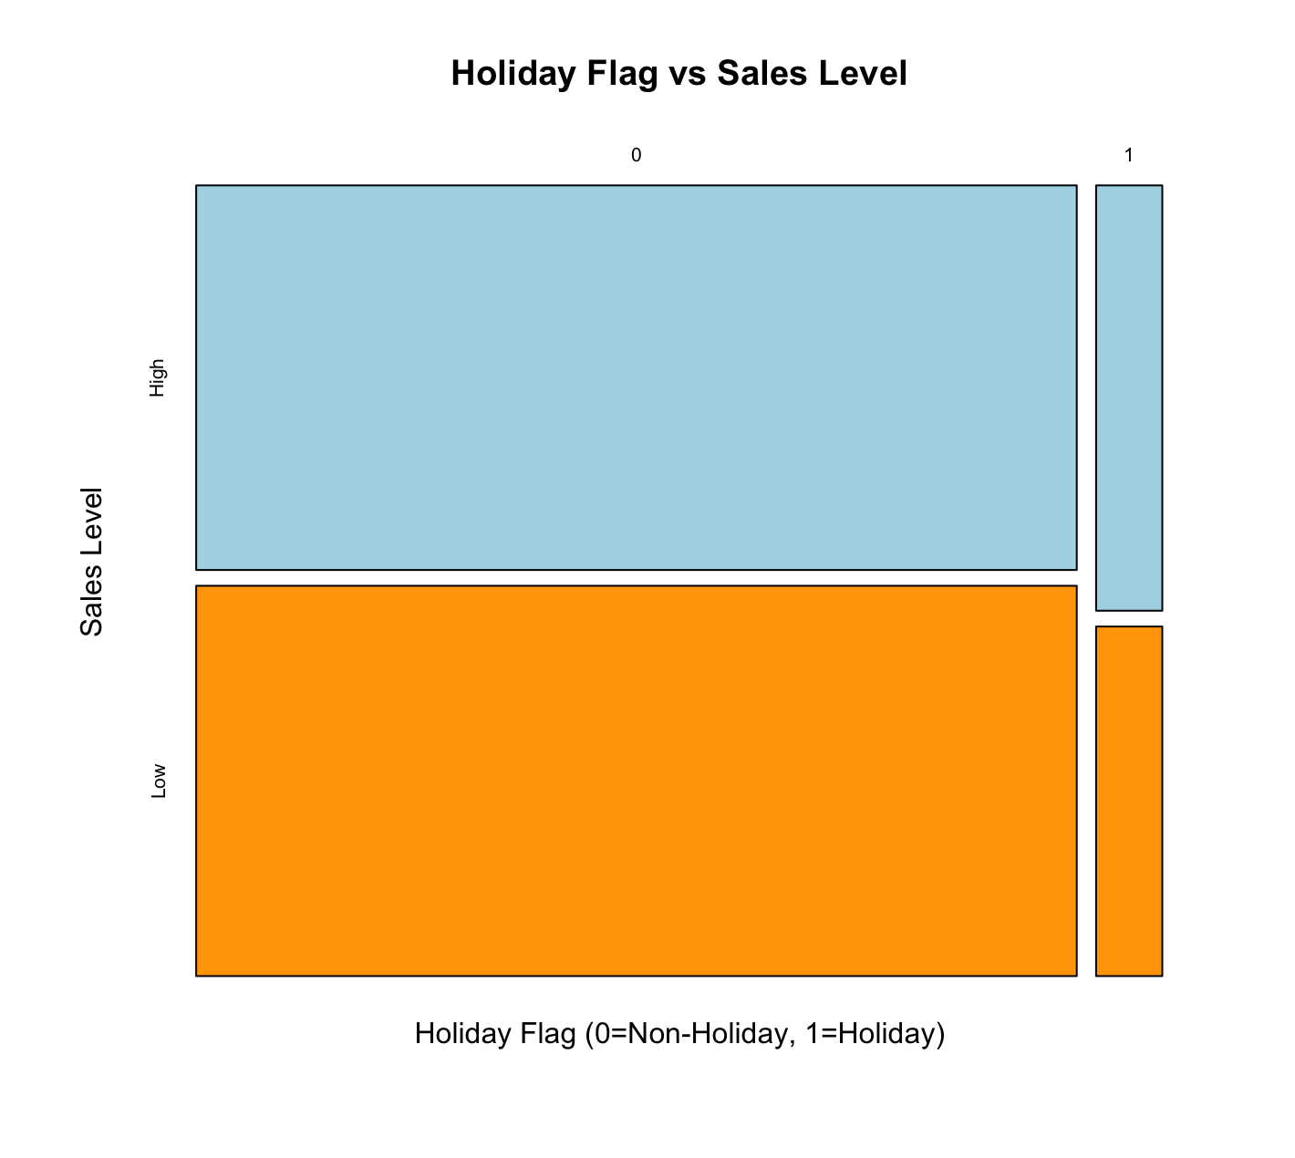
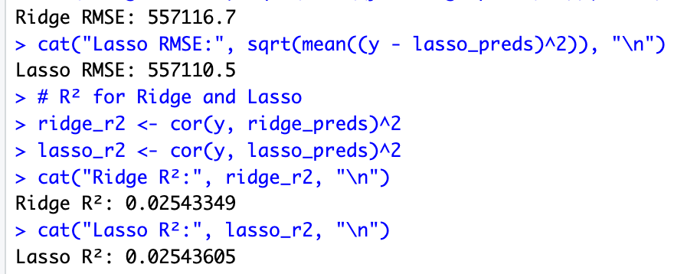
Other Techniques: Experimental Analysis
Both Ridge and Lasso achieved the same R² (2.54%) as Model 2, showing that adding regularization did not improve the model. Model 3 remains the best choice, fewer variables, same accuracy.
Holiday weeks show higher proportion of above median sales (Chi-Square p = 0.036)
Notes:
"We applied additional techniques including Lasso and Ridge regression.
Both methods achieved the same R² of 2.54% as Model 2,
confirming that the predictor variables are not highly correlated with each other,
and Model 3 remains the best choice. We also used a Mosaic Plot with a Chi(kai)-Square test —
Holiday weeks show a significantly higher proportion of above -median sales, with p = 0.036."

Slide 14
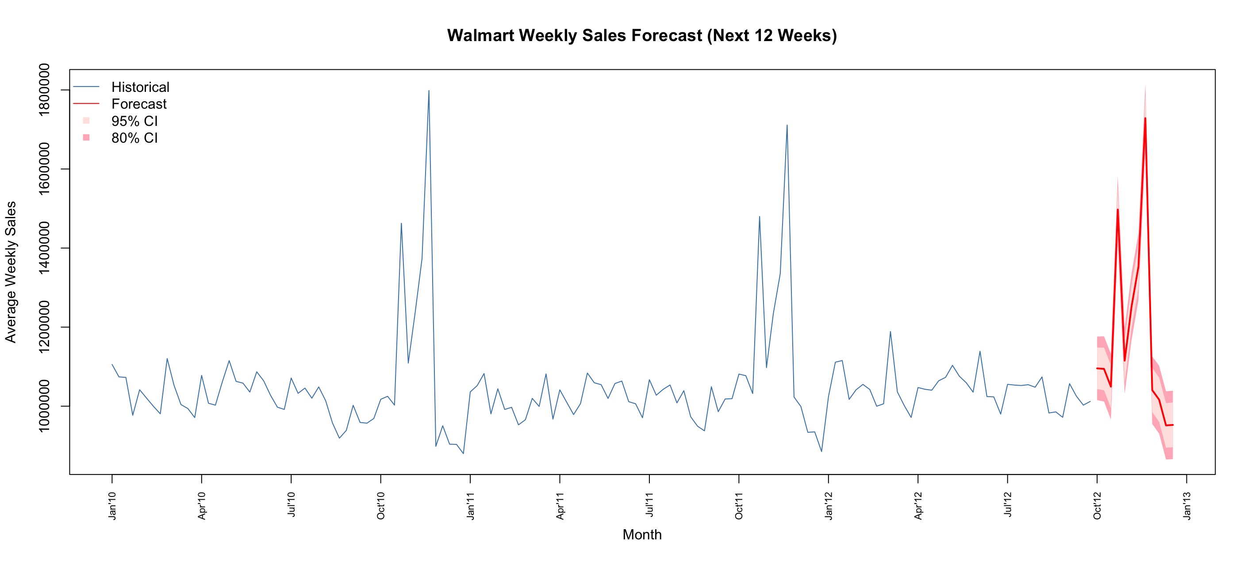
Other Techniques: Experimental Analysis
The ARIMA(AutoRegressive Integrated Moving Average) (1,1,1)(0,1,0)[52] model forecasts a post-holiday sales decline in early 2013, consistent with seasonal patterns observed in 2010 and 2011.
Notes:
We also applied ARIMA time series forecasting .
The model was automatically selected, capturing weekly seasonal patterns.
The forecast predicts sales will remain stable around one million dollars in early 2013,
with a post-holiday decline consistent with patterns from 2010 and 2011."
ARIMA(1,1,1)(0,1,0)[52],

Slide 15
Conclusion
01
Unemployment is the strongest predictor
04
Macroeconomic factors have limited predictive power
A 1% rise in the unemployment rate is associated with a $42,520 drop in weekly sales, the largest economic effect observed.
R² = 2.5%. Other factors like promotions, inventory, and store-specific effects likely explain most of the variation.
02
Holiday weeks significantly boost sales
05
ARIMA Forecasts Seasonal Stability
Holiday weeks generate $84,439 more in sales on average (p = 0.002), confirmed by both regression and Chi-Square test.
Sales will remain ~$1,000,000 in early 2013, consistent with historical patterns
03
Fuel Price and Temperature are not useful
06
Best Model： Model 3
Neither variable was statistically significant. Removing them from Model 3 did not reduce accuracy.
Variables: CPI + Unemployment + Holiday Flag R² = 2.48% | RMSE = $557,302 | AIC = 188,524
Notes:
"In conclusion — Model 3 is the best model among the three tested to explain weekly sales in this Walmart dataset. It uses CPI, Unemployment, and Holiday Flag — all statistically significant — achieving R² = 2.48%, RMSE = $557,302, and AIC = 188,524. However, with R² = 2.5%, the model explains only a small portion of sales variation, suggesting that other factors not captured in this dataset likely play a more important role."

Slide 16

Thank you
Notes:
That's all for our presentation today. Thank you for listening!

