Slide 1
A Novel Hybrid Modeling Method for Predicting Energy Use of Hydronic Radiant Slab Systems
Lichen WU¹, Liping WANG¹, James BRAUN²
¹Department of Civil and Architectural Engineering, University of Wyoming, Laramie, WY, 82071, United States
lwang12@uwyo.edu
²School of Mechanical Engineering, Purdue University, West Lafayette, IN 47907-2088, United States

Slide 2
Motivation
Challenge
radiant slab systems with large thermal capacitance
Existing approaches
first-principles (e.g., CFD)
Inverse grey-box Resistor-Capacitor (RC) model
Data-driven approach (Gaussian mixture regression, growing-GMR)
Notes:
How to describe the current challenges

Slide 3
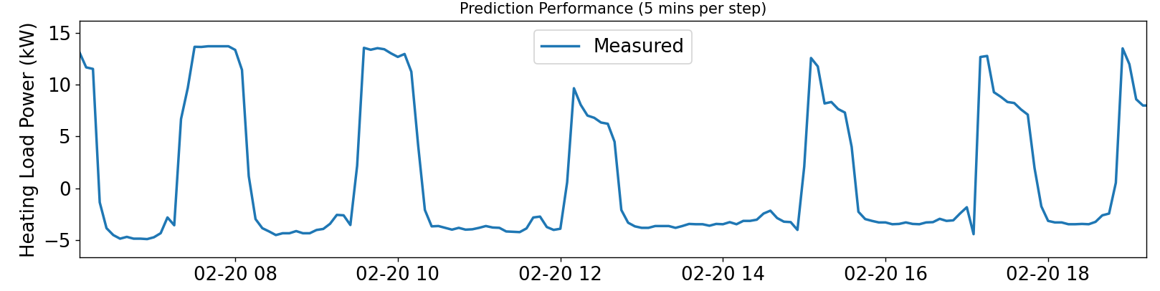

System load preview
$load=cρV\left(T_{su}−T_{re}\right)$
where $T_{su},T_{re}$ is the supply and return water temperature; $c$ is the heat capacity; $ρ$ is density; $V$ is the flow volume rate.

Slide 4
Intro to RC, GMR and GGMR
RC
Developing (flexible)
Predict (warm-up time steps)
Inputs randomly initialize
Recursive prediction
Notes:
1 Developing
Heat balance -> State space representation
(Physical components ->Temperature nodes (Which one? How many?))
Inputs -> Outdoor temperature, solar radiation
Output -> Space load, secondary load, primary energy loads

Slide 5


Intro to RC, GMR and GGMR
RC
Developing (flexible)
Predict (warm-up time steps)
Inputs randomly initialize
Recursive prediction
Notes:
1 Developing
Heat balance -> State space representation
(Physical components ->Temperature nodes (Which one? How many?))
Inputs -> Outdoor temperature, solar radiation
Output -> Space load, secondary load, primary energy loads

Slide 6

Intro to RC, GMR and GGMR
RC
Developing (flexible)
Predict (warm-up time steps)
Inputs randomly initialize
Recursive prediction
Notes:
1 Developing
Heat balance -> State space representation
(Physical components ->Temperature nodes (Which one? How many?))
Inputs -> Outdoor temperature, solar radiation
Output -> Space load, secondary load, primary energy loads

Slide 7
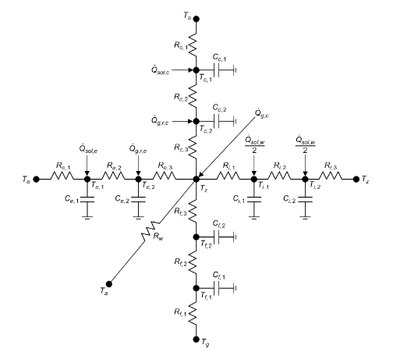
Intro to RC, GMR and GGMR
RC
Developing (flexible)
Predict (warm-up time steps)
Inputs randomly initialize
Recursive prediction
Notes:
1 Developing
Heat balance -> State space representation
(Physical components ->Temperature nodes (Which one? How many?))
Inputs -> Outdoor temperature, solar radiation
Output -> Space load, secondary load, primary energy loads

Slide 8
Intro to RC, GMR and GGMR
RC
Developing (flexible)
Predict (warm-up time steps)
Inputs randomly initialize
Recursive prediction
Notes:
1 Developing
2. Training process

Slide 9
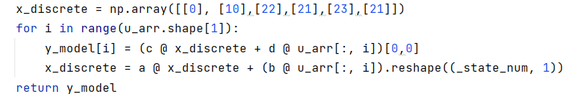
Intro to RC, GMR and GGMR
RC
Developing (flexible)
Predict (warm-up time steps)
Inputs randomly initialize
Recursive prediction
Notes:
1 Developing
2. Training process

Slide 10
Intro to RC, GMR and GGMR
RC
Developing (flexible)
Predict (warm-up time steps)
Inputs randomly initialize
Recursive prediction
Notes:
1 Developing
2. Training process

Slide 11
Intro to RC, GMR and GGMR
RC
Developing (flexible)
Predict (warm-up time steps)
Inputs randomly initialize
Recursive prediction
Notes:
1 Developing
2. Training process

Slide 12
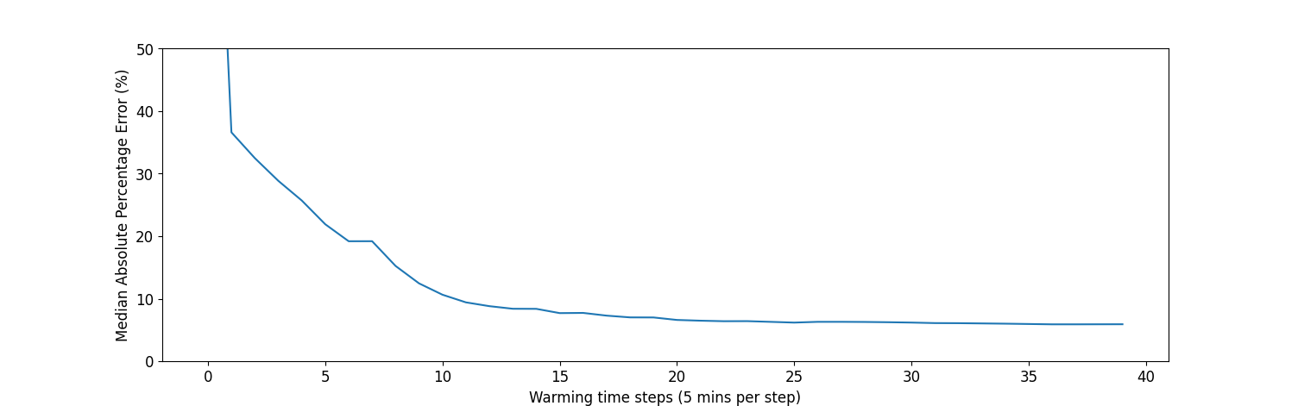
Intro to RC, GMR and GGMR
RC
Developing (flexible)
Predict (warm-up time steps)
Inputs randomly initialize
Recursive prediction
Notes:
1 Developing
2. Training process

Slide 13
Intro to RC, GMR and GGMR
RC
Developing (flexible)
Predict (warm-up time steps)
Inputs randomly initialize
Recursive prediction
Notes:
1 Developing
2. Training process

Slide 14
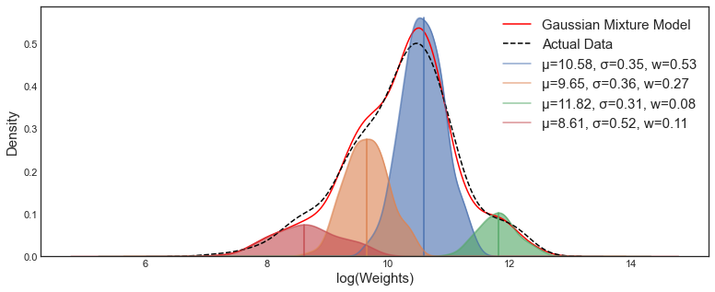



Intro to RC, GMR and GGMR
GMR
Notes:
https://stats.stackexchange.com/q/517652
Expected Maximization algorithm

Slide 15
Intro to RC, GMR and GGMR
New Data
New
Component
New Data
New
Component
…
Components
grow
Components
grow
Components

Slide 16





Novel approach
Hybrid approach
RC + GGMR
Current timestamp, $j$
${\left(j−k\right)}_{th}$ input
RC model
warming up
$$…$$
$j_{th}$ input
GGMR
Module
RC predicted load at timestamp j, $RC_{predicted,j}$
RC model prediction
RC Module
Notes:
Simple RC models and warming up steps

Slide 17


Novel approach
Hybrid approach
RC + GGMR
Current timestamp, $j$
${\left(j−k\right)}_{th}$ input
RC model
warming up
$$…$$
$j_{th}$ input
GGMR
Module
RC predicted load at timestamp j, $RC_{predicted,j}$
RC model prediction
RC Module
Notes:
Simple RC models and warming up steps

Slide 18



Novel approach
Hybrid approach
RC + GGMR
Warm-up time steps
Complexities
Current timestamp, $j$
${\left(j−k\right)}_{th}$ input
RC model
warming up
$$…$$
$j_{th}$ input
GGMR
Module
RC predicted load at timestamp j, $RC_{predicted,j}$
RC model prediction
RC Module
Notes:
Simple RC models and warming up steps

Slide 19
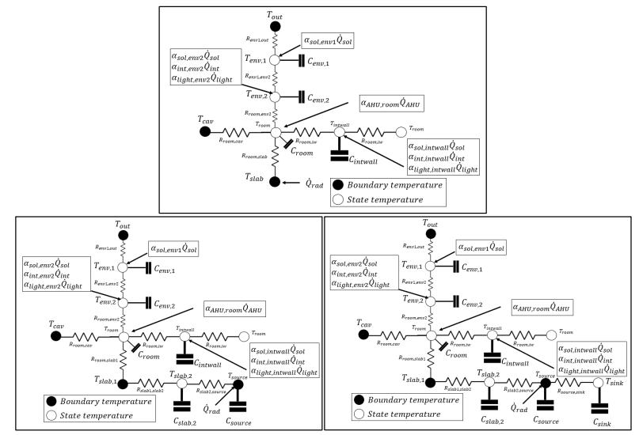
RC approach

Slide 20
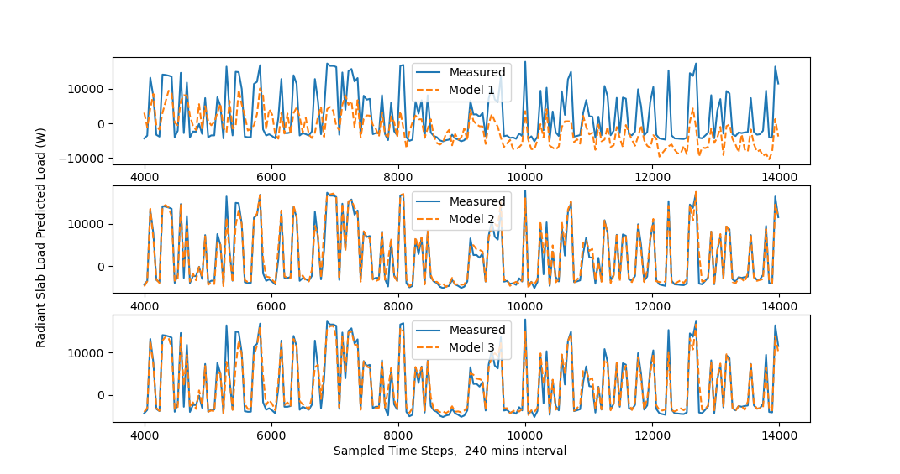
RC approach

Slide 21

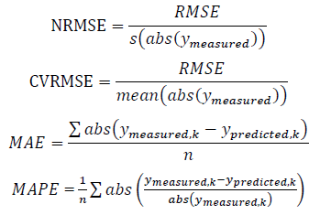
Metrics
Absolute error
Mean absolute errors (MAE)
Relative percentage errors
RMSE (NRMSE, CVRMSE)
Mean absolute percentage error

Slide 22
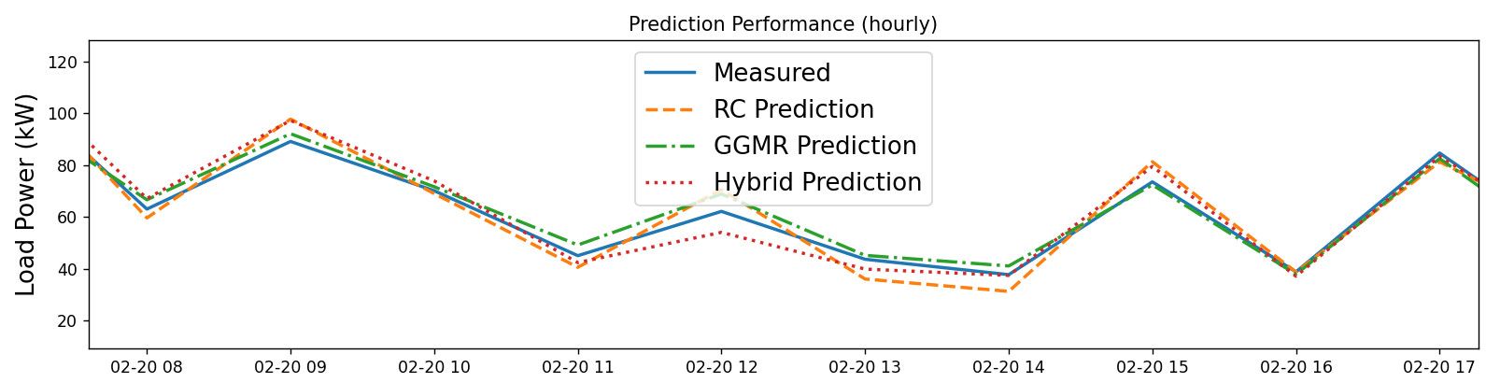
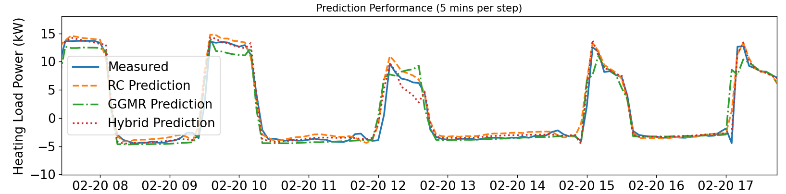
Performance

Slide 23
Q & A
Why GGMR is necessary
Why RC is necessary?
Why hybrid is necessary?
Have you tried other features for GGMR?
What’s the input variables for RC (dTsource can be predicted?)

Slide 24
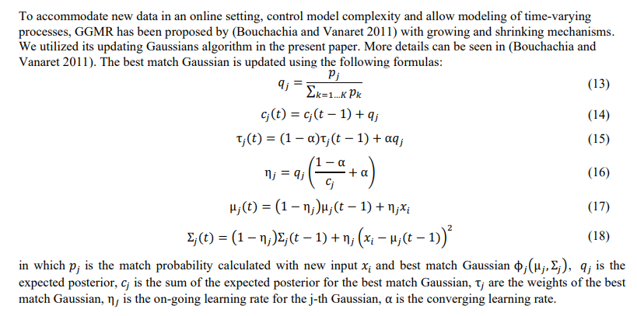
GGMR-Update Rules

Slide 25
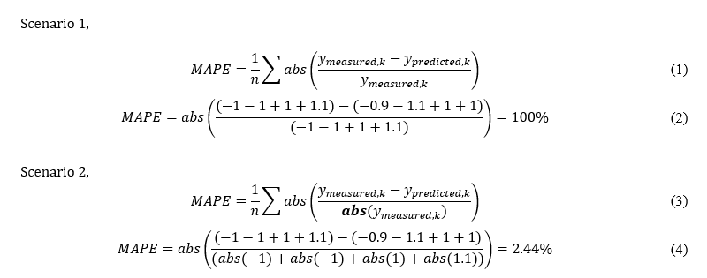
Hourly Performance

Slide 26

Metrics
Absolute error
Mean absolute errors (MAE)
Relative percentage errors
RMSE (NRMSE, CVRMSE)
Mean absolute percentage error

Slide 27
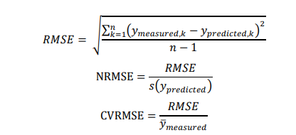
Metrics
Absolute error
Mean absolute errors (MAE)
Relative percentage errors
RMSE (NRMSE, CVRMSE)
Mean absolute percentage error

Slide 28

Metrics
Absolute error
Mean absolute errors (MAE)
Relative percentage errors
RMSE (NRMSE, CVRMSE)
Mean absolute percentage error
Notes:
Mape

Slide 29
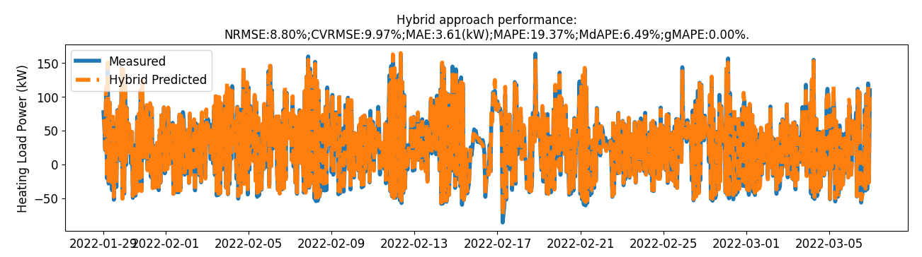
Performance
Dated load predictions, percentage errors

Slide 30
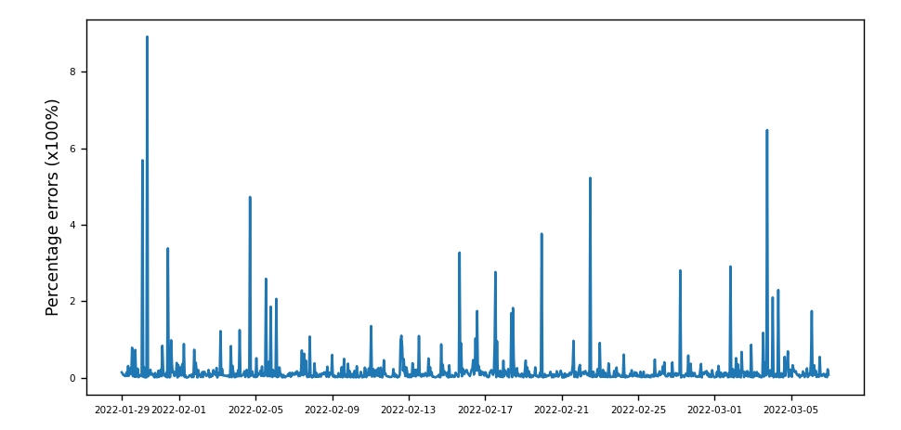
Performance
Dated load predictions, percentage errors

Slide 31
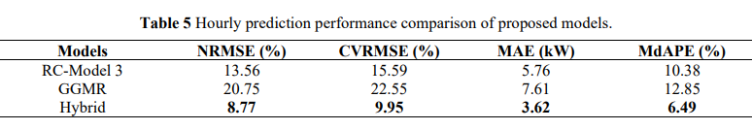
Performance

Slide 32
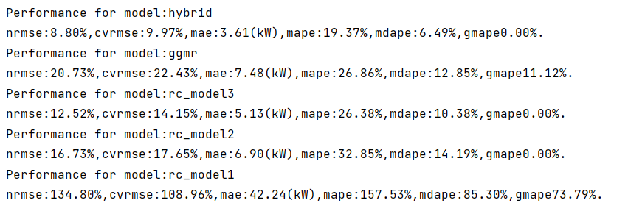
Conclusions?

Slide 33
Motivation
Challenge
radiant slab systems with large thermal capacitance
Existing approaches
first-principles (e.g., CFD)
Inverse grey-box Resistor-Capacitor (RC) model
Data-driven approach (Gaussian mixture regression, growing-GMR)
Notes:
How to describe the current challenges

Slide 34
Motivation
Challenge
radiant slab systems with large thermal capacitance
Existing approaches
first-principles (e.g., CFD)
Inverse grey-box Resistor-Capacitor (RC) model
Data-driven approach (Gaussian mixture regression, growing-GMR)
Notes:
How to describe the current challenges

Slide 35
Motivation
Challenge
radiant slab systems with large thermal capacitance
Existing approaches
first-principles (e.g., CFD)
Inverse grey-box Resistor-Capacitor (RC) model
Data-driven approach (Gaussian mixture regression, growing-GMR)
Notes:
How to describe the current challenges

Slide 36
Novel approach
Hybrid approach
RC + GGMR
Complexities
Warm-up time steps
Current timestamp, $j$
${\left(j−k\right)}_{th}$ input
RC model
warming up
$$…$$
$j_{th}$ input
GGMR
Module
RC predicted load at timestamp j, $RC_{predicted,j}$
RC model prediction
RC Module
Notes:
Simple RC models and warming up steps

Slide 37
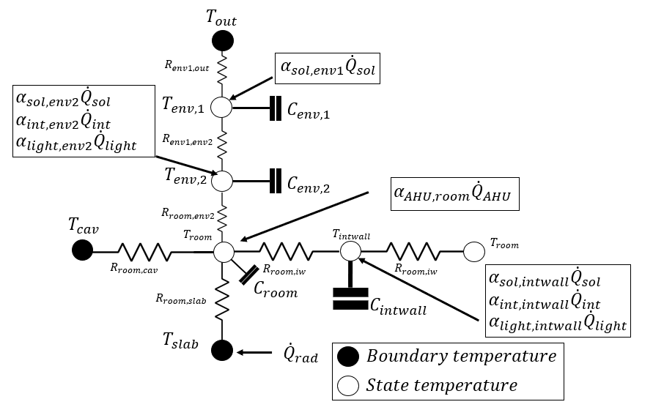
RC approach

Slide 38
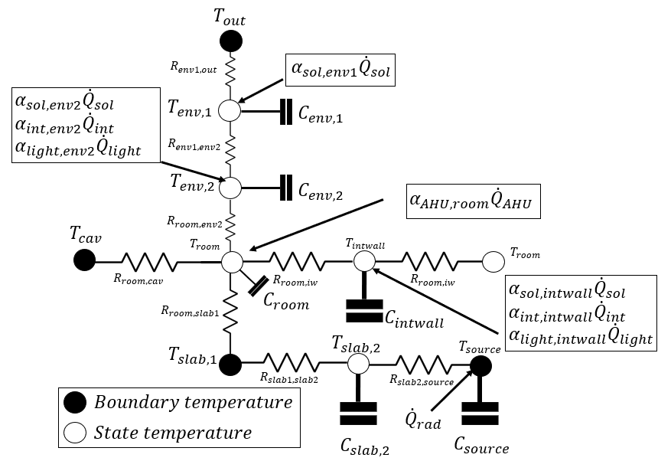
RC approach

Slide 39
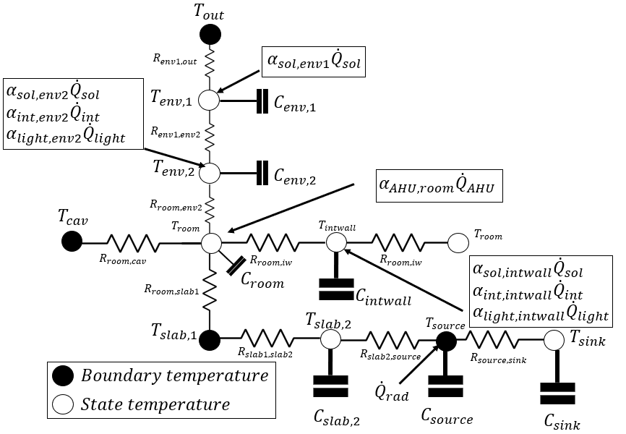
RC approach

