Slide 1
A Novel Hybrid Modeling Method for Predicting Energy Use of Hydronic Radiant Slab Systems
Lichen WU¹, Liping WANG¹, James BRAUN²
¹Department of Civil and Architectural Engineering, University of Wyoming, Laramie, WY, 82071, United States
²School of Mechanical Engineering, Purdue University, West Lafayette, IN 47907-2088, United States

Slide 2
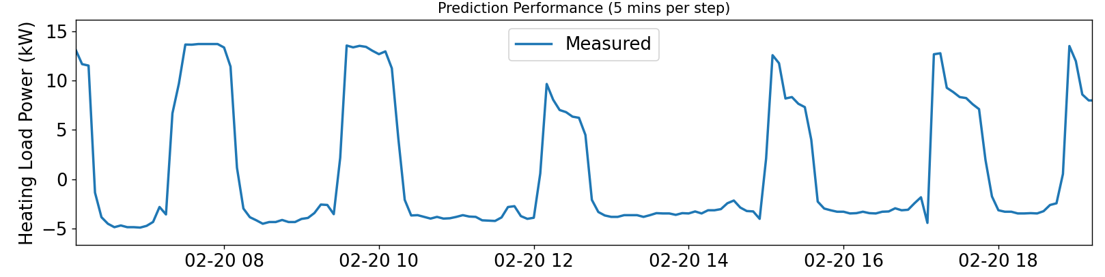

Energy loads calculation
$load=c_{p}ρV\left(T_{su}−T_{re}\right)$
where $T_{su},T_{re}$ is the supply and return water temperature; $c_{p}$ is the specific heat capacity; $ρ$ is density; $V$ is the flow volume rate.
Challenge
radiant slab systems large thermal capacitance
Notes:
Radiant slab (concrete, pipe, chilled/water)/ thermal insulation
Existing methods

Slide 3
Building performance models
This study: RC+GGMR
White box:
Finite difference
Gray box:
Resistor-Capacitor (RC)
Black box:
Neural network;
(Growing) Gaussian Mixture Regression
Notes:
Absolute physical

Slide 4
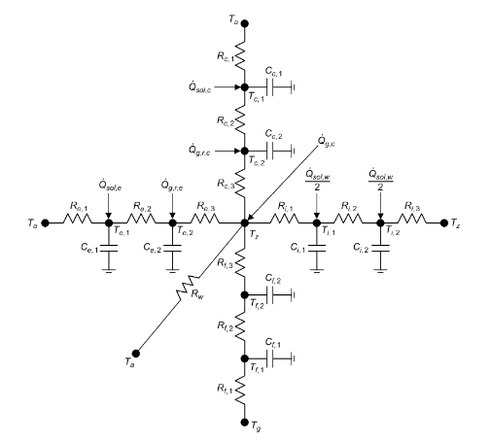
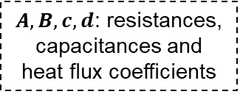
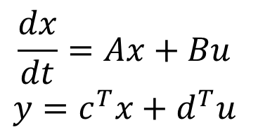
Resistor Capacitor network introduction
RC
Developing (flexible)
Predict (warm-up time steps)
State variables randomly initialized
Recursive prediction
State variables
$$\frac{dx}{dt}=Ax+Bu$$
$$y=c^{T}x+d^{T}u$$
input variables
$A,B,c,d$: resistances, capacitances and heat flux coefficients
Output variables
Braun, James E., and Nitin Chaturvedi. 2002. “An Inverse Gray-Box Model for Transient Building Load Prediction.” HVAC&R Research 8(1): 73–99.
Notes:
Input variables, State variables, (Abcd) -> Output variable
Flexible choice for state variables (how many states will be used to represent external wall)
The training purpose is to ABCD;

Slide 5
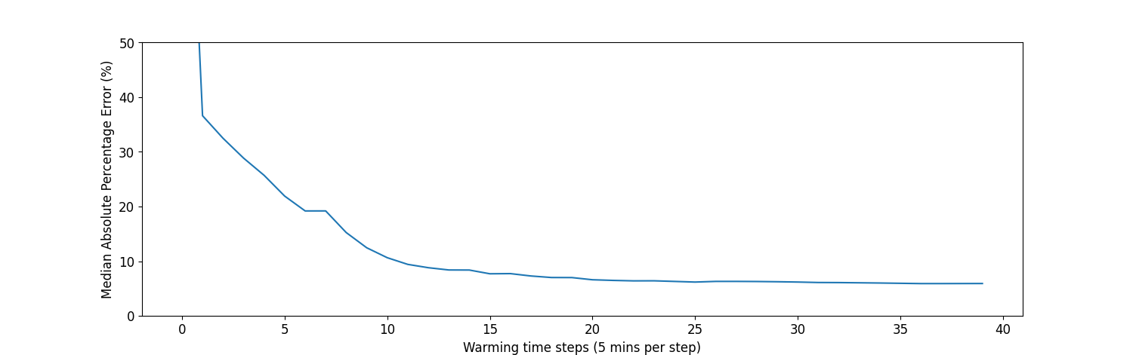
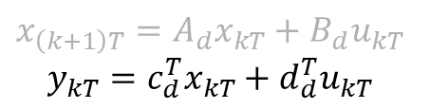
RC model prediction needs warm up
RC
Developing (flexible)
Predict (warm-up time steps)
State variables randomly initialized
Recursive prediction
$$x_{\left(k+1\right)T}=A_{d}x_{kT}+B_{d}u_{kT}$$
$$y_{kT}=c_{d}^{T}x_{kT}+d_{d}^{T}u_{kT}$$
Notes:
c, d, input, state
State is updated with older states
Random initialized
Chaotic <- prediction is not stable
Warm up period is needed. Statistically (input, stable state, Abcd -> determine prediction)

Slide 6
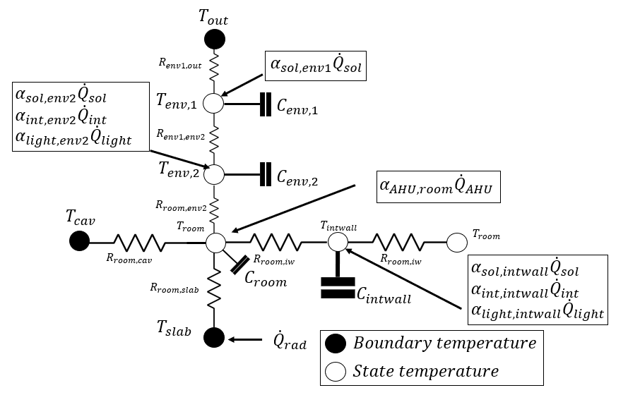
RC models development 1/3
Notes:
Radiant system (concrete, pipes, water inside the pipes)

Slide 7
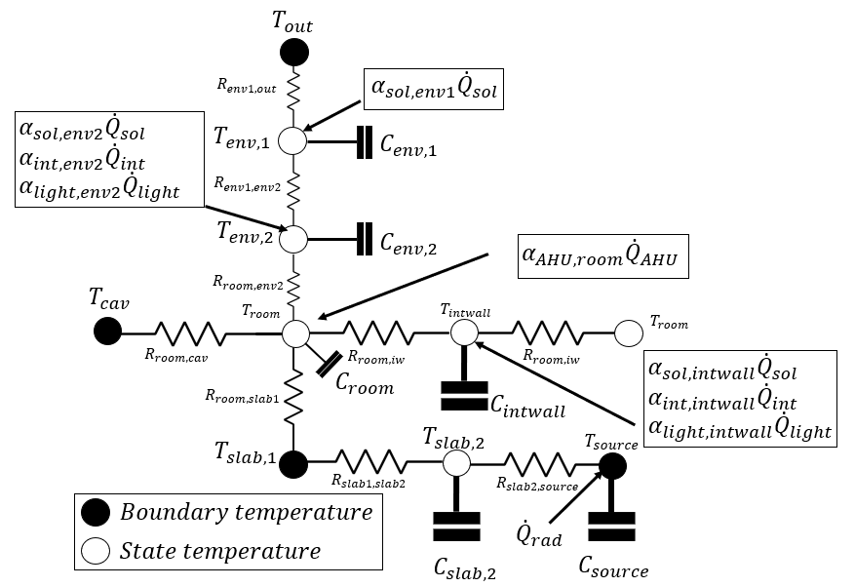
RC models development 2/3

Slide 8
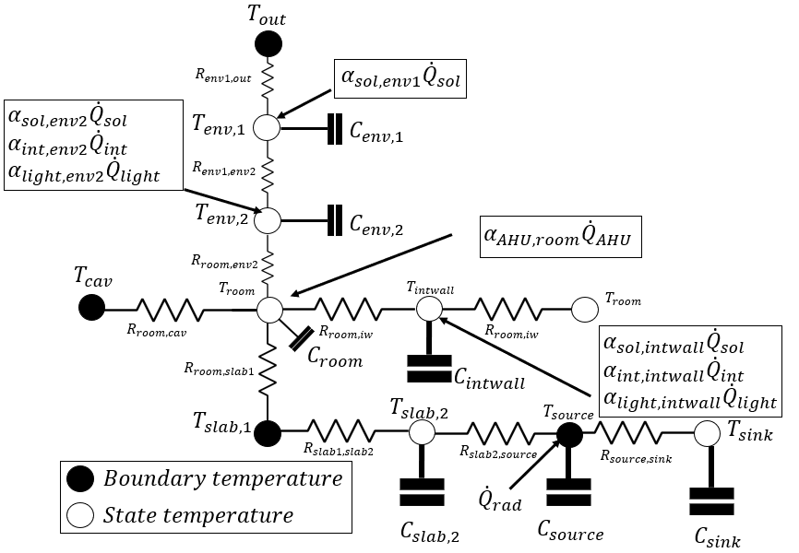
RC models development 3/3

Slide 9
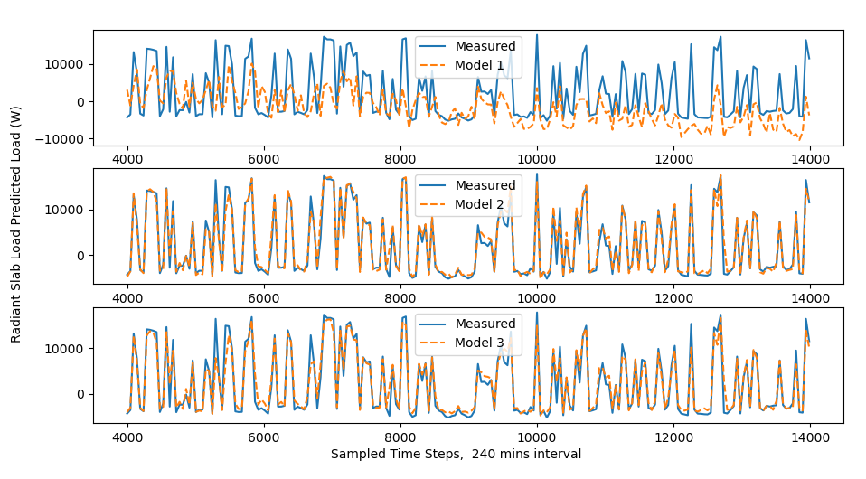
RC models performance

Slide 10
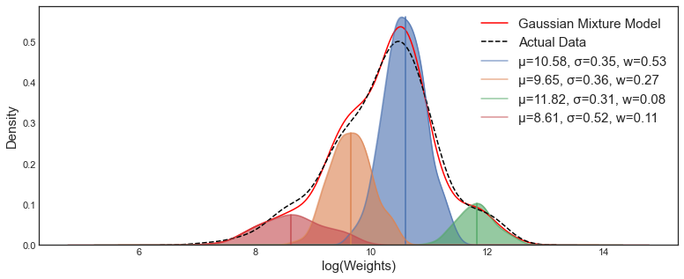
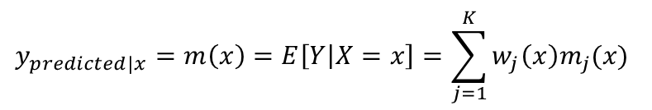
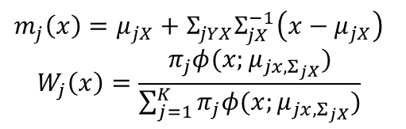
Gaussian Mixture Regression introduction
GMR
$$m_{j}\left(x\right)=μ_{jX}+Σ_{jYX}Σ_{jX}^{−1}\left(x−μ_{jX}\right)$$
$$W_{j}\left(x\right)=\frac{π_{j}φ(x;μ_{jx,Σ_{jX}})}{\sum_{j=1}^{K}{π_{j}φ(x;μ_{jx,Σ_{jX}})}}$$
$$y_{predicted|x}=m\left(x\right)=E\left[Y | X=x\right]=\sum_{j=1}^{K}{w_{j}\left(x\right)m_{j}(x)}$$
O.rka. (2021, March 31). How to evaluate the loss on a Gaussian Mixture Model? [Forum post]. Cross Validated. https://stats.stackexchange.com/q/517652
Notes:
Gaussian -> components (multivariate gaussian (mu, mean; sigma, covariance))
The sum over different components
Weighting coefficients
(mu, covariance -> determine prediction) (working condition is change over time, eveloving)

Slide 11
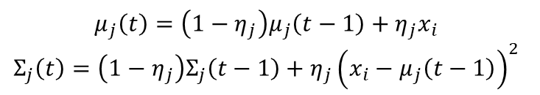
Growing GMR introduction
New
Data
GMR
New
Component
New
Data
GMR
New
Component
…
Components
update
Components
update
Components
$$μ_{j}\left(t\right)=\left(1−η_{j}\right)μ_{j}\left(t−1\right)+η_{j}x_{i}$$
$$Σ_{j}\left(t\right)=\left(1−η_{j}\right)Σ_{j}\left(t−1\right)+η_{j}{\left(x_{i}−μ_{j}\left(t−1\right)\right)}^{2}$$
Li, Deyang, and Zhihuan Song. 2020. “A Novel Incremental Gaussian Mixture Regression and Its Application for Time-Varying Multimodal Process Quality Prediction.” In 2020 IEEE 9th Data Driven Control and Learning Systems Conference (DDCLS), , 645–50.
Bouchachia, Hamid, and Charlie Vanaret. 2011. “Incremental Learning Based on Growing Gaussian Mixture Models.”
Notes:
New inputs;
Learning rate
Older version -> newer version
Guidance (as accurate as possible) needed for GGMR
RC prediction

Slide 12





The Novel Hybrid Approach
Hybrid approach
RC + GGMR
Warm-up time steps
Complexities
Current timestamp, $j$
${\left(j−k\right)}_{th}$ input
RC model
warming up
$$…$$
$j_{th}$ input
GGMR
Module
RC predicted load at timestamp j, $RC_{predicted,j}$
RC model prediction
RC Module
Notes:
Workflow 14 time steps ago
Update the historical componments

Slide 13
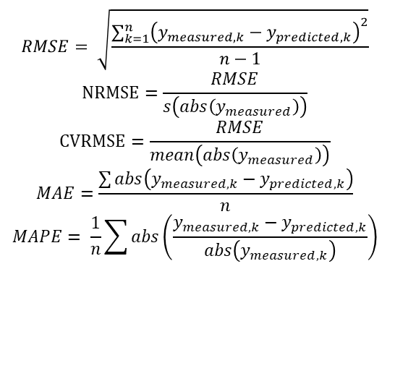
Metrics
Absolute error
Mean absolute errors (MAE)
Relative percentage errors
RMSE (NRMSE, CVRMSE)
Mean absolute percentage error
$$RMSE= \sqrt{\frac{\sum_{k=1}^{n}{{\left(y_{measured,k}−y_{predicted,k}\right)}^{2}}}{n−1}}$$
$$NRMSE=\frac{RMSE}{s\left(abs\left(y_{measured}\right)\right)}$$
$$CVRMSE=\frac{RMSE}{mean\left(abs\left(y_{measured}\right)\right)}$$
$$MAE=\frac{\sum{abs\left(y_{measured,k}−y_{predicted,k}\right)}}{n}$$
$$MAPE= \frac{1}{n}\sum{abs\left(\frac{y_{measured,k}−y_{predicted,k}}{abs\left(y_{measured,k}\right)}\right)}$$
Notes:
Absolute error/ Relative error
Coefficient of variation;
The ASHRAE Guideline 14, hourly should be below 30%
MAPE ()

Slide 14
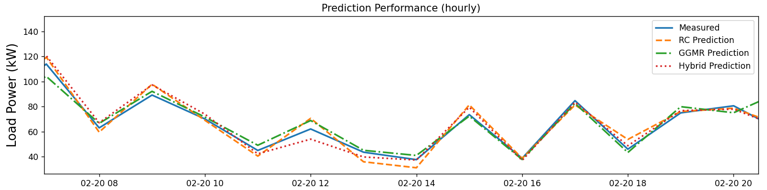
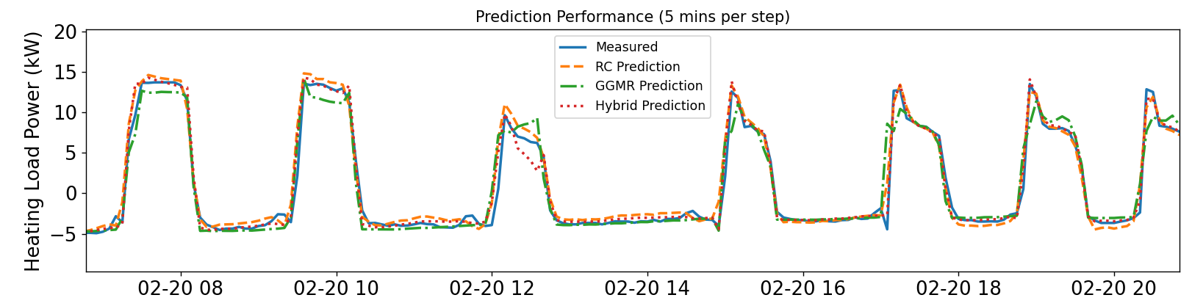
Performance
Notes:
Measurement;
RC, GGMR, Hybrid
Performance difference is not obvious. Hourly
GGMR doesn’t perform well than the other two.
When get the prediction from RC, it become Hybrid, the best performance.

Slide 15
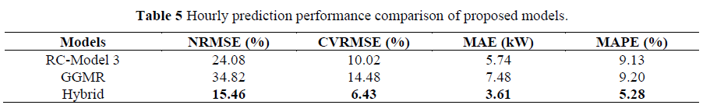
Performance

Slide 16
Conclusions
In the current study, from the comparison of the Resistor Capacitor network, GGMR, and the hybrid approach:
RC model has better explainability, prediction than GGMR.
GGMR is easier to get constructed and trained than RC model.
The hybrid approach (RC+GGMR) has the best prediction performance among these approaches.

Slide 17
Q&A
Thank you!

Slide 18
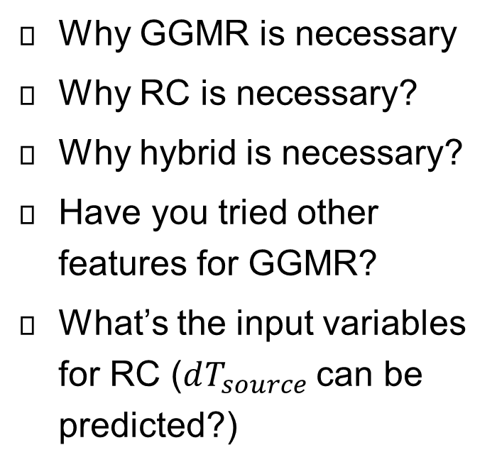
Possible Questions
Why GGMR is necessary
Why RC is necessary?
Why hybrid is necessary?
Have you tried other features for GGMR?
What’s the input variables for RC ($dT_{source}$can be predicted?)

Slide 19
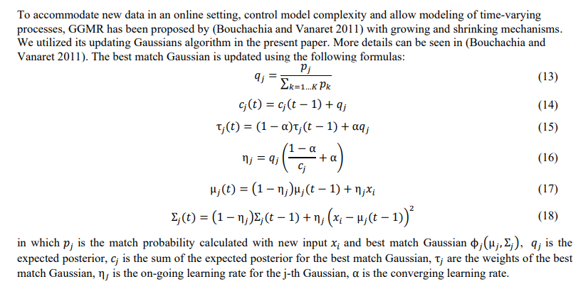
GGMR-Update Rules

Slide 20
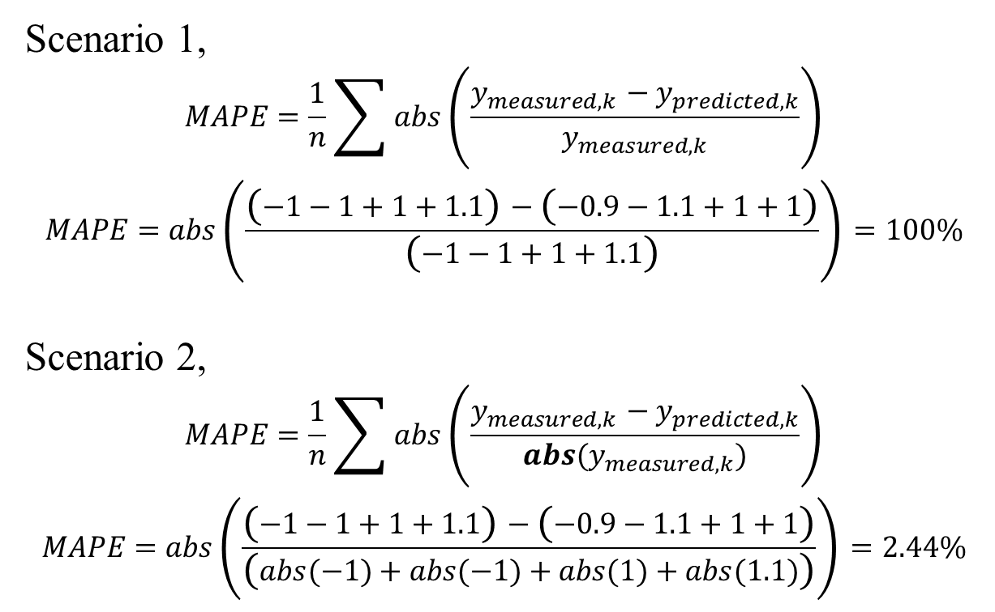
Hourly Performance Explanation
Scenario 1,
$$MAPE=\frac{1}{n}\sum{abs\left(\frac{y_{measured,k}−y_{predicted,k}}{y_{measured,k}}\right)}$$
$$MAPE=abs\left(\frac{\left(−1−1+1+1.1\right)−\left(−0.9−1.1+1+1\right)}{\left(−1−1+1+1.1\right)}\right)=100\%$$
Scenario 2,
$$MAPE=\frac{1}{n}\sum{abs\left(\frac{y_{measured,k}−y_{predicted,k}}{abs(y_{measured,k})}\right)}$$
$$MAPE=abs\left(\frac{\left(−1−1+1+1.1\right)−\left(−0.9−1.1+1+1\right)}{\left(abs(−1)+abs(−1)+abs(1)+abs(1.1)\right)}\right)=2.44\%$$

