Slide 1
A Novel Hybrid Modeling Method for Predicting Energy Use of Hydronic Radiant Slab Systems
Lichen WU¹, Liping WANG¹, James BRAUN²
¹Department of Civil and Architectural Engineering, University of Wyoming, Laramie, WY, 82071, United States
²School of Mechanical Engineering, Purdue University, West Lafayette, IN 47907-2088, United States

Slide 2
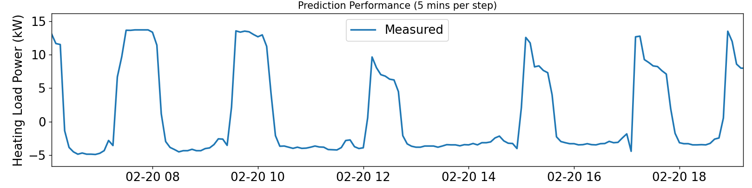

System load
$load=c_{p}ρV\left(T_{su}−T_{re}\right)$
where $T_{su},T_{re}$ is the supply and return water temperature; $c_{p}$ is the specific heat capacity; $ρ$ is density; $V$ is the flow volume rate.
Challenge
radiant slab systems large thermal capacitance
Notes:
The load definition in the current study.

Slide 3
Building performance models
This study: RC+GGMR
White box:
Finite difference
Gray box:
Resistor-Capacitor (RC)
Black box:
Neural network
(Growing) Gaussian Mixture Regression

Slide 4
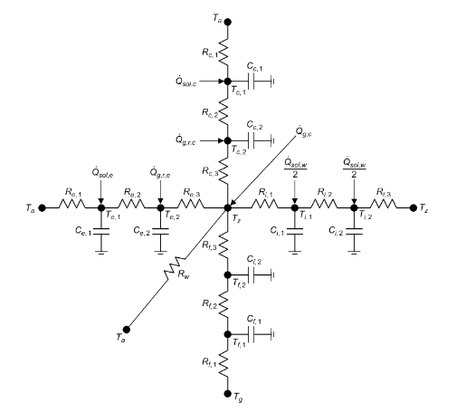


RC
RC
Developing (flexible)
Predict (warm-up time steps)
Inputs randomly initialized
Recursive prediction
Notes:
Input variables, State variables, Output variables
Training purpose (realistic enough/ And the trained parameters will be fixed for prediction)
1 Developing
Heat balance -> State space representation
(Physical components ->Temperature nodes (Which one? How many?))
Inputs -> Outdoor temperature, solar radiation
Output -> Space load, secondary load, primary energy loads

Slide 5
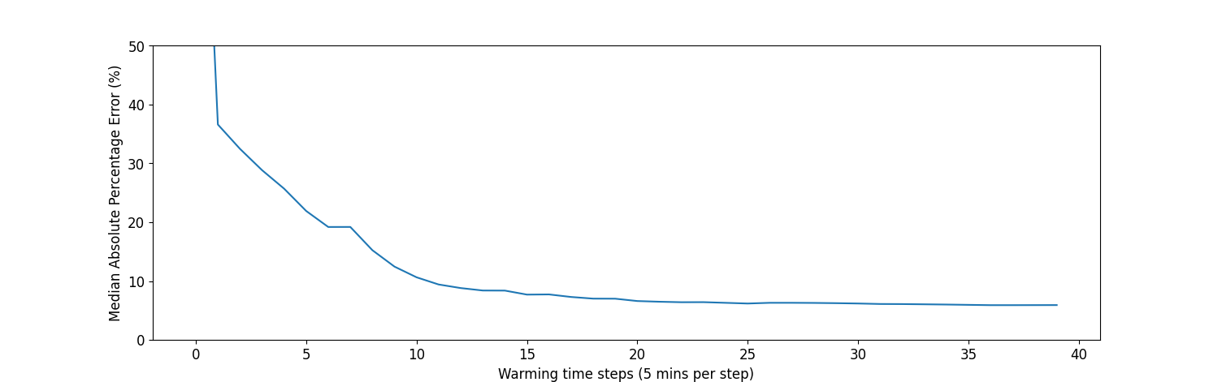

RC
RC
Developing (flexible)
Predict (warm-up time steps)
Inputs randomly initialized
Recursive prediction
Notes:
Discretized State Space equation is used, why?
How the discretized equations are related to spin-up/warm-up time steps?
1 Developing
2. Training process

Slide 6
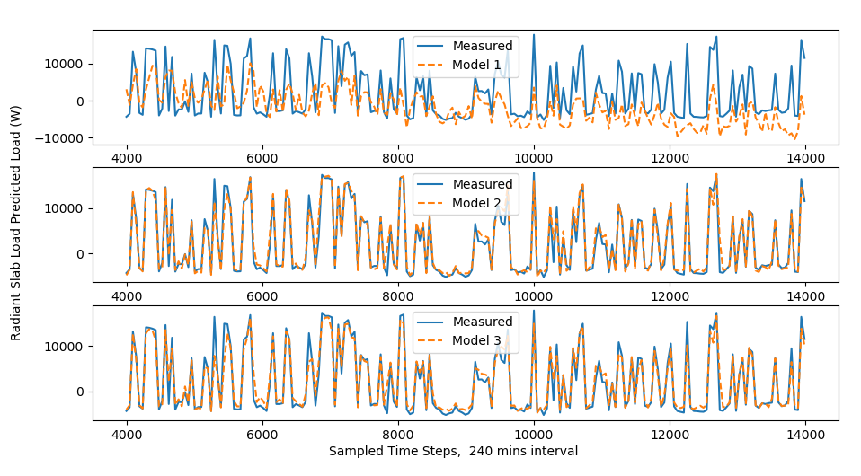
RC models

Slide 7
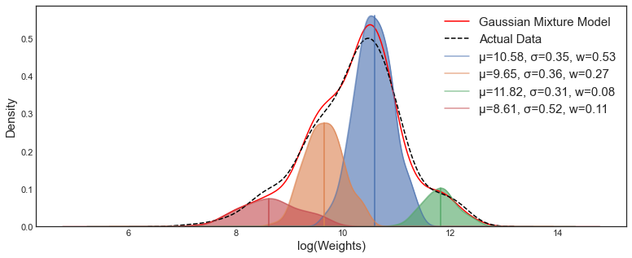



GMR
GMR
Notes:
https://stats.stackexchange.com/q/517652
Expected Maximization algorithm

Slide 8
GGMR
New Data
New
Component
New Data
New
Component
…
Components
grow
Components
grow
Components
Notes:
To add the GMR model
To add the updated rules

Slide 9





Hybrid
Hybrid approach
RC + GGMR
Warm-up time steps
Complexities
Current timestamp, $j$
${\left(j−k\right)}_{th}$ input
RC model
warming up
$$…$$
$j_{th}$ input
GGMR
Module
RC predicted load at timestamp j, $RC_{predicted,j}$
RC model prediction
RC Module
Notes:
Simple RC models and warming up steps

Slide 10

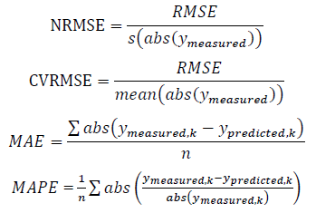
Metrics
Absolute error
Mean absolute errors (MAE)
Relative percentage errors
RMSE (NRMSE, CVRMSE)
Mean absolute percentage error

Slide 11
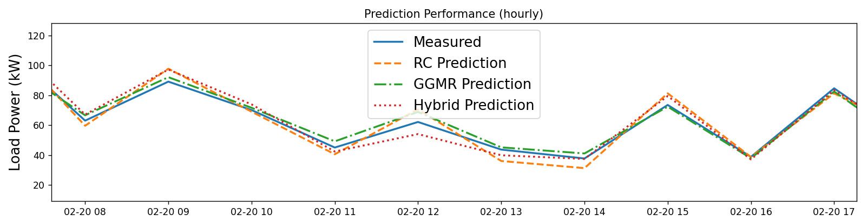
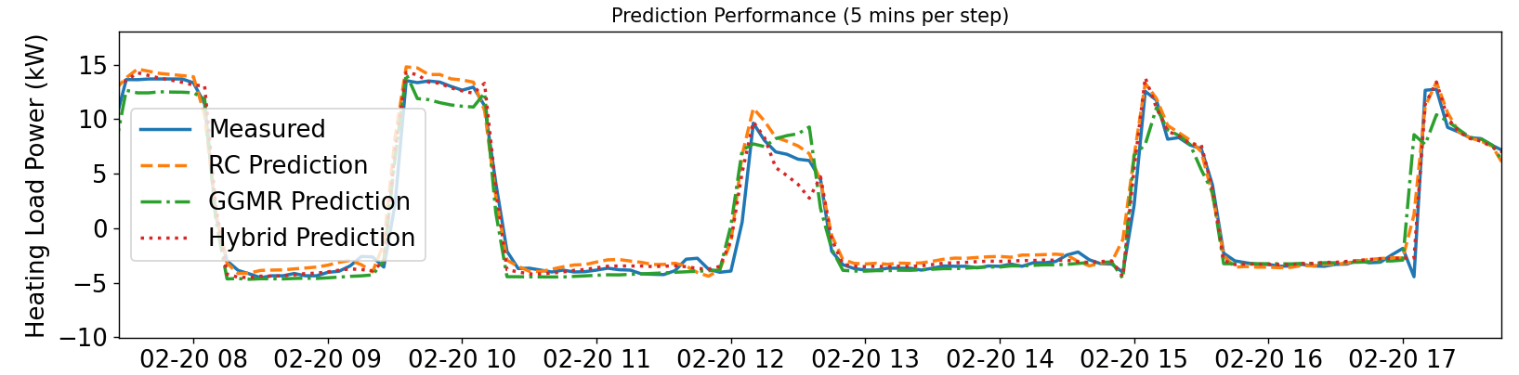
Performance

Slide 12
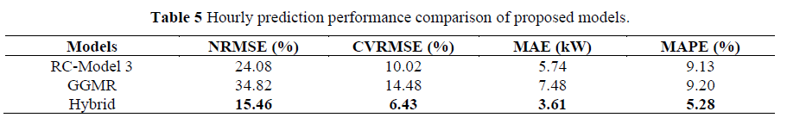
Performance

Slide 13
Q&A
Thank you!

Slide 14
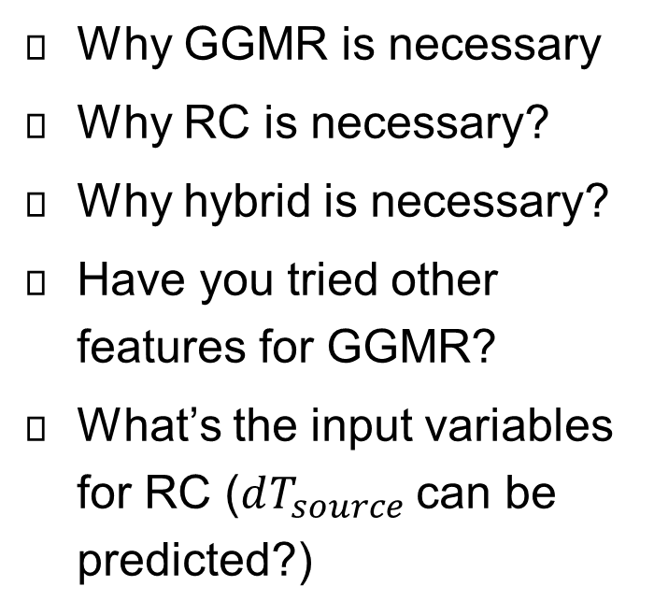
Q & A
Why GGMR is necessary
Why RC is necessary?
Why hybrid is necessary?
Have you tried other features for GGMR?
What’s the input variables for RC ($dT_{source}$can be predicted?)

Slide 15
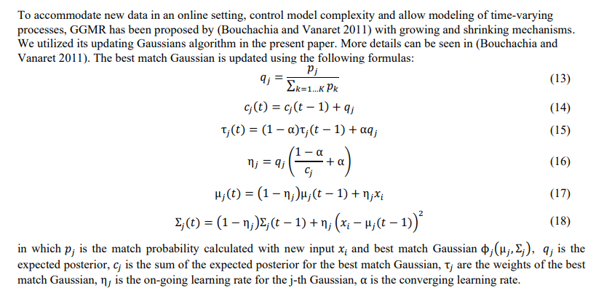
GGMR-Update Rules

Slide 16
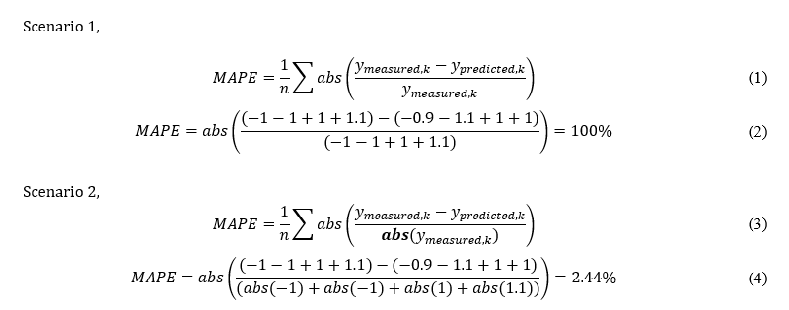
Hourly Performance Explanation

Slide 17
RC
RC
Developing (flexible)
Predict (warm-up time steps)
Inputs randomly initialize
Recursive prediction
Notes:
1 Developing
Heat balance -> State space representation
(Physical components ->Temperature nodes (Which one? How many?))
Inputs -> Outdoor temperature, solar radiation
Output -> Space load, secondary load, primary energy loads

Slide 18
RC
RC
Developing (flexible)
Predict (warm-up time steps)
Inputs randomly initialize
Recursive prediction
Notes:
1 Developing
Heat balance -> State space representation
(Physical components ->Temperature nodes (Which one? How many?))
Inputs -> Outdoor temperature, solar radiation
Output -> Space load, secondary load, primary energy loads

Slide 19
RC
RC
Developing (flexible)
Predict (warm-up time steps)
Inputs randomly initialize
Recursive prediction
Notes:
1 Developing
Heat balance -> State space representation
(Physical components ->Temperature nodes (Which one? How many?))
Inputs -> Outdoor temperature, solar radiation
Output -> Space load, secondary load, primary energy loads

Slide 20
RC
RC
Developing (flexible)
Predict (warm-up time steps)
Inputs randomly initialize
Recursive prediction
Notes:
1 Developing
2. Training process

Slide 21
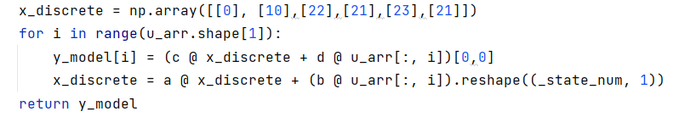
RC
RC
Developing (flexible)
Predict (warm-up time steps)
Inputs randomly initialize
Recursive prediction
Notes:
1 Developing
2. Training process

Slide 22
RC
RC
Developing (flexible)
Predict (warm-up time steps)
Inputs randomly initialize
Recursive prediction
Notes:
1 Developing
2. Training process

Slide 23
RC
RC
Developing (flexible)
Predict (warm-up time steps)
Inputs randomly initialize
Recursive prediction
Notes:
1 Developing
2. Training process

Slide 24
Motivation
Challenge
radiant slab systems with large thermal capacitance
Existing approaches
first-principles (e.g., CFD)
Inverse grey-box Resistor-Capacitor (RC) model
Data-driven approach (Gaussian mixture regression, growing-GMR)
Notes:
How to describe the current challenges

Slide 25





Hybrid
Hybrid approach
RC + GGMR
Current timestamp, $j$
${\left(j−k\right)}_{th}$ input
RC model
warming up
$$…$$
$j_{th}$ input
GGMR
Module
RC predicted load at timestamp j, $RC_{predicted,j}$
RC model prediction
RC Module
Notes:
Simple RC models and warming up steps

Slide 26
Hybrid
Hybrid approach
RC + GGMR
Current timestamp, $j$
${\left(j−k\right)}_{th}$ input
RC model
warming up
$$…$$
$j_{th}$ input
GGMR
Module
RC predicted load at timestamp j, $RC_{predicted,j}$
RC model prediction
RC Module
Notes:
Simple RC models and warming up steps

Slide 27
RC
RC
Developing (flexible)
Predict (warm-up time steps)
Inputs randomly initialize
Recursive prediction
Notes:
1 Developing
2. Training process

Slide 28
RC
RC
Developing (flexible)
Predict (warm-up time steps)
Inputs randomly initialize
Recursive prediction
Notes:
1 Developing
2. Training process

Slide 29
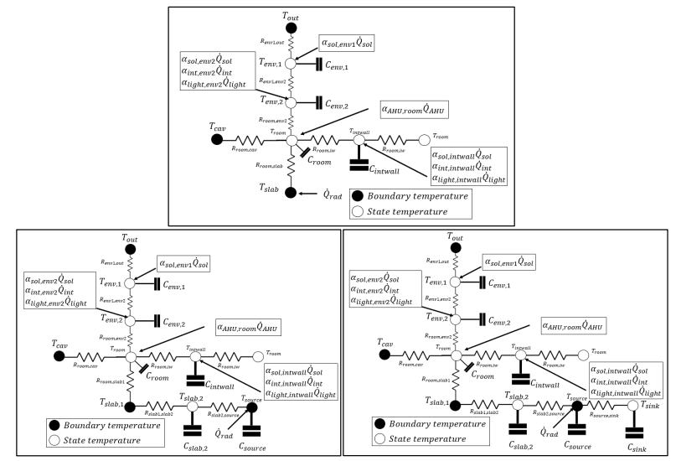
RC models

