Slide 1
A Novel Hybrid Modeling Method for Predicting Energy Use of Hydronic Radiant Slab Systems
Lichen WU¹, Liping WANG¹, James BRAUN²
¹Department of Civil and Architectural Engineering, University of Wyoming, Laramie, WY, 82071, United States
²School of Mechanical Engineering, Purdue University, West Lafayette, IN 47907-2088, United States

Slide 2
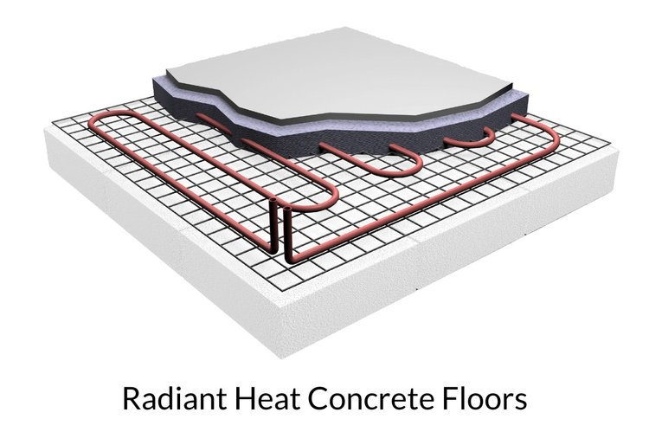
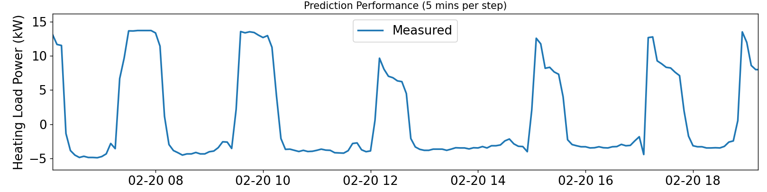

Energy loads calculation
$load=c_{p}ρV\left(T_{su}−T_{re}\right)$
where $T_{su},T_{re}$ is the supply and return water temperature; $c_{p}$ is the specific heat capacity; $ρ$ is density; $V$ is the flow volume rate.
Challenge
radiant slab systems large thermal capacitance
Notes:
equation
Radiant slab (concrete, pipe, chilled/water)/ thermal insulation
profile
Existing methods

Slide 3
Building performance models
This study: RC+GGMR
White box:
Finite difference
Gray box:
Resistor-Capacitor (RC)
Black box:
Neural network;
(Growing) Gaussian Mixture Regression
Notes:
Absolute physical

Slide 4
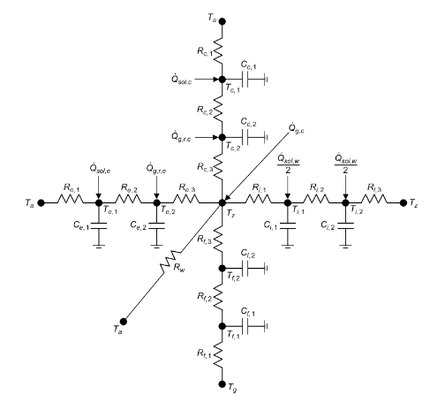
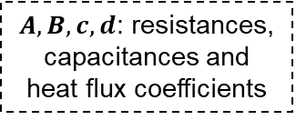



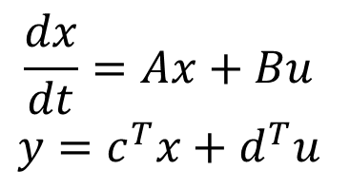
Resistor Capacitor network introduction
RC
Developing (flexible)
Predict (warm-up time steps)
State variables randomly initialized
Recursive prediction
State variables: $T_{room}$
$$\frac{dx}{dt}=Ax+Bu$$
$$y=c^{T}x+d^{T}u$$
Input variables: $T_{out}$
$A,B,c,d$: resistances, capacitances and heat flux coefficients
Output variables:$Energy$
Braun, James E., and Nitin Chaturvedi. 2002. “An Inverse Gray-Box Model for Transient Building Load Prediction.” HVAC&R Research 8(1): 73–99.
Notes:
Output variable (Energy), State variables (Troom), Input variables (Disturbance), Abcd (RC, coefficients).
Takeaway:
1. The training purpose is to ABCD;
2. Flexible choices for state variables (how many states will be used to represent the radiant slab?)

Slide 5
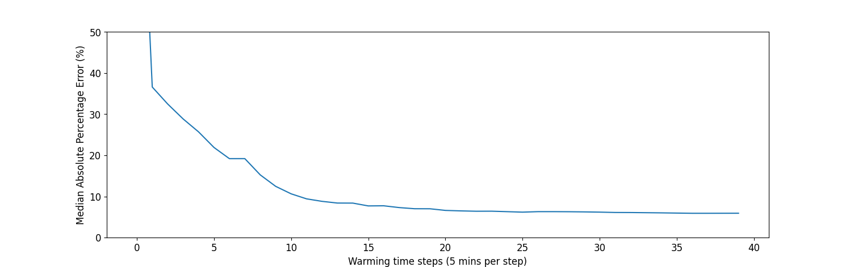
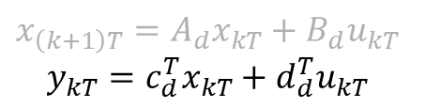
RC model prediction needs warm up
RC
Developing (flexible)
Predict (warm-up time steps)
State variables randomly initialized
Recursive prediction
$$x_{\left(k+1\right)T}=A_{d}x_{kT}+B_{d}u_{kT}$$
$$y_{kT}=c_{d}^{T}x_{kT}+d_{d}^{T}u_{kT}$$
Notes:
c, d, input, state
State is updated with older states
Random initialized
Chaotic <- prediction is not stable
Warm up period is needed. Statistically (input, stable state, Abcd -> determine prediction)

Slide 6
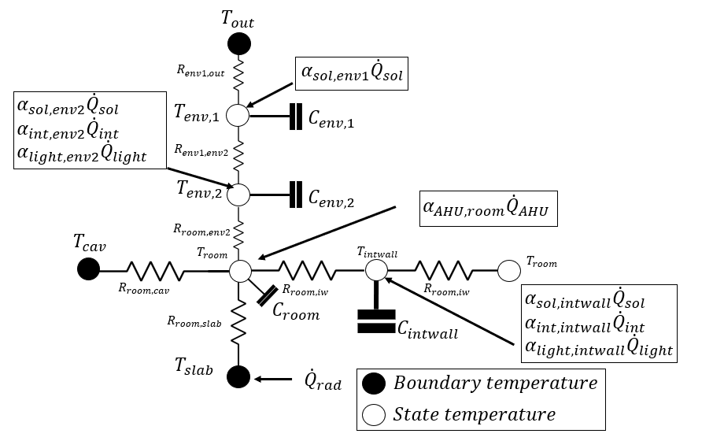
RC models development 1/3
Notes:
Radiant system (concrete, pipes, water inside the pipes)

Slide 7
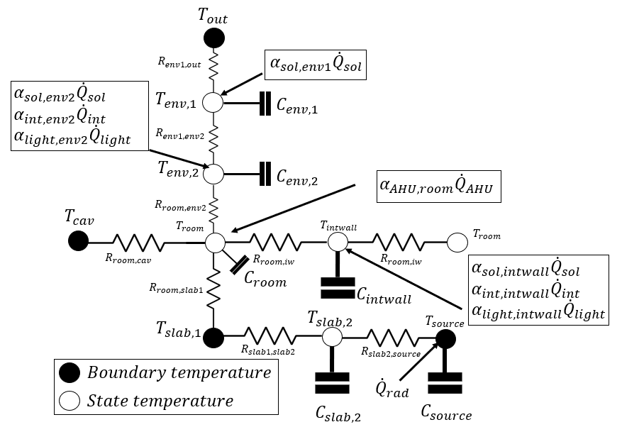
RC models development 2/3

Slide 8
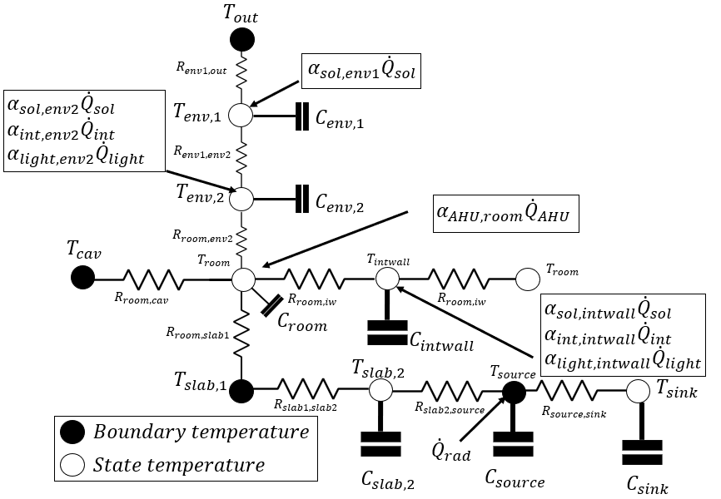
RC models development 3/3

Slide 9
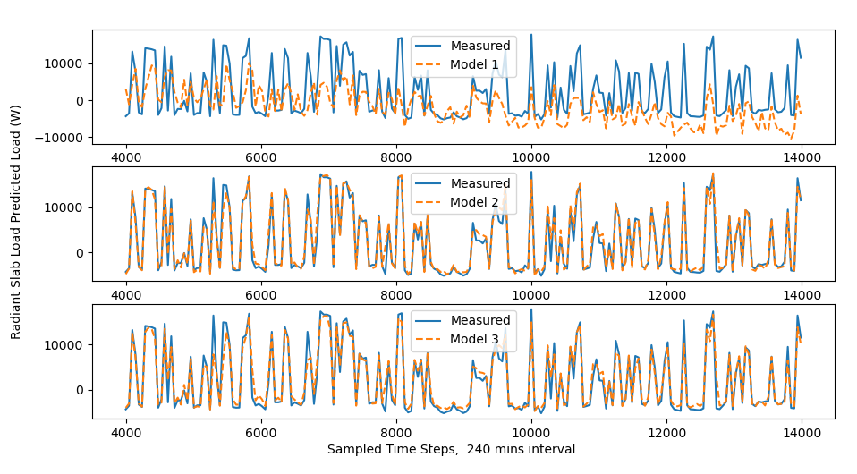
RC models performance

Slide 10
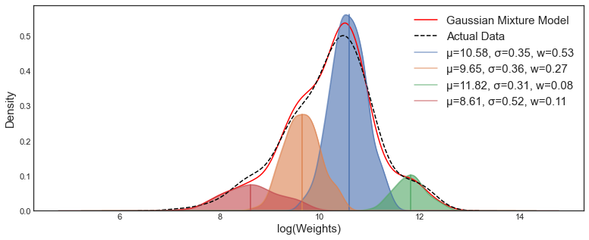
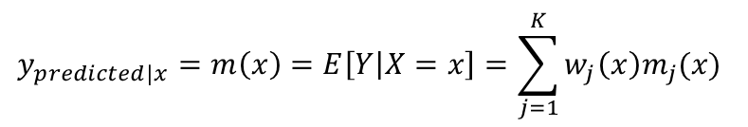
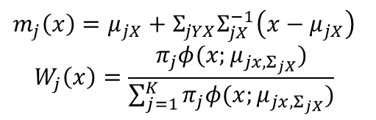
Gaussian Mixture Regression introduction
GMR
$$m_{j}\left(x\right)=μ_{jX}+Σ_{jYX}Σ_{jX}^{−1}\left(x−μ_{jX}\right)$$
$$W_{j}\left(x\right)=\frac{π_{j}φ(x;μ_{jx,Σ_{jX}})}{\sum_{j=1}^{K}{π_{j}φ(x;μ_{jx,Σ_{jX}})}}$$
$$y_{predicted|x}=m\left(x\right)=E\left[Y | X=x\right]=\sum_{j=1}^{K}{w_{j}\left(x\right)m_{j}(x)}$$
O.rka. (2021, March 31). How to evaluate the loss on a Gaussian Mixture Model? [Forum post]. Cross Validated. https://stats.stackexchange.com/q/517652
Notes:
Gaussian -> components (multivariate gaussian (mu, mean; sigma, covariance))
The sum over different components
Weighting coefficients
(mu, covariance -> determine prediction) (working condition is change over time, update mechanism)

Slide 11
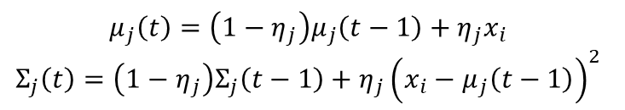
Growing GMR introduction
New
Data
GMR
New
Component
New
Data
GMR
New
Component
…
Components
update
Components
update
Components
$$μ_{j}\left(t\right)=\left(1−η_{j}\right)μ_{j}\left(t−1\right)+η_{j}x_{i}$$
$$Σ_{j}\left(t\right)=\left(1−η_{j}\right)Σ_{j}\left(t−1\right)+η_{j}{\left(x_{i}−μ_{j}\left(t−1\right)\right)}^{2}$$
Li, Deyang, and Zhihuan Song. 2020. “A Novel Incremental Gaussian Mixture Regression and Its Application for Time-Varying Multimodal Process Quality Prediction.” In 2020 IEEE 9th Data Driven Control and Learning Systems Conference (DDCLS), , 645–50.
Bouchachia, Hamid, and Charlie Vanaret. 2011. “Incremental Learning Based on Growing Gaussian Mixture Models.”
Notes:
New inputs;
Learning rate
Older version -> newer version
Guidance (as accurate as possible) needed for GGMR
RC prediction

Slide 12





The Novel Hybrid Approach
Hybrid approach
RC + GGMR
Warm-up time steps
Complexities
Current timestamp, $j$
${\left(j−k\right)}_{th}$ input
RC model
warming up
$$…$$
$j_{th}$ input
GGMR
Module
RC predicted load at timestamp j, $RC_{predicted,j}$
RC model prediction
RC Module
Notes:
Workflow:
Current -> RC starts warming up from 14 time steps ago
RC prediction -> Update the historical components

Slide 13
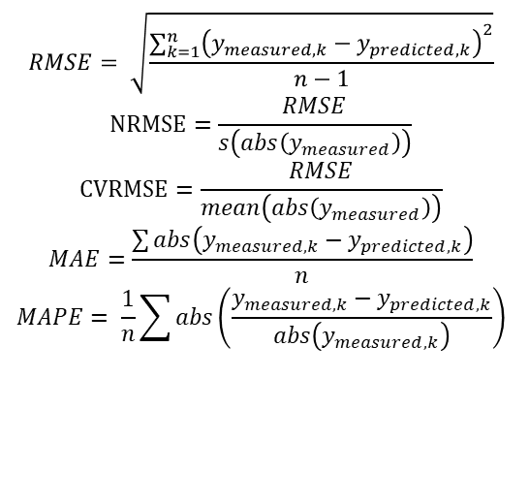
Metrics
Absolute error
Mean absolute errors (MAE)
Relative percentage errors
RMSE (NRMSE, CVRMSE)
Mean absolute percentage error
$$RMSE= \sqrt{\frac{\sum_{k=1}^{n}{{\left(y_{measured,k}−y_{predicted,k}\right)}^{2}}}{n−1}}$$
$$NRMSE=\frac{RMSE}{s\left(abs\left(y_{measured}\right)\right)}$$
$$CVRMSE=\frac{RMSE}{mean\left(abs\left(y_{measured}\right)\right)}$$
$$MAE=\frac{\sum{abs\left(y_{measured,k}−y_{predicted,k}\right)}}{n}$$
$$MAPE= \frac{1}{n}\sum{abs\left(\frac{y_{measured,k}−y_{predicted,k}}{abs\left(y_{measured,k}\right)}\right)}$$
Notes:
Absolute error/ Relative error
1. Coefficient of variation; The ASHRAE Guideline 14, hourly should be below 30%
2. MAPE (absolute energy consumption)

Slide 14
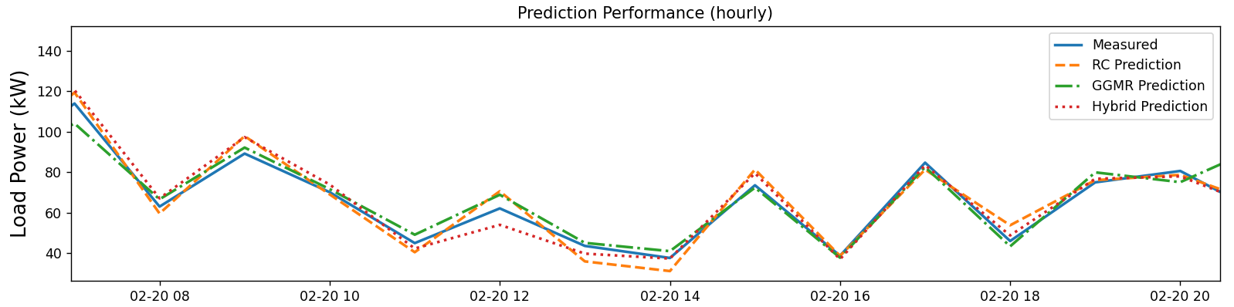
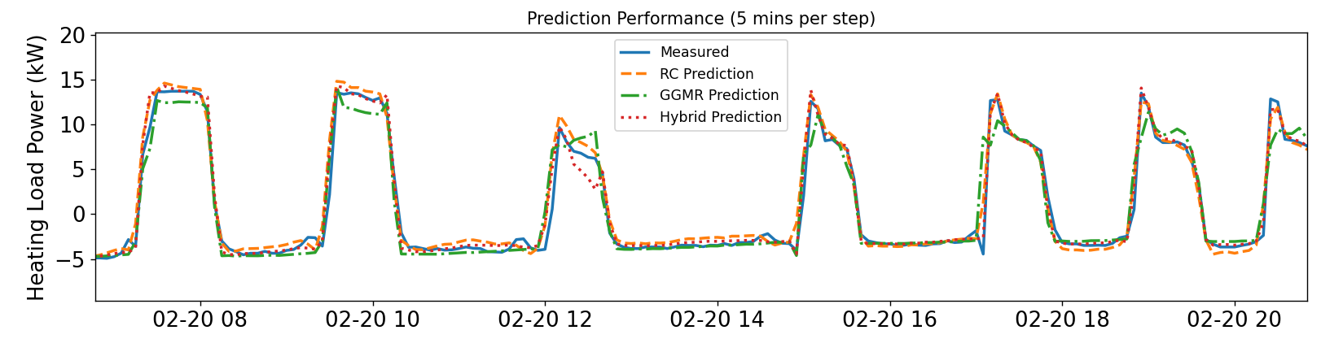
Performance
Notes:
Measurement;
RC, GGMR (No RC prediction), Hybrid (With RC prediction available)
When get the prediction from RC, it become Hybrid, the best performance.

Slide 15
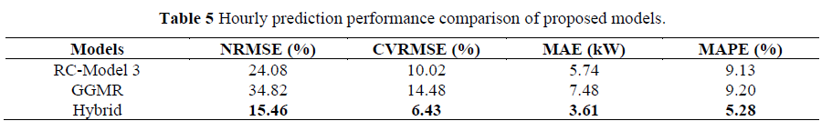
Performance
Notes:
6.43 CVRMSE (Much lower than 30%)

Slide 16
Conclusions
In the current study, from the comparison of the Resistor Capacitor network, GGMR, and the hybrid approach:
RC model has better explainability, prediction than GGMR.
GGMR is easier to get constructed and trained than RC model.
The hybrid approach (RC+GGMR) has the best prediction performance among these approaches.

Slide 17
Q&A
Thank you!

Slide 18
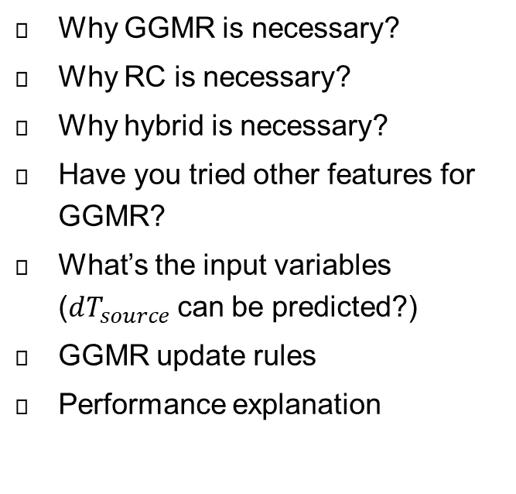
Possible Questions
Q
A
Why GGMR is necessary?
Why RC is necessary?
Why hybrid is necessary?
Have you tried other features for GGMR?
What’s the input variables ($dT_{source}$can be predicted?)
GGMR update rules
Performance explanation
RC: 𝑇𝑜𝑢𝑡,𝑇𝑠𝑙𝑎𝑏1,𝑇𝑐𝑎𝑣,𝑇𝑠𝑜𝑢𝑟𝑐𝑒,𝑄̇𝑠𝑜𝑙,𝑄̇𝑖𝑛𝑡,𝑄̇𝑙𝑖𝑔ℎ𝑡,𝑄̇𝐴𝐻𝑈,𝑑𝑇𝑠𝑜𝑢𝑟𝑐𝑒/𝑑𝑡
GGMR: 𝑇𝑜𝑢𝑡,𝑇𝑠𝑙𝑎𝑏𝑠,𝑇𝑐𝑎𝑣,𝑉𝑎𝑙𝑣𝑒𝑐𝑙,𝑉𝑎𝑙𝑣𝑒ℎ𝑡,𝐹𝑙𝑜𝑤𝑃𝑟𝑒𝑑𝑖𝑐𝑡𝑒𝑑,𝐺𝐺𝑀𝑅
Hybrid:
𝑇𝑜𝑢𝑡,𝑇𝑠𝑙𝑎𝑏𝑠,𝑇𝑐𝑎𝑣,𝑉𝑎𝑙𝑣𝑒𝑐𝑙,𝑉𝑎𝑙𝑣𝑒ℎ𝑡, 𝐹𝑙𝑜𝑤𝑃𝑟𝑒𝑑𝑖𝑐𝑡𝑒𝑑,𝐺𝐺𝑀𝑅,𝑅𝐶𝑝𝑟𝑒𝑑𝑖𝑐𝑡𝑒𝑑,𝑅𝑒𝑎𝑙𝑇𝑖𝑚𝑒
Notes:
RC: [𝑇𝑜𝑢𝑡,𝑇𝑠𝑙𝑎𝑏1,𝑇𝑐𝑎𝑣,𝑇𝑠𝑜𝑢𝑟𝑐𝑒,𝑄̇𝑠𝑜𝑙,𝑄̇𝑖𝑛𝑡,𝑄̇𝑙𝑖𝑔ℎ𝑡,𝑄̇𝐴𝐻𝑈,𝑑𝑇𝑠𝑜𝑢𝑟𝑐𝑒/𝑑𝑡]
GGMR: 𝑇𝑜𝑢𝑡,𝑇𝑠𝑙𝑎𝑏𝑠,𝑇𝑐𝑎𝑣,𝑉𝑎𝑙𝑣𝑒𝑐𝑙,𝑉𝑎𝑙𝑣𝑒ℎ𝑡,𝐹𝑙𝑜𝑤𝑃𝑟𝑒𝑑𝑖𝑐𝑡𝑒𝑑,𝐺𝐺𝑀𝑅
Hybrid: 𝑇𝑜𝑢𝑡,𝑇𝑠𝑙𝑎𝑏𝑠,𝑇𝑐𝑎𝑣,𝑉𝑎𝑙𝑣𝑒𝑐𝑙,𝑉𝑎𝑙𝑣𝑒ℎ𝑡, 𝐹𝑙𝑜𝑤𝑃𝑟𝑒𝑑𝑖𝑐𝑡𝑒𝑑,𝐺𝐺𝑀𝑅,𝑅𝐶𝑝𝑟𝑒𝑑𝑖𝑐𝑡𝑒𝑑,𝑅𝑒𝑎𝑙𝑇𝑖𝑚𝑒

Slide 19
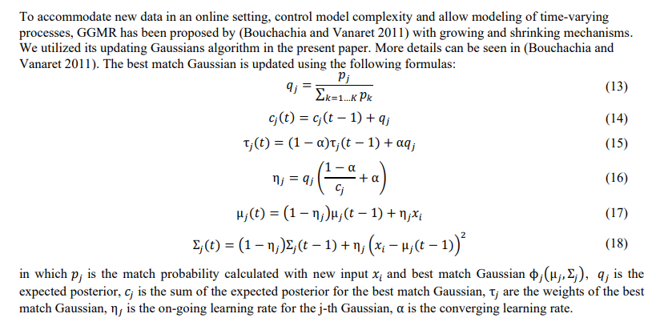
GGMR-Update Rules

Slide 20
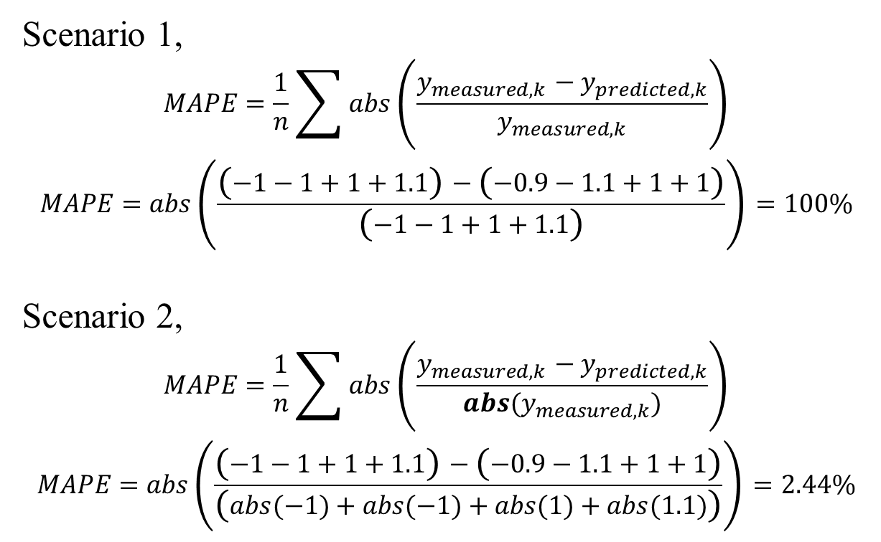
Hourly Performance Explanation
Scenario 1,
$$MAPE=\frac{1}{n}\sum{abs\left(\frac{y_{measured,k}−y_{predicted,k}}{y_{measured,k}}\right)}$$
$$MAPE=abs\left(\frac{\left(−1−1+1+1.1\right)−\left(−0.9−1.1+1+1\right)}{\left(−1−1+1+1.1\right)}\right)=100\%$$
Scenario 2,
$$MAPE=\frac{1}{n}\sum{abs\left(\frac{y_{measured,k}−y_{predicted,k}}{abs(y_{measured,k})}\right)}$$
$$MAPE=abs\left(\frac{\left(−1−1+1+1.1\right)−\left(−0.9−1.1+1+1\right)}{\left(abs(−1)+abs(−1)+abs(1)+abs(1.1)\right)}\right)=2.44\%$$

