Slide 1
New Batch
BIC EM
Gmm_new
Gmm_old

Slide 2





Current timestamp, $j$
${\left(j−k\right)}_{th}$ input
RC model
warming up
$$…$$
$j_{th}$ input
GGMR
Module
RC predicted load at timestamp j, $RC_{predicted,j}$
RC model prediction
RC Module

Slide 3































$$T_{out}$$
$$R_{env1,out}$$
$${α_{sol,env1}\dot{Q}}_{sol}$$
$${α_{sol,env2}\dot{Q}}_{sol}$$
$$T_{env,1}$$
$${α_{int,env2}\dot{Q}}_{int}$$
$$C_{env,1}$$
$${α_{light,env2}\dot{Q}}_{light}$$
$$R_{env1,env2}$$
$$T_{env,2}$$
$$C_{env,2}$$
$${α_{AHU,room}\dot{Q}}_{AHU}$$
$$T_{cav}$$
$$R_{room,env2}$$
$$T_{room}$$
$$T_{intwall}$$
$$T_{room}$$
$$R_{room,cav}$$
$$R_{room,iw}$$
$$R_{room,iw}$$
$${α_{sol,intwall}\dot{Q}}_{sol}$$
$$C_{room}$$
$${α_{int,intwall}\dot{Q}}_{int}$$
$$R_{room,slab}$$
$$C_{intwall}$$
$${α_{light,intwall}\dot{Q}}_{light}$$
$$T_{slab}$$
$${\dot{Q}}_{rad}$$
$$Boundary temperature$$
$$State temperature$$

Slide 4











$$T_{out}$$
$$R_{env1,out}$$
$${α_{sol,env1}\dot{Q}}_{sol}$$
$${α_{sol,env2}\dot{Q}}_{sol}$$
$$T_{env,1}$$
$${α_{int,env2}\dot{Q}}_{int}$$
$$C_{env,1}$$
$${α_{light,env2}\dot{Q}}_{light}$$
$$R_{env1,env2}$$
$$T_{env,2}$$
$$C_{env,2}$$
$${α_{AHU,room}\dot{Q}}_{AHU}$$
$$T_{cav}$$
$$R_{room,env2}$$
$$T_{room}$$
$$T_{intwall}$$
$$T_{room}$$
$$R_{room,cav}$$
$$R_{room,iw}$$
$$R_{room,iw}$$
$${α_{sol,intwall}\dot{Q}}_{sol}$$
$$C_{room}$$
$${α_{int,intwall}\dot{Q}}_{int}$$
$$R_{room,slab1}$$
$$C_{intwall}$$
$$T_{slab,2}$$
$${α_{light,intwall}\dot{Q}}_{light}$$
$$T_{slab, 1}$$
$$T_{source}$$
$$R_{slab1,slab2}$$
$$R_{slab2,source}$$
$$Boundary temperature$$
$${\dot{Q}}_{rad}$$
$$State temperature$$
$$C_{source}$$
$$C_{slab,2}$$

Slide 5



$$T_{out}$$
$$R_{env1,out}$$
$${α_{sol,env1}\dot{Q}}_{sol}$$
$${α_{sol,env2}\dot{Q}}_{sol}$$
$$T_{env,1}$$
$${α_{int,env2}\dot{Q}}_{int}$$
$$C_{env,1}$$
$${α_{light,env2}\dot{Q}}_{light}$$
$$R_{env1,env2}$$
$$T_{env,2}$$
$$C_{env,2}$$
$${α_{AHU,room}\dot{Q}}_{AHU}$$
$$T_{cav}$$
$$R_{room,env2}$$
$$T_{room}$$
$$T_{intwall}$$
$$T_{room}$$
$$R_{room,cav}$$
$$R_{room,iw}$$
$$R_{room,iw}$$
$${α_{sol,intwall}\dot{Q}}_{sol}$$
$$C_{room}$$
$${α_{int,intwall}\dot{Q}}_{int}$$
$$R_{room,slab1}$$
$$C_{intwall}$$
$$T_{slab,2}$$
$${α_{light,intwall}\dot{Q}}_{light}$$
$$T_{slab, 1}$$
$$T_{source}$$
$$T_{sink}$$
$$R_{slab1,slab2}$$
$$R_{slab2,source}$$
$$R_{source,sink}$$
$$Boundary temperature$$
$${\dot{Q}}_{rad}$$
$$State temperature$$
$$C_{source}$$
$$C_{slab,2}$$
$$C_{sink}$$

Slide 6
Historical data
(HRSS operation, outdoor, indoor condition)
GMM
Training
Update
Building physical description
RC
Hybrid
Approach
Training
Predicted load
RC model Inputs
GGMR model inputs
Real-time measurements
Notes:
$$T_{source},{\dot{Q}}_{sol},{\dot{Q}}_{int},{\dot{Q}}_{light},{\dot{Q}}_{AHU},\frac{dT_{source}}{dt},T_{out},T_{slab1},T_{cav},Valve_{cl},Valve_{ht}$$

Slide 7
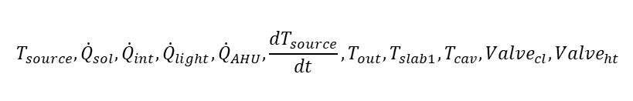
Historical data
(HRSS operation, outdoor, indoor condition)
GMM
Training
Update
Building physical description
RC
Hybrid
Training
Predicted load
$$T_{source},{\dot{Q}}_{sol},{\dot{Q}}_{int},{\dot{Q}}_{light},{\dot{Q}}_{AHU},\frac{dT_{source}}{dt},T_{out},T_{slab1},T_{cav},Valve_{cl},Valve_{ht}$$
Real-time measurements
Notes:
$$T_{source},{\dot{Q}}_{sol},{\dot{Q}}_{int},{\dot{Q}}_{light},{\dot{Q}}_{AHU},\frac{dT_{source}}{dt},T_{out},T_{slab1},T_{cav},Valve_{cl},Valve_{ht}$$

Slide 8












$$T_{out}$$
$${α_{sol,env2}\dot{Q}}_{sol}$$
$${α_{int,env2}\dot{Q}}_{int}$$
$${α_{sol,env1}\dot{Q}}_{sol}$$
$${α_{light,env2}\dot{Q}}_{light}$$
$$T_{env,1}$$
$$C_{env,1}$$
$$T_{env,2}$$
$$C_{env,2}$$
$${α_{AHU,room}\dot{Q}}_{AHU}$$
$$T_{cav}$$
$$T_{room}$$
$$T_{intwall}$$
$$T_{room}$$
$$C_{room}$$
$${α_{sol,intwall}\dot{Q}}_{sol}$$
$${α_{int,intwall}\dot{Q}}_{int}$$
$$C_{intwall}$$
$${α_{light,intwall}\dot{Q}}_{light}$$
$$T_{slab}$$
$${\dot{Q}}_{rad}$$
$$Boundary temperature$$
$$State temperature$$
$$C_{slab}$$

Slide 9


$$T_{out}$$
$${α_{sol,env2}\dot{Q}}_{sol}$$
$${α_{int,env2}\dot{Q}}_{int}$$
$${α_{sol,env1}\dot{Q}}_{sol}$$
$${α_{light,env2}\dot{Q}}_{light}$$
$$T_{env,1}$$
$$C_{env,1}$$
$$T_{env,2}$$
$$C_{env,2}$$
$${α_{AHU,room}\dot{Q}}_{AHU}$$
$$T_{cav}$$
$$T_{room}$$
$$T_{intwall}$$
$$T_{room}$$
$$C_{room}$$
$${α_{sol,intwall}\dot{Q}}_{sol}$$
$${α_{int,intwall}\dot{Q}}_{int}$$
$$C_{intwall}$$
$${α_{light,intwall}\dot{Q}}_{light}$$
$$T_{slab,2}$$
$$T_{slab}$$
$$T_{source}$$
$$Boundary temperature$$
$$State temperature$$
$${\dot{Q}}_{rad}$$
$$C_{slab,2}$$
$$C_{source}$$

Slide 10
Pipe
Concrete
Insulation

Slide 11




$$T_{out}$$
$${α_{sol,env2}\dot{Q}}_{sol}$$
$${α_{int,env2}\dot{Q}}_{int}$$
$$R_{out, env1}$$
$${α_{sol,env1}\dot{Q}}_{sol}$$
$${α_{light,env2}\dot{Q}}_{light}$$
$$T_{env,1}$$
$$C_{env,1}$$
$$T_{env,2}$$
$$C_{env,2}$$
$${α_{AHU,room}\dot{Q}}_{AHU}$$
$$T_{cav}$$
$$T_{room}$$
$$T_{intwall}$$
$$T_{room}$$
$R_{cav, room}$
$$C_{room}$$
$${α_{sol,intwall}\dot{Q}}_{sol}$$
$${α_{int,intwall}\dot{Q}}_{int}$$
$$C_{intwall}$$
$${α_{light,intwall}\dot{Q}}_{light}$$
$$T_{slab}$$
$${\dot{Q}}_{rad}$$
$$C_{slab}$$

Slide 12




















$$Radiant Slab Systems Heating Power Prediction RC Model$$
$$T_{out}$$
$$R_{out, env}$$
$${α_{sol,env}\dot{Q}}_{sol}$$
$$T_{env}$$
$$C_{env}$$
$$R_{env, room}$$
$$T_{cav}$$
$$R_{cav, room}$$
$$T_{room}$$
$${α_{sol,room}\dot{Q}}_{sol}$$
$${α_{int,room}\dot{Q}}_{int}$$
$${α_{light,room}\dot{Q}}_{light}$$
$$C_{room}$$
$${α_{AHU,room}\dot{Q}}_{AHU}$$
$$R_{room, slab}$$
$$T_{slab}$$
$${\dot{Q}}_{rad}$$
$$α_{sol,slab}{\dot{Q}}_{sol}$$
$$α_{light,slab}{\dot{Q}}_{light}$$
$$C_{slab}$$

Slide 13































$${α_{sol,env2}\dot{Q}}_{sol}$$
$$T_{out}$$
$${α_{int,env2}\dot{Q}}_{int}$$
$${α_{light,env2}\dot{Q}}_{light}$$
$$R_{out, env}$$
$${α_{sol,env}\dot{Q}}_{sol}$$
$${α_{AHU,env2}\dot{Q}}_{AHU}$$
$${α_{sol,cav2}\dot{Q}}_{sol}$$
$$T_{env,1}$$
$$C_{env,1}$$
$${α_{int,cav2}\dot{Q}}_{int}$$
$${α_{sol,room}\dot{Q}}_{sol}$$
$${α_{light,cav2}\dot{Q}}_{light}$$
$${α_{int,room}\dot{Q}}_{int}$$
$${α_{AHU,cav2}\dot{Q}}_{AHU}$$
$$T_{env,2}$$
$${α_{light,room}\dot{Q}}_{light}$$
$$C_{env,2}$$
$${α_{AHU,room}\dot{Q}}_{AHU}$$
$$T_{cav,1}$$
$$T_{cav,2}$$
$$T_{room}$$
$$T_{intwall}$$
$$T_{room}$$
$R_{cav, room}$ / 2
$R_{cav, room}$ / 2
$$C_{room}$$
$$C_{intwall}$$
$${α_{sol,intwall}\dot{Q}}_{sol}$$
$$C_{cav,2}$$
$${α_{int,intwall}\dot{Q}}_{int}$$
$$T_{slab,2}$$
$$C_{slab,2}$$
$${α_{light,intwall}\dot{Q}}_{light}$$
$${α_{AHU,intwall}\dot{Q}}_{AHU}$$
$${α_{sol,slab}\dot{Q}}_{sol}$$
$${α_{int,slab}\dot{Q}}_{int}$$
$$T_{slab,1}$$
$${\dot{Q}}_{rad}$$
$${α_{light,slab}\dot{Q}}_{light}$$
$${α_{AHU,slab}\dot{Q}}_{AHU}$$
$$C_{slab,1}$$

Slide 14












$$1. Radiant Slab Floor Radiation\left(Heating Flux\right)Prediction RC Model$$
$$R_{room, slab}$$
$$R_{slab, source}$$
$$R_{source, sink}$$
$$T_{room}$$
$$T_{slab}$$
$$T_{source}$$
$$T_{sink}$$
$$α_{sol,slab}{\dot{Q}}_{sol}$$
$$C_{slab}$$
$$C_{source}$$
$$C_{sink}$$
$$α_{light,slab}{\dot{Q}}_{light}$$

Slide 15


$$2.Room Temperature Prediction RC Model$$
$$T_{out}$$
$$R_{out, env}$$
$${α_{sol,env}\dot{Q}}_{sol}$$
$$T_{env}$$
$$C_{env}$$
$$R_{env, room}$$
$$T_{cav}$$
$$R_{cav, room}$$
$$T_{room}$$
$${α_{sol,room}\dot{Q}}_{sol}$$
$${α_{int,room}\dot{Q}}_{int}$$
$${α_{light,room}\dot{Q}}_{light}$$
$$C_{room}$$
$${\dot{Q}}_{AHU }$$
$$R_{room, slab}$$
$$T_{slab}$$

Slide 16



$$Radiant Slab Floor Temperature Prediction RC Model$$
$$α_{light,slab}{\dot{Q}}_{light}$$
$$R_{room, slab}$$
$$R_{slab, source}$$
$$R_{source, sink}$$
$$T_{room}$$
$$T_{slab}$$
$$T_{source}$$
$$T_{adj}$$
$$α_{sol,slab}{\dot{Q}}_{sol}$$
$$C_{slab}$$
$${\dot{Q}}_{rad}$$
$$C_{source}$$

Slide 17







$$Facade Space Temperature Prediction RC Model$$
$$R_{out, cav}$$
$$T_{cav}$$
$$R_{cav, room}$$
$$T_{out}$$
$$T_{room}$$
$$α_{sol,cav}{\dot{Q}}_{sol}$$
$$C_{cav}$$

Slide 18























$$T_{out}$$
$$R_{out, room}$$
$$R_{out, cav}$$
$$T_{cav}$$
$$R_{cav, room}$$
$${\dot{Q}}_{int,room}$$
$$T_{out}$$
$$T_{room}$$
$${\dot{Q}}_{int,sur}$$
$$C_{room}$$
$$R_{room,sur}$$
$$C_{cav}$$
$${\dot{Q}}_{sol, cav}$$
$${\dot{Q}}_{sol, room}$$
$$T_{sur}$$
$$R_{sur, so}$$
$${\dot{Q}}_{sol, sur}$$
$$T_{so}$$
$$C_{sur}$$
$$R_{so, si}$$
$$C_{so}$$
$$T_{si}$$
$$C_{si}$$

Slide 19







$$3.Radiant Slab Systems Heating Power Prediction RC Model$$
$$T_{out}$$
$$R_{out, env}$$
$${α_{sol,env}\dot{Q}}_{sol}$$
$$T_{env}$$
$$C_{env}$$
$$R_{env, room}$$
$$T_{cav}$$
$$R_{cav, room}$$
$$T_{room}$$
$${α_{sol,room}\dot{Q}}_{sol}$$
$${α_{int,room}\dot{Q}}_{int}$$
$${α_{light,room}\dot{Q}}_{light}$$
$$C_{room}$$
$${\dot{Q}}_{AHU }$$
$$R_{room, slab}$$
$$R_{slab, source}$$
$$R_{source, sink}$$
$$T_{source}$$
$$T_{sink}$$
$$T_{slab}$$
$$α_{sol,slab}{\dot{Q}}_{sol}$$
$$α_{light,slab}{\dot{Q}}_{light}$$
$$C_{slab}$$
$${\dot{Q}}_{rad}$$
$$C_{source}$$
$$C_{sink}$$

Slide 20
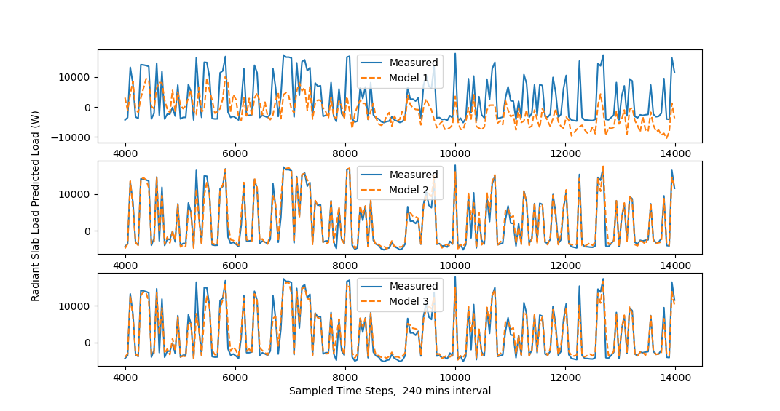
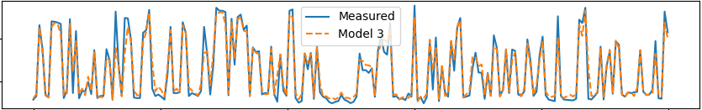
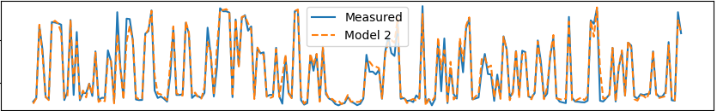
2
3

Slide 21
Electricity /Gas …
Hot Water / Chilled Water
Heating/cooling loads due to outdoor/indoor environment

