Slide 1
A Novel Hybrid Modeling Method for Predicting Energy Use of Hydronic Radiant Slab Systems
Lichen WU¹, Liping WANG¹, James BRAUN²
¹Department of Civil and Architectural Engineering, University of Wyoming, Laramie, WY, 82071, United States
lwang12@uwyo.edu
²School of Mechanical Engineering, Purdue University, West Lafayette, IN 47907-2088, United States

Slide 2
Motivation
Challenge
radiant slab systems with large thermal capacitance
Existing approaches
first-principles (e.g., CFD)
Inverse grey-box Resistor-Capacitor (RC) model
Data-driven approach (Gaussian mixture regression, growing-GMR)
Notes:
How to describe the current challenges

Slide 3
Motivation
Challenge
radiant slab systems with large thermal capacitance
Existing approaches
first-principles (e.g., CFD)
Inverse grey-box Resistor-Capacitor (RC) model
Data-driven approach (Gaussian mixture regression, growing-GMR)
Notes:
How to describe the current challenges

Slide 4
Motivation
Challenge
radiant slab systems with large thermal capacitance
Existing approaches
first-principles (e.g., CFD)
Inverse grey-box Resistor-Capacitor (RC) model
Data-driven approach (Gaussian mixture regression, growing-GMR)
Notes:
How to describe the current challenges

Slide 5
Motivation
Challenge
radiant slab systems with large thermal capacitance
Existing approaches
first-principles (e.g., CFD)
Inverse grey-box Resistor-Capacitor (RC) model
Data-driven approach (Gaussian mixture regression, growing-GMR)
Notes:
How to describe the current challenges

Slide 6
Intro to RC, GMR and GGMR
RC
Developing (flexible)
Training
Predict
Inputs randomly initialize
Recursive prediction
Notes:
1 Developing
Heat balance -> State space representation
(Physical components ->Temperature nodes (Which one? How many?))
Inputs -> Outdoor temperature, solar radiation
Output -> Space load, secondary load, primary energy loads

Slide 7
Intro to RC, GMR and GGMR
RC
Developing (flexible)
Training
Predict
Inputs randomly initialize
Recursive prediction
Notes:
1 Developing
Heat balance -> State space representation
(Physical components ->Temperature nodes (Which one? How many?))
Inputs -> Outdoor temperature, solar radiation
Output -> Space load, secondary load, primary energy loads

Slide 8


Intro to RC, GMR and GGMR
RC
Developing (flexible)
Training
Predict
Inputs randomly initialize
Recursive prediction
Notes:
1 Developing
Heat balance -> State space representation
(Physical components ->Temperature nodes (Which one? How many?))
Inputs -> Outdoor temperature, solar radiation
Output -> Space load, secondary load, primary energy loads

Slide 9

Intro to RC, GMR and GGMR
RC
Developing (flexible)
Training
Predict
Inputs randomly initialize
Recursive prediction
Notes:
1 Developing
Heat balance -> State space representation
(Physical components ->Temperature nodes (Which one? How many?))
Inputs -> Outdoor temperature, solar radiation
Output -> Space load, secondary load, primary energy loads

Slide 10
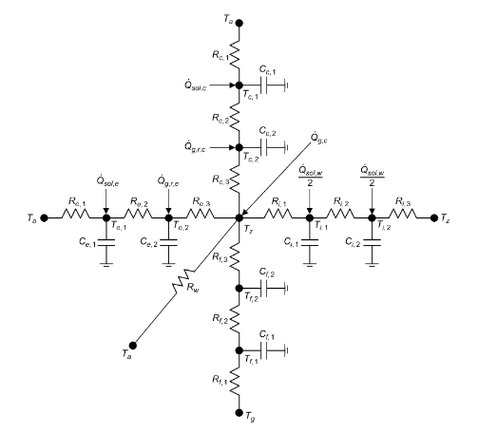
Intro to RC, GMR and GGMR
RC
Developing (flexible)
Training
Predict
Inputs randomly initialize
Recursive prediction
Notes:
1 Developing
Heat balance -> State space representation
(Physical components ->Temperature nodes (Which one? How many?))
Inputs -> Outdoor temperature, solar radiation
Output -> Space load, secondary load, primary energy loads

Slide 11
Intro to RC, GMR and GGMR
RC
Developing (flexible)
Training
Predict
Inputs randomly initialize
Recursive prediction
Notes:
1 Developing
2. Training process

Slide 12

Intro to RC, GMR and GGMR
RC
Developing (flexible)
Training
Predict
Inputs randomly initialize
Recursive prediction
Notes:
1 Developing
2. Training process

Slide 13
Intro to RC, GMR and GGMR
RC
Developing (flexible)
Training
Predict
Inputs randomly initialize
Recursive prediction
Notes:
1 Developing
2. Training process

Slide 14
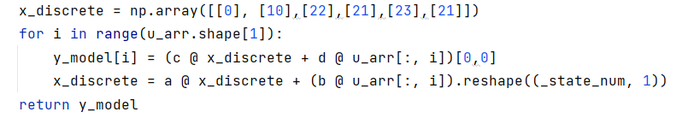
Intro to RC, GMR and GGMR
RC
Developing (flexible)
Training
Predict
Inputs randomly initialize
Recursive prediction
Notes:
1 Developing
2. Training process

Slide 15
Intro to RC, GMR and GGMR
RC
Developing (flexible)
Training
Predict
Inputs randomly initialize
Recursive prediction
Notes:
1 Developing
2. Training process

Slide 16
Intro to RC, GMR and GGMR
RC
Developing (flexible)
Training
Predict
Inputs randomly initialize
Recursive prediction
Notes:
1 Developing
2. Training process

Slide 17
Intro to RC, GMR and GGMR
RC
Developing (flexible)
Training
Predict
Inputs randomly initialize
Recursive prediction
Notes:
1 Developing
2. Training process

Slide 18
Intro to RC, GMR and GGMR
RC
Developing (flexible)
Training
Predict
Inputs randomly initialize
Recursive prediction
Notes:
1 Developing
2. Training process

Slide 19
Intro to RC, GMR and GGMR
RC
Developing (flexible)
Training
Predict
Inputs randomly initialize
Recursive prediction
Notes:
1 Developing
2. Training process

Slide 20
Intro to RC, GMR and GGMR
RC
Developing (flexible)
Training
Predict
Inputs randomly initialize
Recursive prediction
Notes:
1 Developing
2. Training process

Slide 21
Intro to RC, GMR and GGMR
RC
Developing (flexible)
Training
Predict (warm-up time steps)
Inputs randomly initialize
Recursive prediction
Notes:
1 Developing
2. Training process

Slide 22
Intro to RC, GMR and GGMR
RC
Developing (flexible)
Training
Predict (warm-up time steps)
Inputs randomly initialize
Recursive prediction
Notes:
1 Developing
2. Training process

Slide 23
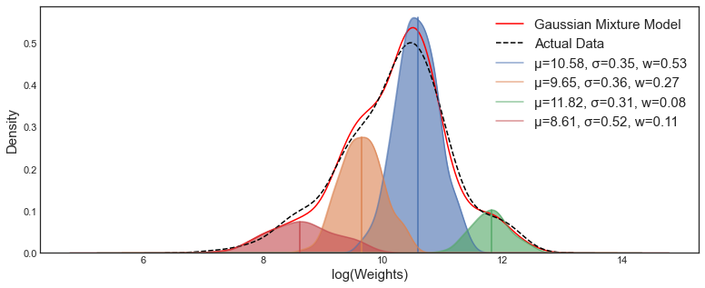
Intro to RC, GMR and GGMR
GMR
Notes:
1 Developing
2. Training process

Slide 24
Intro to RC, GMR and GGMR
New Data
New
Component
New Data
New
Component
…
Components
grow
Components
grow
Components

Slide 25





Novel approach
Hybrid approach
RC + GGMR
Current timestamp, $j$
${\left(j−k\right)}_{th}$ input
RC model
warming up
$$…$$
$j_{th}$ input
GGMR
Module
RC predicted load at timestamp j, $RC_{predicted,j}$
RC model prediction
RC Module
Notes:
Simple RC models and warming up steps

Slide 26


Novel approach
Hybrid approach
RC + GGMR
Current timestamp, $j$
${\left(j−k\right)}_{th}$ input
RC model
warming up
$$…$$
$j_{th}$ input
GGMR
Module
RC predicted load at timestamp j, $RC_{predicted,j}$
RC model prediction
RC Module
Notes:
Simple RC models and warming up steps

Slide 27



Novel approach
Hybrid approach
RC + GGMR
Complexities
Warm-up time steps
Current timestamp, $j$
${\left(j−k\right)}_{th}$ input
RC model
warming up
$$…$$
$j_{th}$ input
GGMR
Module
RC predicted load at timestamp j, $RC_{predicted,j}$
RC model prediction
RC Module
Notes:
Simple RC models and warming up steps

Slide 28
Novel approach
Hybrid approach
RC + GGMR
Complexities
Warm-up time steps
Current timestamp, $j$
${\left(j−k\right)}_{th}$ input
RC model
warming up
$$…$$
$j_{th}$ input
GGMR
Module
RC predicted load at timestamp j, $RC_{predicted,j}$
RC model prediction
RC Module
Notes:
Simple RC models and warming up steps

Slide 29
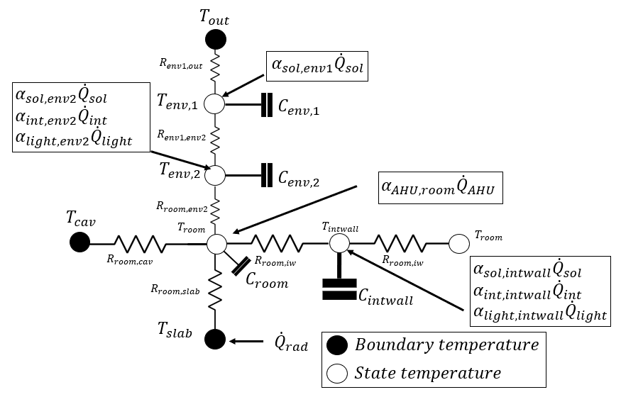
RC approach

Slide 30
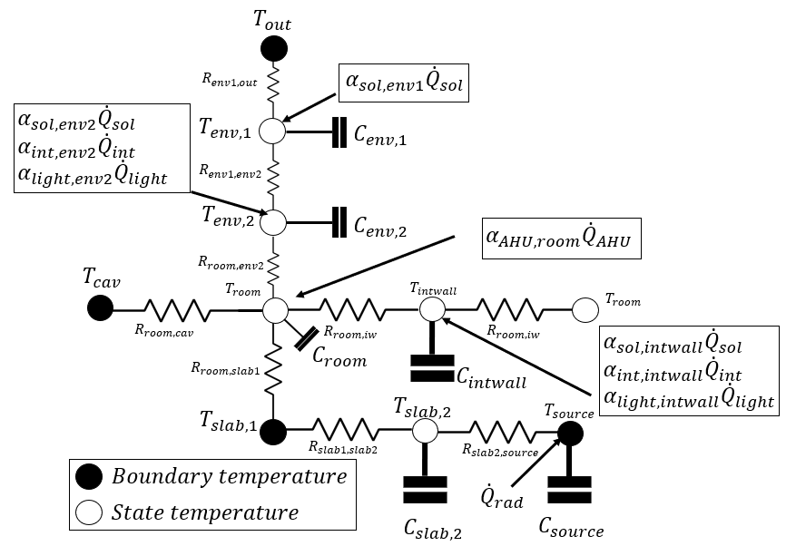
RC approach

Slide 31
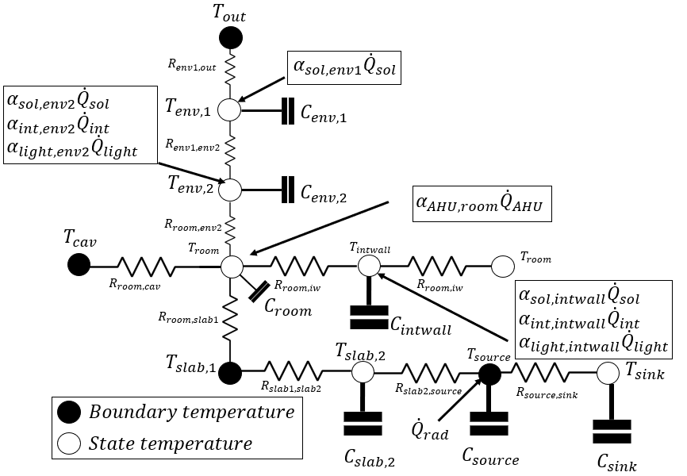
RC approach

Slide 32
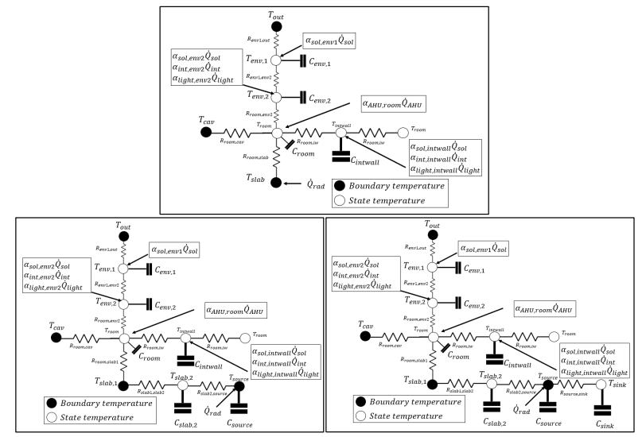
RC approach

Slide 33
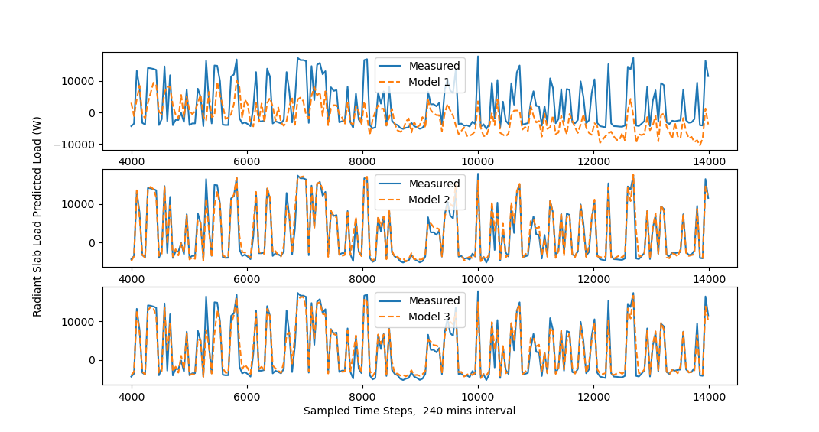
RC approach

Slide 34
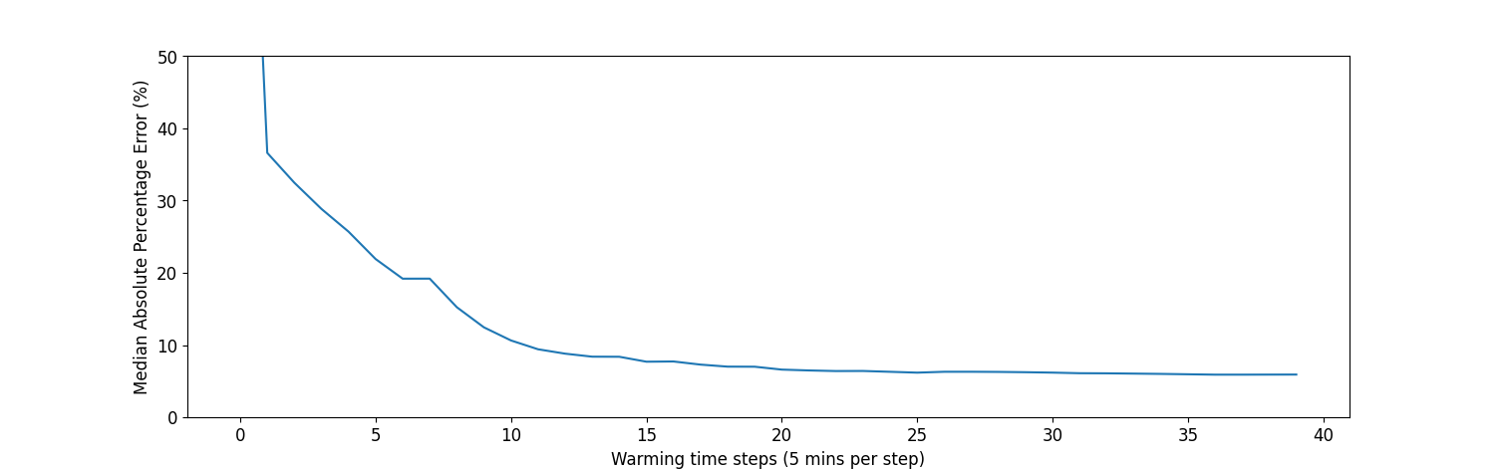
Warming up steps

Slide 35

Metrics
Absolute error
Mean absolute errors (MAE)
Relative percentage errors
RMSE (NRMSE, CVRMSE)
Mean absolute percentage error
Median absolute percentage error

Slide 36
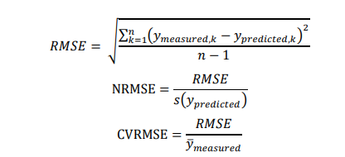
Metrics
Absolute error
Mean absolute errors (MAE)
Relative percentage errors
RMSE (NRMSE, CVRMSE)
Mean absolute percentage error
Median absolute percentage error

Slide 37

Metrics
Absolute error
Mean absolute errors (MAE)
Relative percentage errors
RMSE (NRMSE, CVRMSE)
Mean absolute percentage error
Median absolute percentage error

Slide 38
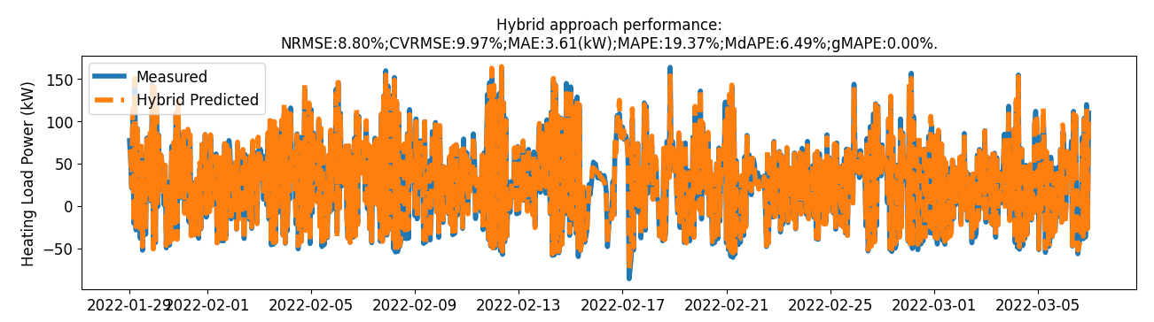
Performance
Dated load predictions, percentage errors

Slide 39
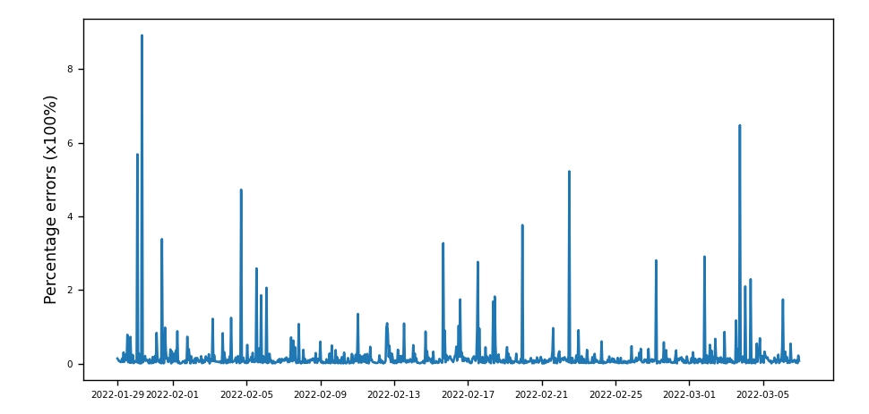
Performance
Dated load predictions, percentage errors

Slide 40
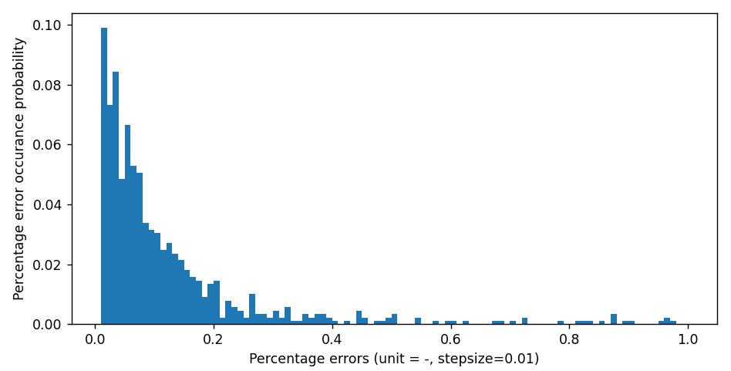
Performance
Percentage errors histograms

Slide 41
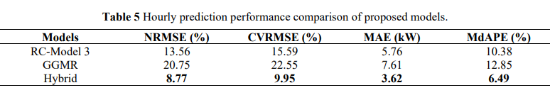
Performance

Slide 42
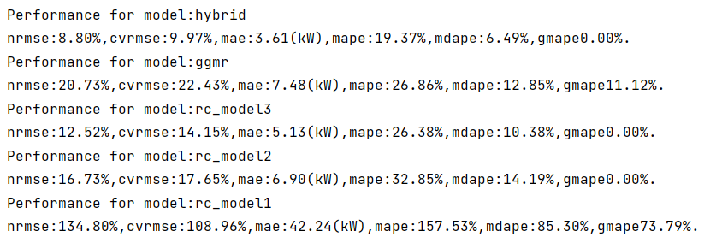
Conclusions?

Slide 43
Q & A
Why GGMR is necessary
Have you tried other features for GGMR?

Slide 44
