Slide 1

Predicting mortality

Slide 2
Title of presentation
Secondary title
Name
Name
Department
Institution
Month XX, 20XX

Slide 3
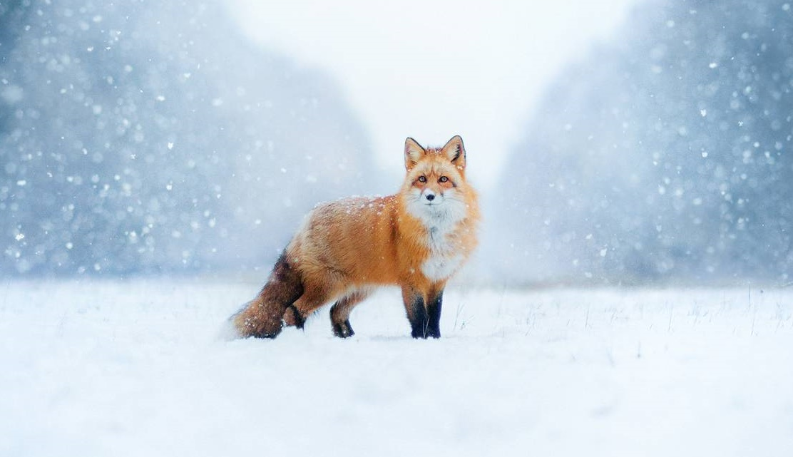
Coat-color variation in red foxes
Environmental factors that affect fur color
Hayden Cook
Quinn Campbell, Ph.D.
Department of Biology
Jasper University
December 12, 2021

Slide 4
Title of presentation
Secondary title
Name
Name
Department
Institution
Month XX, 20XX

Slide 5

Coat-color variation in red foxes
Environmental factors that affect fur color
Hayden Cook
Quinn Campbell, Ph.D.
Department of Biology
Jasper University
December 12, 2021

Slide 6
Short summary of the presentation; no longer than two lines​
Title of section 1
Title of section 2
Title of section 3

Slide 7
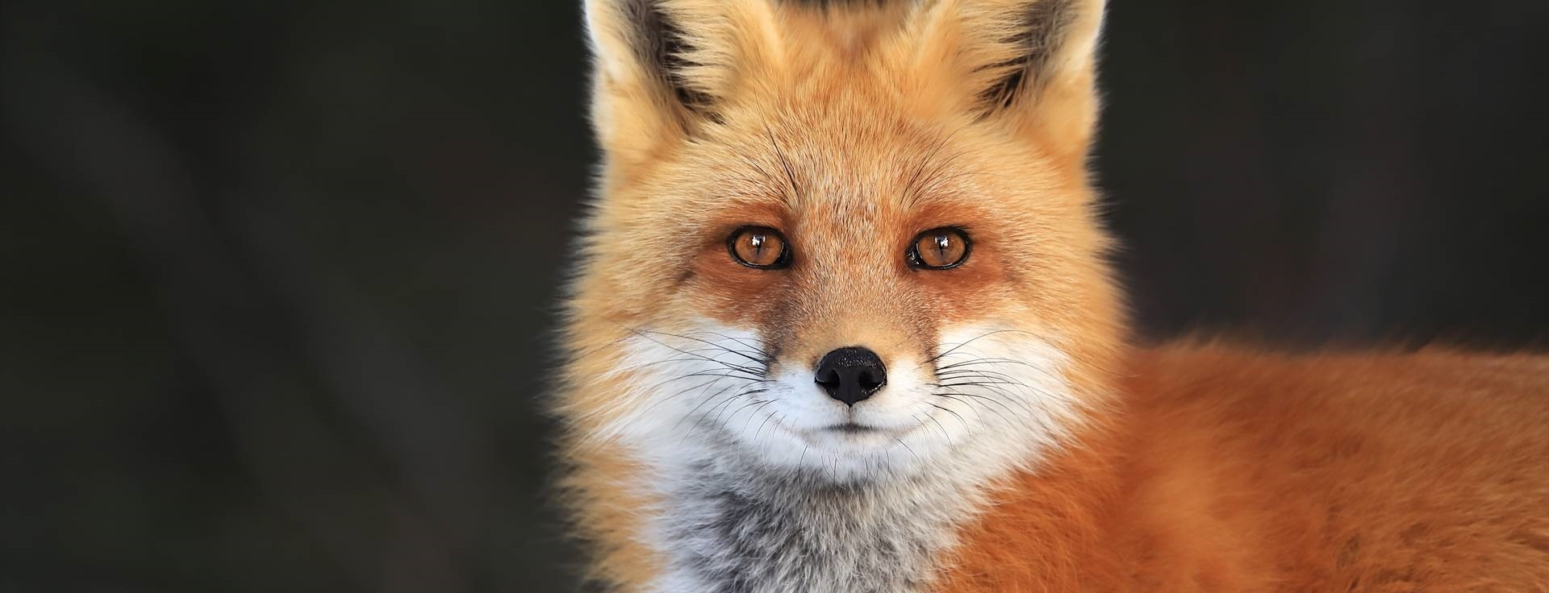
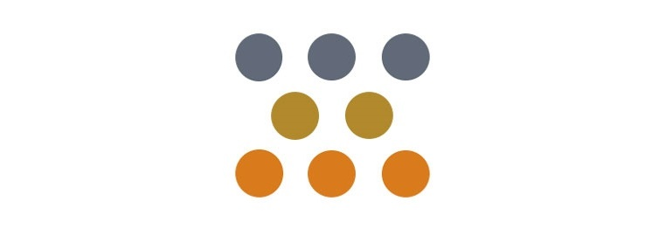

This study focused on coat-color variation in red foxes to learn if environmental factors affect coat-color outcomes
Coat-color variation in
red foxes
Population density and
coat color​
Elevation and coat
color​

Slide 8
One-sentence headline stating the main takeaway message for the slide; no longer than two lines
Info or call-out
Info or call-out
Info or call-out

Slide 9
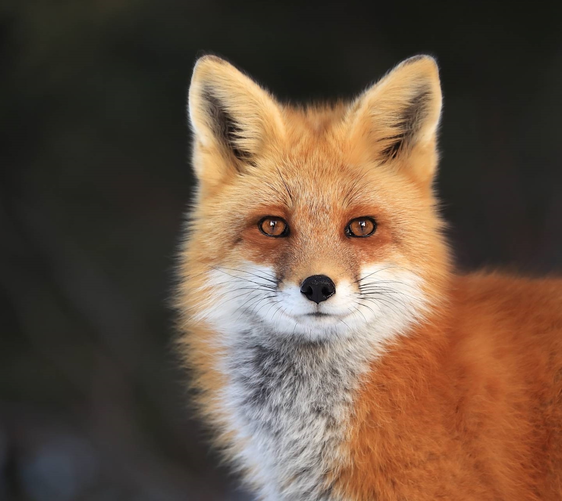
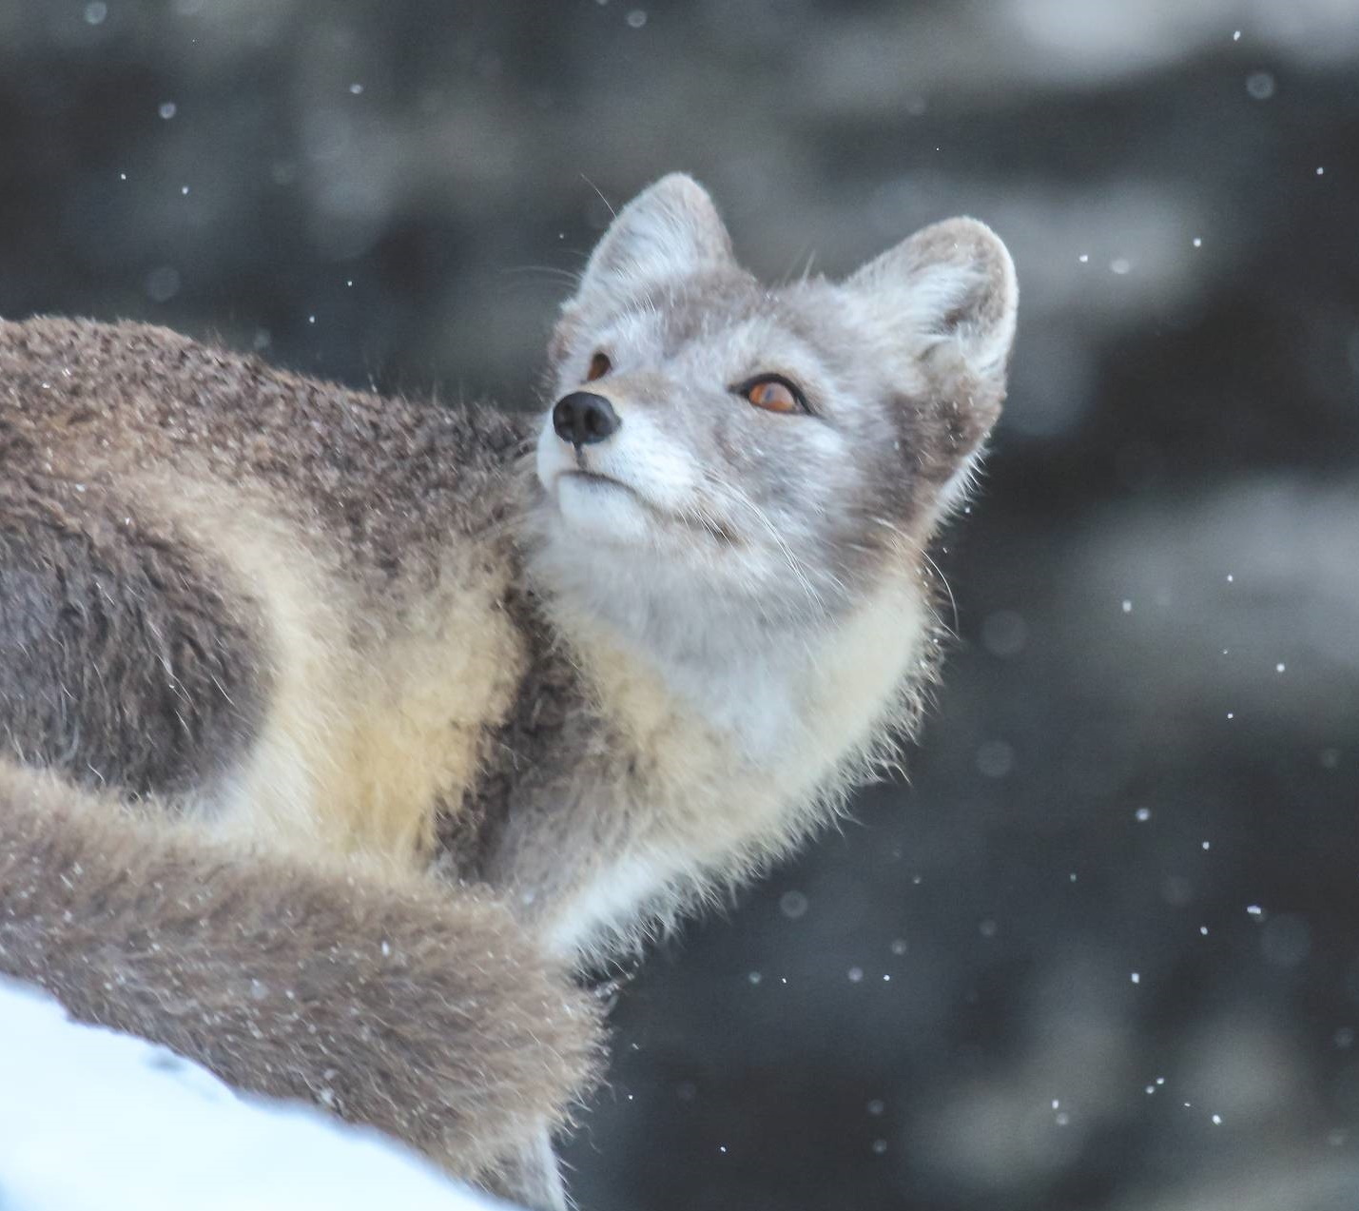
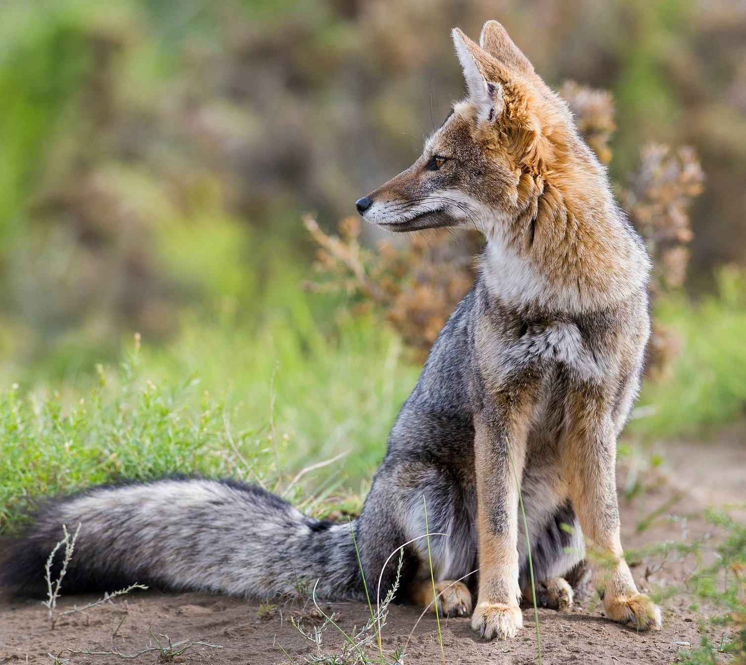
Red, cross, and silver color outcomes are controlled by two pairs of non-linked autosomal genes
Red: AABB​
Silver: AAbb​
Cross: AaBb​

Slide 10
One-sentence headline stating the main takeaway message for the slide; no longer than two lines

Slide 11
Cross and silver color variants occur less frequently in dense fox populations
Coat color distribution in different size populations
15%
Silver
10%
10%
Cross
5%
75%
Red
85%
Average sized population
(<100 foxes in territory)
Dense sized population
(<100 foxes in territory)

Slide 12
One-sentence headline stating the main takeaway message for the slide; no longer than two lines

Slide 13
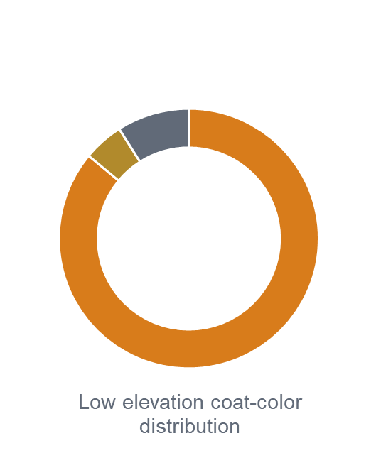
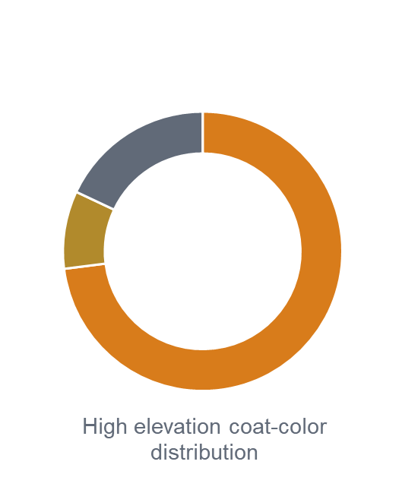

Elevation plays a role: Cross and silver color variants occur more frequently at elevations over 1828 meters (6000 ft)
9% silver
18% silver
5% cross
9% cross
86% red
73% red

Slide 14
In summary… followed by a sentence which restates the most important assertion of the presentation
Supporting point 1. No longer than two lines
Supporting point 2. No longer than two lines
Questions?

Slide 15

In summary, environmental factors affect coat-color variation in red foxes​
Population density impacts coat-color outcomes
Geographic elevation impacts coat-color outcomes
Questions?

Slide 16
In summary… followed by a sentence which restates the most important assertion of the presentation
Supporting point 1. no longer than two lines
Supporting point 2. no longer than two lines
Questions?

Slide 17

In summary, environmental factors affect coat-color variation in red foxes​
Population density impacts coat-color outcomes
Geographic elevation impacts coat-color outcomes
Questions?

Slide 18

This template was created in cooperation with scientific presentations expert Melissa Marshall. This template will help those presenting technical information be more understandable and engaging by using an “assertion/evidence” strategy. For more information, visit her website or listen to her TED talk.​ ​ Melissa’s approach is also informed by Michael Alley’s book, The Craft of Scientific Presentations.​

