Slide 1


医者初心
构建宠物健康养护新生态

Slide 2
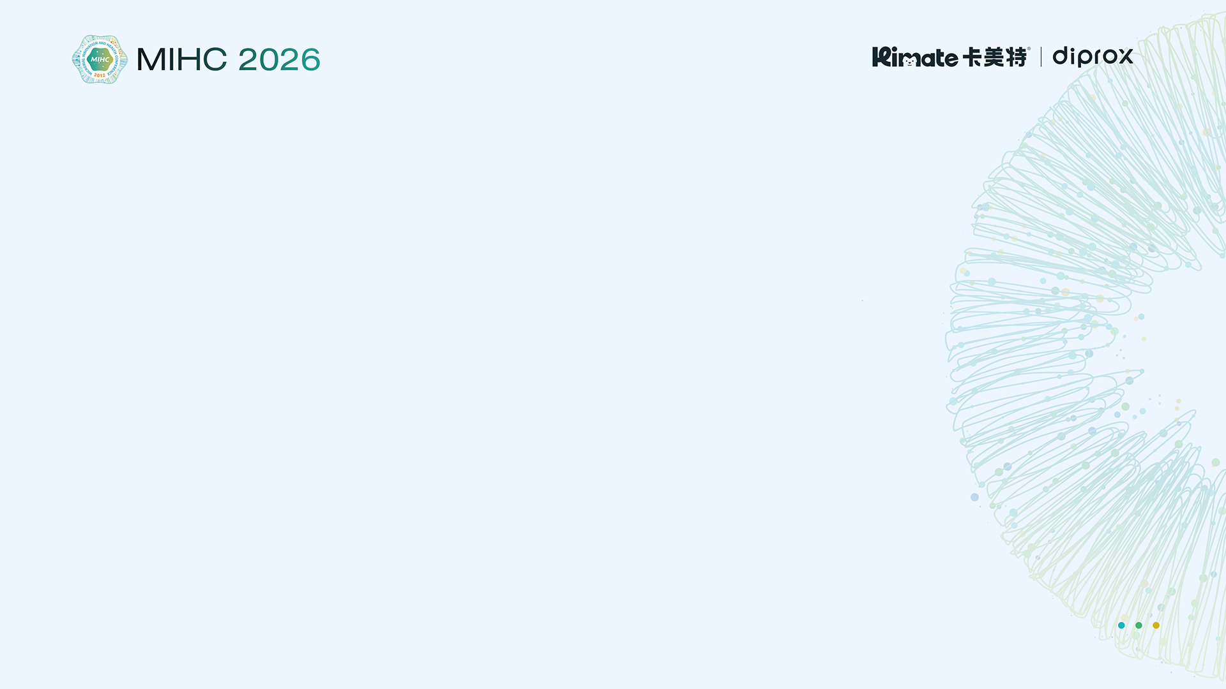






LOVE PET DAY
SINCE 2009
兰多湾 × LU CAFE × FUR · 创始人
董小琛 | 兰多湾宠物&LUCAFE 创始人CEO
FUR-VETRESKA PET STORE全球合伙人
运营10余家商场连锁宠物店(中国)FUR VETRESKA PET STORE(全球)
从业16年成功打造了兰多湾室外宠物乐园，室内恒温泳池，宠物下午茶兰多湾·LUCAFE，全网二百万粉丝网红IP
带领兰多湾两次获得亚展全国创新五强门店
擅长客户定位和新的消费风向把控，制定发展战略
专注服务与零售,每一步都努力奔向动物福利
2025-2026年用兽医视角赋能宠物健康养护体系
Dong Xiaochen | Founder & CEO of LDW PET & LUCAFE
Global Partner of FUR-VETRESKA PET STORE
Operates 10+ pet stores in shopping malls across China, while partnering with FUR-VETRESKA PET STORE on its global expansion.
With 16 years of experience in the pet industry, Dong Xiaochen has successfully developed a diverse portfolio of innovative pet lifestyle concepts, including the LDW Outdoor Pet Park, Indoor Heated Pet Swimming Pool, and LDW· LUCAFE, a pet café concept that has built a strong social media presence with over 2 million followers.
Under her leadership, LDW has twice been recognized as one of the Top 5 Most Innovative Pet Stores in China at Pet Fair Asia.
She specializes in customer positioning, emerging consumer trends, and strategic business development, with a strong focus on both service and retail. Every step of LDW’s growth is guided by a commitment to animal welfare.
From 2025 to 2026, she has focused on developing and empowering LDW’s Pet Health & Wellness Care System from a veterinary perspective, integrating professional health management concepts into everyday pet care and retail services.
十余家商场连锁购物中心PET SHOP和兰多湾·LU CAFE,占据天津核心商圈,总经营面积2000㎡。
二O二四年 未卡VETRESKA携手兰多湾打造布局 全球首家旗舰店FUR。完成首家中国宠物门店出海，开启全新海外业务。

Slide 3

兰多湾的健康养护理念
开启兰多湾4.0（4.5）版的全方位养护

Slide 4

兰多湾专注宠物健康生活与福祉
做最有影响力的高端宠物健康护理零售品牌
种下每一粒种子
终有一天，它们会连成金色的光
照亮每一个生命
THANK YOU

