Slide 1
MACHINE LEARNING
Section 5 EM Algorithm
Likelihood, Mixture Models and Clustering

Slide 2
Contact Information
Instructor: Qi Hao
E-mail: hao.q@sustc.edu.cn
Office: Nanshan iPark A7 Room 906
Office Hours: M 2:00-4:00pm
Available other times by appointment or the open door policy
Office Phone: (0755) 8801-8537
QQ: 463715202 机器学习2018
Web: http://hqlab.sustc.science/teaching/CS405/

Slide 3
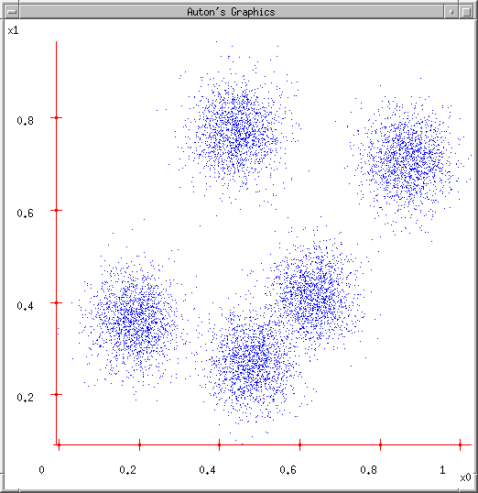
Some Data
K-means
This could easily be modeled by a Gaussian Mixture (with 5 components)
But let’s look at an satisfying, friendly and infinitely popular alternative…
K-means algorithm for clustering.

Slide 4
Lossy Compression
Suppose you transmit the coordinates of points drawn randomly from this dataset.
You can install decoding software at the receiver.
You’re only allowed to send two bits per point.
It’ll have to be a “lossy transmission”.
Loss = Sum Squared Error between decoded coords and original coords.
What encoder/decoder will lose the least information?

Slide 5
Idea One
Break into a grid, decode each bit-pair as the middle of each grid-cell
Suppose you transmit the coordinates of points drawn randomly from this dataset.
You can install decoding software at the receiver.
You’re only allowed to send two bits per point.
It’ll have to be a “lossy transmission”.
Loss = Sum Squared Error between decoded coords and original coords.
What encoder/decoder will lose the least information?
00
01
10
11
Any Better Ideas?

Slide 6
Idea Two
Break into a grid, decode each bit-pair as the centroid of all data in that grid-cell
Suppose you transmit the coordinates of points drawn randomly from this dataset.
You can install decoding software at the receiver.
You’re only allowed to send two bits per point.
It’ll have to be a “lossy transmission”.
Loss = Sum Squared Error between decoded coords and original coords.
What encoder/decoder will lose the least information?
00
01
11
10
Any Further Ideas?

Slide 7
K-means
Ask user how many clusters they’d like. (e.g. k=5)

Slide 8
K-means
Ask user how many clusters they’d like. (e.g. k=5)
Randomly guess k cluster Center locations

Slide 9
K-means
Ask user how many clusters they’d like. (e.g. k=5)
Randomly guess k cluster Center locations
Each datapoint finds out which Center it’s closest to. (Thus each Center “owns” a set of datapoints)

Slide 10
K-means
Ask user how many clusters they’d like. (e.g. k=5)
Randomly guess k cluster Center locations
Each datapoint finds out which Center it’s closest to.
Each Center finds the centroid of the points it owns

Slide 11
K-means
Ask user how many clusters they’d like. (e.g. k=5)
Randomly guess k cluster Center locations
Each datapoint finds out which Center it’s closest to.
Each Center finds the centroid of the points it owns…
…and jumps there
…Repeat until terminated!

Slide 12
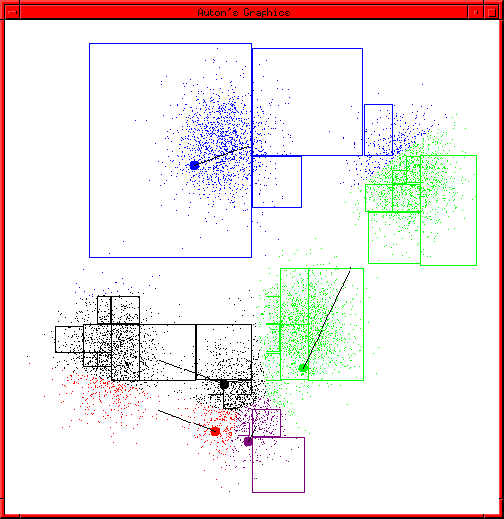
K-means Start
Advance apologies: in Black and White this example will deteriorate
Example generated by Dan Pelleg’s super-duper fast K-means system:
  Dan Pelleg and Andrew Moore. Accelerating Exact k-means Algorithms with Geometric Reasoning. Proc. Conference on Knowledge Discovery in Databases 1999, (KDD99) (available on www.autonlab.org/pap.html)

Slide 13
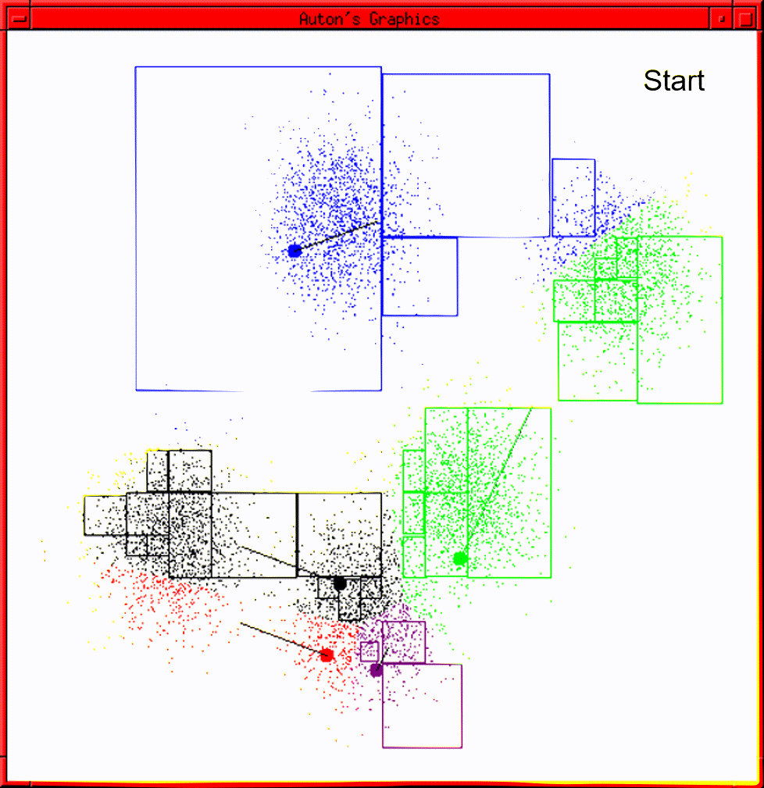
K-means continues…
(animation)

Slide 14
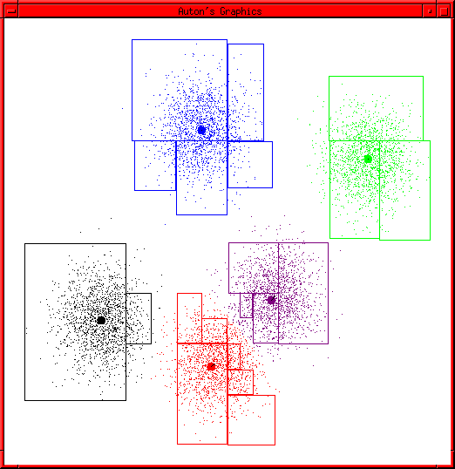
K-means terminates

Slide 15
Summary
The two steps of K-means: assignment and update appear frequently in data mining tasks.
In fact a whole framework under the title “EM Algorithm” where EM stands for Expectation and Maximization is now a standard part of the data mining toolkit

Slide 16
Outline
What is Likelihood?
Examples of Likelihood estimation?
Information Theory – Jensen Inequality
The EM Algorithm and Derivation
Example of Mixture Estimations
Clustering as a special case of Mixture Modelling

Slide 17
Meta-Idea
Probability
Model
Data
Inference
(Likelihood)
A model of the data generating process gives rise to data.
Model estimation from data is most commonly through Likelihood estimation
From PDM by HMS

Slide 18
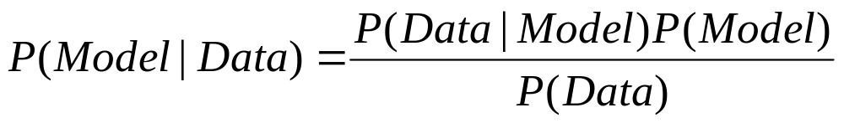
Likelihood Function
Likelihood Function
Find the “best” model which has generated the data. In a likelihood function
the data is considered fixed and one searches for the best model over the
different choices available.

Slide 19
Model Space
The choice of the model space is plentiful but not unlimited.
There is a bit of “art” in selecting the appropriate model space.
Typically the model space is assumed to be a linear combination of known probability distribution functions.

Slide 20
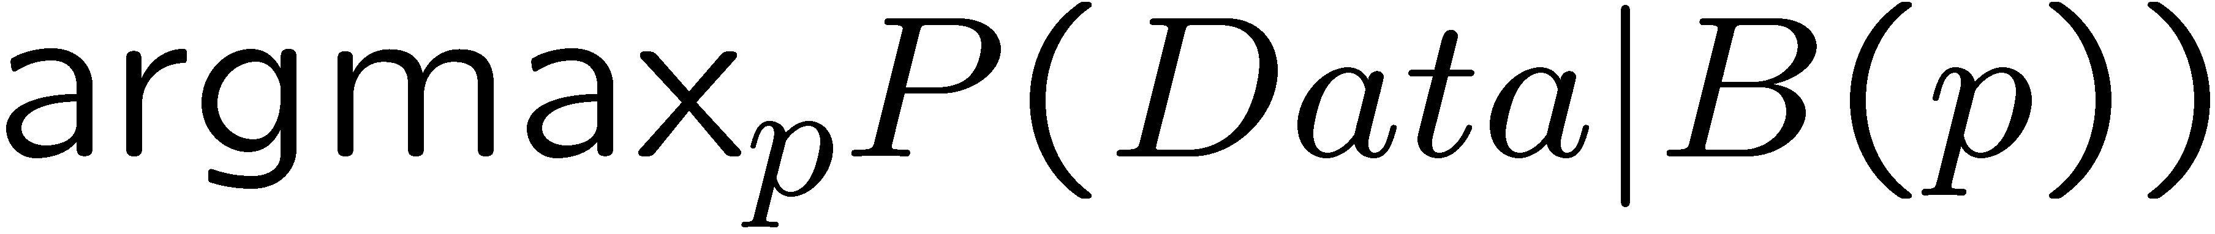
Examples
Suppose we have the following data
  0,1,1,0,0,1,1,0
In this case it is sensible to choose the Bernoulli distribution (B(p)) as the model space.
Now we want to choose the best p, i.e.,

Slide 21
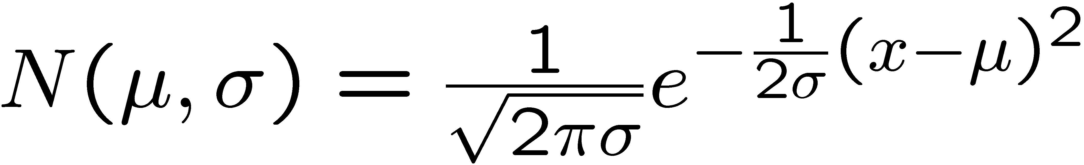
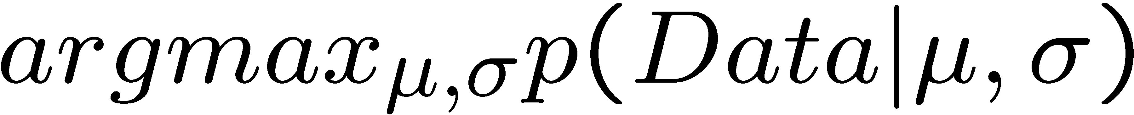
Examples
Suppose the following are marks in a course
55.5, 67, 87, 48, 63
Marks typically follow a Normal distribution whose density function is
Now, we want to find the best μ,σ such that

Slide 22
Examples
Suppose we have data about heights of people (in cm)
  185,140,134,150,170
Heights follow a normal (log normal) distribution but men on average are taller than women. This suggests a mixture of two distributions

Slide 23
Maximum Likelihood Estimation
We have reduced the problem of selecting the best model to that of selecting the best parameter.
We want to select a parameter p which will maximize the probability that the data was generated from the model with the parameter p plugged-in.
The parameter p is called the maximum likelihood estimator.
The maximum of the function can be obtained by setting the derivative of the function ==0 and solving for p.

Slide 24
Two Important Facts
If A₁,…,A_{n} are independent then
The log function is monotonically increasing. x · y ! Log(x) · Log(y)
Therefore if a function f(x) >= 0, achieves a maximum at x1, then log(f(x)) also achieves a maximum at x1.

Slide 25
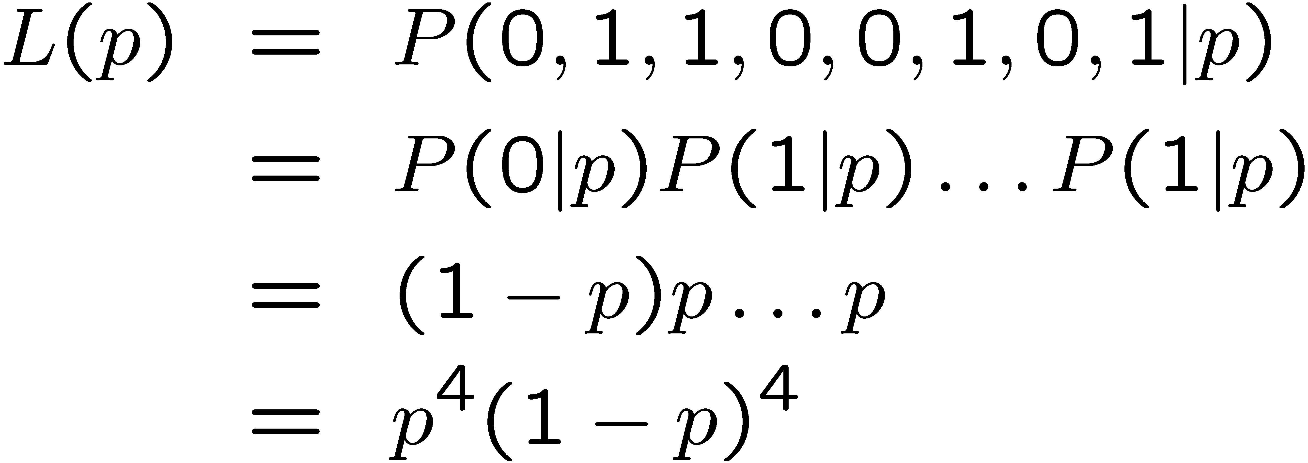
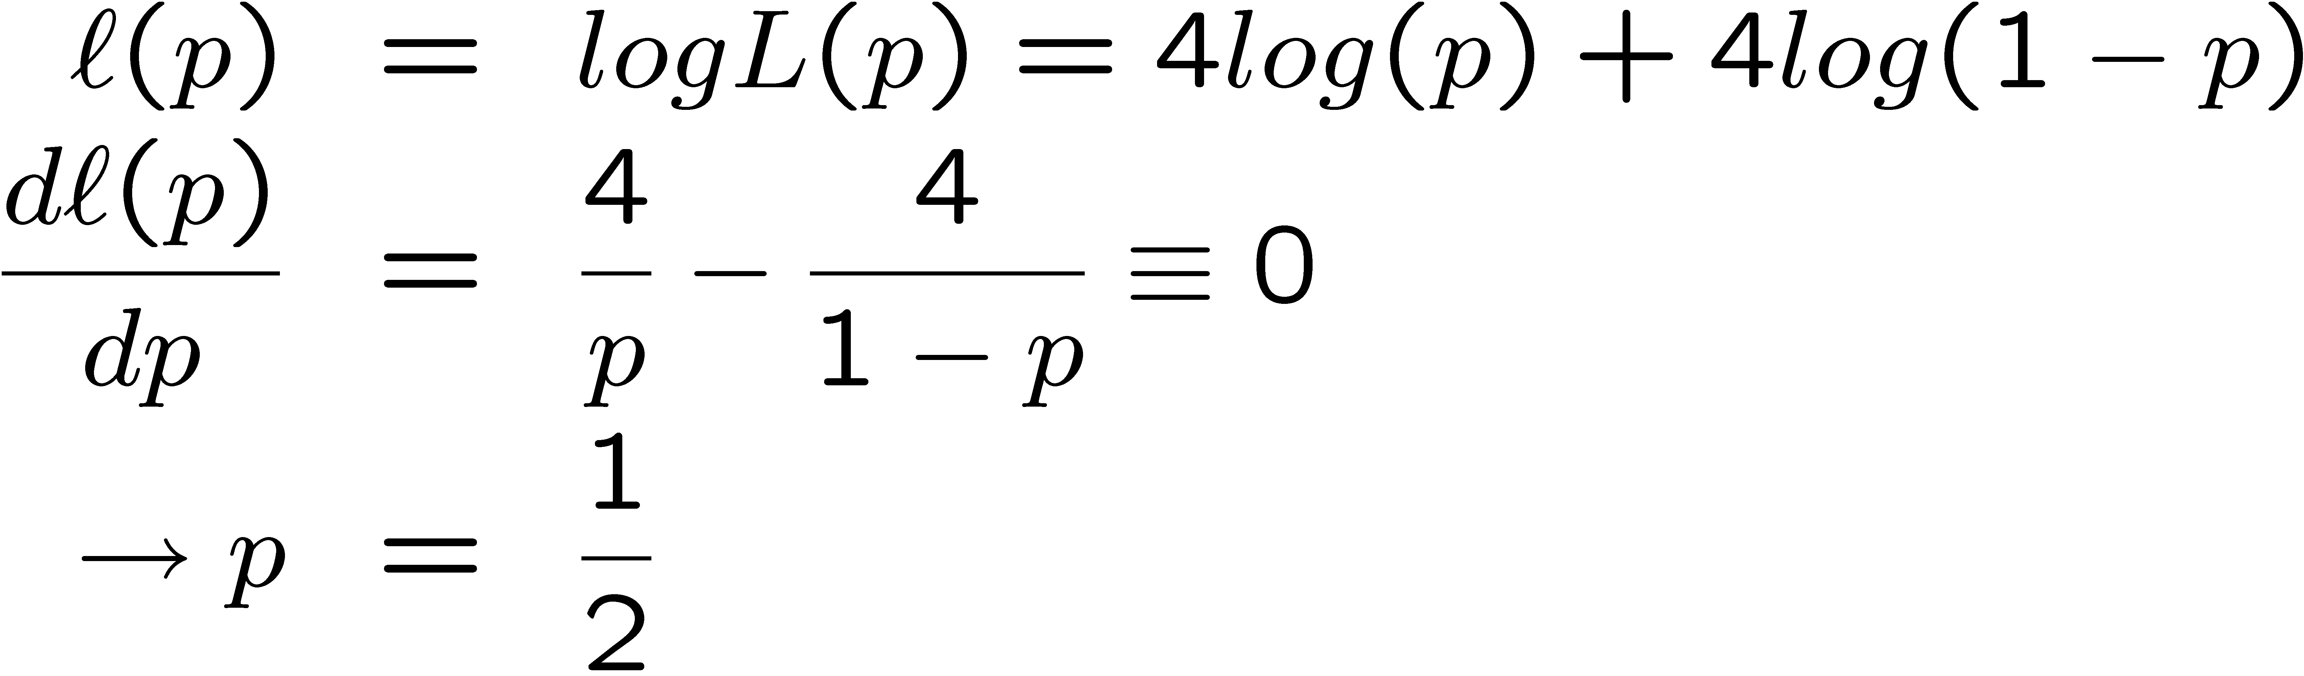
Example of MLE
Now, choose p which maximizes L(p). Instead we will maximize l(p)= LogL(p)

Slide 26
Properties of MLE
There are several technical properties of the estimator but lets look at the most intuitive one:
  As the number of data points increase we become more sure about the parameter p

Slide 27
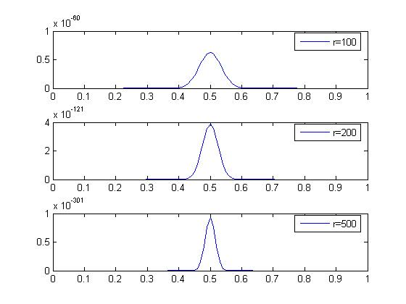
Properties of MLE
r is the number of data points. As the number of data points increase the
confidence of the estimator increases.

Slide 28
Matlab commands
[phat,ci]=mle(Data,’distribution’,’Bernoulli’);
[phi,ci]=mle(Data,’distribution’,’Normal’);

Slide 29
MLE for Mixture Distributions
When we proceed to calculate the MLE for a mixture, the presence of the sum of the distributions prevents a “neat” factorization using the log function.
A completely new rethink is required to estimate the parameter.
The new rethink also provides a solution to the clustering problem.

Slide 30
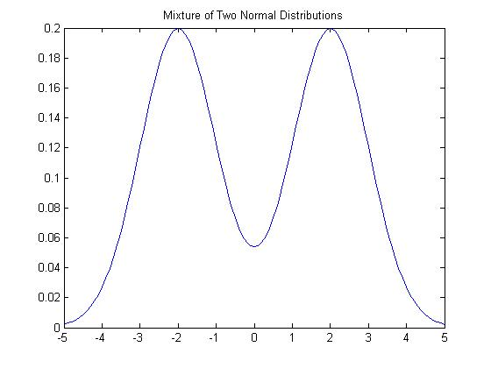
A Mixture Distribution

Slide 31
Missing Data
We think of clustering as a problem of estimating missing data.
The missing data are the cluster labels.
Clustering is only one example of a missing data problem. Several other problems can be formulated as missing data problems.

Slide 32
Missing Data Problem
Let D = {x(1),x(2),…x(n)} be a set of n observations.
Let H = {z(1),z(2),..z(n)} be a set of n values of a hidden variable Z.
  z(i) corresponds to x(i)
Assume Z is discrete.

Slide 33
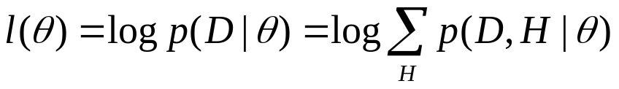
EM Algorithm
The log-likelihood of the observed data is
Not only do we have to estimate θ but also H
Let Q(H) be the probability distribution on the missing data.

Slide 34
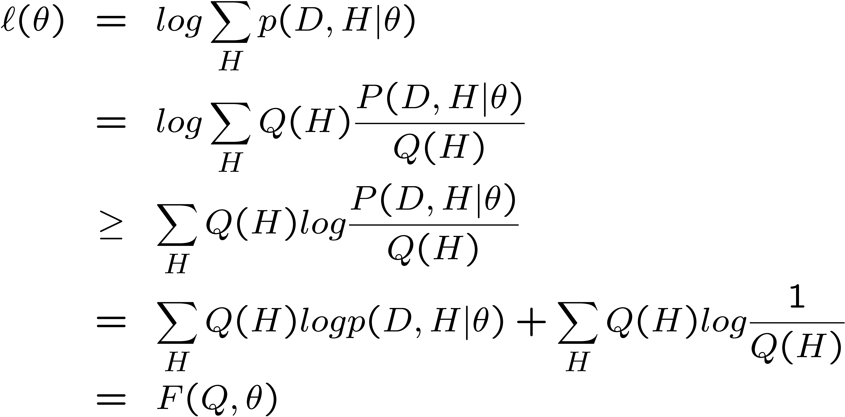
EM Algorithm
Inequality is because of Jensen’s Inequality.
This means that the F(Q,θ) is a lower bound on l(θ)
Notice that the log of sums is become a sum of logs

Slide 35
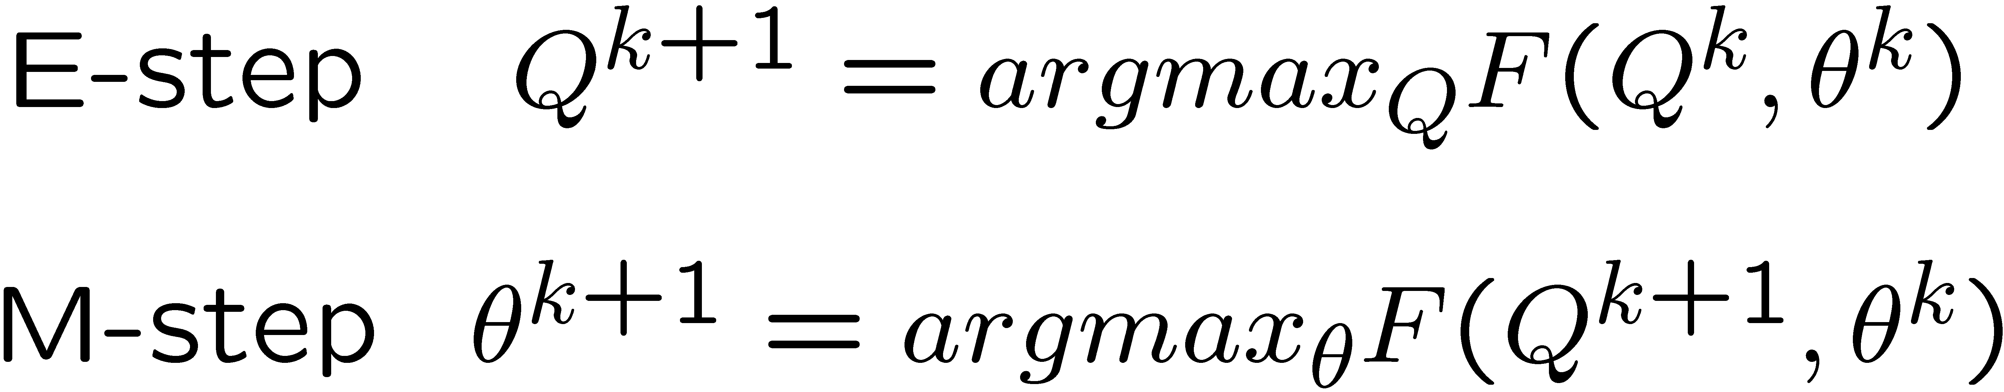
EM Algorithm
The EM Algorithm alternates between maximizing F with respect to Q (theta fixed) and then maximizing F with respect to theta (Q fixed).

Slide 36
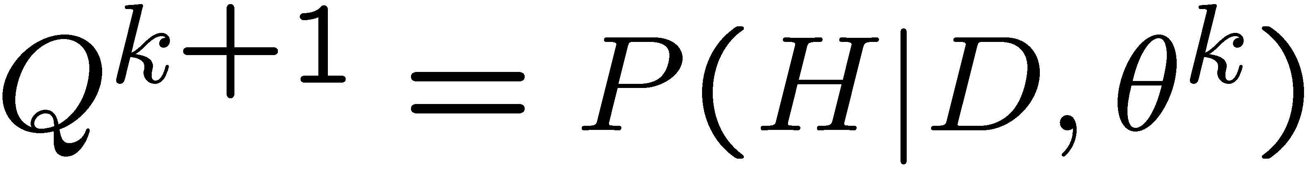
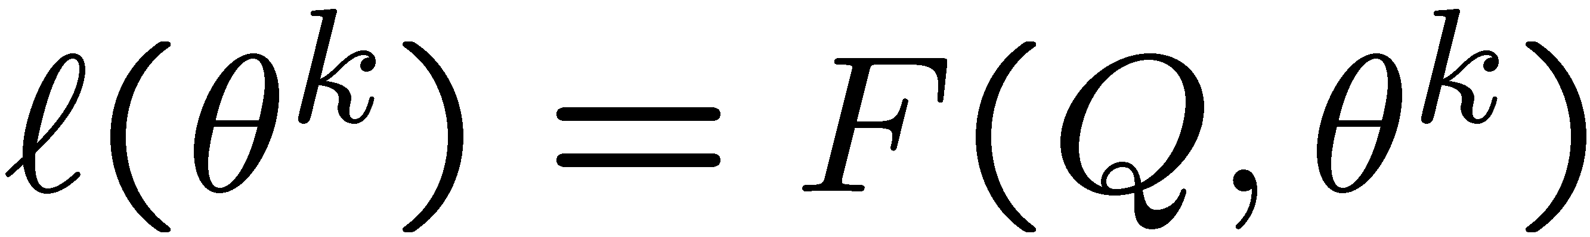
EM Algorithm
It turns out that the E-step is just
And, furthermore
Just plug-in

Slide 37
EM Algorithm
The M-step reduces to maximizing the first term with respect to θ as there is no θ in the second term.

Slide 38
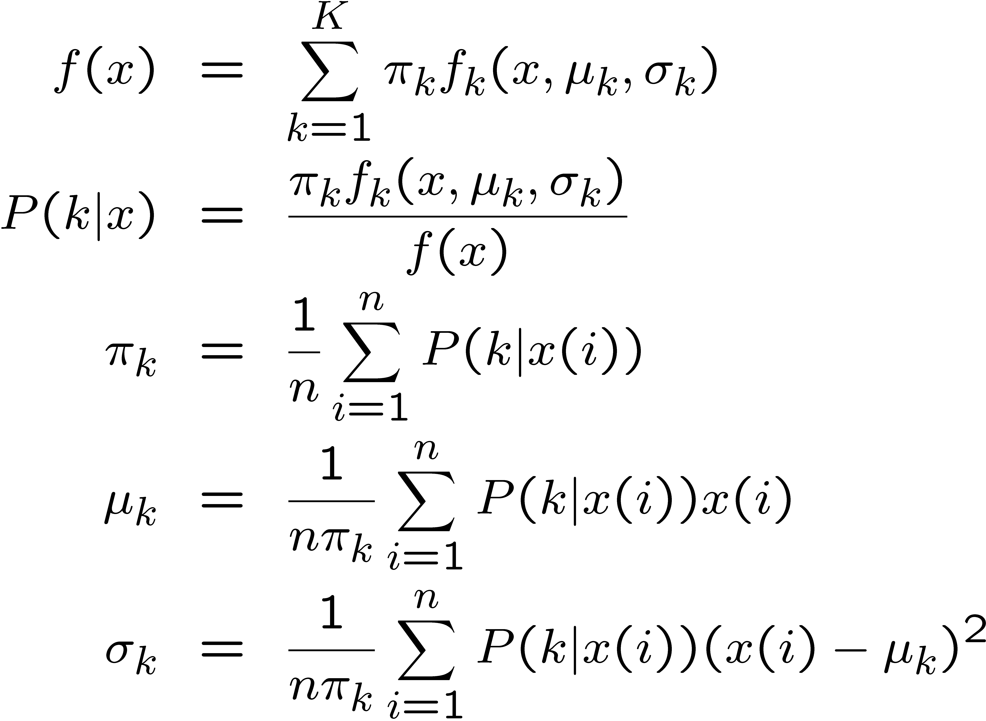
EM Algorithm for Mixture of Normals
Mixture of
Normals
E Step
M-Step

Slide 39
EM and K-means
Notice the similarity between EM for Normal mixtures and K-means.
The expectation step is the assignment.
The maximization step is the update of all centers.

