Slide 1

CS102A 期末project Othello
陈曦耀
常旭峰

Slide 2
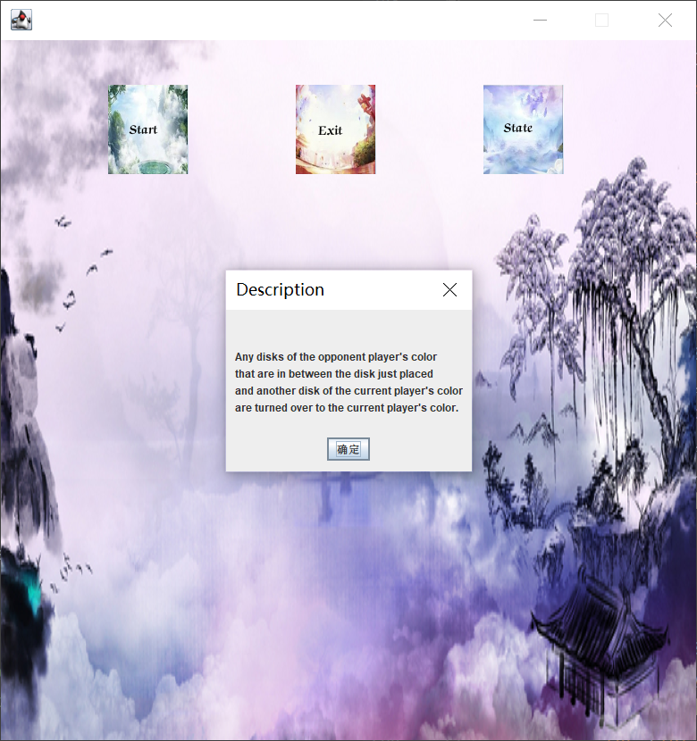
项目简介
There are 64 identical game pieces called disks (棋子), which are light (白) on one side
and dark (黑) on the other. Players take turns placing disks on the board with their
assigned color facing up. When a player places a disk on her/his turn, it is called a
play. During a play, any disks of the opponent player's color that are in between the
disk just placed and another disk of the current player's color are turned over to the
current player's color. The objective of the game is to have the majority of disks
turned to display one's color when the last playable empty square is filled.

Slide 3
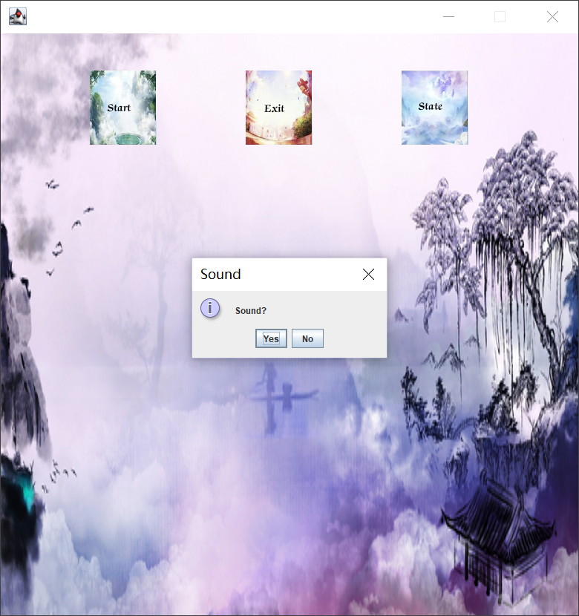




Task 1: Graphical User Interface
主界面美化
游戏按钮有对应按下图标，鼠标反馈

Slide 4
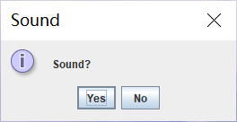
添加背景音乐，可选择是否打开

Slide 5
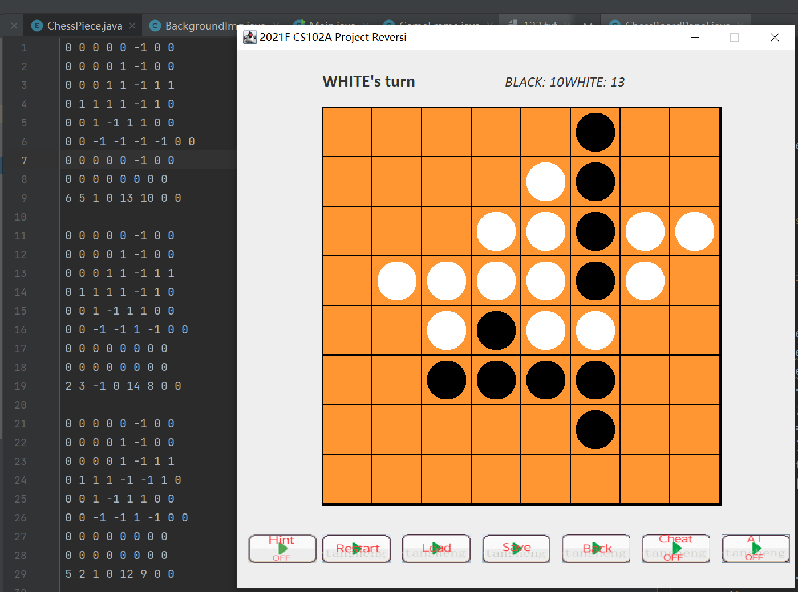
Task 2: Load and Save a Game
1 读写存档以txt格式读存，
2 同时记录了currentPlayer,是否开启了cheatMode

Slide 6
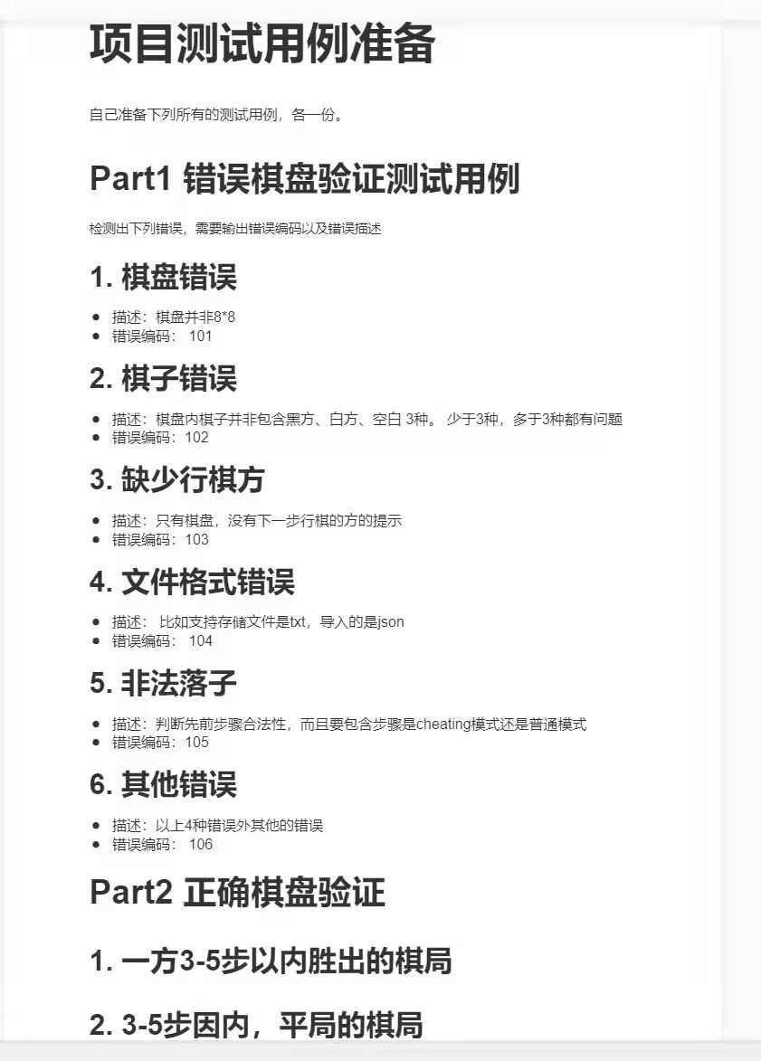
Task 3: Load and Save a Game—error check
1 复盘分析是否被改过棋盘（可以辨别是否开启cheatMode)
2 棋盘格式错误
3 是否加减内容
4 文档不存在或者格式错误

Slide 7
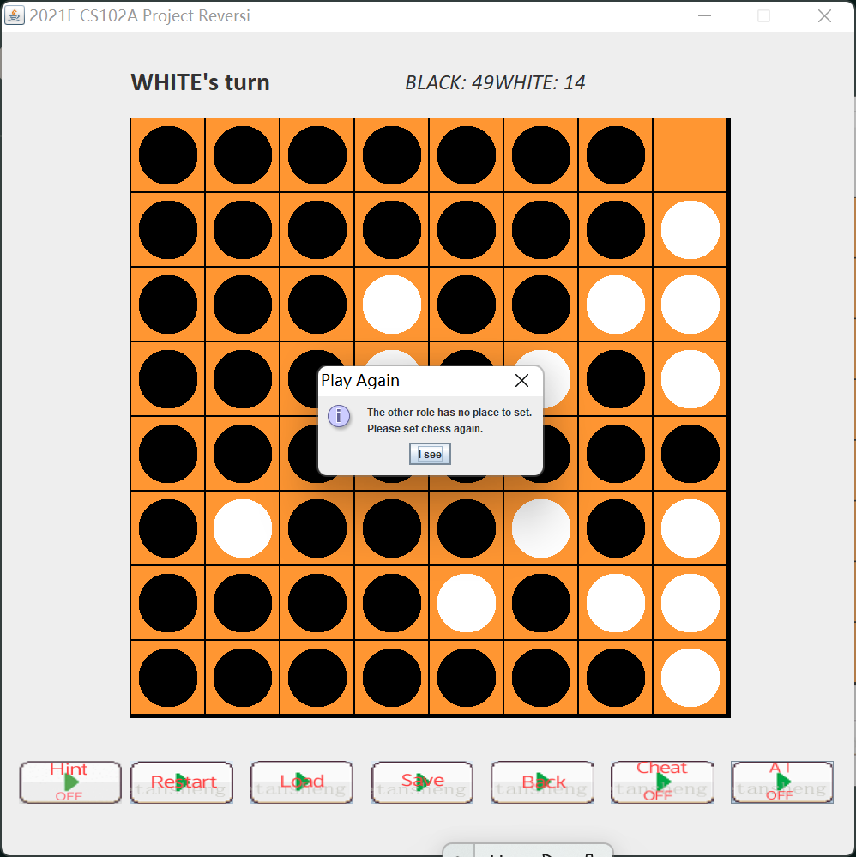
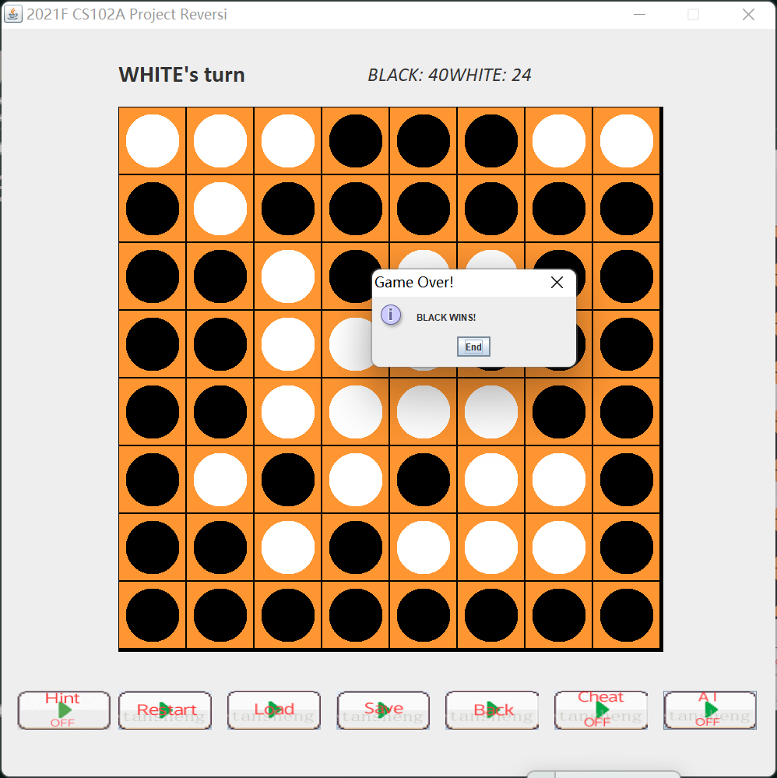
Task 4:平局和胜负以及无子可下
1 对方无子可下会弹出提示继续下 2胜负判断 3平局判断

Slide 8
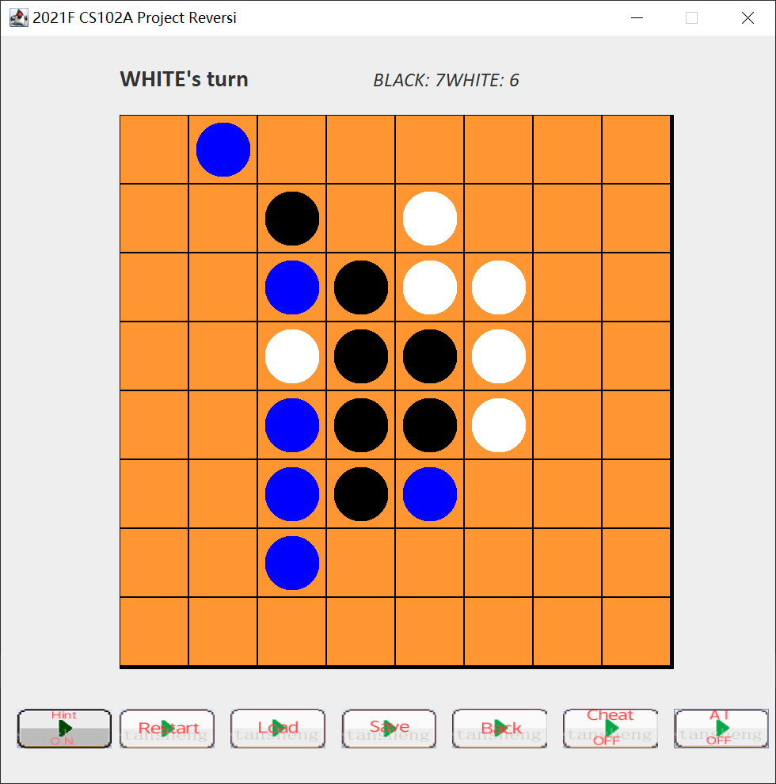
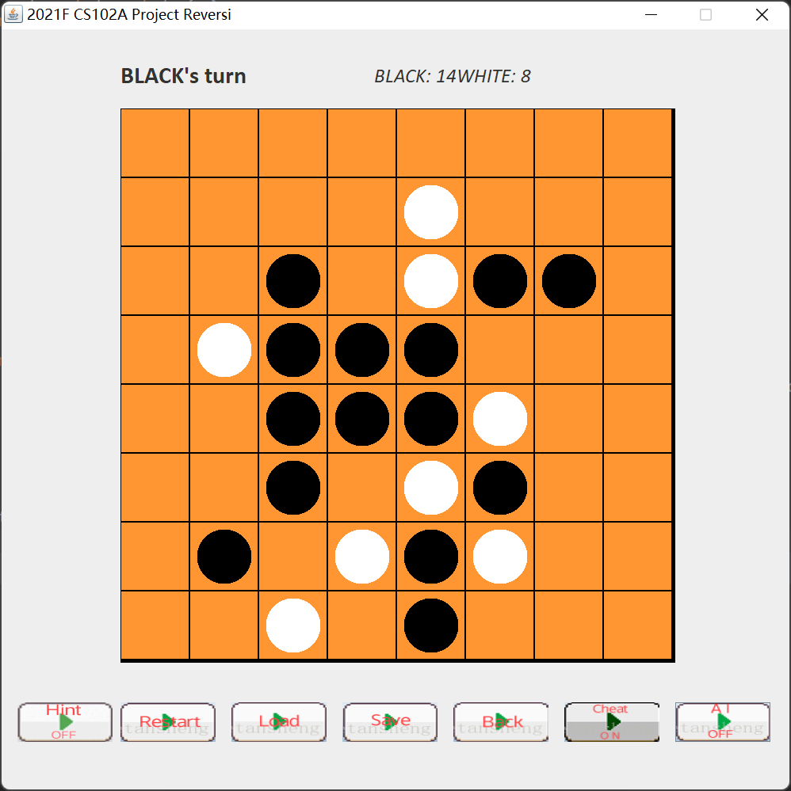
Task 4 ：load如果是cheat模式 hint 会自动按下cheat按钮

Slide 9
Back
栈实现悔棋
悔棋支持悔到最初

Slide 10
人机算法
Easy:猴子算法，随机选取
Hard：贪心算法，计算下一步能翻转最多棋子的位置，
边角优先：能下边角就下边角

Slide 11
感谢

