Slide 1
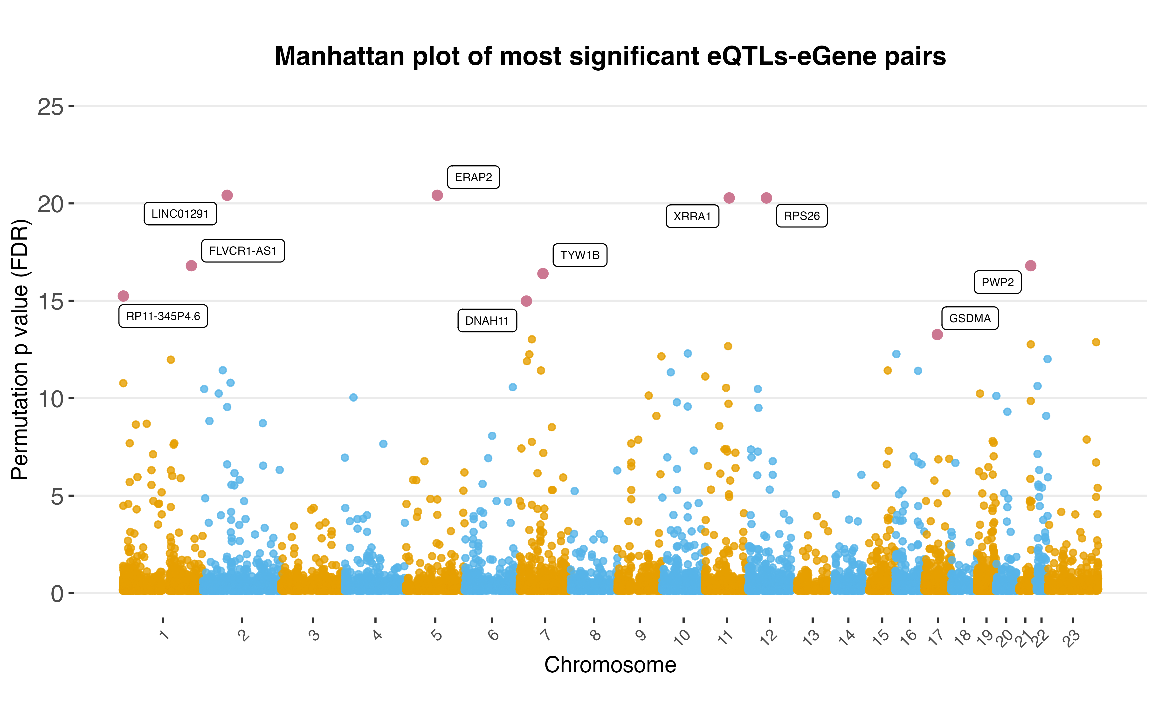




Identification of survival associated eQTLs in clear cell renal cell carcinoma
Authors: Xiya Song¹, Cheng Zhang¹, Han Jin¹, Adil Mardinoglu^{1,2}
¹ Science for Life Laboratory, KTH Royal Institute of Technology, SE-17165 Stockholm, Sweden，xiyas@kth.se
² Centre for Host-Microbiome Interactions, Faculty of Dentistry, Oral & Craniofacial Sciences, King’s College London, London SE1 9RT, UK,adilm@kth.se
Introduction
Results
Clear cell renal cell carcinoma (ccRCC) is one of the most common and aggressive kidney cancer subtypes. The eQTL analysis allows identifying risk SNPs with interpreting potential mechanisms through eGenes. In order to systematically identify potential risk SNPs and genes in ccRCC, eQTL mapping analysis was applied to a Japanese ccRCC cohort (n=100). Then, several downstream analyses were applied to find survival associated eGenes and eQTLs. Finally, we tried to build a model using limited numbers of eQTLs as features to predict patients' survival.
The Manhattan plot shows all the genes tested with their top-variants (labeled with the top 10 eGenes).
A
B
Aims
C
To identify eQTLs and eGenes specific to the Japanese ccRCC cohort, and compare them with the GTEx kidney eQTL database.
Identify survival-associated eQTLs and eGenes, combine with WGCNA to find key prognostic eGenes.
Build a model capable of predicting a patient's survival based on a limited number of survival-associated eQTLs.
The box plot shows strong correlation between top 4 eGenes and top eQTLs (A), and the distance distribution of top eQTLs with eGenes (B) shows that most of the top eQTLs are close to the TSS. The Venn diagram (C) shows the relationships between JP eGenes, GTEx kidney eGenes, and the results of survival analysis for JP eGenes.
A
B
C
D
Methodology
EPHX2, one of the five key prognostic eGenes. KM plots of JP (A) and TCGA (B) ccRCC cohorts show significant survival associations. Through EPHX2's top eQTL, rs1042064 is not significant as a single variable for survival (C), but the genotypes of rs1042064 are associated with EPHX2 expression level (D).
A
B
In the comparison of CV C-Index and predicted C-Index for 5 learners, there is a decrease of around 0.1 (A). From 100 sampling repeats of 5 learners, learner rangers have the highest average performance of around 0.7 (B).
Conclusions
We have constructed an eQTL database for the Japanese ccRCC cohort, providing cancer-specific and Asia-specific eQTLs and eGenes.
We examined the correlations between eQTLs and eGenes with patients' survival.
We built predictive models using eQTLs with dynamic feature selection and the learner ranger shows the highest mean C-Index (>0.7).

