Slide 1
WM&CV FOR
RRUL81 (LTE TDD) China
RRUl62b40/b38(LTE TDD) China
Notes:
Final LU for MR30097&MR30528
2014-05-22
3/1597-CXP 902 5219/2 Uen, Rev PA3

Slide 2
Overall view
In order to be more close to PD Radio’s test strategy , and fully utilize all level test to avoid overlap test .
  Increase automation test scope, hourly loop such as 40º/50º, daily loop such as Nightly loop , weekly loop such as 80º (adapt to daily loop when TERASS transfer to JCAT done)
  Utilize CIRV’s STP & test result, pre-test on CIRV STP
  Weekly fixed manual scope needed to guarantee test coverage : RET/CPRI plug_unplug/maintenance button..etc(aiming to move all manual scope to automatic run)

Slide 3
RRUL81&L62 cirv Coverage
LU Stability(TDD2,TDD5)
  RRUL81 is included in TDD2 cluster in L14B
LU Robustness (Asfand Yar Khan)
  RRUL62 4level cascading
  RRUL81
LU Performance (Thomas lund)
  RRUL81B38 on existing CIRV performance STP carrier pooling
Notes:
Final LU for MR30097&MR30528
2014-05-22
3/1597-CXP 902 5219/2 Uen, Rev PA3

Slide 4
QA rOBUSTNESS
Replace 1 RRUL81 with 1RRUL82 + 1RRUS82. No new test cases needed.
Cell 1 with
20 MHz
8 Tx & 8 Rx
Cell 2 with
20 MHz
8 Tx & 8 Rx
Cell 3 with
20 MHz
8 Tx & 8 Rx
l_robustnessStability_restart_SUITE
tc_noderestart_warm
tc_noderestart_cold
tc_noderestart_refresh
tc_noderestart_coldwtest
tc_rul_auxpiu_restart
multiDu
tc_extension_du_restart
multiDu
tc_jvm_restart
RRUL81
B38
RRUL82 /
RRUS82
A
B
DUS
DUS
TN
Notes:
Final LU for MR30097&MR30528
2014-05-22
3/1597-CXP 902 5219/2 Uen, Rev PA3

Slide 5
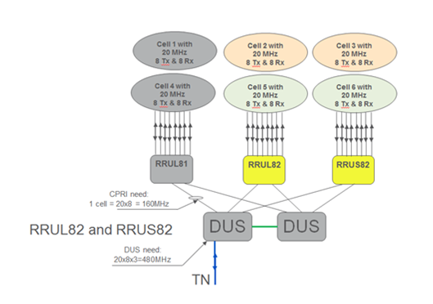
Qa PERFORMANCE 1
Cell Throughput, 8 UEs in one cell | LTE00092033 | Throughput
 | LTE00092036
 | LTE00092034
 | LTE00092035
Throughput in 3 cells | LTE00092037 | Throughput
 | LTE00092038
Latency | LTE00092039 | Latency
 | LTE00092040
 | LTE00104826
Single UE Throughput | LTE00086302 | Throughput
 | LTE00086303
 | LTE00086306
 | LTE00086307
Carrier Polling | tma S to K switch | TMA switch
 | handoverTest | Handover
 | SF2 SSF5 TM7 | Throughput
 | SF2 SSF5 TM8
 | LTE00091906 | Restart
 | LTE00092059 | Lock/Unlock
 | tma K to S switch | TMA switch
Notes:
Open issue: if can combine IDL2?
if we can share robustness and performance?
Final LU for MR30097&MR30528
2014-05-22
3/1597-CXP 902 5219/2 Uen, Rev PA3

Slide 6
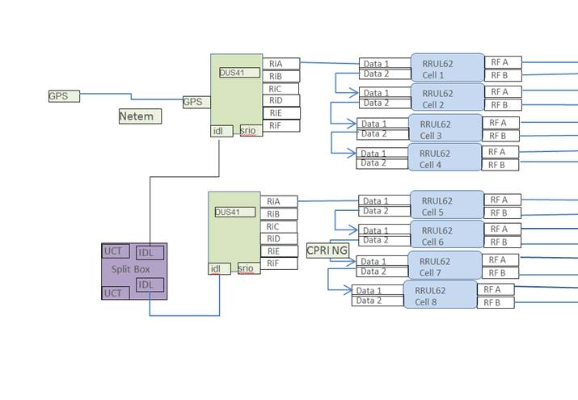
RRUL62 Robustness cluster
Notes:
LU for MR27493
2014-05-13

Slide 7
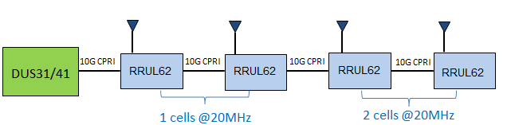
RRUL62 Robustness cluster
Dual carrier on cascading feature:
1.Du cold restart
2.Du warm restart
Dual carrier on cascading feature:
1.Restart RRUL62 one by one
2.Restart RRUL62 at the same time
3.Du cold restart
4.Du warm restart
Notes:
LU for MR27493
2014-05-13

Slide 8

CD radio ci&cv
TGF
STP
STP
1DU+1RRU
40° WASH
/// EIS
50° WASH
1DU+1RRU
2DU+1RRU Carrier pooling
1DU+1RRU 40MIBW
Nightly run
LAB RESOURCE
JOB QUEUE
STP
STP
STPs
TERASS
FS level
On demand
Weekly level
NETS NGR only
Major RPV TCs
On demand
Weekly level
Notes:
NGR_LFT_TEST_Overview

Slide 9
Stp PLAN
40 degree&50 degree loop & Nightly Robust without traffic & Fault Handling
  2*(1DU+1RRUL81B38, 1DU+1RRUL81B39)
  2*(1DU+1RRUL62B38, 1DU+1RRUL62B40)
  1DU +4RRUL62 mix cascading
Nightly loop (50 degree & Nightly robust with traffic & Performance test)
  1DU+1RRUL82B41E 40MIBW+ UE
  2DU+1RRUL82B41E 40MIBW+ UE
  1DU+1RRUL62B40 40MIBW +UE
  1DU+1RRUL62B40 40MIBW + UE
  1DU+4RRUL62 mix cascading +4UE
TERASS
  CT10+1RRUL81
  CT10+1RRUL62

Slide 10
Current radio IV maintenance WOW
R:3-5(Susie + EGX) STP:12(16DU+44RRU+1TM500+8Hisi+12D2)
R:10 IV+2JCAT
STP:8(12DU+4CT10+35RRU+5TM500+30D2)
TR/CR
DV scope
Module scope
Node scope
CIRV result
For L81/62 :Totally ~16 IV , 28DU, 4CT10, 79 RRU,6 TM500,8Hisi, 42D2
Highly overlap test between DV-module-Node
No STP share between DV/module/Node
TM500 usage rate too low

Slide 11
Adapt to NGR WOW
TGF
R: 5 IV+ 2Jcat
STP:8(15DU+2CT10+40RRU+2TM500+25D2)
Share STP to all level test
Utilize CIRV’s STP
More frequent test loop to shorten deliver time
STP
STP
DV
40° WASH
/// EIS
50° WASH
DV+Module
Setup connections to Clearcase also
Can easily trig test by put SW in a folder
Nightly run
Module+Node
LAB RESOURCE
JOB QUEUE
STP
STP
STPs
TERASS
FS level
On demand
Weekly level
NETS NGR only
Major RPV TCs
On demand
Weekly level
Notes:
NGR_LFT_TEST_Overview

Slide 12
What we need to maintain RRUx82
R: ~5 IV +1 JCAT in total , covers DV/Module/Node
STP: ~12STP(15DU+2ct10+2TM500+12dongle)
  Reuse CIRV’s STP
  Share STP to all level test

Slide 13
Automatic Test loop
40 degree
  Basic all kinds of cell setup /alarm check/PWR meter check
  SSI key cases
50 degree
  All SSI test cases
Nightly run
  Robustness without traffic + Fault handling
  Robustness with traffic

Slide 14
WeekLY MANUAL SCOPE
RET
CPRI PLUG/UNPLUG
TERASS
…

Slide 15

Notes:
Final LU for MR30097&MR30528
2014-05-22
3/1597-CXP 902 5219/2 Uen, Rev PA3

