Slide 1
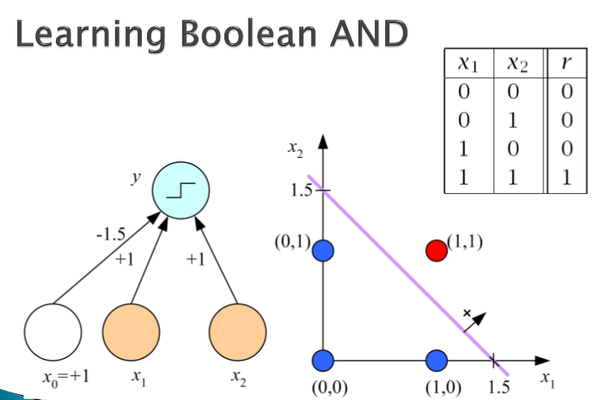

Slide 2
x1 | x2 | r
0 | 0 | 0
1 | 0 | 1
0 | 1 | 1
1 | 1 | 1
y
x2
-0.5 1 1
(1,0)
(1,1)
0.5
X0=1 x1 x2
(0,0)
(0,0)
0.5
(1,0)
x1

