Slide 1
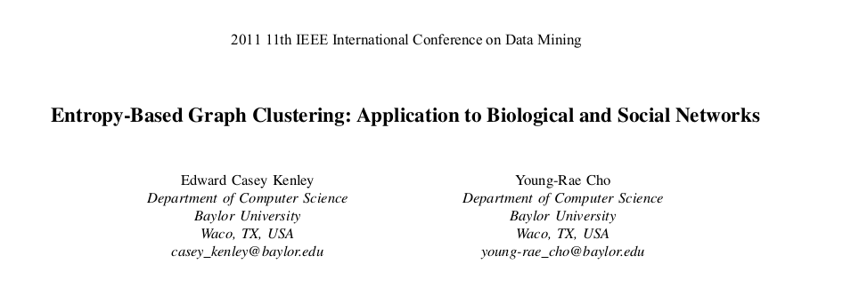
Xiyu Xie

Slide 2
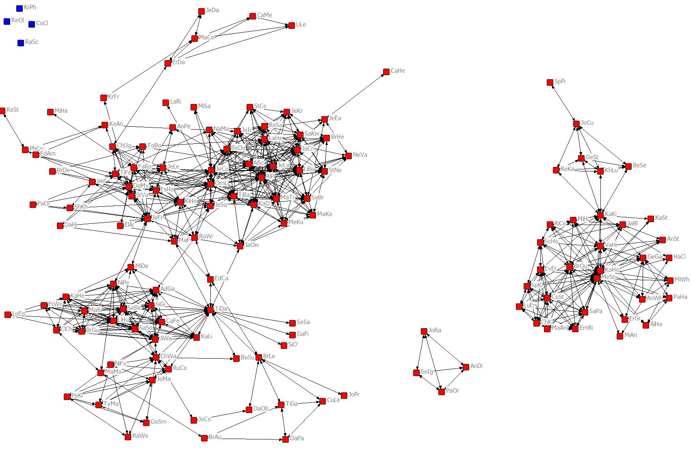
Graph Clustering

Slide 3
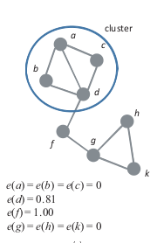
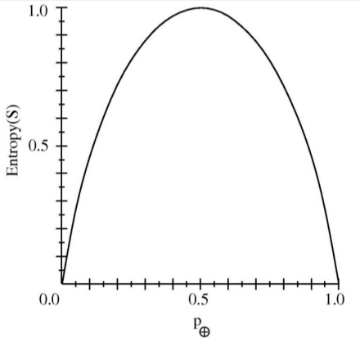
Vertex Entropy
e(v) = −pi (v) log2 pi (v) − po (v) log2 po (v)

Slide 4
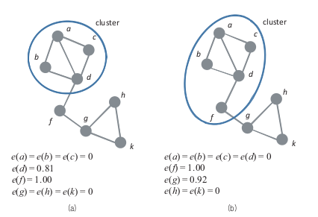
Graph Entropy
Sum of Vertex Entropy
e(G) = 1.81
e(G) = 1.92

Slide 5
Assumption
a network has the lowest entropy, or the highest structural stability,
when it is composed of sub-graphs that
are isolated from each other.

Slide 6
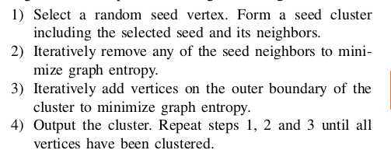
Algorithm

Slide 8
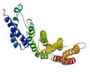
Test on
Database of Interacting Protein

Slide 9
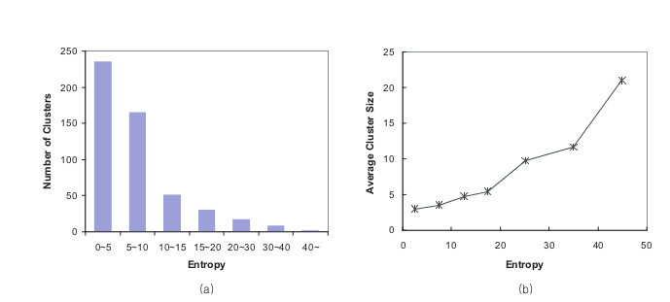
Results

Slide 10
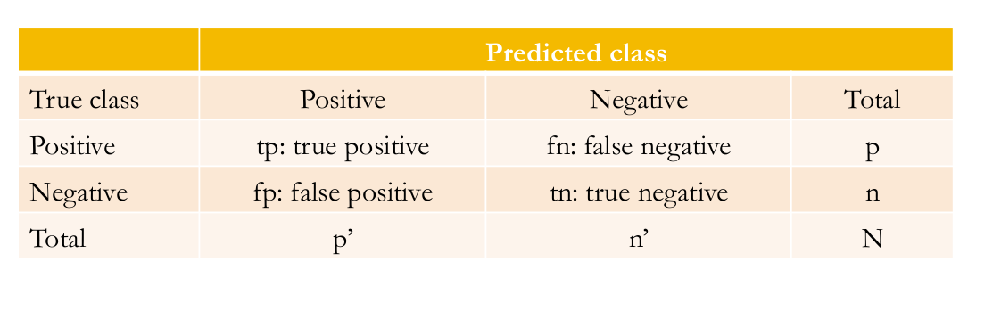
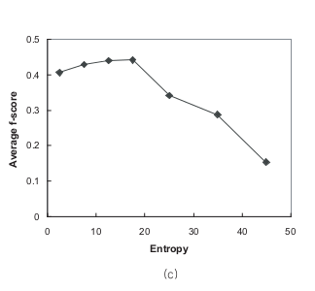

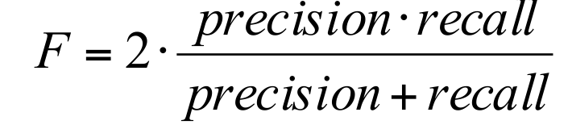
Accuracy

Slide 11
Improvements on Algorithm
Hub
Lower entropy added earlier

Slide 12
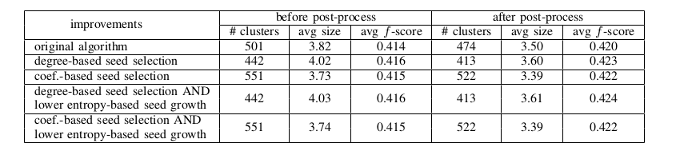
Results of Improvements

Slide 13
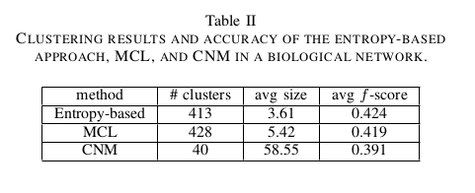
Comparing with Other Methods

Slide 14
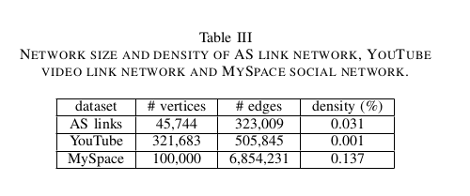
Test
Social network

Slide 15
Parallelization

Slide 16
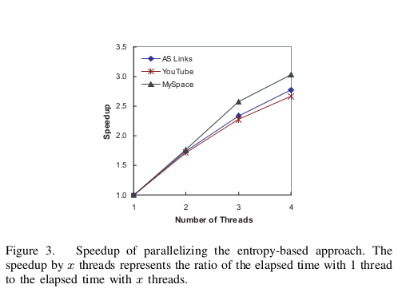
Speed up

Slide 17
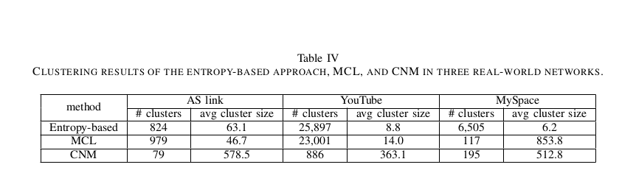
Results cluster size

Slide 18
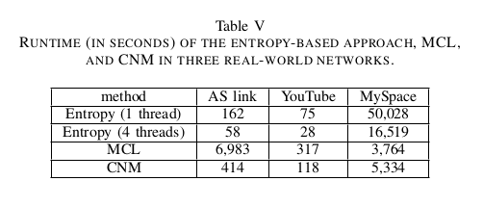
Run Time

Slide 19
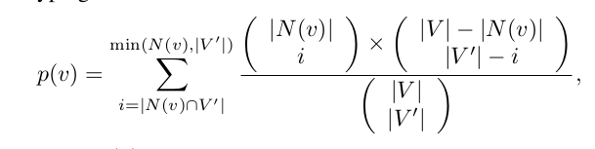
Accuracy
p-score: - logp(v)
Average p-score 5.49 vs 4.31.
hypergeometric distribution

Slide 20
Conclusion
a novel information-theoretic approach for
graph clustering
vertex entropy and graph entropy,
greedy-style algorithm to find each locally optimal cluster
high accuracy and efficiency
biological networks & social networks.

Slide 21
My opinion
Overlapping but not
duplicate cluster
Better parralization
Remember core

