Slide 1
Code Review @ Harbrick
Monte Carlo Tree Search
with Reinforcement Learning
Xiyu Xie

Slide 2


Slide 3
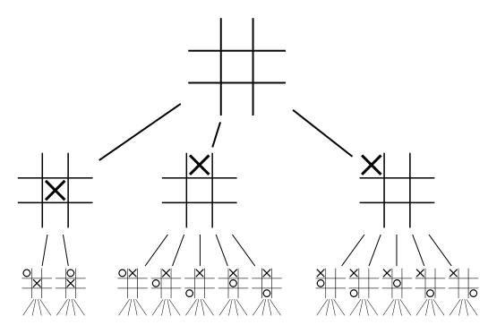
Game Tree Search

Slide 4
Simplest Monte Carlo
int dummyMove()
{
//srand (time(NULL));
int num= rand() %remain;
int id = findID(num);
return id;
}
// in select.c

Slide 5
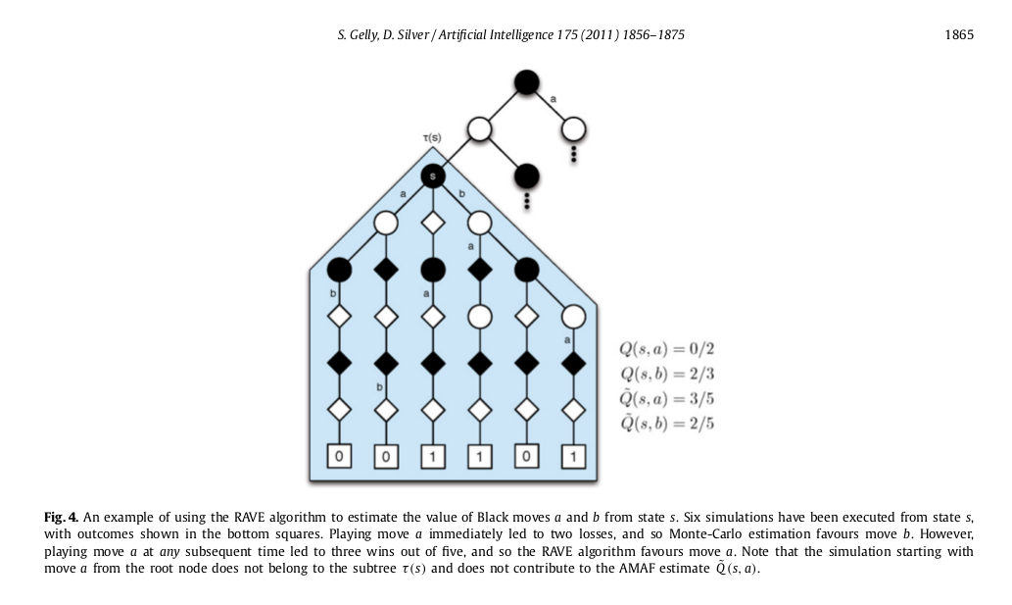

Slide 6
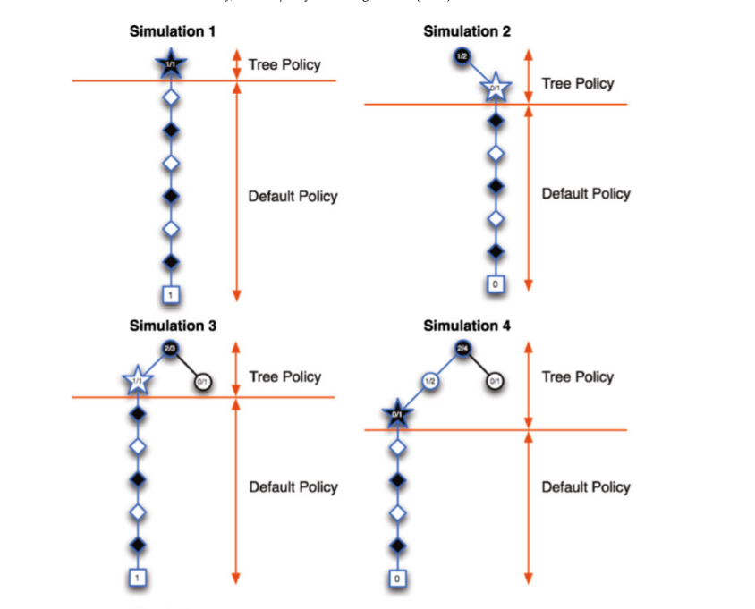

Slide 7
Reinforcement Learning
float combinedQ(float treeQ, float subQ)
{
beta *=0.999999; // iteratively decreasing
return (1-beta)*treeQ+beta*subQ; // mixing two scores
}
// in selection.c

Slide 8
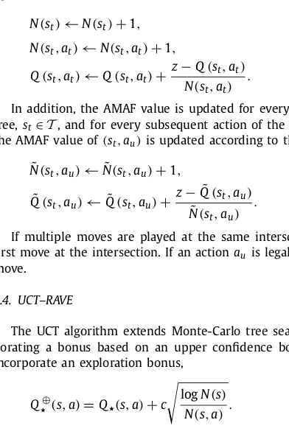

Slide 9
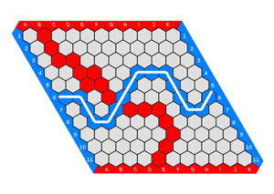
Winning Score

Slide 10
