Slide 1
Algorithms in Nature
A Biological Solution to
a Fundamental Distributed Computing Problem
Xiyu Xie
Science, 331 (6014), pp. 183–185.

Slide 2
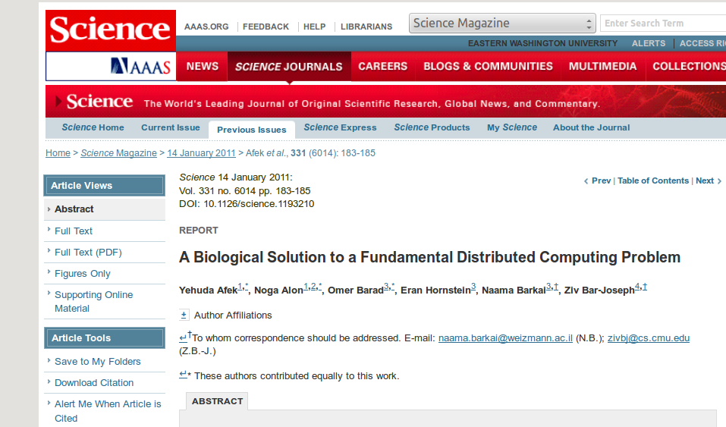

Slide 3
Distributed Computing
Processors are as Independent as possible
Automatic dynamic
Time, Space, Message Complexity
Unknown number of processor
Unknown network topology
Independent input
Nondeterministic processor
Unknown massage ordering
...

Slide 4
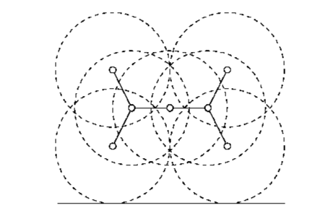
Wireless/ Radio Network

Slide 5
Maximal Independent Set
MIS
MaxIS
Independent Set: no two nodes are adjacent
Nodes are either in MIS or connected to MIS

Slide 6
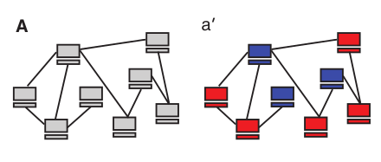
Wide Rage of Application
Backbone Recover
Elect local leaders which together cover the entire nodes
Vertex coloring, MST, Cluster
symmetry breaking

Slide 7
Maximal Independent Set
MIS stochasticity
MaxIS
Independent Set: no two nodes are adjacent
Nodes are either in MIS or connected to MIS

Slide 8
Challenging Parallel Problem
Sequential Solution is trivial
  repeatedly pick a node, delete it and its neighbors
Parallelization

Slide 9
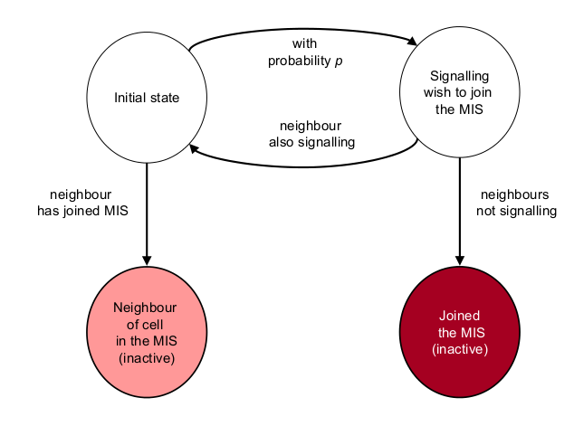
Randomized Algorithm

Slide 10
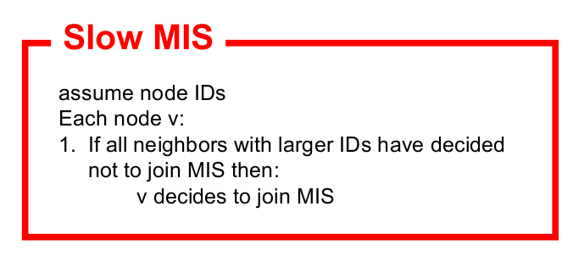
Time O(n)
Message O(n^2) e.g. Complete Graph, Everyone send to everyone

Slide 11
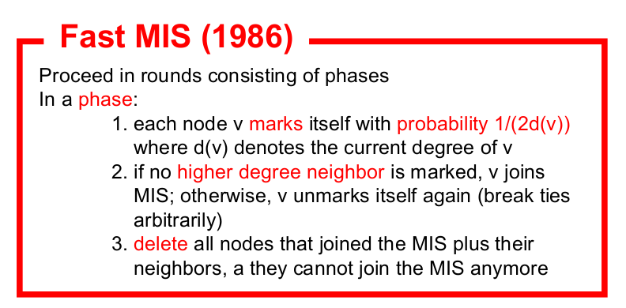
Probability increase as neighbor decrease
Time O(log N)
Need degree of itself, and degree of its neighbor

Slide 12
Cells Are Distributed Processors!

Slide 13
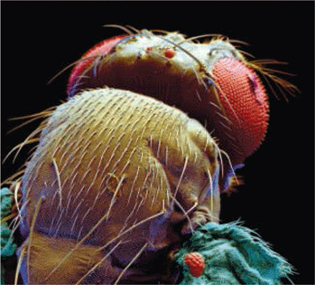
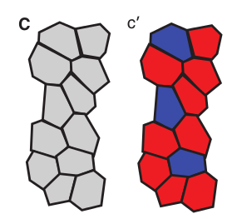
SOP selection in fly

Slide 14
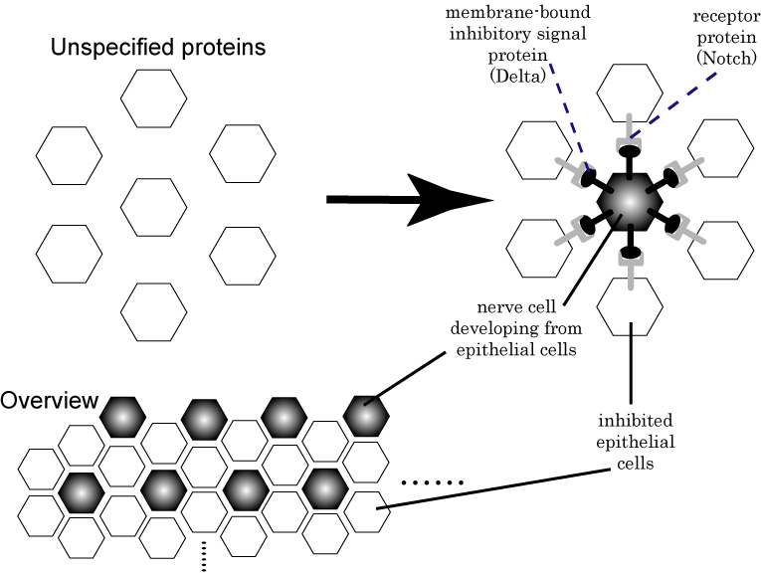
lateral inhibition

Slide 15
Similarity
MIS pattern,
  either SOP or next to SOP, SOP are not adjacent
Stochasticity
  begin as the same cell, randomly become SOP, SOP is default unless inhibited
Massage passing
  lateral inhibition, inhibitor is a message

Slide 16
Differences
Cells do not know degree of their neighbors
Cells probably do not know the number of active neighbors
Inhibitor is a Binary Message
accumulation of inhibitor?
Number of neighbor is limited (6) ?

Slide 17
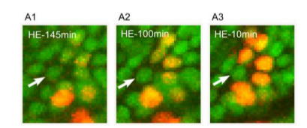
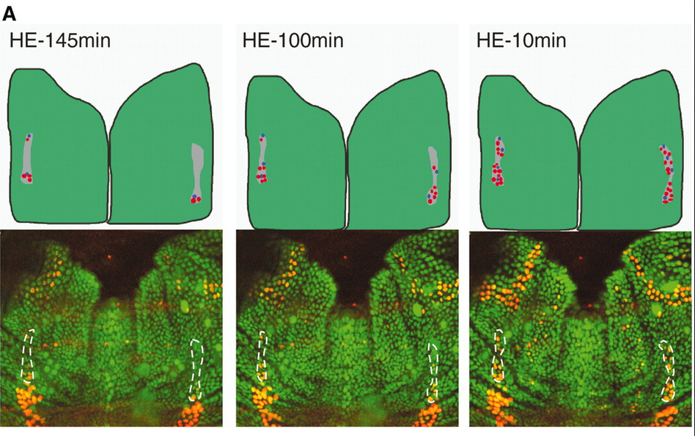
Time-lapse image

Slide 18
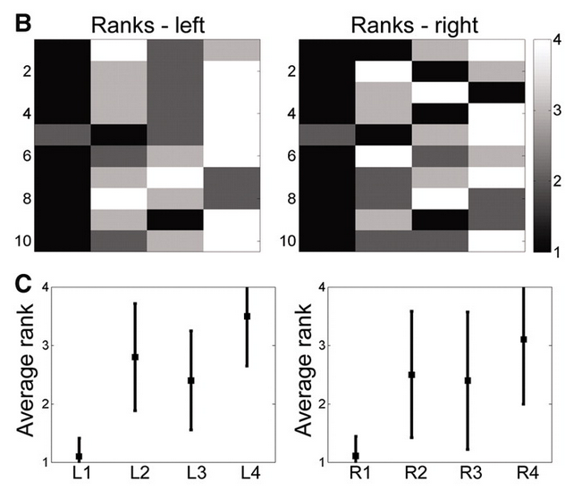
Stochastic Behavior on Last Three

Slide 19
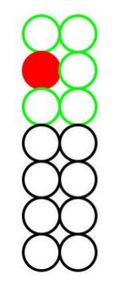
Simulation
  Selection Time → Round
Inhibitor burst → Probability
Constant Rate: U(0~1), degrade
Rate Change: continuously increase
Accumulation: Sum of Pois(1)
Fixed Accumulation:
    choose some fixed numbers from Norm
    for each processor at the beginning

Slide 20
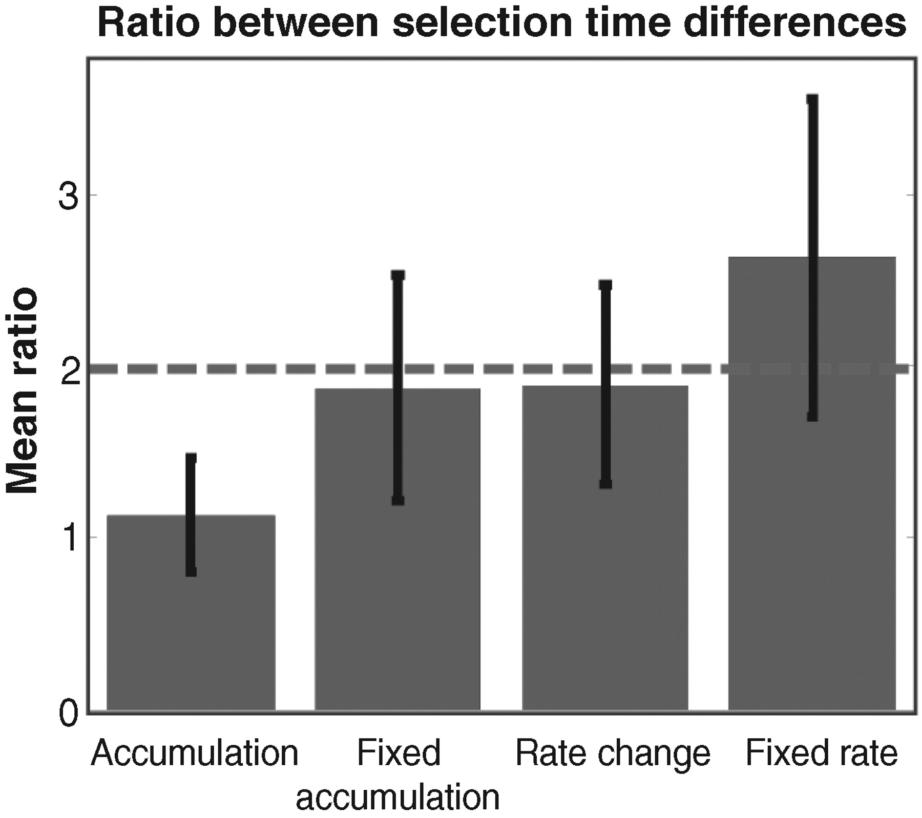
Result

Slide 21
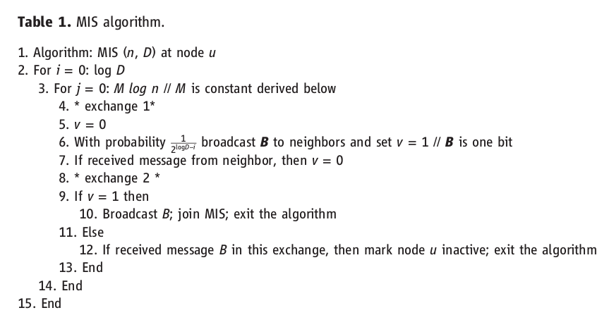
Increase Probability every round, Time O(log^2n)
only One Bit to count receive message or not,
Message O(n) (optimal)

Slide 22
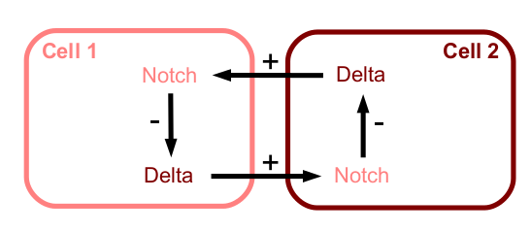
Improvement

Slide 23
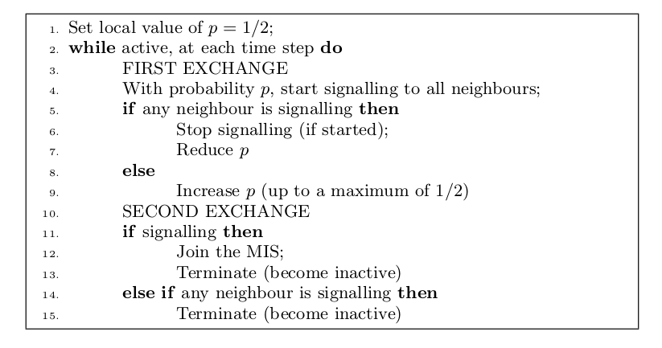
Improvement

Slide 24
Learning from nature
Science & Engineering: Optimization Problems
Life Organism: Best fit, Nature selection
http://www.sciencemag.org/content/327/5964/439.full
Systems Biology & Distributed System
http://www.algorithmsinnature.org/
http://www.sciencemag.org/content/327/5964/439.full

Slide 25
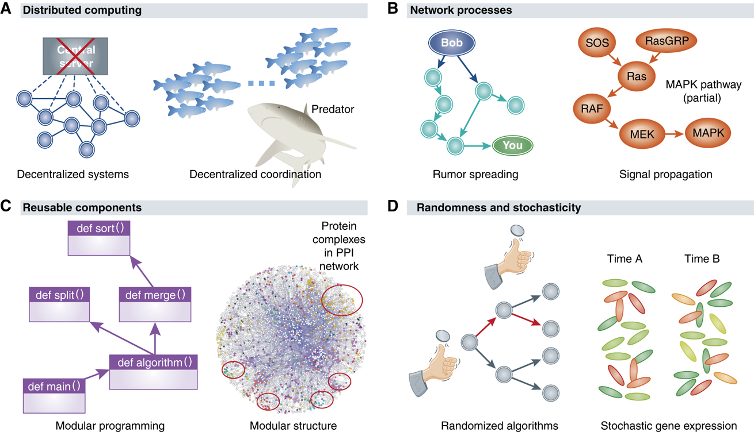

Slide 26
Reference
http://www.sciencemag.org/content/331/6014/183.long
http://people.maths.ox.ac.uk/scott/Papers/maxis.pdf

