Slide 1
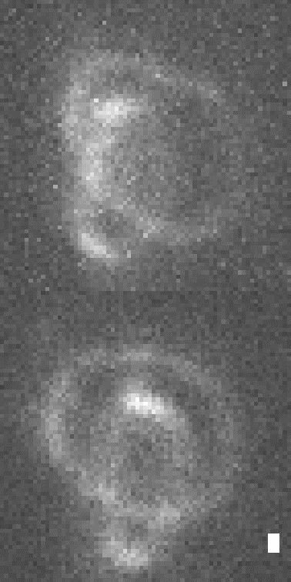
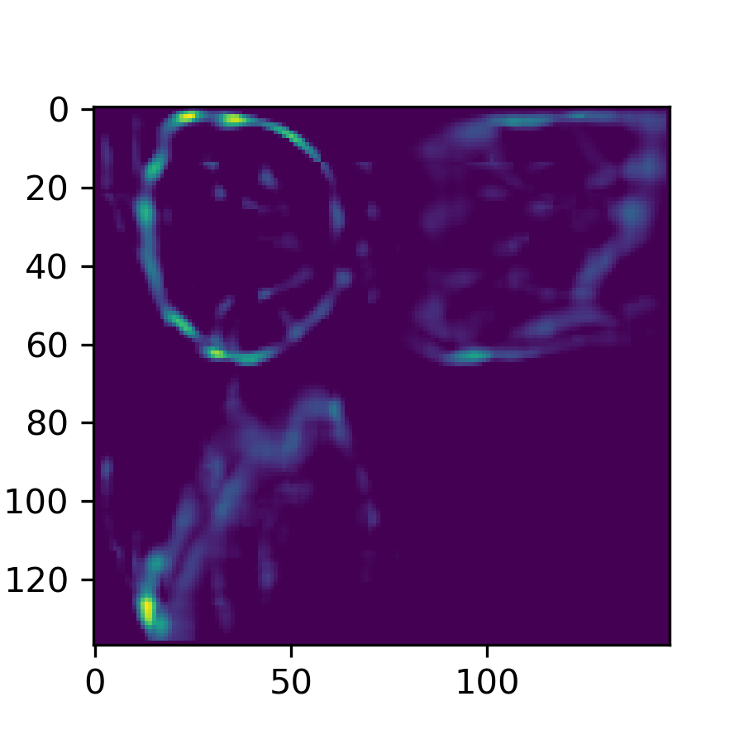
Notes for the parameter search results of Feature 1.
The analysis of Feature 1 was performed at the time when a systematic parameter searching strategy was not available. The results are recorded in a time-line manner. Details of the decisions for each set of data are kept on the Github repository, in the form of comments for each commit, and organized in the associated issues:
Feature1 Set5 #65
Feature1 Set5-long #64
Feature1 Set6 --------- [5.3][7:50pm] #67
Datafiles for the results are kept in “PyPRIS_tickets_F1_F2_results5.5” in the PyPRIS_data_archive folder.
*F1_set1 to *F1_set6 are data files for Feature 1.
Recovery
x
z
Input
y
y
Scale bars: 300 nm
z
Ticket:
~\PyPRIS\Documents\Feature1\good_ticket_for_Feature1\Go.pris_ticket
Need to write a script to draw this information from a ticket, and a linbreg object.

Slide 2



y
x
z
z
Scale bars: 300 nm

Slide 3
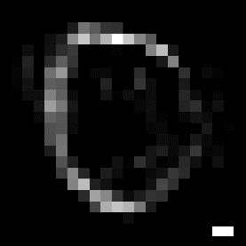


y
x
z
z
Scale bars: 300 nm

Slide 4
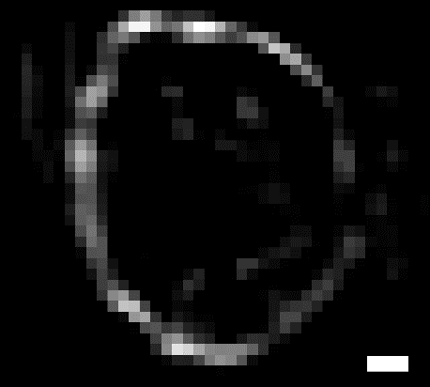
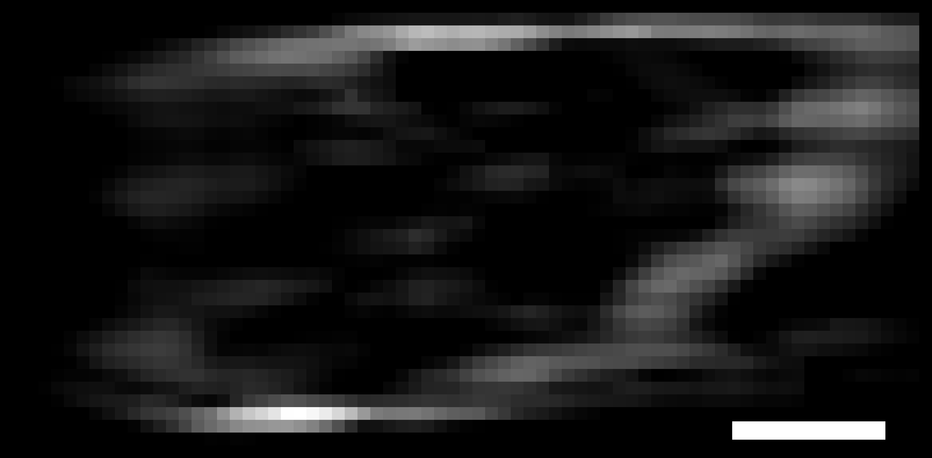
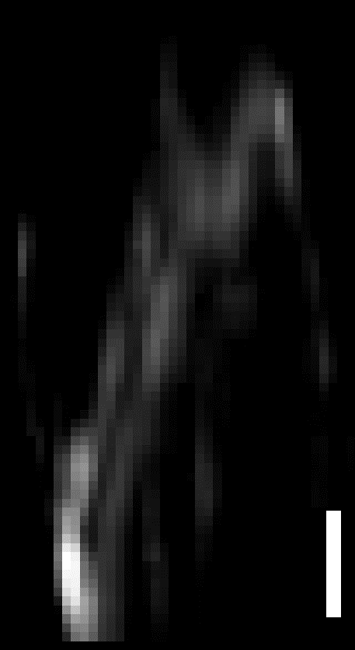
y
x
z
z
Scale bars: 300 nm

Slide 5
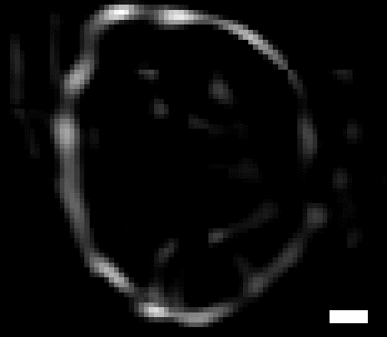
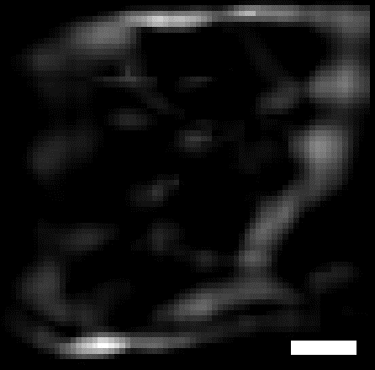
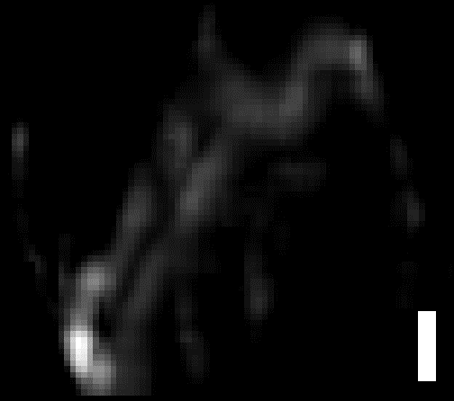
y
x
z
z
Scale bars: 300 nm

