Slide 1
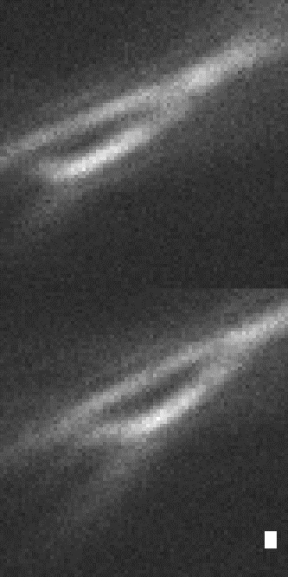
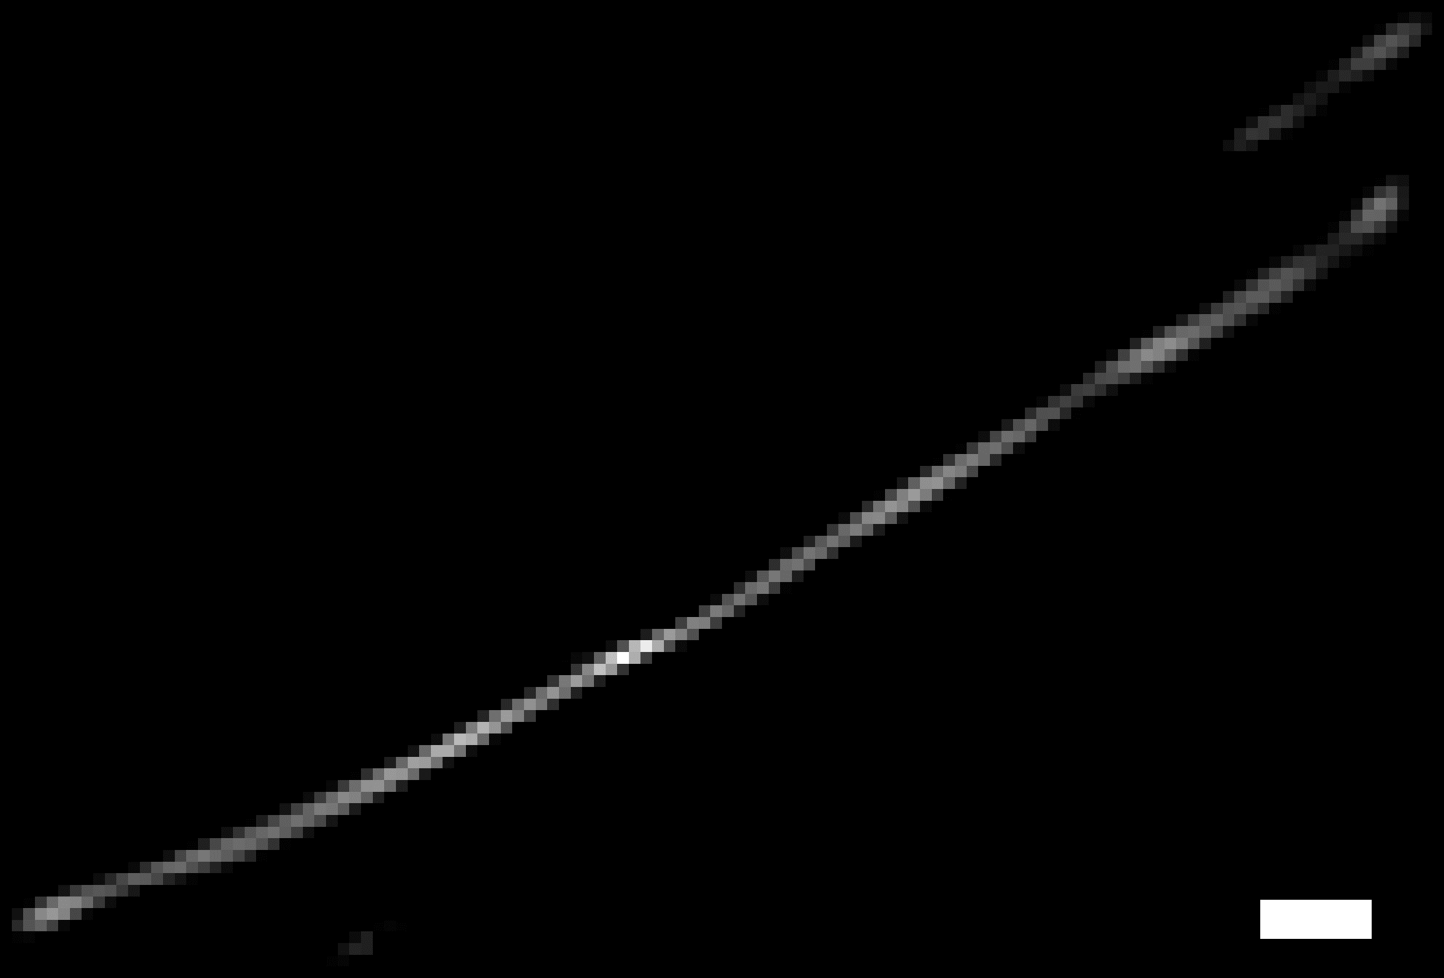
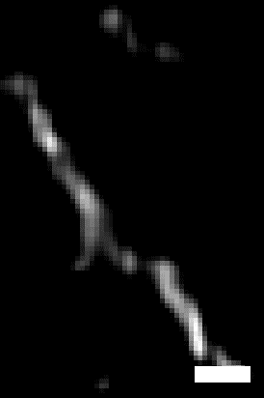
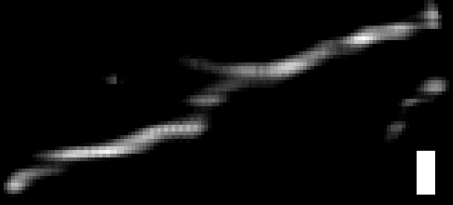
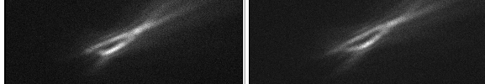
Notes for the parameter search results of a bent curve
A bent curve in 3D
2
Resolution in the z-direction is worse than that in the x or y direction. This is physically reasonable and is expected.
1
Input
Reconstruction
XY
Red dashed lines: Interesting kink in z-direction. It could be real.
y
red arrows: a branch. This curve should be a bundle of multiple actin filaments based on it’s brightness. So this branch could be real. Or it is just an artifact. We don’t know. Maybe it is a branch, given the fact that there is a dimmer (which means more thinner, more flexible..) kink. (this is just wishful thinking, simulation validation can definitely suggest insights, but let’s wrap up and publish the first peer-reviewed PRIS paper.)
YZ
x
z
300 nm
XZ
All the scale bars are 300 nm in the direction indicated by the yellow double sided arrows.
z
3
Wrap up (for the first PRIS journal paper):
Recovery the following patch with a few (i.e. 6) partially overlapping windows (roughly indicated below) → stich the results together in 3D → produce 3D rendering as a SI movie → make better figures → DONE.
Some artifact due to edge effect (the feature in the observation is outside of the cropped FOV). Such artifact is expected to be removed when we take surrounding FOVs and stich the result together, which will be the immediate next step. Then we perform a 3D rendering, this experimental demonstration should be settled.

