Slide 1

Scholarship Tracker
Cal Poly Humboldt Hackathon 2025
Rachael Brower, Blake Culbertson, Enrique Lopez, Chan Rain, Garrett Willis

Slide 2

Why?
Unified scholarship application system
Simple scholarship database
Simple applicant and application management

Slide 3
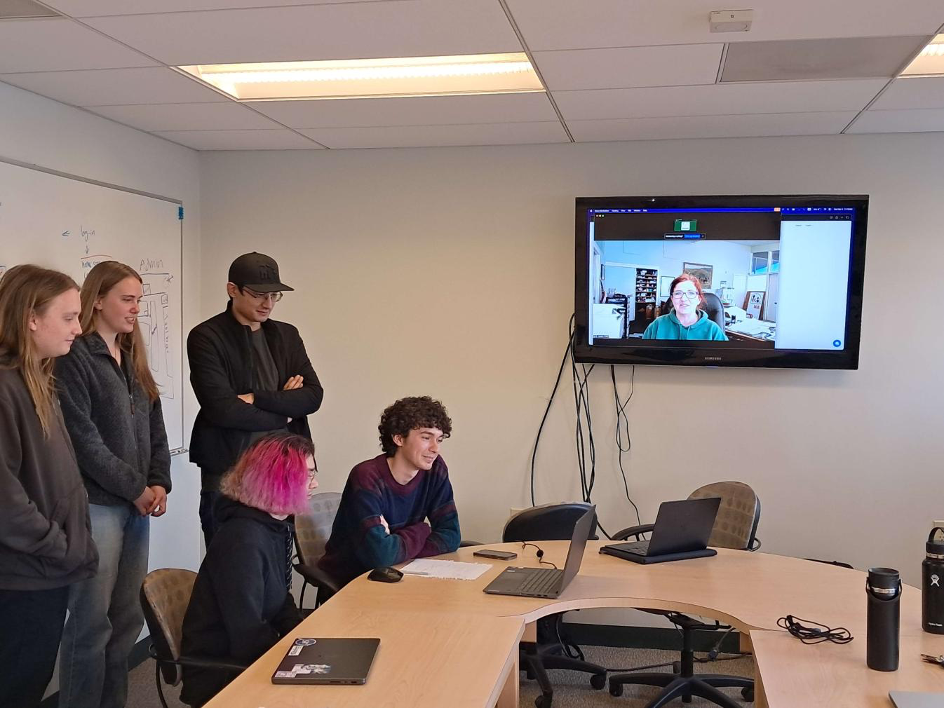
Importance
Acknowledged specific client requirements and expectations
Created relationship and future plans with client to continue project production

Slide 4
How
Utilization of MongoDB and NodeJS for scalability and performance-focused data management

Slide 5
Impact
Exploratory minimum viable product to gauge needs and wants from the organization
Creating broader impact and relationships with the community

