Slide 1
Energy Efficient
Geographical Load Balancing via Dynamic Deferral of Workload
M.A. Adnan, R. Sugihara, R.K. Gupta
CLOUD 2012
Huangxin Wang
11/19/2014
CS773 Presentation 2

Slide 2
Outline
Introduction
  Background
  Related work
Technical content
Conclusion and critiques

Slide 3
Background
Geographical data center
Dynamic energy price
Introduction

Slide 4
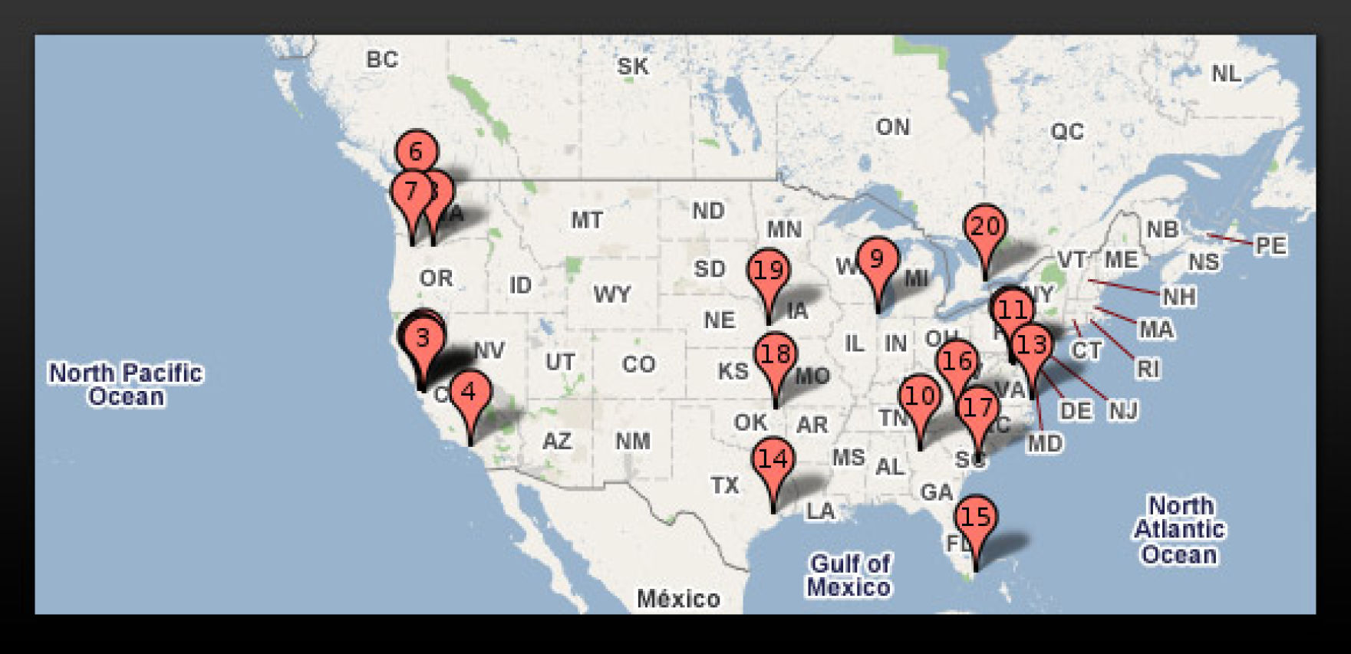
Geographical Data Centers(1/2)
Distribution of Parts of Google Data Centers (19 in US, 36 in total)
Introduction
Notes:
Large companies such as Google, Amazon need to deal with tremendous user request everyday. In order to guarantee the performance with low latency and high availability. These companies build data centers around the world.

Slide 5
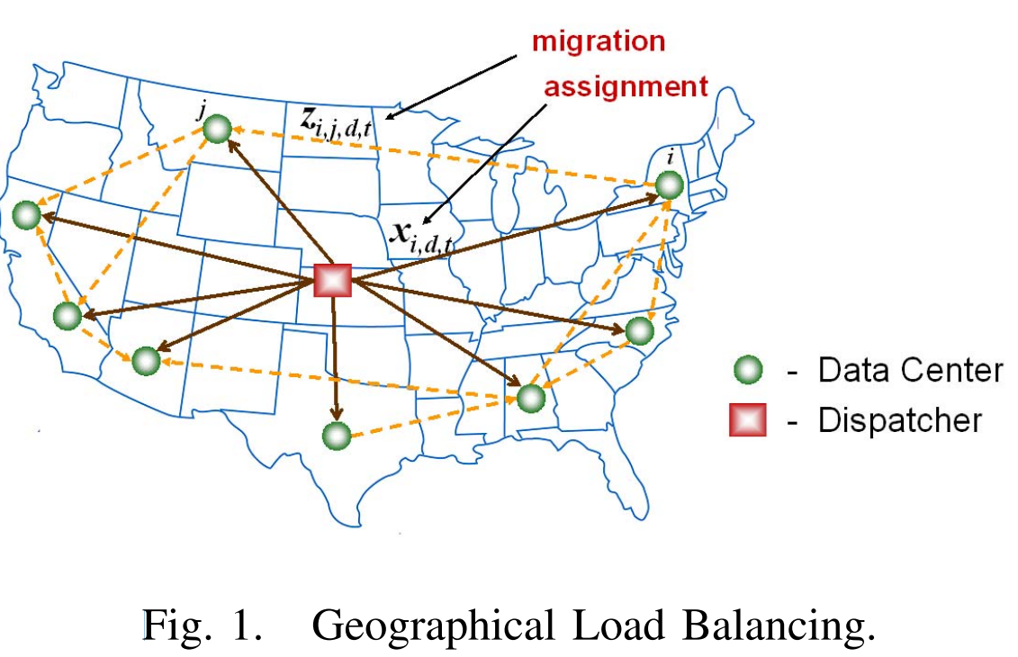
Geographical Data Centers(2/2)
Dispatcher:
Dispatch jobs to different data centers
No storage
Introduction

Slide 6
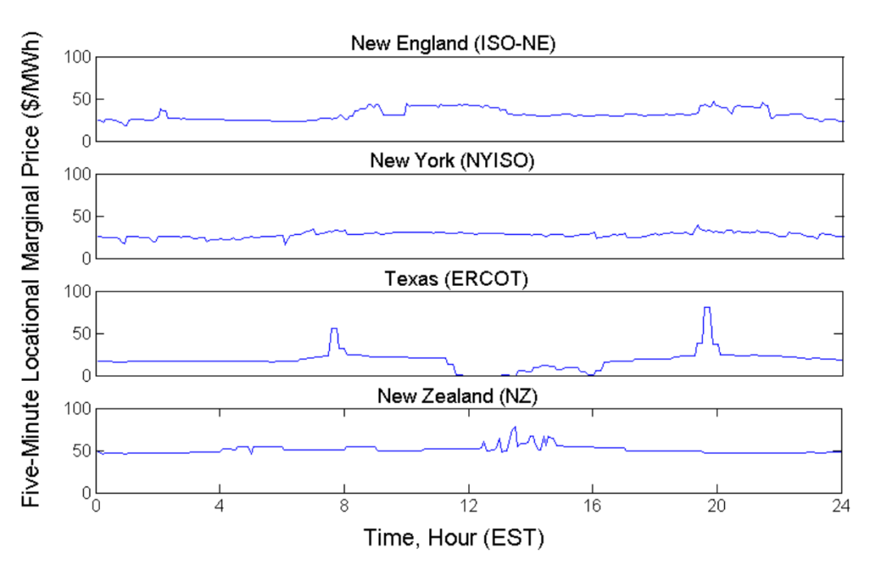
Dynamic Energy Price
Wholesale market:
Electricity Price
Different from on/off-peak scheme
More fluctuations
Price adjust every 5 minutes!
Fig. Electricity price
Introduction
Notes:
The power price is adjust dynamic by the power company in order to incentivize consumers to reduce their power usage when there has high power demand.

Slide 7

Problem Statement
Taking into account of the dynamic energy price
  How to dispatch jobs to data centers
  How to migrate jobs among data centers
  In order to reduce the electricity cost
  Challenge
  Future electricity price is unknown
  Future workload arrival is also unknown
Introduction

Slide 8
Related work
[Qureshi-2009 SIGCOMM]
  does not consider job deadlines, no workload migration
  Greedy heuristic
[Liu-GreenMetric-2011]: renewable energy, no deadline
Novelty:
  Consider job deadline
  Consider dynamic energy price and its prediction
Introduction

Slide 9
Technical Content
Problem model
Algorithms and analysis
Simulation
Technical Contents

Slide 10
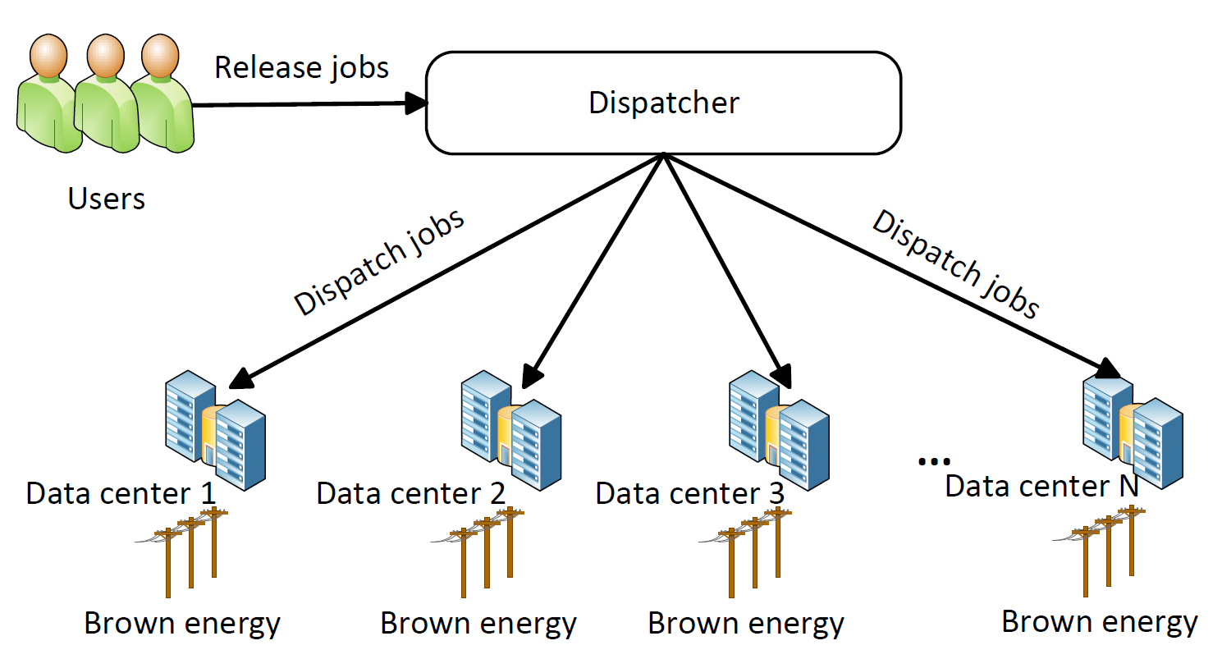
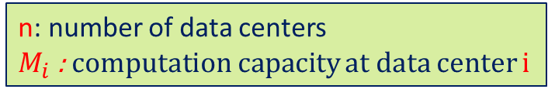
Problem Model(1/2)
n: number of data centers
$M_{i}$ : computation capacity at data center i
Technical Contents

Slide 11


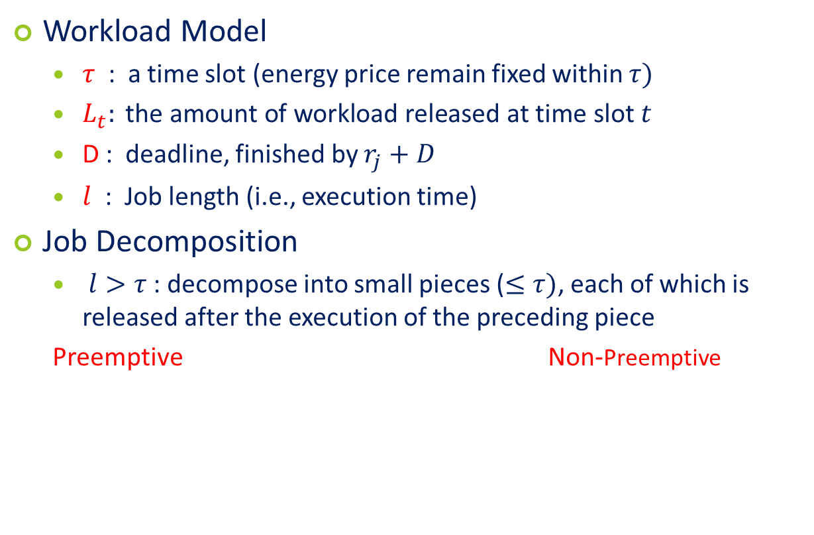



Problem Model(2/2)
Workload Model
  $τ$ : a time slot (energy price remain fixed within $τ)$
  $L_{t}: \text{the} \text{amount} \text{of} \text{workload} \text{released} \text{at} \text{time} \text{slot} t$
  D : deadline, finished by $r_{j}+D$
  $l$ : Job length (i.e., execution time)
Job Decomposition
  $l>τ$ : decompose into small pieces ($≤τ)$, each of which is released after the execution of the preceding piece
  Preemptive Non-Preemptive
1
2
3
4
5
1
2
3
4
5
$\left\lfloor \frac{D}{l}\right\rfloor$-1
$\left\lfloor \frac{D}{l}\right\rfloor$-1
$\left\lfloor \frac{D}{l}\right\rfloor$-1
$\left\lfloor \frac{D}{l}\right\rfloor$-1
$\left\lfloor \frac{D}{l}\right\rfloor$-1
$$D−l$$
0
0
0
0
Technical Contents

Slide 12

How to use linear program?
Goal of LP
- Dispatch
- Migration
Format of LP
Objective
  Minimize energy cost
Constraints
  Deadline
  Capacity

Slide 13
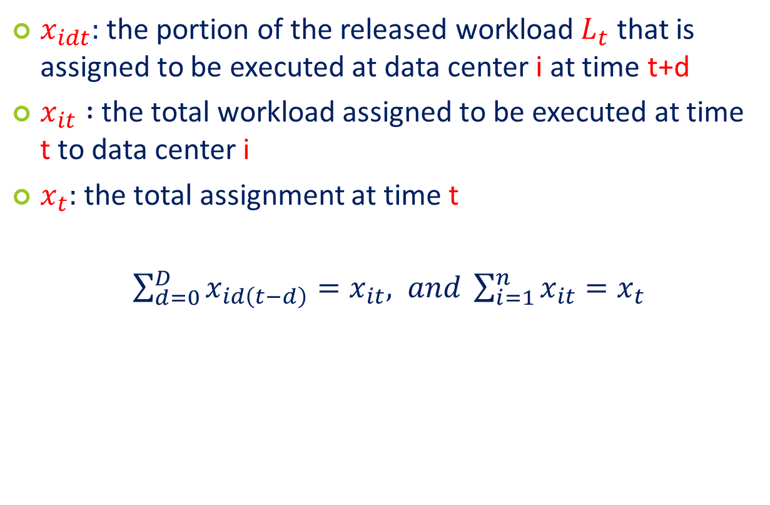
Notation - Dispatch (1/4)
$x_{idt}:$ the portion of the released workload $L_{t}$ that is assigned to be executed at data center i at time t+d
$x_{it} :$ the total workload assigned to be executed at time t to data center i
$x_{t}:$ the total assignment at time t
$\sum_{d=0}^{D}{x_{id\left(t−d\right)}=x_{it}, and \sum_{i=1}^{n}{x_{it}}}=x_{t}$
Technical Contents
Notes:
First, consider uniform deadline
The purpose of define the other two notations is to make it more concise when writing the linear program.

Slide 14
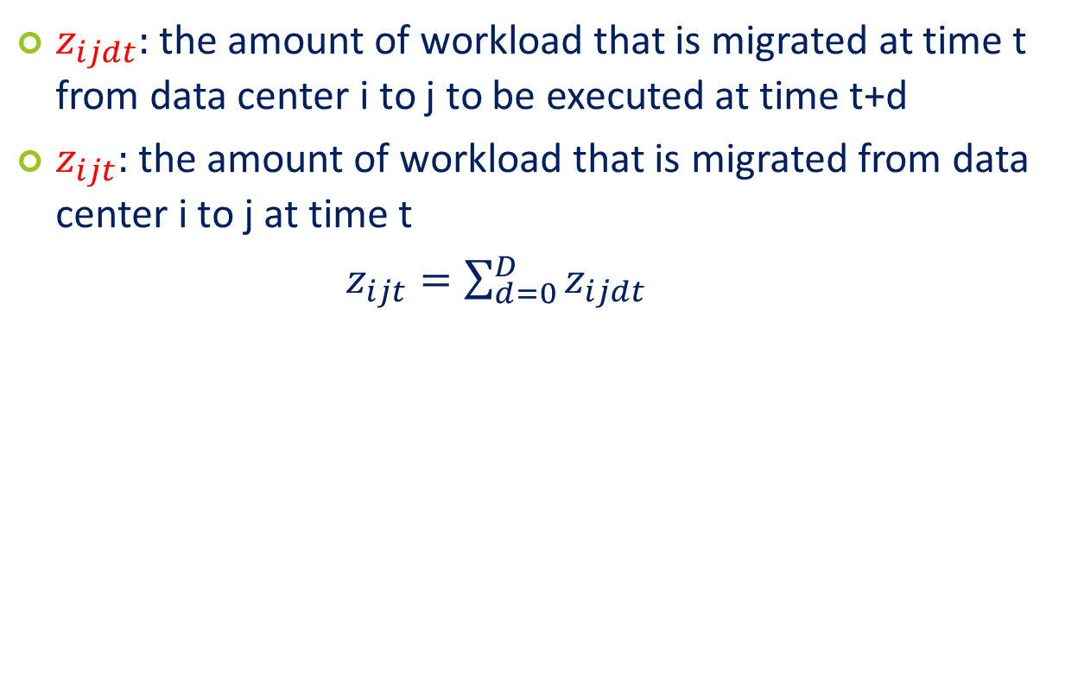
Notations – Migration (2/4)
$z_{ijdt}:$the amount of workload that is migrated at time t from data center i to j to be executed at time t+d
$z_{ijt}:$ the amount of workload that is migrated from data center i to j at time t
$z_{ijt}=\sum_{d=0}^{D}{z_{ijdt}}$
Technical Contents

Slide 15
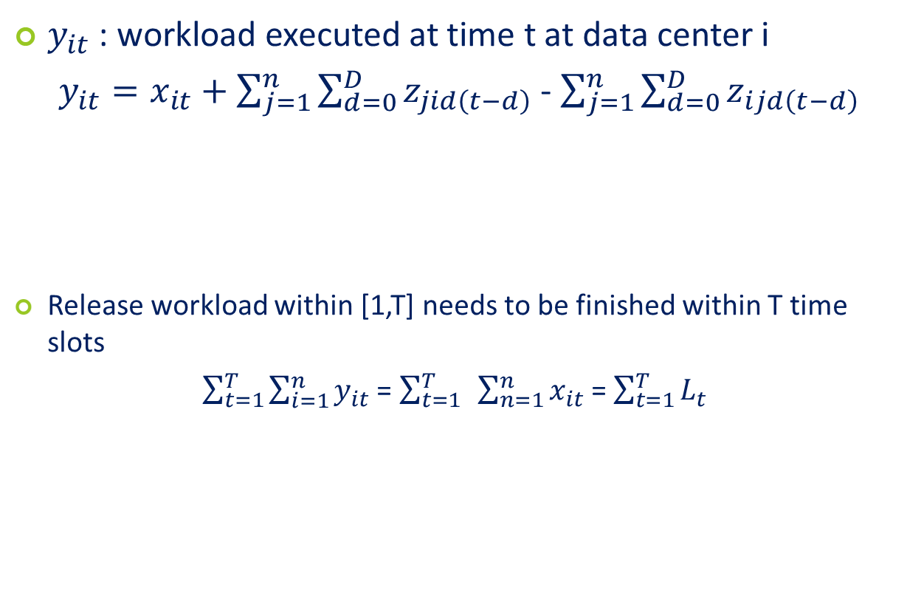
Notations – execute (3/4)
$y_{it}$ : workload executed at time t at data center i
$y_{it}=x_{it}+\sum_{j=1}^{n}{\sum_{d=0}^{D}{z_{jid\left(t−d\right)}}}$ - $\sum_{j=1}^{n}{\sum_{d=0}^{D}{z_{ijd\left(t−d\right)}}}$
Release workload within [1,T] needs to be finished within T time slots
$\sum_{t=1}^{T}{\sum_{i=1}^{n}{y_{it}}}$ = $\sum_{t=1}^{T}{ }\sum_{n=1}^{n}{x_{it}}$ = $\sum_{t=1}^{T}{L_{t}}$
dispatch to i
migrate into i
migrate out of i
executed workload
released workload
Technical Contents

Slide 16
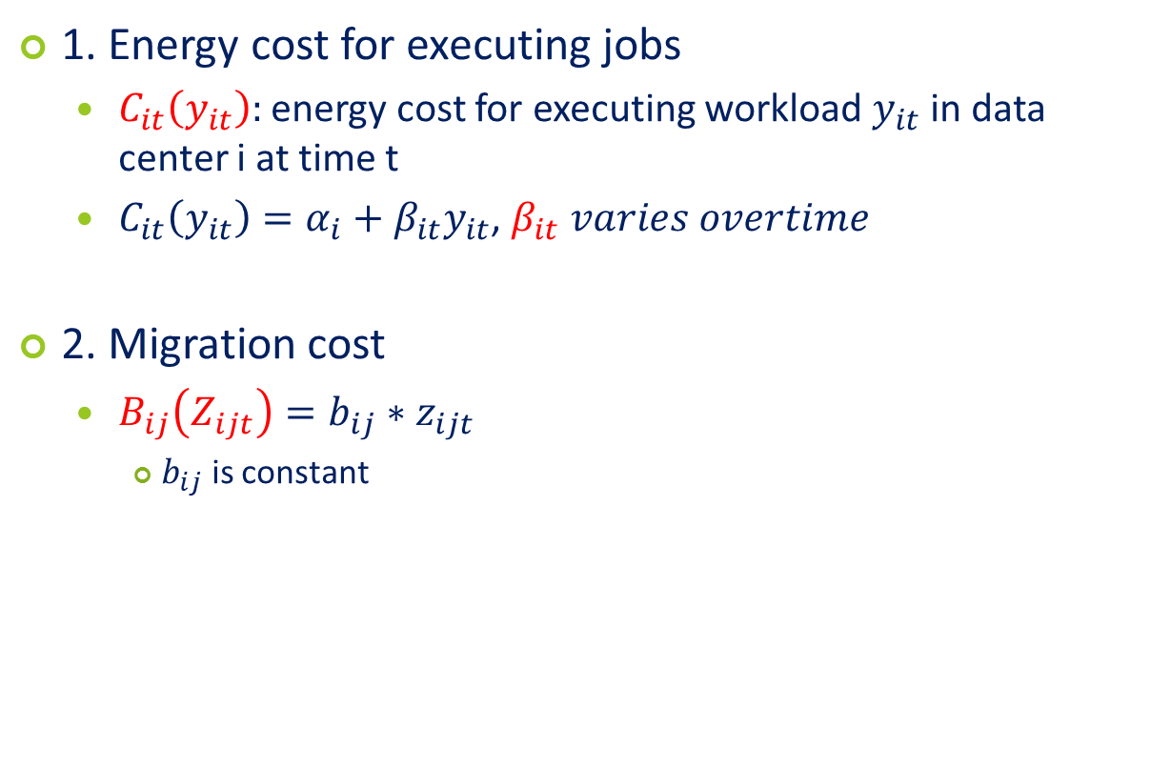
Notations – Cost (4/4)
1. Energy cost for executing jobs
  $C_{it}\left(y_{it}\right):$ energy cost for executing workload $y_{it}$ in data center i at time t
  $C_{it}\left(y_{it}\right)=α_{i}+β_{it}y_{it}$, $β_{it} varies overtime$
2. Migration cost
  $B_{ij}\left(Z_{ijt}\right)=b_{ij}∗z_{ijt}$
    $b_{ij}$ is constant
Technical Contents
Notes:
The goal of this paper is to minimize the operation cost in the cloud which is the sum of the energy costs for executing workload at the data centers and the cost for migration jobs between data centers

Slide 17








Notations
Job: deadline D,
Constraint:
Deadline
Migration amount
Data center capacity
$L_{t}$ : workloads at time t
$$x_{1dt}$$
$$x_{2dt}$$
$$x_{3dt}$$
$$x_{ndt}$$
$$z_{12dt}$$
$$z_{3ndt}$$
$$y_{it}=x_{it}+migrate in −migrate out$$
Technical Contents
Notes:
$x_{idt}$ : assignment of workload to the data centers
$z_{ijdt}$: the amount of migrated workload during each time slot t

Slide 18
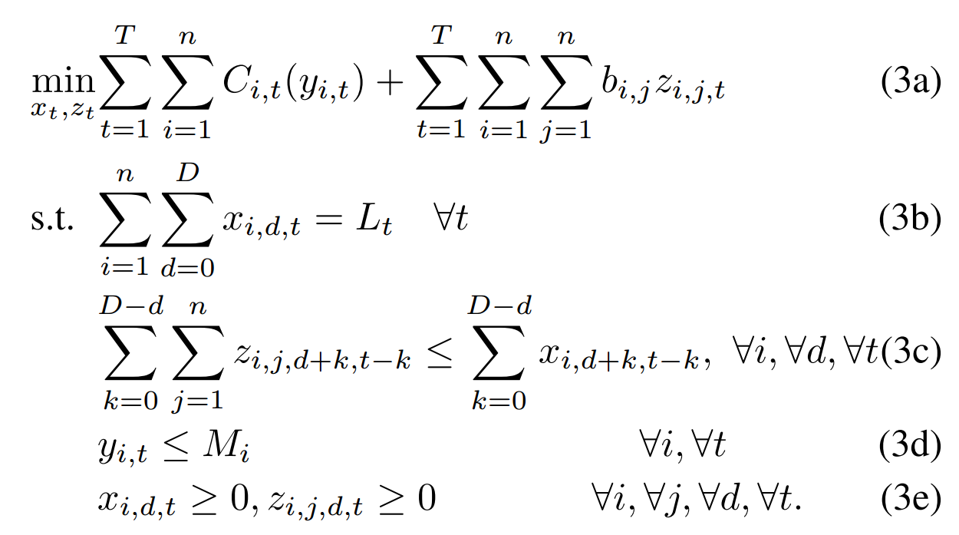
Offline Algorithm (1/2)
Linear Program
Cost = exe cost + migration cost
all workloads execute before deadline
maximum workload to migrate
computation capacity constraint
Technical Contents

Slide 19
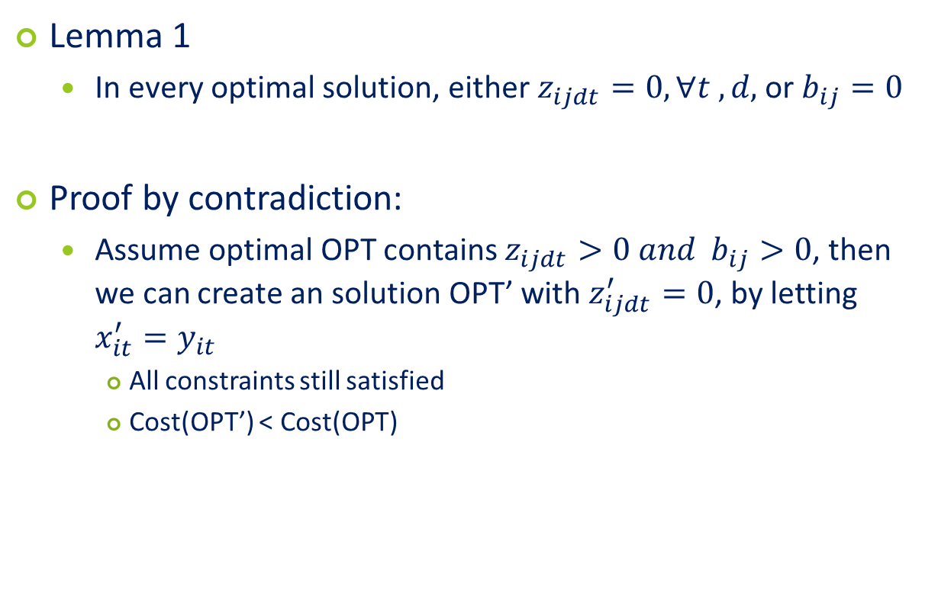
Offline algorithm (2/2)
Lemma 1
  In every optimal solution, either $z_{ijdt}=0, ∀t ,d,$ or $b_{ij}=0$
Proof by contradiction:
  Assume optimal OPT contains $z_{ijdt}>0 and$ $b_{ij}>0$, then we can create an solution OPT’ with $z_{ijdt}^{′}=0$, by letting $x_{it}^{′}=y_{it}$
    All constraints still satisfied
    Cost(OPT’) < Cost(OPT)
Conclusion: migration is not needed for an optimal offline algorithm
Technical Contents

Slide 20
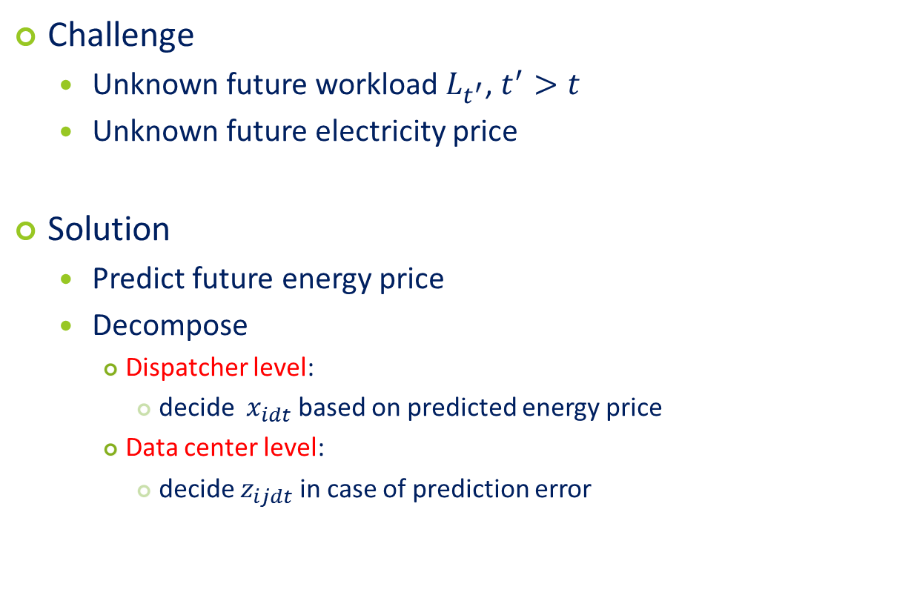
Online Algorithm (1/7)
Challenge
  Unknown future workload $L_{t^{′}}$, $t^{′}>t$
  Unknown future electricity price
Solution
  Predict future energy price
  Decompose
    Dispatcher level:
      decide ${ x}_{idt}$ based on predicted energy price
    Data center level:
      decide $z_{ijdt}$ in case of prediction error
Technical Contents

Slide 21
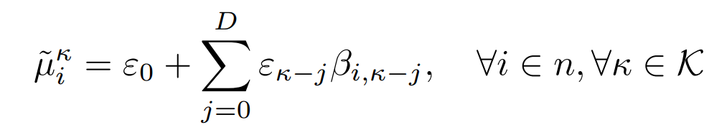
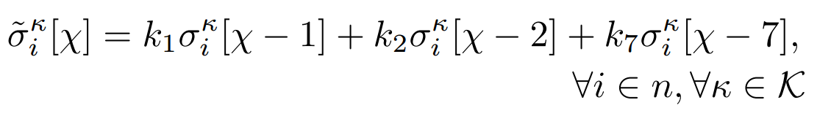
Online Algorithm (2/7)
Electricity Price Prediction Model
  Model the price using Gaussian random variable
    Mean: moving average method
    Variance: estimated using weighted average price prediction filter [Mohsenian-Rad-2010]
Current day
yesterday
the day before yesterday
the same day last week
Technical Contents

Slide 22
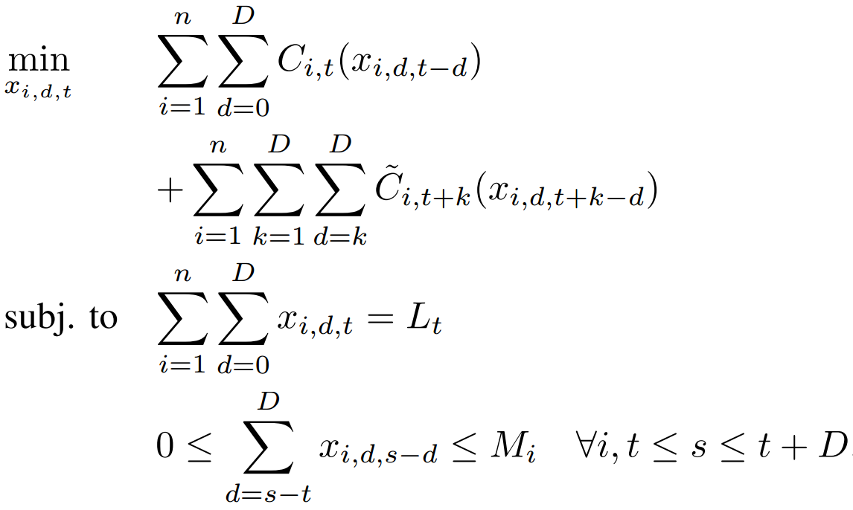
Online Algorithm (3/7)
Level 1: Optimization for Dispatcher
cost = exe cost
deadline constraint
data center capacity constraint
Technical Contents

Slide 23
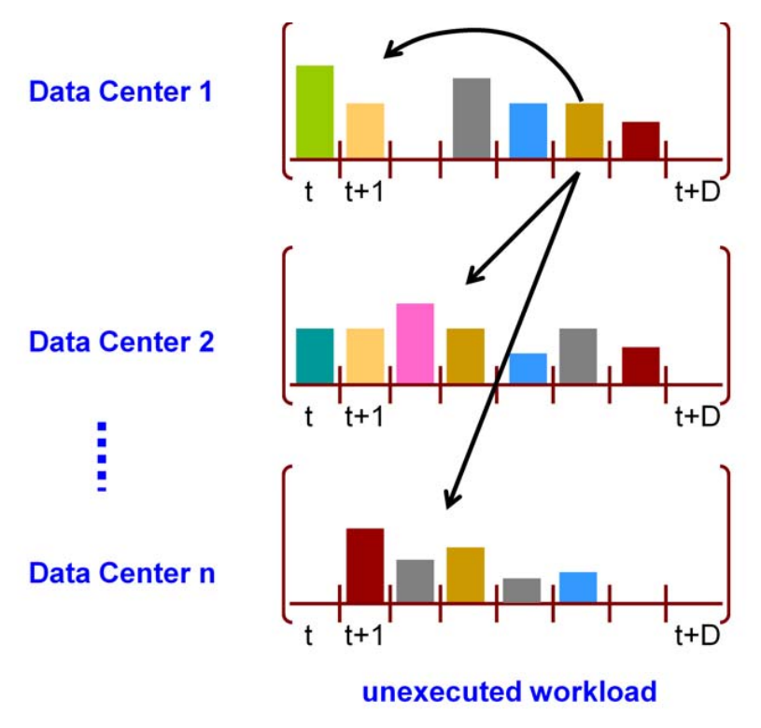
Online algorithm (4/7)
Level 2: Optimization for data center level
  Motivation: adjust assignment to overcome prediction error
Decision to make:
How much workload to execute at time t
How much to migrate to other data centers
Version 1: without migration
Version 2: with migration
Technical Contents

Slide 24
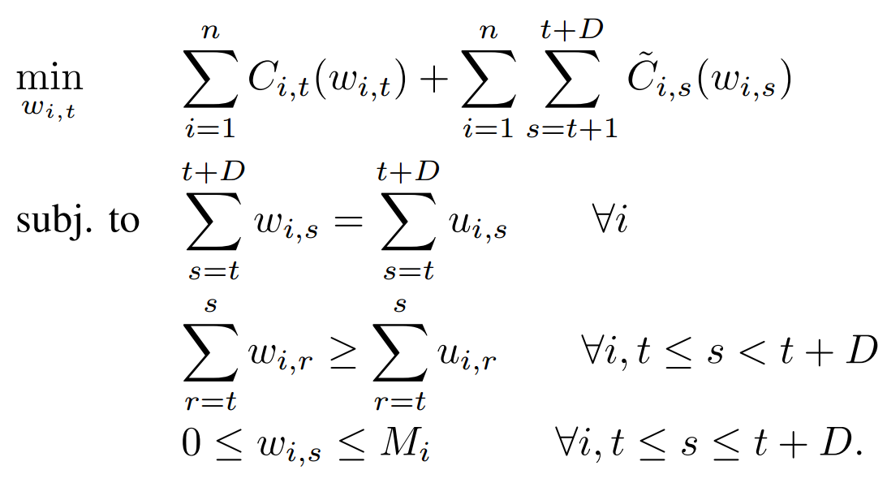
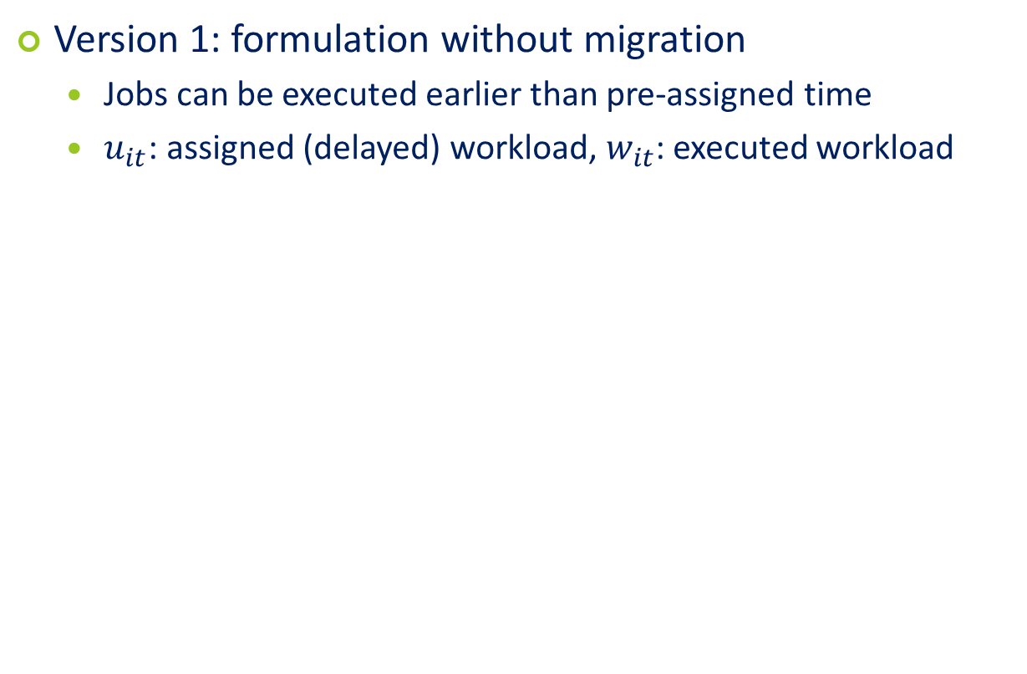
Online algorithm (5/7)
Version 1: formulation without migration
  Jobs can be executed earlier than pre-assigned time
  $u_{it}$: assigned (delayed) workload, $w_{it}$: executed workload
Jobs can only be move earlier
Technical Contents
Notes:
Although there is no migration, still the data centers can improve the assignment by executing the delayed workload early in previous time slots without violating deadline

Slide 25
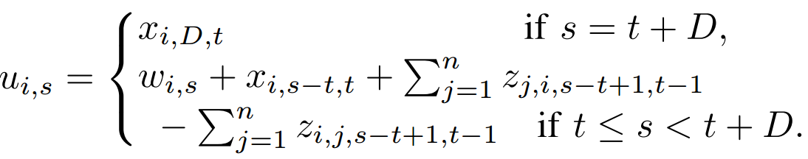
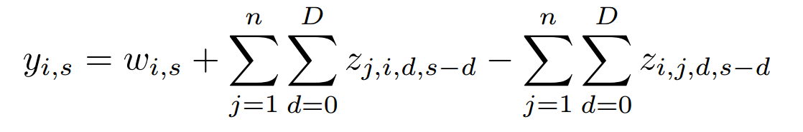
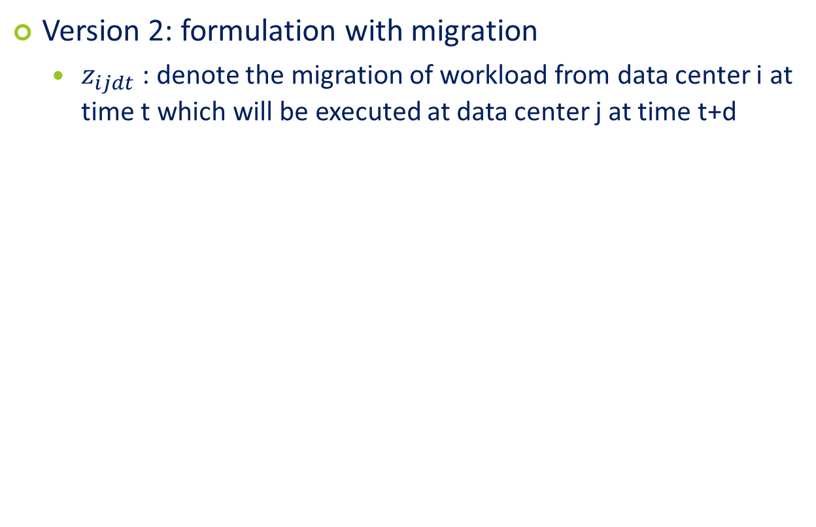

Online algorithm (6/7)
Version 2: formulation with migration
  $z_{ijdt}$ : denote the migration of workload from data center i at time t which will be executed at data center j at time t+d
Amount to execute
assigned of workload $L_{t}$
Workload to execute at time s at data center i
Technical Contents
Notes:
w_(is) is the amount of workload moved earlier; u_(is) is the amount of workload assigned;

Slide 26
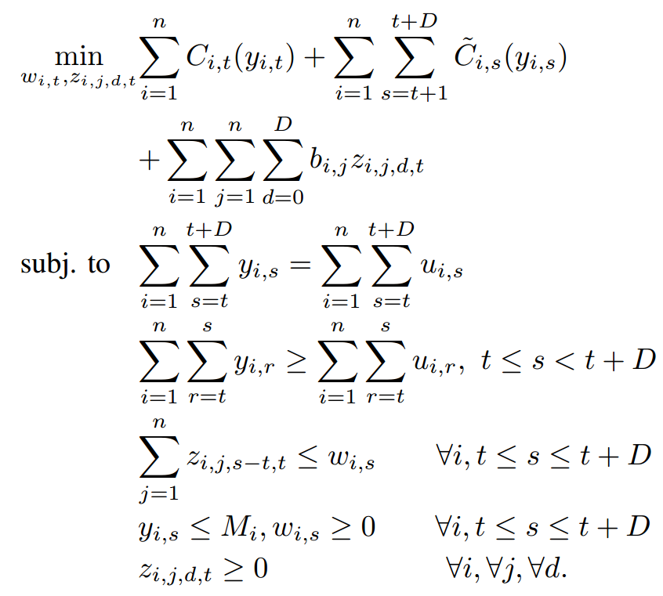
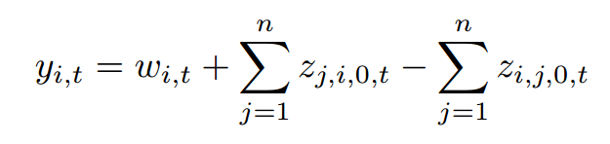
Online algorithm (7/7)
Level 2: Optimization for data center
Contradict:
Technical Contents
Notes:
Expression of y_(it) is wrong, need to deduct z_(ijkt), k from 0 to D

Slide 27


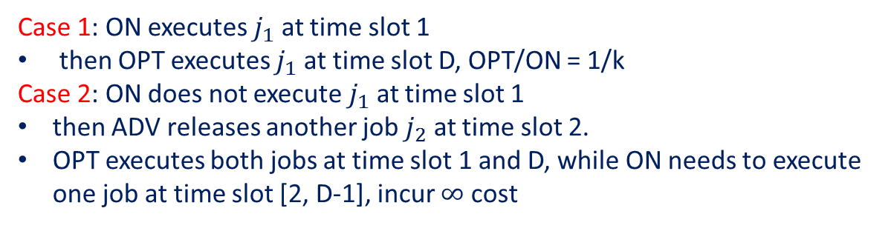
Analysis of algorithm (1/2)
Lemma 3: No online algorithm has constant competitive ratio with respect to the offline algorithm.
Proof: OPT/ON can be arbitrary small
ka | $$∞$$ | $$∞$$ | … | a
1
2
3
D
$$j_{1}:length=1$$
Case 1: ON executes $j_{1}$ at time slot 1
then OPT executes $j_{1}$ at time slot D, OPT/ON = 1/k
Case 2: ON does not execute $j_{1}$ at time slot 1
then ADV releases another job $j_{2}$ at time slot 2.
OPT executes both jobs at time slot 1 and D, while ON needs to execute one job at time slot [2, D-1], incur $∞$ cost
Technical Contents

Slide 28
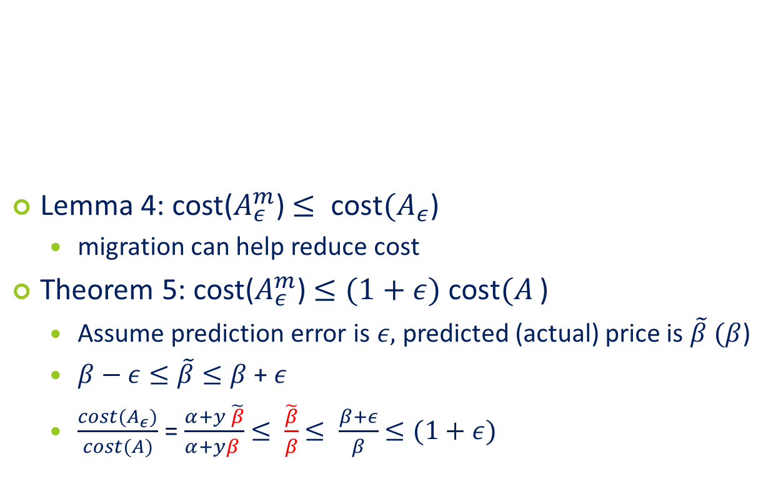
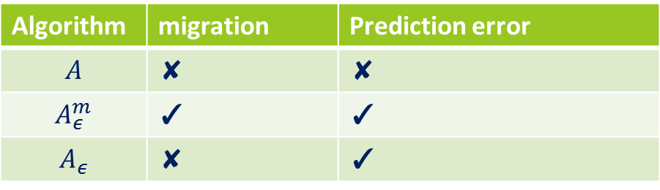
Algorithm Analysis (2/2)
Lemma 4: cost($A_{ε}^{m}$) $≤ {\text{cost}(A}_{ε}$)
  migration can help reduce cost
Theorem 5: cost($A_{ε}^{m}$) $≤(1+ε) {\text{cost}(A}_{ }$)
  Assume prediction error is $ε,$ predicted (actual) price is $\tilde{β} (β$)
  $β−ε≤\tilde{β}≤β$ + $ε$
  $\frac{cost(A_{ε})}{cost(A)}$ = $\frac{α+y \tilde{β}}{α+yβ }$ $≤ \frac{\tilde{β}}{β}$ $≤ \frac{β+ε}{β}$ $≤(1+ε)$
Algorithm | migration | Prediction error
$$A$$ | ✘ | ✘
$$A_{ε}^{m}$$ | ✓ | ✓
$$A_{ε}$$ | ✘ | ✓
Technical Contents
Notes:
Use another parameter, otherwise, confusing

Slide 29
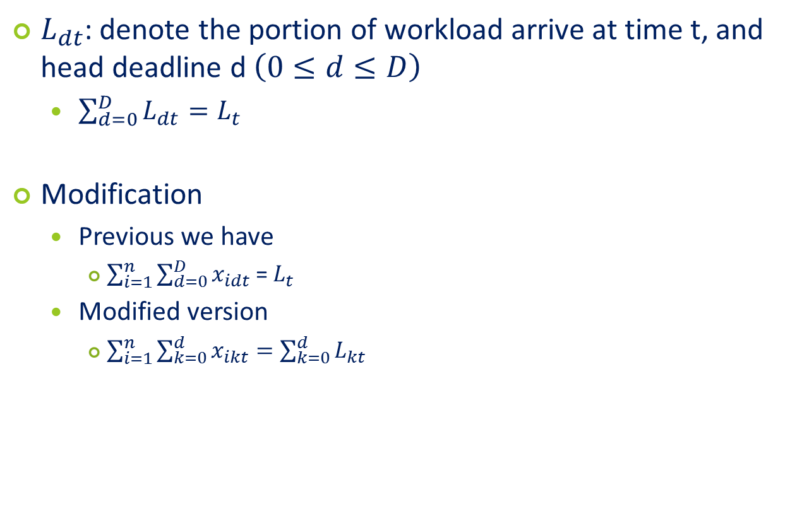
Nonuniform deadline
$L_{dt}$: denote the portion of workload arrive at time t, and head deadline d $\left(0≤d≤D\right)$
  $\sum_{d=0}^{D}{L_{dt}=L_{t}}$
Modification
  Previous we have
    $\sum_{i=1}^{n}{\sum_{d=0}^{D}{x_{idt}}}$ = $L_{t}$
  Modified version
    $\sum_{i=1}^{n}{\sum_{k=0}^{d}{x_{ikt}=\sum_{k=0}^{d}{L_{kt}}}}$
Technical Contents

Slide 30
Simulation setting (1/3)
4 geographical data centers
  Location: New England, New York, Texas, New Zealand
  Capacity: tuned to accommodate all workloads
Electricity price
  Wholesale
  5 minutes spot
Technical Contents

Slide 31
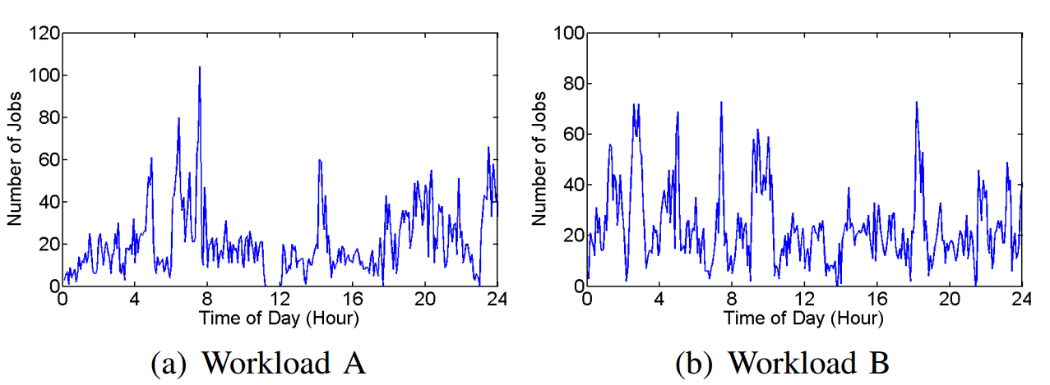
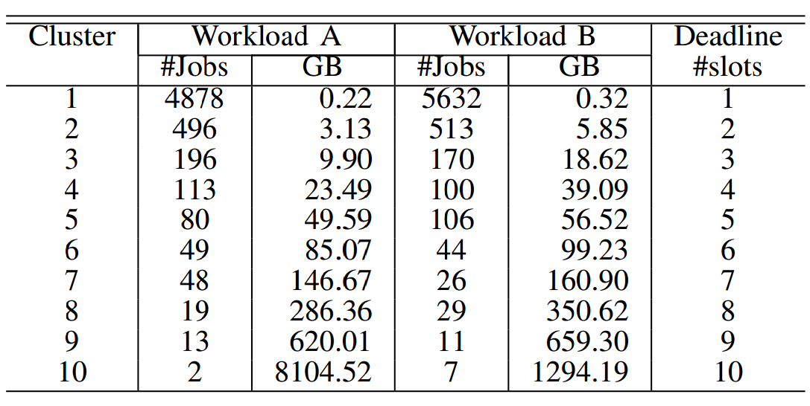
Simulation setting (2/3)
  Workload: Facebook
  Workload types
    Workload A: typical
    Workload B: bursty
  Deadline
    Uniform deadline: vary deadline from 1-12
    Non-uniform deadline: k-mean clustering based on total size
Larger class has smaller deadline
Technical Contents

Slide 32
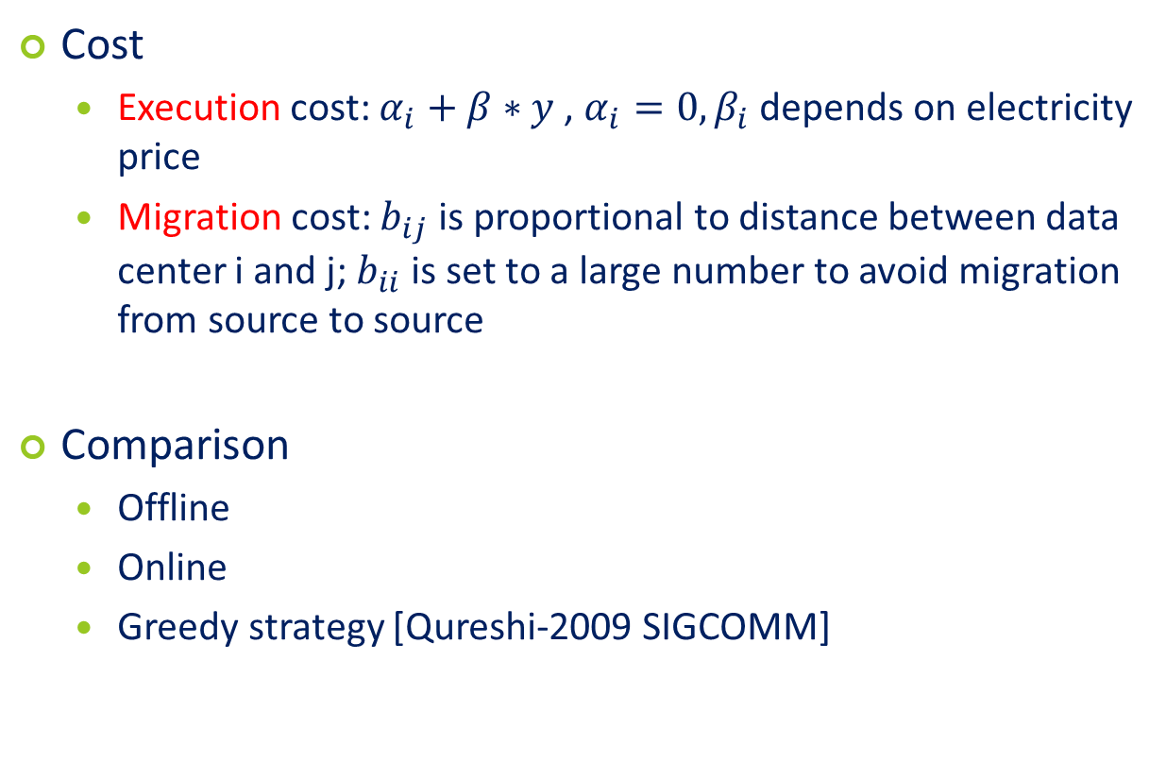
Simulation setting (3/3)
Cost
  Execution cost: $α_{i}+β∗y$, $α_{i}=0, β_{i}$ depends on electricity price
  Migration cost: $b_{ij}$ is proportional to distance between data center i and j; $b_{ii}$ is set to a large number to avoid migration from source to source
Comparison
  Offline
  Online
  Greedy strategy [Qureshi-2009 SIGCOMM]
Technical Contents

Slide 33
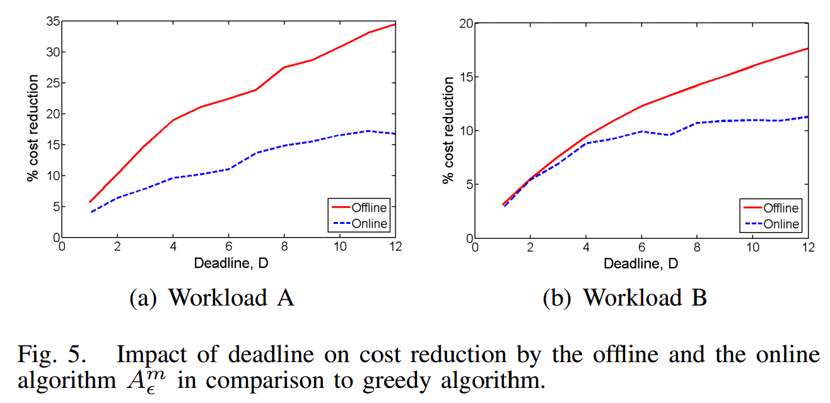
Simulation result (1/3)
Uniform Deadline
Technical Contents
Notes:
The cost saving can be as high as 30% for deadline of 12 slots; even for one slot, we can get 5% cost saving

Slide 34
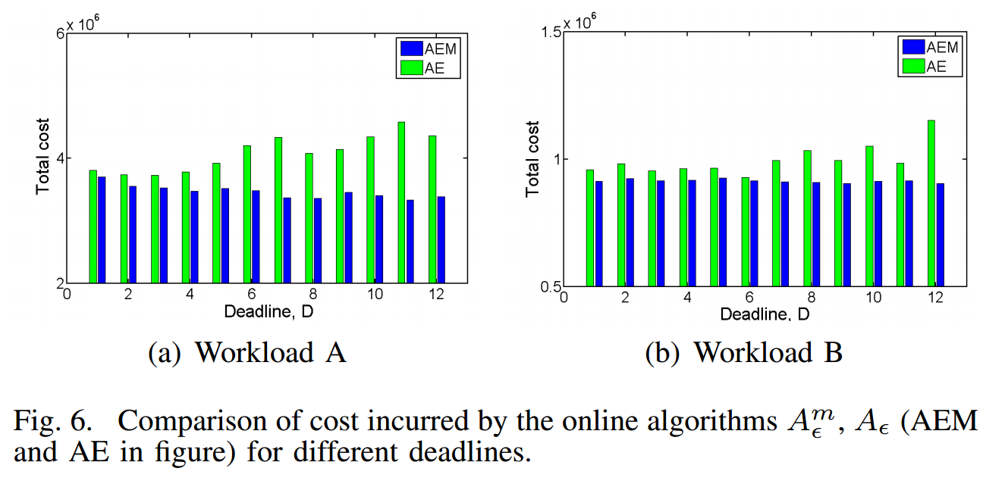
Simulation result (2/3)
Power of migration
Technical Contents
Notes:
When deadline increase, cost of AE increase, due to the prediction error

Slide 35
Simulation result (3/3)
Non-uniform deadline
  15.64% cost saving for workload A
  9.23% cost saving for workload B
Technical Contents

Slide 36
Conclusion
The author study the problem of workload schedule among geographical data centers aiming at minimizing cost while meeting deadlines
Offline algorithm
Online algorithm
Simulation results illustrate that their mechanism can achieve significant cost saving.
Conclusion and Critiques

Slide 37
Merits
The problem they investigate is novel. Meeting deadline constraints is important to guarantee the service quality.
The decomposing of the online algorithm into two steps make the problem easier to be solved.
The analysis of the online algorithm is interesting.
Conclusion and Critiques

Slide 38
Weakness
They assume migration time is negligible which may not be true for data-intensive workloads, e.g., MapReduce
The time overhead of the online algorithm and offline algorithm is not measured.
In online algorithm, jobs can only be migrated to earlier time slots.
The decomposing of workloads to unit seems have some problem.
How to ensure that the dynamic deferral will not affect future arriving jobs? Deadline miss?
Conclusion and Critiques

Slide 39
Possible Extensions
Consider renewable energy.
Consider heterogeneity of data centers, e.g., assign clients to the data centers closer to them
Consider power capping
Consider the prediction of future arrival workloads to improve deadline miss ratio
Conclusion and Critiques

Slide 40
Thank You!
Conclusion and Critiques

Slide 41
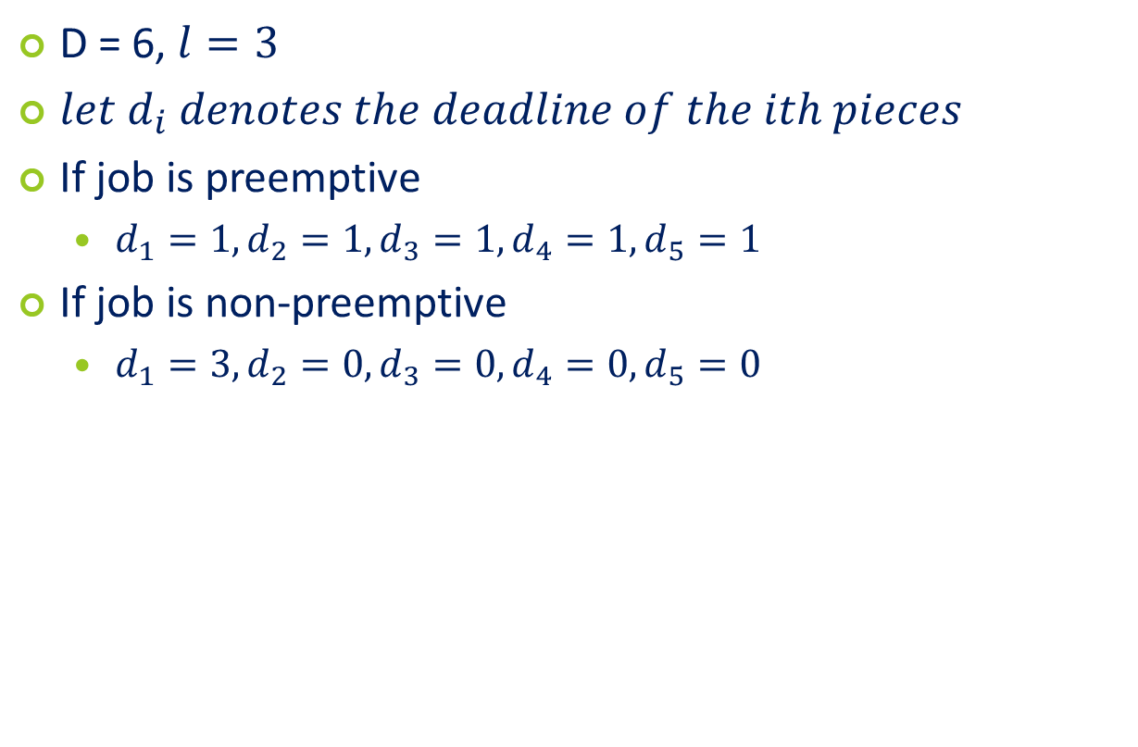
Confused: Job decomposition
D = 6, $l=3$
$let d_{i} denotes the deadline of the ith pieces$
If job is preemptive
  $d_{1}=1, d_{2}=1, d_{3}=1, d_{4}=1, d_{5}=1$
If job is non-preemptive
  $d_{1}=3, d_{2}=0, d_{3}=0, d_{4}=0, d_{5}=0$
Backup

Slide 42
Optimization of dispatcher
Greedy algorithm also works
Backup

Slide 43
Weakness
Typo: In Page-189, "that is migrated form data center i to j", "form" -> "from"
Backup

Slide 44
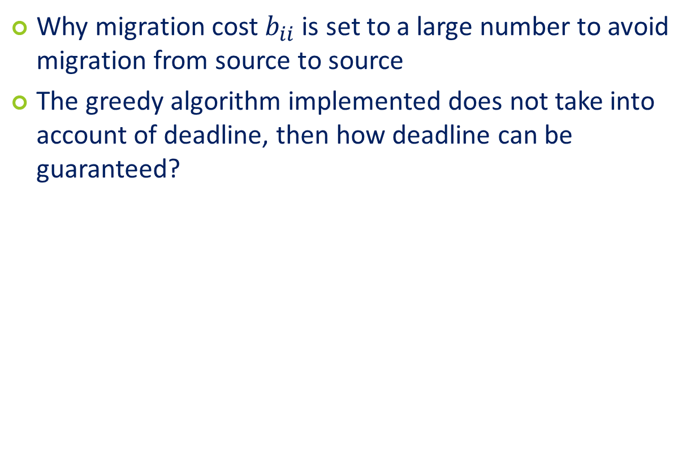
Confusion
Why migration cost $b_{ii}$ is set to a large number to avoid migration from source to source
The greedy algorithm implemented does not take into account of deadline, then how deadline can be guaranteed?
Backup

Slide 45
Greedy
Given a client, the price-conscious optimizer maps it to a
cluster with the lowest price, only considering clusters within some maximum radial geographic distance.
For clients that do not have any clusters within that maximum distance, the routing scheme finds the closest cluster and considers any other nearby clusters (< 50km). If the selected cluster is nearing its capacity (or the 95/5 boundary), the optimizer iteratively finds another good cluster.

