Slide 1
Energy Efficient Geographical Load Balancing via Dynamic Deferral of Workload
M.A. Adnan, R. Sugihara, R.K. Gupta
CLOUD 2012
Huangxin Wang
11/19/2014
CS773 Presentation 2

Slide 2
Outline
Introduction
Background
Related work
Technical content
Conclusion and critiques

Slide 3
Background
Geographical data center
Dynamic energy price

Slide 4
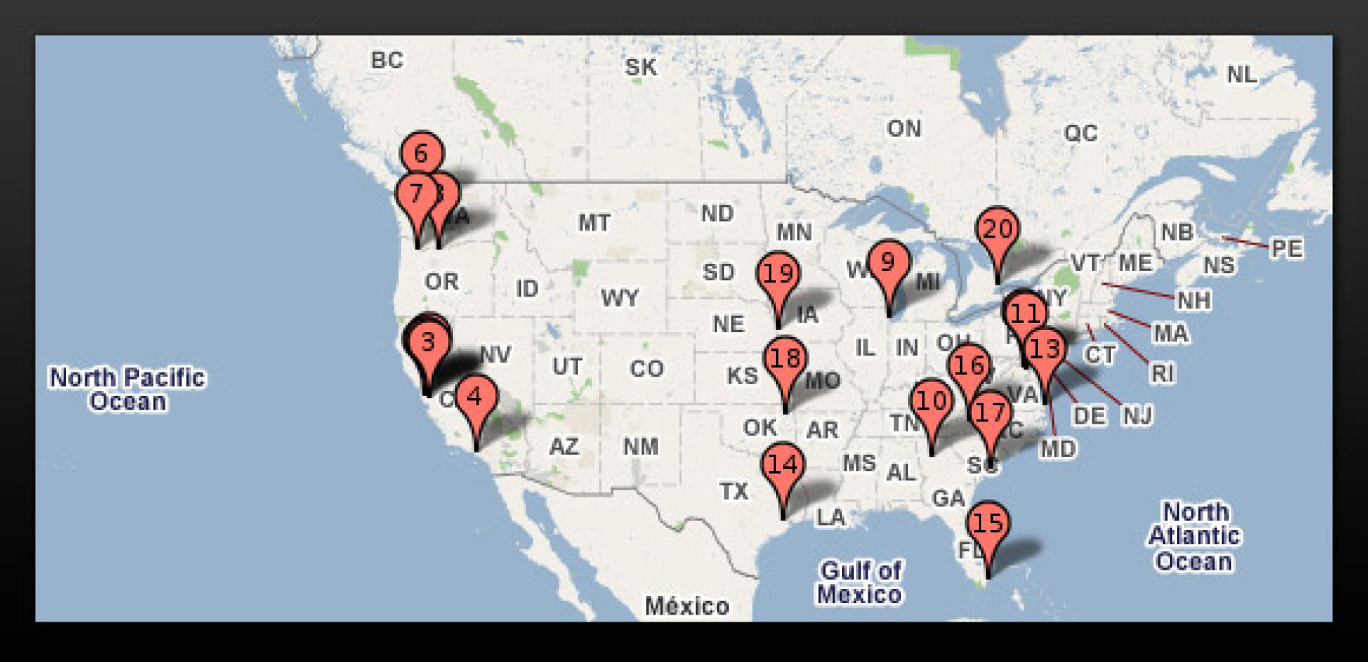
Geographical Data Centers(1/2)
Distribution of Parts of Google Data Centers (19 in US, 36 in total)
Notes:
Large companies such as Google, Amazon need to deal with tremendous user request everyday. In order to guarantee the performance with low latency and high availability. These companies build data centers around the world.

Slide 5
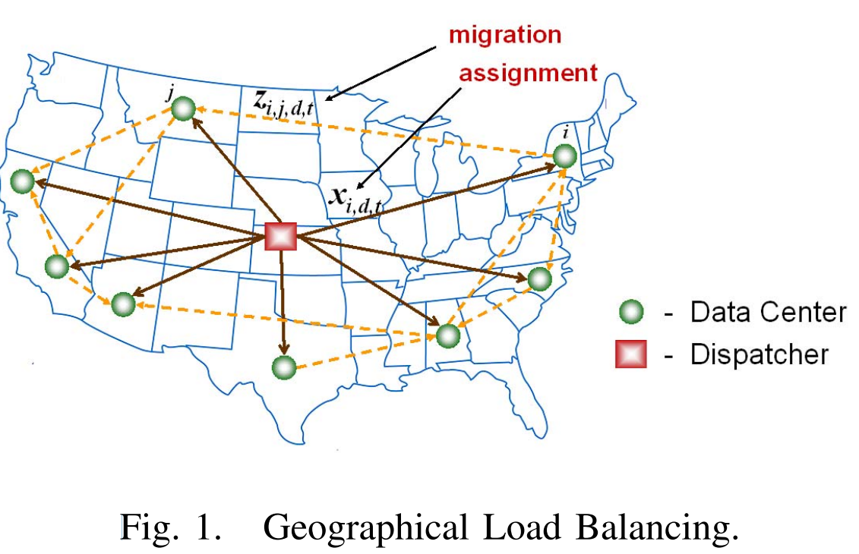
Geographical Data Centers(2/2)
Dispatcher:
Dispatch jobs to different data centers
No storage

Slide 6
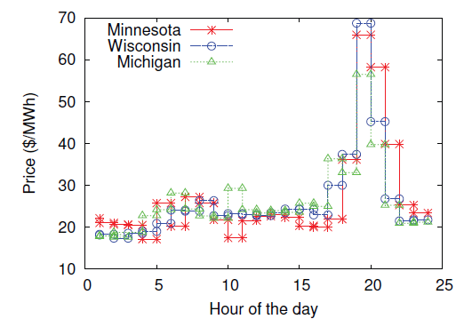
Dynamic Energy Price
Wholesale market:
Electricity Price
Different from on/off-peak scheme
More fluctuations
Fig. Electricity price
Notes:
The power price is adjust dynamic by the power company in order to incentivize consumers to reduce their power usage when there has high power demand.

Slide 7
Problem Statement
Taking into account of the dynamic energy price
How to dispatch jobs to data centers
How to migrate jobs among data centers
In order to reduce the electricity cost

Slide 8
Related work
[Qureshi-2009 SIGCOMM]
does not consider job deadlines
no workload/energy price prediction
Novelty:
Consider job deadline
Consider dynamic energy price and its prediction
Consider job migration

Slide 9
Technical Content
Problem model
Algorithms and analysis
Simulation

Slide 10
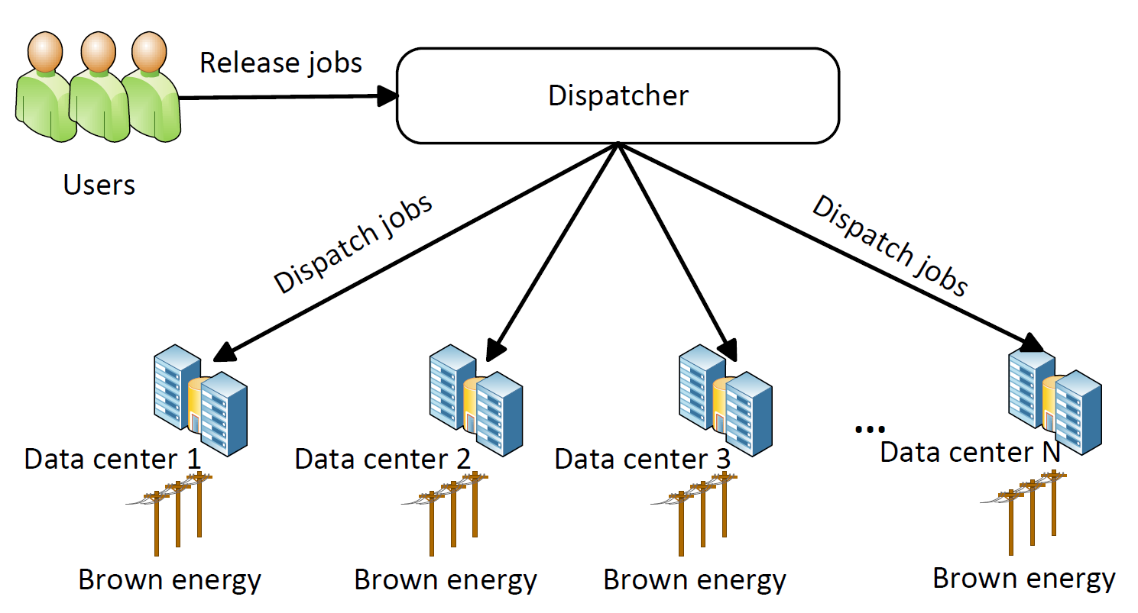
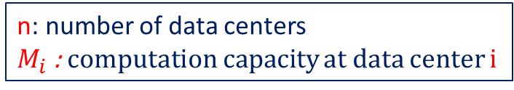
Problem Model(1/2)
n: number of data centers
$M_{i}$ : computation capacity at data center i

Slide 11


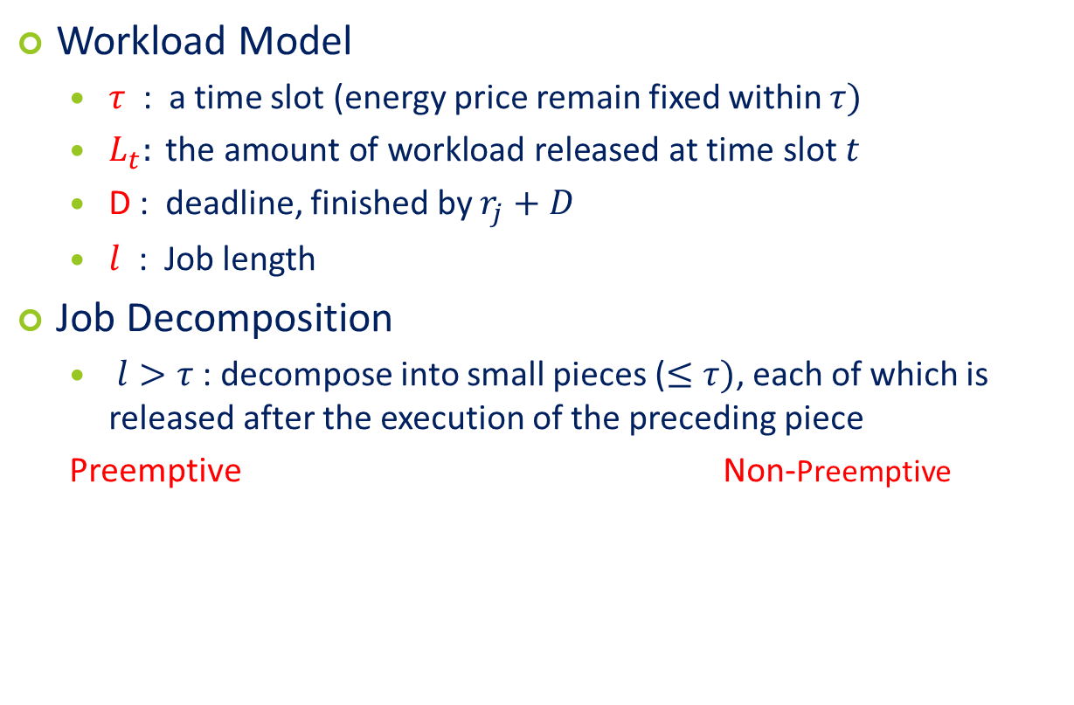



Problem Model(2/2)
Workload Model
$τ$ : a time slot (energy price remain fixed within $τ)$
$L_{t}: \text{the} \text{amount} \text{of} \text{workload} \text{released} \text{at} \text{time} \text{slot} t$
D : deadline, finished by $r_{j}+D$
$l$ : Job length
Job Decomposition
$l>τ$ : decompose into small pieces ($≤τ)$, each of which is released after the execution of the preceding piece
Preemptive Non-Preemptive
1
2
3
4
5
1
2
3
4
5
$\left\lfloor \frac{D}{l}\right\rfloor$-1
$\left\lfloor \frac{D}{l}\right\rfloor$-1
$\left\lfloor \frac{D}{l}\right\rfloor$-1
$\left\lfloor \frac{D}{l}\right\rfloor$-1
$\left\lfloor \frac{D}{l}\right\rfloor$-1
$$D−l$$
0
0
0
0

Slide 12
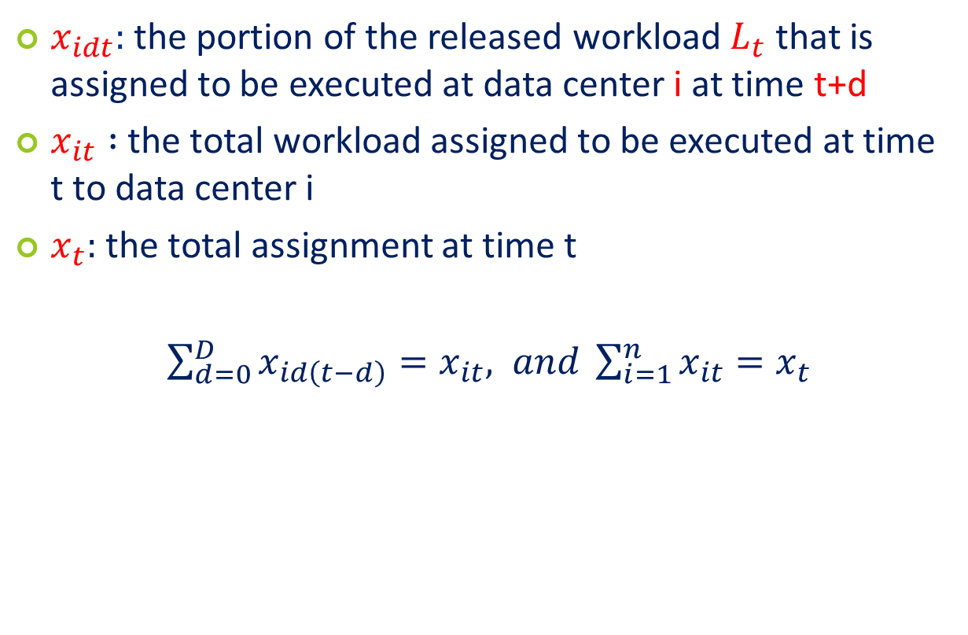
Notation - Dispatch (1/3)
$x_{idt}:$ the portion of the released workload $L_{t}$ that is assigned to be executed at data center i at time t+d
$x_{it} :$ the total workload assigned to be executed at time t to data center i
$x_{t}:$ the total assignment at time t
$\sum_{d=0}^{D}{x_{id\left(t−d\right)}=x_{it}, and \sum_{i=1}^{n}{x_{it}}}=x_{t}$

Slide 13

Notations – Migration (2/3)
$z_{ijdt}:$the amount of workload that is migrated at time t from data center i to j to be executed at time t+d
$z_{ijt}:$ the amount of workload that is migrated from data center i to j at time t
$z_{ijt}=\sum_{d=0}^{D}{z_{ijdt}}$

Slide 14
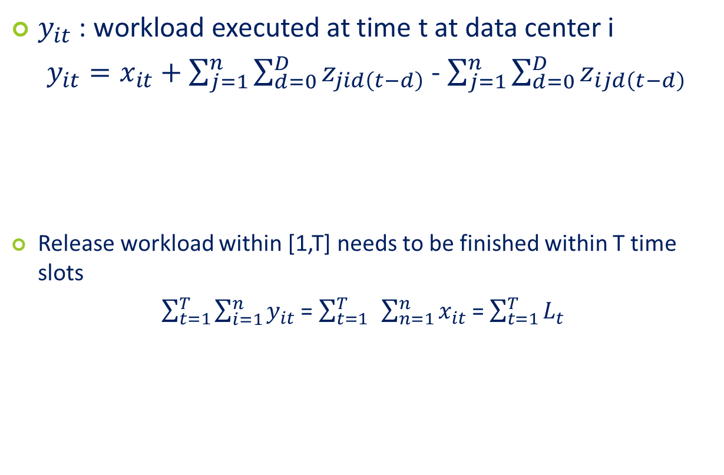
Notations – execute (3/3)
$y_{it}$ : workload executed at time t at data center i
$y_{it}=x_{it}+\sum_{j=1}^{n}{\sum_{d=0}^{D}{z_{jid\left(t−d\right)}}}$ - $\sum_{j=1}^{n}{\sum_{d=0}^{D}{z_{ijd\left(t−d\right)}}}$
Release workload within [1,T] needs to be finished within T time slots
$\sum_{t=1}^{T}{\sum_{i=1}^{n}{y_{it}}}$ = $\sum_{t=1}^{T}{ }\sum_{n=1}^{n}{x_{it}}$ = $\sum_{t=1}^{T}{L_{t}}$
assign to i
migrate into i
migrate out of i

Slide 15
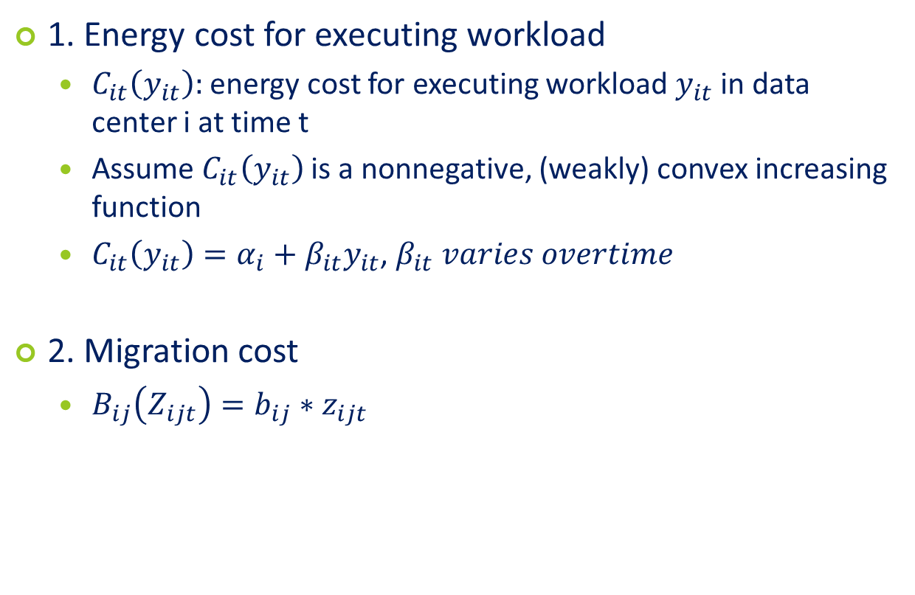

Notations – Cost ()
1. Energy cost for executing workload
$C_{it}\left(y_{it}\right):$ energy cost for executing workload $y_{it}$ in data center i at time t
Assume $C_{it}\left(y_{it}\right)$is a nonnegative, (weakly) convex increasing function
$C_{it}\left(y_{it}\right)=α_{i}+β_{it}y_{it}$, $β_{it} varies overtime$
2. Migration cost
$B_{ij}\left(Z_{ijt}\right)=b_{ij}∗z_{ijt}$
$b_{ij}$ is constant, e.g., band width cost
Notes:
The goal of this paper is to minimize the operation cost in the cloud which is the sum of the energy costs for executing workload at the data centers and the cost for migration jobs between data centers

Slide 16

Recap- Problem Statement
Determine two important decisions
$x_{idt}$ : assignment of workload to the data centers
$z_{ijdt}$: the amount of migrated workload during each time slot t

Slide 17

Offline Algorithm
$z_{ijdt}:$the amount of workload that is migrated at time t from data center i to j to be executed at time t+d

Slide 18
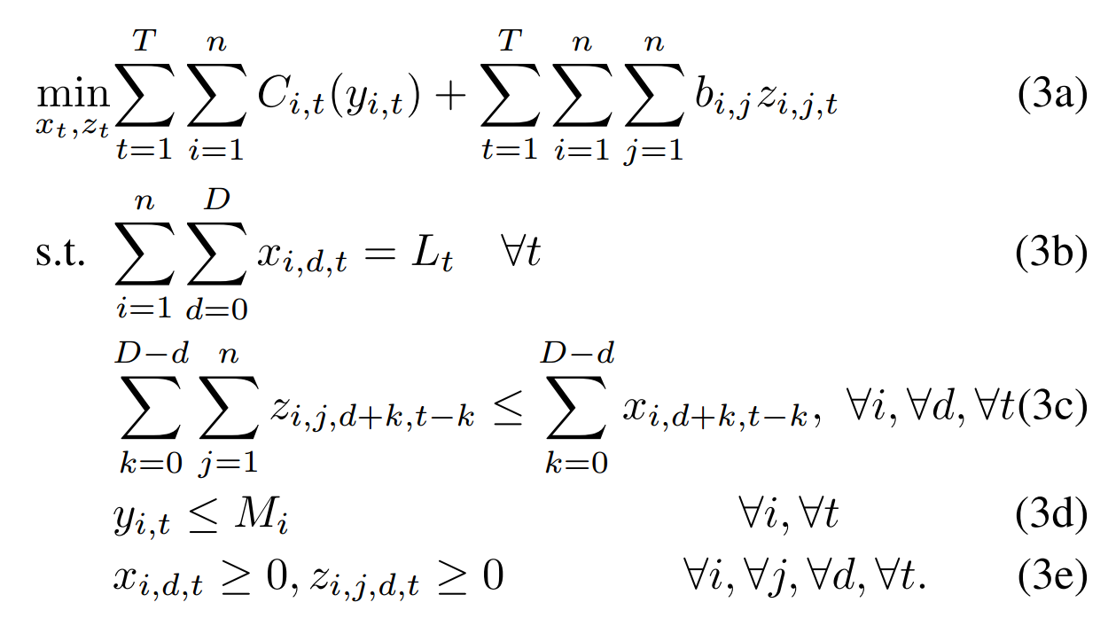
Offline Algorithm (1/2)
Linear Program
Cost = exe cost + migration cost
all workloads need to be assigned
maximum workload to migrate
Constraint of variable
computation capacity constraint

Slide 19
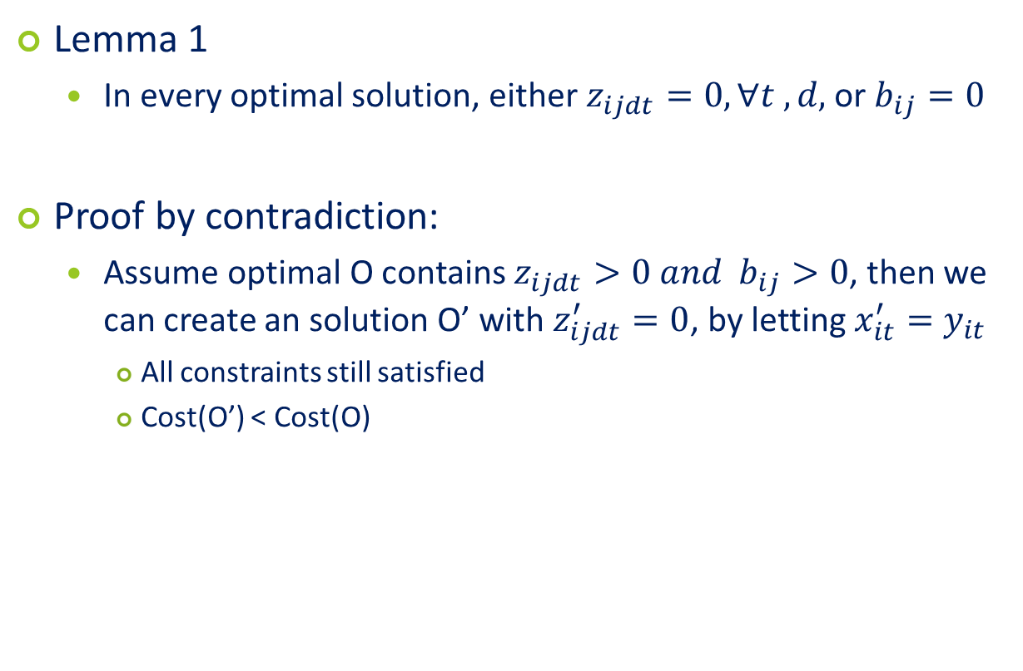
Offline algorithm (2/2)
Lemma 1
In every optimal solution, either $z_{ijdt}=0, ∀t ,d,$ or $b_{ij}=0$
Proof by contradiction:
Assume optimal O contains $z_{ijdt}>0 and$ $b_{ij}>0$, then we can create an solution O’ with $z_{ijdt}^{′}=0$, by letting $x_{it}^{′}=y_{it}$
All constraints still satisfied
Cost(O’) < Cost(O)
Conclusion: migration is not needed for an optimal offline algorithm

Slide 20
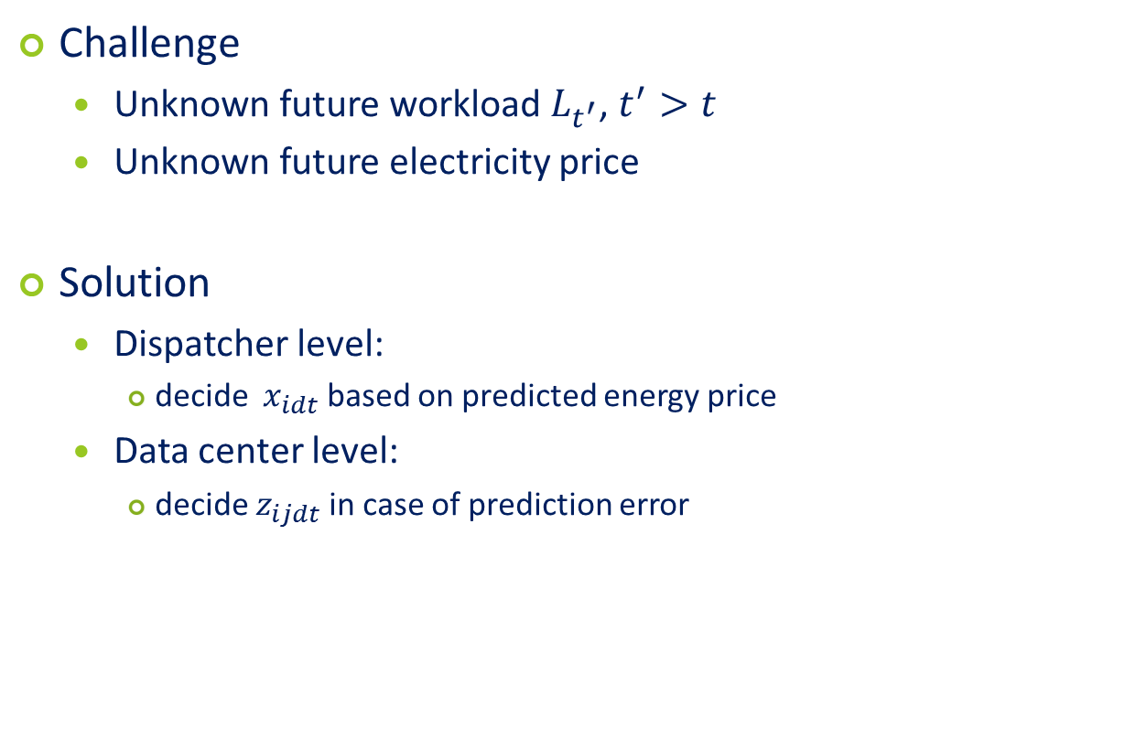
Online Algorithm
Challenge
Unknown future workload $L_{t^{′}}$, $t^{′}>t$
Unknown future electricity price
Solution
Dispatcher level:
decide ${ x}_{idt}$ based on predicted energy price
Data center level:
decide $z_{ijdt}$ in case of prediction error

Slide 21
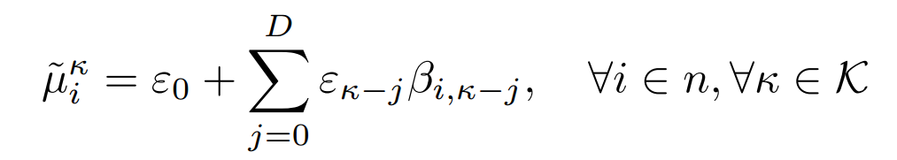
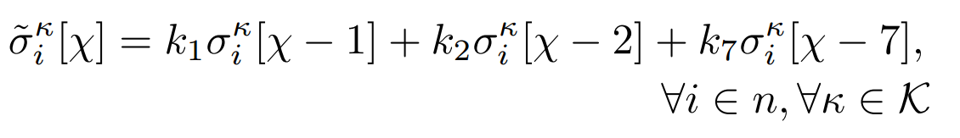
Online Algorithm
Electricity Price Prediction Model
Model the price using Gaussian random variable
Mean: moving average method
Variance: estimated using weighted average price prediction filter [Mohsenian-Rad-2010]
Current day
yesterday
the day before yesterday
the same day last week

Slide 22
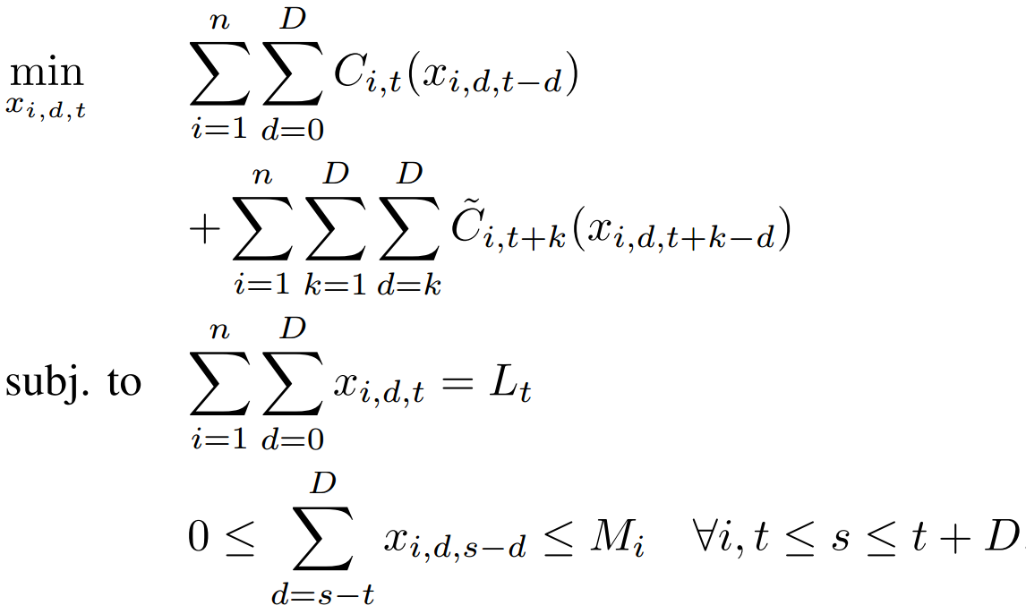
Online Algorithm
Level 1: Optimization for Dispatcher
cost = exe cost
all workloads need to assign
data center computing capacity

Slide 23
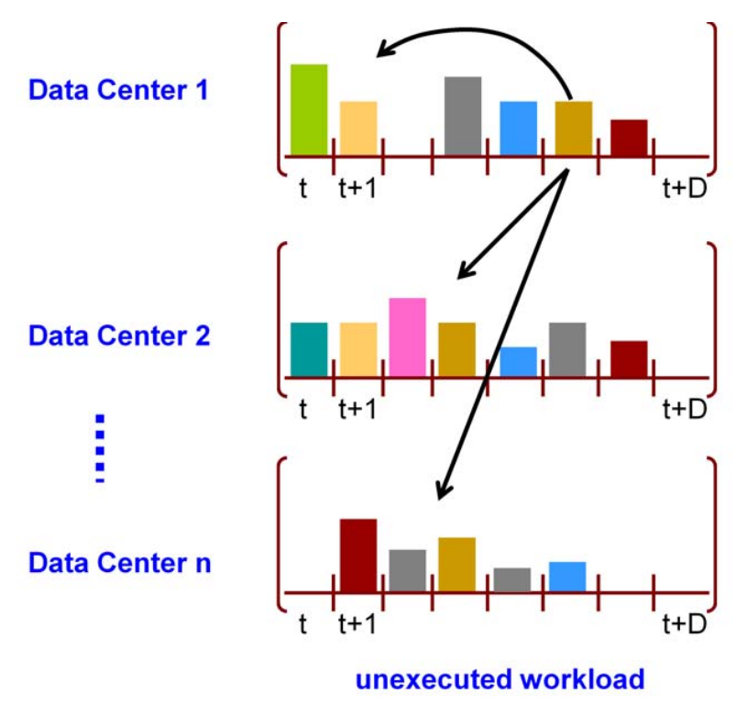
Online algorithm
Level 2: Optimization for data center level
Motivation: adjust assignment to overcome prediction error
Decision to make:
How much workload to execute at time t
How much to defer to execute later
How much to migrate to other data centers

Slide 24
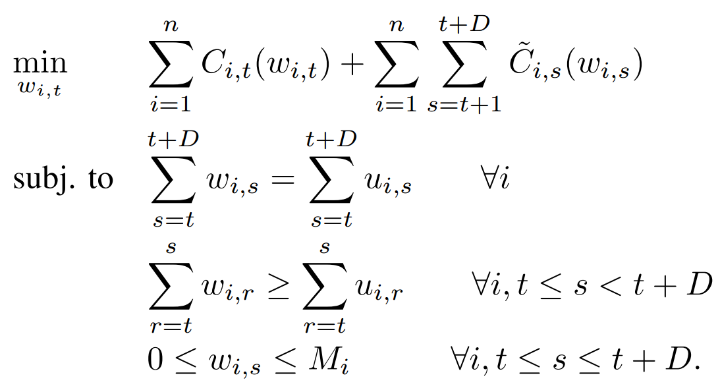

Online algorithm
Level 2: Optimization for data center level (Cont’d)
Version 1: without migration
Jobs can be executed earlier than pre-assigned time
$u_{it}$: assigned (delayed) workload, $w_{it}$: executed workload
Jobs can only be move earlier
Notes:
Although there is no migration, still the data centers can improve the assignment by executing the delayed workload early in previous time slots without violating deadline

Slide 25
Algorithm Analysis

Slide 26
Simulation setting

Slide 27
Simulation result

Slide 28
Conclusion

Slide 29
Metrits

Slide 30
Weakness

Slide 31
Possible Extensions

Slide 32
Thank You!

Slide 33
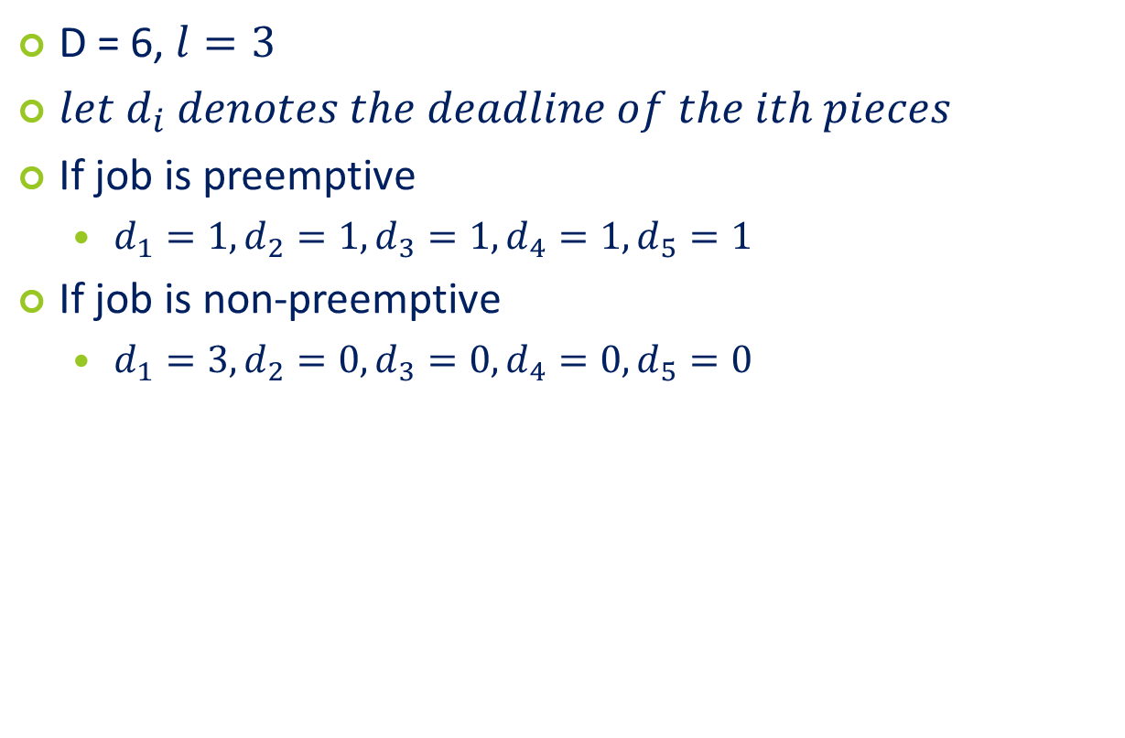
Confused: Job decomposition
D = 6, $l=3$
$let d_{i} denotes the deadline of the ith pieces$
If job is preemptive
$d_{1}=1, d_{2}=1, d_{3}=1, d_{4}=1, d_{5}=1$
If job is non-preemptive
$d_{1}=3, d_{2}=0, d_{3}=0, d_{4}=0, d_{5}=0$

Slide 34
Optimization of dispatcher
Greedy algorithm also works

