Slide 1
GreenHadoop: Leveraging Green Energy in Data-Processing Frameworks
Íñigo Goiri et al., in EuroSys’12, citation 79
Huangxin Wang
10/29/2014

Slide 2
Outline
Introduction
Technical Content
Conclusion and Critique
1
2
3

Slide 3
Background
Green Data Center
Green energy
Dynamic energy price
Peak Power Charges
MapReduce
Hadoop

Slide 4

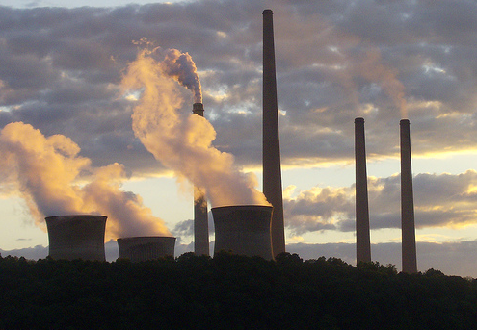
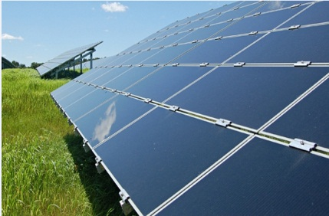

Green Data Center
Electrical grid
Solar panel
Green Energy
Brown energy
Data Center

Slide 5
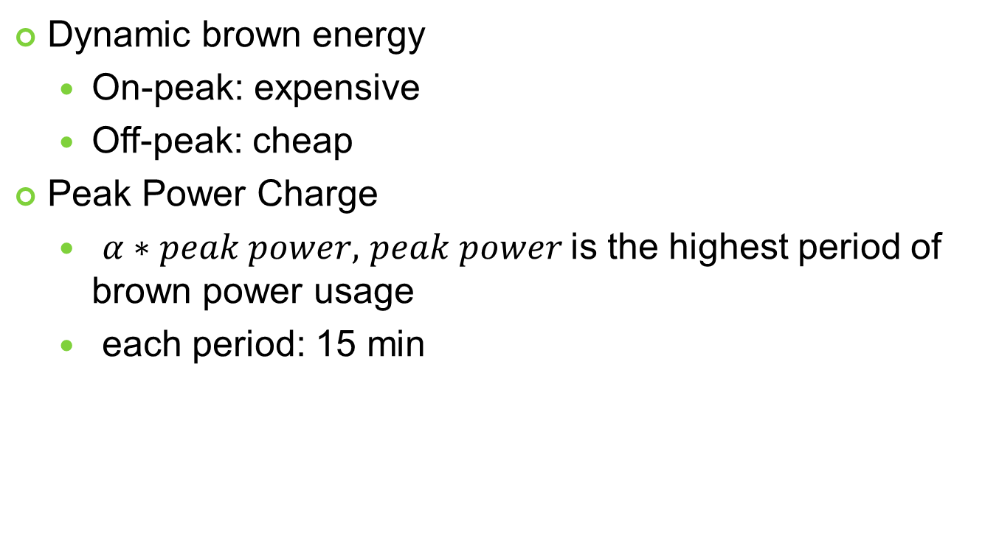
Energy Charging Scheme
Dynamic brown energy
On-peak: expensive
Off-peak: cheap
Peak Power Charge
$α∗peak power,$ $peak power$is the highest period of brown power usage
each period: 15 min
power
peak power
time

Slide 6
MapReduce
input
splitting
mapping
shuffling
reducing
result
Deer, 1
Bear, 1
River, 1
Bear, 1
Bear, 1
Bear, 2
Deer Bear River
Deer Bear River Car Car River Deer Car Bear
Car, 1
Car, 1
River,1
Car, 1
Car, 1,
Car, 1
Car Car River
Car, 3
Bear, 2
Car, 3
Deer, 2
River, 2
Deer, 1
Deer, 1,
Deer, 2
Deer Car Bear
Deer, 1 Car, 1
Bear, 1
River, 1,
River, 1
River, 2
Map:
divide data into blocks
map key/value pair
Data blocks
Reduce:
group value by key

Slide 7
Hadoop
a framework of distributed processing of large data sets.
Hadoop File System(HDFS)
split data across servers
NameNode: keep track of locations of data blocks
Hadoop MapReduce framework
users submit jobs through interface, to JobTracker
JobTracker selects servers to execute jobs
Drawback: is not energy-aware
Execute jobs on their arrival
Let idle machines in active state

Slide 8
Problem Statement
The objective is to design a mechanism to schedule MapReduce jobs, aiming to
increase the green energy usage
reduce the brown energy cost.

Slide 9
Related Work
Maximize green energy consumption, minimize brown energy consumption in distributed/centralized data center
Workloads: internet service requests, traditional batch jobs
But none of them consider peak power, MapReduce job scheduling, variable brown energy price and managing server power state at the same time.

Slide 10
Technical Contents
Problem Model
Algorithm
Evaluation

Slide 11
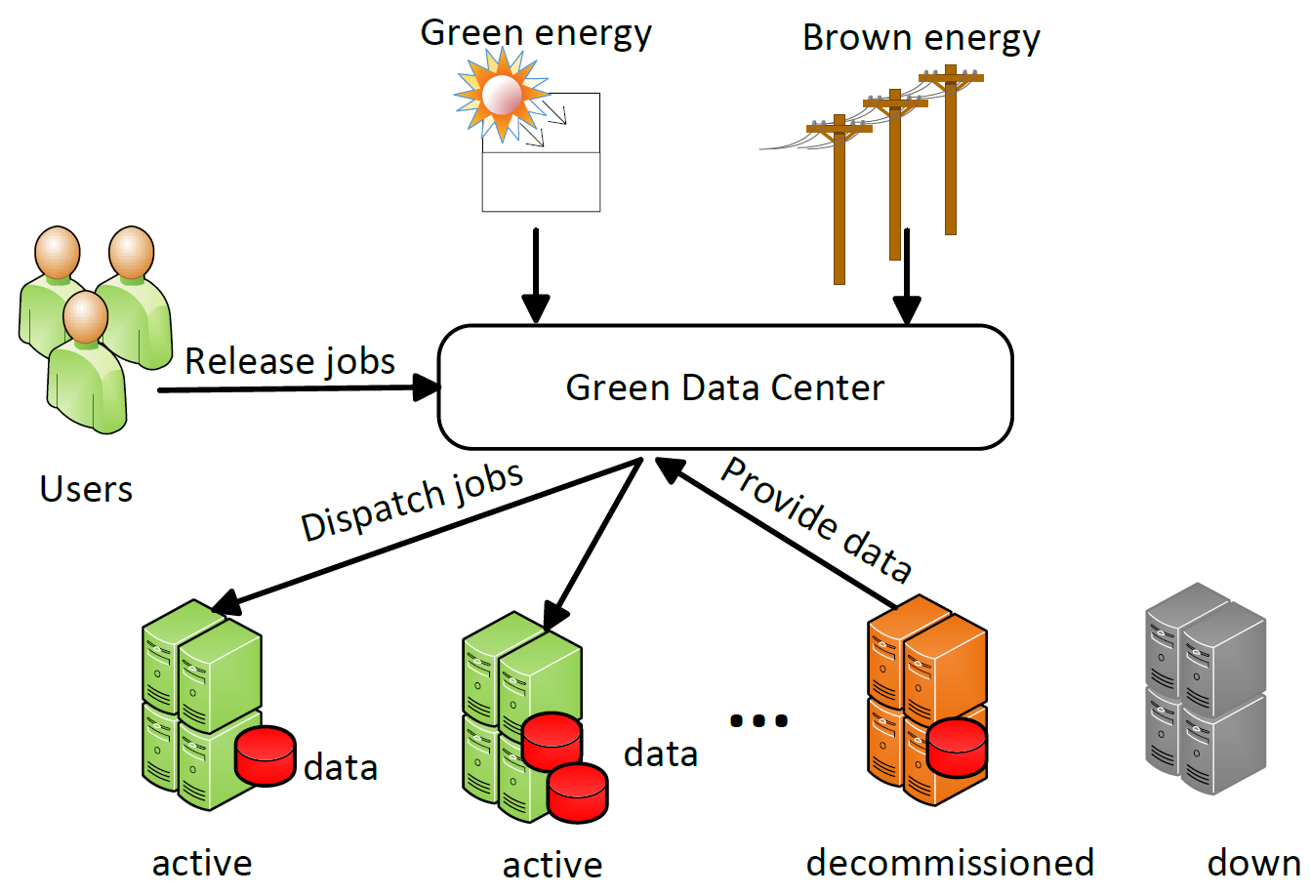
Problem Model
Jobs:
arrival time
bounded-delay
priority
data requirement
Configuration:
No battery
Machine states:
Active: 145W
Decommissioned: 75W
Down: 9W

Slide 12
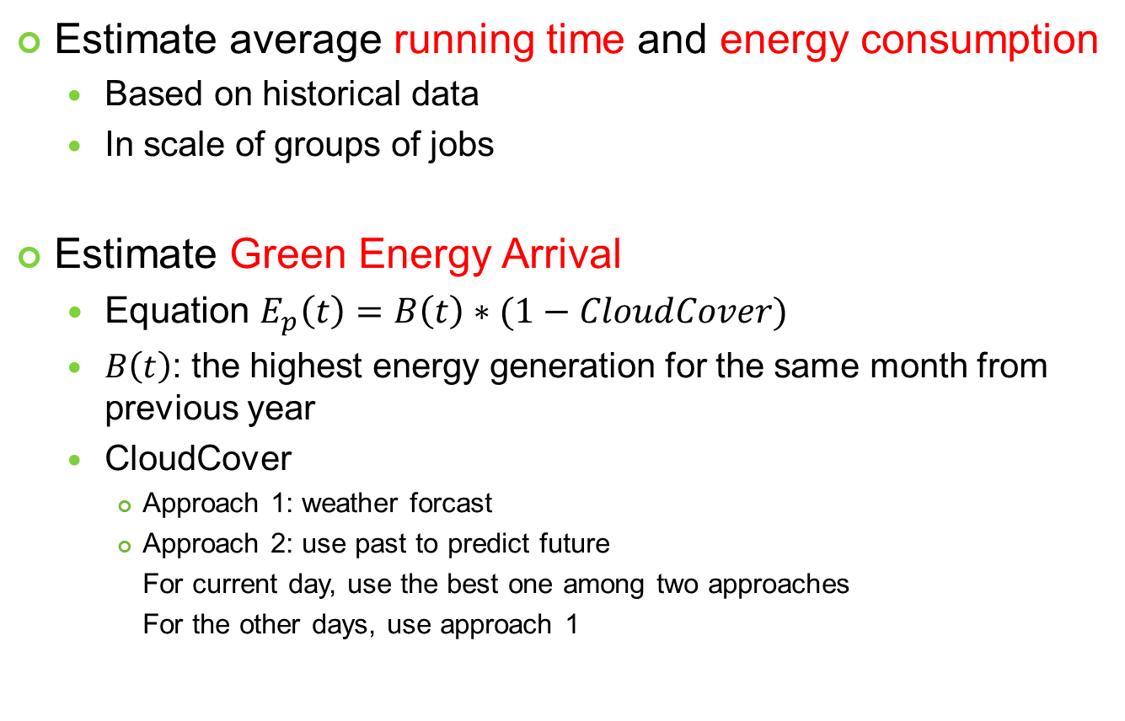
Estimation
Estimate average running time and energy consumption
Based on historical data
In scale of groups of jobs
Estimate Green Energy Arrival
Equation $E_{p}\left(t\right)=B\left(t\right)∗(1−CloudCover)$
$B\left(t\right)$: the highest energy generation for the same month from previous year
CloudCover
Approach 1: weather forcast
Approach 2: use past to predict future
For current day, use the best one among two approaches
For the other days, use approach 1

Slide 13
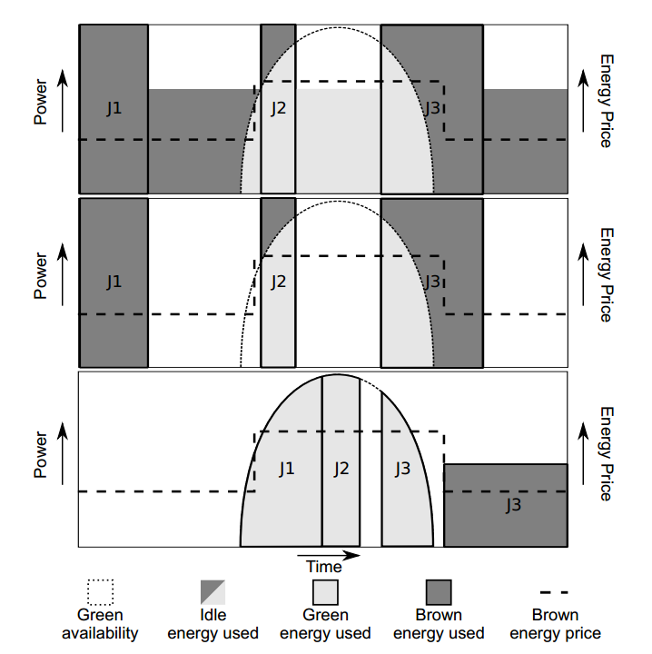
Example: Hadoop v.s. GreenHadoop
Hadoop:
execute jobs immediately
Idle machines in active state
Energy-aware Hadoop:
Idle machines in lower-power state
GreenHadoop:
Use more green energy
Use less cheap brown energy
Use fewer expensive brown energy
Delay scheduling
Avoid peak power

Slide 14
Algorithm: Data Structure
Data Structure
Running queue
FIFO, implement by Hadoop
Waiting queue
FIFO, the extra wrapper

Slide 15
Algorithm: Heuristics
Job priority
5 levels of priority: very high, high, normal, low, very low
high-priority jobs should complete as quick as possible
low priority ones could be delay within time bounds
assign energy
It first assigns the green energy
then the cheap brown energy
finally the expensive brown energy

Slide 16
Algorithms
0. At job submission time:
1. very high and high priority jobs -> Run queue; other jobs -> Wait queue
2. At the beginning at each epoch
assign internal latest-start deadlines to all waiting jobs arrived in previous epoch
calculate the number of active servers to use during the scheduling horizon (line 11-18)
Select waiting jobs to move to the run queue (line 10)
if a job is about to violate the deadline, select it;
if a job has all the data it needs available, select it;
if the active servers are not fully utilized, select the jobs that require the fewest servers
manage the servers’ states and data availability (line 19-26)
when the data required by the selected jobs is available, move them the run queue

Slide 17
Algorithms(cont’d)
11. Calculate the number of active servers to use:
12. calculate the dynamic energy required by all running and waiting jobs
13. compute/predict the energy available during the scheduling horizon
14. subtract the static energy of the entire system form the energy available
15. subtract the dynamic energy required by jobs with very high and high priority
16. assign the remaining green energy to waiting jobs
17. assign the remaining brown energy/power to waiting jobs(consider energy price)
18. if some waiting jobs not been assigned energy, reject new jobs that arrive in next epoch
$$Remaing Energy=Energy available −static energy −dynamic energy$$
Heuristic: first assign very high and high priority, then assign others

Slide 18
Algorithms(cont’d)
19. Manage the servers’ states and data availability
ensure that all the data required by the selected jobs is available
if some data is not available, down -> decommissioned state
if current servers is less than needed, transition decommissioned -> active
if need more, transition down -> active
if current server is more than needed, transition active -> decommissioned
replicate the data from servers in decommissioned state, if necessary
check if servers that are in decommissioned state that can be set to down state
Heuristic:
active -> decommissioned, favor the one with less data required by jobs in run queue
decommissioned -> active, down -> active, favor the one with more data required by
jobs in run queue

Slide 19
Example: server state transition
Active
Decommissioned
Down
1)
2)
3)
4)
5)
6)
7)

Slide 20
Simulation Settings
Hardware
16 server clusters
power consumption
CPU: 4-core Xeon
Memory: 8GB
Disk: 64 GB 7200-rpm SATA
active:
Execute 1-4 tasks: 100W, 115W, 130W, 145W
decommissioned: 75W
down: 9 W

Slide 21
Simulation Settings (Cont’d)
Workloads
Facebook-derived
wide varying jobs execution time and data size
Nutch Indexing
homogeneous, batch jobs
Solar Traces: Rutgers solar farm
Dynamic Brown Energy
On-peak: $1.13/kWh, Off-peak: $0.08/kWh (summer)
Peak Brown Power Charge
$13.61/kW (summer) , $5.59/kW(rest of years)

Slide 22
Comparison
Hadoop
Executes jobs immediately when they arrive
Keeps all servers active even if they are idle
Energy-aware Hadoop (EAHadoop)
Transition idle servers to low power state
GreenHadoop variance 1: GreenOnly
Only consider green energy availability
GreenHadoop variance 2: GreenVarPrices
Consider green energy, variable brown energy cost
GreenHadoop: GreenVarPricesPeak
Full version

Slide 23
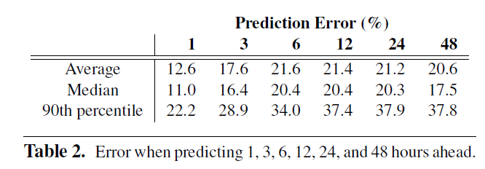
Evaluation of energy prediction
Accuracy:
Impact:
Compared with using perfect future energy, the difference is under 16.4%

Slide 24
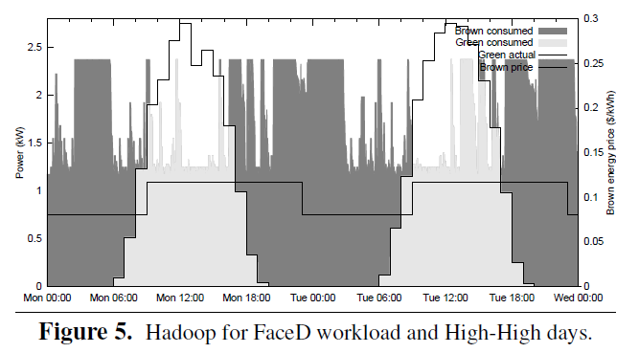
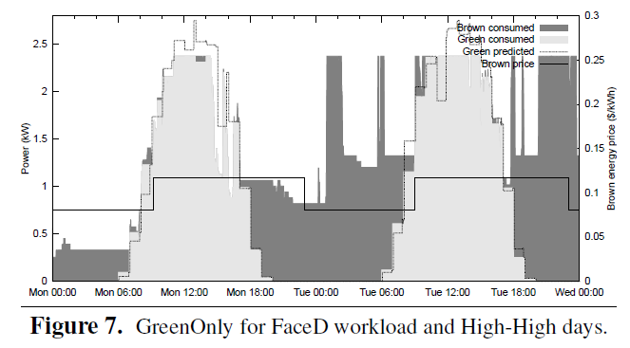
Evaluation: GreenOnly
Green Energy:
increase more than 30% compare to Hadoop
Brown Energy Cost
Reduce more than 30% compare to Hadoop,

Slide 25
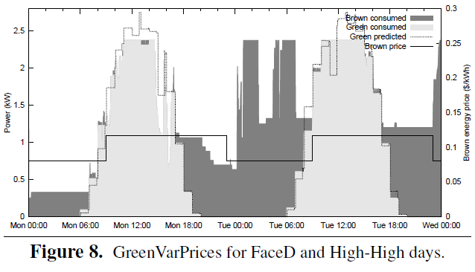
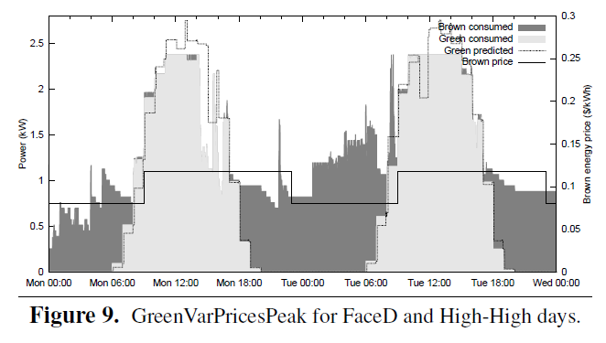
Evaluation: GreenVarPrice*
Brown Energy Cost
Reduce more than 41% compare to Hadoop,
Peak Power:
GreenVarPricesPeak: 1.47kW
The others: 2.36 kW
Brown Energy Cost:
Reduce more than 39% than Hadoop

Slide 26
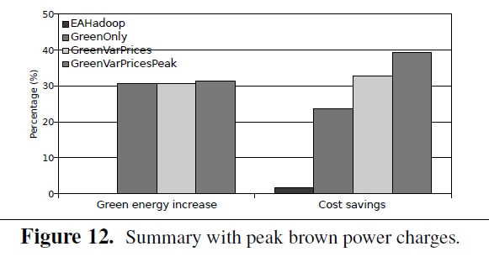
Summary

Slide 27
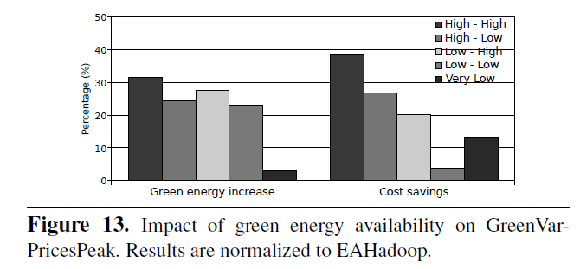
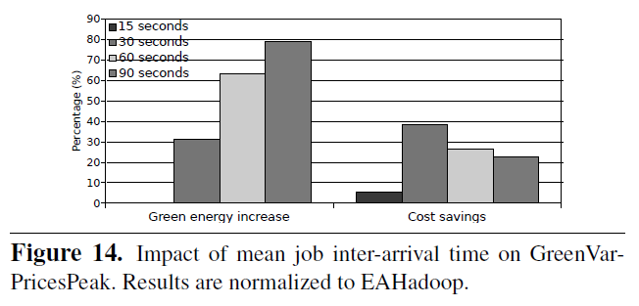
Evaluation of Impact Factors
GreenHadoop v.s. EAHadoop
GreenHadoop v.s. EAHadoop

Slide 28
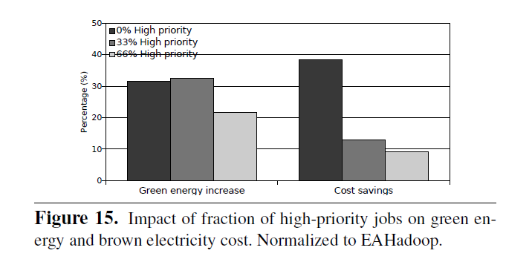
Evaluation of Impact Factor (Cont’d)

Slide 29
Conclusion
In this paper, the authors propose a GreenHadoop mechanism to schedule MapReduce workloads in green data centers.
Simulation demonstrates that their propose mechanism is effective in both increasing green energy consumption and reducing brown energy cost.

Slide 30
Merits
The problem they study is novel and meaningful.
The design of the experiments
They compare several variants of GreenHadoop with Hadoop
Thus we can only which factor makes how much contribution to the overall performance improvements
They study many impact factors
e.g., inaccurate predictions, different workload utilizations

Slide 31
Weakness
The study of impact of bounded-delay is not sufficient
The minimum of delay they studied is 6 hours
From Table 1, we can see that 59% of jobs have execution time in several seconds or minutes.
In the simulation, they didn’t evaluate how many jobs are rejected.
It seems they only evaluate the portion of (accepted) jobs that are violating their deadlines. (has no deadline violation when the utilization is 92%)
Thus the evaluation results are not persuasive. Because Hadoop may accept more jobs.
They neglect the energy cost for transferring servers between different states.

Slide 32
Weakness (Cont’d)
It is not clear why they only delay scheduling of non-high priority jobs.
It is not clear how to decide whether a job is about to miss its deadline.
For the simulation, they always assume jobs have Poisson arrival pattern, why not also study jobs with other arrival patterns?
Or it would be better to use the real arriving time from the workload traces if available.

Slide 33
Possible Extensions
Study the same problem with the configuration of batteries, i.e., green energy can be stored in battery to be used when energy is expensive.
Study of the trade off the energy saving of turning machines to down state with the energy consumption of replicating data.
Design mechanisms for the case when jobs are not with bounded delay, but with arbitrary deadlines.
Study problems in the same model with different objective, e.g., consider maximize revenue assuming that complete each job before its deadline will earn some revenue.

Slide 34
Thanks!

Slide 35
Backup Slides

Slide 36
Tradeoff Peak Power
Has smaller peak power,
but consume more expensive brown energy
Has larger peak power,
but consume less expensive brown energy
Time
off-peak
on-peak
Thus we could find the best power that tradeoff the peak power consumption
and the brown energy consumption

