Slide 1
House Price Prediction– part 1
8.21.18

Slide 2
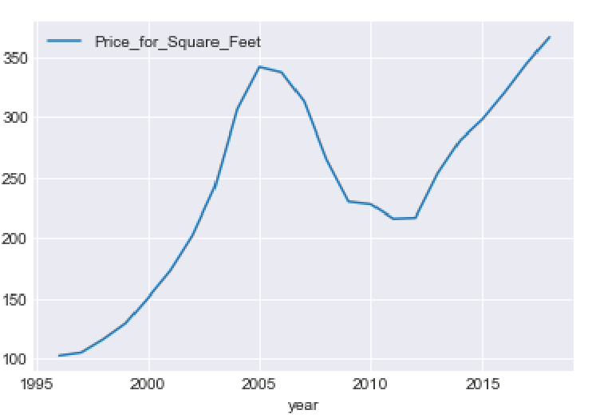
SD Sqf Trend
Housing price peaked in early 2005 , began decling in 2006
2008 : Home sales continue to fall. Fears of a U.S. recession
2009: More than 2.21 percent of all households were in some stage of foreclosure.
2012: Turn point. House price reaching the lowest point.
2013 to now: House price keeps going up and cost even more than year 2005

Slide 3
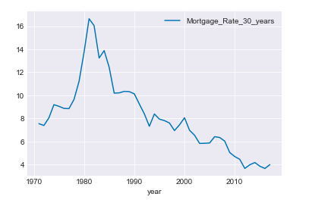
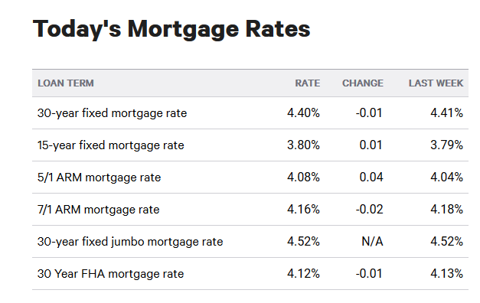
Mortgage Rate History Data

Slide 4
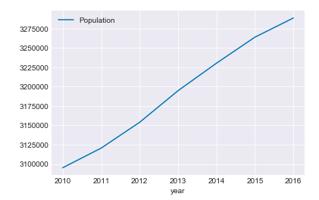
Population Of San Diego County

Slide 5
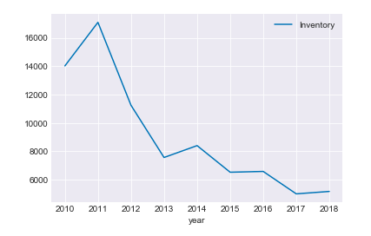
House Inventory Of San Diego County

Slide 6
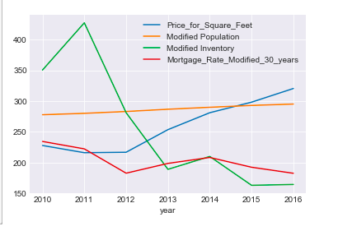
Trend From 2010 To 2016

Slide 7
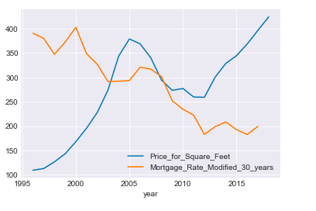
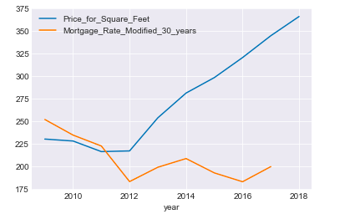
Mortgage Rate Vs SQF

Slide 8
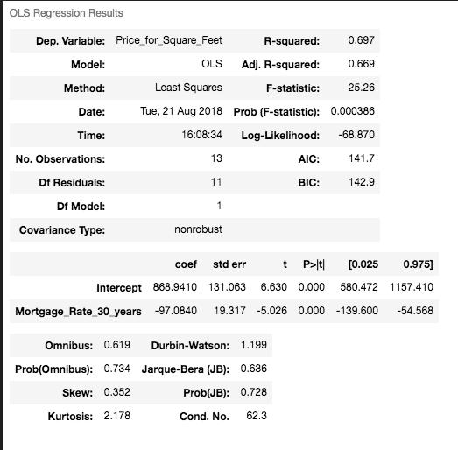
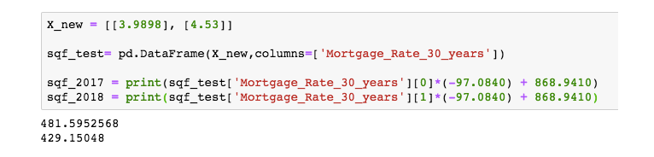
use the data from 1970 to now

Slide 9
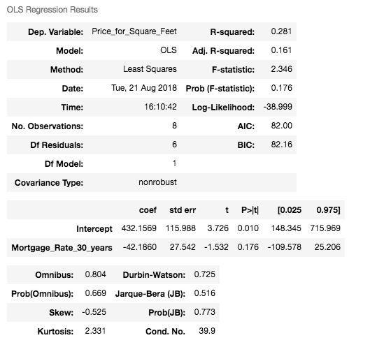
Use The Data From 2008 To 2018

Slide 10
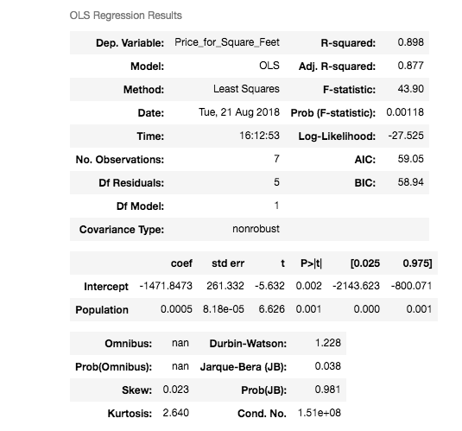
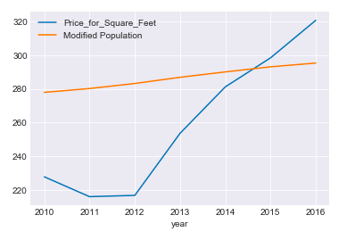
Population Vs Sqf

Slide 11
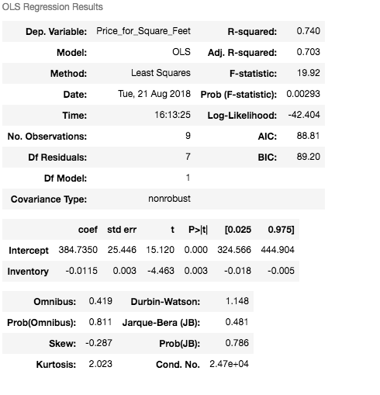
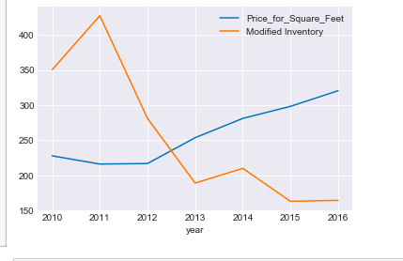
Inventory Vs SQF

Slide 12
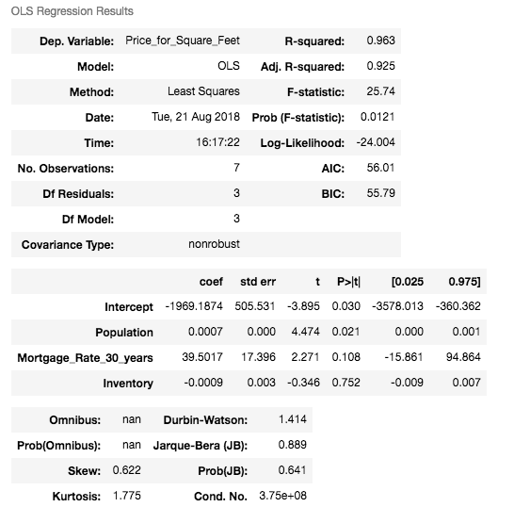


Multilinear Regression (Data from 2010 to 2016)

Slide 13
Why?
It was over estimate the Price per Sqf .
Limit points
Solution:
Need more data to apply, such as population historical data of San Diego
Drill down to zipcode

Slide 14
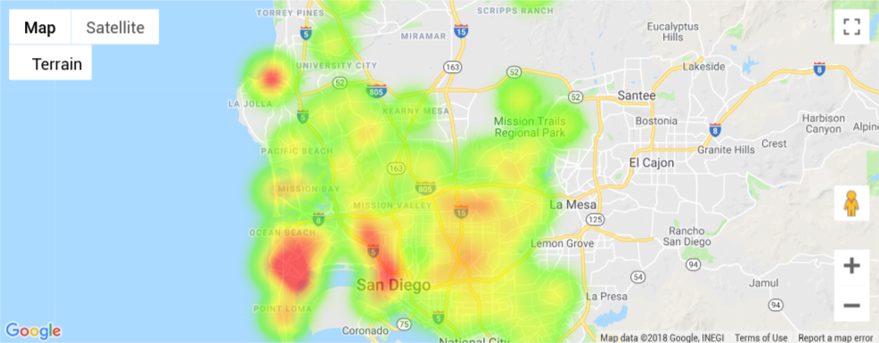
Region verifications zip code 92130
z_value from Zillow API

Slide 15
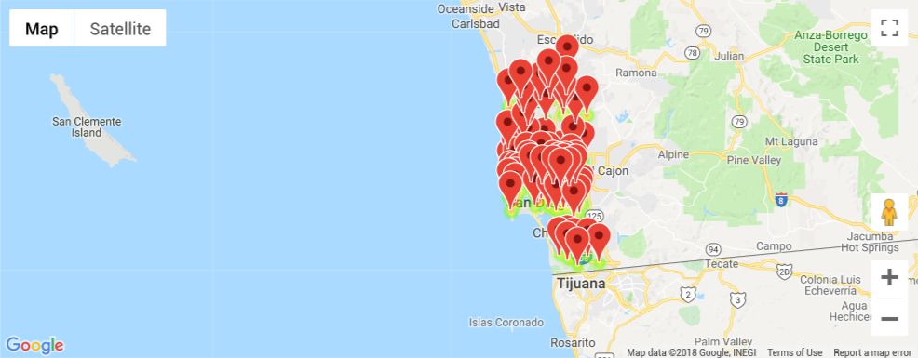
Z_Value shown Google map

Slide 16
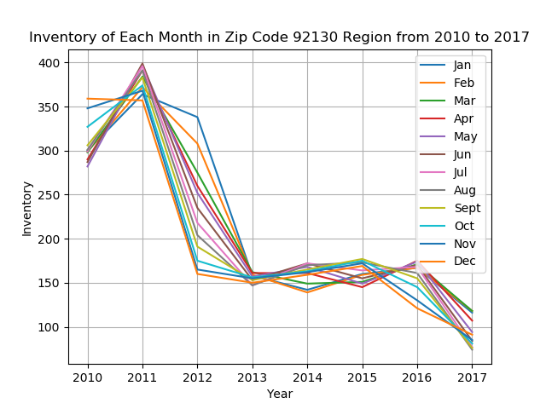
Inventory v.s. time

Slide 17
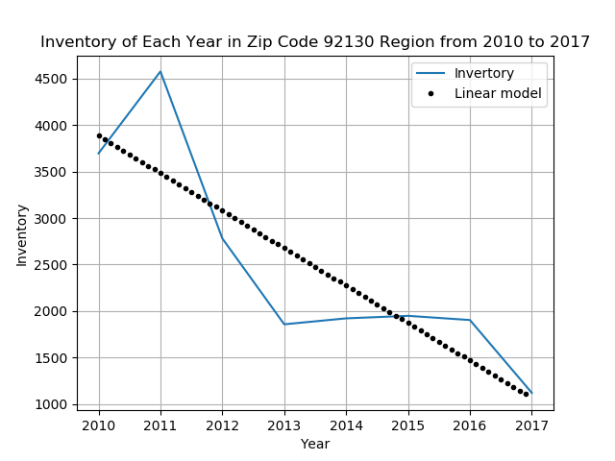
Inventory v.s. time and Estimated linear model

Slide 18
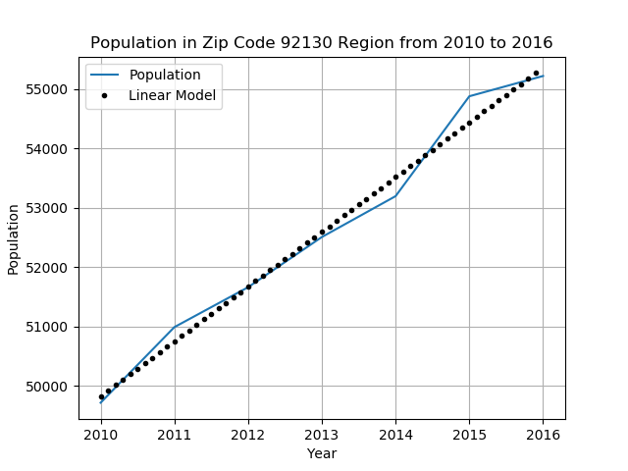
population v.s. time from 2010 to 2016

Slide 19
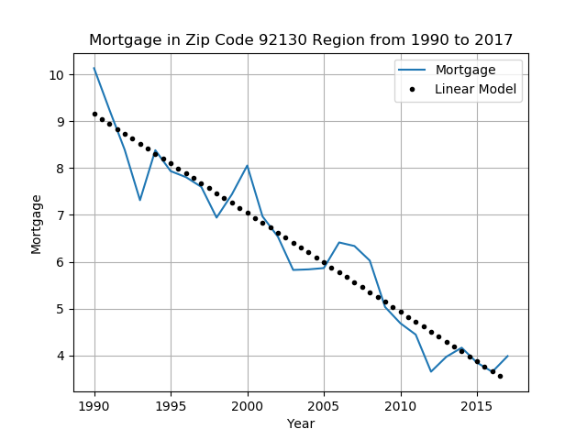
mortgage from 1990 to 2017

Slide 20
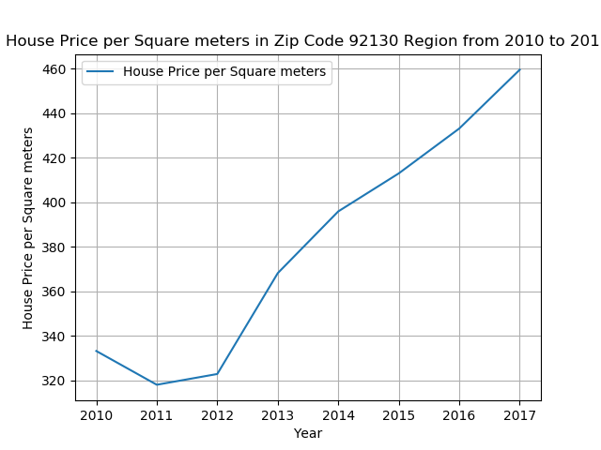
house price in zip code 92130 region

Slide 21
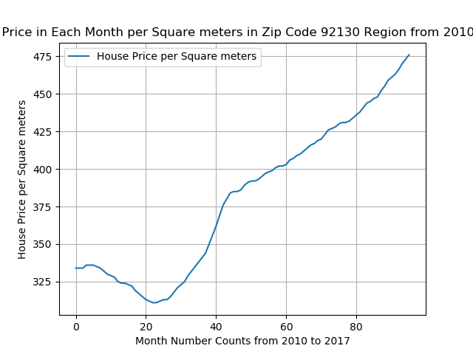

Slide 22
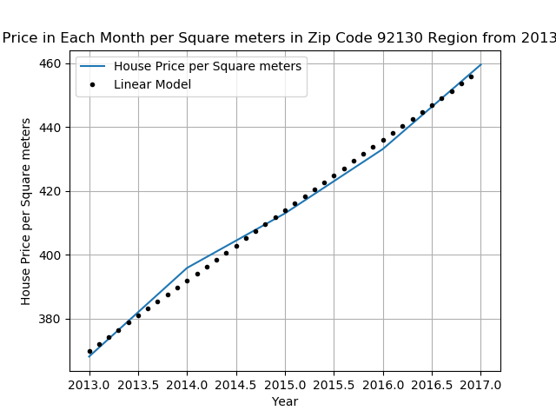
Strong linear relationship over year

Slide 23
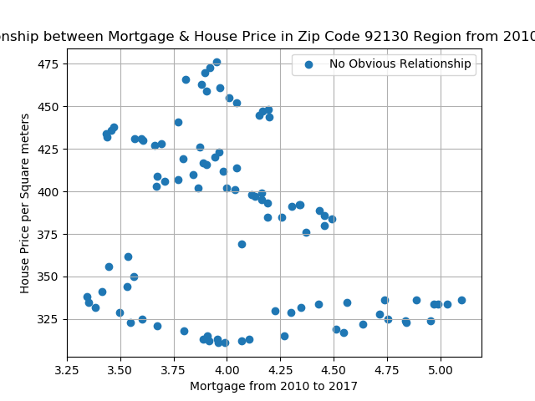

Slide 24
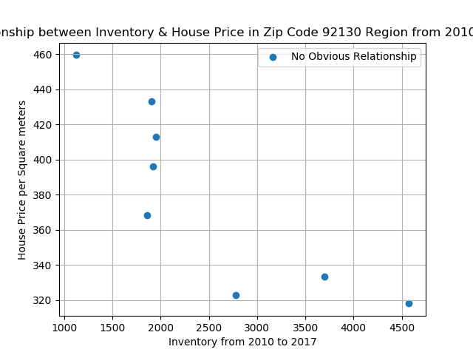
inventory v.s. house price

Slide 25
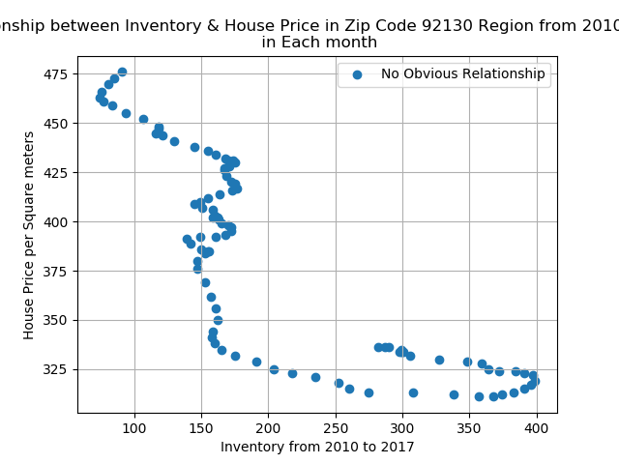
inventory v.s. house price

Slide 26
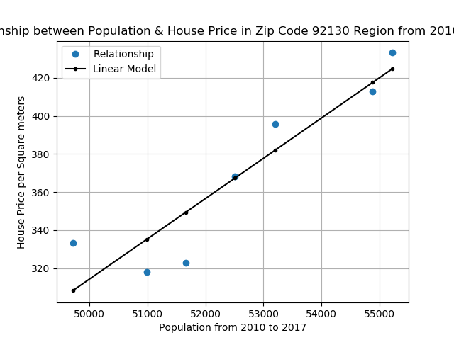
population v.s. house price

Slide 27
Conclusion
Strong linear relationship between population and house price in region ZIP code 92130
Weak or non-linear relationship between inventory, mortgage and house price(value)
Strong linear increase of price over year from 2010 to 2017

Slide 28
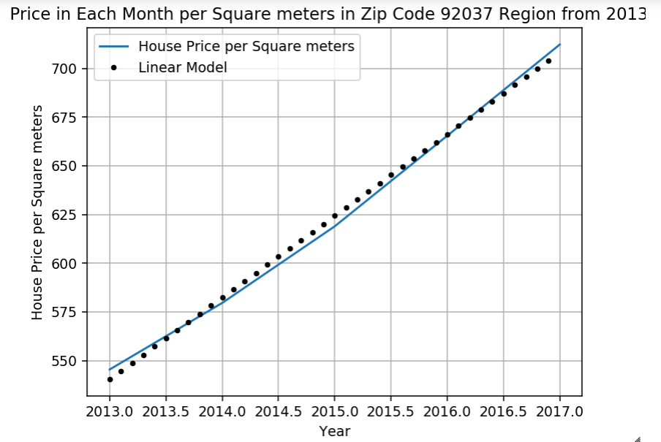
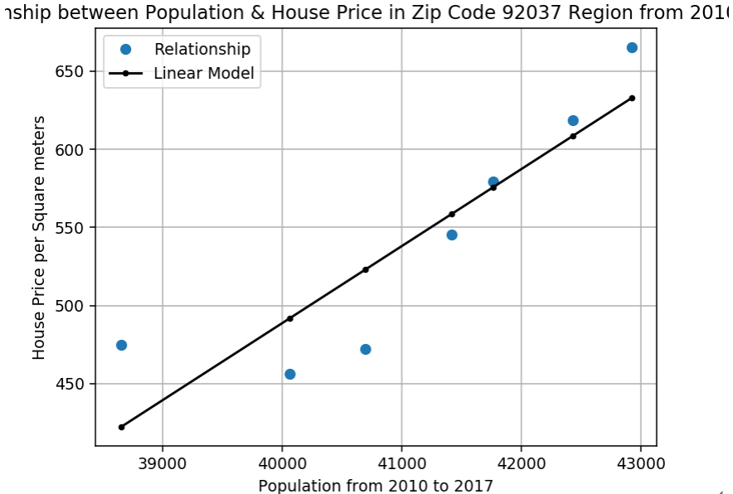
Other regions for verification

