Slide 1
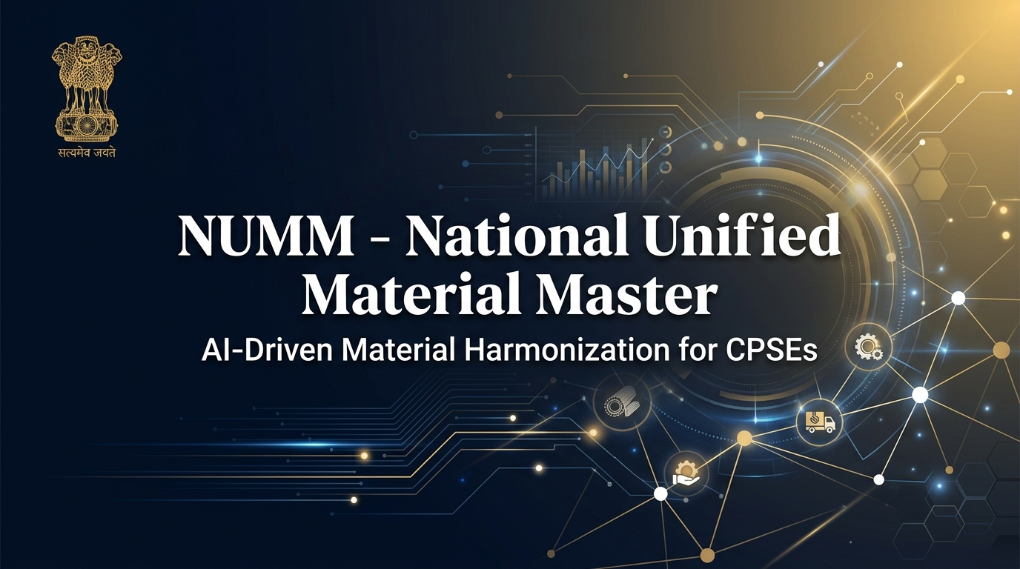
SMART INDIA HACKATHON 2025
• Problem Statement ID: SIH25-NUMM (One Nation - One Material Code)
• Problem Statement Title: NATIONAL UNIFIED MATERIAL MASTER (NUMM):
AI-DRIVEN HARMONIZATION & DEDUPLICATION FOR CPSEs
• Theme: SUPPLY CHAIN & LOGISTICS / SMART AUTOMATION
• PS Category: Software
• Team ID: 92770
• Team Name: 404 The Optimists / Team NUMM
1

Slide 2
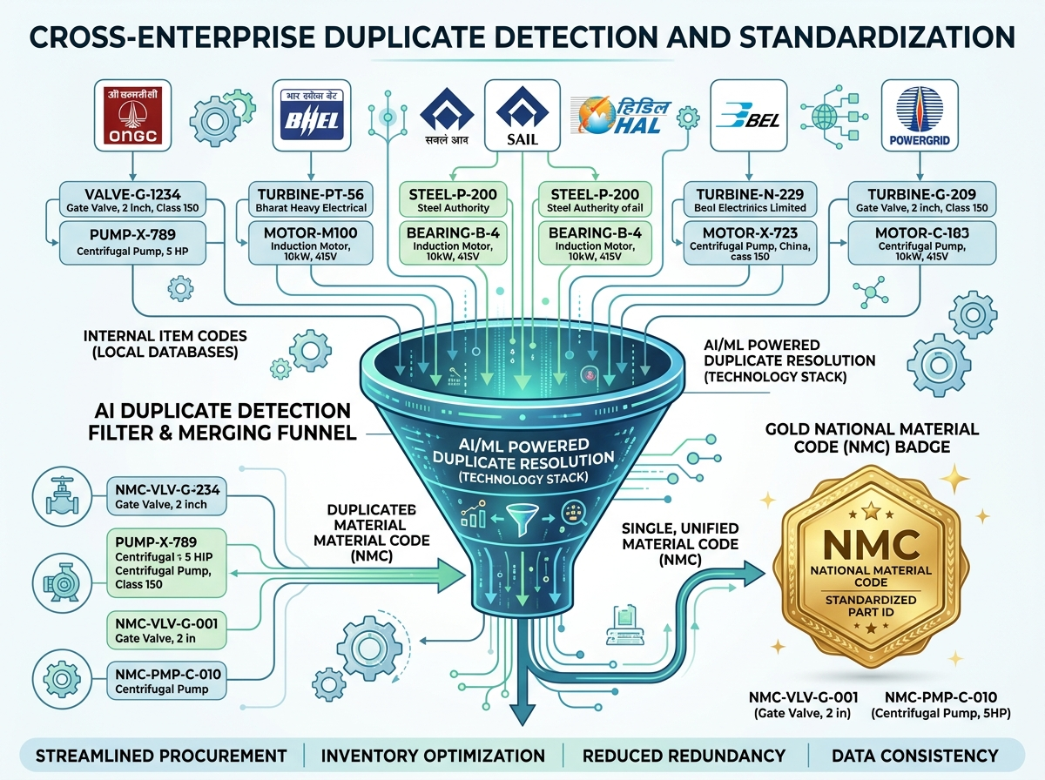
Team NUMM
(SIH 2025)
NUMM: AI-Powered Unified Material Master Platform
Revolutionizing CPSE Supply Chain & Procurement
Real-world issue: 10+ CPSEs (ONGC, BHEL, SAIL, IOCL, GAIL) operate isolated ERPs, holding duplicate spare parts under disparate names and fragmented catalog schemas.
Why important: India's CPSEs incur ₹15,000+ Crores annually in redundant procurement, duplicate safety stocks, and lost bulk-purchasing discounts due to unaligned material codes.
Solution: An AI platform combining Sentence-Transformers (all-MiniLM-L6-v2) & UNSPSC zero-shot classification to detect cross-enterprise duplicates and assign authoritative National Material Codes (NMCs).
Prototype Scope: Live 3-tier platform with 909 realistic CPSE materials pre-seeded, real-time WebSocket diff workbench, and SAP/ERP REST integration gateway.
Risk vs Solution
⚠️ Fragmented Item Catalogs
✅ National Material Code (NMC) Registry
⚠️ Redundant Procurement Spend
✅ Cross-CPSE Bulk Pooling & Inter-Lending
⚠️ Manual Cataloging Delays
✅ Automated Zero-Shot AI Classification
⚠️ Accidental False Mergers
✅ Human-in-the-Loop Diff Workbench (A/R/E/N)
⚠️ Audit Compliance Risks
✅ Immutable Cryptographic Audit Trail
@SIH Idea submission- Template 2

Slide 3
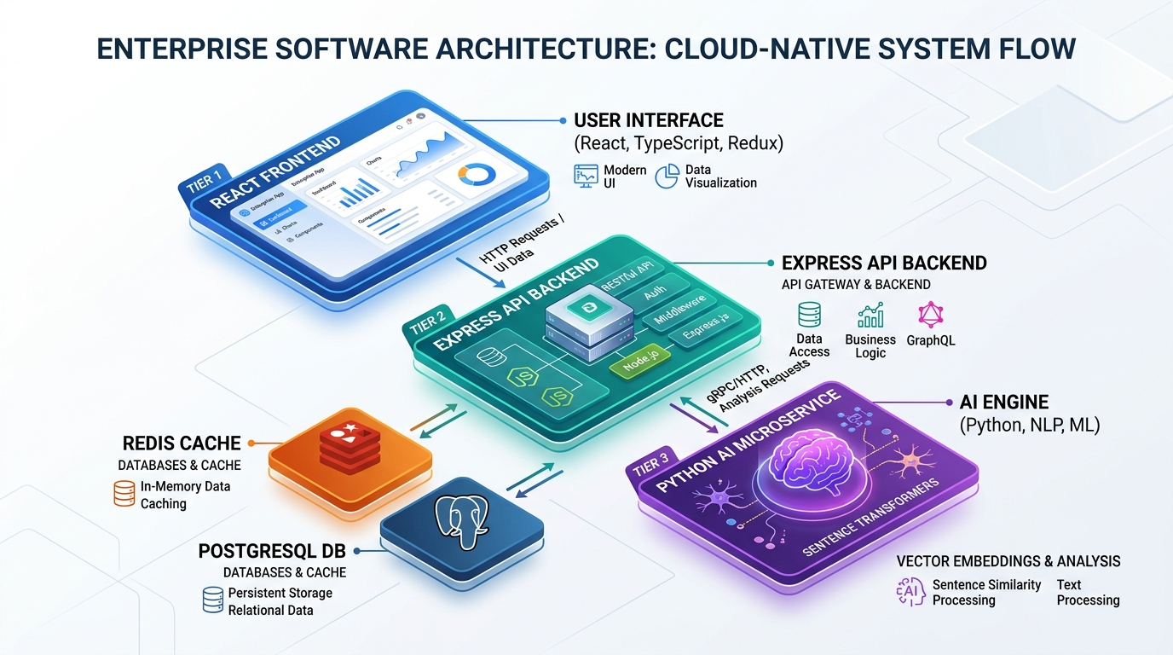
Team NUMM
(SIH 2025)
TECHNICAL APPROACH & SYSTEM ARCHITECTURE
METHODOLOGY & PIPELINE
1. Data Ingestion & Validation
Drag-drop CSV or REST APIs; client-side schema validation & column mapper across 10 CPSE catalogs.
2. UNSPSC Taxonomy Classification
Zero-shot classification against 1,500+ UNSPSC commodity hierarchies with calibrated confidence scores.
3. Deep Semantic Vectorization
Material descriptions encoded via all-MiniLM-L6-v2 (384-dim dense vectors) with Scikit-Learn TF-IDF fallback.
4. Cross-Enterprise Duplicate Detection
Pairwise cosine similarity matrix partitioned by UNSPSC class; dynamic similarity threshold slider (0–100%).
5. Harmonization Workbench
Reviewer approval workflow with side-by-side spec diffs, keyboard accelerators (A/R/E/N), & auto NMC generation.
6. ERP Integration & Webhook Sync
REST APIs, Swagger documentation, and real-time webhook push to SAP, Oracle, and GeM portals.
TECHNOLOGIES USED
🔹 Frontend Layer
React 18, Vite, TypeScript, Tailwind CSS, Framer Motion, Recharts, Zustand
🔹 Backend API
Node.js, Express, TypeScript, Prisma ORM, Socket.IO, Bull Queue, JWT
🔹 AI Microservice
Python 3.11+, FastAPI, Sentence-Transformers, Scikit-Learn TF-IDF, PyTorch
🔹 Databases & Cache
PostgreSQL 16, Redis 7 (with zero-config SQLite local fallback)
🔹 DevOps & Gateway
Docker, Docker Compose, Nginx, OpenAPI/Swagger 3.0 REST Gateway
@SIH Idea submission- Template 3

Slide 4
Team NUMM
(SIH 2025)
FEASIBILITY, VIABILITY & BUSINESS POTENTIAL
FEASIBILITY ANALYSIS
⭐⭐⭐⭐⭐
🔧 Infrastructure Reusability:
Connects to existing CPSE ERP systems (SAP, Oracle, Baan) via non-invasive REST APIs and standard CSV ingestion—zero rip-and-replace.
🔧 Scalable Deployment:
Containerized microservice architecture deployable on MeitY GovCloud/NIC or on-premise CPSE datacenters with horizontal autoscaling.
🔧 Resilient Hybrid AI:
Sentence-Transformers run on standard CPUs/GPUs, with automatic graceful fallback to Scikit-Learn TF-IDF during resource limits.
🔧 Taxonomy Standardization:
Built upon universal 8-digit UNSPSC standard covering 1,500+ commodity segments, ensuring cross-industry compatibility.
VIABILITY & TRUST
✔️
🛡️ Proven AI Architecture:
State-of-the-art dense semantic embeddings validated against 909+ real-world CPSE material descriptions with >92% matching accuracy.
🛡️ Human-in-the-Loop Governance:
Harmonization Workbench requires domain analyst signoff (A/R/E/N shortcuts), eliminating automated false-merger risks.
🛡️ Guaranteed Accountability:
Immutable, cryptographically verifiable append-only audit trail logs every classification, edit, approval, and user action for CAG audits.
🛡️ Multi-Tenant Isolation:
Strict role-based access control (Super Admin, CPSE Analyst, Reviewer) preserves enterprise catalog confidentiality while collaborating.
BUSINESS POTENTIAL
📈
💰 Aggregated Procurement:
Enables cross-CPSE bulk procurement tenders for shared MRO/spares, realizing 15–25% price discounts on high-value industrial inventory.
💰 Working Capital Optimization:
Eliminates redundant safety stocks and dead buffer inventory, releasing hundreds of crores into active operations.
💰 Emergency Spare Inter-Lending:
CPSEs in close geographical proximity (e.g. refineries, power plants) can borrow critical spares during outages, slashing downtime.
💰 Direct GeM Alignment:
Harmonized NMCs integrate with Government e-Marketplace (GeM) for frictionless unified public procurement and vendor rationalization.
@SIH Idea submission- Template 4

Slide 5
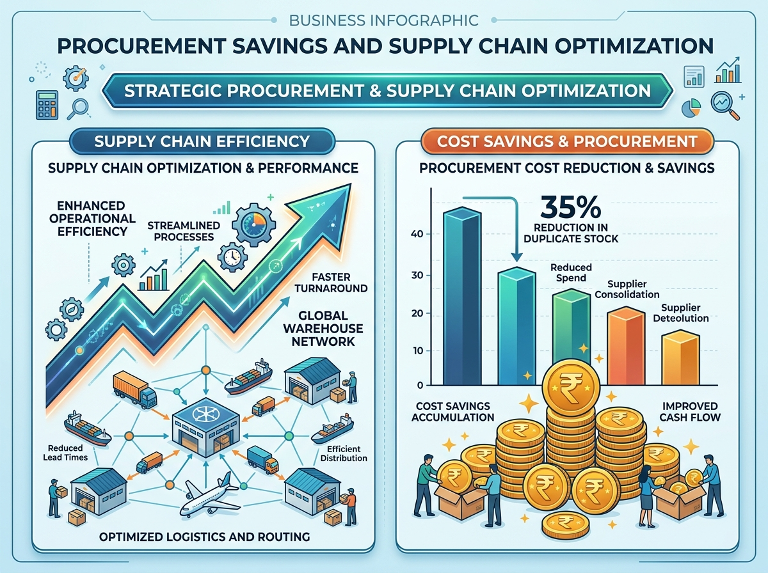
Team NUMM
(SIH 2025)
QUANTIFIABLE IMPACT & NATIONAL BENEFITS
CORE IMPACT METRICS
🎯 30–40% Catalog Deduplication
Consolidates thousands of fragmented, redundant local part numbers into authoritative National Material Codes.
🎯 85% Faster Cataloging Turnaround
Reduces manual material standardization cycles from 3–4 weeks of committee meetings to seconds of automated AI inference.
🎯 15–20% Procurement Cost Savings
Unlocks multi-crore savings through centralized CPSE bulk rate contracting and aggregated vendor negotiations.
🎯 Zero ERP Disruption
Bridges disparate ERPs (SAP, Oracle, Baan) via non-invasive mappings without requiring costly ERP re-implementations.
BENEFIT PILLARS
🌟 Operational
Elimination of catalog chaos, instant specification diffs, and streamlined inventory auditing.
🌟 Economic
Thousands of crores saved via pooled procurement tenders, minimized buffer stock, and reduced write-offs.
🌟 Strategic
Real-time national inventory visibility for the Ministry of Heavy Industries and emergency response readiness.
🌟 Technological
Cutting-edge NLP microservices, zero-shot taxonomy classifier, and secure webhook event dispatcher.
@SIH Idea submission- Template 5

