Slide 1
Ubiquitous and Mobile Computing
CS 528: Final Project Proposal - PlayerPooling
Xinjie Hao
Zishan Qin
Computer Science Dept.
Worcester Polytechnic Institute (WPI)

Slide 2
Introduction
Background
  Board games are popular among WPI students.
  Sometimes hard to find players
Objective
  PlayerPooling targets to solve this problem by pooling the people who have the common interests and let the game holder find players efficiently.

Slide 3
Related Work
Commercial Apps
Find My Friends!, WeChat, WhatsApp
  Advantage: find friends in real-time map,
  Disadvantage: confine the scope to your friends only; need to actively communicate with friends and describe the event.
PlayerPooling Features:
  Login to be Online/ Logout to be offline
  Create board game freely and wait for players to join
  Browse and join the interested board game
  See nearby participates in real-time map.

Slide 4
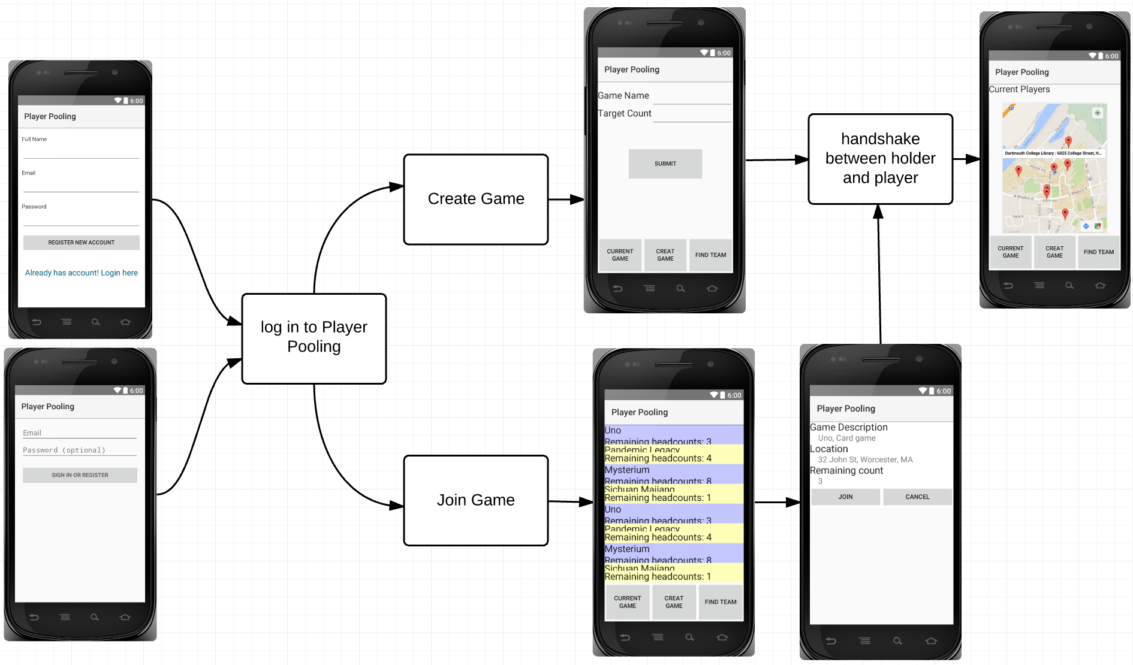
Methodology

Slide 5
Project Timeline
Sub-tasks | Due time
Requirements collection Project proposal Design the MVC architecture | week 9
Login/Logout Issue create game request Server database build up | week 10
Respond and join game Handshake between issuer and responder | week 11
Test the functions using localhost Deploy the project on Web Service(like Amazon Web Service) for multiple-users access and test | week 12
Prepare presentation and wrap up final paper | Week 13

Slide 6
Thank You!

