Slide 1
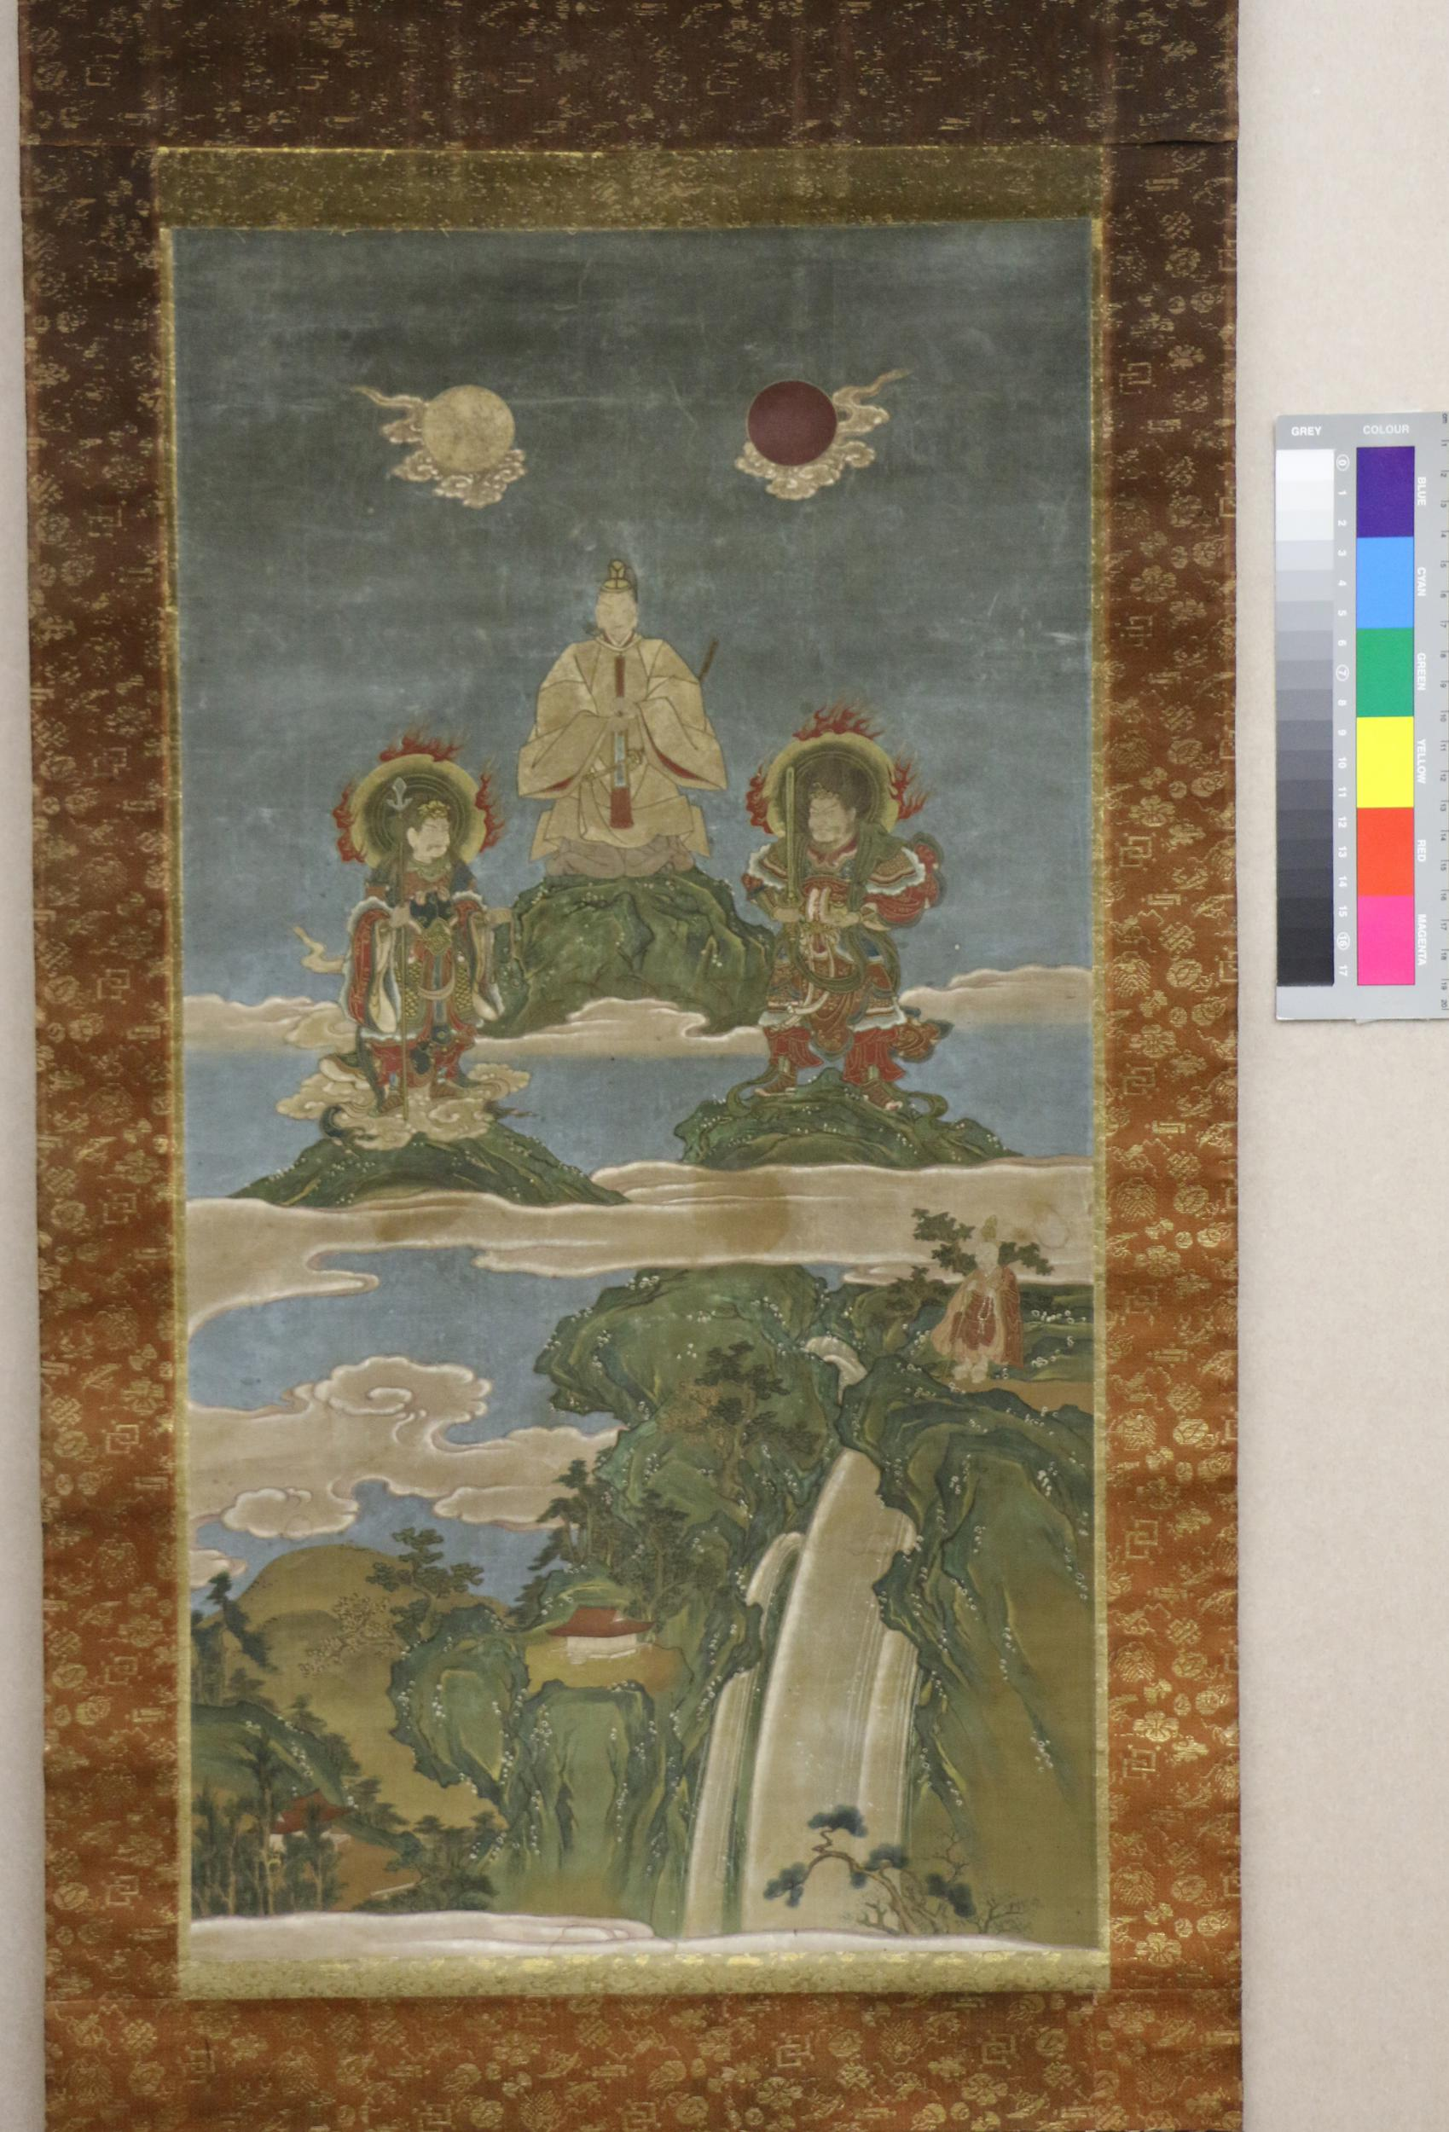
Gods and Saints?
ASIAN RELIG ST 236 02.21.22
Painting, hanging scroll. Kanshojo 菅丞相 (Sugawara no Michizane) standing on a rock, flanked by two Devas, beneath sits Issan Gyoja (?); in the upper part, symbols of the sun and moon. Ink and colour on silk.
16th century. British Museum.

Slide 2
Talk 1: Example (prompt from Feb. 14)
Introduce an online, English-language source about an East, South, or Southeast Asian god, ghost, or monster that improves on the source you examined in Paper 1 in two major ways. Refer to both sources in your talk but focus on the new one.
The new source may discuss the same being from your source for Paper 1 or another one.
The talk should be 2 minutes (audio) and 250 words (transcript) total, plus or minus 10%.

Slide 3
Ambros, Barbara. 2014. “Animals in Japanese Buddhism: The Third Path of Existence.” Religion Compass 8 (8): 251–263.
First part of prompt: State what kind of source the new source is and summarize its content. Note how the kind of source and its content compare to the old source (90-110 words, give count in transcript).
First part of example: This scholarly article discusses how Japanese Buddhism treats animals, reviewing recent research (at time of publication) as well as some juicy quotes from old Japanese Buddhist texts. It emphasizes the contradictions within premodern Japanese sources in order to cast doubt on the view that Japanese Buddhism is particularly concerned with the welfare of actual animals. My earlier source was not peer-reviewed and focused more narrowly on ox-headed and horse-faced demons in Chinese and Japanese literature and art, at much shorter length. (81 words, so I should expand this).
Can you think of some places where I could do that? How else could I improve it?

Slide 4
Ambros, Barbara. 2014. “Animals in Japanese Buddhism: The Third Path of Existence.” Religion Compass 8 (8): 251–263.
Second part of prompt: Explain the new source’s strengths and weakness for someone unfamiliar with the god, ghost, or monster in question. What is it good for and not good for? Why do you say that? (70-80 words, give count in transcript).
Second part of example: This article suggests how the horse-headed demon from “Take a Good Look!” might have reflected a worldview in which animals like horses were considered negative forms of rebirth for humans as well as opportunities to demonstrate compassion. The author mentions our monster once or twice and ties it to literary texts, which helps readers to make connections to works like our story. However, she does not discuss the story itself, so we cannot know how closely she would link it to the examples that she does bring up. (88 words, so I should cut some).
Can you think of some places where I could do that? How else could I improve it?

Slide 5
Ambros, Barbara. 2014. “Animals in Japanese Buddhism: The Third Path of Existence.” Religion Compass 8 (8): 251–263.
Third part of prompt: Identify your source from Paper 1 and the two ways in which the new source significantly improves on it. Explain why you think that with specifics (70–80 words, give count in transcript).
Third part of example: Since my source in Paper 1 was a Wikipedia page, this scholarly article is obviously more credible. We know that the author specializes in her subject, and that other experts assessed the facts that she presents and her interpretations of them. However, the bigger improvement here might be how this source reviews other research relevant to the horse-headed demon in our story. We can easily follow the citations to other credible sources in the areas that we care about. (79 words, within the acceptable range).
How could I improve on this part? Remember, think of the reader who doesn’t know the source or the creature in question. There is almost always room for clarification.

Slide 6
Don’t forget both citations in your transcript!
References (you can also label this section Works Cited)
Ambros, Barbara. 2014. “Animals in Japanese Buddhism: The Third Path of Existence.” Religion Compass 8 (8): 251–263.
Wikipedia. 2021. “Ox-Head and Horse-Face.” Last modified December 23. https://en.wikipedia.org/wiki/Ox-Head_and_Horse-Face.
Pro-tips:
List citations in alphabetical order at the end of your transcript. This is how we construct bibliographies & reference lists.
Indent the second & subsequent lines in each entry.
We will be requiring these conventional details in Paper 2 & Talk 2.

Slide 7
I’ll try to re-record part of my talk in Canvas right now.
Go to “Turn in draft audio of Talk 1” and click the "Submit Assignment" button.
Click the "Record / Upload Media" button under the submission area.
Click “Mic” button to select your microphone (no need for webcam).
Click "Start Recording" when you are ready to begin. When you are done, playback the audio for review.

Slide 8
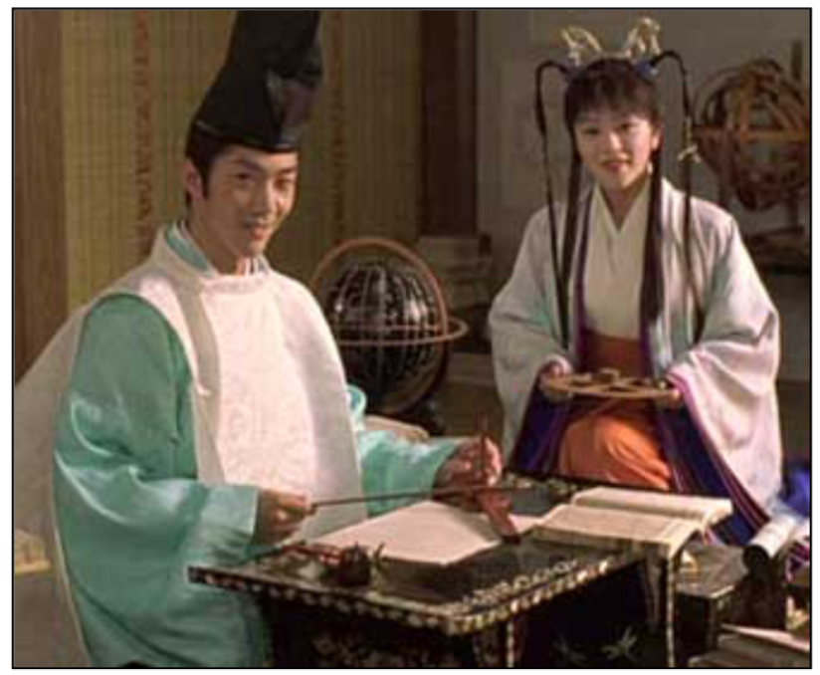
Thoughts on today’s texts?
Post a detailed response to one scene from the film or one tale from today’s reading in JT. This is how you get credit for participating in today’s class.
Some titles & characters:
Onmyо̄ji: Hiromasa, Seimei, Dо̄son.
JT: “The Giant Oak,” “Melon Magic,” “The Sparrows’ Gifts,” “The Maiden from the Sky,” “The Flea,” “The Little Spider,” “A Flash in the Palace,” “Salt Fish and Doctored Wine,” “The Tapeworm’s Sad End,” “A Toad to Reckon With.”

Slide 9
Onmyо̄ji & tales vs. “parables” setsuwa 説話
The yin-yang tradition came to Japan from China. In the West, most people know now that “yin” means the dark, moist, cold, passive, female principle of the universe, while “yang” means the bright, dry, hot, active, male principle. This is not wrong, of course, but it represents such a high level of philosophical abstraction that it has little to do with yin-yang lore as it figures in these stories. Yin-yang knowledge, intricate and practical, involved astrology, geomancy, purification, divination, and offensive or defensive magic. (JT, xxix)
Buddhism began in India about 500 B.C. and first came officially to the Japanese court’s attention in the mid-sixth century A.D. In between it had permeated Southeast Asia, Central Asia, China, and Korea, and gone through a thousand years of evolution. In time it all but vanished from India and faded in China. During the thirteenth century, certain Japanese Buddhists even began claiming that the center of Buddhism was now Japan. (JT, xxxvi)

Slide 10
Prompt and rubric for Paper 2
Answer one open-ended question about an Asian god, ghost, or monster in one of our books or movies using 3 online, English-language, peer-reviewed sources.
500 words total, plus or minus about 10%.

Slide 11

Your sources must be ALSO be accessible through the UW library and fall into one of the following two categories: Book-chapters. Journal articles. I recommend using this site: https://www.library.wisc.edu/#articles Make sure to check the boxes “available online” & “scholarly (peer-reviewed)” before you start searching. Remember that your source doesn’t have to be about your creature to contain relevant information.

Slide 12
Paper 2: required steps.
1
Turn in topic by 8pm, Tuesday, March 1.
OPEN-ENDED QUESTION re: specific being in specific, assigned film/story.
2
Turn in draft of paper by 8pm, Thursday, March 10 (file upload).
You must turn in something to be assigned peer reviews.
3
Finish peer reviews by 8pm, Tuesday, March 22 (in-Canvas tool).
Use rose-bud-thorn format. See slides from 9 February for a refresher.
4
Turn in revision of paper by 8pm, Thursday, March 24 (file upload).
This is the point at which we score the paper, using the rubric.

Slide 13
Detailed prompt. Remember, this paper is about answering the question.
Use your open-ended question (just one!) as the title of your paper. It is fine if your question changes after submitting your topic, but the draft should concern the same being and film/story.
Use the first paragraph to introduce the being & film/story. Explain why your question about them matters. Then state your working answer in one sentence. This is your thesis. Underline it.
Use the next three paragraphs to explain how your sources support your answer. Discuss each source in a new paragraph. Use the first sentence of each paragraph to state how each source contributes to your answer (that is, your argument). These are your topic sentences. Keep an eye on them as you write. Limit your discussion of each source to an accurate representation of the relevant parts of it.
Use the final paragraph(s) to explain why the points that you made suffice to answer your question. This is also a good place to note any lingering doubts and areas for future research.
At the end, give the total word count for the paper (paragraphs only) and a reference list. Follow pages 5 and 6 of https://ebookcentral.proquest.com/lib/wisc/reader.action?docID=4877146 as usual. Put the entries in alphabetical order, with the second and later lines of each indented. Along with the peer-reviewed sources, cite the film or story that inspired you.

Slide 14
Scoring rubric. Remember, the paper is about your question.
Is the title one open-ended question about the being and context from your topic submission?
Does the first paragraph introduce the being & context and explain why your question about them matters? Does it state your working answer in one underlined sentence?
Do the next three paragraphs explain how your sources support your answer? Do you discuss each source in a new paragraph, with the first sentence of each paragraph stating how each source contributes to your answer (that is, your argument)? Do you limit your discussion of each source to an accurate representation of the relevant parts of it?
Do you use the final paragraph(s) to explain why the points that you made suffice to answer your question? If relevant, do you note any lingering doubts and areas for future research?
At the end, do you give the total word count for the paper (paragraphs only) and a reference list following our usual model (Chicago style, author-date format)? Do you list the entries in alphabetical order, with the second and later lines of each indented? Along with the peer-reviewed sources, do you cite any other work noted in the paper (e.g., text that inspired you)?

Slide 15
On Wednesday: partial example & 25 options from ST
Remember to turn in your topic for Talk 1 on Tuesday: working link to your new & improved source.

