Slide 1
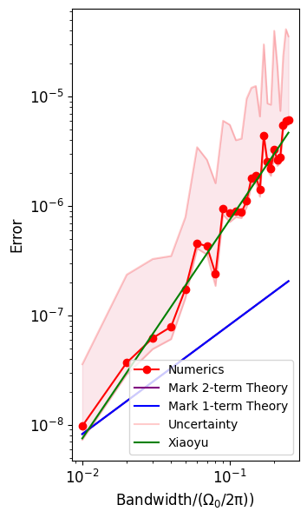
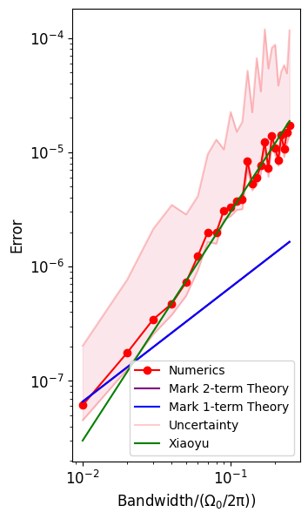
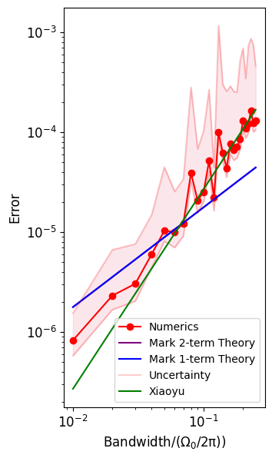
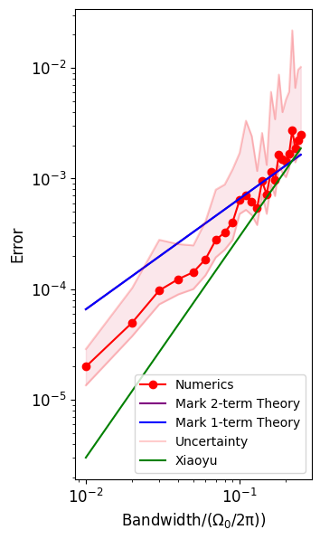
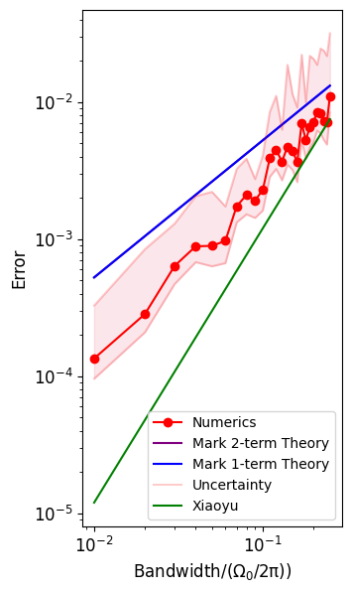
1. Starting At h_0=10kHz, 25 cases, scanning h from h=h_0 to h=25*h_0
Omega=1MHz ; 2π Εrror
F_c=0.005Omega
F_c=0.01Omega
F_c=0.03Omega
F_c=0.1Omega
F_c=0.2Omega
h/MHz
h/MHz
h/MHz
h/MHz
h/MHz

Slide 2
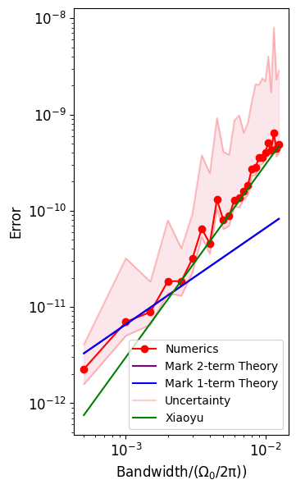
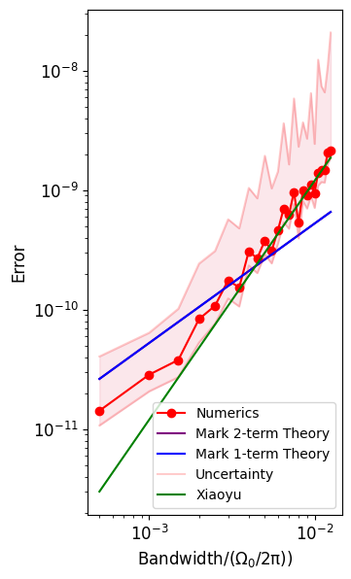
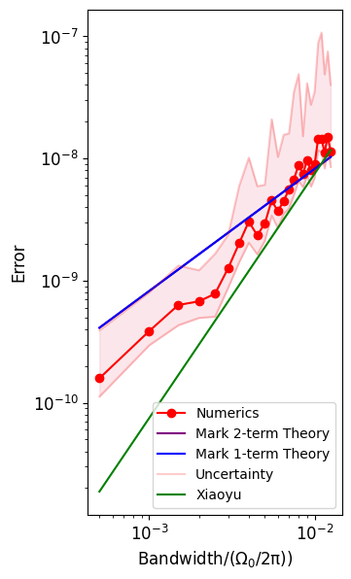
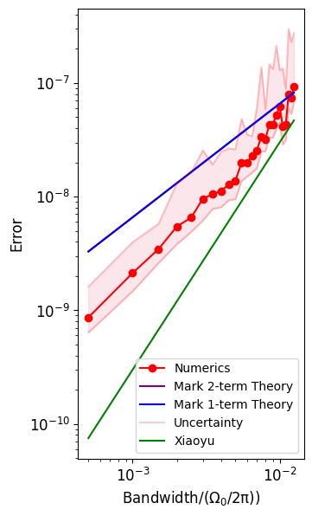
2. Starting At h_0=500Hz, 25 cases, scanning h from h=h_0 to h=25*h_0
Omega=1MHz
F_c=0.001Omega
F_c=0.002Omega
F_c=0.005Omega
F_c=0.01Omega
h/MHz
h/MHz
h/MHz
h/MHz

Slide 3
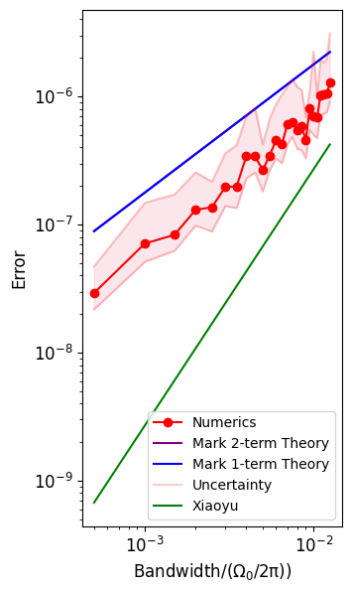
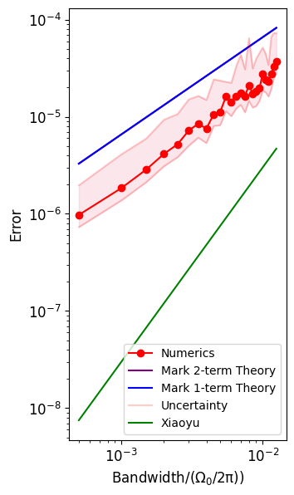
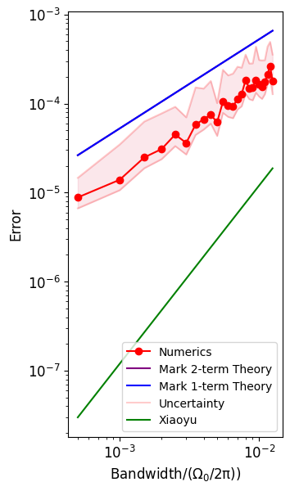
2. Starting At h_0=500Hz, 25 cases, scanning h from h=h_0 to h=25*h_0
Omega=1MHz
F_c=0.03Omega
F_c=0.1Omega
F_c=0.2Omega
h/MHz
h/MHz
h/MHz

