Slide 1


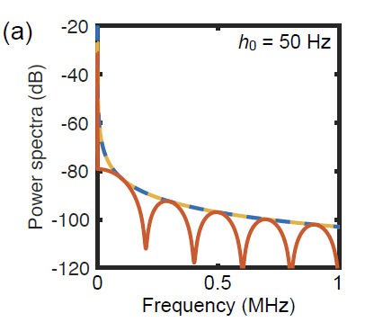
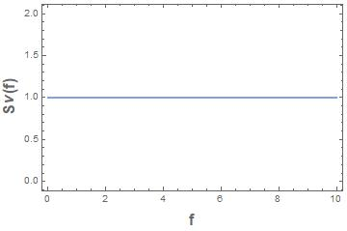
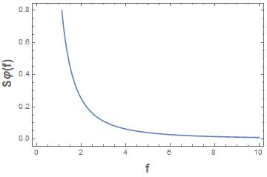
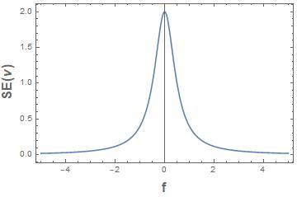

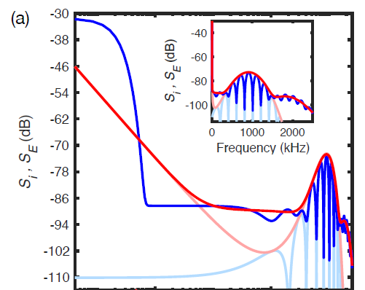
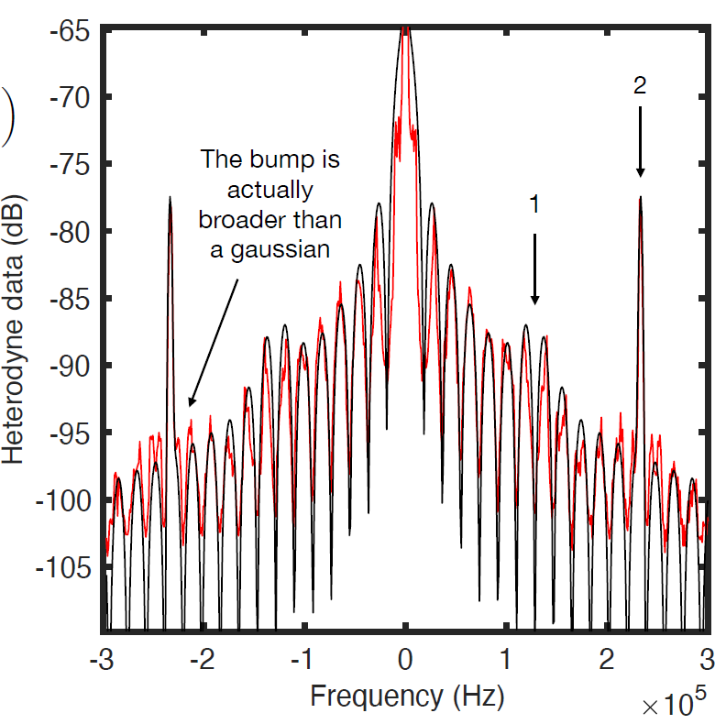
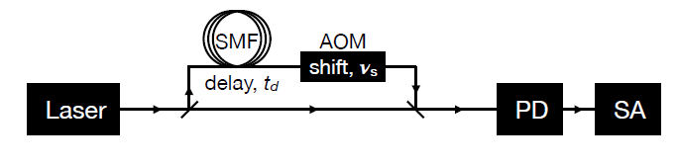
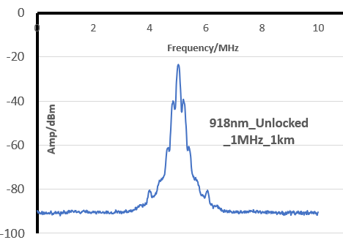
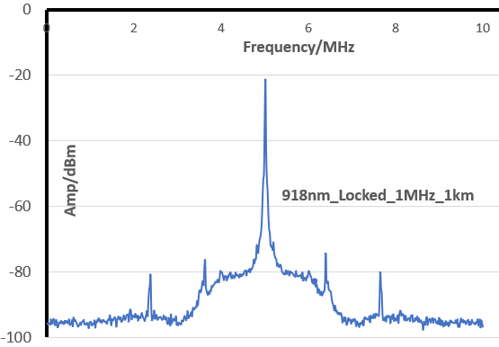
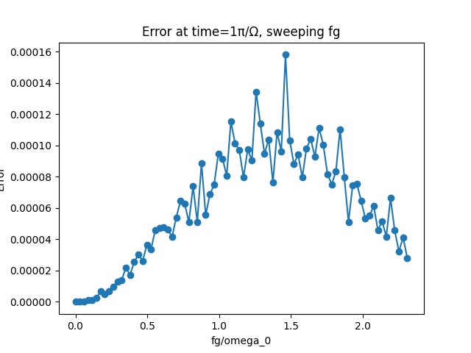
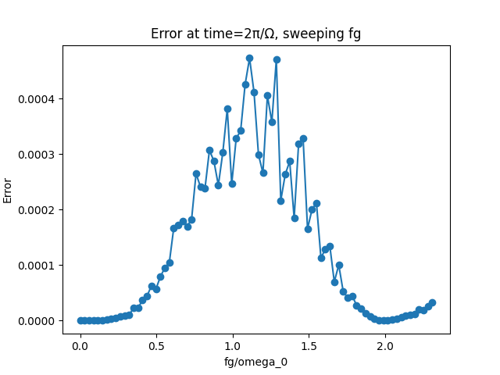
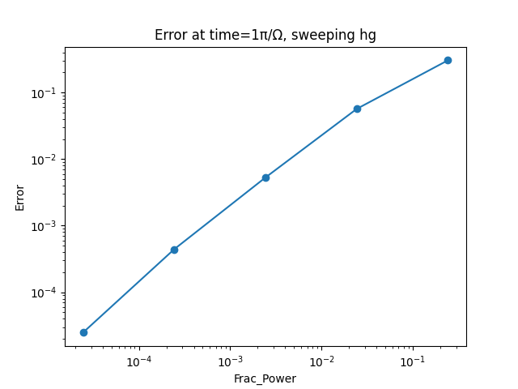
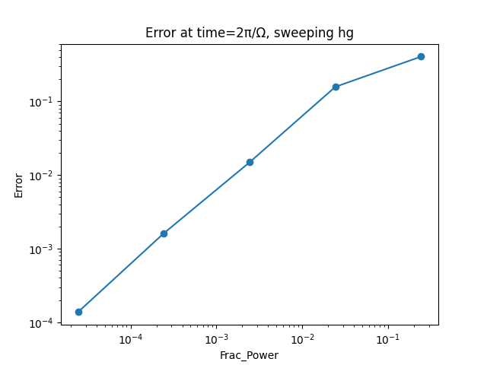
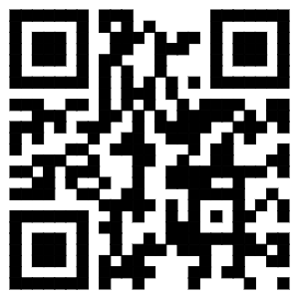

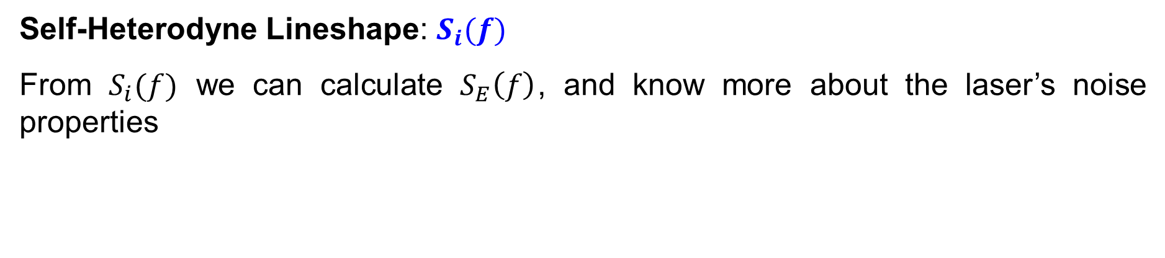





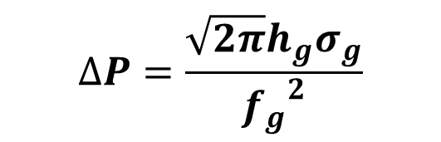
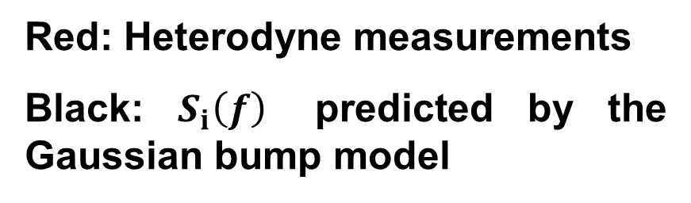



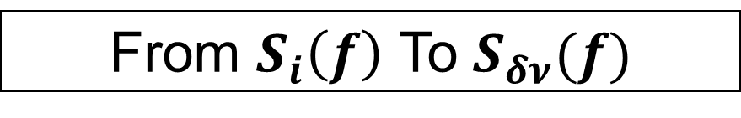
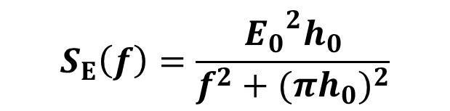



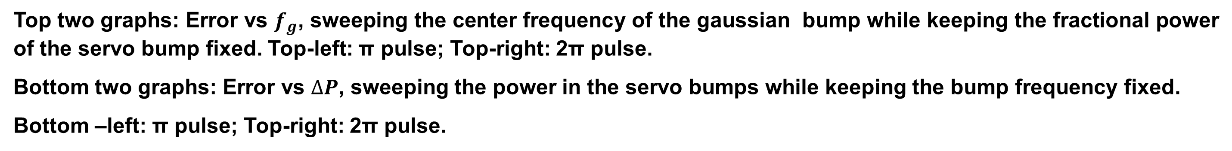
The Effect of Laser Noise on Rabi Oscillations
X. Jiang¹, M. Friesen¹, J. Scott¹ and M. Saffman^{1,2}
1: Department of Physics, University of Wisconsin-Madison, Madison, WI, 53706
2: ColdQuanta, Inc., 811 E. Washington Ave., Madison, WI, 53703
1. Introduction
2. Noise Modeling: From Self-Heterodyne Measurement to Noise Spectrum
We study the effect of laser noise on one- and two-photon Rabi oscillations with realistic noise models with the goal of quantifying the influence of laser noise on neutral atom quantum gate fidelity.
First we study the relation between self-heterodyne measurements, the laser lineshape $S_{E}$(𝑓), and its underlying phase noise described by the power spectral density 𝑆𝜑(𝑓). There is a universal relation satisfied between the two quantities for locked and well-filtered lasers with low noise, which is useful for practical experiments. Noise spectra that include servo bump features are modeled analytically.
We simulated the effect of laser noise on the fidelity and coherence of one-photon and two-photon Rabi oscillations by reconstructing samples of time-varying phase noise with realistic parameters for phase noise $S_{φ}\left(f\right)$, extracted from laboratory heterodyne measurements.
We also proposed quasi-static models for calculating the effect of phase and intensity noise. The models can be used when the bandwidth of the power spectral density for the phase and frequency noise is much smaller than the Rabi frequency.
Noise Spectrum and Laser Lineshape
Laser Field: 𝐸(𝑡)$=E_{0}exp⁡[−i(2πν_{0}t+φ\left(t\right)]$
Phase Noise : $φ\left(t\right)$
Frequency Noise : $δν\left(t\right)=\frac{1}{2π}\frac{d}{dt}\left(2πν_{0}t+φ\left(t\right)\right)−ν_{0}$
$S(f)$: Power spectral density of a random process
Frequency Noise spectrum: $S_{δν}\left(f\right)$
Phase Noise spectrum: $S_{φ}(f)$ $=S_{δν}(f)/f^{2}$
Laser Lineshape: $S_{Ε}(f)$
Example: White Noise
From $S_{i}\left(f\right)$ To $S_{δν}(f)$
Example: White noise
Dashed blue: $S_{φ}(f)$
Dashed Gold: $S_{Ε}(f)/{E_{0}}^{2}$
Red: $S_{i}(f)$
$S_{i}\left(f\right)=δ\left(f\right)+\frac{1}{4}\left[δ{(f−ν}_{s}\right)+δ(f+ν_{s})]+$
$$\frac{h_{0}\sin^{2}[π\left(f−ν_{s}\right)t_{d}]}{{{(f−ν}_{s})}^{2}+(2π{h_{0})}^{2}}+\frac{h_{0}\sin^{2}[π\left(f+ν_{s}\right)t_{d}]}{{{(f+ν}_{s})}^{2}+(2π{h_{0})}^{2}}$$
$$S_{δν}\left(f\right)=h_{0}$$
$S_{φ}\left(f\right)$ $=h_{0}/f^{2}$
$$S_{Ε}\left(f\right)=\frac{{E_{0}}^{2}h_{0}}{f^{2}+{(πh_{0})}^{2}}$$
3. Numerical method and simulation results
Numerical Method
$$|\left.e\right\rangle$$
Consider a 2-level system with resonant Rabi Frequency, if phase noise in the laser is considered, then we have:
$$\frac{d}{dt}c_{g}\left(t\right)=i\frac{Ω_{0}}{2}e^{−iφ\left(t\right)}C_{e}(t)$$
$$\frac{d}{dt}c_{e}\left(t\right)=i\frac{Ω_{0}}{2}e^{iφ\left(t\right)}C_{g}(t)$$
$$Ω_{0}$$
Self-Heterodyne Measurement
Example: Noise with servo bumps
Servo bumps are often seen in the lineshape of locked lasers. We model the servo bumps in the noise spectrum $S_{δν}(f)$, and study how it affects our experiments with lasers.
Proposed noise model for a lineshape wth servo bumps: a “Gaussian bump” with center frequency $f_{g}$in background of white noise in the frequency noise spectrum:
$$S_{δν}\left(f\right)=h_{0}+h_{g}exp⁡[−\frac{{(f{−f}_{g})}^{2}}{2σ^{2}}]$$
After some approximations an expression for $S_{Ι}\left(f\right)$ can be obtained.
$S_{i}\left(f\right)≈$ $δ\left(f\right)+\frac{1}{4}\left[δ{(f−ν}_{s}\right)$ $\sin^{2}\left[π\left(f−ν_{s}\right)t_{d}\right]+$
$$×\{\frac{h_{0}}{{{(f−ν}_{s})}^{2}+(2π{h_{0})}^{2}}+\frac{h_{g}}{{{(f−ν}_{s})}^{2}}exp[−\frac{{(f−ν_{s}−f_{g})}^{2}}{2{σ_{g}}^{2}}]$$
$$+\frac{h_{g}}{{{(f−ν}_{s})}^{2}}exp[−\frac{{\left(f−ν_{s}+f_{g}\right)}^{2}}{2{σ_{g}}^{2}}]\}$$
Fractional power in the servo bumps:
$$|\left.g\right\rangle$$
Self-Heterodyne is a technique to use optical interference to transfer the noise signal to lower frequencies that are more conducive to conventional measurements.
Our numerical method:
Lab self-heterodyne measurement of the laser
From the measurement $S_{i}\left(f\right)$calculate the frequency noise spectrum $S_{δν}\left(f\right).$
From $S_{φ}\left(f\right)=\frac{S_{δν}\left(f\right)}{f^{2}}$, generate a sample of time series of the phase noise $φ\left(t\right)$. See
deLeseleuc et al. PRA 97, 053803 (2018)
Simulate the Schrödinger equations with $φ\left(t\right)$
Self-Heterodyne Lineshape: $S_{i}(f)$
From $S_{i}(f)$ we can calculate $S_{E}\left(f\right)$, and know more about the laser’s noise properties
Simulation Results for Lineshapes with Servo Bumps
Red: Heterodyne measurements
Black: $S_{i}\left(f\right)$ predicted by the Gaussian bump model
Red: $S_{Ε}\left(f\right)$ solutions
Salmon: Approximate
$S_{Ε}\left(f\right)$ solutions
Blue: $S_{i}\left(f\right)$ solutions
Light Blue: Approximate $S_{i}\left(f\right)$ solutions
$$∆P=\frac{\sqrt{2π}h_{g}σ_{g}}{{f_{g}}^{2}}$$
Example: Lab self-heterodyne measurement of unlocked(left) and locked laser (right). Laser system is a cw Ti:Sa laser.
Servo bumps
10⁻³ pulse error
requires -32.6 dBc
servo bump power
10⁻³ pulse error
requires -37 dBc
servo bump power
Top two graphs: Error vs $f_{g}$, sweeping the center frequency of the gaussian bump while keeping the fractional power of the servo bump fixed. Top-left: π pulse; Top-right: 2π pulse.
Bottom two graphs: Error vs $∆P$, sweeping the power in the servo bumps while keeping the bump frequency fixed.
Bottom –left: π pulse; Top-right: 2π pulse.
Scan Here

