Slide 1
Slow variant noise eater for lasers
Xiaoyu Jiang, University of Wisconsin-Madison, Department of Physics
Introduction: Stabilizing the power of lasers is always very important in optics experiments. In this project, a DC noise eater is designed to deal with the slow power drift of lasers.

Slide 2
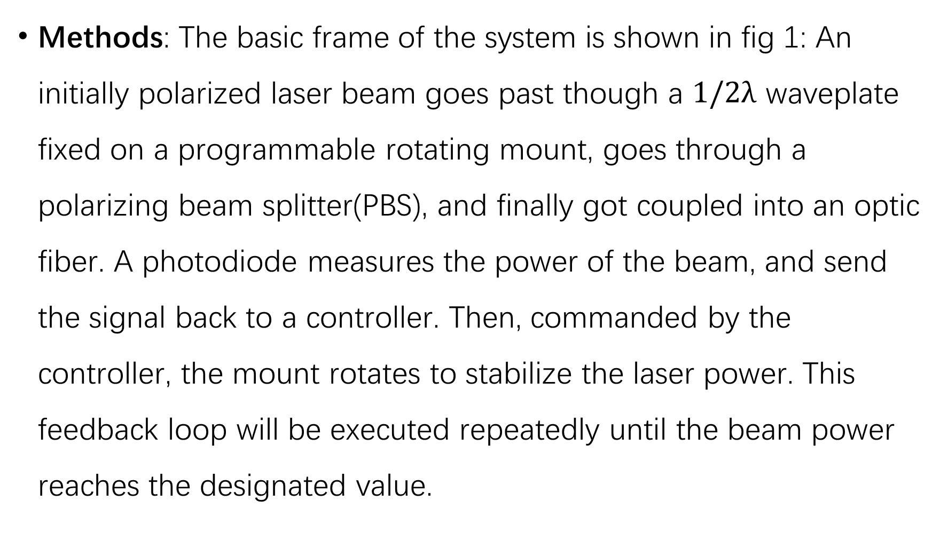
Methods: The basic frame of the system is shown in fig 1: An initially polarized laser beam goes past though a $1/2λ$ waveplate fixed on a programmable rotating mount, goes through a polarizing beam splitter(PBS), and finally got coupled into an optic fiber. A photodiode measures the power of the beam, and send the signal back to a controller. Then, commanded by the controller, the mount rotates to stabilize the laser power. This feedback loop will be executed repeatedly until the beam power reaches the designated value.

Slide 3
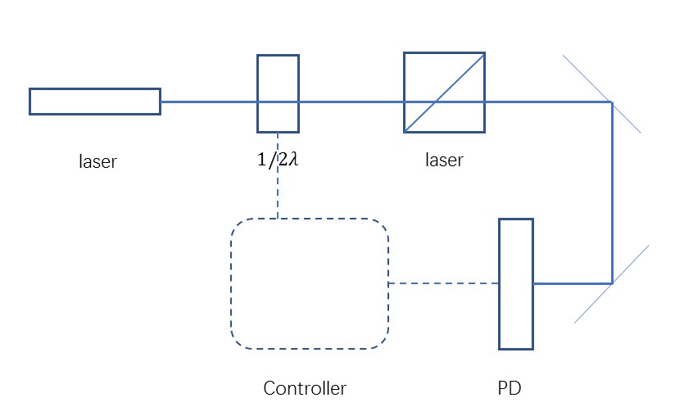
Fig 1: Basic frame of the system

Slide 4
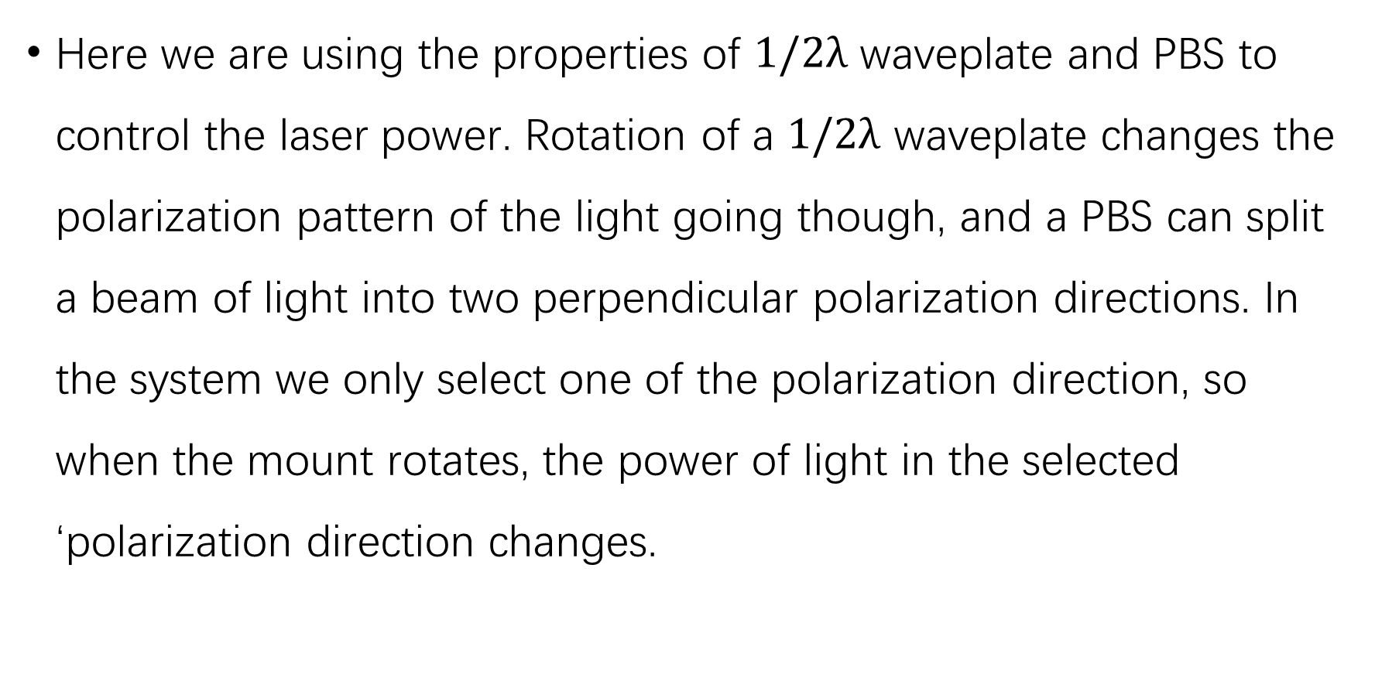
Here we are using the properties of $1/2λ$ waveplate and PBS to control the laser power. Rotation of a $1/2λ$ waveplate changes the polarization pattern of the light going though, and a PBS can split a beam of light into two perpendicular polarization directions. In the system we only select one of the polarization direction, so when the mount rotates, the power of light in the selected ‘polarization direction changes.

Slide 5

Proportional–integral–derivative(PID) algorithm is used to calculate the feedback signal.
Here e(t) is the error signal, and u(t) is the feedback signal.

Slide 6
Results: A demonstration systems has been designed and tested. The functionality of the system is achieved. In the demonstration system, an Arduino board is used to do the Analog-Digital conversion, and a PC is used as a controller.
Future Design Consideration: Considering the amount of lasers needed to be stabilized in the lab, we need to make the controlling unit more simple and compact. Currently I’m trying to use a raspberry Pi board as AD and microcontroller of the system.

