Slide 2
Laser Noise Modeling and Simulation
Xiaoyu Jiang
Saffman Group Meeting Talk 2022/04/14

Slide 3

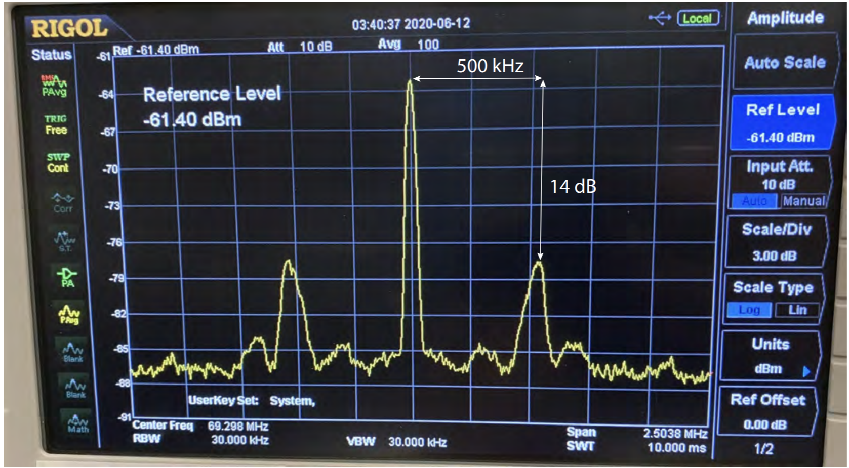
Laser noise analysis
Perfect laser: δ-function lineshape
Reality: Self-heterodyne measurements of a locked laser’s lineshape.
Finite Linewidth + Servo bumps

Slide 4
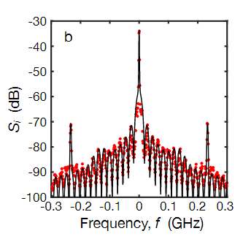
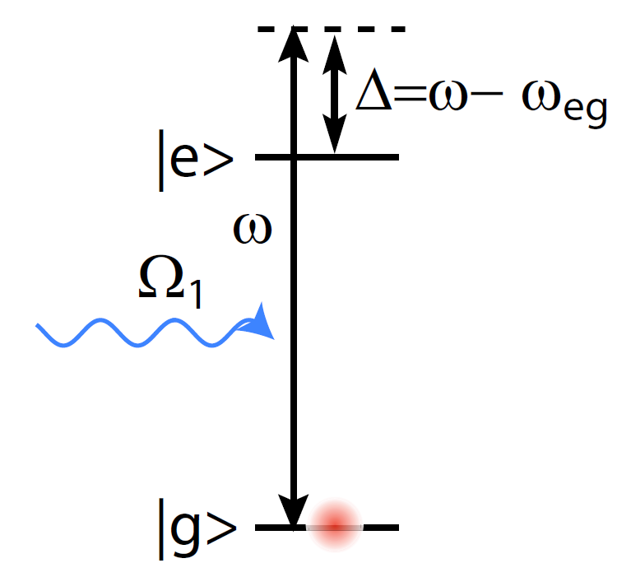
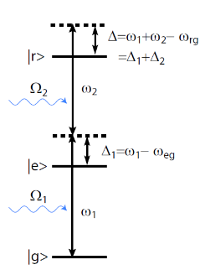
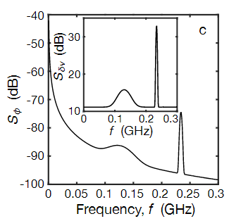
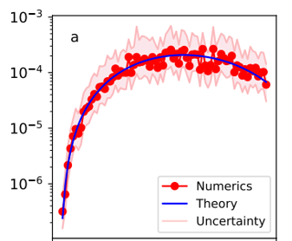
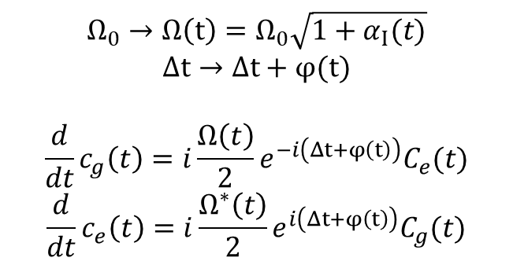
How to model laser noise
Lab self-heterodyne measurements
step1
Frequency noise spectrum
step2
step2
Error calculated by simulation
Error predicted by theory
$$Ω_{0}→Ω\left(t\right)=Ω_{0}\sqrt{1+α_{Ι}(t)}$$
$$Δt→Δt+φ(t)$$
$$\frac{d}{dt}c_{g}\left(t\right)=i\frac{Ω\left(t\right)}{2}e^{−i\left(Δt+φ\left(t\right)\right)}C_{e}(t)$$
$$\frac{d}{dt}c_{e}\left(t\right)=i\frac{Ω^{∗}\left(t\right)}{2}e^{i\left(Δt+φ\left(t\right)\right)}C_{g}(t)$$
Quasi-static model
Time-series master equation

Slide 5
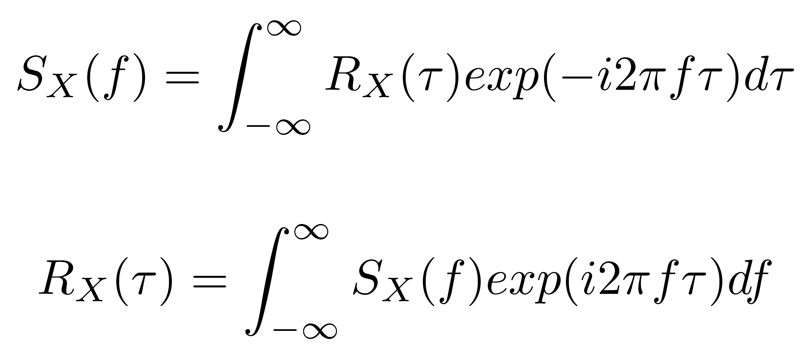
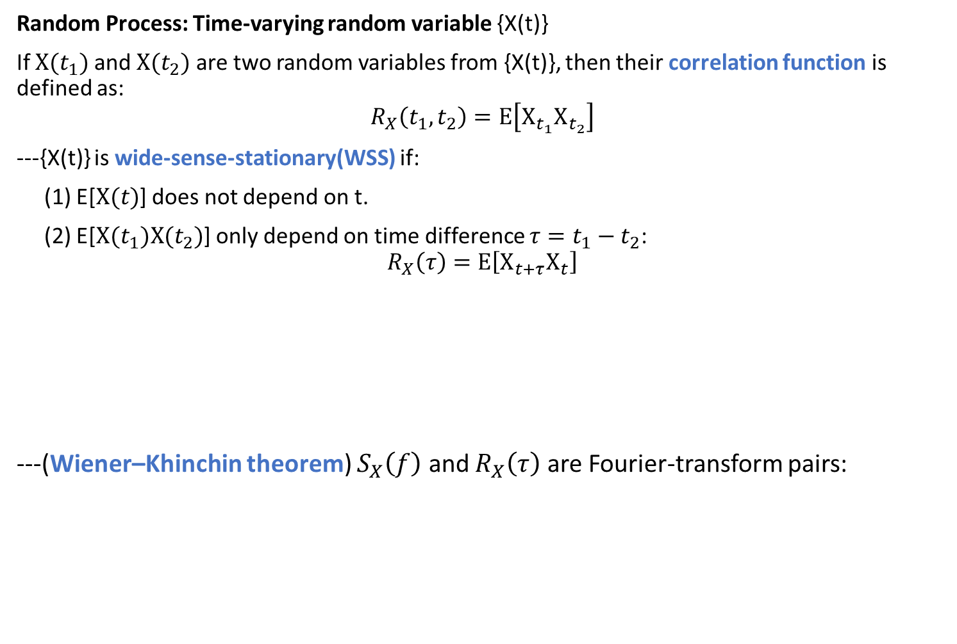
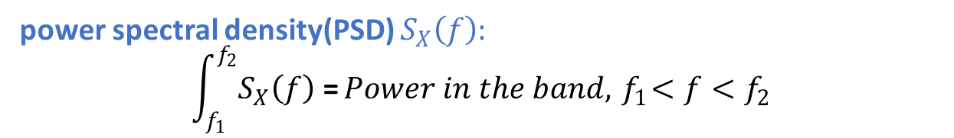
Random Process: Time-varying random variable {X(t)}
If $X(t_{1})$ and $X(t_{2})$ are two random variables from {X(t)}, then their correlation function is defined as:
$$R_{X}\left(t_{1},t_{2}\right)=E\left[X_{t_{1}}X_{t_{2}}\right]$$
---{X(t)} is wide-sense-stationary(WSS) if:
(1) E[$X(t)$] does not depend on t.
(2) E[$X(t_{1})X(t_{2})$] only depend on time difference $τ=t_{1}−t_{2}$:
$$R_{X}\left(τ\right)=E\left[X_{t+τ}X_{t}\right]$$
---(Wiener–Khinchin theorem) $S_{X}\left(f\right)$ and $R_{X}\left(τ\right)$ are Fourier-transform pairs:
power spectral density(PSD) $S_{X}\left(f\right):$
$$\int_{f_{1}}^{f_{2}}{S_{X}\left(f\right)\text{ =}}Power in the band,{ f}_{1}<f<f_{2}$$

Slide 6
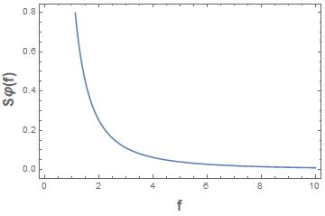
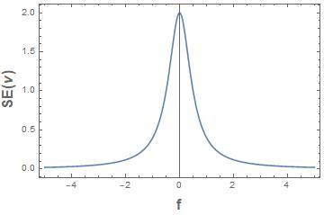
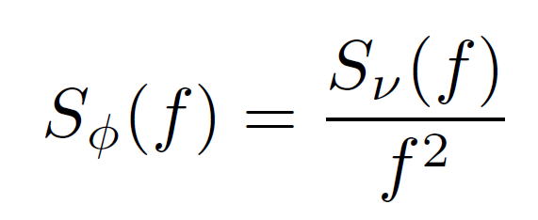
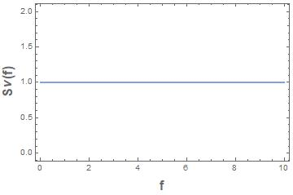
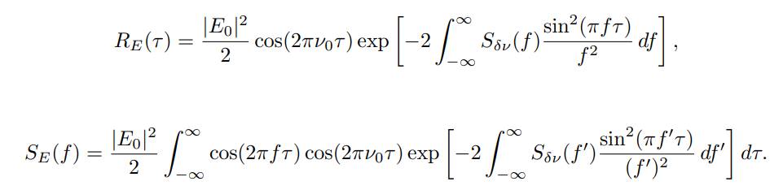





Example: frequency noise with Lorentzian lineshape
Laser Field:
$$E\left(t\right)=\frac{ε_{0}}{2}e^{−i(2πν_{0}t+φ\left(t\right))}+c.c.$$
$$S_{φ}(f)$$
$$S_{I}(ν)$$
$$S_{E}(ν)$$
$$S_{f}(f)$$
Self-Heterodyne Spectrum
Carrier Spectrum
(Example: Lorentzian Lineshape)
Noise Spectrum for phase(above) and
frequency (below) noise
G. Di Domenico, S. Schilt, and P. Thomann, “Simple approach to the relation between laser frequency noise and laser line shape,” Appl. Opt. 49, 4801 (2010)

Slide 7
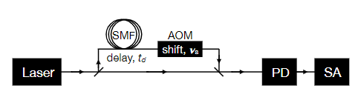



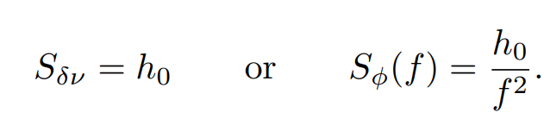





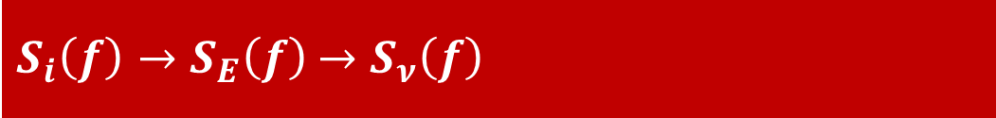
$S_{i}\left(f\right)→S_{E}\left(f\right)$ $→S_{ν}\left(f\right)$
$i(t)$ proportional to $E^{2}(t)$
White noise:
Servo bump noise:
M. Zhu and J. L. Hall, “Stabilization of optical phase/frequency of a laser system: application to a com-mercial dye laser with an external stabilizer,” J. Opt.Soc. Am. B 10, 802 (1993)

Slide 8
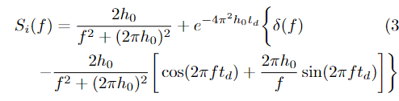
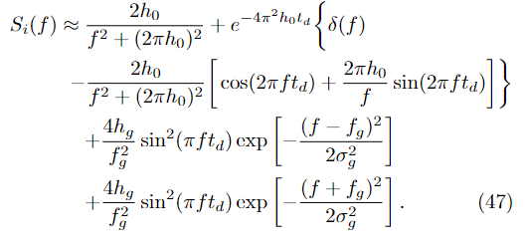
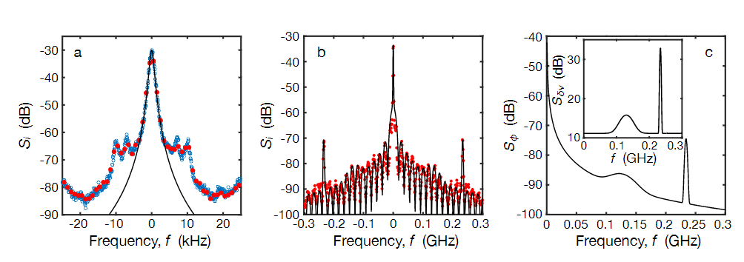
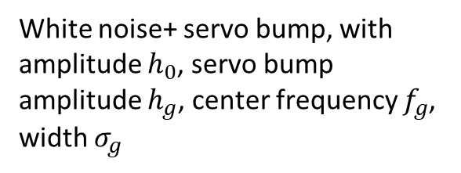

$S_{i}\left(f\right)→S_{E}\left(f\right)$ $→S_{ν}\left(f\right)$
White noise, with amplitude $h_{0}$
White noise+ servo bump, with amplitude $h_{0}$, servo bump amplitude $h_{g}$, center frequency $f_{g}$, width $σ_{g}$

Slide 9

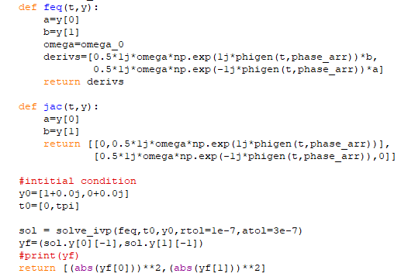
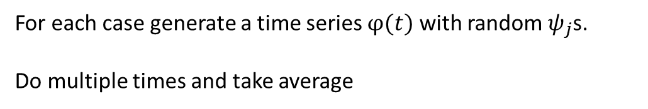
Error calculation: Simulation with python
For each case generate a time series $φ(t)$ with random $ψ_{j}$s.
Do multiple times and take average

Slide 10


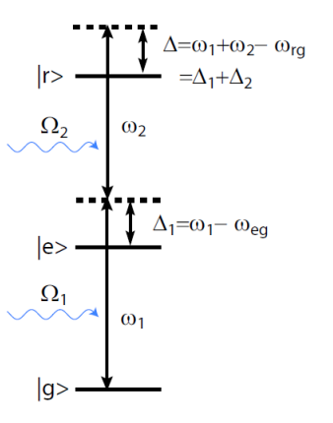


Error prediction: Quasi-static model
When the bandwidth of the laser noise is much less than the Rabi Frequency Ω, we can treat the noise simply as a random variable(not time-varying) drawn from a Gaussian distribution with variance σ.
One photon transition with frequency noise:
Two-photon transition with frequency noise, assuming the two photons have the same noise spectrum:

Slide 11
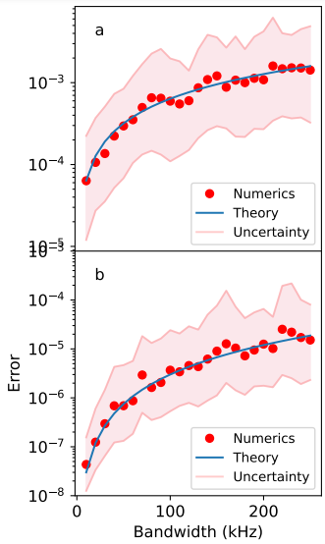
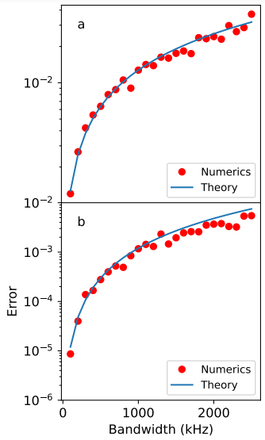
Comparison: Numerics and Theory
Quasi-static theory, 1 photon
2 photon
Bandwidth=0.01 Ω
1π
2π
Linewidth (kHz)
Linewidth (kHz)

Slide 12
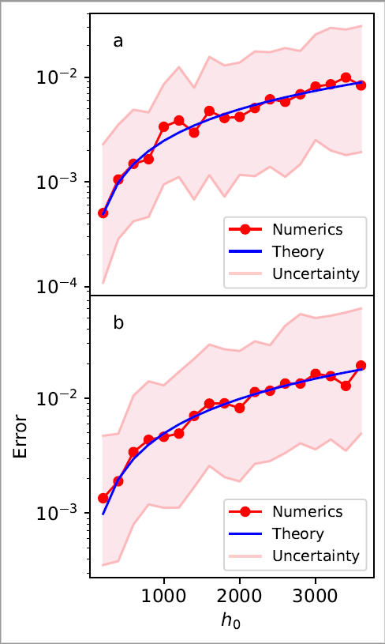

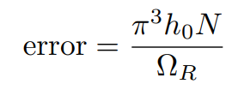
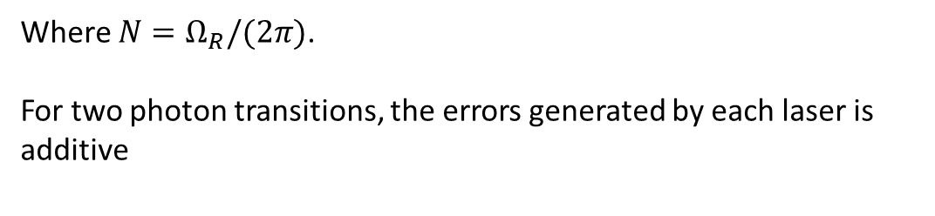
Error prediction: Time series master equation
We consider a two-level system of frequency $ν_{e}$driven resonantly by a monochromatic laser, with Rabi angular frequency $Ω_{R}$:
Consider extracting $φ(t)$ from the noise spectrum $S_{ν}(f)$:
Finally we get:
White Noise
Where $N=Ω_{R}/(2π)$.
For two photon transitions, the errors generated by each laser is additive
a: 1π pulse
b: 2π pulse

Slide 13
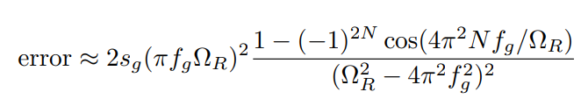
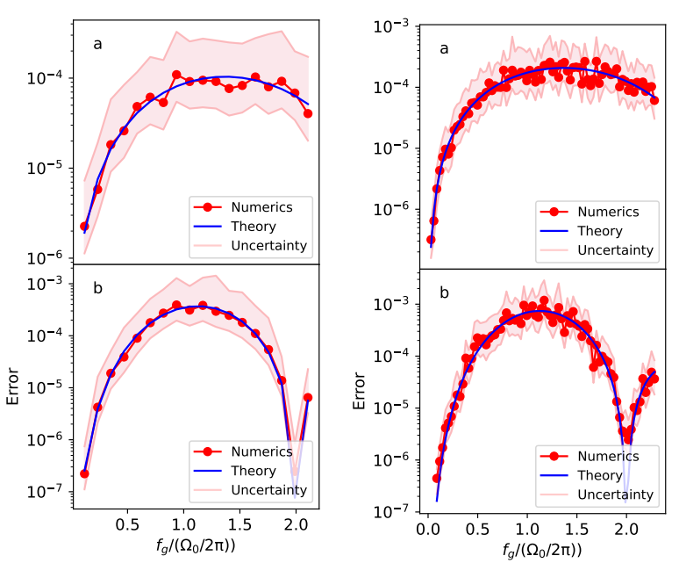
Servo bump spectrum, 1 photon
2 photon
1π
2π

Slide 14
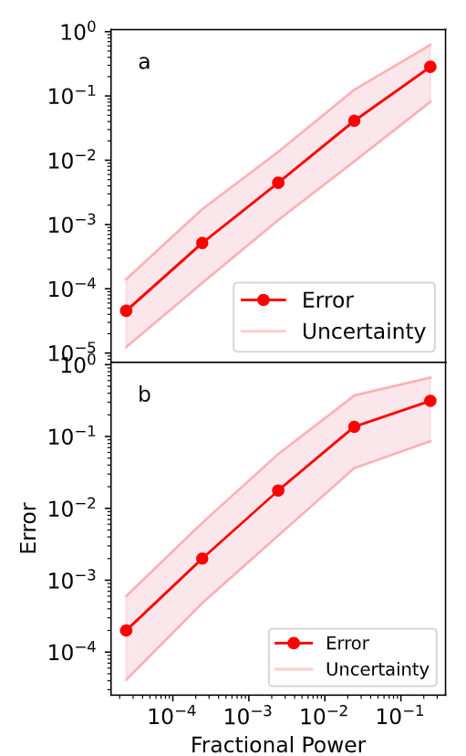
Comparison: Numerics and Theory
Error vs Fractional power in the servo bump
Next step: experiment with microwaves

Slide 15
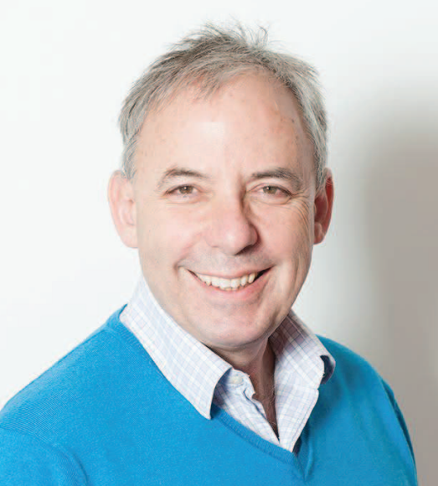
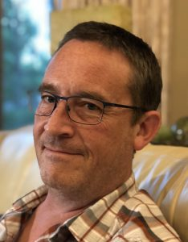
Mark Saffman
Mark Friesen
Thank you!

