Slide 1
Laser Noise Modeling and Simulation
Xiaoyu Jiang
Saffman Group Meeting Talk 2020/05/11

Slide 2
Overview:
Mathematical Background
Laser noise modeling
Simulating laser noise in two-level systems
Work to be done

Slide 3
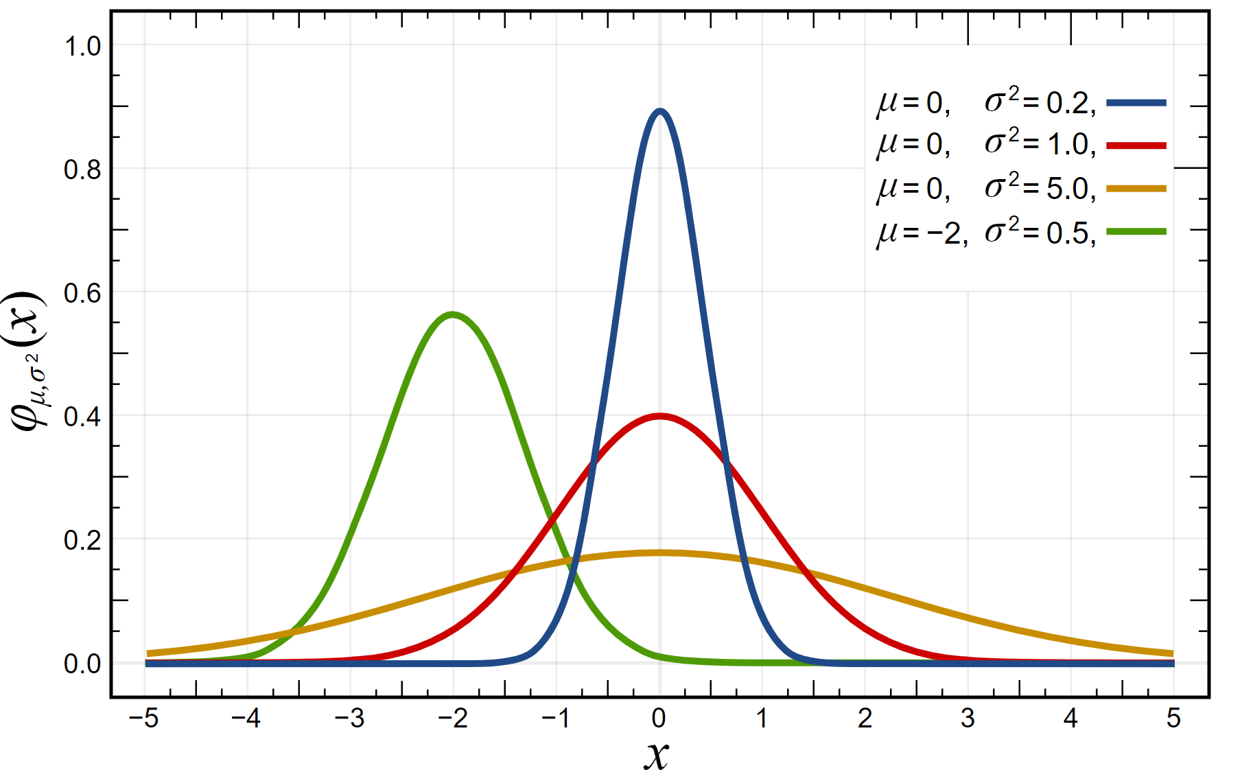
1. Mathematical Background
1.1 Random variable
Example:
Gaussian Distribution X~N(μ,σ)
Sample Space
X ∈ R
Probability Density function
N(μ,σ)

Slide 4
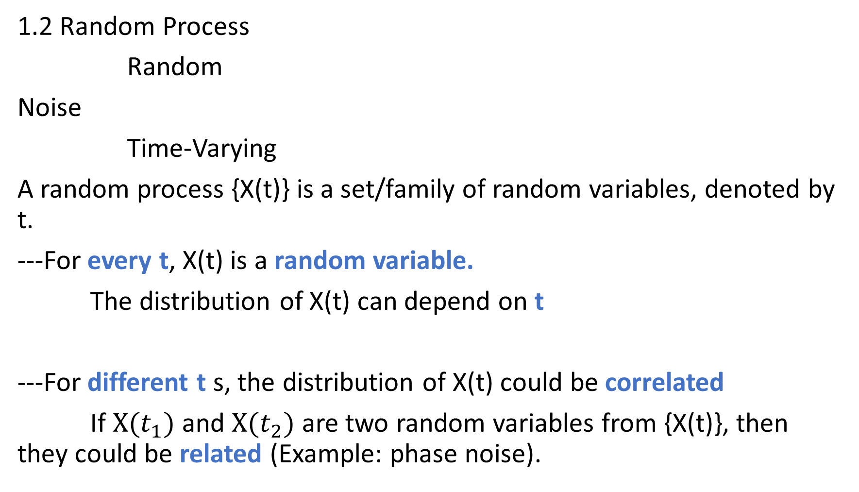
1.2 Random Process
Random
Noise
Time-Varying
A random process {X(t)} is a set/family of random variables, denoted by t.
---For every t, X(t) is a random variable.
The distribution of X(t) can depend on t
---For different t s, the distribution of X(t) could be correlated
If $X(t_{1})$ and $X(t_{2})$ are two random variables from {X(t)}, then they could be related (Example: phase noise).

Slide 5
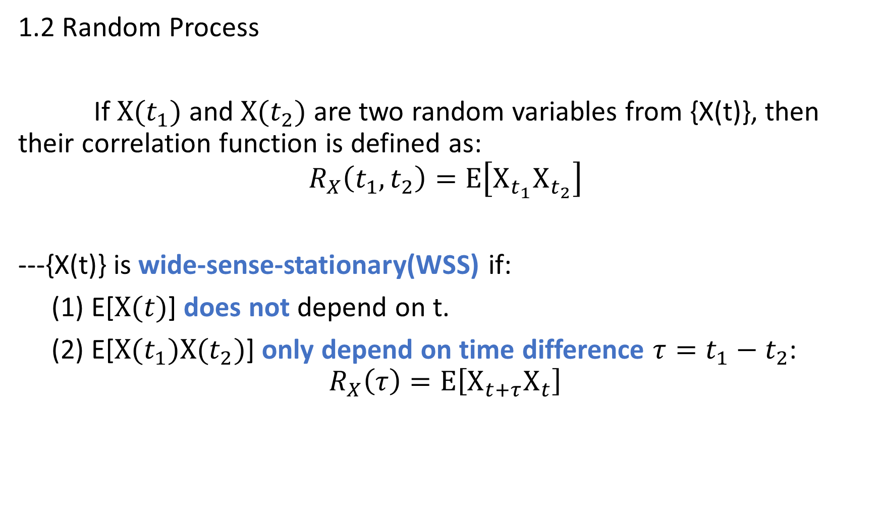
1.2 Random Process
If $X(t_{1})$ and $X(t_{2})$ are two random variables from {X(t)}, then their correlation function is defined as:
$$R_{X}\left(t_{1},t_{2}\right)=E\left[X_{t_{1}}X_{t_{2}}\right]$$
---{X(t)} is wide-sense-stationary(WSS) if:
(1) E[$X(t)$] does not depend on t.
(2) E[$X(t_{1})X(t_{2})$] only depend on time difference $τ=t_{1}−t_{2}$:
$$R_{X}\left(τ\right)=E\left[X_{t+τ}X_{t}\right]$$

Slide 6
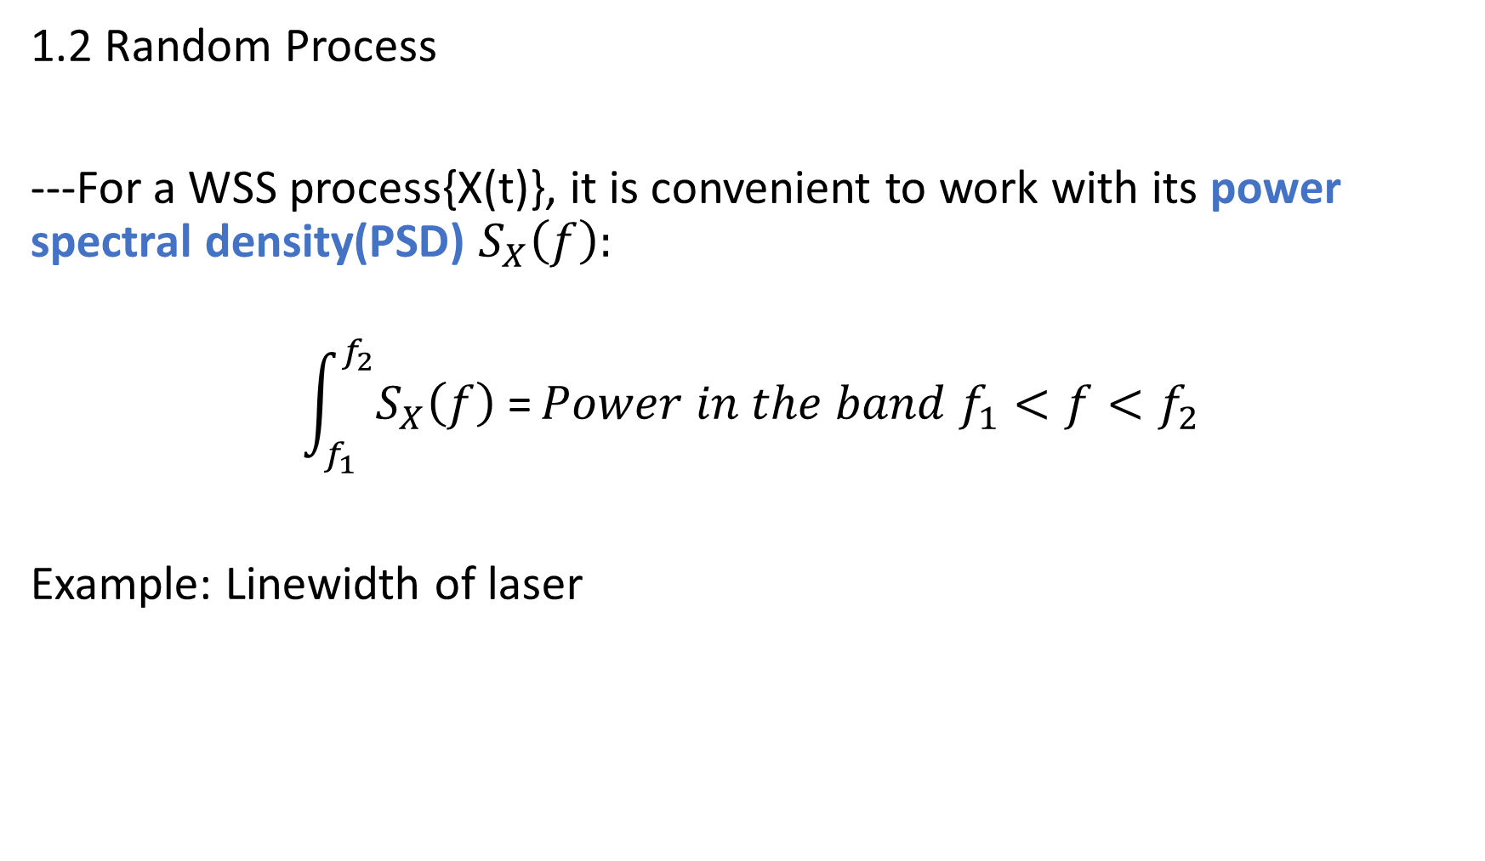
1.2 Random Process
---For a WSS process{X(t)}, it is convenient to work with its power spectral density(PSD) $S_{X}\left(f\right):$
$$\int_{f_{1}}^{f_{2}}{S_{X}\left(f\right) \text{=}}Power in the band{ f}_{1}<f<f_{2}$$
Example: Linewidth of laser

Slide 7
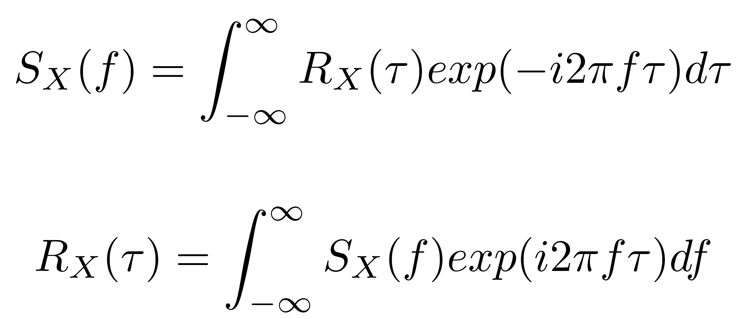

1.2 Random Process
---(Wiener–Khinchin theorem) $S_{X}\left(f\right)$ and $R_{X}\left(τ\right)$ are Fourier-transform pairs:

Slide 8
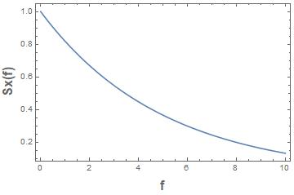
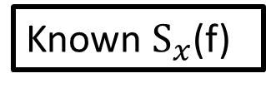
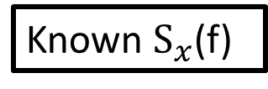
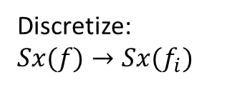

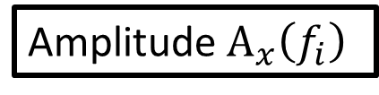
1.3 Time-series reconstruction
Target:
Method
Known $S_{x}$(f)
Sample Path X(t)
Discretize:$Sx(f)→Sx(f_{i})$
Known $S_{x}$(f)
Amplitude${ A}_{x}\left(f_{i}\right)$
Sample Path X(t)
$$Ax\left(f_{i}\right)=\sqrt{Sx(f_{i})}$$

Slide 9
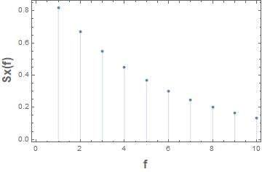
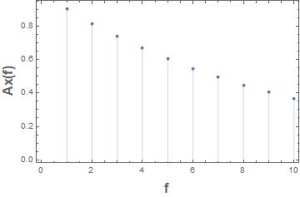
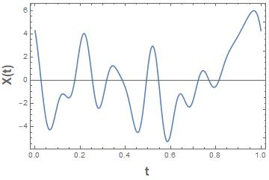
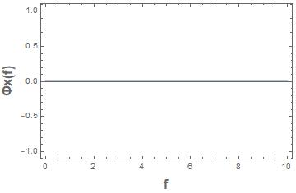

1.3 Time-series reconstruction
$$A_{x}\left(f_{i}\right)=\sqrt{S_{x}\left(f_{i}\right)df}$$
Discretize
IFT with random phase
?

Slide 10
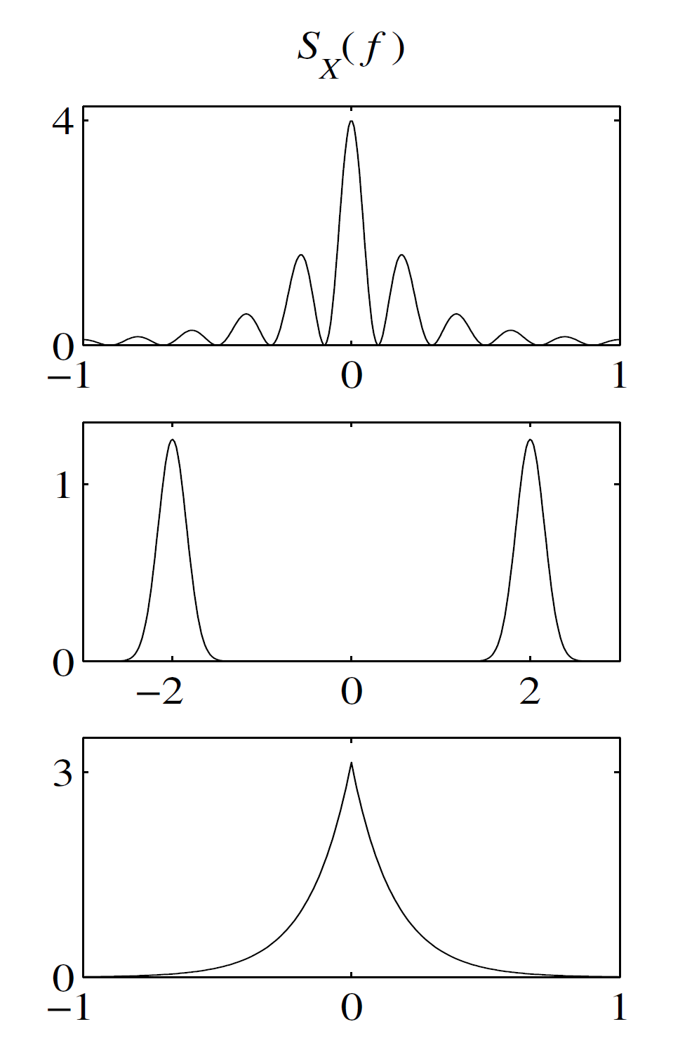
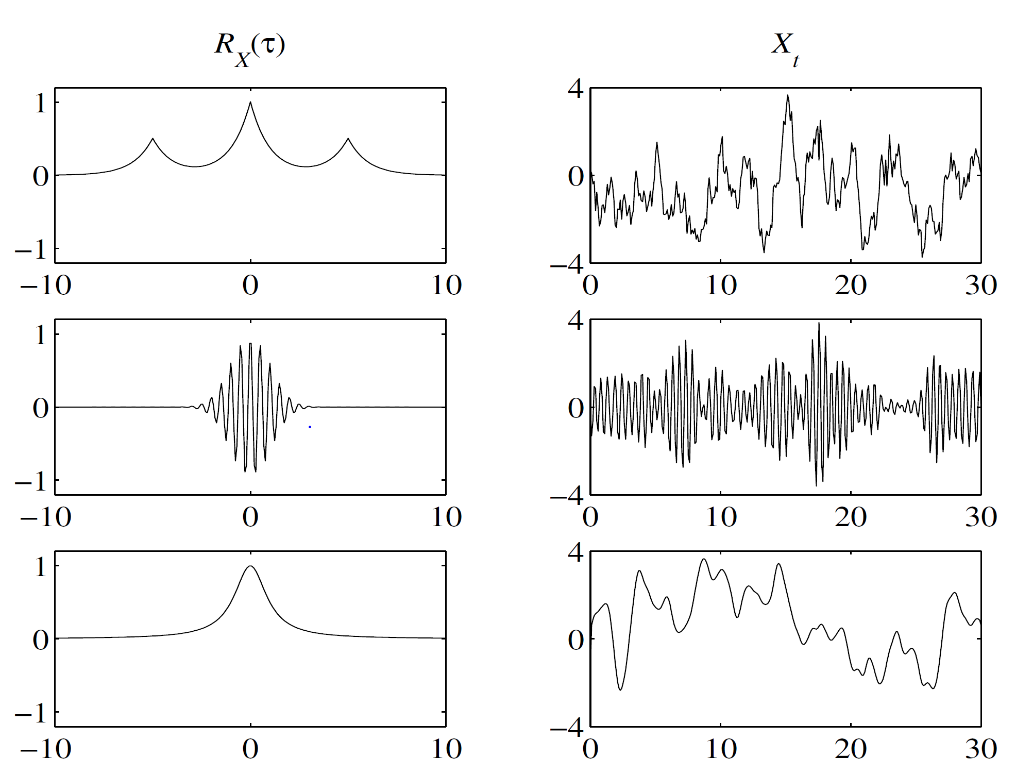
1.3 Time-series reconstruction
Gubner, John A. Probability and random processes for electrical and computer engineers. Cambridge University Press, 2006.

Slide 11
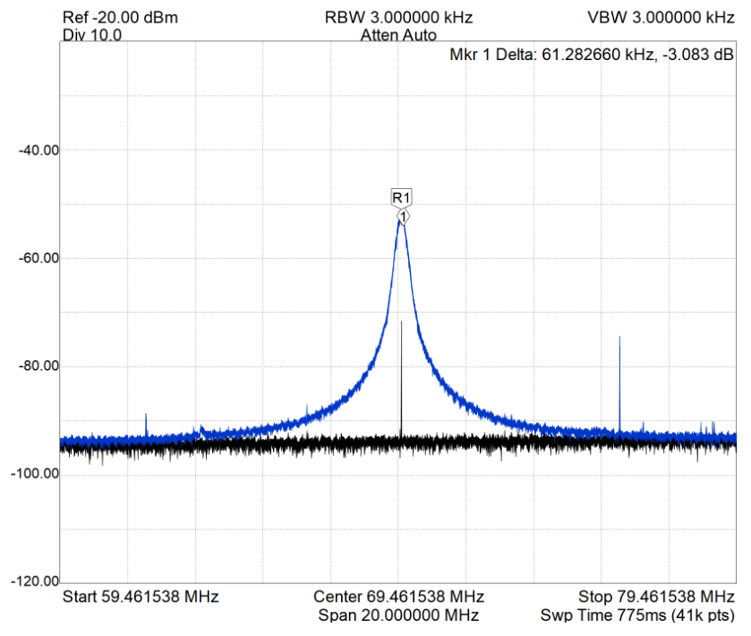
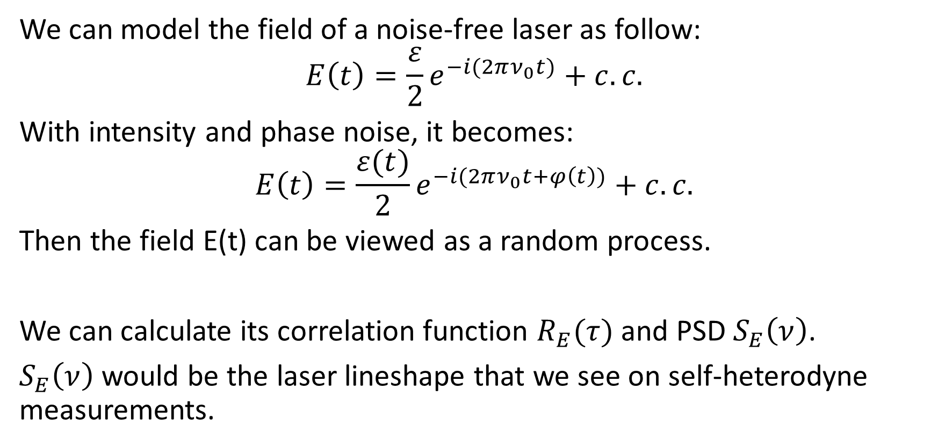
2. Laser noise modeling
We can model the field of a noise-free laser as follow:
$$E\left(t\right)=\frac{ε}{2}e^{−i(2πν_{0}t)}+c.c.$$
With intensity and phase noise, it becomes:
$$E\left(t\right)=\frac{ε(t)}{2}e^{−i(2πν_{0}t+φ\left(t\right))}+c.c.$$
Then the field E(t) can be viewed as a random process.
We can calculate its correlation function $R_{E}(τ)$ and PSD $S_{E}\left(ν\right)$.
$S_{E}\left(ν\right)$ would be the laser lineshape that we see on self-heterodyne measurements.

Slide 12
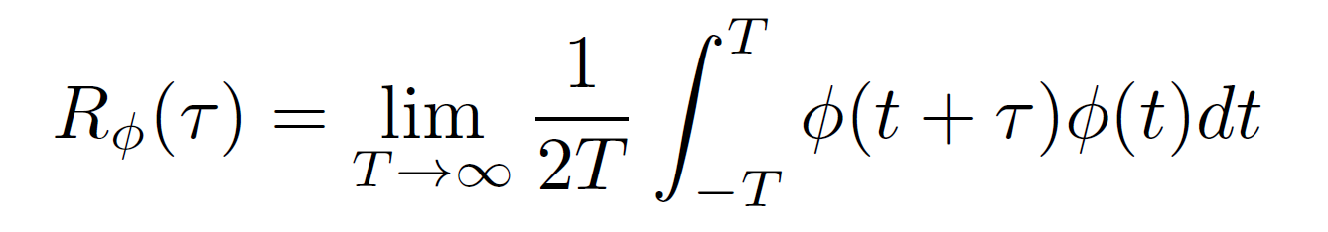
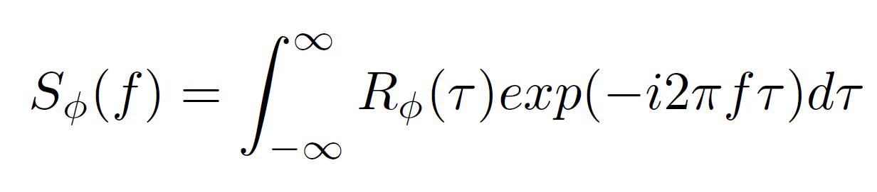
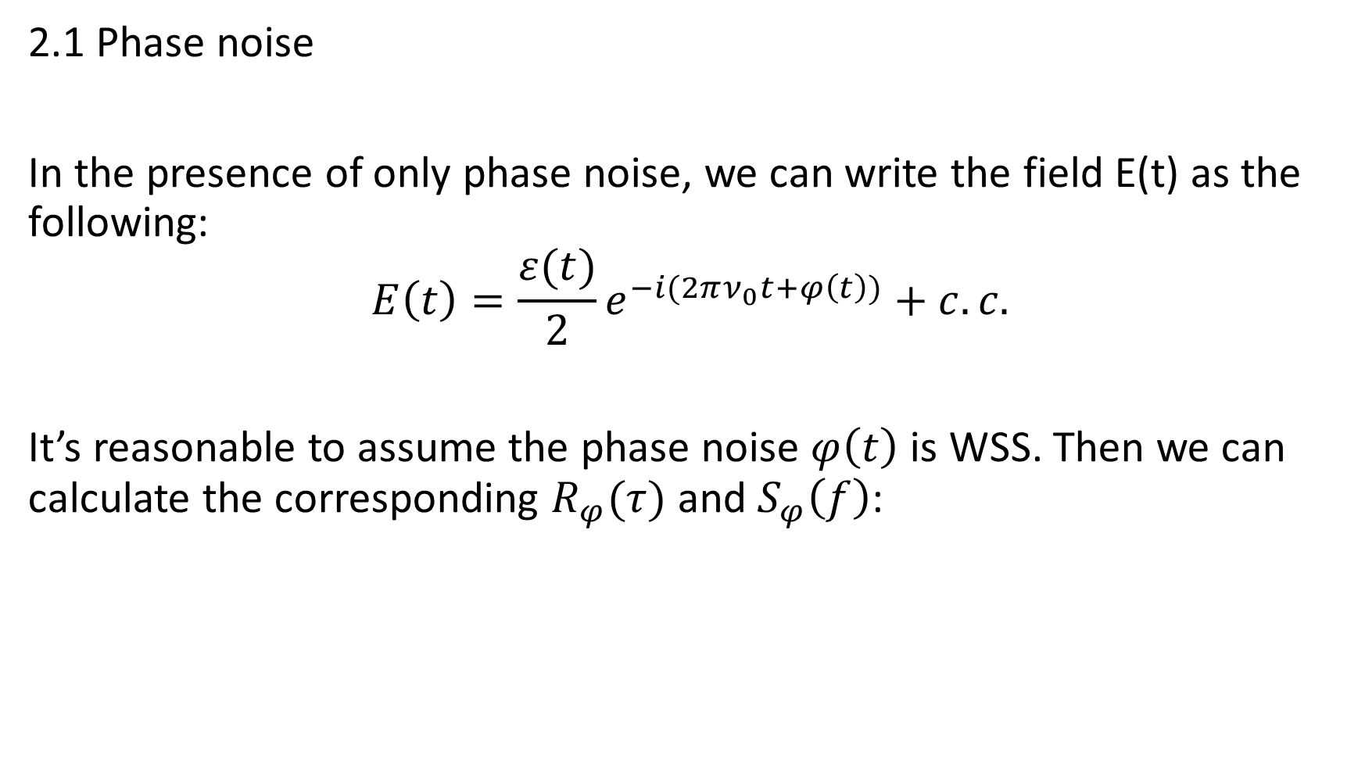
2.1 Phase noise
In the presence of only phase noise, we can write the field E(t) as the following:
$$E\left(t\right)=\frac{ε(t)}{2}e^{−i(2πν_{0}t+φ\left(t\right))}+c.c.$$
It’s reasonable to assume the phase noise $φ\left(t\right)$ is WSS. Then we can calculate the corresponding $R_{φ}(τ)$ and $S_{φ}\left(f\right)$:

Slide 13
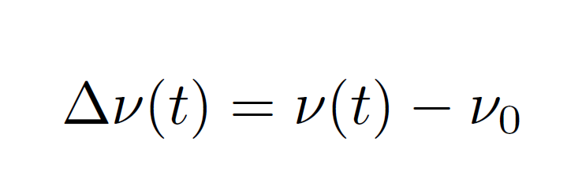
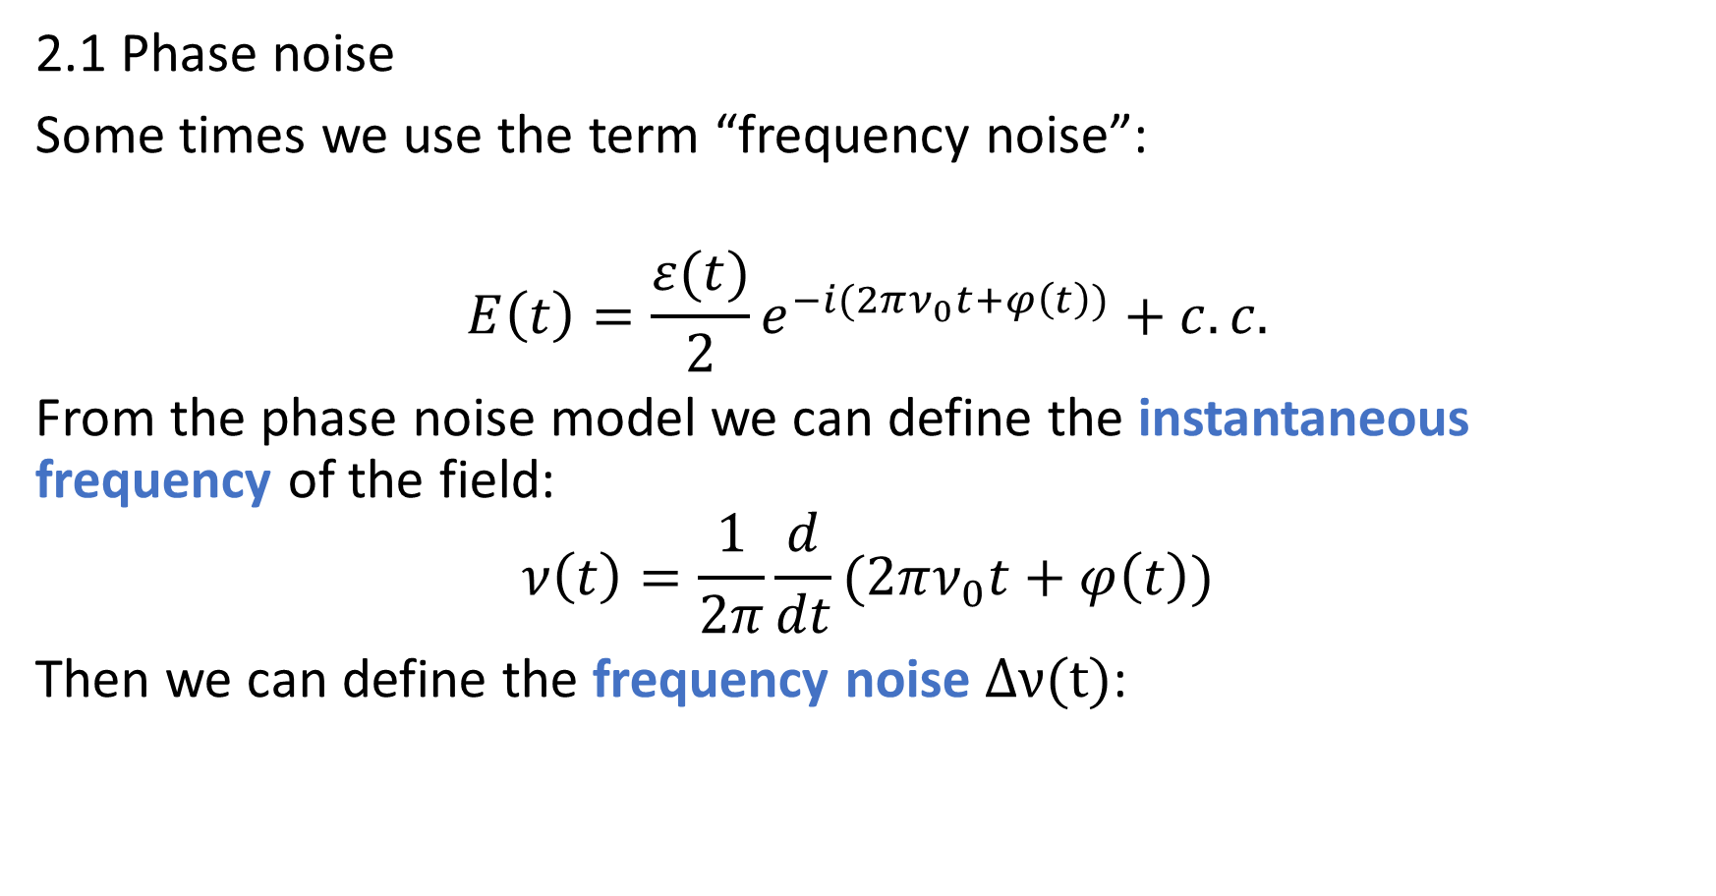
2.1 Phase noise
Some times we use the term “frequency noise”:
$$E\left(t\right)=\frac{ε(t)}{2}e^{−i(2πν_{0}t+φ\left(t\right))}+c.c.$$
From the phase noise model we can define the instantaneous frequency of the field:
$$ν\left(t\right)=\frac{1}{2π}\frac{d}{dt}(2πν_{0}t+φ\left(t\right))$$
Then we can define the frequency noise $Δν(t)$:

Slide 14
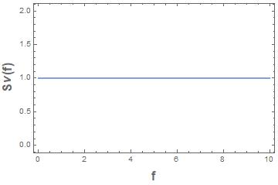
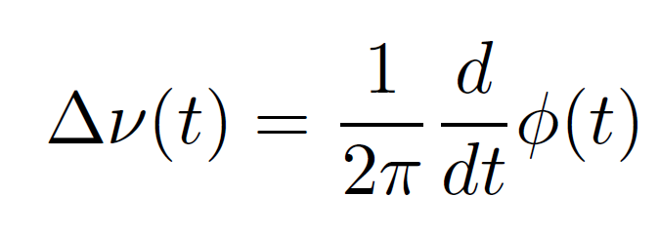
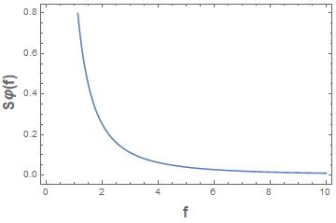
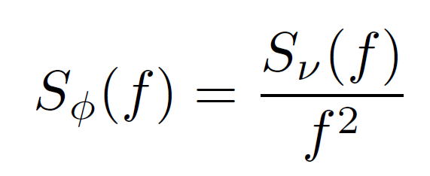
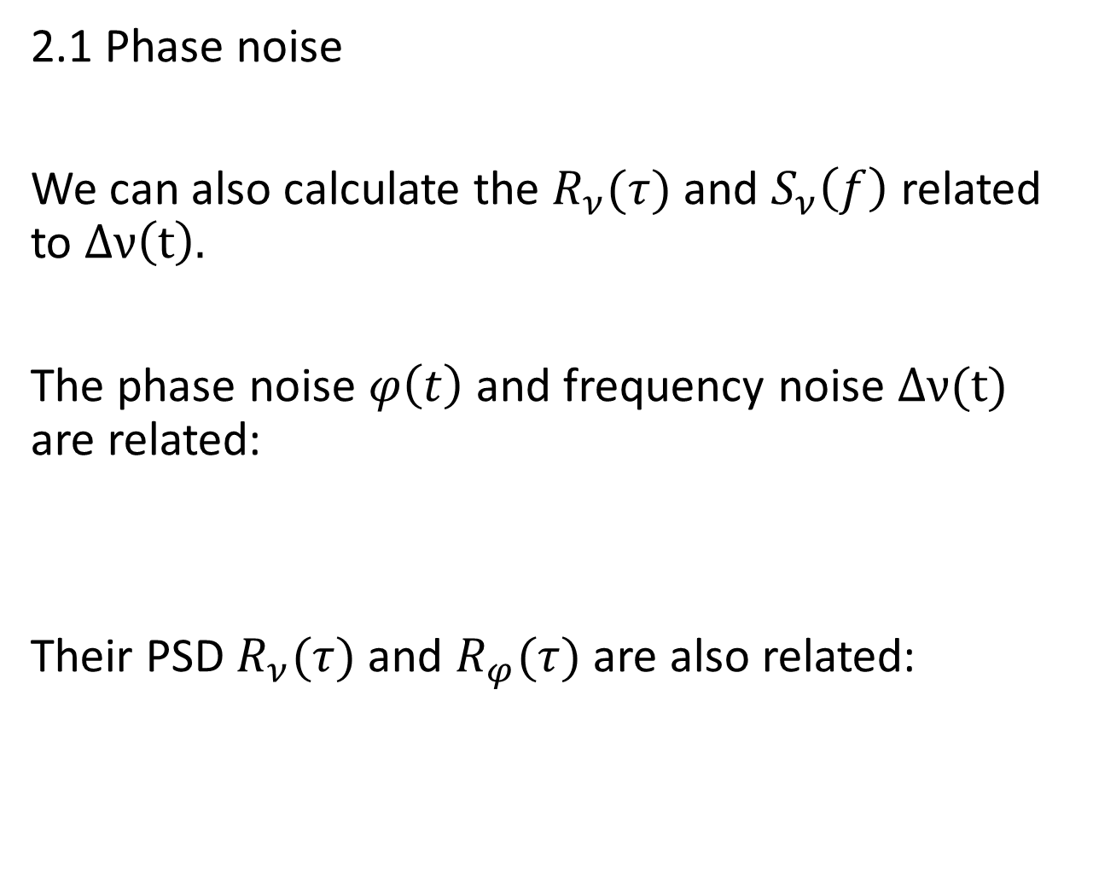
2.1 Phase noise
We can also calculate the $R_{ν}(τ)$ and $S_{ν}\left(f\right)$ related to $Δν\left(t\right).$
The phase noise $φ\left(t\right)$and frequency noise $Δν(t)$ are related:
Their PSD $R_{ν}(τ)$ and $R_{φ}(τ)$ are also related:
Example: White noise

Slide 15
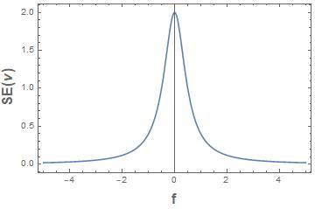

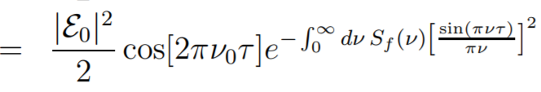
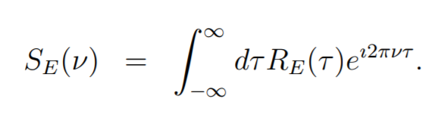
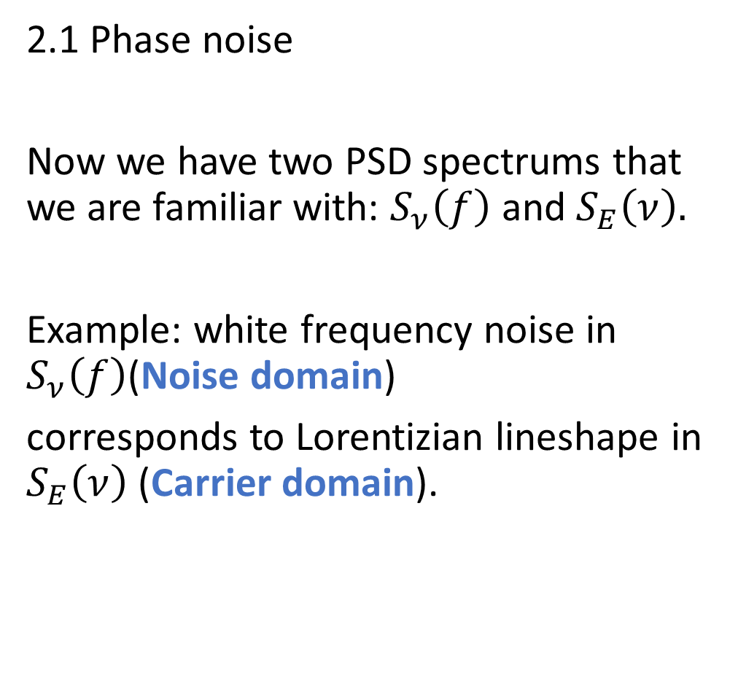
2.1 Phase noise
Now we have two PSD spectrums that we are familiar with: $S_{ν}\left(f\right)$ and $S_{E}\left(ν\right).$
Example: white frequency noise in $S_{ν}\left(f\right)$(Noise domain)
corresponds to Lorentizian lineshape in $S_{E}\left(ν\right)$ (Carrier domain).

Slide 16
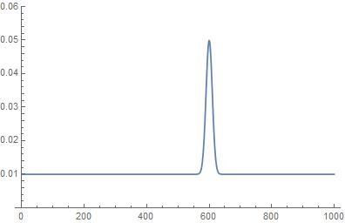
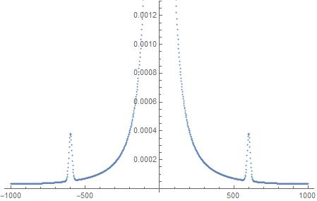


2.1 Phase noise
$S_{ν}\left(f\right)$ : white noise +bump
$S_{E}\left(ν\right)$

Slide 17
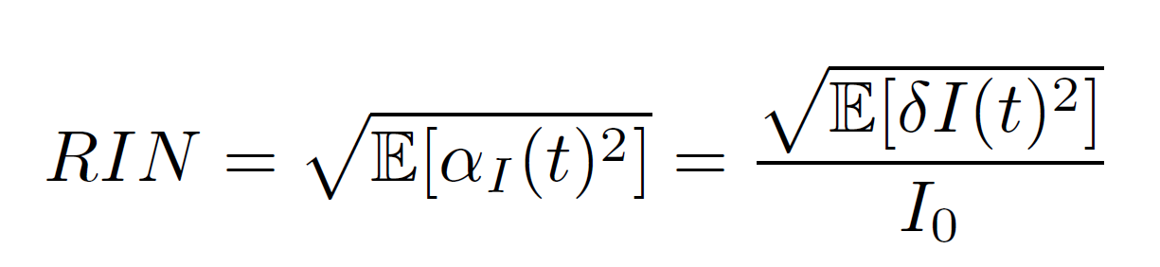
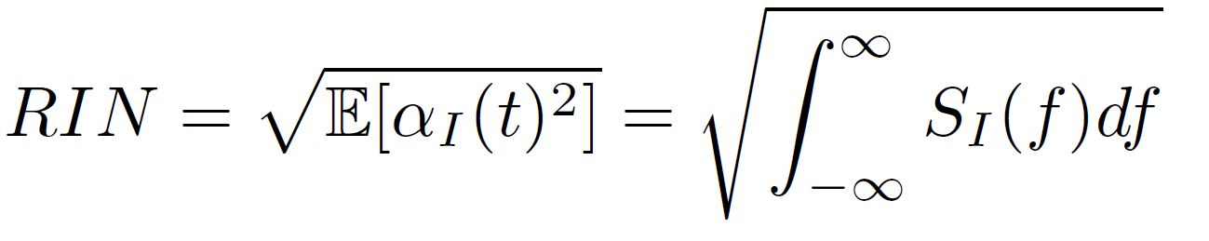
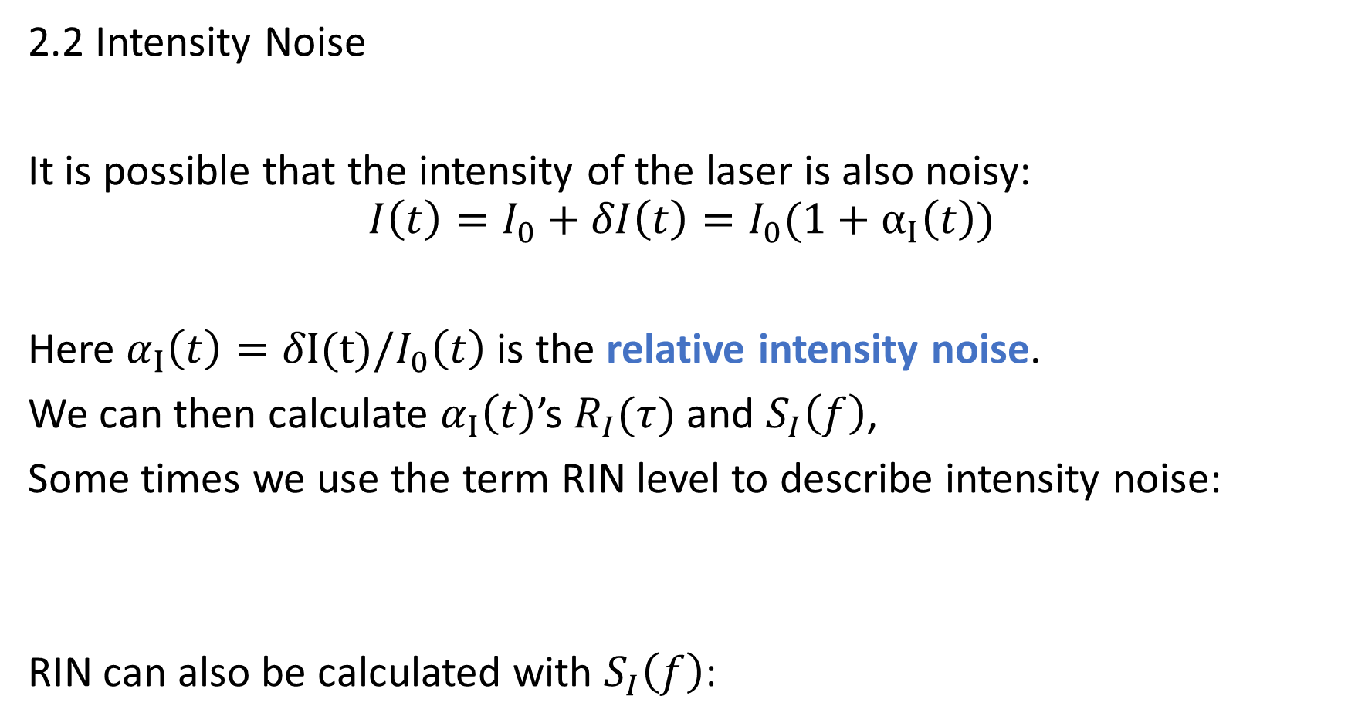
2.2 Intensity Noise
It is possible that the intensity of the laser is also noisy:
$$I\left(t\right)=I_{0}+δI\left(t\right)=I_{0}(1+α_{Ι}\left(t\right))$$
Here $α_{Ι}\left(t\right)=δI(t)/I_{0}\left(t\right)$ is the relative intensity noise.
We can then calculate $α_{Ι}\left(t\right)$’s $R_{I}(τ)$ and $S_{I}\left(f\right)$,
Some times we use the term RIN level to describe intensity noise:
RIN can also be calculated with $S_{I}\left(f\right)$:

Slide 18
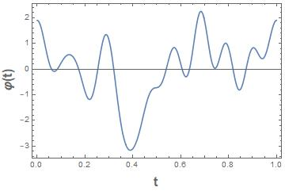

2.3 Noise generation:
Having known/measured the PSD of the noise signals($S_{E}\left(ν\right)$, $S_{I}\left(f\right)$), οne can use the method introduced in 1.3 to generate a sample path for corresponding noise.

Slide 19
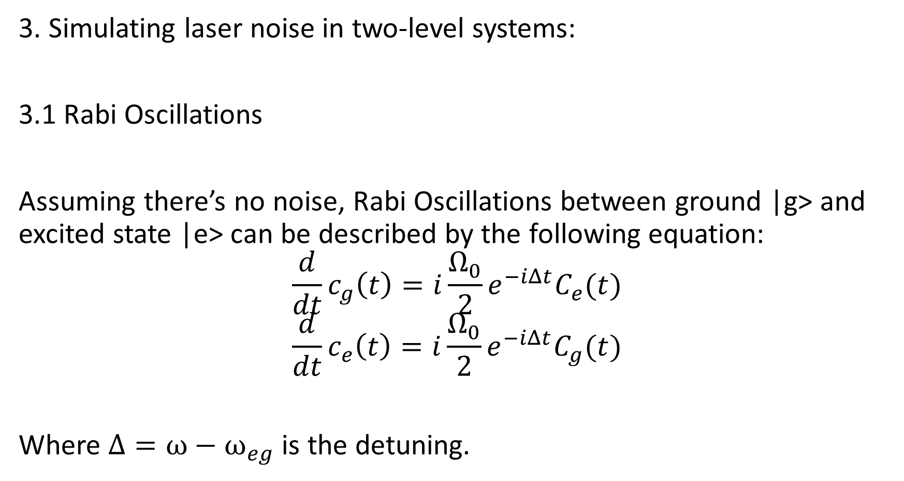
3. Simulating laser noise in two-level systems:
3.1 Rabi Oscillations
Assuming there’s no noise, Rabi Oscillations between ground |g> and excited state |e> can be described by the following equation:
$$\frac{d}{dt}c_{g}\left(t\right)=i\frac{Ω_{0}}{2}e^{−iΔt}C_{e}(t)$$
$$\frac{d}{dt}c_{e}\left(t\right)=i\frac{Ω_{0}}{2}e^{−iΔt}C_{g}(t)$$
Where $Δ={ω−ω}_{eg}$ is the detuning.

Slide 20
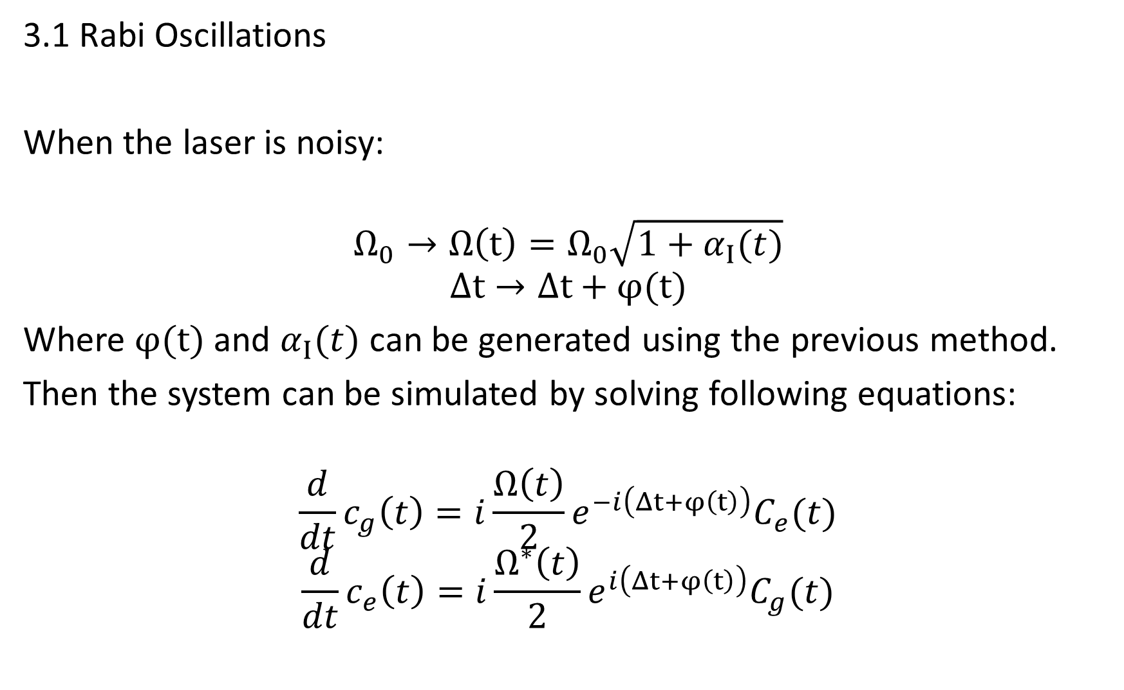
3.1 Rabi Oscillations
When the laser is noisy:
$$Ω_{0}→Ω\left(t\right)=Ω_{0}\sqrt{1+α_{Ι}(t)}$$
$$Δt→Δt+φ(t)$$
Where $φ(t)$ and $α_{Ι}(t)$ can be generated using the previous method.
Then the system can be simulated by solving following equations:
$$\frac{d}{dt}c_{g}\left(t\right)=i\frac{Ω\left(t\right)}{2}e^{−i\left(Δt+φ\left(t\right)\right)}C_{e}(t)$$
$$\frac{d}{dt}c_{e}\left(t\right)=i\frac{Ω^{∗}\left(t\right)}{2}e^{i\left(Δt+φ\left(t\right)\right)}C_{g}(t)$$

Slide 21
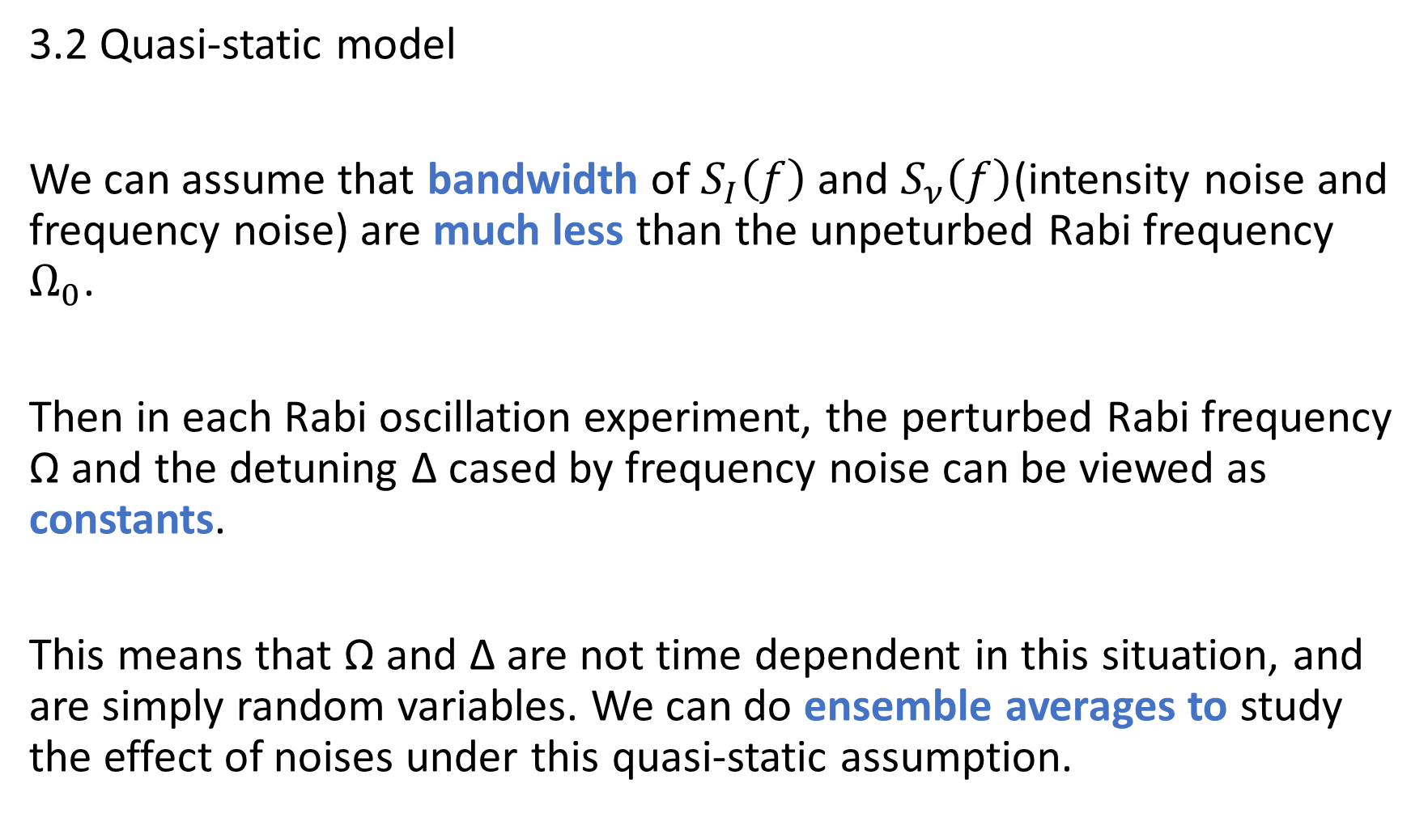
3.2 Quasi-static model
We can assume that bandwidth of $S_{I}\left(f\right)$ and $S_{ν}\left(f\right)$(intensity noise and frequency noise) are much less than the unpeturbed Rabi frequency $Ω_{0}$.
Then in each Rabi oscillation experiment, the perturbed Rabi frequency Ω and the detuning Δ cased by frequency noise can be viewed as constants.
This means that Ω and Δ are not time dependent in this situation, and are simply random variables. We can do ensemble averages to study the effect of noises under this quasi-static assumption.

Slide 22
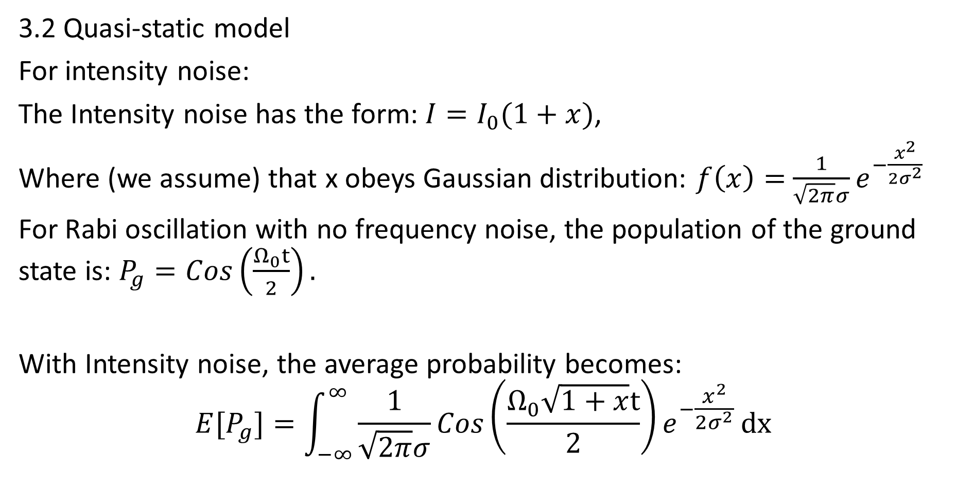
3.2 Quasi-static model
For intensity noise:
The Intensity noise has the form: $I=I_{0}(1+x)$,
Where (we assume) that x obeys Gaussian distribution: $f\left(x\right)=$ $\frac{1}{\sqrt{2π}σ}e^{−\frac{x^{2}}{2σ^{2}}}$
For Rabi oscillation with no frequency noise, the population of the ground state is: $P_{g}=Cos\left(\frac{Ω_{0}t}{2}\right).$
With Intensity noise, the average probability becomes:
$${E[P}_{g}]=\int_{−∞}^{∞}{\frac{1}{\sqrt{2π}σ}{Cos\left(\frac{Ω_{0}\sqrt{1+x}t}{2}\right)e}^{−\frac{x^{2}}{2σ^{2}}}}dx$$

Slide 23
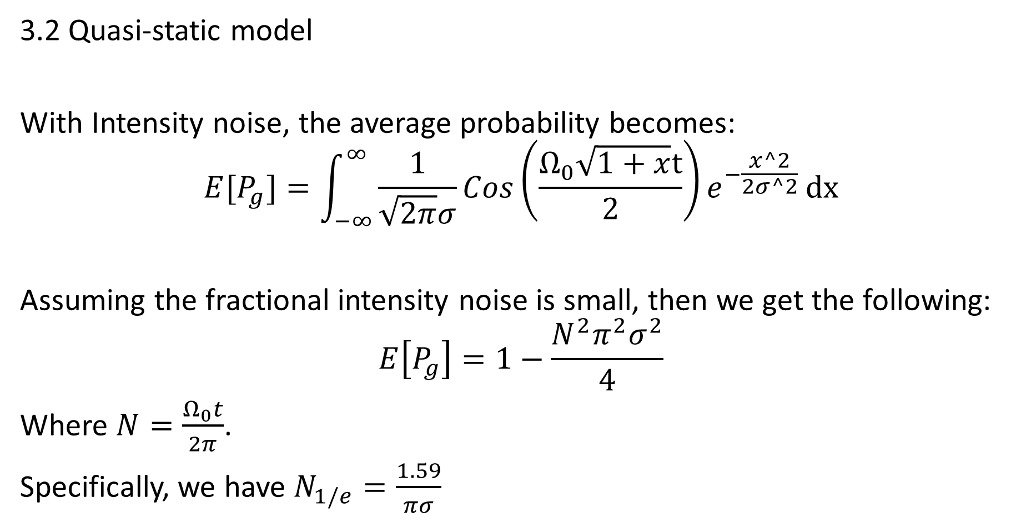
3.2 Quasi-static model
With Intensity noise, the average probability becomes:
$$E[P_{g}]=\int_{−∞}^{∞}{\frac{1}{\sqrt{2π}σ}{Cos\left(\frac{Ω_{0}\sqrt{1+x}t}{2}\right)e}^{−\frac{x^2}{2σ^2}}}dx$$
Assuming the fractional intensity noise is small, then we get the following:
$$E\left[P_{g}\right]=1−\frac{N^{2}π^{2}σ^{2}}{4}$$
Where $N=\frac{Ω_{0}t}{2π}$.
Specifically, we have $N_{1/e}=\frac{1.59}{πσ}$

Slide 24
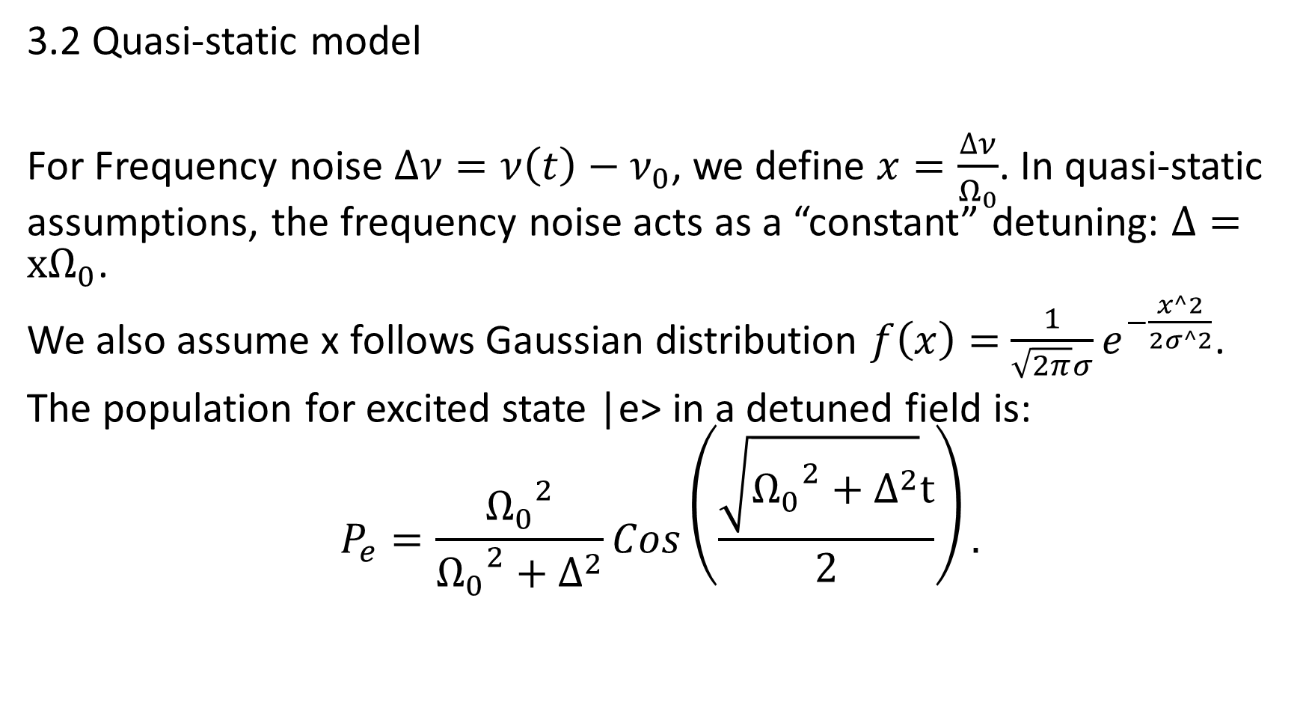
3.2 Quasi-static model
For Frequency noise $∆ν=ν\left(t\right)−ν_{0}$, we define $x=\frac{∆ν}{Ω_{0}}$. In quasi-static assumptions, the frequency noise acts as a “constant” detuning: $Δ=xΩ_{0}$.
We also assume x follows Gaussian distribution $f\left(x\right)=$ $\frac{1}{\sqrt{2π}σ}e^{−\frac{x^2}{2σ^2}}$.
The population for excited state |e> in a detuned field is:
$$P_{e}=\frac{{Ω_{0}}^{2}}{{Ω_{0}}^{2}+∆^{2}}Cos\left(\frac{\sqrt{{Ω_{0}}^{2}+∆^{2}}t}{2}\right).$$

Slide 25
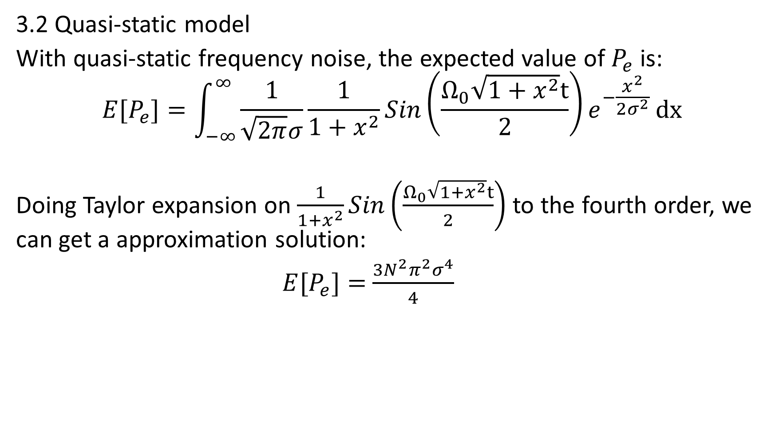
3.2 Quasi-static model
With quasi-static frequency noise, the expected value of $P_{e}$ is:
$$E[P_{e}]=\int_{−∞}^{∞}{\frac{1}{\sqrt{2π}σ}{\frac{1}{1+x^{2}}Sin\left(\frac{Ω_{0}\sqrt{1+x^{2}}t}{2}\right)e}^{−\frac{x^{2}}{2σ^{2}}}}dx$$
Doing Taylor expansion on $\frac{1}{1+x^{2}}Sin\left(\frac{Ω_{0}\sqrt{1+x^{2}}t}{2}\right)$ to the fourth order, we can get a approximation solution:
$E[P_{e}]=$ $\frac{{3N}^{2}π^{2}σ^{4}}{4}$

Slide 26
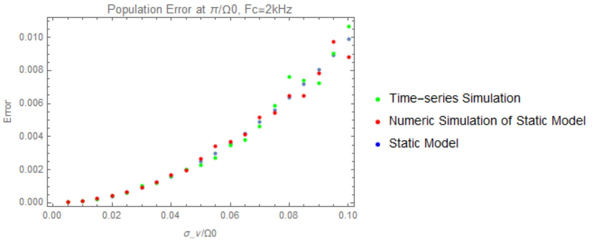
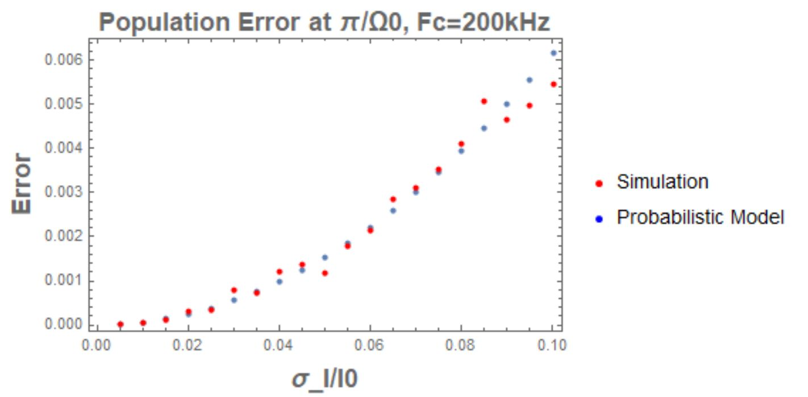
3.3 Quasi-static model vs simulations
Simulations shows agreement between numerical results(3.1) and quasi-static model(3.2):
Frequency noise: Intensity noise:
White Noise

Slide 27
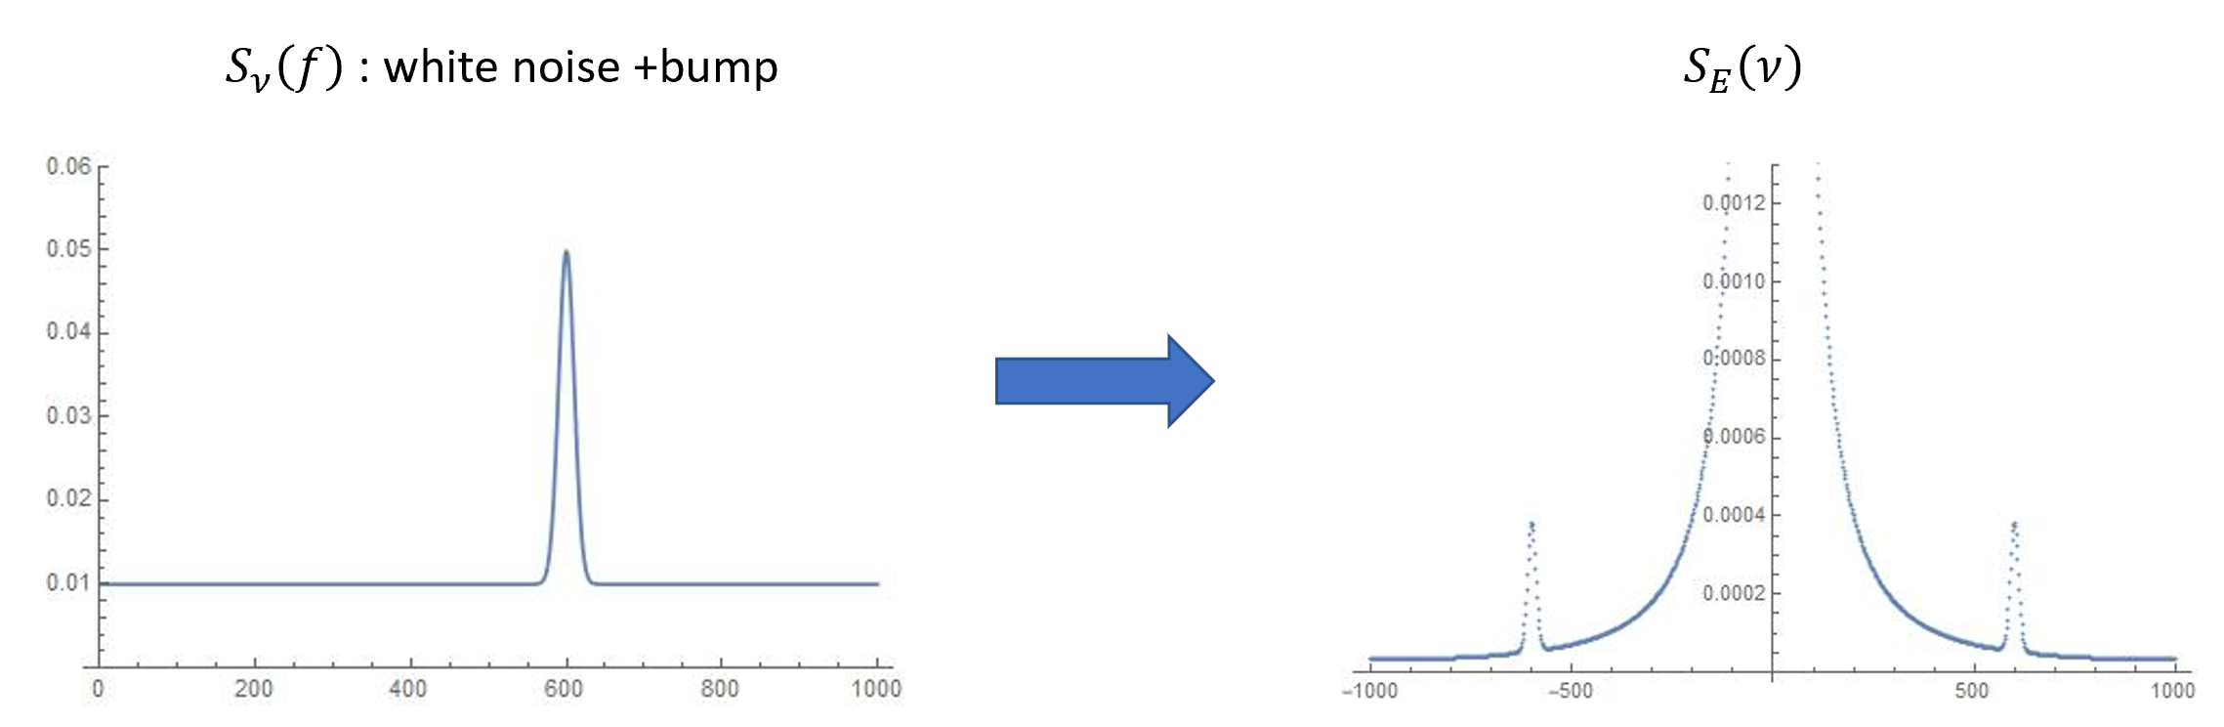

3.4 Servo bumps in carrier domain
To start with: assume a Gaussian-structure bump in $S_{ν}\left(f\right)$:
$$S_{ν}\left(f\right)=h_{0}+\frac{h_{1}}{\sqrt{2π}σ_{w}}e^{−\frac{{(f−f_{center})}^{2}}{2{σ_{w}}^{2}}}$$

Slide 28


3.4 Servo bumps in carrier domain
Then after converting $S_{ν}\left(f\right)$ to $S_{E}\left(ν\right)$ with some approximation technique, we find:
$$S_{E}\left(ν\right)=\frac{{Ε_{0}}^{2}h_{0}}{{(ν−ν_{0})}^{2}+{(πh_{0})}^{2}}+\frac{{Ε_{0}}^{2}h_{1}}{{f_{center}}^{2}}[V\left(ν−\left(ν_{0}−f_{center}\right); σ_{w},\frac{πh_{0}}{2}\right)+V\left(ν−\left(ν_{0}+f_{center}\right); σ_{w},\frac{πh_{0}}{2}\right)]$$
where $V\left(x;σ,γ\right)$ is the convolution between a Gaussian and a Lorentzian(Voigt Profile):

Slide 29

3.4 Servo bump in carrier domain
The equation above describes a Lorentzian lineshape carrier, and two Voigt-profile bumps in $S_{E}\left(ν\right)$.
The ratio of power in one of the bumps over the power in the carrier can be calculated:
$$\frac{P_{bump}}{P_{carrier}}=\frac{h_{1}}{{{2f}_{center}}^{2}}$$
With these knowledge, we can:
Set(or actually measure) the offset frequency $f_{center}$ and the dBc level of the bumps $\frac{P_{bump}}{P_{carrier}}$
Calculate the corresponding parameters in $S_{ν}\left(f\right)$
Generate time-varying phase noise and do simulations.

Slide 30




3.4 Servo bump in carrier domain
Simulation results for π pulse Rabi-flopping error while sweeping bump frequencies. Bump power=-10 dBc.
$$P_{error}$$
$$P_{error}$$
$$f_{center}/Ω_{0}$$

Slide 31
4. Work to be done
Coherence
Two photon Rabi Oscillations
Other noisy systems…

Slide 32

References & Useful Materials:
Marks’ atomic notes.
My note ResearchProjects/AQuA/AQuALabNotes/laserSystems/NoiseSimulation
Riehle, Fritz. Frequency standards: basics and applications. John Wiley & Sons, 2006.
Gubner, John A. Probability and random processes for electrical and computer engineers. Cambridge University Press, 2006.

Slide 33
Thank You!

