Slide 2
Improving the Efficiency of
SHG with Critical Phase Matching
Xiaoyu Jiang
08/25/2017

Slide 3

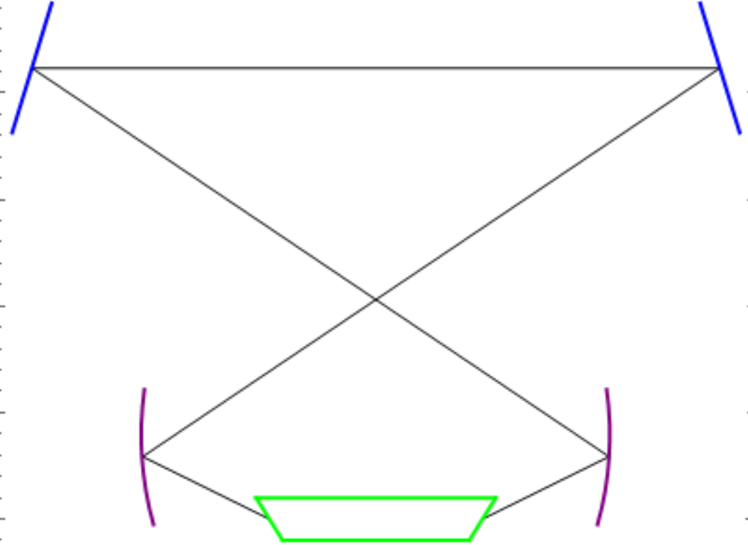
952nm->476nm
LBO crystal with Brewster cut
(ladder-shaped)
Critical Phase Matching
Bow-tie cavity
Second Harmonic Generation(SHG):
High efficiency SHG:
Meet phase-matching condition
High pumping intensity in the crystal
952nm
476nm
https://www.rp-photonics.com/frequency_doubling.html

Slide 4
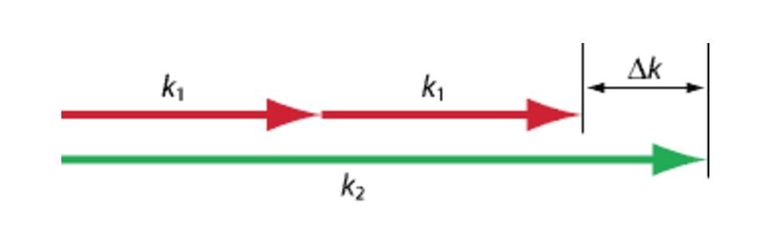
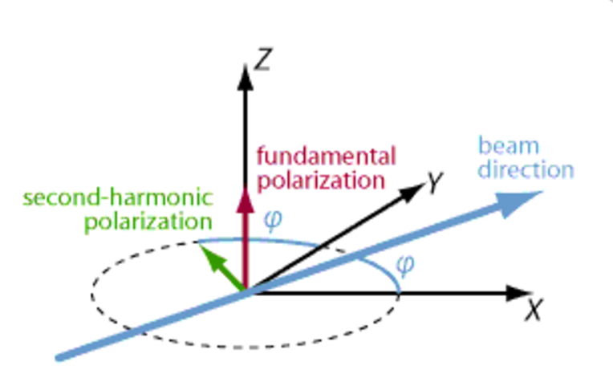
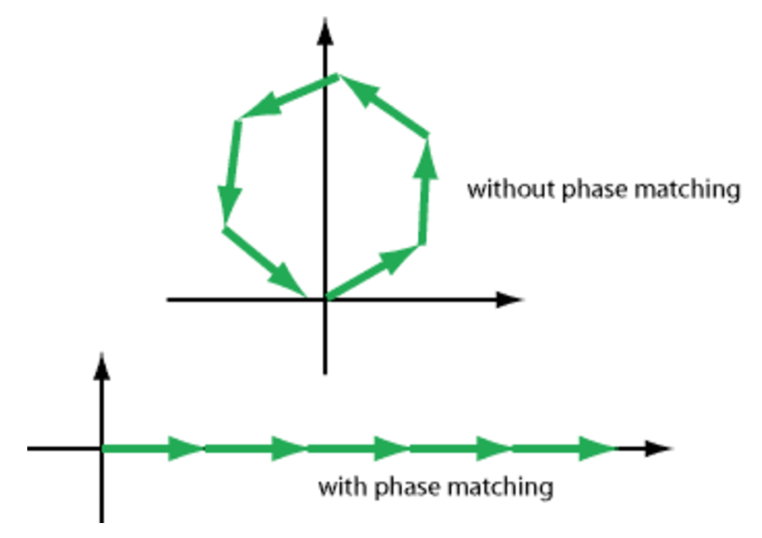
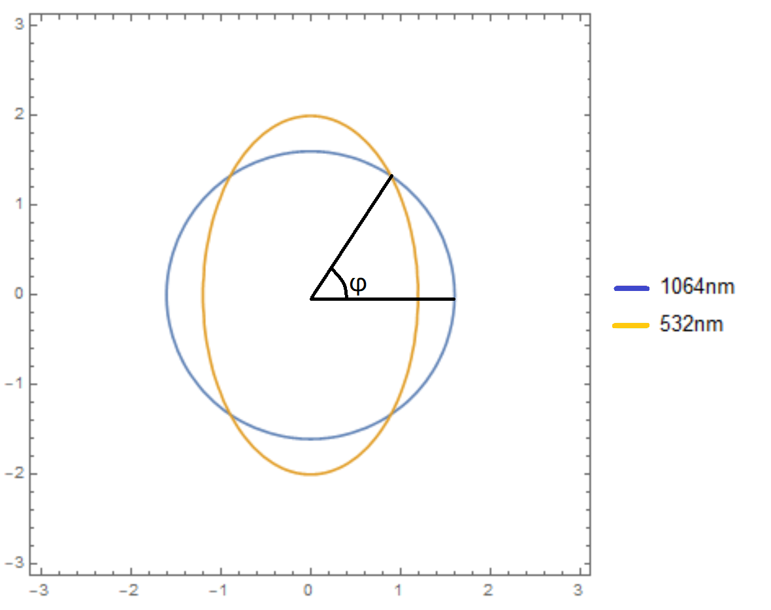




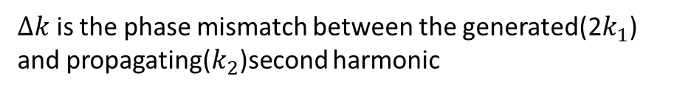



Phase matching: Critical phase matching:
$$n_{z}$$
$Δk=\frac{4π}{λ}(n_{2ω}$- $n_{ω})$
$$n_{x}$$
$∆k$ is the phase mismatch between the generated(2$k_{1}$) and propagating($k_{2}$)second harmonic
$$n_{y}$$
https://www.rp-photonics.com/critical_phase_matching.html
$n_{z,ω}=$ $n_{xy, 2ω}$
$$n_{2ω}$$
$$n_{ω}$$
https://www.rp-photonics.com/phase_matching.html

Slide 5
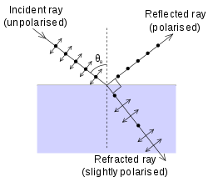
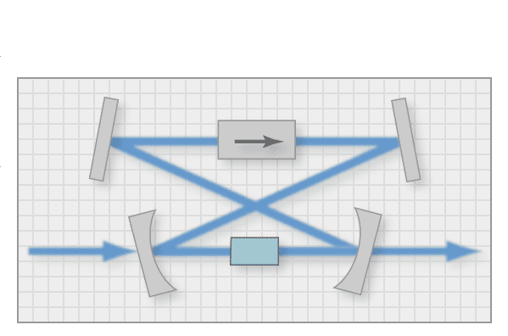
High intensity in the crystal:
Use Brewster-cut surface: reduce reflection loss
Cavity: power built up in the cavity increases SHG.
https://en.wikipedia.org/wiki/Brewster%27s_angle

Slide 6
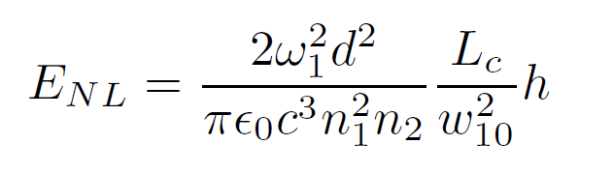
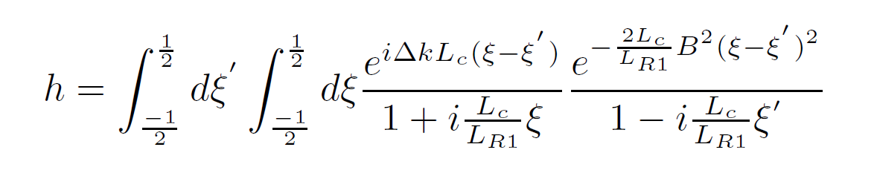


Cavity design:
---$E_{NL}:$Single Pass Efficiency
There’s an optimal beam waist $ω_{BK}$ to maximize $E_{NL}(\text{Boyd}\text{, }\text{Kleinman} \text{J}\text{. }\text{Appl}\text{. }\text{Phys}\text{. 39, 3597 (1968))}$
, ,
Shape the beam waist to $ω_{BK}$ by changing the parameters of the cavity.

Slide 7
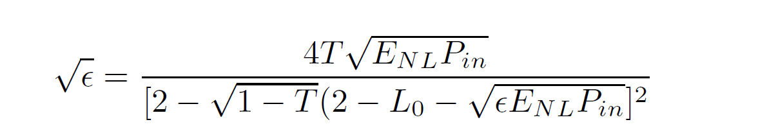

Cavity design:
---$ε$=$P_{out}/P_{in}$ : Power conversion efficiency
Maximize $ε$ by finding an optimal transmission coefficient T.
L0=1%

Slide 8
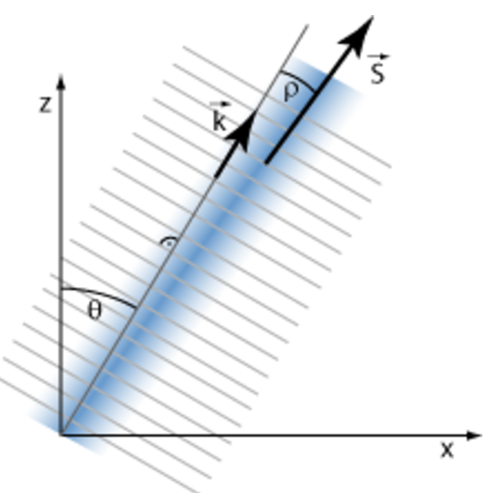
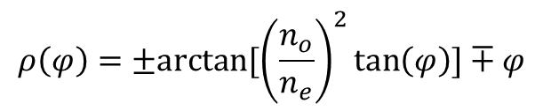




Spatial walk-off:
$D=εE$ ,
$S=E×H$
$$n_{z}$$
$$n_{x}$$
$$n_{y}$$
$$ρ\left(φ\right)=±arctan[{\left(\frac{n_{o}}{n_{e}}\right)}^{2}\tan\left(φ\right)]∓φ⁡$$
https://www.rp-photonics.com/spatial_walk_off.html

Slide 9
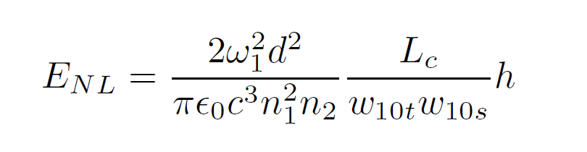
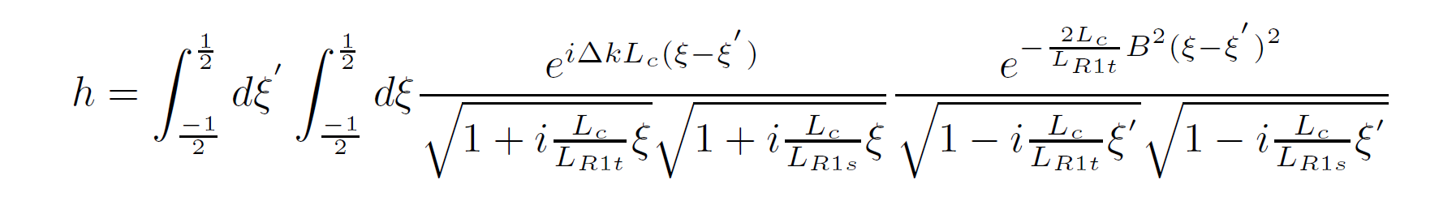
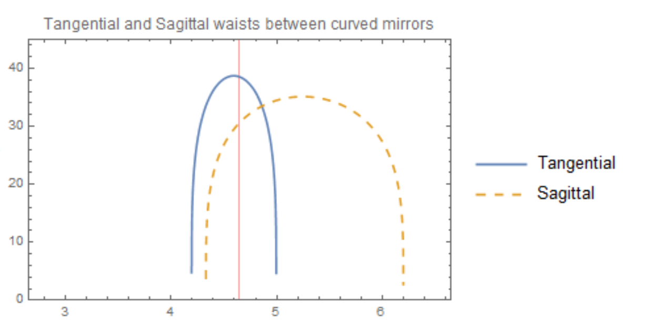
B-K optimization:
With walk off, it’s beneficial to make the beam waist in the crystal elliptic(Steinbach et.al, 1995):

Slide 10
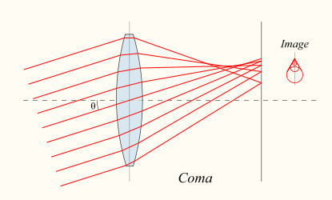
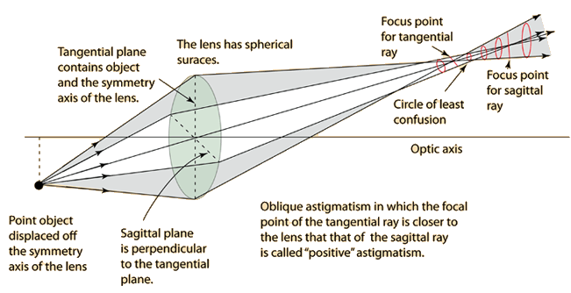
Brewster-cut Off-axes beams Abberations(coma, astigmatism)
Solution(Dunn and Ferguson, 1977): Self-compensate the abberations by choosing appropriate R and α
https://en.wikipedia.org/wiki/Coma_(optics)
α
R
R
http://hyperphysics.phy-astr.gsu.edu/hbase/geoopt/coma.html

