Slide 1
Neutral Atom Implementation of the Surface Code
Xiaoyu Jiang
Saffman Group Meeting Talk
12/15/2020

Slide 2
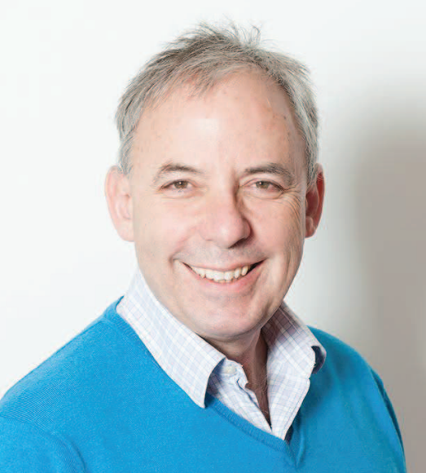
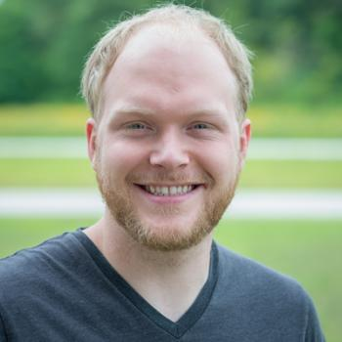
Surface code, in brief
Surface code with neutral atoms
Mark Saffman
Matt Otten
HRL Laboratory

Slide 3
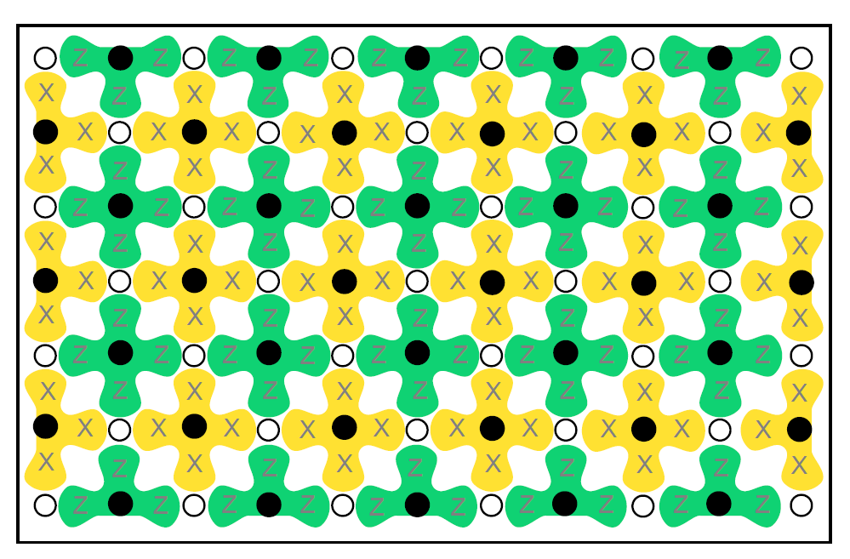
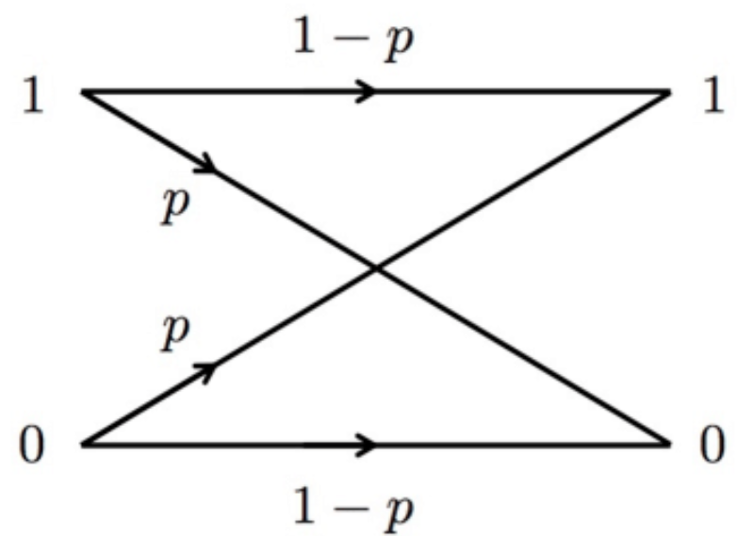
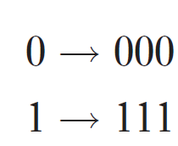
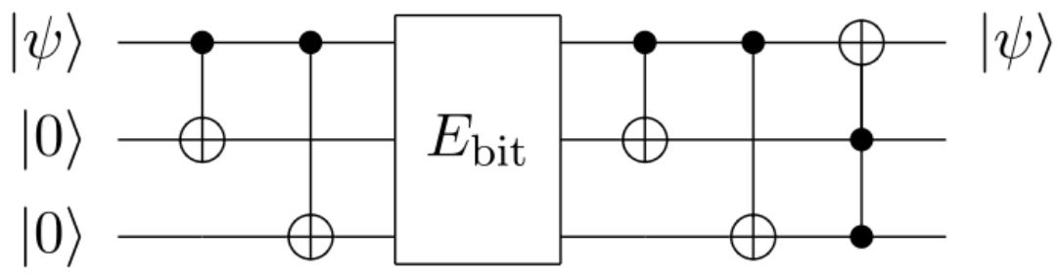
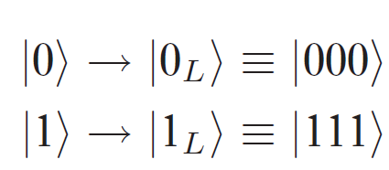
Surface code
● Error-correcting code that uses many physical qubits into a smaller number of logical qubits.
Example:
single (qu)bit-flip error channel
Classical:
Three qubit bit flip code:
Encode
Error
Decode
Correction
Logical Qubits

Slide 4
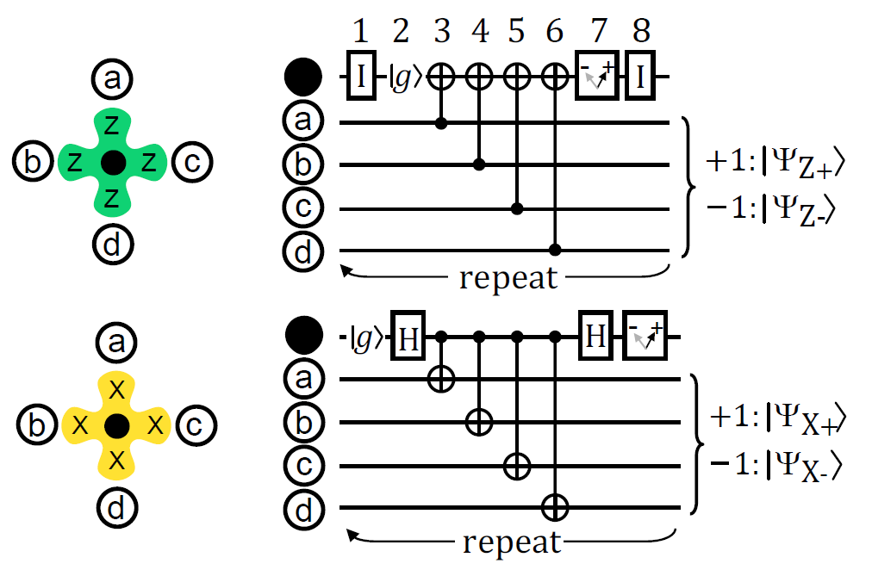


Surface code
● Applies stabilizer measurements to detect syndromes:
white dots: data qubits
black dots: measurement qubits
In one stabilizer measurement, there are
four C-NOTs and one projective measurements on the measurement qubit(syndrome).
Every round of stabilizer measurement is completed over the whole array before the next round begins.

Slide 5
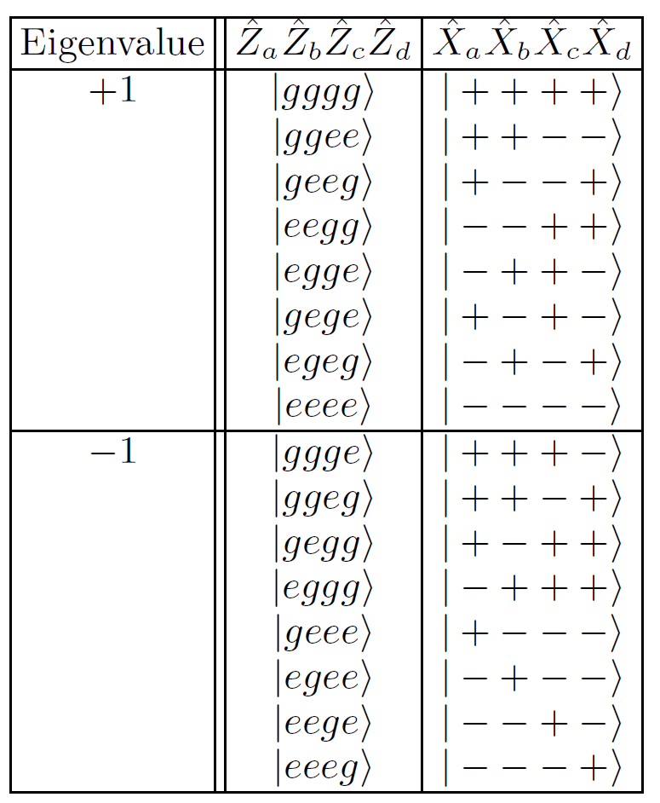
Surface code
● Quiescent state of the stabilizer:
The quiescent state is random selected after 1st round of stabilizer measurements, but is then maintained, unless there is error.

Slide 6
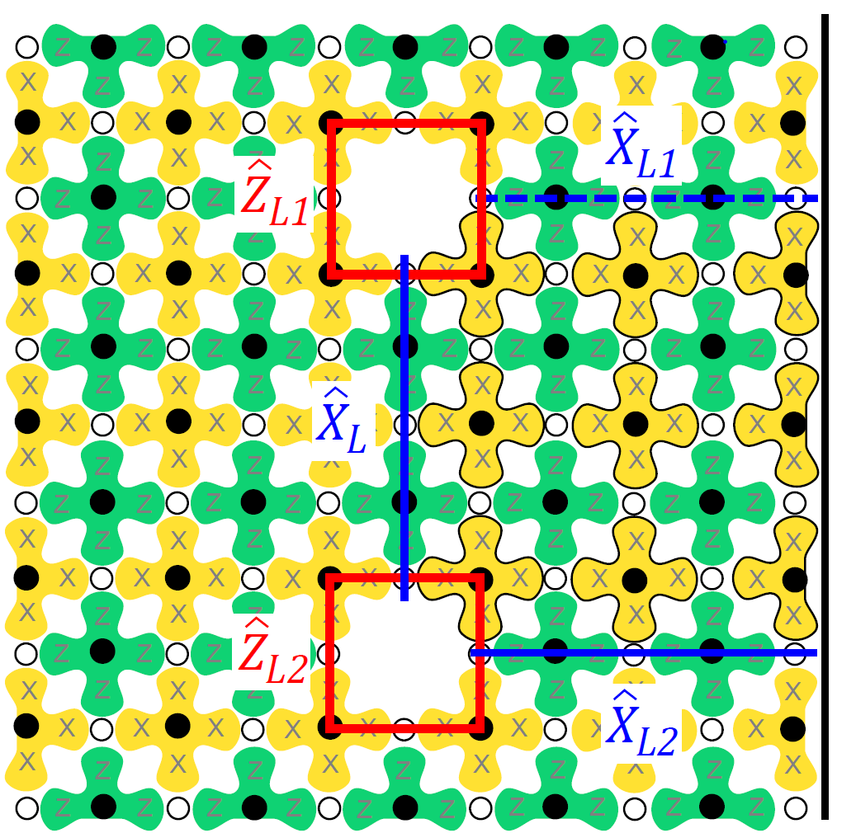
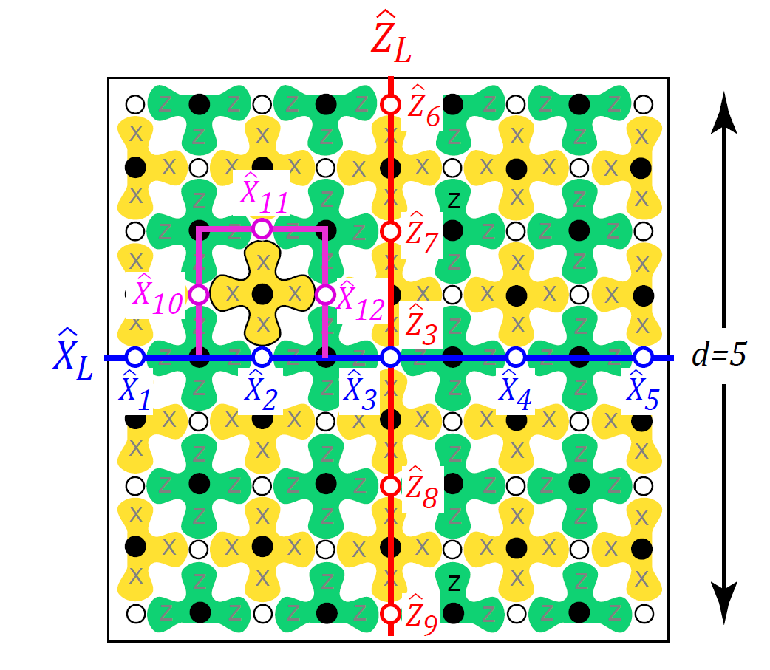


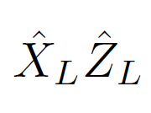
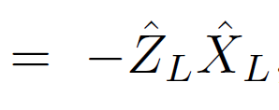
Surface code
● Logical qubits:
41 data qubits=41×2 degrees of freedom.
40 measurement qubits=40×2
restrictions.
2 additional degrees of freedom to define a logical qubit.
One can define:
as the operations on the logical qubit.

Slide 7
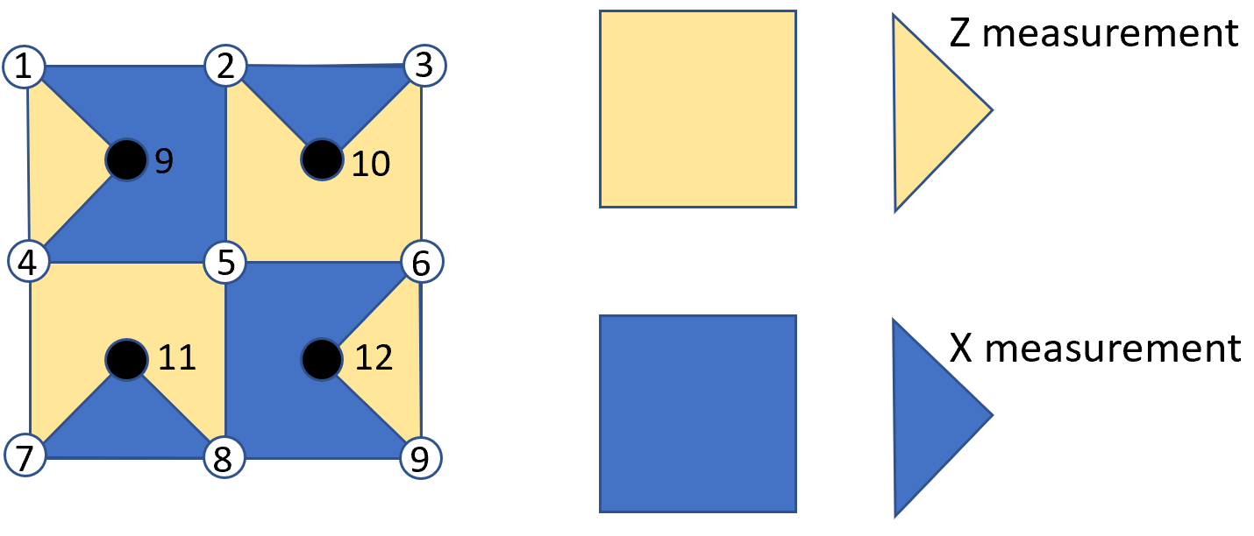
Surface code
● Each round of stabilizer measurements gives a map of syndromes.
● Keep repeating to get a time series of syndrome maps.
● Decode from the syndrome maps to see which qubit is affected by error
● Apply error correction
Example: Surface-13 code

Slide 8
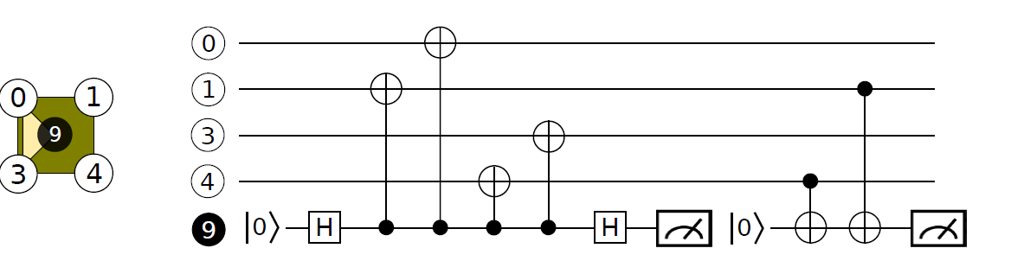
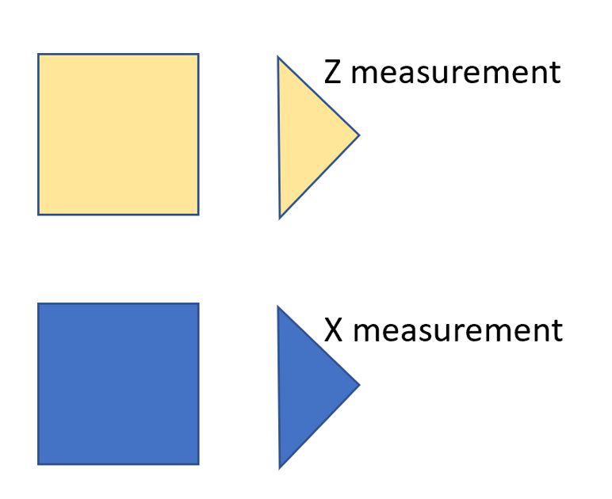
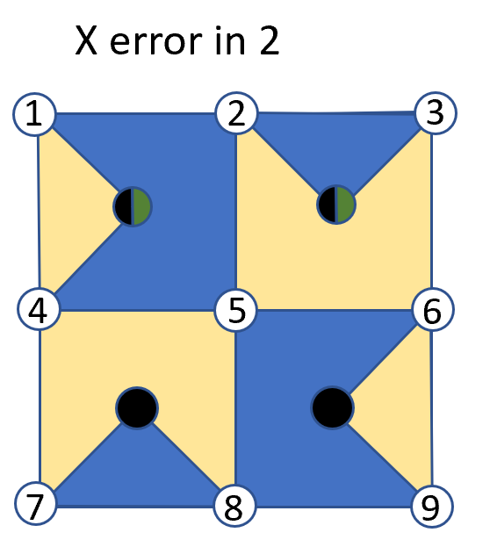
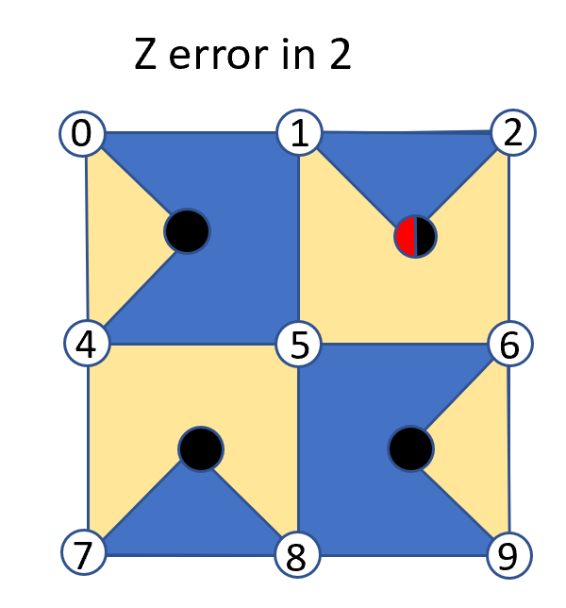
Syndrome Measurement:
Red: Syndrome flips in Z measurement
Green: Syndrome flips in X measurement
Black: No Syndrome flip
Y error in 2
1
2
3
4
5
6
7
8
9

Slide 9
1
Surface code
9
10
Choosing a decoder…
Z error
4
5
6
What could have happened:
● in 2: more likely
● X error in 1 and 3
11
12
7,8
9
1,4
3
2
9
10
5
X error
Decoder:
● Small codes like surface 13: Look-up table
● Larger codes: Minimum weight perfect matching, etc(dependent on noise type)
11
8
12
7
6,9

Slide 10
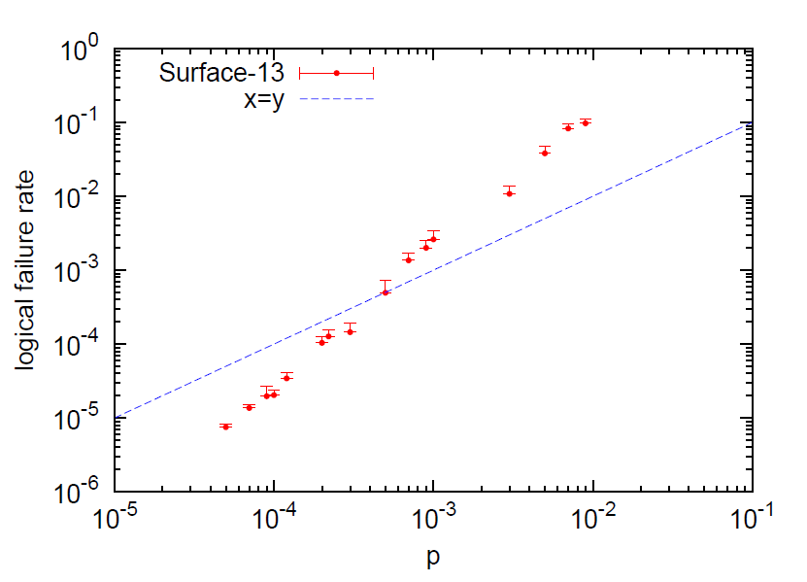
Surface code
The threshold is the maximum physical error rate possible that allows for quantum error correction to lower the logical error rate
To simulate:
Assume a noise model
Define a decoder
Simulate noise, syndrome measurement, decoding
Calculate the threshold
Physical error rate

Slide 11
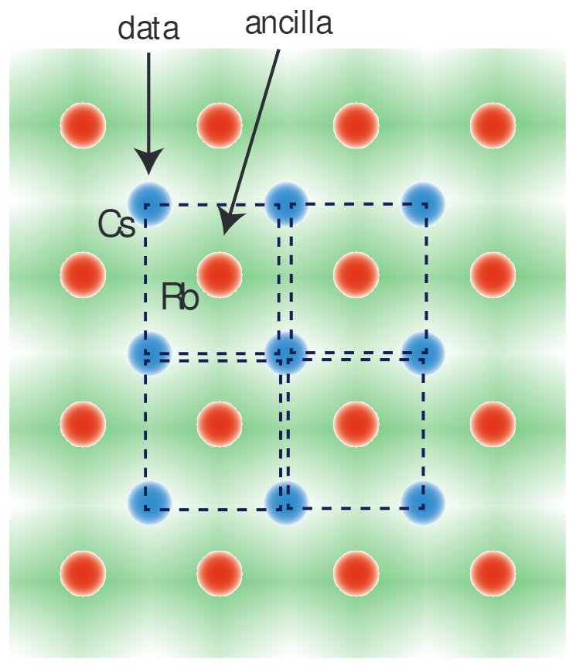
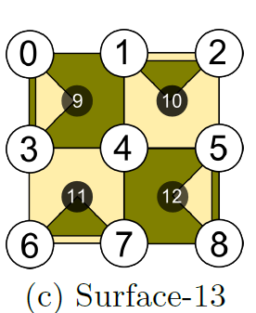
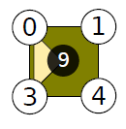
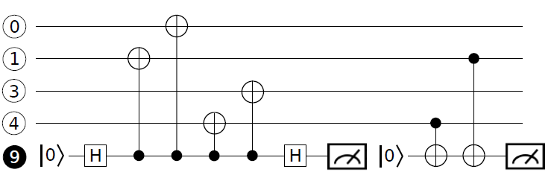
Surface code with neutral atoms
Advantages:
· Scalable and Reconfigurable
· Two-Species configuration supresses crosstalk between data and ancilla qubits

Slide 12
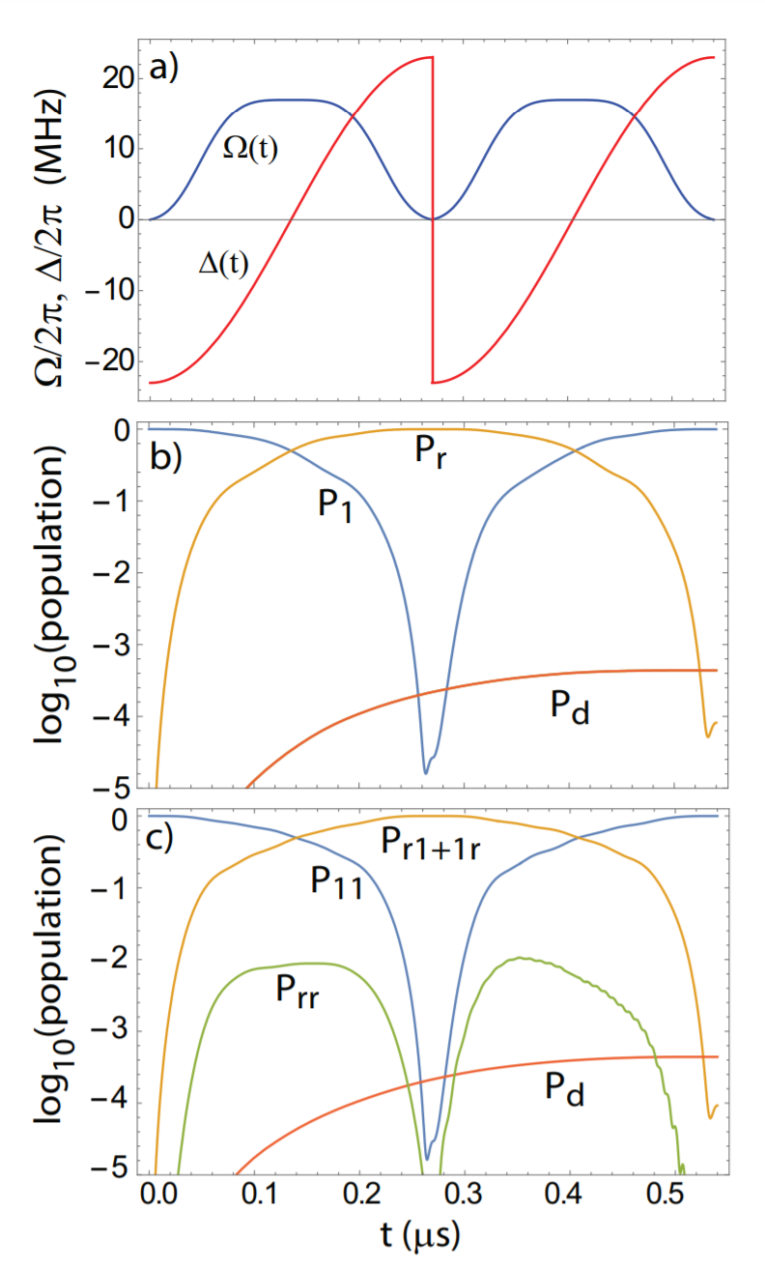
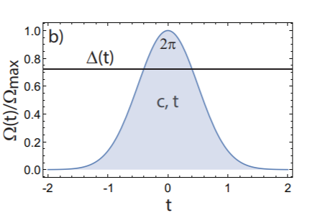
Surface code with neutral atoms
ARP gate
Single-pulse gate

Slide 13
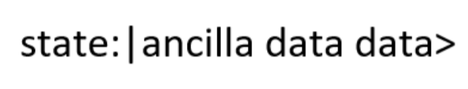
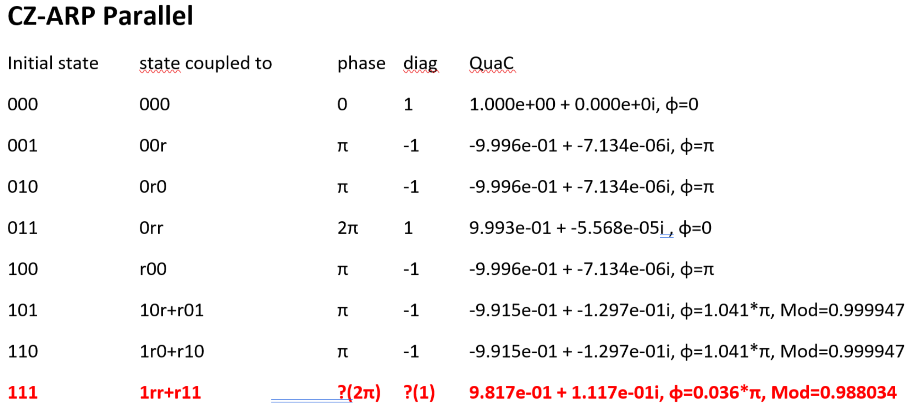
Surface code with neutral atoms
1. Assuming that data qubits don’t interact, can we implement CNOTs in parallel?
There are no local phase operations that can make the parallel CZ-ARP gates equivalent to sequential standard CZ gates
QuaC: https://github.com/0tt3r/QuaC

Slide 14
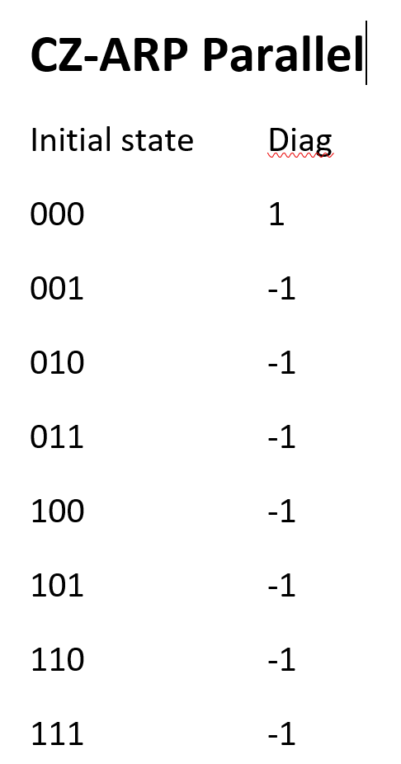
Surface code with neutral atoms
2. What happends if all the 3 qubits interact(blockaded)
Could be a useful way to implement CCZ gates

Slide 15
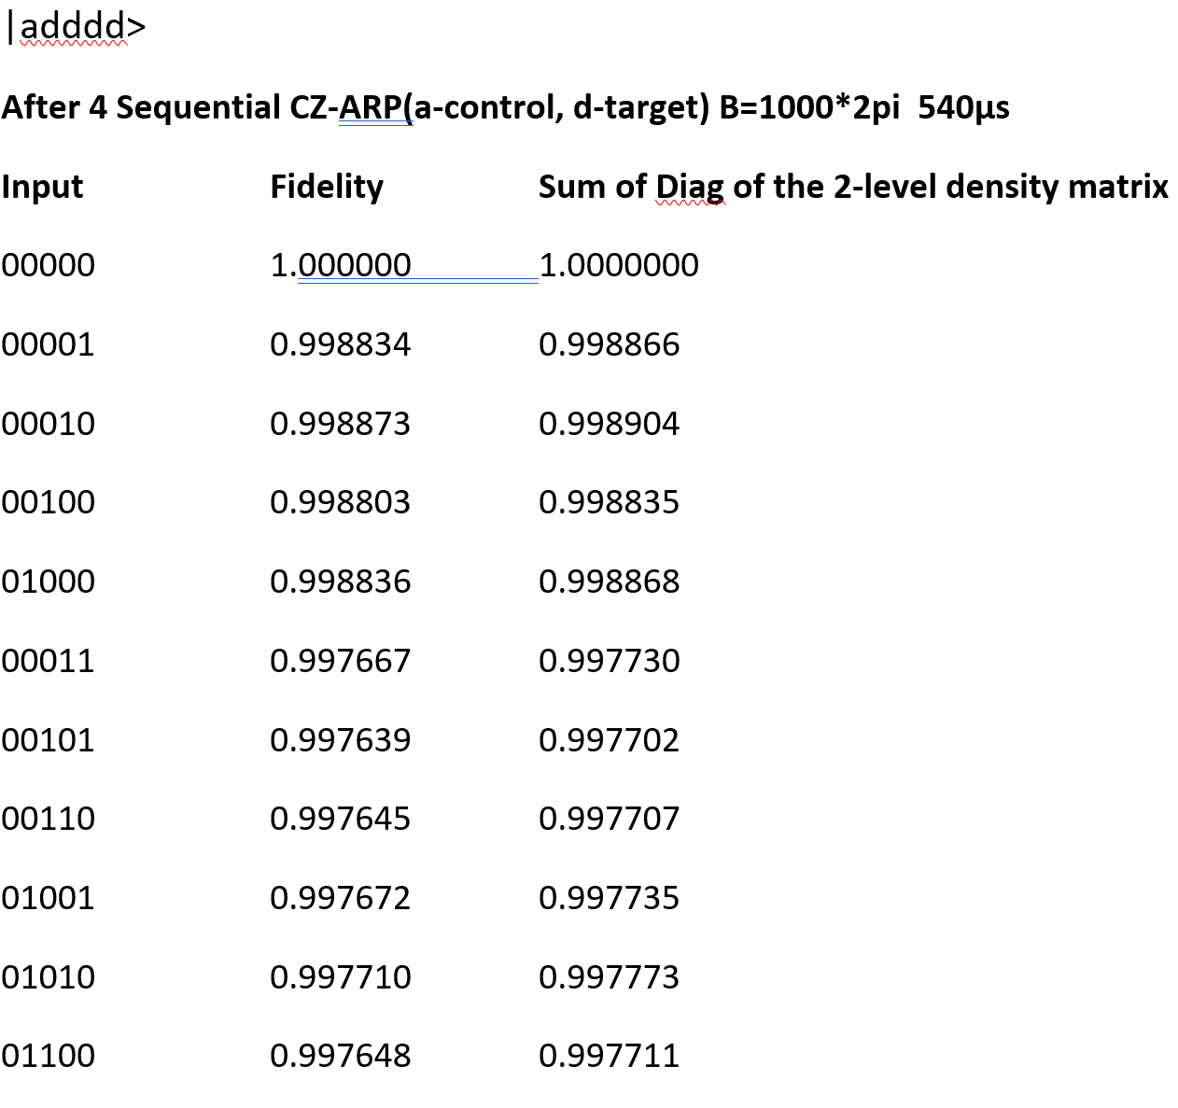
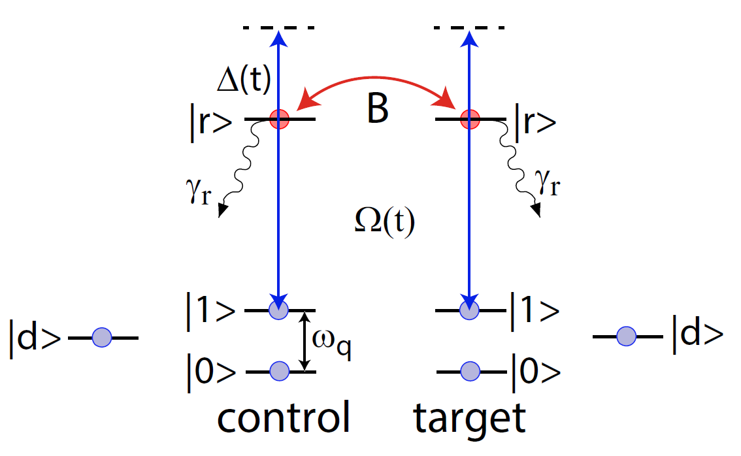
Surface code with neutral atoms
3. Erasure errors(leakage):

Slide 16
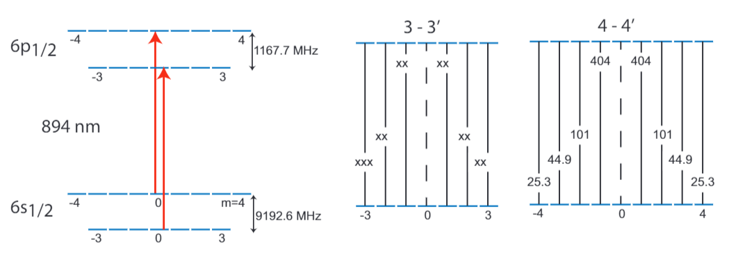
Surface code with neutral atoms
3. Erasure errors(leakage):

Slide 17
Surface code with neutral atoms
3. Erasure errors(leakage):
A pair of π polarized optical fields couple 6s1/2,f= 3 to 6p1/2,f′= 3, and 6s1/2,f= 4 to 6p1/2,f′= 4.

Slide 18
Thanks!
Nielsen, Michael A., and Isaac Chuang. "Quantum computation and quantum information." (2002): 558-559.
Mark’s note for quantum information
Fowler, Austin G., et al. "Surface codes: Towards practical large-scale quantum computation." Physical Review A 86.3 (2012): 032324.
Tomita, Yu, and Krysta M. Svore. "Low-distance surface codes under realistic quantum noise." Physical Review A 90.6 (2014): 062320.
Saffman, M., et al. "Symmetric Rydberg controlled-Z gates with adiabatic pulses." Physical Review A 101.6 (2020): 062309.
Auger, James M., Silvia Bergamini, and Dan E. Browne. "Blueprint for fault-tolerant quantum computation with Rydberg atoms." Physical Review A 96.5 (2017): 052320.
Robicheaux, F., T. M. Graham, and M. Saffman. "Photon recoil and laser focusing limits to Rydberg gate fidelity." arXiv preprint arXiv:2011.09639 (2020).
Beterov, I. I., and M. Saffman. "Rydberg blockade, Förster resonances, and quantum state measurements with different atomic species." Physical Review A 92.4 (2015): 042710.

