Slide 1
Autoyast introduction
Glad to take this chance to share with you what is it and basically what it could help you do, If you like it, there are more things you could work on.
--xjin

Slide 2
Agenda:
- general talk about mass installation steps with autoyast
- details on each step
- examples and references

Slide 3
* steps for mass installation:

Slide 4
- create profile
- determine the source of the profile
- the source of the installation data
- set up boot scenario
- adding para by modify info file
- launch the auto-installation process

Slide 5
1. how to create autoyast profile

Slide 6
- Clone a fresh installation from a reference machine to a set of identical machines (profile saved under /root/autoyast.xml by default)
* after normal installation is done, clone button show up.
- Use the AutoYaST GUI to create and modify a profile to meet your requirements
* launched via yast2-> auto, then UI show up
** there will be a small show for the execution
- Use an XML editor and create a profile from scratch

Slide 7
2. distribute the profile and determine the autoyast parameter

Slide 8
- location of the profile could be passed to the installation routines by means of the boot prompt or an info file that is loaded upon boot
- parameter is transferred as : autoyast=file://path, when the autoyast=pro://ip/path/, if profile to be used is given, then use it directly. Else yast will search profile via the sequence followed in the next page
- there is feature: bind certain profile to client's MAC address
* make MAC address as the profile file name
* then autoyast=http://192.168.1.115/path/

Slide 9
* sequence as below (ip is 192.0.2.91 in this example):
C000025B
C000025
C00002
C0000
C000
C00
C0
C
0080C8F6484C
default

Slide 10
3. providing the installation date

Slide 11
- use info file to pass the server's location to installation routines
- and also could provide it via para: install=pro://ip/path

Slide 12
4. set up boot scenario

Slide 13
- totally auto-inst could be achieved by boot from PXE
- if hardware do not support PXE, could boot from DVD media
- take DVD media for example
* installation media-- server provide profile-- info file to tell location of profile

Slide 14
5. details about info file

Slide 15
- about info file:
a command line file containing all the parameters needed to locate the AutoYaST components, installation sources, and the parameters needed to control the installation process
- one example for info file:
autoyast:profile_source \
install:install_source \
hostip:some_ip \
netmask:some_netmask \
gateway:some_gateway

Slide 16
- The info data can be made available to linuxrc in various different ways:
As a file on a floppy or CD Rom that is in the client's drive at installation time. Add the info parameter similar to info=floppy:/info or info=cd:/info.
As a file in the root directory of the initial RAM disk used for booting the system provided either from custom installation media or via PXE boot.
As part of the AutoYaST profile. In this case, the AutoYaST file needs to be called info to enable linuxrc to parse it. An example for this approach is given below.
- Linuxrc looks for a string (start_linuxrc_conf) in the profile that represents the beginning of the file. If it is found, it parses the content starting from that string and finishes when the string end_linuxrc_conf is found. The options are stored in the profile as follows:

Slide 17
6. initiating and monitoring the auto installation process

Slide 18
If the client system boots from any kind of physical media, either product media or custom CDs, you need to insert these into the client's drives.
If the client is not switched on via Wake on LAN, you need to at least switch on the client machine.
If you have not opted for remote controlled autoinstallation, the graphical feedback from AutoYaST is sent to the client's attached monitor or, if you use a headless client, to a serial console.

Slide 19
* rule-based autoinstallation

Slide 20
Rule-based installation:
- to distinguish different vender/ hw configuration/...
- autoyast file used is: rules.xml
- next slide will show the architect of rule-based autoinstallation

Slide 21
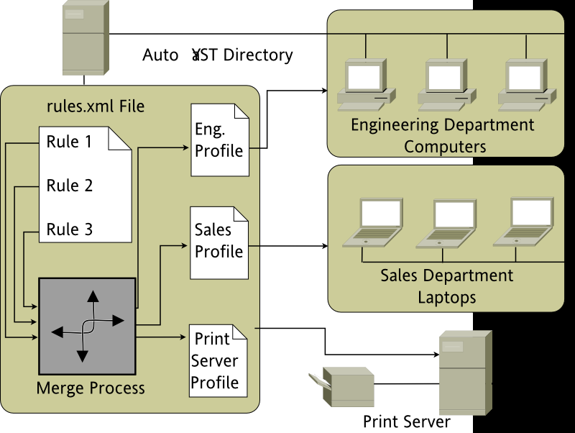

Slide 22
* Examples

Slide 23
– info inserted in profile
....
<install>
....
<init>
<info_file>
<![CDATA[
#
# Don't remove the following line:
# start_linuxrc_conf
#
install: nfs:server/path
vnc: 1
vncpassword: test
autoyast: file:///info
# end_linuxrc_conf
# Do not remove the above comment
#
]]>
</info_file>
</init>
......
</install>
....

Slide 24
– rule-based installation
take one example:
- first create print.xml, engineering.xml, and sales.xml.
<?xml version="1.0"?>
<!DOCTYPE autoinstall SYSTEM "/usr/share/autoinstall/dtd/rules.dtd">
<autoinstall xmlns="http://www.suse.com/1.0/yast2ns"
xmlns:config="http://www.suse.com/1.0/configns">
<rules config:type="list">
<rule>
<hostaddress>
<match>192.168.2.253</match>
<match_type>exact</match_type>
</hostaddress>
<result>
<profile>print.xml</profile>
<continue config:type="boolean">false</continue>
</result>
</rule>
<rule>
<haspcmcia>
<match>1</match>
<match_type>exact</match_type>
</haspcmcia>
<custom1>
<script>
if grep -i intel /proc/cpuinfo > /dev/null; then
echo -n "intel"
else
echo -n "non_intel"
fi;
</script>
<match>*</match>
<match_type>exact</match_type>
</custom1>
<result>
<profile>sales.xml</profile>
<continue config:type="boolean">false</continue>
</result>
<operator>and</operator>
</rule>
<rule>
<haspcmcia>
<match>0</match>
<match_type>exact</match_type>
</haspcmcia>
<result>
<profile>engineering.xml</profile>
<continue config:type="boolean">false</continue>
</result>
</rule>
</rules>
</autoinstall>

Slide 25
References
1. http://doc.opensuse.org/products/draft/SLES/SLES-deployment_sd_draft/cha.deployment.autoinst.html
2. https://www.novell.com/documentation/oes11/mgmt_bp_guide_lx/data/b13y85sp.html

