Slide 1
openQA hackweek 13 - 10st Dec 2015
Xiaojun Jin (xjin@suse.com)
Desktop and development team

Slide 2
Title
OpenQA ?
What I have tried
Tips and notes

Slide 3
openQA
Open Source distribution testing framework
Started in 2009
Tests Operating Systems and their applications
GUI & Console Testing
Used by the openSUSE® distribution, Tumbleweed, and now SUSE®

Slide 4
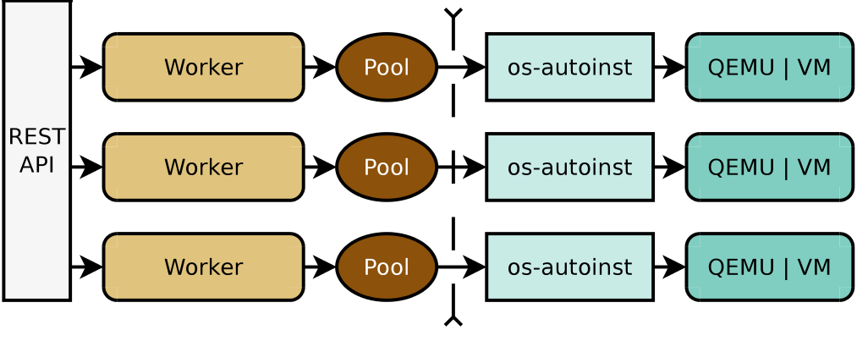
openQA Architecture
Web
UI
openQA
openqa-worker
os-autoinst

Slide 5
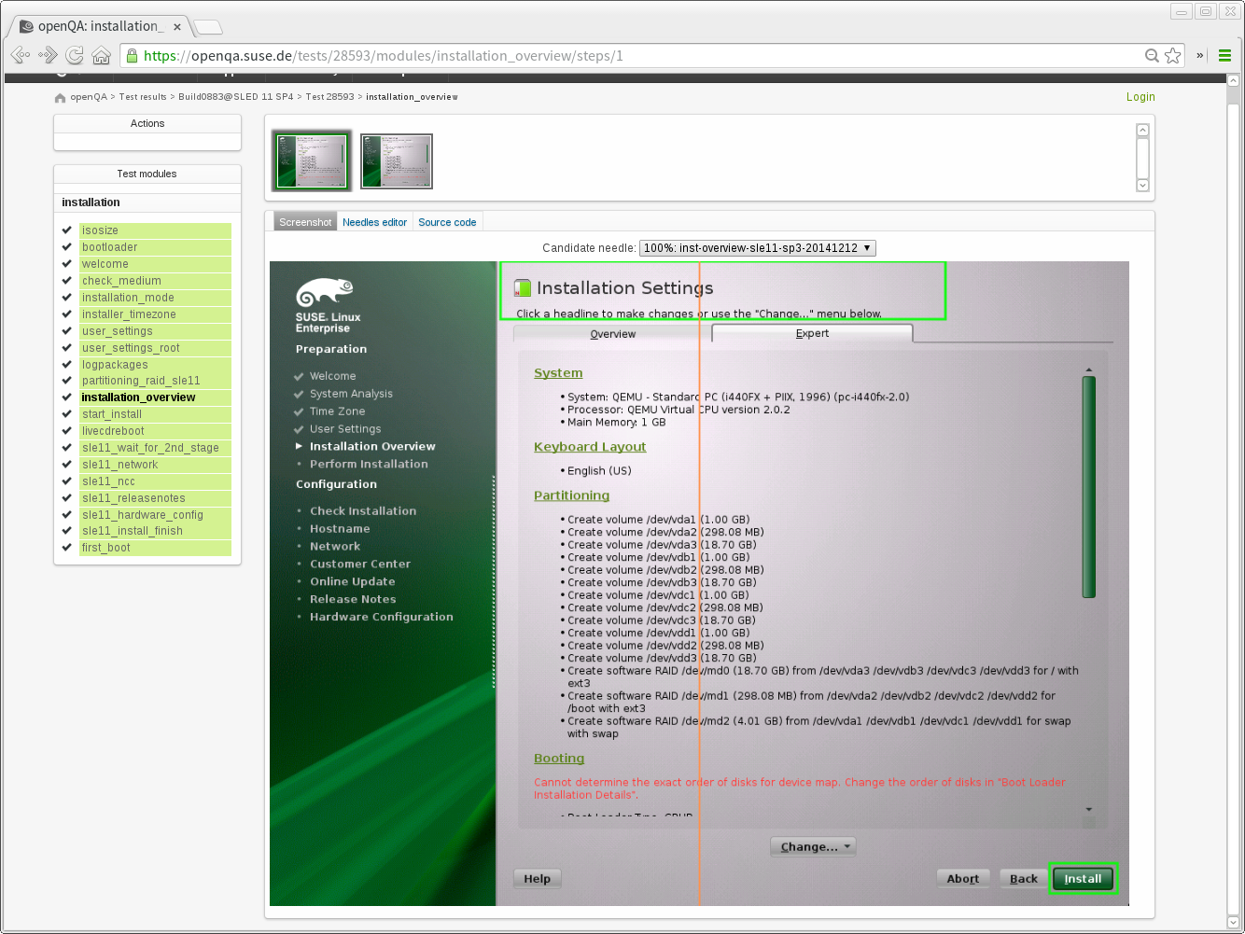
Installation Testing

Slide 6
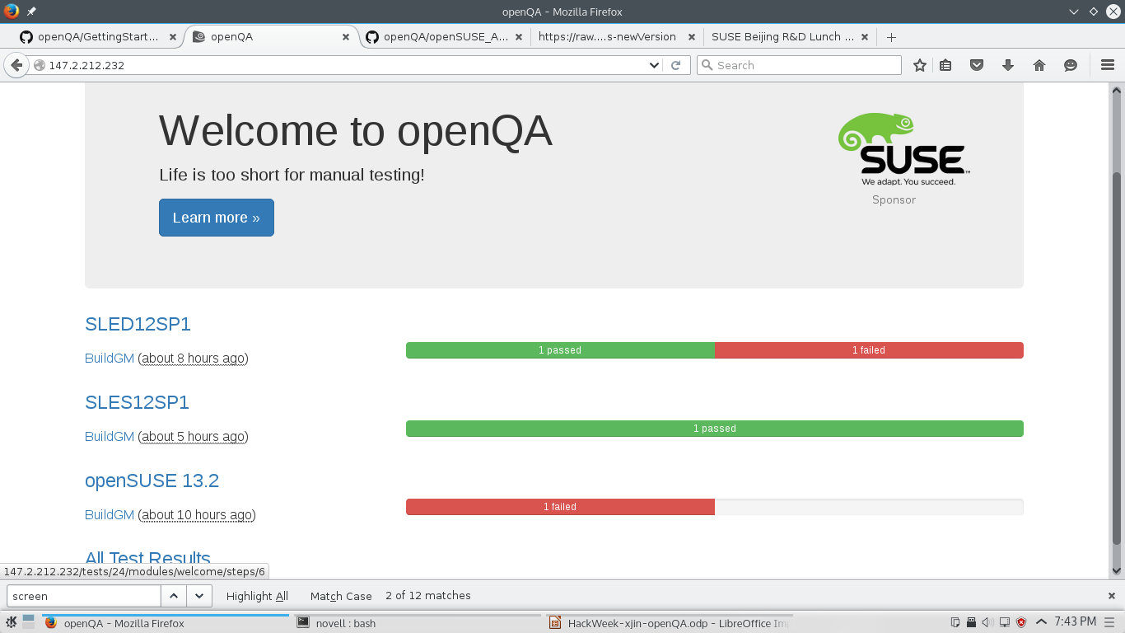
Tried Testing

Slide 7
Contributing to openQA
Repositories
  SLE/openSUSE Tests
    https://github.com/os-autoinst/os-autoinst-distri-opensuse
  Backend
    https://github.com/os-autoinst/os-autoinst
  Frontend/WebUI
    https://github.com/os-autoinst/openQA
  SUSE Internal Tools
    https://gitlab.suse.de/openqa/

Slide 8
Tips and Notes
https://raw.githubusercontent.com/xjinGitty/openQA-note/master/openQAnotes-newVersion

