Slide 1
Introduction to ECG Classification

Slide 2
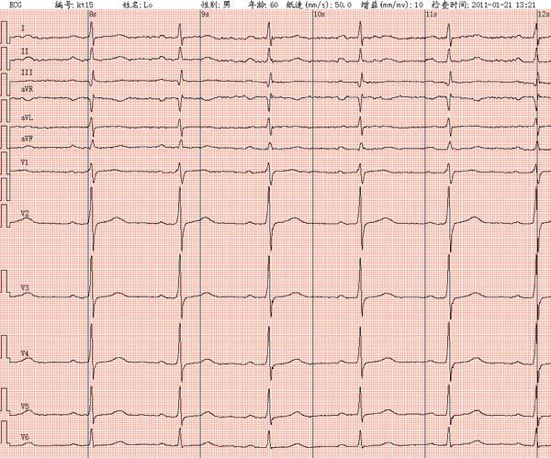
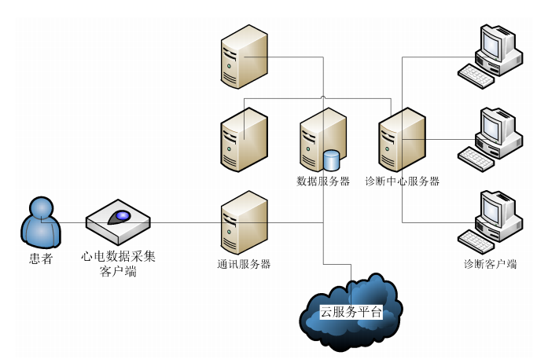
Remote ECG Online Diagnosis

Slide 3
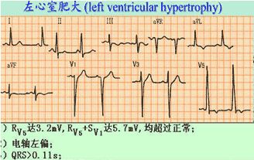
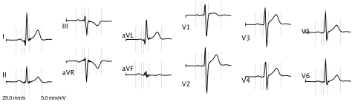
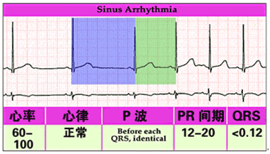
ECG data
ECG for Heart Diseases Diagnosis

Slide 4
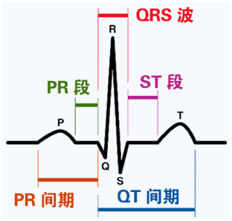
ECG Data
The waveform of ECGs

Slide 5
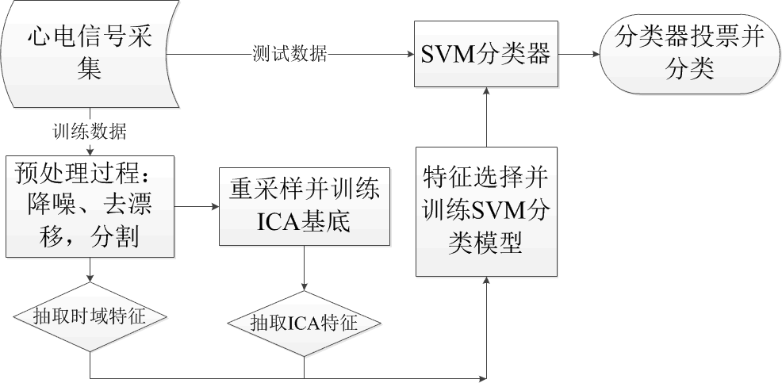
ECG Classification Procedure
Data Preprocessing
Feature Extraction
Classification

Slide 6
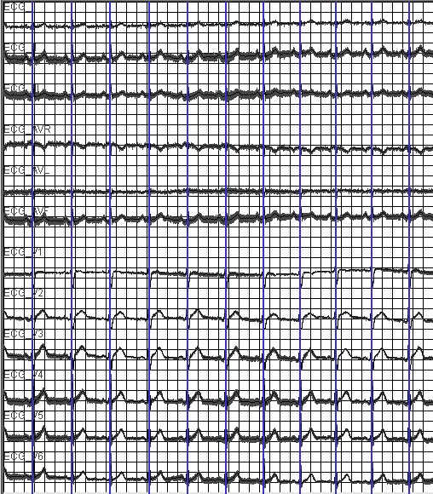
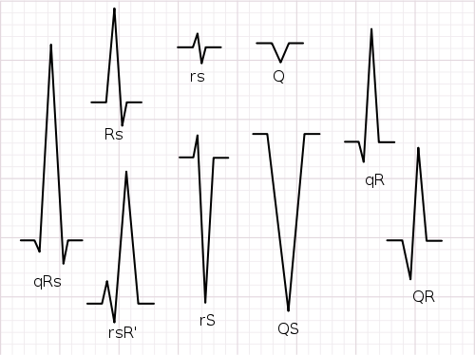
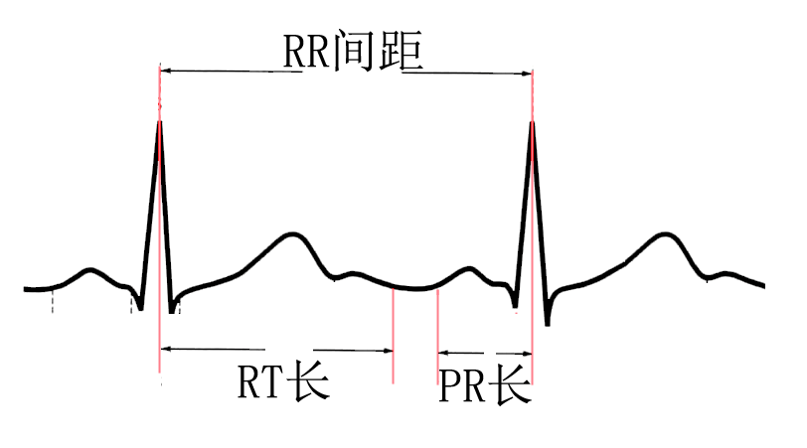
Preprocessing
Denoising
Waveform detection
R-wave detection
Segmentation

Slide 7
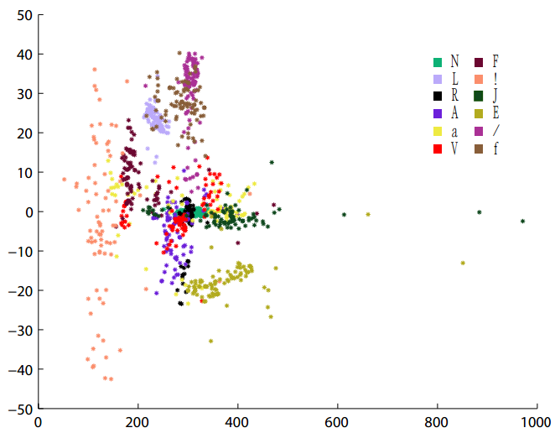
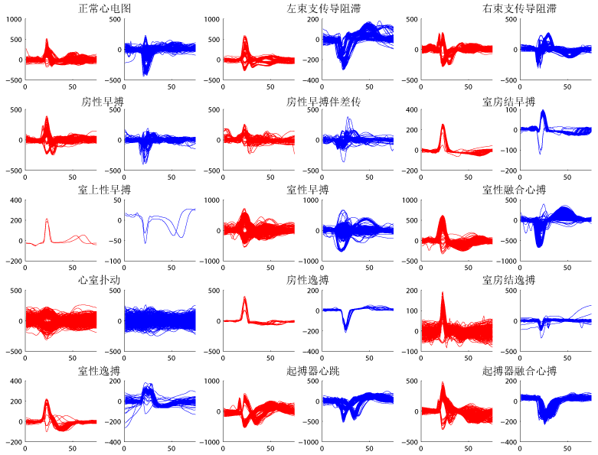
Features
PCA
LDA
ICA

Slide 8
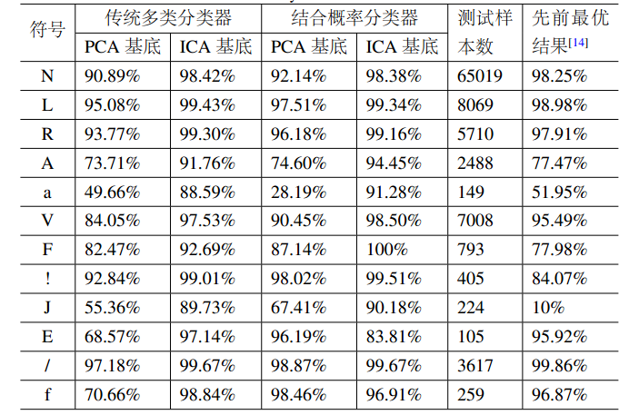
实验结果
整体识别率有所 提高
基于概率的多类 分类器在小样本 识别率有所提高
误分类成因：
两导联上特征相似
多症伴发现象

Slide 9
