Slide 1

OpenCV 3.0
Overview

Slide 2
OpenCV Timeline
Why 3.0?
Version | Released | Reason | Lifetime
pre 1.0 | 2000 (first alpha) | - | 6 years
1.0 | 2006 (ChangeLog) | maturity | 3 years
2.0 | 2009 (ChangeLog) | C++ API | >3 years
3.0 | 2014 | several (next level maturity, ...)
OpenCV 2.x is 3.5-year old already, time to bump the version number!

Slide 3
Dropping old skin
Why 3.0?
OpenCV 1.x: C API
OpenCV 2.x: new C++ API + fully supported C API. It’s quite a burden!
OpenCV 3.0:
refined C++ API + officially deprecated C API in a separate module(s)
no old-style Python bindings
cleaned documentation (just new-style API)
even a few wrong things from 2.x C++ API will be corrected or deprecated
(no way we could do that in 2.5!)

Slide 4
Updated module structure
Why 3.0?
Lot’s of old functionality: various modules => legacy & compat. Some old stuff will be removed completely.
Low-level operations: core, imgproc, … => HAL
Hardware Acceleration Layer (HAL)
Partitioning
gpu => gpuarithm, gpuwarp, …
highgui => imgcodec, videocap, ui, …
...

Slide 5
OpenCV v3.0: moving towards community-driven project
OpenCV 3.0 alpha right after CVPR
Will not be compatible with OpenCV 2.x (users’ code may require some adjustments)
Closer to 2.x than 2.x to 1.x, but:
even more modular and extendible
refined and super-stable API
deprecated old API (CV_*, C API, macros)
better packaging
fast! out-of-box CPU and GPU acceleration
Lot’s of new functionality (familiar to the “master branch” users)

Slide 6
Base + Contrib Model
OpenCV 3.x contributions
OpenCV 2.x
Base OpenCV 3.x
Convenient infrastructure for contributors:
hosted at github: repository, PRs, bug tracker, wiki
buildbot checks every contributed module and every pull request
unit tests (Google Test based)
nightly doc builder (RST-based; Doxygen too?)
automatic package builder (Win/Linux/iOS/Android)
coding guidelines
automatically generated wrappers (Python, Java, …)
convenient acceleration API (HAL; parallel framework; OpenCL)

Slide 7
Using opencv_contrib
Normal OpenCV Directory structure:
opencv/
modules/
core/
include/, doc/, src/, test/, …
CMakeLists.txt
imgproc
…
opencv_contrib/
sfm/
include/, doc/, src/, test/, …
CMakeLists.txt
…
Experimental or proprietary code
$ cmake –D OPENCV_EXTRA_MODULES_PATH=~/opencv_contrib …
http://github.com/itseez/opencv_contrib is the official repository of such modules

Slide 8
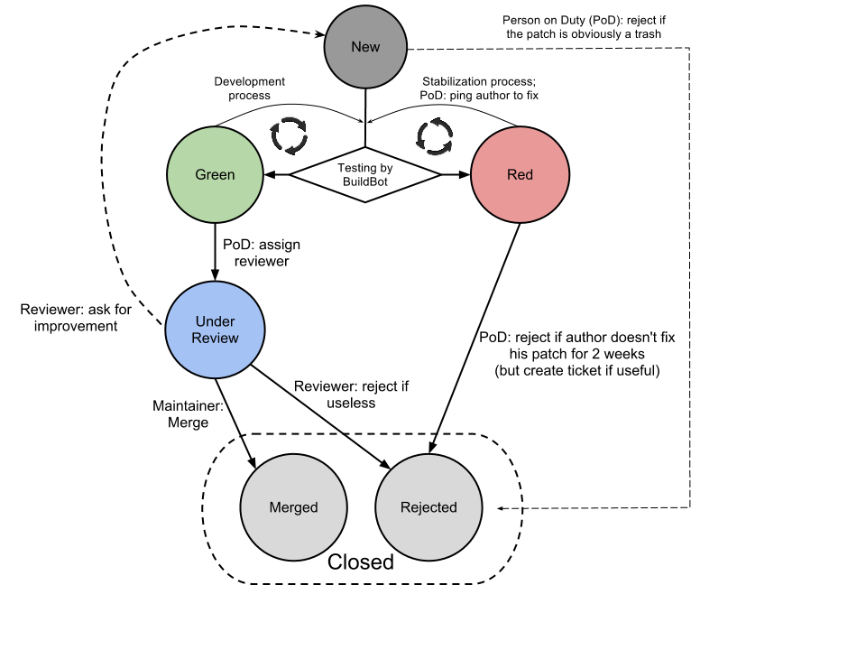
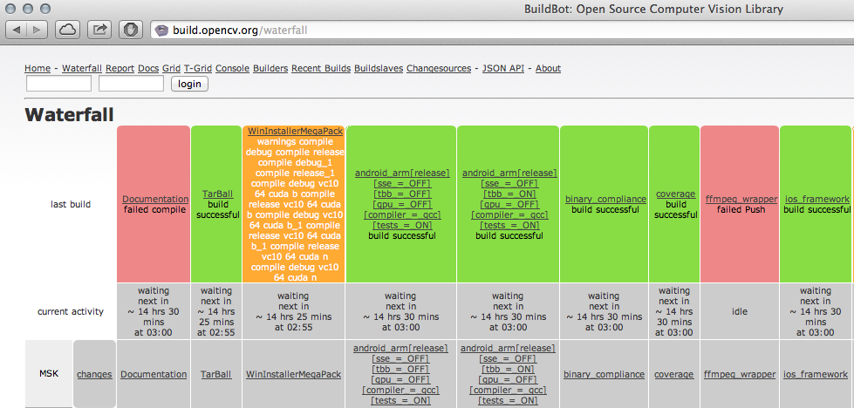
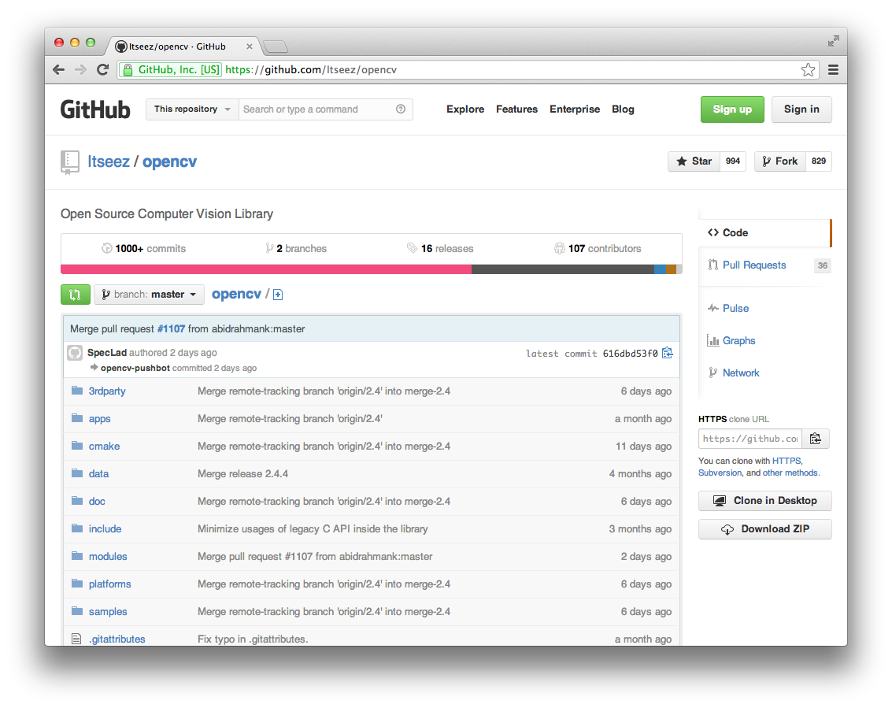
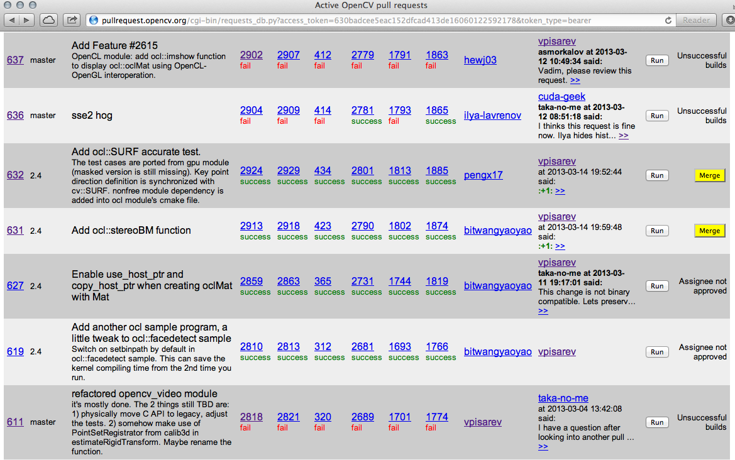
OpenCV QA
Contribution/patch workflow:
see OpenCV wiki
build.opencv.org: buildbot with 50+ builders
github.com/itseez/opencv
pullrequest.opencv.org: tests each pullrequest

Slide 9
OpenCV QA Workflow
Contribution/patch workflow:
see OpenCV wiki http://code.opencv.org/projects/opencv/wiki/How_to_contribute

Slide 10
OpenCV QA Git
github.com/itseez/opencv

Slide 11
OpenCV QA Waterfall
build.opencv.org: buildbot with 50+ builders

Slide 12
OpenCV QA Pull Request
pullrequest.opencv.org: tests each pullrequest

Slide 13
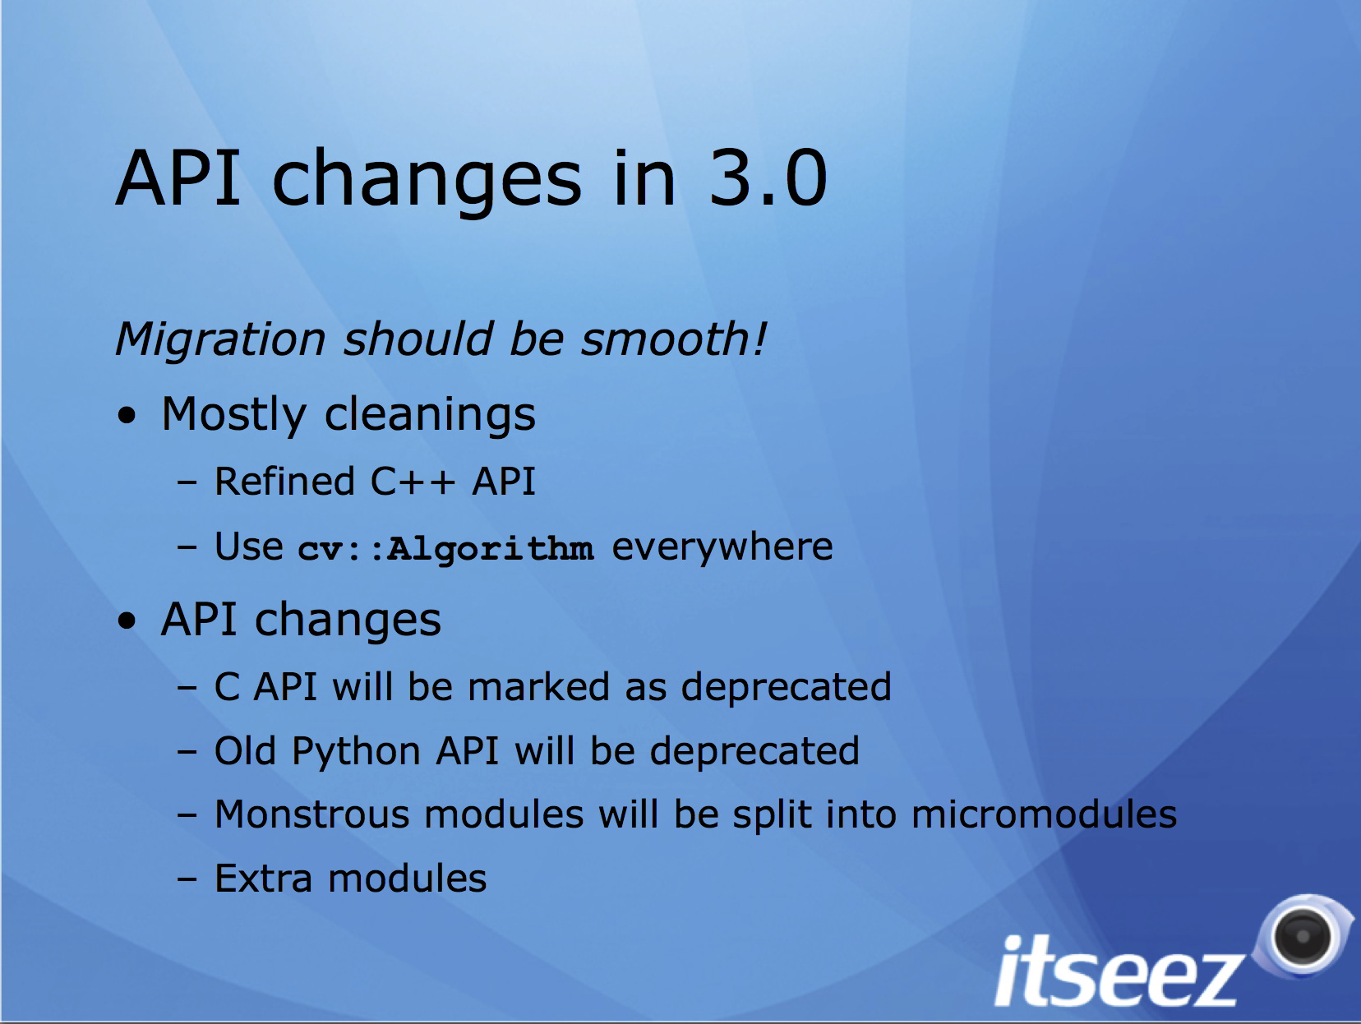

Slide 14
New-style API: hidden implementation
All the high-level vision algorithms (face detectors, optical flow estimators, stereo matchers etc.) are declared as pure abstract classes (aka interfaces in Java)
Constructed using special “factory” function
Array/image parameters are declared as Input/OutputArray(s)
class StereoMatcher : public Algorithm // Algorithm is used as a base
{
public: // common methods for all stereo matchers
virtual void compute(InputArray left, InputArray right,
OutputArray disp) = 0;
…
};
class StereoBM : public StereoMatcher
{
public: // specific methods for particular algorithm
virtual void setUniquenessRatio(int ratio) = 0;
…
};
// factory function
Ptr<StereoBM> createStereoBM(…);

Slide 15
New-style API: Impact
Implementation may be changed arbitrary as long as interface stays the same => binary compatibility can be preserved for years!
Interface stability will be checked by our buildbot automatically
Input/OutputArray(s) enable automatic CPU/GPU dispatching (see further slides on UMat)
With a different factory function one can provide drop-out replacements for existing algorithms
Wrappers are generated easily and automatically

Slide 16
Emphasis on binaries
For a long time OpenCV principles were:
Source-level compatibility
“Build it yourself!”
Binary compatibility in 2.4.x
In OpenCV 3.0 we continue the trend:
provide high-quality binary packages for each major platform => easier to maintain, more convenient for users
maintain binary compatibility for years!

Slide 17
Emphasis on Binaries: What does it take? - A lot
OpenCV 3.0 uses custom embedded STL subset instead of stock STL.
The whole API is revised not to use std::vector, std::string etc. Memory management is revised too.
Users can still pass std::vector to OpenCV!
All the private class details will be moved to *.cpp (interface-implementation pattern), see http://code.opencv.org/projects/opencv/wiki/Coding_Style_Guide

Slide 18
Regularly built high-quality packages
Automated regular builds: Windows (.exe/.zip), Linux (.deb), iOS (framework), Android (archive & GooglePlay(?))
One-size-fits-all: all the optimization is put in and is engaged if host hardware supports it
SSE2 optimization is built-in; Neon optimization to come later
x86/x64 builds include a subset of Intel IPP
universal parallel_for implementation is already in.
OpenCL acceleration is enabled by default on most platforms.

Slide 19
GPU acceleration: Transparent API
same code can run on CPU or GPU – no specialized cv::Canny, ocl::Canny, etc; no recompilation is needed
minimal or no changes in the existing code
CPU-only processing – no changes required
includes the following key components:
new data structure UMat
simple and robust mechanism for async processing
open to extensions: convenient OpenCL wrappers for accelerating user algorithms

Slide 20
UMat
UMat is new type of array that wraps clmem when OpenCL is available
Replacing Mat with UMat is often the only change needed
int main(int argc, char** argv)
{
Mat img, gray;
img = imread(argv[1], 1);
imshow("original", img);
cvtColor(img, gray, COLOR_BGR2GRAY);
GaussianBlur(gray, gray,
Size(7, 7), 1.5);
Canny(gray, gray, 0, 50);
imshow("edges", gray);
waitKey();
return 0;
}
int main(int argc, char** argv)
{
UMat img, gray;
imread(argv[1], 1, img);
imshow("original", img);
cvtColor(img, gray, COLOR_BGR2GRAY);
GaussianBlur(gray, gray,
Size(7, 7), 1.5);
Canny(gray, gray, 0, 50);
imshow("edges", gray);
waitKey();
return 0;
}

Slide 21
Transparent API: under the hood
bool _ocl_cvtColor(InputArray src, OutputArray dst, int code) {
static ocl::ProgramSource oclsrc(“//cvtcolor.cl source code …”);
UMat src_ocl = src.getUMat(), dst_ocl = dst.getUMat();
if (code == COLOR_BGR2GRAY) {
// get the kernel; kernel is compiled only once and cached
ocl::Kernel kernel(“bgr2gray”, oclsrc, <compile_flags>);
// pass 2 arrays to the kernel and run it
return kernel.args(src, dst).run(0, 0, false);
} else if(code == COLOR_BGR2YUV) { … }
return false;
}
void _cpu_cvtColor(const Mat& src, Mat& dst, int code) { … }
// transparent API dispatcher function
void cvtColor(InputArray src, OutputArray dst, int code) {
dst.create(src.size(), …);
if (useOpenCL(src, dst) && _ocl_cvtColor(src, dst, code)) return;
// getMat() uses zero-copy if available; and with SVM it’s no op
Mat src_cpu = src.getMat();
Mat dst_cpu = dst.getMat();
_cpu_cvtColor(src_cpu, dst_cpu, code);
}
Notes:
Now what happens internally in each of those functions:
We hide and rename existing CPU version of the algorithm and the slightly reworked a variant of OpenCL version. We add a top-level public function that checks whether it’s possible and it makes sense to go with OpenCL branch, if yes, tries to use it. On success it exits, otherwise Mat’s are retrieved and passed to the CPU version.
Different code paths, different memory models.

Slide 22
OpenCV+OpenCL execution model
CPU threads
…
…
cv::ocl::Queue
cv::ocl::Queue
cv::ocl::Queue
…
cv::ocl::Device
cv::ocl::Device
cv::ocl::Context
One queue and one OpenCL device per CPU thread
OpenCL kernels are executed asynchronously
cv::cl::finish() puts the barrier in the current CPU thread;
.getMat() automatically calls it.

Slide 23
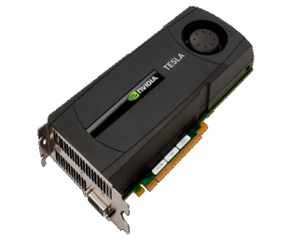
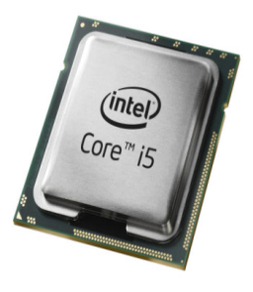
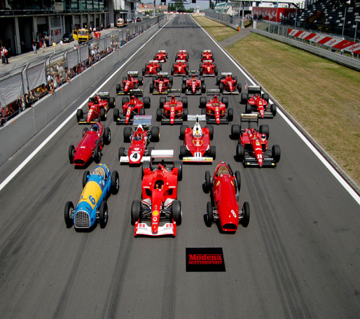
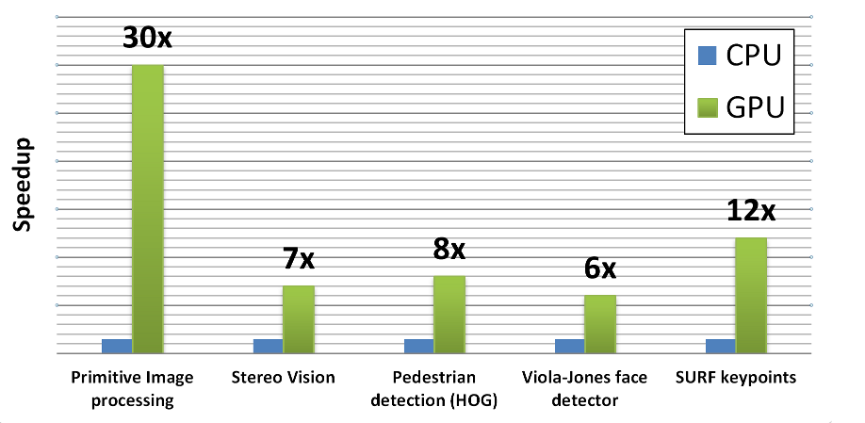
GPU acceleration highlights
Tesla C2050 (Fermi) vs. Core i5-760 2.8GHz (4 cores, TBB, SSE)
Average speedup for primitives: 33×
For “good” data (large images are better)
Without copying to GPU
What can you get from your computer?
opencv\samples\gpu\perfomance

Slide 24
The HAL + Accelerators
opencv_hal - IPP-like, fastcv-like low-level API to accelerate OpenCV for different platforms.
opencv_ocl module (OpenCL acceleration) will be universal (any SDK) and the binary will be shipped within official OpenCV packages.
Possible universal Mat (vMat, xMat …?) structure instead of existing cv::Mat, GpuMat, OclMat.
Preliminary OpenVX support?

Slide 25
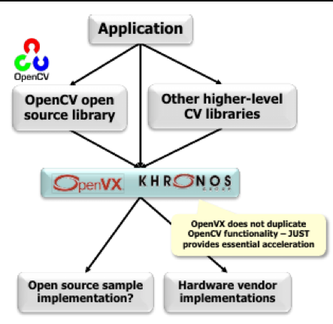
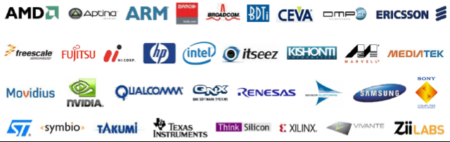
OpenVX (Khronos HAL)

Slide 26
New Functionality
Computational Photography:
HDR
denoising
edge-aware filtering
Video processing:
state-of-art optical flow (3.0 gold)
TLD (aka Predator) tracker (3.0 gold)
video stabilization
state-of-art features: KAZE & AKAZE
Better pedestrian&car detector (3.0 gold)
Text detection
New/improved bindings:
Python 3 support
experimental Matlab support
library-wide (every module is covered; not just basic)

Slide 27
New Functionality
RGBD – processing data from depth sensors
Wrappers for bundle adjustment engines (libmv, ceres …)
Viz – VTK-based visualization
Numerical optimization
New denoising algorithms
Text detection, barcode readers
Python 3.0 bindings
Matlab bindings

Slide 28
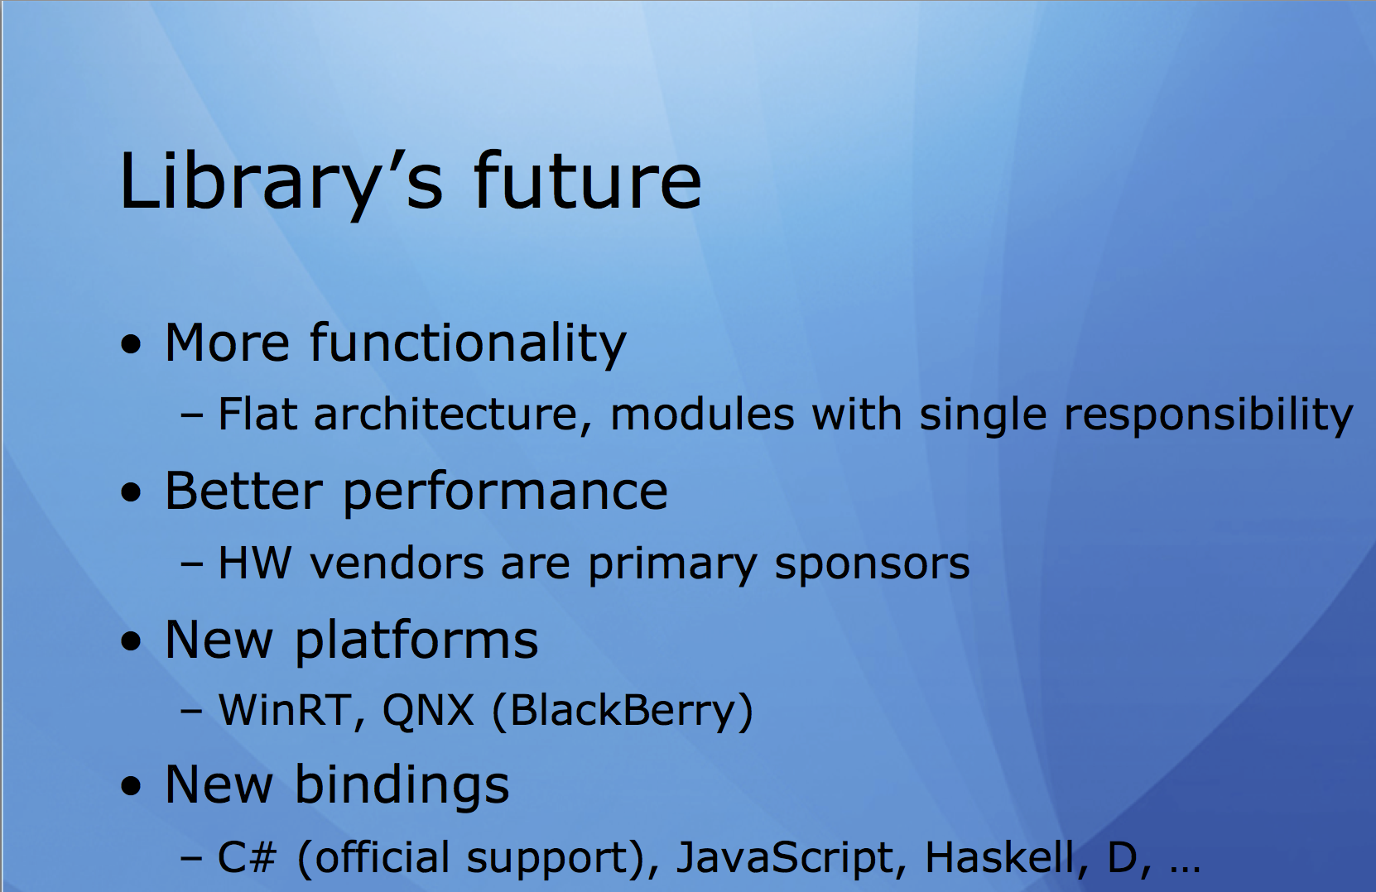

Slide 29
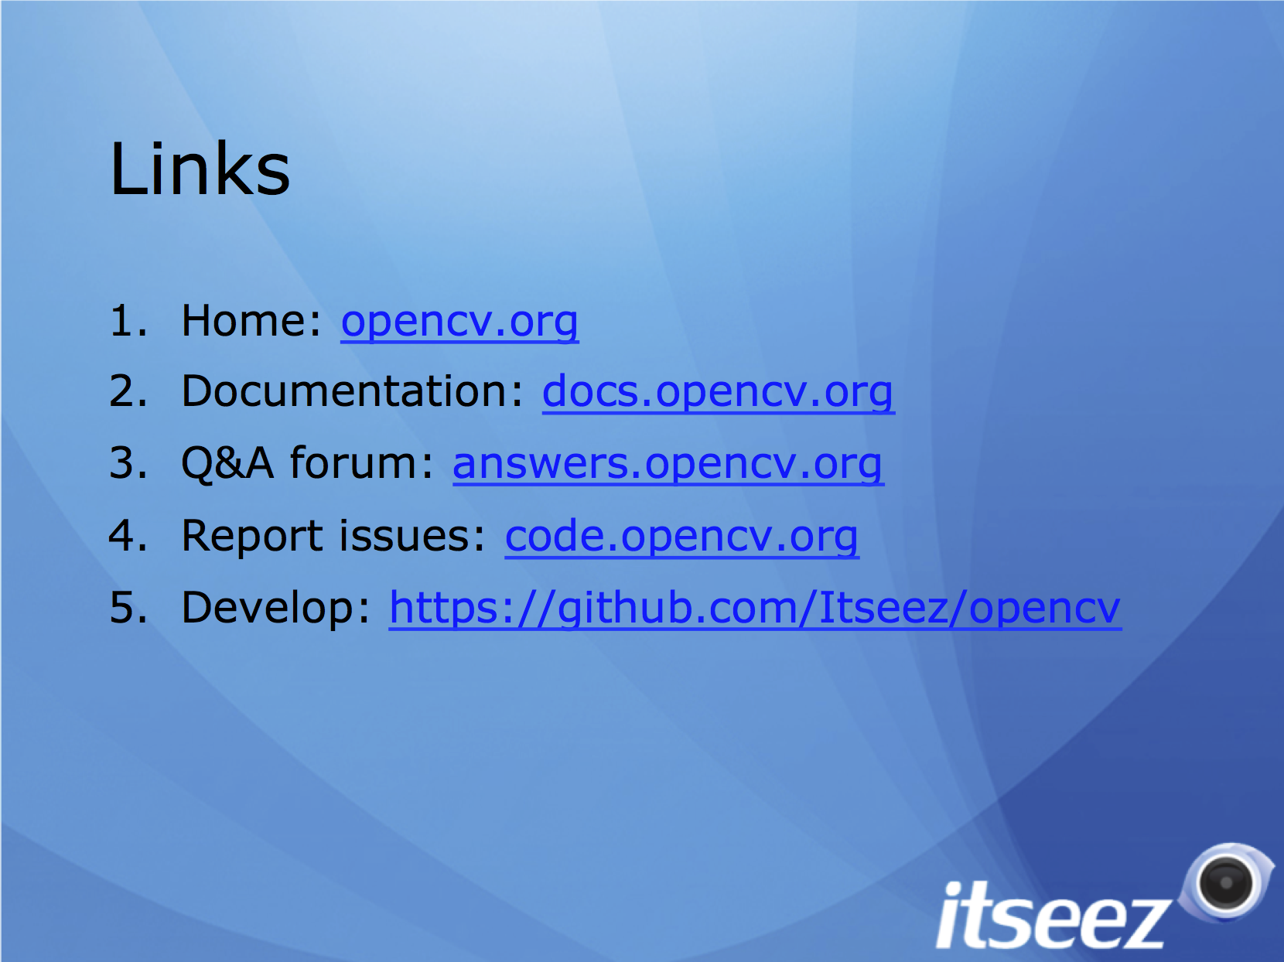
Questions?

