Slide 1
Advantage-Critic Grounded LLM Planning for Multi-UAV Wildfire Response
The LLM's task-allocation plan is scored by a pre-trained advantage critic and refined
until it passes the threshold, then executed by a task-aware MATD3 policy
Framework backbone: LLM-MATD3 (Dong et al., Aerospace Sci. Tech. 177 (2026) 112218)
Critic / plan-scoring mechanism: ReAd — Reinforced Advantage feedback
(Zhang, Yang, Bai, Wu, Li, Wang, Li. “Towards Efficient LLM Grounding for
Embodied Multi-Agent Collaboration”, ACL 2025, arXiv:2405.14314)
Scenario / tasks: PRS-HRL wildfire response (Xiang et al., mission-driven sensing & communication)

Slide 2
Wildfire Environment
LLM Task Planner (frozen, prompt-only)
ReAd Advantage Critic
Accepted τ / State
(S > α)
Task Embedding Network
Wind
Observations / State
frozen BERT + MLP(256, 1 hidden) → Q_{θ}
State s
s ∈ R¹⁷
Head
Task Assignment
Task Advice
1) Encode (state text ∥ plan text)
• Agent_0: Fire Sensing (0)
• Agent_1: Comm. Relay (1)
• Agent_2: Recharging (2)
• Agent_3: Fire Sensing (0)
• Agent_4: Comm. Relay (1)
...
• Cordon: “Head-Flank”
• Priority Fronts: [Head, Flank]
• Relay Layout: “Balanced”
• Handover: “Proactive”
...
BERT (frozen, 768-d) ⊕ raw state (17-d)
→ MLP head → Q_{θ}^{1:i}(s_{t}, τ^{1:i})
Task Embedding
e_{τ} ∈ R^{d}
Flank
adjustments
2) Score the generated plan
Label τ
τ ∈ {0,1,2}
S_{ReAd-S}(τ^{i}) = Q_{θ}^{1:i} − Q_{θ}^{1:i−1}
S_{ReAd-J}(τ) = Q_{θ}(s,τ) − (1/γ)Q_{θ}(s,w)
Rear
MLP encoder shared by all task labels
3) Gate: S > α ?
CS
yes → accept & execute no → refine (α ← α/2, ≤ 15 rounds)
Offline: MC regression on D (Alg. 1) — no LLM fine-tuning
Forest-Fire Simulation (5 km x 5 km grid, CA spread)
Refinement loop: candidate plan τ → critic scores S_{ReAd} → [Evaluation Score] + [Improvement Feedback] → re-plan until S > α (≤ 15 rounds)
Accepted Task Labels & Mission Advice (S_{ReAd} > α)
N UAVs / M = 8 Ground Rescuers / Charging Stations
UAV
Rescuer
Fire front
CS
Hierarchical Task Decomposition Mechanism
State (350-dim)
Reward Function
Action a
Fire Sensing (τ=0)
Comm. Relay (τ=1)
Recharging (τ=2)
g₁⁰(s)
g₂⁰(s)
g₃⁰(s)
g₁¹(s)
g₂¹(s)
g₃¹(s)
g₁²(s)
g₂²(s)
g₃²(s)
Selector (by τ)
ẽ_{τ} = W_{base} e_{τ} + W_{sub} g_{τ}(s) + b_{task}
e_{τ} = Embedding(τ) ∈ R^{d}
Experience storage
Enhanced Embedding ẽ_{τ} ∈ R³²
Actor Network
Critic Network (twin Q, task-aware)
(s, a, r, s′, τ)
State Input (17 dims)
Task Embedding
(32 embed-dims)
State (17) + Action + ẽ_{τ}
State (17) + Action + ẽ_{τ}
Batch sample
layerNorm (17)
layerNorm (17)
layerNorm (17)
Linear(256)+ReLU
Linear(256)+ReLU
Linear(256)+ReLU
Experience Replay Buffer
Linear(256)+ReLU
Linear(256)+ReLU
Linear(256)+ReLU
Linear(action_dim)+Tanh()
Linear(1)
Linear(1)
Action a
Q1 Value
Target Q
Min(Q1,Q2)
Q2 Value
Notes:
人员指挥系统也加入进来，大模型输入可以加入电磁层

Slide 3
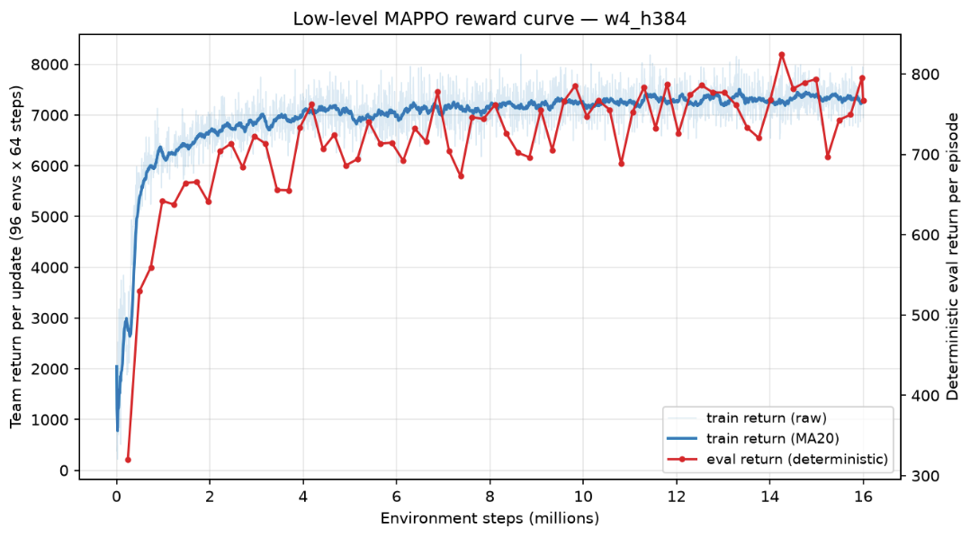

Slide 4
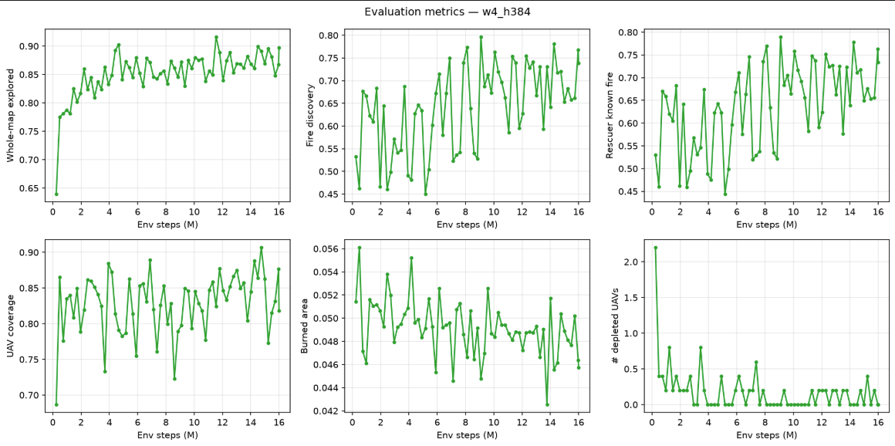

Slide 5
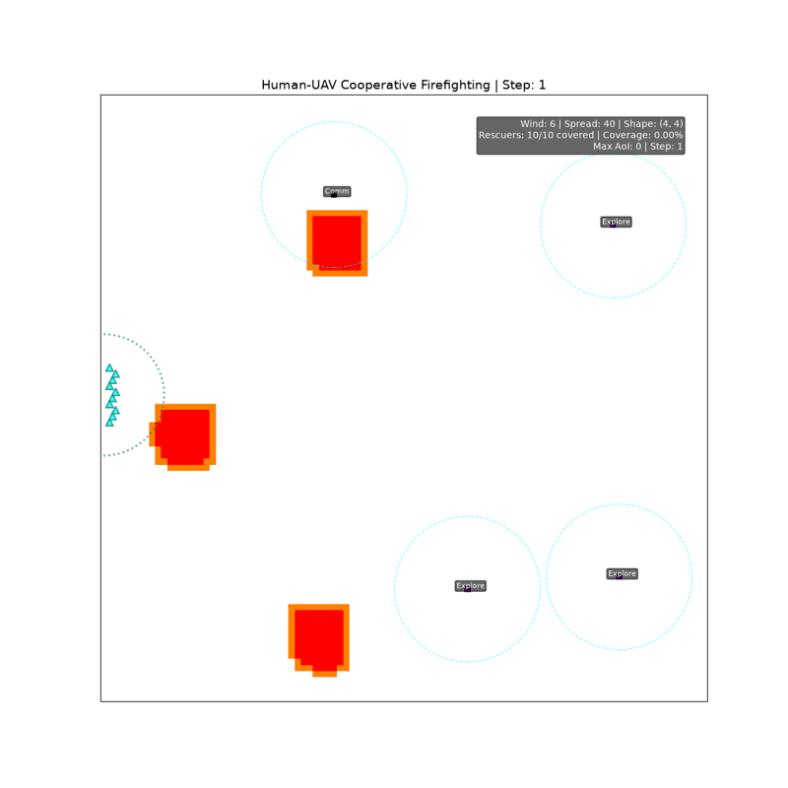

Slide 6
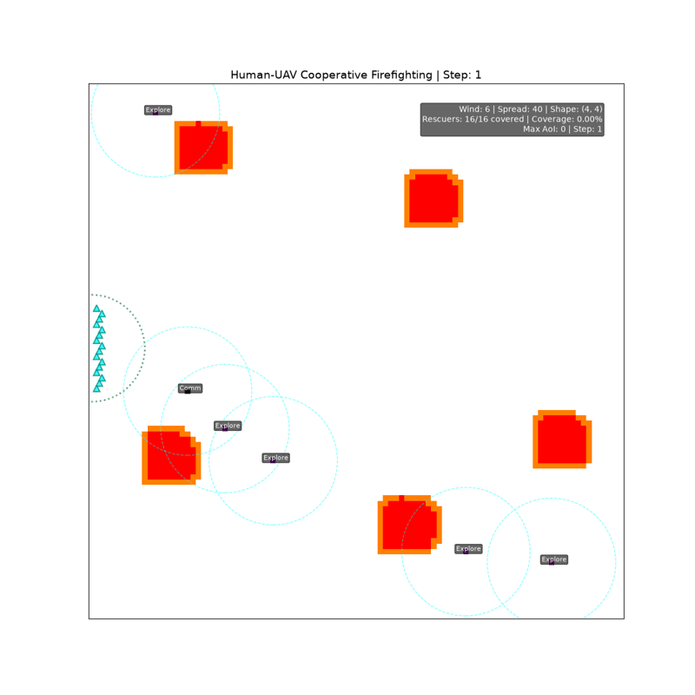

Slide 7
ReAd: Scoring the LLM's Plan with a Sequential Advantage Critic
Zhang et al., “Towards Efficient LLM Grounding for Embodied Multi-Agent Collaboration”, ACL 2025 (arXiv:2405.14314)
1 What is scored
2 Score functions
3 Refinement loop
• Plan = task-label vector τ ∈ {0,1,2}^{N}
(fire sensing / relay / recharging)
• Critic takes the PLAN as input, not only
the state — so it can judge the generation
• WAIT action w = hover & hold current role;
r(s,w) = 0, s′ = s ⇒ Q(s,w) = γV(s)
• That identity removes the need for a
separate value network
ReAd-J (one joint plan for all UAVs)
S(τ) = Q_{θ}(s,τ) − (1/γ)·Q_{θ}(s,w)
ReAd-S (UAV-by-UAV, sequential)
S(τ^{i}) = Q_{θ}^{1:i}(s,τ^{1:i−1},τ^{i})
− Q_{θ}^{1:i−1}(s,τ^{1:i−1})
Lemma 1: A(s,τ) = Σ_{k} A^{ik}(s, τ^{i1:k−1}, τ^{ik})
• S > α → accept, release τ downstream
• S ≤ α → return two prompt blocks:
[Evaluation Score] + [Improvement Feedback]
(score, “the plan need to be changed”, and
the rejected plan echoed back)
• Re-plan; α ← α/2 each failed attempt,
α ← 2α at each new timestep
• Cap: 15 re-planning rounds per step
• Only the LAST round is kept in history
Why this is the right critic for wildfire response
• The score is an ADVANTAGE, i.e. a prediction of how much this plan contributes to finishing the mission — exactly
“run the plan for a while and grade it by how the environment changed”, but WITHOUT paying for the rollout at inference.
• A bad plan is rejected before any UAV moves. Sending every UAV to the fire head scores low because rescuers lose relay
coverage and must halt; deferring recharging past the return budget scores low because the UAV strands.
• The LLM planner stays frozen — no LoRA, no RLHF. Only the small critic is trained, so the loop is cheap to iterate.
• Proposition 2: behaviour cloning on the set filtered by 1[A(s,τ^{1:i−1},τ^{i}) > ε], ε ≥ 0, gives J(π) − J(μ) > 0 — the
refined planner provably improves on the raw LLM planner μ = π_{llm}.

Slide 8
Training the Advantage Critic (offline, Monte-Carlo regression)
ReAd Algorithm 1 — no TD bootstrapping, no target network, no LLM gradient
Dataset D
Regression objective
• Collected by the LLM planner itself with physical verification
(a RoCo-style planner), giving high-quality interaction samples
• Transitions stored as (s_{t}, τ_{t}, r_{t}) until task completion
• Coverage augmentation: deliberately reset the environment to
hard / unreachable states and start planning from there, to
mitigate the offline out-of-distribution problem
• Ablation: mixing in expert (human) trajectories does NOT help —
it raises MC variance and narrows state coverage
Monte-Carlo return for an ordered UAV subset i_{1:u}
R_{s,τ} = Σ over τ^{−i1:u} ∈ D: Σ_{t=0..T} γ^{t} r_{t}
Fit one shared family of local critics
min_{Q} E_{s,τ ~ D} [ ‖ R_{s,τ} − Q_{μ}^{i1:u}(s, τ^{i1:u}) ‖² ]
Joint quantities are recovered by setting τ^{i1:u} = τ^{1:N}
(the real joint plan, or the joint WAIT plan w)
Critic architecture and hyper-parameters (ReAd Fig. 12 / Table 8)
• Text branch: FROZEN pre-trained BERT encodes the language-described state and the plan → 768-d features
• Numeric branch: raw simulator state vector (17-d compact wildfire state)
• The two are concatenated and passed to an MLP head predicting the scalar Q
• Input dim: 768 + 17 for ReAd-J; N × 768 + 17 for ReAd-S • Hidden 256, 1 hidden layer
• LR 1e−3, batch 32, 9e5 iterations • Reward r_{t} is the wildfire task reward (coverage / exploration gain)

Slide 9
Wildfire Scenario and Task Set
Replaces the A-vs-B adversarial game; environment and tasks follow the PRS-HRL wildfire response setting
Environment
Task labels τ assigned by the LLM planner
• 5 km x 5 km gridded forest, real topography; cellular-automaton
spread (Wang Zhengfei semi-empirical model, k_{s} = 2)
• Cell states: unknown / healthy / burning / burnt / extinguished
• Wind 12 m/s East, 30 °C, 20 % humidity; ignition 400 m x 400 m
• Fire front compressed into a head / flank / rear topology
• M = 8 ground rescuers suppress the fire boundary, and may only
advance while covered by at least one UAV (safety protocol)
• Comm. radius R_{a} = 1000 m (UAV-UAV), R_{b} = 800 m (UAV-rescuer)
τ = 0 Fire Sensing
target unknown cells near the active fire edge; patrol the
boundary when no candidate remains
τ = 1 Communication Relay
position to maximize covered rescuers (marginal gain minus
redundancy and travel cost); keep AoI low
τ = 2 Recharging
fly to the nearest charging station and restore the battery;
hand the relay role over before a coverage gap appears
Compact high-level state s_{H} = s_{env} ‖ s_{uav} ‖ s_{coord} (17 dims)
s_env (7): wind speed w, fire exploration rate E, fire growth ΔA, head / flank / rear front lengths L_h, L_f, L_r, coverage rate C
s_uav (4): remaining energy e_i, distance to rescuer centroid d_i, previous task ratio ρ^{t−1}, min swarm-to-rescuer distance d_m
s_coord (6): min energy among relay UAVs e_m, relative distances d_im / d_mm, distance to nearest non-recharging UAV d_in,
exclusively covered rescuers n_i, maximum Age of Information a_i
Objective
Sensing-communication fusion metric J = (1/T) Σ_{t} [ λ·E(t) + (1−λ)·C(t) ], λ ∈ [0,1]
Reward function combines fire-front discovery gain, rescuer coverage continuity, energy safety, and a switching-aware term
that rewards proactive role handover before a relay UAV departs to recharge.

Slide 10
End-to-End Data Flow
One macro cycle; step 3 loops back to step 2 until the plan passes the threshold
1
Wildfire Environment
17-dim high-level state + head/flank/rear fire topology + rescuer & energy status
2
LLM Task Planner (frozen)
Situation analysis → candidate plan τ ∈ {0,1,2}^{N} + mission advice
refine
3
ReAd Advantage Critic
Score S_{ReAd}(τ) from Q_{θ}; if S ≤ α return [Evaluation Score] + [Improvement Feedback] to step 2 (≤ 15 rounds)
4
Task Embedding Network
Accepted τ and state → base embedding e_{τ} ∈ R^{d}
closed loop
5
Hierarchical Task Decomposition
Sub-goal scores g_{τ}(s) → selector → ẽ_{τ} = W_{base}e_{τ} + W_{sub}g_{τ}(s) + b_{task} ∈ R³²
6
Task-enhanced MATD3
Task-aware actor emits continuous action a; twin critics give min(Q1,Q2) target
7
Buffers
(s, a, r, s′, τ) → replay buffer for MATD3; (s, τ, r) → dataset D for offline critic regression

