Slide 1
Robust Heterogeneous Graph Neural Networks against Adversarial Attacks
刘慧祥
Xi'an Jiaotong University
May 2022

Slide 2
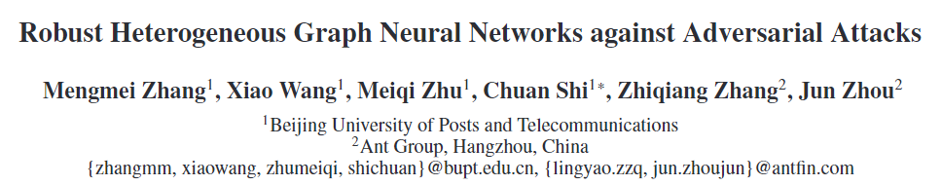
About the paper
“Robust Heterogeneous Graph Neural Networks against Adversarial Attacks. AAAI(2022).
It first systematically study the robustness of HGNNs and show that they can be easily fooled by adding the adversarial edge between the target node and large-degree node (i.e., hub).

Slide 3
Outline
Background and motivation
The Proposed Robust HGNN
Experiments and results
Notes:
It’s the outline of the talk. Let us first discuss the background and motivation of the research.

Slide 4
Background and motivation
The robustness of HGNNs remains unknown
Heterogeneous Graph Neural Networks (HGNNs) have achieved outstanding performance in many tasks.
Despite their wide use, there is currently no understanding of their robustness to adversarial attacks.
Two key reasons for such vulnerabilities of HGNNs
Perturbation enlargement effect, i.e., HGNNs, failing to encode transiting probability, will enlarge the effect of the adversarial hub in comparison of GCNs.
Soft attention mechanism, i.e., such mechanism assigns positive attention values to obviously unreliable neighbors.

Slide 5
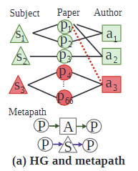
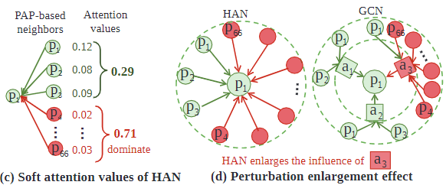
Background and motivation
Two key reasons for such vulnerabilities of HGNNs
Perturbation enlargement effect, i.e., HGNNs, failing to encode transiting probability, will enlarge the effect of the adversarial hub in comparison of GCNs.
Soft attention mechanism, i.e., such mechanism assigns positive attention values to obviously unreliable neighbors.

Slide 6
Background and motivation
Solutions: equipping an attention purifier which prune malicious neighbors based on topology and feature.
to eliminate the perturbation enlargement
introduce the metapath-based transiting probability as the prior criterion of the purifier.
to alleviate the negative effect of malicious neighbors in the soft attention mechanism
the purifier learns to mask out neighbors with low confidence.
restraining the confidence of malicious neighbors from adversarial hub.
learns a differentiable mask vector.

Slide 7
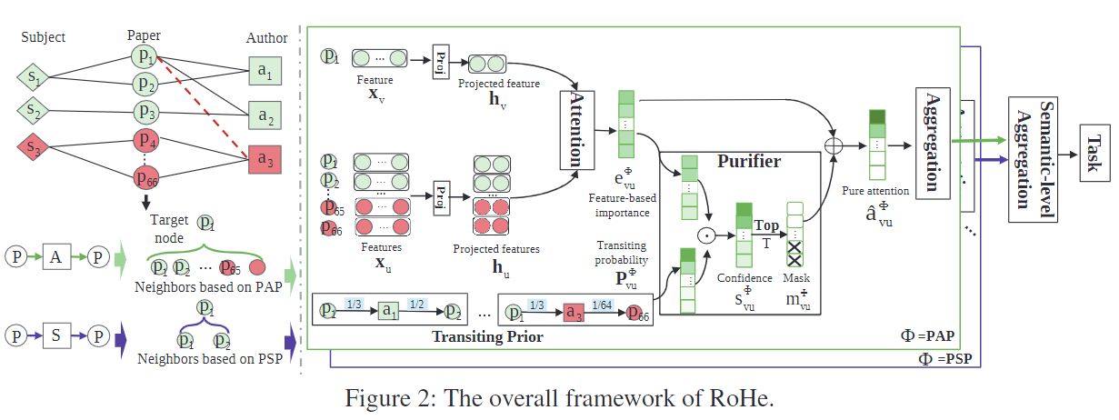
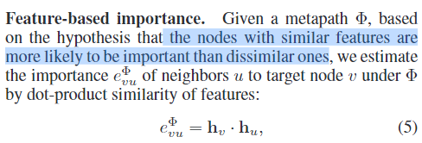
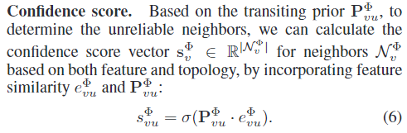
The Proposed Robust HGNN
HGNNs often adopt a hierarchical aggregation (including node-level and semantic-level), and our RoHe is applied to purify the node-level aggregation.

Slide 8
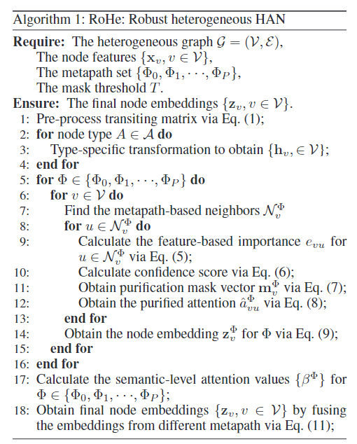
The Proposed Robust HGNN

Slide 9
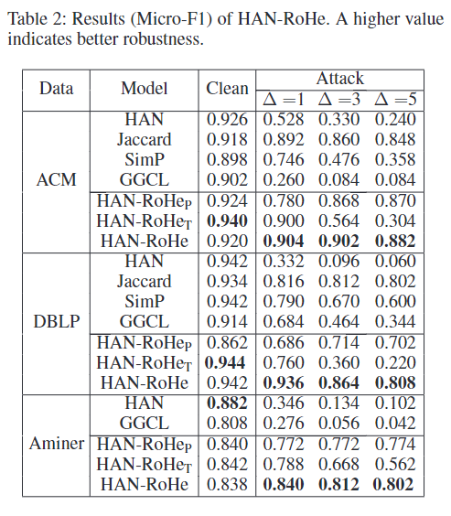
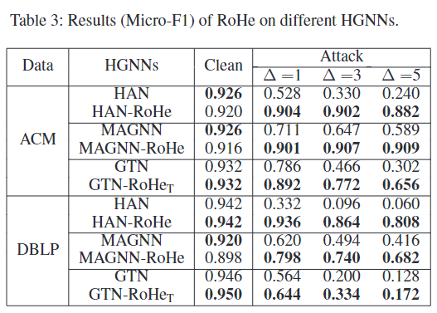
Experiments and results

Slide 10
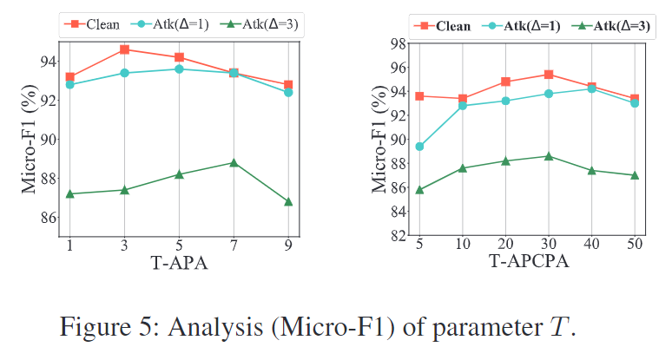
Experiments and results

Slide 11
Thanks for Attention!
刘慧祥
Xi'an Jiaotong University
May 2022

