Slide 1
Masked Label Prediction: Unified Message Passing Model for Semi-Supervised Classification
掩蔽标签预测：半监督分类的统一消息传递模型
汇报人：刘慧祥
2022年3月25日

Slide 2
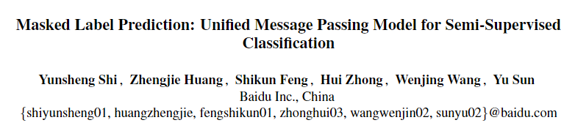
论文概况
“Masked Label Prediction: Unified Message Passing Model for Semi-Supervised Classification” Yunsheng Shi et al. IJCAI(2021).
提出了一种新的统一消息传递模型(UniMP)，该模型可以在训练时和推理时同时结合特征传播(feature propagation)和标签传播(label propagation)。

Slide 3
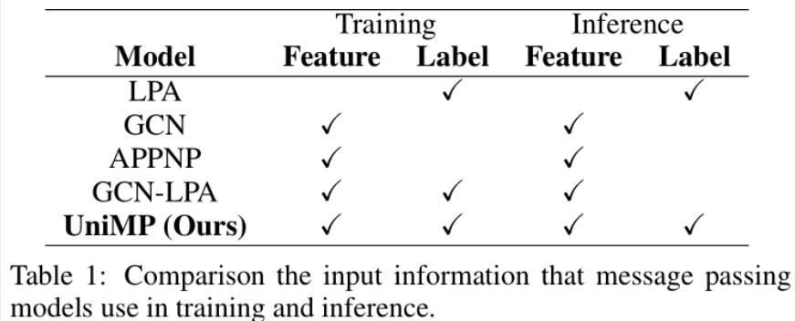
研究目的
“Masked Label Prediction: Unified Message Passing Model for Semi-Supervised Classification” Yunsheng Shi et al. IJCAI(2021).
LPA：通过图邻接矩阵上的标签传播来得到结果。
GCN：通过神经网络进行特征传播来进行预测。
APPNP：使用GNN预测软标签，并利用个性化PageRank对软标签进行传播。
统一消息传递模型，在训练时和推理时同时结合特征传播和标签传播。
GCN-LPA：使用LPA正则化GNN。
消息传递模型输入信息的对比
Notes:
Since GNN and LPA are based on the same assumption（the Laplacian smoothing assumption）, making semi-supervised classifications by information propagation, there is an intuition that incorporating them together for boosting performance.
However, as shown in Table 1, aforementioned methods still can not directly incorporate GNN and LPA within a message passing model, propagating feature and label in both training and inference procedure.

Slide 4
研究目的
“Masked Label Prediction: Unified Message Passing Model for Semi-Supervised Classification” Yunsheng Shi et al. IJCAI(2021).
主要思想
结合节点特征传播和标签传播
transforms the partial node labels from one-hot to dense vector likes node features.
And a multi-layer Graph Transformer network takes them as input to perform attentive information propagation between nodes.
掩蔽标签预测
标签泄露: take the node label as input, using it for supervised training.
A masked label prediction strategy: randomly masks some training instances’ label and then predicts them to overcome label leakage.
Inspired by masked word prediction in BERT.
simulates the procedure of transducing labels information from labeled to unlabeled examples in the graph.
Notes:
Previous GNN-based methods only take node features as input with the partial observed node labels for supervised training. And they discard the observed labels during inference.

Slide 5
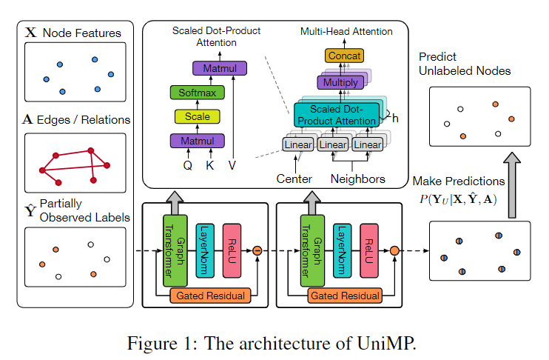

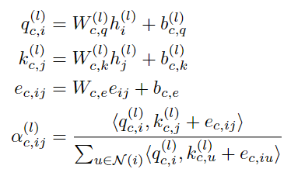
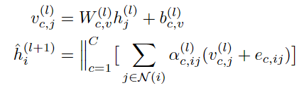
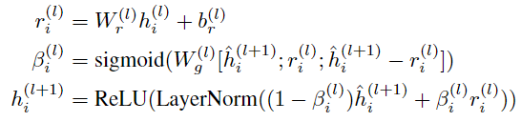

模型方法
“Masked Label Prediction: Unified Message Passing Model for Semi-Supervised Classification” Yunsheng Shi et al. IJCAI(2021).
Graph Transformer
node features：
calculate c-th multi-head attention for each edge from j to i :
Prevent over-smoothing
注：

Slide 6



模型方法
“Masked Label Prediction: Unified Message Passing Model for Semi-Supervised Classification” Yunsheng Shi et al. IJCAI(2021).
Label Embedding and Propagation
Feature propagation
Label propagation

Slide 7



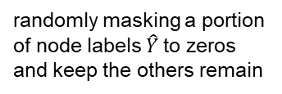
模型方法
“Masked Label Prediction: Unified Message Passing Model for Semi-Supervised Classification” Yunsheng Shi et al. IJCAI(2021).
Masked Label Prediction
randomly masking a portion of node labels $\hat{Y}$to zeros and keep the others remain
those masked labels

Slide 8
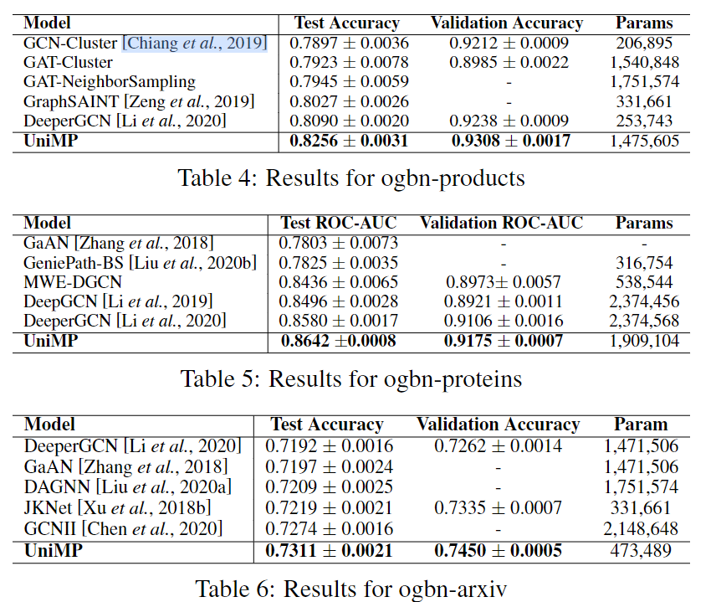
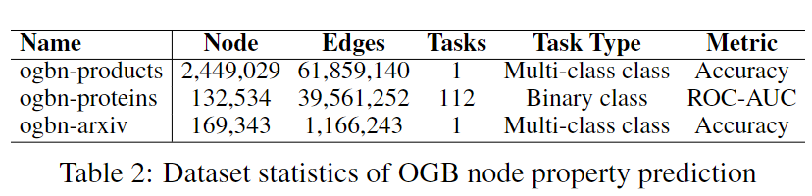
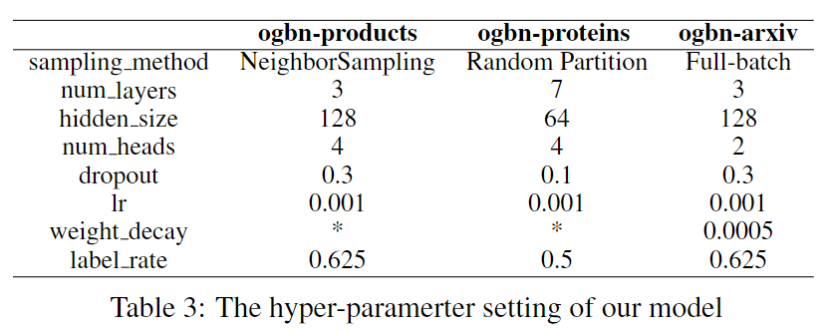
实验结果
“Masked Label Prediction: Unified Message Passing Model for Semi-Supervised Classification” Yunsheng Shi et al. IJCAI(2021).

Slide 9
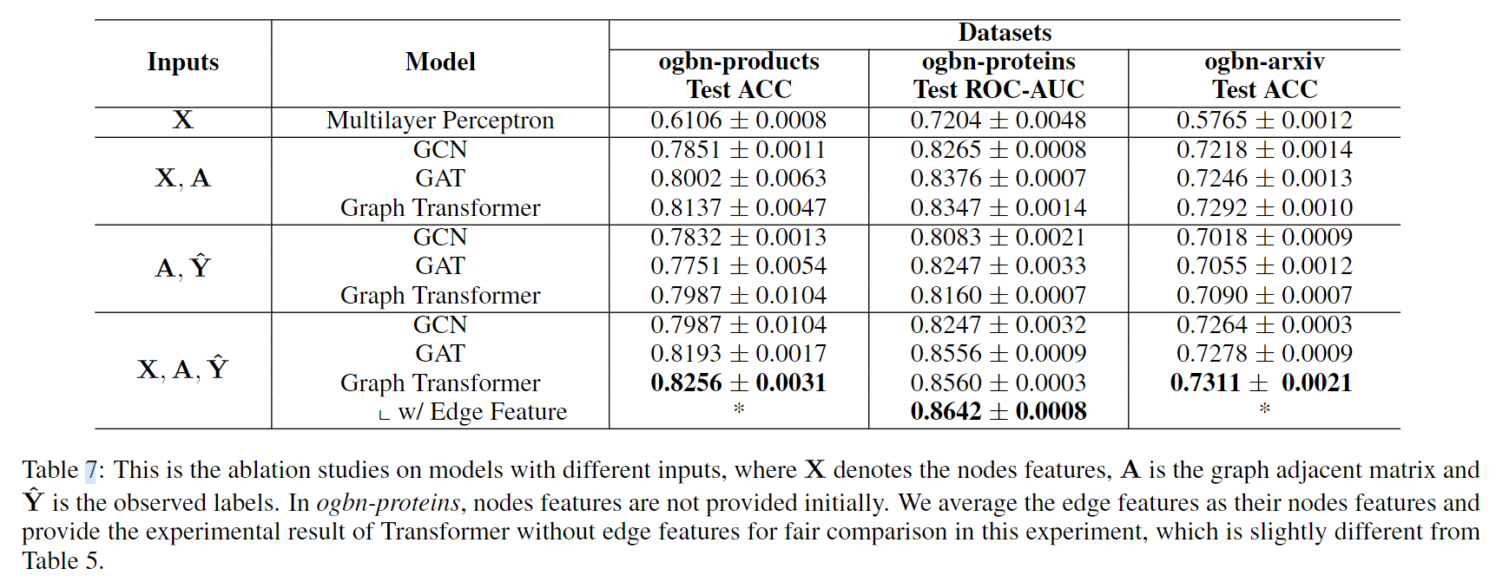
实验结果
“Masked Label Prediction: Unified Message Passing Model for Semi-Supervised Classification” Yunsheng Shi et al. IJCAI(2021).

Slide 10
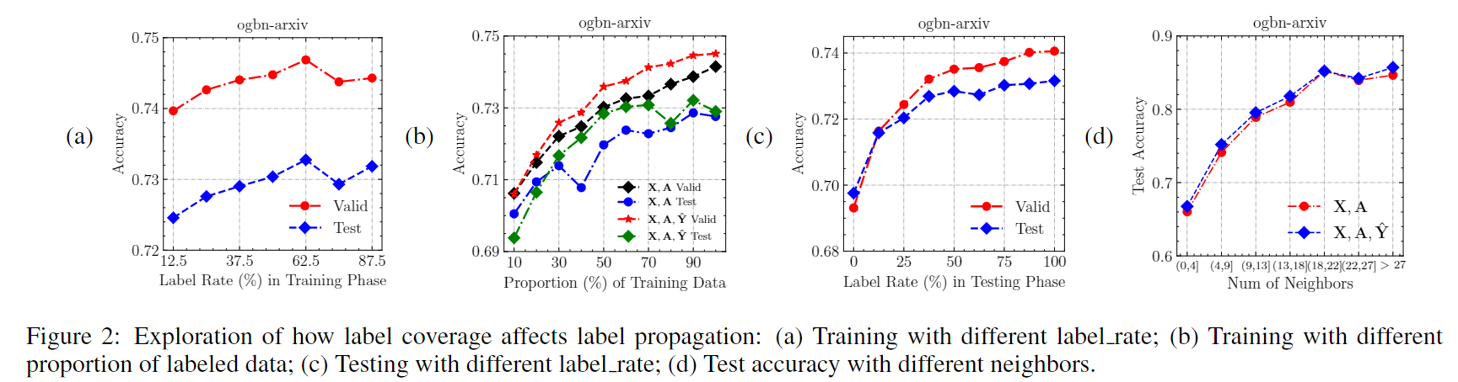
实验结果
“Masked Label Prediction: Unified Message Passing Model for Semi-Supervised Classification” Yunsheng Shi et al. IJCAI(2021).

Slide 11
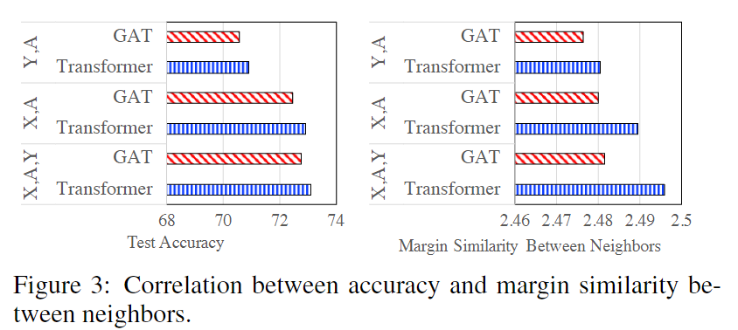
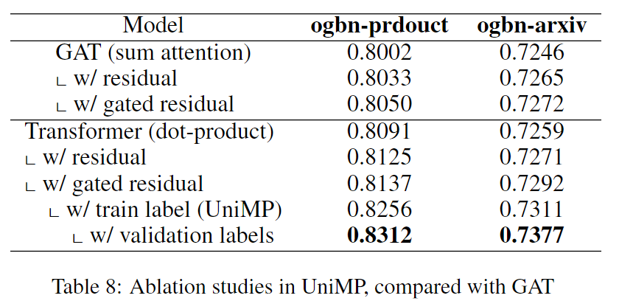
实验结果
“Masked Label Prediction: Unified Message Passing Model for Semi-Supervised Classification” Yunsheng Shi et al. IJCAI(2021).

