Slide 1
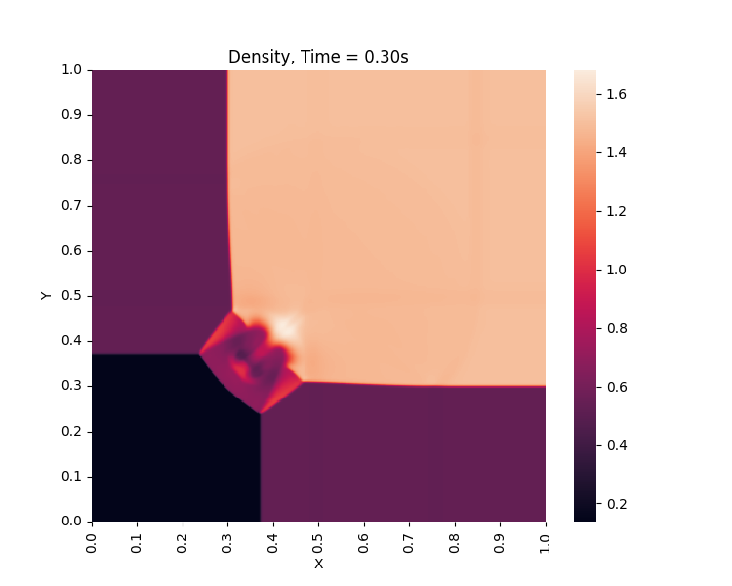
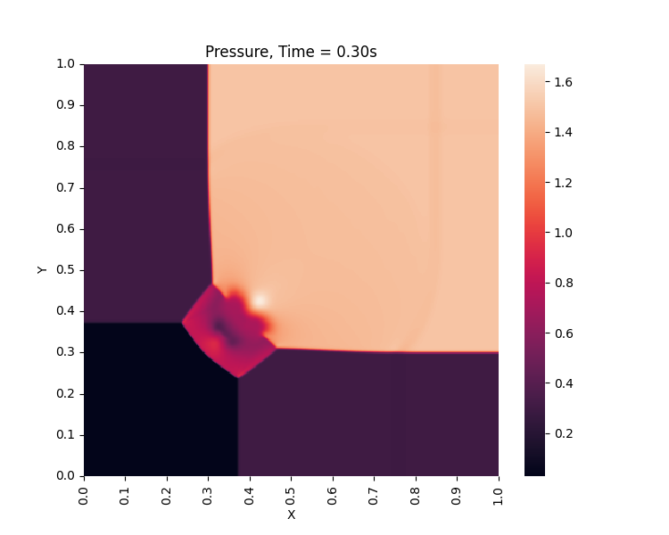
CPU (Intel i9), Qudrant Test, 400*400, CFL=0.8, tStop=0.3, Domain: x∈[0,1], y∈[0,1]
=== Timing Results ===
Total execution time: 99.97 sec
computeTimeStep: 6.785 sec
Boundary Conditions: 0.018 sec
X-direction evolution: 44.485 sec
Y-direction evolution: 42.919 sec

Slide 2

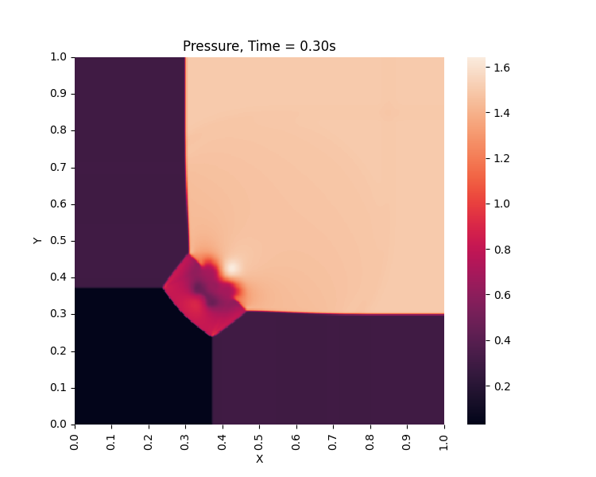
GPU (RTX 4070), Qudrant Test, 400*400, CFL=0.8, tStop=0.3, Domain: x∈[0,1], y∈[0,1]
=== Timing Results ===
Total execution time: 2.191 sec
computeTimeStep: 0.51 sec
Boundary Conditions: 0.008 sec
X-direction evolution: 0.849 sec
Y-direction evolution: 0.821 sec

Slide 3
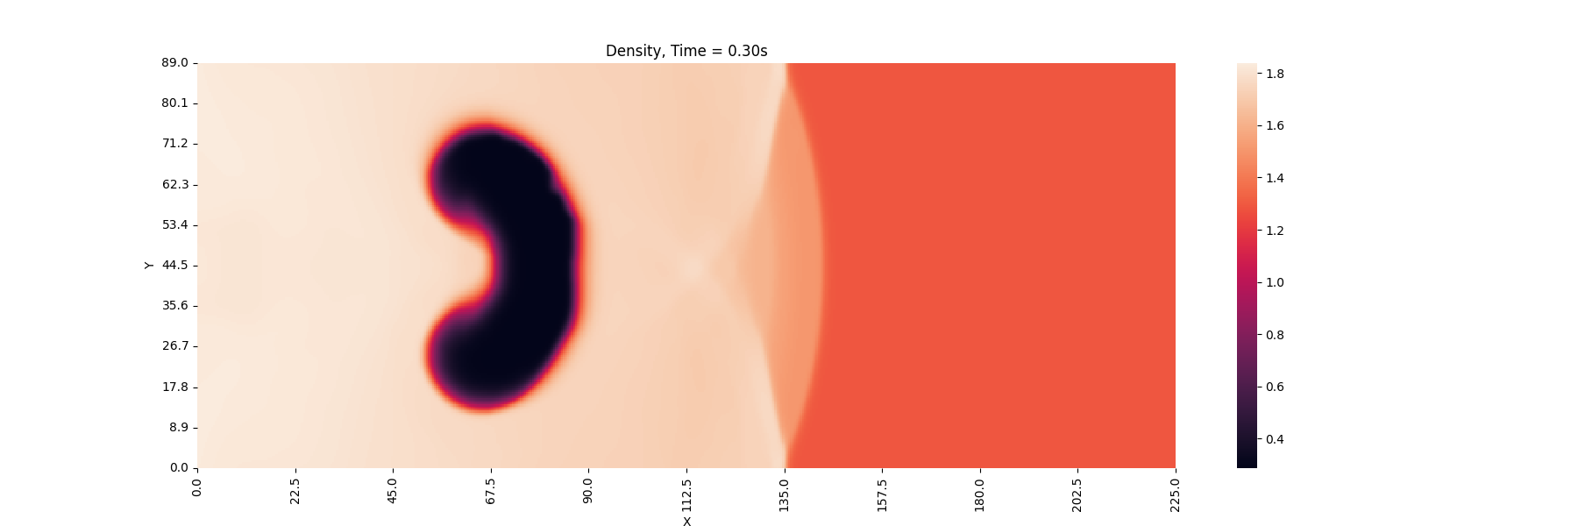
CPU (Intel i9), Shock-Bubble Test, 500*197, CFL=0.8, tStop = 0.3, Domain: x∈[0,255], y∈[0,89]
=== Timing Results ===
Total execution time: 134.389 sec
computeTimeStep: 9.213 sec
Boundary Conditions: 0.049 sec
X-direction evolution: 59.624 sec
Y-direction evolution: 58.061 sec

Slide 4
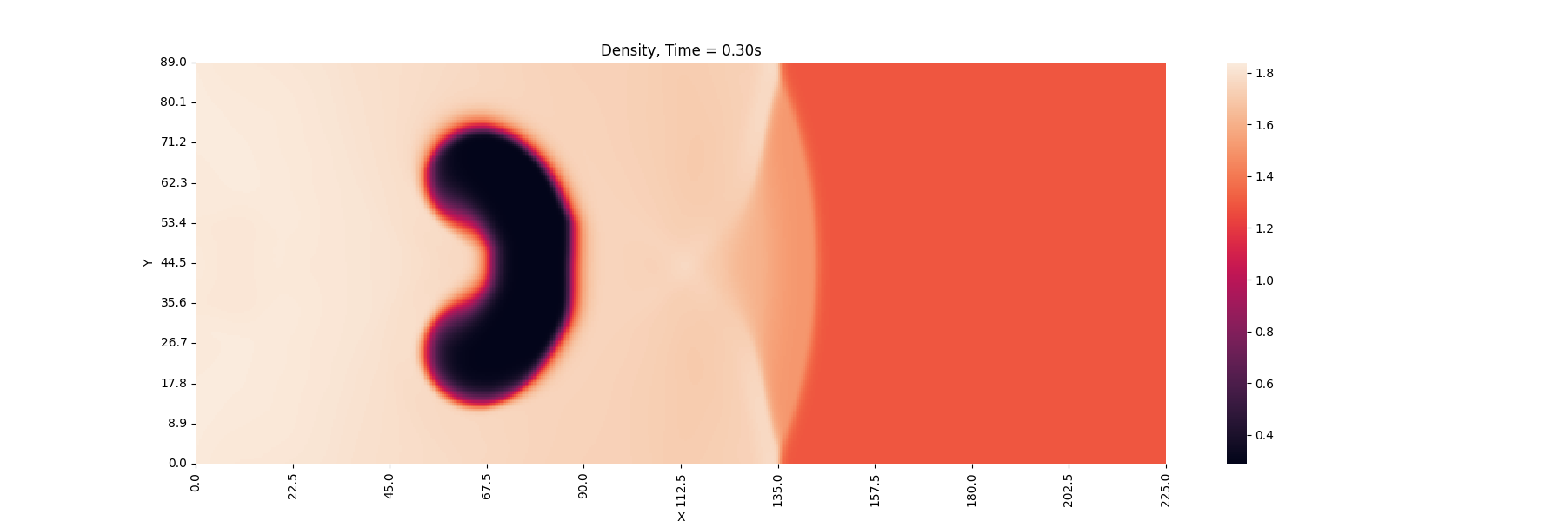
GPU (RTX 4070), Shock-Bubble Test, 500*197, CFL=0.8, tStop = 0.3, Domain: x∈[0,255], y∈[0,89]
=== Timing Results ===
Total execution time: 3.104 sec
computeTimeStep: 0.738 sec
Boundary Conditions: 0.023 sec
X-direction evolution: 1.18 sec
Y-direction evolution: 1.16 sec

Slide 5
GPU (RTX 4070), Shock-Bubble Test, 500*197, CFL=0.8, tStop = 0.3, Domain: x∈[0,255], y∈[0,89]
=== Kernel Resource Usage: computeAmaxOpt ===
Registers used: 40
Shared memory per block: 8192 bytes
Constant memory used: 0 bytes
Local memory per thread: 0 bytes
Max threads per block: 1024
=== Kernel Resource Usage: SLIC_Evolution_X ===
Registers used: 62
Shared memory per block: 16384 bytes
Constant memory used: 0 bytes
Local memory per thread: 0 bytes
Max threads per block: 1024
=== Kernel Resource Usage: SLIC_Evolution_Y ===
Registers used: 61
Shared memory per block: 16384 bytes
Constant memory used: 0 bytes
Local memory per thread: 0 bytes
Max threads per block: 1024

Slide 6
GPU (RTX 4070), Qudrant Test, 400*400, CFL=0.8, tStop=0.3, Domain: x∈[0,1], y∈[0,1]
=== Timing Results ===
Total execution time: 2.191 sec
computeTimeStep: 0.51 sec
Boundary Conditions: 0.008 sec
X-direction evolution: 0.849 sec
Y-direction evolution: 0.821 sec
Without time step calculation optimization:
=== Timing Results ===
Total execution time: 2.489 sec
computeTimeStep: 0.8 sec
Boundary Conditions: 0.014 sec
X-direction evolution: 0.85 sec
Y-direction evolution: 0.82 sec

Slide 7
GPU (RTX 4070), Shock-Bubble Test, 500*197, CFL=0.8, tStop = 0.3, Domain: x∈[0,255], y∈[0,89]
=== Timing Results ===
Total execution time: 3.104 sec
computeTimeStep: 0.738 sec
Boundary Conditions: 0.023 sec
X-direction evolution: 1.18 sec
Y-direction evolution: 1.16 sec
Without time ttep calculation optimization:
=== Timing Results ===
Total execution time: 3.592 sec
computeTimeStep: 1.232 sec
Boundary Conditions: 0.024 sec
X-direction evolution: 1.172 sec
Y-direction evolution: 1.162 sec

