Slide 1
Step1 Find Monitorable points
Path1
Path2
Path3
s3
Path4
Path5
Path6
Monitorable points: 通过该点的最短路的交集为该点
Monitorable = [s0,s1,s7]
s6
s0
s4
s5
s2
s1
s7

Slide 2
Step2 Find KeyPath of Monitorable points
Path1
Path2
Path3
s3
Path4
Path5
Path6
KeyPath: 从通过Monitorable point的最短路集合中选出来的能唯一确定Monitorable point的路径。
为了保证路径最少采用贪心算法：
count(p) =
for temp in Keypath p&=keypath return p.count(1)
对于s1：
第一步选择p1，p2，p4中的一条, 假设选择p1
因为count(p1)=count(p2)=count(p4)=3
count(p3)=4
第二步选择p3
因为count(p2)=count(p4)=2
count(p3)=1
keypath[s1] = [p1, p3]
s6
s0
s4
s5
s2
s1
s7

Slide 3
Step3 删除keypath上不能选择的点
Path1
Path2
Path3
s3
Path4
Path5
Path6
KeyPath为了检测到s1, 需要在keypath-s1中每条path上部署一个监测点, 但是有些点需要删除:
keypath-s1 = [p1, p3]
p1-monitor: [s0,s3]
p3-monitor: [s2,s5,s6]
需要从p1-monitor和p3-monitor中删除被检测点s1,
s6
s0
s4
s5
s2
s1
s7

Slide 4
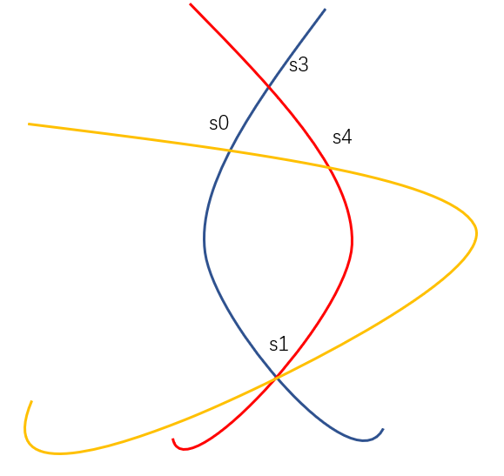
Step3 删除keypath上不能选择的点
1
2
3
s3
假设s1节点是被检测的节点
路径1,2,3两两之间分别交于2个节点, 三个路径(每个路径上都安放一个监测点)都选择的情况下才可以检测到s1出故障。但是在每个路径上安放监测点时，要避免选到路径上的交叉点。
(ex:
假如路径3选到了s0
3:{s3,s0,s1,s4,s2}
2:{s3,s4,s1}
1:{s3,s0,s1}
交集是{s3,s1}
)
依据: s0在keypath-s1中覆盖到了p1和p3所以需要删除
s0
s4
s2
s1

Slide 5
Step4 Choose Monitors by Greedy Algorithm
Path1
Path2
Path3
s3
Path4
Path5
Path6
keypath[s0] = [p1,p5]
keypath[s1] = [p1, p3]
keypath[s7] = [p5,p6]
p1-s0: [s3,s1]
p5-s0: [s7]
p1-s1: [s0,s3]
p3-s1: [s2,s5,s6]
p5-s7: [s0]
p6-s7: [s5,s6]
[s0,s1,s2,s3,s5,s6,s7]
求MaxCover
[p1-s0, p5-s0, p1-s1, p3-s1, p5-s7, p6-s7]
第一次选: s0或s5 或s3 或 s6 假设选s0
s6
s0
s4
s5
s2
s1
s7

Slide 6
Step4 Choose Monitors by Greedy Algorithm
Path1
Path2
Path3
s3
Path4
Path5
Path6
keypath[s0] = [p1,p5]
keypath[s1] = [p1, p3]
keypath[s7] = [p5,p6]
p1-s0: [s3,s1]
p5-s0: [s7]
p1-s1: [s0,s3]
p3-s1: [s2,s5,s6]
p5-s7: [s0]
p6-s7: [s5,s6]
[s0,s1,s2,s3,s5,s6,s7]
求MaxCover
[p1-s0, p5-s0, p1-s1, p3-s1, p5-s7, p6-s7]
第一次选 s0
第二次选 s5
s6
s0
s4
s5
s2
s1
s7

Slide 7
Step4 Choose Monitors by Greedy Algorithm
Path1
Path2
Path3
s3
Path4
Path5
Path6
keypath[s0] = [p1,p5]
keypath[s1] = [p1, p3]
keypath[s7] = [p5,p6]
p1-s0: [s3,s1]
p5-s0: [s7]
p1-s1: [s0,s3]
p3-s1: [s2,s5,s6]
p5-s7: [s0]
p6-s7: [s5,s6]
[s0,s1,s2,s3,s5,s6,s7]
求MaxCover
[p1-s0, p5-s0, p1-s1, p3-s1, p5-s7, p6-s7]
第一次选 s0 第二次选 s5
s6
s0
s4
s5
s2
s1
s7

Slide 8
Step4 Choose Monitors by Greedy Algorithm
Path1
Path2
Path3
s3
Path4
Path5
Path6
keypath[s0] = [p1,p5]
keypath[s1] = [p1, p3]
keypath[s7] = [p5,p6]
p1-s0: [s3,s1]
p5-s0: [s7]
p1-s1: [s0,s3]
p3-s1: [s2,s5,s6]
p5-s7: [s0]
p6-s7: [s5,s6]
[s0,s1,s2,s3,s5,s6,s7]
求MaxCover
[p1-s0, p5-s0, p1-s1, p3-s1, p5-s7, p6-s7]
第一次选 s0
第二次选 s5
第三次选 s7
第四次选 s3
s6
s0
s4
s5
s2
s1
s7

Slide 9
Step4 根据贪心算法选择Monitor
Path1
Path2
Path3
s3
Path4
Path5
Path6
keypath[s0] = [p1,p5]
keypath[s1] = [p1, p3]
keypath[s7] = [p5,p6]
p1-s0: [s3,s1]
p5-s0: [s7]
p1-s1: [s0,s3]
p3-s1: [s2,s5,s6]
p5-s7: [s0]
p6-s7: [s5]
[s0,s1,s2,s3,s5,s6,s7]
求MaxCover
[p1-s0, p5-s0, p1-s1, p3-s1, p5-s7, p6-s7]
Monitor = [s0,s5,s7,s3]
Monitorable points = [s0,s1,s7]
s6
s0
s4
s5
s2
s1
s7

Slide 10
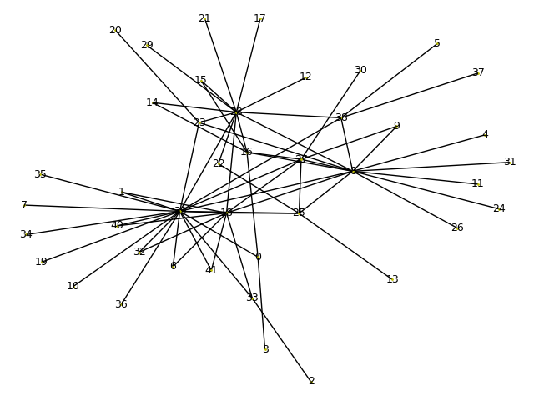
ChinaNet选点结果
0 :3: (0, 3 2) 1: (0, 1 3) 1 :18: (1, 18 2) 0: (0, 1 3) 6 :18: (6, 18 2) 0: (0, 6 3) 8 :4: (4, 8 2) 0: (0, 8 3) 9 :8: (8, 9 2) 0: (0, 9 4) 14 :16: (14, 16 2) 1: (1, 14 4) 15 :16: (15, 16 2) 1: (1, 15 4) 16 :0: (0, 16 2) 8: (4, 15 4) 18 :1: (1, 18 2) 0: (0, 18 3) 22 :25: (22, 25 2) 0: (0, 22 4) 23 :8: (8, 23 2) 0: (0, 20 4) 25 :8: (8, 25 2) 0: (0, 13 4) 27 :8: (8, 27 2) 0: (0, 9 4) 28 :8: (8, 28 2) 0: (0, 12 4) 32 :18: (18, 32 2) 0: (0, 32 3) 33 :2: (2, 33 2) 0: (0, 33 3) 38 :5: (5, 38 2) 0: (0, 37 4) 39 :0: (0, 39 2) 2: (1, 2 4) 40 :18: (18, 40 2) 0: (0, 40 3) 41 :18: (18, 41 2) 0: (0, 41 3)
Notes:
3 39 18 4 8 27 16 0 1 25 5 2

