Slide 1
Pingmesh: A Large-Scale System for Data Center Network Latency Measurement and Analysis
Presented by Tuo Yu

Slide 2
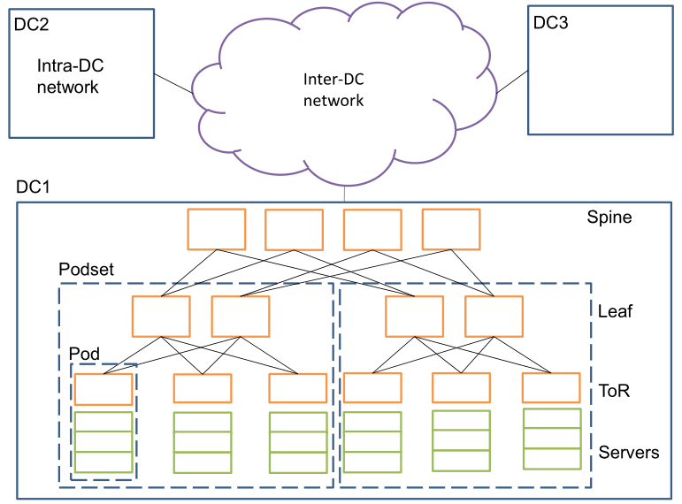
Data Center Networks
[1] Guo et al, “Pingmesh: A Large System for Data Center Network Latency Measurement and Analysis”, SIGCOMM 2015
Notes:
Before I introduce this paper, let’s have a brief review on the structure of datacenter networks.
This Figure shows a typical data center network structure.

Slide 3
Data Center Networks
[1] Guo et al, “Pingmesh: A Large System for Data Center Network Latency Measurement and Analysis”, SIGCOMM 2015
Notes:
The network has two parts: intra data center (Intra-DC) network and inter data center (Inter-DC) network.

Slide 4
Data Center Networks
ToR switch
Servers
[1] Guo et al, “Pingmesh: A Large System for Data Center Network Latency Measurement and Analysis”, SIGCOMM 2015
Notes:
A intra-dc network consists of several tiers. At the first tier, tens of servers connect to a top-of-rack (ToR) switch and form a Pod.

Slide 5
Data Center Networks
Leaf
switches
[1] Guo et al, “Pingmesh: A Large System for Data Center Network Latency Measurement and Analysis”, SIGCOMM 2015
Notes:
Tens of ToR switches (e.g., 20) are then connected to a second tier of Leaf switches (e.g., 2-8). These servers and ToR and
Leaf switches form a Podset.

Slide 6
Data Center Networks
Spine
switches
[1] Guo et al, “Pingmesh: A Large System for Data Center Network Latency Measurement and Analysis”, SIGCOMM 2015
Notes:
Multiple Podsets then connect to a third tier of Spine switches

Slide 7
Data Center Networks
[1] Guo et al, “Pingmesh: A Large System for Data Center Network Latency Measurement and Analysis”, SIGCOMM 2015
Notes:
Using existing Ethernet switches, an intra-DC network can connect tens of thousands or more servers with high network capacity.

Slide 8

Motivation
In such large systems, software and hardware
failures are the norm rather than the exception.
Challenge 1: Determine if an application perceived latency issue is caused by the network or not.
End-to-end latency shows a sudden increase;
Network throughput degrades;
…
Around 50% of these “network” problems are not caused by the network.
Notes:
The problem is that, In such large systems, software and hardware failures are the norm rather than the exception.
As a result, the network team faces several challenges.
The first challenge is, how to Determine if an application perceived latency issue is caused by the network or not.
Actually Around 50% of these “network” problems are not caused by the network. Many failures happen outside of network show as “network" problems.

Slide 9
Motivation
Challenge 2: Define and track network service level agreements (SLAs).
The performance guarantees provided by the network need to be tracked individually because different services may use different set of servers and different part of the network.
Notes:
The second challenge is that, how to Define and track network service level agreements (SLAs).
Many services need the network to provide certain performance guarantees.
Network SLA needs to be measured and tracked individually
for different services since they may use different set
of servers and different part of the network.

Slide 10
Motivation
Challenge 3: Network troubleshooting.
Live-site incidents(events that impact customers) need to be detected, mitigated, and resolved as soon as possible.
It is hard to locate the problem in the case of millions of components.
Notes:
The 3rd challenge is that, since there are millions of components in the network, it is hard to quickly locate the problem when the Live-site incidents happen. Live-site incidents are the events that impact customers.

Slide 11
Motivation
Can we get network latency between any two servers at any time in large-scale data center networks?
Notes:
To solve these problems, one idea is to measure the network latency between servers in the network, which can help for network analysis. So the main question is, Can we get network latency between any two servers at any time in large-scale data center networks?

Slide 12
Network Latency
Network latency: the time interval from the time Application A sends the message to the time Application B receives the message. A and B are at different servers.
In practice, use roundtrip-time (RTT) to indicate network latency.
Does not need to synchronize the server clocks.
Notes:
In this paper, the network latency is defined as the time interval from the time Application A sends the message to the time Application B receives the message. A and B are at different servers.
Note that this definition is based on the application's point of view.
In practice we measure roundtrip-time (RTT), because RTT measurement does not need to synchronize the server clocks.

Slide 13
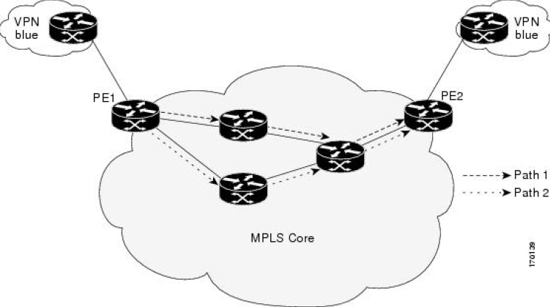
Related Work
Cisco IPSLA
Runs at Cisco switches.
Collects network latency, packet loss, server response time, and even voice quality scores.
IPSLA works only for Cisco devices.
IPSLA does not provide any data analysis plane.
Cisco. IP SLAs Conguration Guide, Cisco IOS Release 12.4T.
http://www.cisco.com/c/en/us/td/docs/ios-xml/ios/ipsla/conguration/12-4t/sla-12-4t-book.pdf.

Slide 14
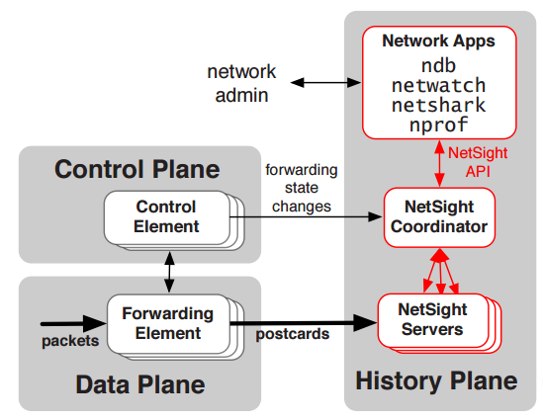
Related Work
NetSight
Tracks packet history by applying postcard filters at switches.
Network troubleshooting services, netshark, ndb
can be built on top of NetSight.
NetSight needs to introduce additional rules into the switches.
Nikhil Handigol, Brandon Heller, Vimalkumar
Jeyakumar, David Mazieres, and Nick McKeown.
I Know What Your Packet Did Last Hop: Using
Packet Histories to Troubleshoot Networks. In
NSDI, 2014.

Slide 15
Pingmesh
Pingmesh is a large-scale system for data center network latency measurement and analysis.
Pingmesh leverages all the servers to launch TCP/HTTP pings to provide the maximum latency measurement coverage.
Notes:
In this paper, the authors present Pingmesh, which is a large-scale system for data center network latency measurement and analysis.
Pingmesh leverages all the servers to launch TCP or HTTP pings to provide the maximum latency measurement coverage.
后面跟上design goals

Slide 16
Design Goals
Always-on
Needs to track the network status all the time.
Provides network latency data for all the servers
The maximum data coverage is essential for management and troubleshooting.
Current network tools cannot be used because they are not always-on and can only work when a source-destination pair is known.
Notes:
There are two design goals for Pingmesh. First it must be Always-on, because We need to track the network status all the time.
Second, it need to Provide network latency data for all the servers, because The maximum data coverage is essential for management and troubleshooting.
Therefore Current network tools cannot be used because they are not always-on and can only work when a source-destination pair is known.

Slide 17
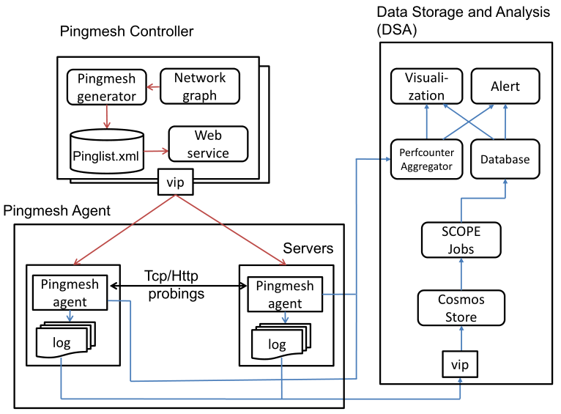
Pingmesh Architecture
Notes:
As shown in this figure, the architecture of XX consists of three parts: The XX controller, the XX agent, and the Data storage and analysis, in short, DSA component.

Slide 18
Pingmesh Architecture
Notes:
The XX controller is the brain of the whole system. it decides how servers should probe each other.
Based on the network topology, it generates a pinglist file for every server. The pinglist filecontains the list of peer servers to ping.

Slide 19
Pingmesh Architecture
Download
pinglist
Notes:
Every server runs a Pingmesh Agent. It downloads the pinglist from the Pingmesh Controller, and then launches TCP/HTTP pings to the
peer servers in the pinglist.
It periodically upload the measured data to the DSA. It also do some calculations on the measured data, and these data are also collected by DSA.

Slide 20
Pingmesh Architecture
Notes:
DSA uses a pipeline to stored and processed the data uploaded by the XX agent.
Latency data is stored in Cosmos. SCOPE jobs are developed to analyze the data.
The analyzed results are then stored in an SQL database.
The PA also collects the data calculated by the XX agent.
Reports and alerts are generated based on the data in this database and the PA counters.
Let’s look at XXX one by one.
(SCOPE jobs are written in declarative language similar to SQL)

Slide 21
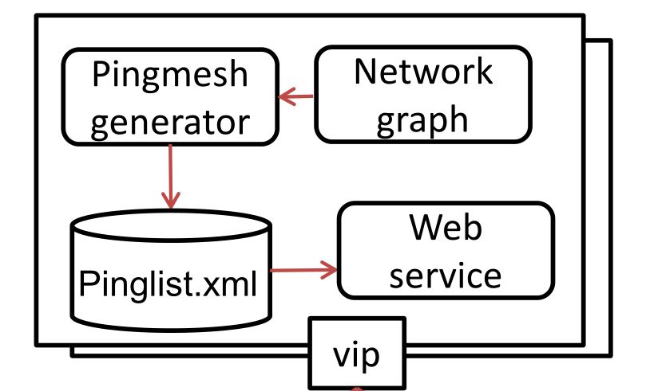
Pingmesh Controller
Pingmesh Generator (core)
Runs an algorithm to decide which server should ping which set of servers.
Following a server-level complete graph is costly.
A server needs to probe hundreds of thousands servers.
Notes:
For the Pingmesh Controller, its core is the Pingmesh Generator, which Runs an algorithm according to a network graph to decide which server should ping which set of servers.
However, following a server-level complete graph is not feasible because a server needs to probe hundreds of thousands servers.

Slide 22
Multiple Level of Complete graphs
Within a Pod, all the servers under the same ToR switch form a complete graph.
Pod
ToR switch
Servers
Notes:
We then come up with a design of multiple level of
complete graphs. Within a Pod, we let all the servers
under the same ToR switch form a complete graph.

Slide 23
Multiple Level of Complete graphs
At intra-DC level, we treat each ToR switch as a virtual node, and let the ToR switches form a complete graph.
Intra-DC level
Spine
Spine
Spine
Spine
Leaf
Leaf
Leaf
Leaf
ToR
ToR
ToR
ToR
ToR
ToR
Notes:
At intra-DC level, we treat each ToR switch as a virtual
node, and let the ToR switches form a complete graph.

Slide 24
Multiple Level of Complete graphs
Inter-DC level
At inter-DC level, each data center acts as a virtual node, and all the data centers form a complete graph.
Notes:
At inter-DC level, each data center acts as a virtual
node, and all the data centers form a complete graph.

Slide 25


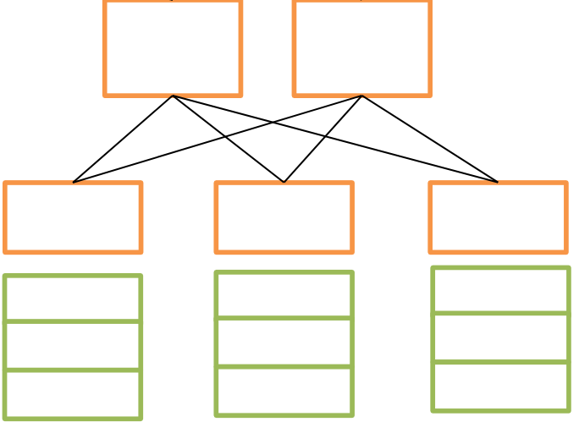
Pinglist Generation Algorithm
Intra-DC algorithm: for any ToR-pair ( , ), let server i in ping server i in .

Slide 26
Pinglist Generation Algorithm
Intra-DC algorithm: for any ToR-pair ( , ), let server i in ping server i in .

Slide 27
Pinglist Generation Algorithm
Intra-DC algorithm: for any ToR-pair ( , ), let server i in ping server i in .

Slide 28
Pinglist Generation Algorithm
Intra-DC algorithm: for any ToR-pair ( , ), let server i in ping server i in .

Slide 29
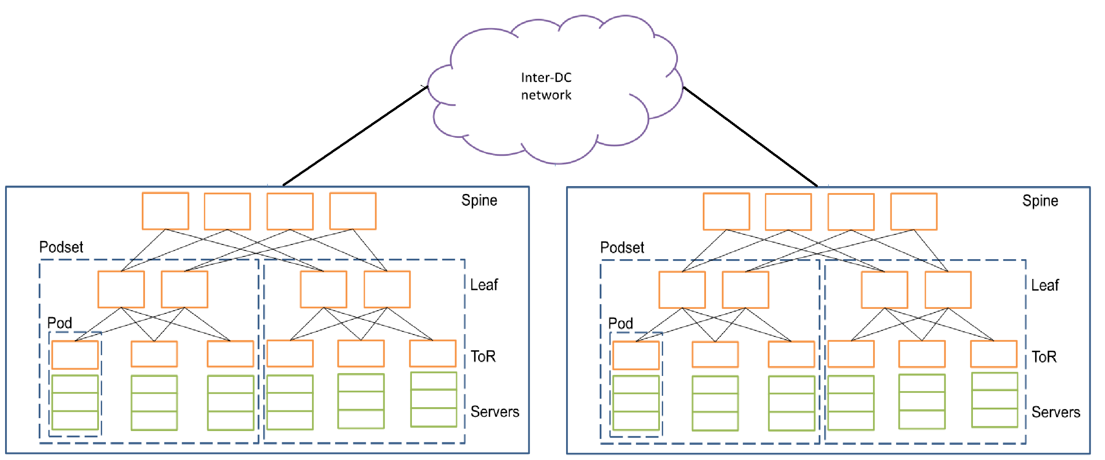
Pinglist Generation Algorithm
Inter-DC level: In each DC, the Pingmesh controller selects a number of servers (with several servers selected from each Podset).
Notes:
In the Inter-DC level, In each DC, we select a number of servers (with several servers selected from each Podset).
Combining the three complete graphs, a server in Pingmesh needs to ping 2000-5000 peer servers depending on the size of the data center.
The Pingmesh Controller
uses threshold values to limit the total number of
probes of a server and the minimal time interval of two
successive probes for a source destination server pair.

Slide 30
Pingmesh Controller - Implementation
Pingmesh Controller is implemented as an Autopilot service.
Autopilot is a centralized data center management system.
Pingmesh Agents downloads pinglist files from Pingmesh Controller with a simple Web API.
A Pingmesh Controller has a set of servers behind a single VIP (virtual IP address).
Notes:
For the implementation detail, Pingmesh Controller is implemented as an Autopilot service and becomes part of the Autopilot management stack. Where Autopilot is a centralized data center management systems.
Pingmesh Agents can downloads Pinglist files from Pingmesh Controller with a simple Web API.
A Pingmesh Controller has a set of servers behind a single VIP (virtual IP address). A Software Load-Balancer is used to distributes the requests to the servers.

Slide 31
Pingmesh Agent
Tasks:
Downloads pinglist from Pingmesh Controller.
Pings the servers in the pinglist.
Uploads the ping result to DSA.
Notes:
Now we come to the Pingmesh Agent. Its task is simple:
Download pinglist from Pingmesh Controller.
Ping the servers in the pinglist.
Upload the ping result to DSA.

Slide 32
Pingmesh Agent
Acts as both client and server for ping.
Uses specifically designed network library instead of the libraries used by the applications.
To differentiate if a “network” issue is caused by the network or the applications.
Notes:
During this process it Act as both client and server for ping.
To differentiate if a “network” issue is caused by the network or the applications.
It Use specifically designed network library instead of the libraries used by the applications

Slide 33
Pingmesh Agent - Implementation
Must be fail-closed and not create live-site incidents.
The OS confines the CPU and maximum memory usages.
Limits the minimum probe interval and the probe payload length.
Stops all its ping activities when it loses the connect to the controller.
Discards the in-memory data when it cannot upload latency data.
Notes:
For the Implementation of Pingmesh Agent , it Must be fail-closed and not create live-site incidents.
The authors used several methods. For instance,
The OS confines the CPU and maximum memory usages.
Limits the minimum probe interval and the probe payload length.
Stops all its ping activities when it loses the connect to the controller.
Discards the in-memory data when it cannot upload latency data.

Slide 34
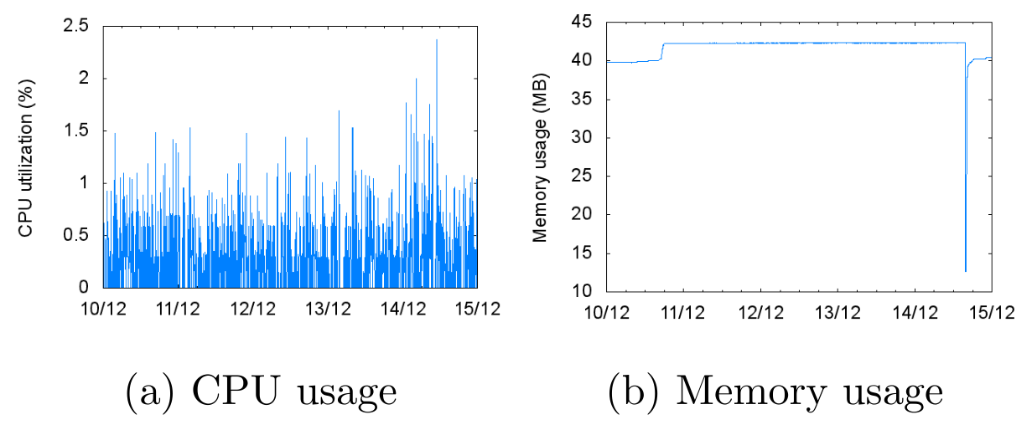
Pingmesh Agent - Implementation
Should minimize resources usage.
Use C++ instead of Java or C#.
Use a specifically-developed network library.
Average memory footprint < 45MB
Average CPU usage: 0.26%.
Notes:
Also, it Should minimize resources usage.
To realize this, the authors use C++ instead of Java or C#, and developed a network library specifically for Pingmesh.
The result of evaluation shows that Average memory footprint < 45MB
Average CPU usage: 0.26%.

Slide 35
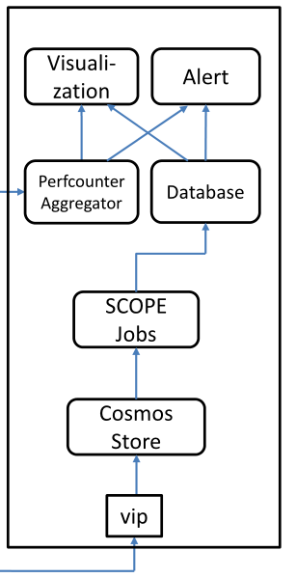
Data Storage and Analysis (DSA)
Performance counters:
Packet drop rate,
Network latency at the 99th percentile,
…
Latency Data
Notes:
The DSA, as I have mentioned before, it has two inputs. The Latency Data, and the Performance counters such as the packet drop rate,
Network latency at the 99th percentile, and so on, which are calculated by the angent.

Slide 36
Pipelines
10-min jobs (near real-time):
For alert triggering and dashboard figure generation.
20-min delay.
1-hour and 1-day jobs:
For network SLA tracking,
network black-hole detection,
packet drop detection, etc.
Notes:
DSA uses two pipelines to process data. The first pipeline consists of XXX and XXX.
Once the results are in Cosmos, we run a set of SCOPE
jobs for data processing.
The job consists of three types: 10-min jobs, 1-hour and 1-day jobs:
The 10-min jobs is near real-time. Its results will fire the alert, or generate the figure for network monitor.
The 1-hour and 1-day jobs is for network SLA tracking,
network black-hole detection,
packet drop detection, etc.
The results of the
SCOPE jobs are stored in a SQL database,

Slide 37
Pipelines
Perfcounter Aggregator pipeline
Collects and aggregates a set of Pingmesh counters.
Faster but less expressive.
Both the two pipelines are used.
Notes:
The second pipeline is the perfcounter Aggregator.
It Collects and aggregates a set of Pingmesh counters.
Compared with the previous pipeline, it is Faster but less expressive.
SO Both the two pipelines are used

Slide 38
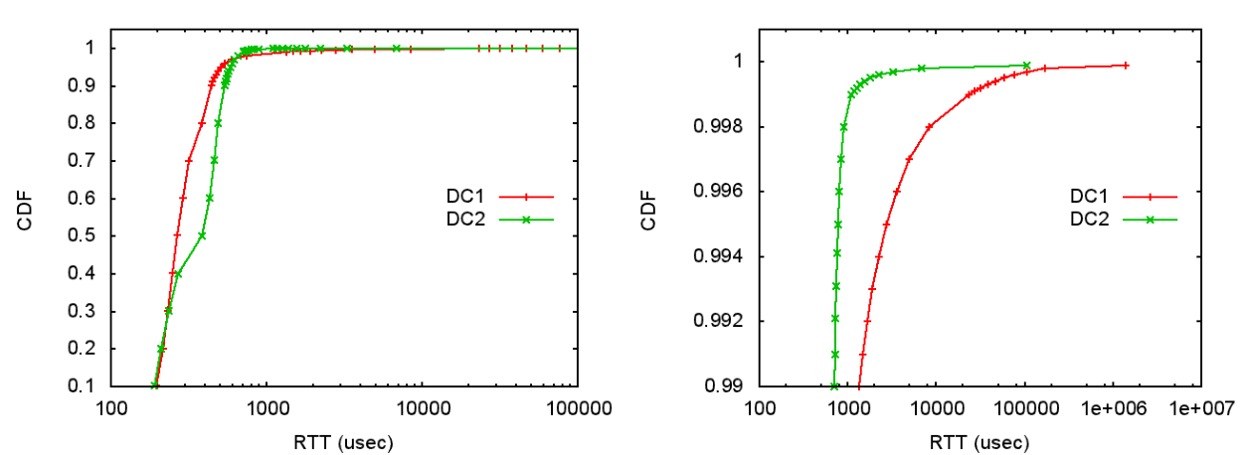
Latency Data Analysis
DC1: heavy network usage, always busy.
DC2: latency sensitive, high fan-in and fan-out, low network throughput, the traffic is bursty.
Inter-pod latency
At high percentile
Notes:
Then the authors show how XXX help to analyze the network latency.
These two figures show the latency distribution of two DC.
DC1 are throughput intensive and use the network heavily
DC2 is latency sensitive, and servers have high fan-in and fan-out (a server needs to communicate
with a large number of other servers). low network throughput, the traffic is bursty.
The left figure shows that DC1 has much higher latency at the high percentile.
Our measurement result shows it is hard to provide low latency at three or four 9s.
This is because the server OS is not a real-time operating system and the traffic in our network is burst.

Slide 39
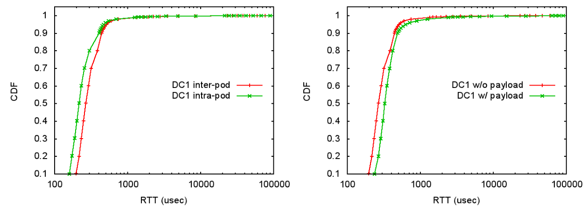
Latency Data Analysis
Intra-pod and inter-pod latency comparison
Latency comparison with and without payload
Notes:
Figure 4(c) compares the intra-pod and inter-pod latency
distributions, and Figure 4(d) studies the interpod
latency with and without payload, all in DC1
As shown in this figure, intra-pod latency is always
smaller than inter-pod latency as expected.
The right figure shows that payload will increase latency.

Slide 40
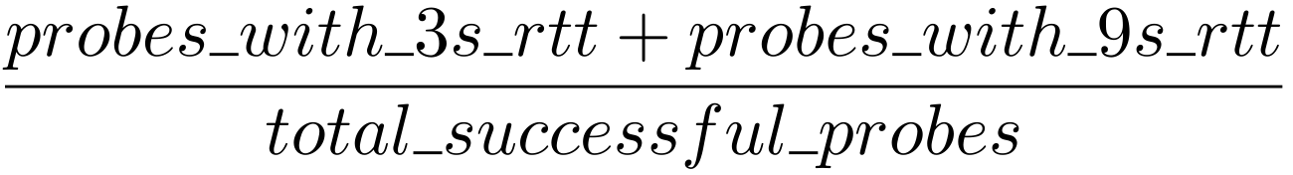
Packet Drop Rate Analysis
Infer packet drop rate from the TCP connection setup time.
First SYN dropped: TCP resends SYN after timeout.
The rest retries: TCP doubles the timeout value every time.
TCP connection RTT ≈ 3 seconds -> one packet drop
TCP connection RTT ≈ 9 seconds -> two packet drops
Drop Rate =
Notes:
The author also introduce how to calculate the packet drop rate.
They did not measure the drop rate directly. Instead, they infer packet drop rate from the TCP connection setup time.
When the first SYN packet is dropped, TCP sender will retransmit the packet after an initial timeout. For the rest successive retries, TCP will double the timeout value every time.
Hence if the measured
TCP connection RTT is around 3 seconds, there is one
packet drop; if the RTT is around 9 seconds, there are
two packet drops.
Therefore the drop rate is equal to the number of probes with 3s rtt plus XXXX 9s rtt, divided by # of total XXX.
Note that we only count one packet drop instead of two for every connection with 9 second
RTT. This is because successive packet drops within a
connection are not independent: the probability the second
SYN is dropped is much higher if the first SYN is dropped.

Slide 41
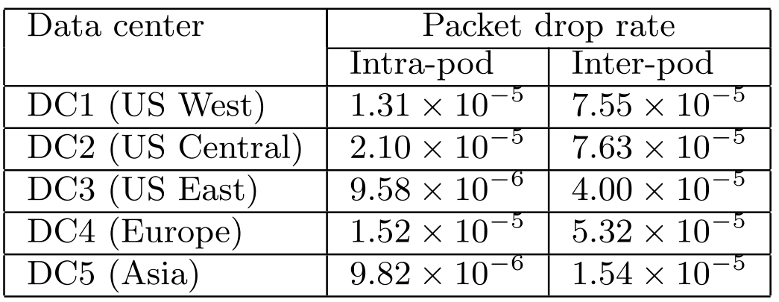
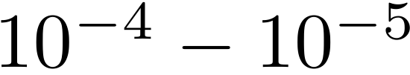
Packet Drop Rate Analysis
The drop rate is in the range unless network incidents happen.
The inter-pod packet drop rate is typically several times higher than that of intra-pod.
Notes:
Table 1 shows the packet drop rates of five data centers.
We can see that the drop rate is in the range ten to the negative four to ten to the negative five unless network incidents happen.
This implies that we can use this rule to detect whether a network incident happens.
Also,
The inter-pod packet drop rate is typically several times higher than that of intra-pod. This indicates most of
the packet drops happen in the network instead of the
hosts.

Slide 42
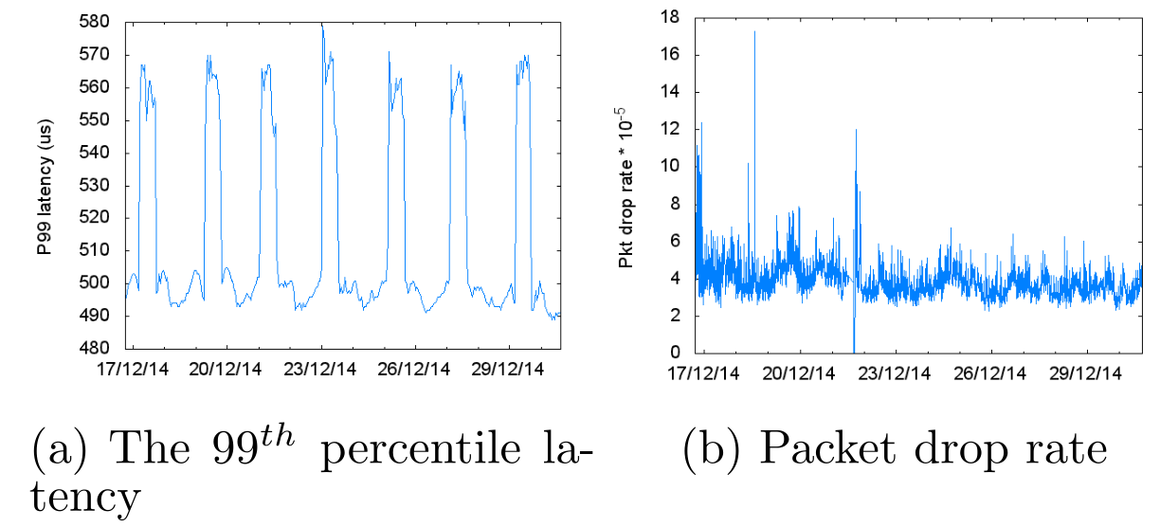
Is it a network issue?
Two network SLA metrics:
Packet drop rate.
Network latency at the 99th percentile.
If these two metrics change significantly, then it is a network issue.
Notes:
Then let’s answer the question: how to determine whether a drop in network performance is really caused by a network issue?
The authors found two useful SLA metrics:
Packet drop rate.
Network latency at the 99th percentile.
If these two metrics change significantly, then it is a network issue.
With the help of XXX, we can easily calculate the results for these two metrics. These figures show a example for a service.
During this one week period, the drop rate and the latency at 99th percentile are nearly stable.

Slide 43
Silent Packet Drop Detection
Silent Packet Drop: the switches do not show information about packet drop and the switches seem innocent.
Packet black-hole
Silent random packet drops
Notes:
The authors use the example of Silent Packet Drop Detection to show the benefit of XXXX.
The Silent Packet Drop: the switches do not show information about packet drops and the switches seem innocent.
It has two types: Packet black-hole and Silent random packet drops.
Let’s look at them one by one.

Slide 44
Packet Black-hole Detection
Packet black-hole: packets that meet certain ‘patterns’ are dropped deterministically (i.e., 100%) by the switch.
Caused by corrupted TCAM table or ECMP-related errors.

Slide 45
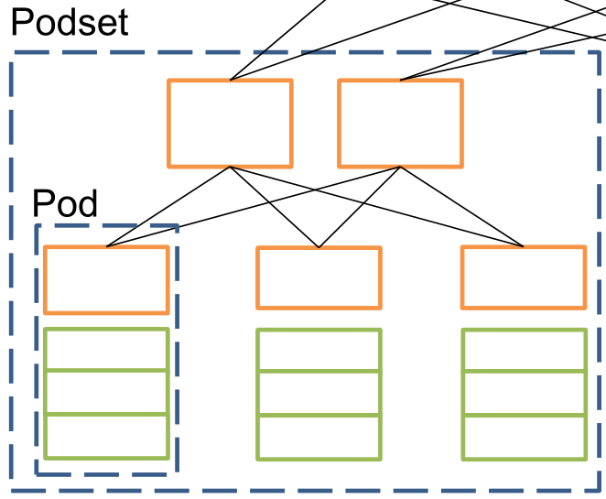
Packet Black-hole Detection
ToR switch black-hole detection algorithm
In a Pod, if the ratio of servers with black-hole symptom is larger than a threshold -> Its ToR switch is a black-hole candidate.
Notes:
ToR switch black-hole detection algorithm is proposed in this paper.
In a Pod, if the ratio of servers with black-hole symptom is larger than a threshold -> Its ToR switch is a black-hole candidate.
In a Podset,
If only part of the ToRs are candidates -> Restart the ToRs.
If all the ToRs are candidates -> Error is in the Leaf or Spine layer.

Slide 46
Packet Black-hole Detection
ToR switch black-hole detection algorithm
In a Podset,
If only part of the ToRs are candidates -> Restart the ToRs.
Restart
Restart
Notes:
ToR switch black-hole detection algorithm is proposed in this paper.
In a Pod, if the ratio of servers with black-hole symptom is larger than a threshold -> Its ToR switch is a black-hole candidate.
In a Podset,
If only part of the ToRs are candidates -> Restart the ToRs.
If all the ToRs are candidates -> Error is in the Leaf or Spine layer.

Slide 47
Packet Black-hole Detection
ToR switch black-hole detection algorithm
In a Podset,
If all the ToRs are candidates -> Error is in the Leaf or Spine layer.
Upper layer problem
Notes:
ToR switch black-hole detection algorithm is proposed in this paper.
In a Pod, if the ratio of servers with black-hole symptom is larger than a threshold -> Its ToR switch is a black-hole candidate.
In a Podset,
If only part of the ToRs are candidates -> Restart the ToRs.
If all the ToRs are candidates -> Error is in the Leaf or Spine layer.

Slide 48
Silent Random Packet Drops Detection
Silent random packet drops: a switch drops packet randomly.
Caused by switching fabric CRC checksum error, switching ASIC deficit, linecard not well seated, etc.
Notes:
The second type of packet drop is the Silent random packet drops. As its name implies, in this case a switch drops packet randomly.
It would be Caused by switching fabric CRC checksum error, switching ASIC deficit, linecard not well seated, etc.

Slide 49
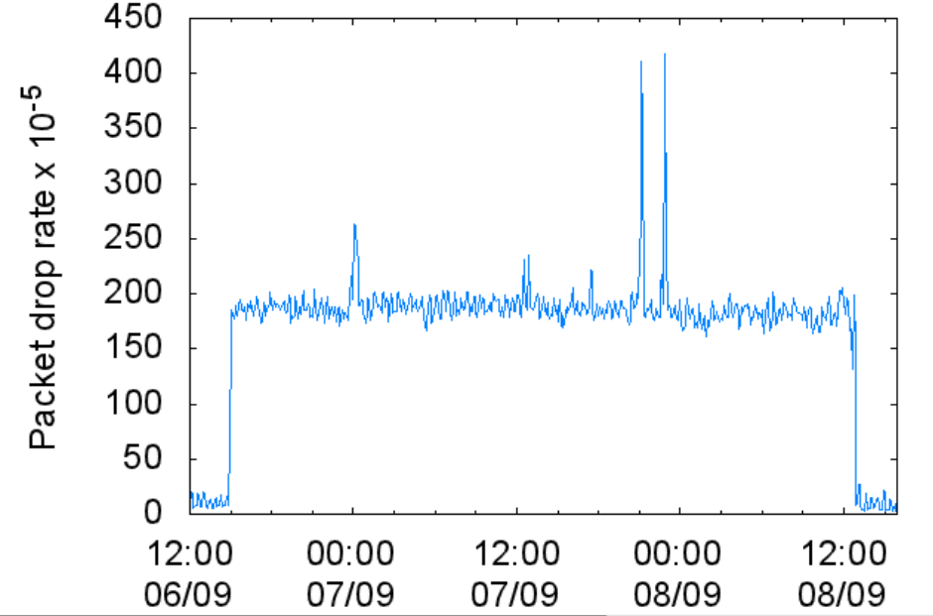
Silent Random Packet Drops Detection
Case study:
In one incident, all the users in a data center began to experience increased network latency at the 99th percentile.
Notes:
The author used an example to show how XXX helps to detect this kind of packet drop.
As shown in the figure, In one incident, all the users in a data center began to experience increased network latency at the 99th percentile. XXX can help to detect this incident in near real time.

Slide 50
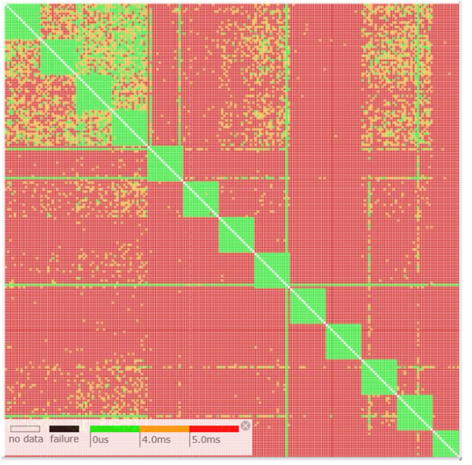
Silent Random Packet Drops Detection
Case study:
The latency between different Podsets increase for all our customers. The problem is in the Spine switch layer.
Network latency patterns
Notes:
The second step is to check the Network latency patterns between different podsets. As shown in this figure, we find that The latency between different Podsets increase for all our customers. The problem is in the Spine switch layer.

Slide 51
Silent Random Packet Drops Detection
Case study:
Cannot find any packet drop hint from the switches -> silent packet drops.
Notes:
Since no packet drop hint is found from the switches, it is the silent packet drops that have happened.

Slide 52
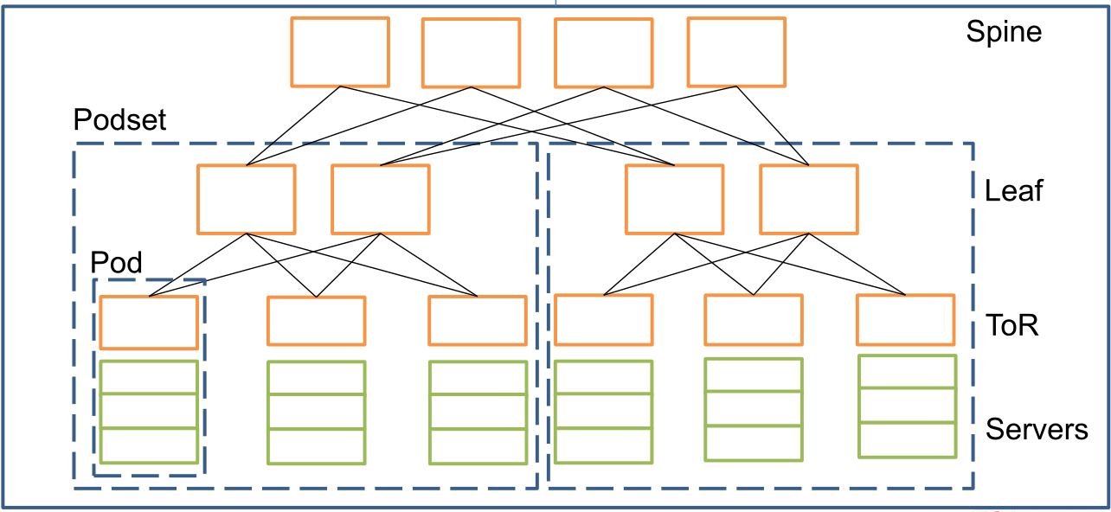
Silent Random Packet Drops Detection
Case study:
Several source and destination pairs experience high random packet drops -> pinpoint one Spine switch (need the help of TCP traceroute).
Notes:
With XXXX and TCP traceroute, we can find that Several source and destination pairs experience high random packet drops -> pinpoint one Spine switch.

Slide 53
Experiences Learned
Always-on vs on-demand
When a live-site incident occurs, having network latency data readily at hands is much better.
Network team does not even have the source destination pairs to launch latency measurement.
Always-on latency measurement enables Automatic failure detection.
Using only selected servers for measurement limits the coverage of latency data, and poses challenges on which servers should be chosen.
Notes:
The authors also summarize some Experiences learned during the development of XXXX.
The reason why they do not use on-demand latency measurement is that, When a live-site incident occurs, having network latency data readily at hands instead of collecting them at that time is a much better choice.
We do not even have the source destination pairs to launch latency measurement.
Always-on latency measurement enables Automatic failure detection.
Also, Using only selected servers for measurement limits the coverage of latency data, and poses challenges on which servers should be chosen. So that is the reason why all the servers are utilized to ping other servers.

Slide 54
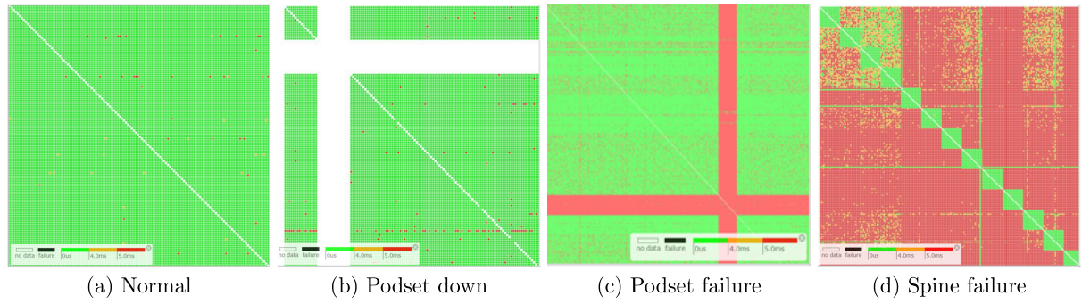
Experiences Learned
Visualization helps to detect latency patterns.
Notes:
Visualization helps to better detect various latency patterns.
In the figure, a small green, or red block
or pixel shows the network latency at the 99th percentile
between a source-destination pod-pair.
Green means
the latency is less than 4ms, yellow means the latency
is between 4-5ms, and red is for latency larger than 5ms.
A white block means there is no latency data available.
Figure 8(a) shows an (almost) all-green pattern, which
means the network works fine.
Figure 8(b) shows a pattern of a white-cross. This pattern shows a Podsetdown
scenario. Podset-down typically is due to the loss of power of the whole Podset.
Figure 8(c) shows a pattern of a red-cross. The
red-cross shows high network latency from and to the
Podset. This pattern shows there is a network issue
within the Podset,
Figure 8(d) shows a pattern of red-color with greensquares
along the diagonal. It shows that the network latencies
within the Podsets are normal, but cross-Podset latency
are all out of network SLA. It shows a network issue at
the Spine switch layer.

Slide 55
Pingmesh Limitations
Pingmesh cannot tell the exact location of a faulty network device.
Pingmesh only uses a single packet for single RTT measurement. It does not cover the case when multiple round trips are needed.
For long distance TCP sessions, the session finish time is increased by several hundreds of milliseconds if the sessions need multiple round trips.
Notes:
Pingmesh still has some limitations.
Pingmesh is able to detect which tier a faulty network device is located in, it cannot tell the exact location.
We only use SYN/SYN-ACK and a single packet for single RTT measurement. It does not cover the case when multiple round trips are needed.
For long distance TCP sessions, the session finish time increased by several hundreds of milliseconds if the sessions need multiple round trips. Pingmesh did not catch this because it only measures single packet RTT.

Slide 56
Conclusion
Pingmesh is always-on and it provides network latency data for all the servers.
Has been running in Microsoft data centers for more than four years.
Helps to answer if a service issue is caused by the network or not.
Helps to define and track network SLAs.
Becomes an indispensable service for network troubleshooting.
Notes:
So in conclusion,
Pingmesh is always-on and it provides network latency data by all the servers and for all the servers.
Has been running in Microsoft data centers for more than four years.
Helps to answer if a service issue is caused by the network or not.
Helps to define and track network SLA.
Becomes an indispensable service for network troubleshooting

Slide 57
Discussion
Pingmesh cannot tell the exact location of a faulty network device. How to improve it?
Is Pingmesh applicable to other types of networks (IoT, WSN) for latency measurement or connectivity tests?
Notes:
Ping测得的时间可能受congestion影响？
如何直接测得位置？
advantage: [18]
can directly pinpoint the switches or links that drop
packets. We have shown in Section 5.2 Pingmesh can
localize faulty devices together with traceroute.
Cisco IPSLA [8] also uses active packets for network
3. 能用在广域网络中吗？
无线网络中的ping不稳定

Slide 58
Thank you

Slide 59
RTT
Not really from the network
RTT=
Application processing latency +
OS kernel TCP/IP stack and driver processing latency +
NIC introduced latency +
Packet transmission delay +
Propagation delay +
Queuing delay introduced by switch buffering.
Our customers and service developers do not care. Once a latency problem is observed, it is usually called a “network” problem.

Slide 60
Packet Black-hole Detection
Packet black-hole: packets that meet certain ‘patterns’ are dropped deterministically (i.e., 100%) by the switch.
Type 1: packets with specific source destination IP address pairs get dropped.
Some TCAM entries in the TCAM table get corrupted
Type 2: packets with specific source destination addresses and transport port numbers are dropped.
Notes:
When the Packet black-hole happens, packets that meet certain ‘patterns’ are dropped deterministically (i.e., 100%) by the switch.
Usually the Packet black-hole have two types.

Slide 61
Experiences Learned
A switch may drop packets even though its SNMP tells us everything is fine.
Simply using switch SNMP and syslog data does not work since they do not tell us about packet black-holes and silent drops.
Notes:
With XXXX, we can find that Several source and destination pairs experience high random packet drops -> pinpoint one Spine switch.

Slide 62
Pinglist Generation Algorithm
Intra-DC algorithm: for any ToR-pair ( , ), let server i in ping server i in .
？
Notes:
Then we introduce the Pinglist Generation Algorithm.
In the Intra-DC layer, for any ToR-pair ( , ), let server i in ping server i in .
However the author did not explain clearly here. Does it mean that a server in TORx needs to probe all the servers in ToRy?
Or it needs to probe only one server?

