Slide 1


Slide 2
Network faults in modern data center networks are often transient and non-reproducible.
Further, for a given network fault, the root cause can come in many forms. For example, a packet drop due to a table miss can happen either due to a parity error or due to temporal inconsistency during a network update
we focus on the problem of finding the root cause of transient and hard-to-reproduce network faults with many possible root causes.

Slide 3
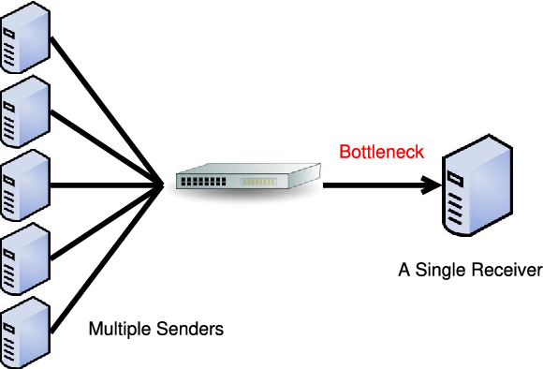
Microbursts
DFS, MapReduce
incast of synchronized application traffic. In
the other scenario, the microburst is caused by the interaction
of uncorrelated flows with different source-destinations.

Slide 4
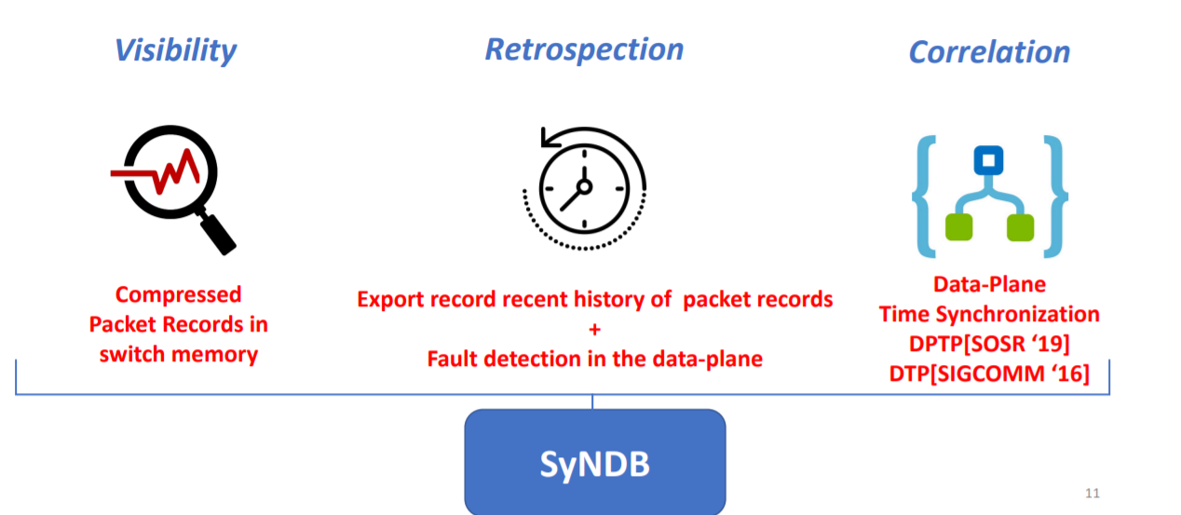

Slide 5
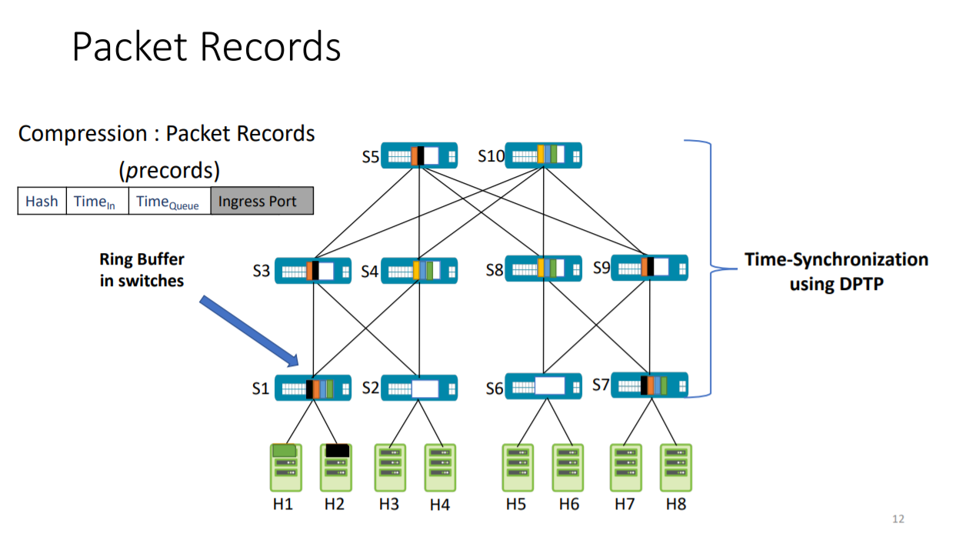

Slide 6
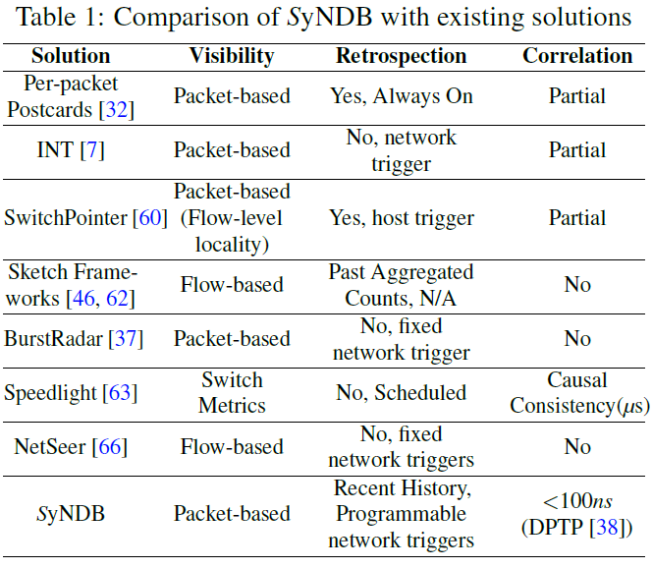
visibility, retrospection and correlation
run-time support for the operator to configure and dynamically change the operating parameters of SyNDB such as fault detection conditions and the recorded metrics, without needing to re-program the data-plane
packet-level telemetry caching mechanism in the data-plane
Notes:
While SyNDB is designed to deal with transient and hard
to-
reproduce network faults, it can be used as a tool to debug
common network faults as well

Slide 7
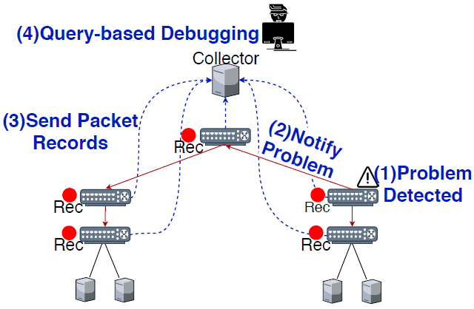
Design
Recording packet telemetry information over a moving time window in a line rate
Upon reception of trigger packets, a switch collects all the packet records from the recording window and forwards them to the collector to be stored in a database
SQL queries-Based Debug
Notes:
数据面记录时间窗口的telemetry 信息。
数据面监视触发条件，一旦满足触发条件就会广播trigger-packet去收集数据面数据
然后发送到collector，存储到关系型数据库MYSQL中
网络管理人员通过SQL语句查询来debug

Slide 8
Visibility
p-record [pID;pTimein; pTimeout]
pID: hash value of the packet headers (5-tuple flow key) and TCP/UDP checksum.
An operator can specify such additional fields via SyNDB configuration, such as queue depth, link utilization, forwarding table version, port counters.

Slide 9

Retrospection
Trigger Initiation: These triggers can be events such as congestion at a link, packet drops or packet reordering. The trigger conditions are monitored in the data-plane. Once a trigger is hit, the p-records can be transmitted to the collector.
Trigger Packet: 1) Trigger ID, 2) Trigger Type: unique type to classify trigger, and 3) Trigger Time: time when the trigger was hit
Trigger Packet
History Buffer
Future Buffer
Notes:
交换机广播trigger packet, 一旦交换机接收到trigger packet之后，发现这个id和之间的id相同就丢弃掉。如果不同，就开辟一个fix buffer去存储未来一段时间的数据。
bulk DMA read could also be employed to collect p-records. However, such techniques require additional packetization in the control-plane to forward the whole set of p-records to a controller.

Slide 10
Reducing Collection Overhead
p-Record Compression
Compress pID pID = BASE+nth
Compress pTime pTime = BASE+nth*length
Corresponding (n-bit) packet counters are sufficient to represent (2^n) packets in the same time window
Reduction on the Network Level:
Only collect selectively multicast to only the links from where the packets were received in the recent recording window.
C
Trigger Packet
A
B
D
Notes:
一条流中的数据包，可以直接让pID+1
假设一个时间窗口内的数据包是均匀到达的。

Slide 11

Correlation
Time-synchronization
To ensure causal consistency between packet records, we should see packet A leave switch X before reaching switch Y.
D = EgressDelay+DeparserDelay+MACDelay+WireDelay
Time-Out-x
Time-Out-y
Ingress pipeline
shared
buffer
Egress pipeline
Ingress pipeline
shared
buffer
Egress pipeline
|CX-CY| = Terr < D
X
Y
Notes:
Terr between neighbouring switches is in the order of tens of ns
Additionally, real world data shows that D between two adjacent switches ranges between 360 ns to 1900 ns under varying traffic conditions

Slide 12
SyNDB Debugger
collector由许多个server组成，将p-record存储在RDBMS中：
Packetrecords: Each p-record stores: 1) Switch ID, 2) Packet ID, 3) Packet Hash, 4) TCP/UDP Checksum 5) Time In, 6) Time Queued, 7) Time Out and, 8) Operator-specified statistics. Note Packet ID is just a combination of packet hash and the checksum. They are stored separately to facilitate flow-level queries as well as packet-level queries.
Triggers: Each trigger event stores: 1) Trigger Type, 2) Trigger Time, and 3) Trigger Origin Switch. This enables SyNDB to classify network faults based on the trigger type.
Links: Each link stores the endpoints and the link capacity.
Switches: This table stores the position of a switch in the topology, e.g. ToR, Aggregation, Core, etc.

Slide 13
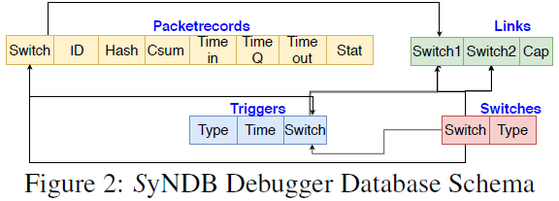
SyNDB Debugger
Notes:
解决哈希冲突： The hash collision removal is performed using a simple heuristic based on the ground-truth of the queuing time of a p-record and the identity of the switch.
Duplicate hashes found are then re-assigned with other p-record ids.
Link utilization is calculated over a window of 10 μs in the data-plane using a low-pass-filter

Slide 14
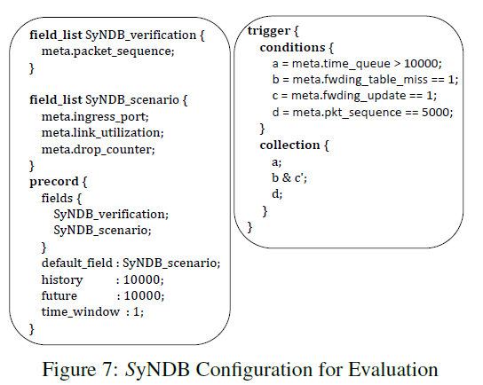
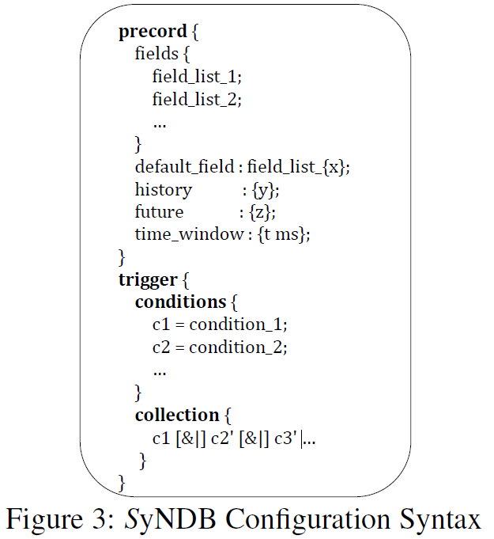
SyNDB Configuration
Notes:
network statistics
the number of p-record entries
the trigger (fault) conditions
fields specified:
switch-provided metadata (queue depth, ingress port, egress port)
packet header data (flowid),
data that is computed and stored in user metadata by the programmer (link_utilization, counters, EWMA).
翻译器：把配置文件转化为P4 代码。
b&c’指的是A交换机上发生b condition，B交换机上发生c‘ condition

Slide 15
SyNDB-Runtime

Slide 16
Implementation
SyNDB Dataplane
DPTP[SOSR ‘19]
Trigger Packet
SyNDB Runtime
Configuration Compiler
Commands to modify configuration
Store collection packets as PCAP files in the local disk. (with PF_RING [15])
PCAP Parser( Parse PCAP, insert p-record into MYSQL)
Collector takes SyNDB configuration for initializing the database
Notes:
A trigger packet is created by cloning the current packet and inserting a new header type for trigger packet after stripping the payload and other headers.
Trigger packet的生成方式是克隆当前数据包，然后插入一个新的header 类型，然后截断payload。
改变新字段，删除新字段，增加trigger的条件。(一个最大集合的字段和条件，已经编译成了P4， 然后控制器下发参数，也就是流表去控制需要存哪些参数)

Slide 17
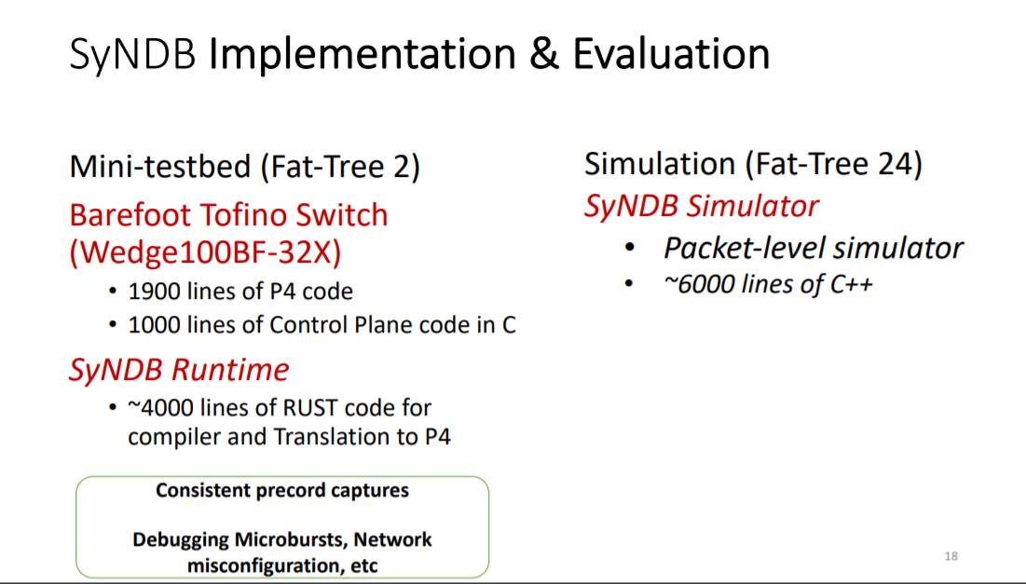

Slide 18
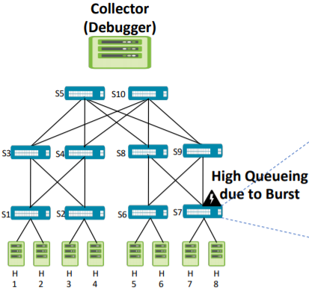
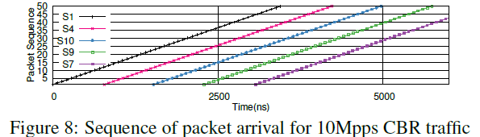
Design Validation
Consistency of p-records
The worst case DPTP synchronization error is less than 50 ns while the propagation delay varies between 400-450 ns.
every packet is recorded in the next switch only after it has left the previous switch

Slide 19
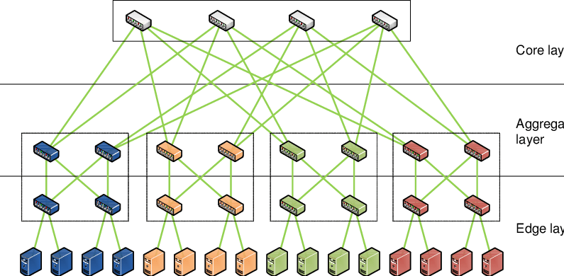
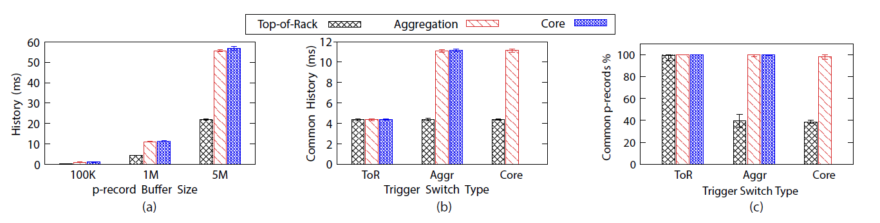
Design Validation
Retrospection and Correlation at Scale
Notes:
The time history available for retrospection varies from 4ms to 11ms using a buffer size of 1M p-record.

Slide 20
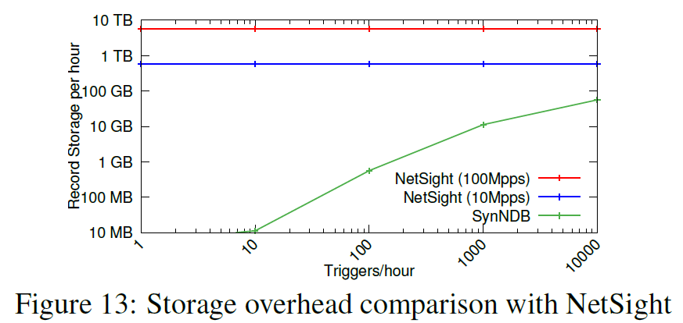
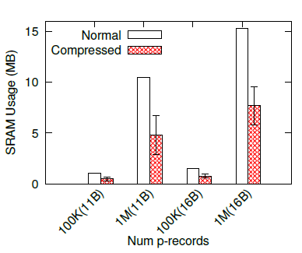
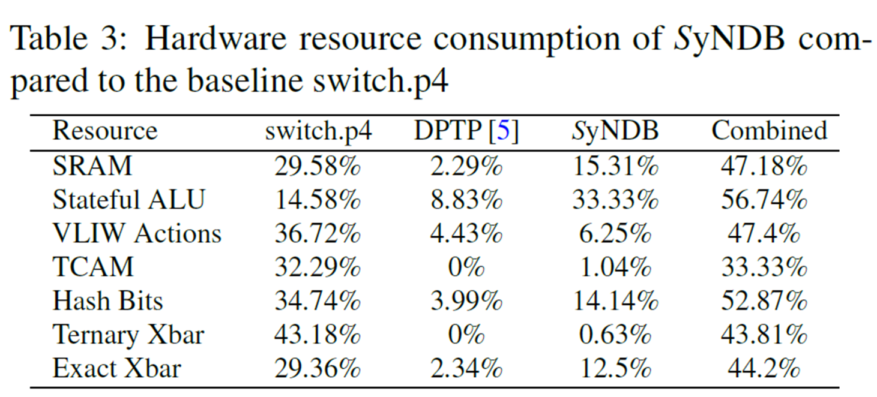
SyNDB Overhead
Collection of 10000 compressed
p-records requires 104 collection packets on average. We observe that it takes a total time of 245μs to evict the p-records.

Slide 21
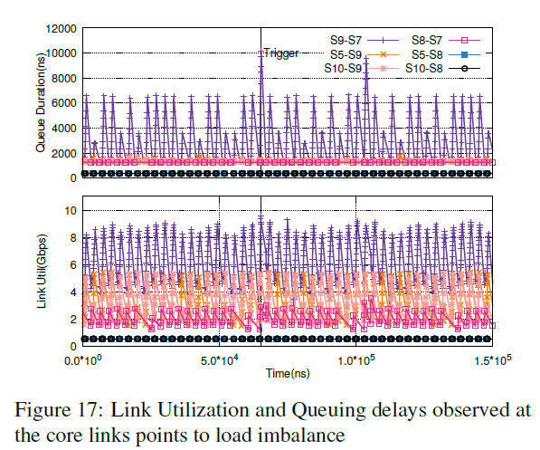
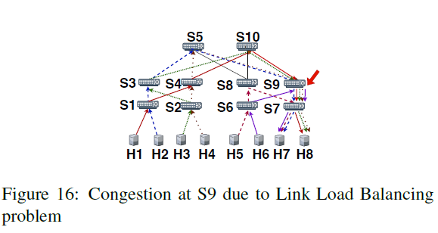
Network Debugging Scenario
Notes:
S9-s7: high
S8-s7: low
s5-s9 s10-s9: normal
S5-s8 比较低

Slide 22
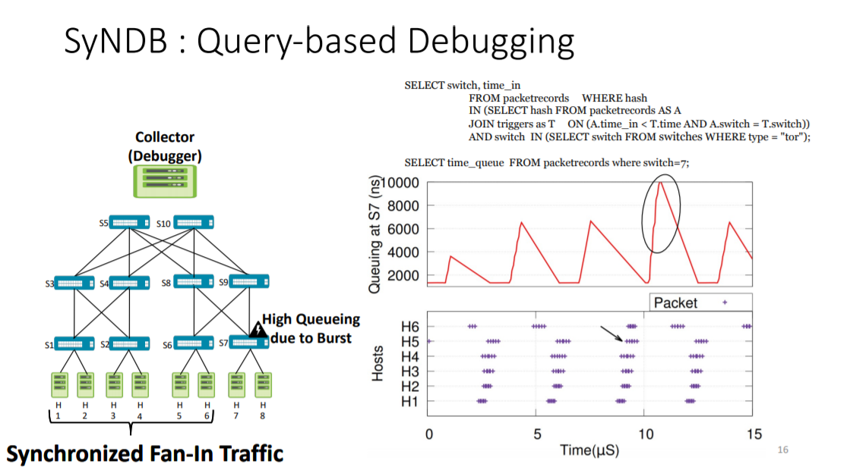

Slide 23
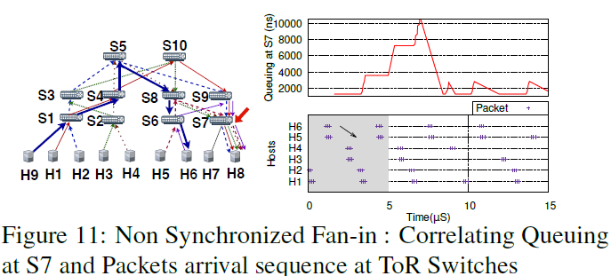

Slide 24
