Slide 1
Elf: Erasing-based Lossless Floating-Point Compression
Ruiyuan Li Zheng Li Chongqing University, China
Yi Wu Chao Chen Chongqing University, China
Yu Zheng JD iCity, JD Technology, China JD Intelligent Cities Research, China

Slide 2
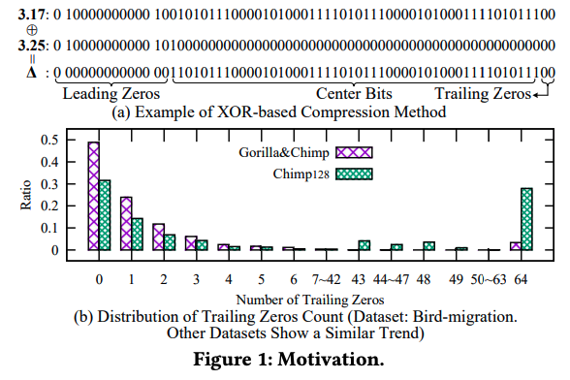
Motivation
More trailing zeros

Slide 3
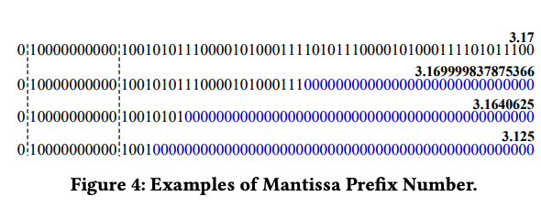
Elf Eraser
Definition 4. Mantissa Prefix Number
3.17 = 𝑀𝑃𝑁 (3.17, 50),
3.169999837875366 = 𝑀𝑃𝑁 (3.17, 23),
3.1640625 = 𝑀𝑃𝑁 (3.17, 8)
3.125 = 𝑀𝑃𝑁 (3.17, 4).
𝐷𝑃 (𝑣), 𝐷𝑆 (𝑣), 𝑆𝑃 (𝑣) : Decimal place count, decimal significand count, start decimal significand position of v
For example, 𝐷𝑃 (3.14) = 2, 𝐷𝑆 (3.14) = 3, and 𝑆𝑃 (3.14) = 0; 𝐷𝑃 (−0.0314) = 4, 𝐷𝑆 (−0.0314) = 3, and 𝑆𝑃 (−0.0314) = −2; 𝐷𝑃 (314.0) = 1, 𝐷𝑆 (314.0) = 4, and 𝑆𝑃 (314.0) = 2.

Slide 4
Observation
𝐷𝐹 (𝑣) = (𝑑_{ℎ−1}𝑑_{ℎ−2} ...𝑑₀.𝑑₋₁𝑑₋₂...𝑑_{𝑙} )₁₀, we can find one of its mantissa prefix numbers 𝑣 ′ and a minor double value 𝛿, 0 ≤ 𝛿 < 10𝑙 , such that 𝑣 ′ = 𝑣 − 𝛿.
𝛼 = 𝐷𝑃 (3.17) = 2 and 𝑣 ′ = 3.1640625,
𝑣 = 𝐿𝑒𝑎𝑣𝑒𝑂𝑢𝑡(𝑣 ′ , 𝛼) + 10^{−𝛼} = (3.1640625)₁₀ + 10⁻² = 3.17

Slide 5
Mantissa Prefix Number Search
Problem I: How to find the best mantissa prefix number 𝑣 ′ of 𝑣 with the minimum efforts?
Brute-force idea: 𝑣 ′ = 𝑀𝑃𝑁 (𝑣,𝑖) until 𝛿 = 𝑣 − 𝑣 ′ is greater than 10^{−𝛼} , where 𝑖 is sequentially from 52 to 1.
worst case: 52 times
Binary search: O(log₂52)
It proposes a method with O(1)

Slide 6
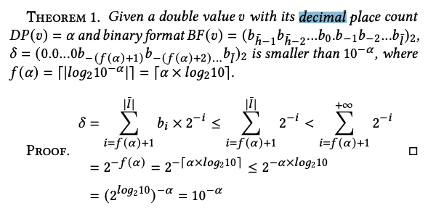
Mantissa Prefix Number Search
Theorem 1: decimal and binary mantissa
𝑔(𝛼) = 𝑓 (𝛼) + 𝑒 − 1023 = ⌈𝛼 × 𝑙𝑜𝑔₂10⌉ + 𝑒 − 1023
calculate the best mantissa prefix number 𝑣 ′ by simply erasing the mantissa bits after 𝑚𝑔(𝛼) of 𝑣, which takes only O (1).
Notes:
? In general, we can also calculate it

Slide 7
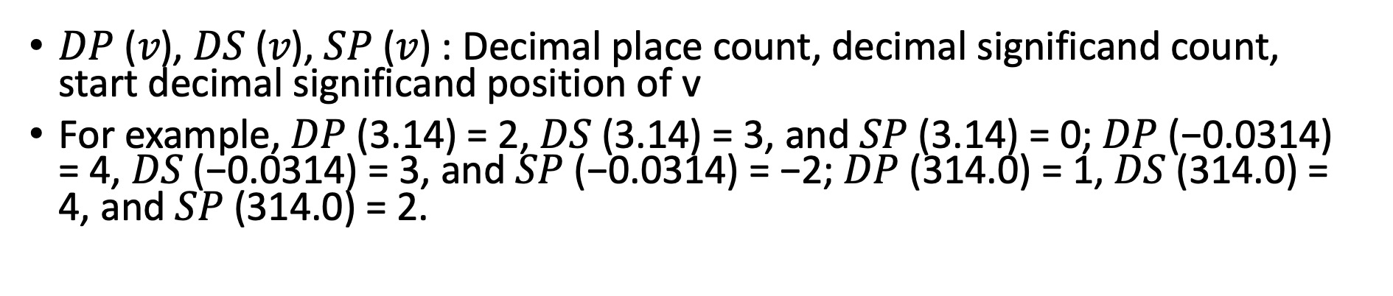
Decimal Place Count Calculation
Problem II: How to store the decimal place count 𝛼 with the minimum storage cost
the minimum value of the double-precision floating-point number is about 4.9 × 10⁻³²⁴, so 𝛼_{𝑚𝑎𝑥} = 324 and ⌈𝑙𝑜𝑔₂𝛼_{𝑚𝑎𝑥} ⌉ = 9, i.e., the basic method needs as many as 9 bits to store 𝛼 during the compression process for each double value
𝛼 = 𝐷𝑃 (𝑣) = |𝑙| = −𝑙, 𝛽 = 𝐷𝑆 (𝑣) = 𝑆𝑃 (𝑣) + 1 − 𝑙, 𝑆𝑃 (𝑣) = ⌊𝑙𝑜𝑔10 |𝑣|⌋.
𝛼 = 𝛽 − (𝑆𝑃 (𝑣) + 1)
Store 𝛽

Slide 8
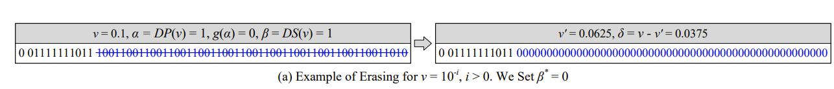
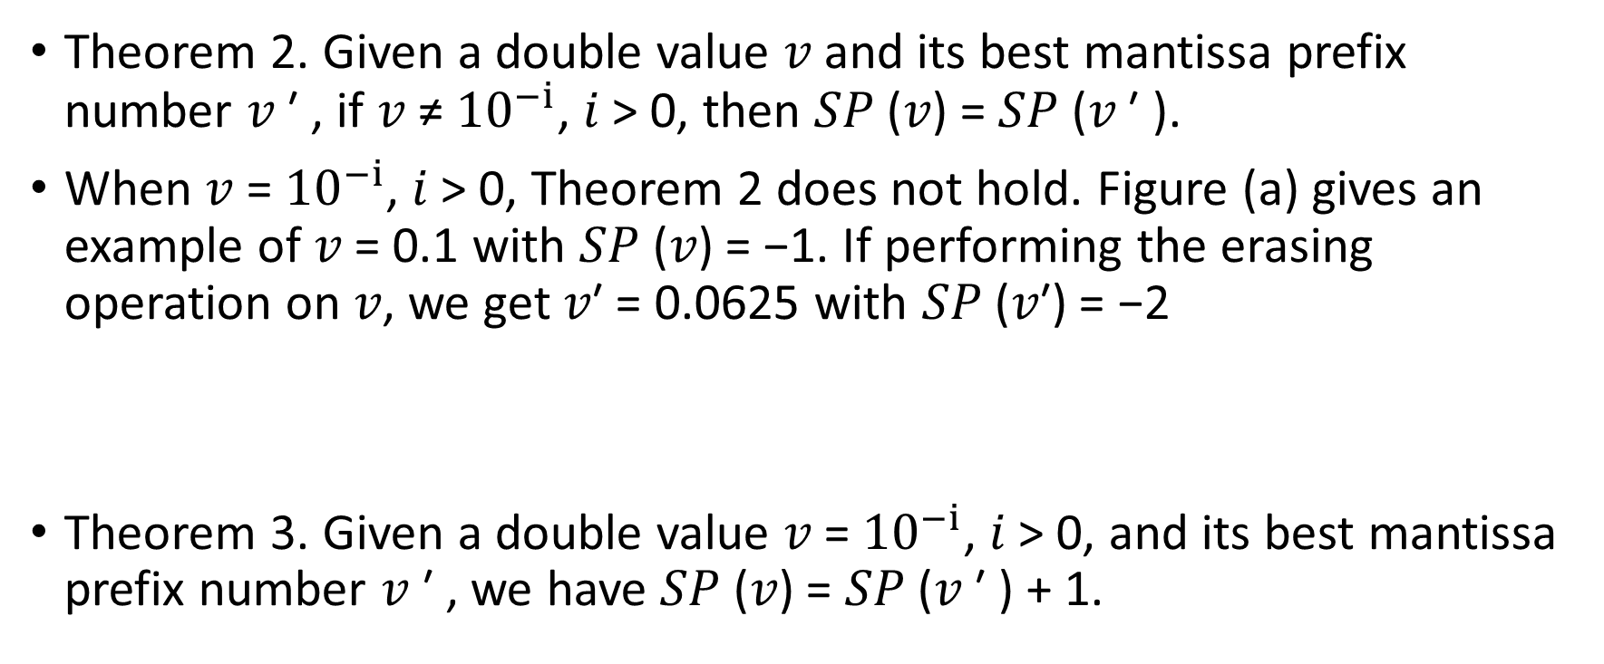
Decimal Place Count Calculation
Theorem 2. Given a double value 𝑣 and its best mantissa prefix number 𝑣 ′ , if 𝑣 ≠ ${10}^{−i}$, 𝑖 > 0, then 𝑆𝑃 (𝑣) = 𝑆𝑃 (𝑣 ′ ).
When 𝑣 = ${10}^{−i}$, 𝑖 > 0, Theorem 2 does not hold. Figure (a) gives an example of 𝑣 = 0.1 with 𝑆𝑃 (𝑣) = −1. If performing the erasing operation on 𝑣, we get 𝑣′ = 0.0625 with 𝑆𝑃 (𝑣′) = −2
Theorem 3. Given a double value 𝑣 = ${10}^{−i}$, 𝑖 > 0, and its best mantissa prefix number 𝑣 ′ , we have 𝑆𝑃 (𝑣) = 𝑆𝑃 (𝑣 ′ ) + 1.

Slide 9

Decimal Place Count Calculation
𝛼 = 𝛽 − (𝑆𝑃 (𝑣) + 1)
𝑣 = 10^{− (𝑆𝑃 (𝑣′)+1)}

Slide 10


Decimal Place Count Calculation
$β^{∗}$∈ {0, 1, 2, ..., 17}, we do not consider the situations when $β^{∗}$ = 16 or 17

Slide 11
When 𝛿 is Zero
once 𝛿 = 0, we will keep 𝑣 as it is.
Notes:
As shown in Figure 5(c), given 𝑣 = 0.75, we get 𝑣 ′ = 𝑣 and 𝛿 = 0. In this situation, we cannot recover 𝑣 from 𝑣 ′ according to Equation (4). In fact, 𝛿 = 0 indicates that 𝑣 itself has long trailing zeros. Therefore, once 𝛿 = 0, we will keep 𝑣 as it is.

Slide 12
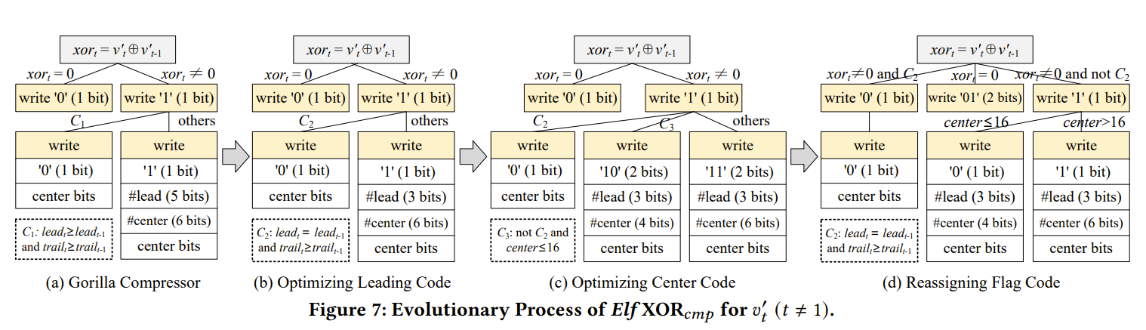

Elf ${XOR}_{cmp}$
a novel XOR-based compressor

