Slide 1
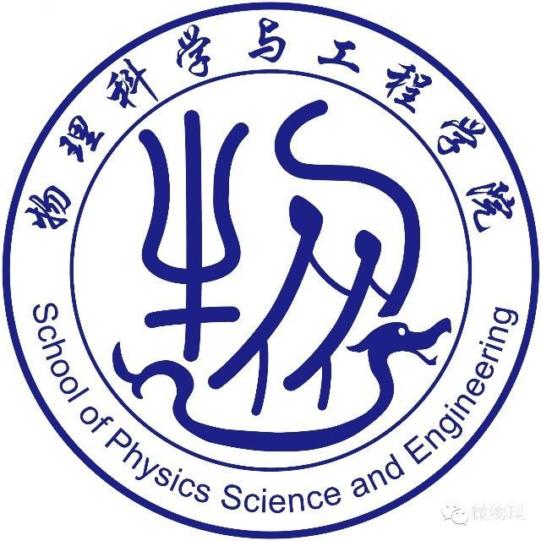
Generative Adversarial Networks
生成对抗网络（GANs）
分享人：任冠衡
2025/03/06
人工智能原理与技术

Slide 2
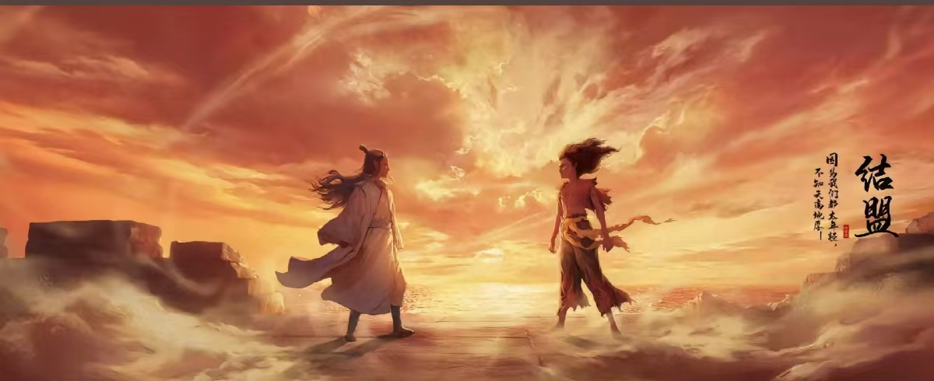
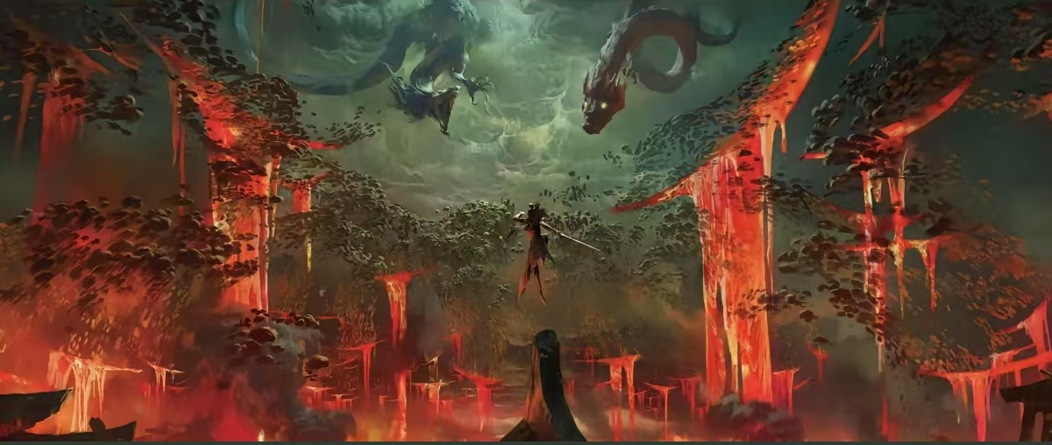
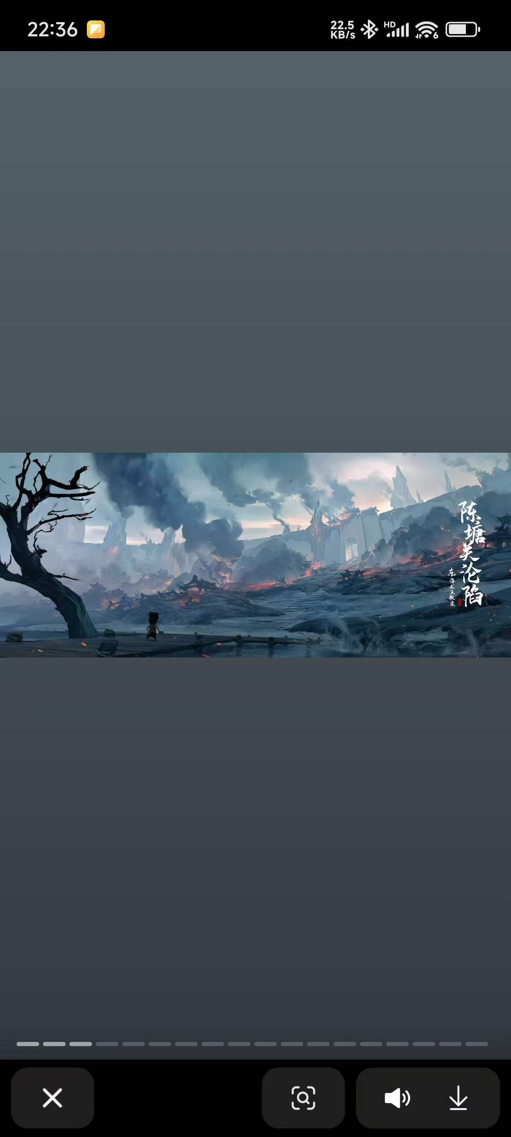
自动生成场景
Generative Adversarial Networks
生成对抗网络（GANs）
深度学习算法自动生成场景

Slide 3
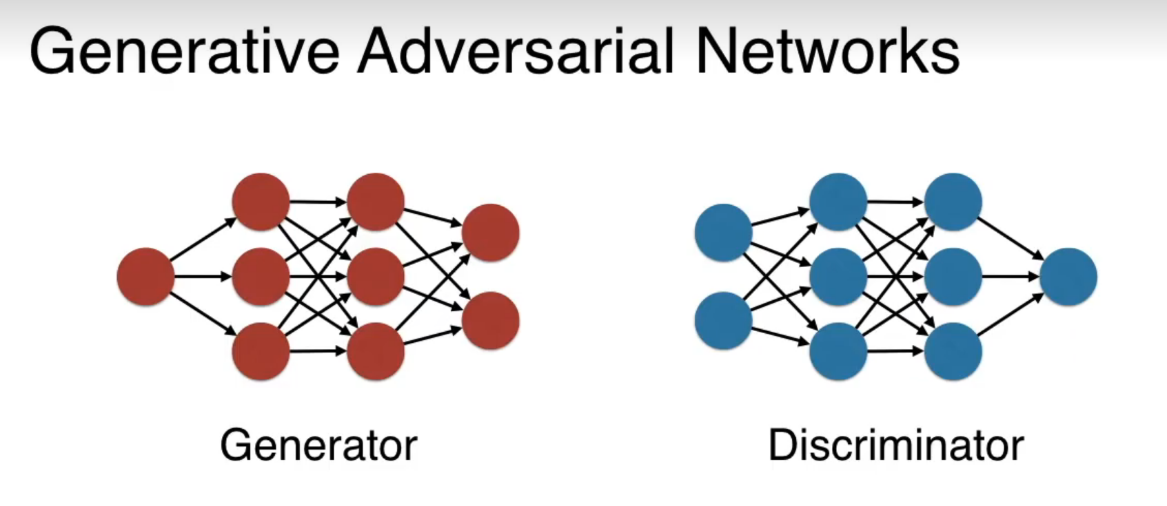
生成器、鉴别器网络
生成器
监察器
[1]Alankrita Aggarwal, Mamta Mittal, Gopi Battineni,Generative adversarial network: An overview of theory and applications,International Journal of Information Management Data Insights,Volume 1, Issue 1,2021,100004,ISSN 2667-0968,
https://doi.org/10.1016/j.jjimei.2020.100004.(https://www.sciencedirect.com/science/article/pii/S2667096820300045)

Slide 4
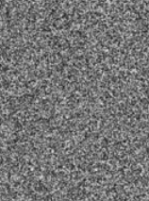
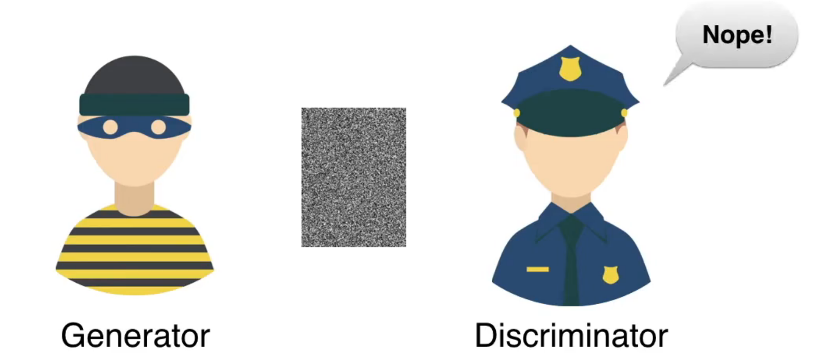

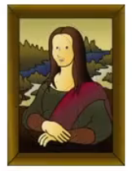
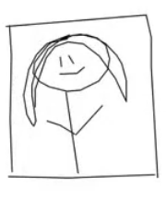
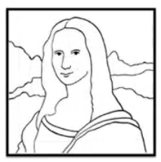
原理概述
[2]Youtube(https://www.youtube.com/watch?v=8L11aMN5KY8&list=PLs8w1Cdizvalz9ltXmarqyeQ49wfKFqf&index=4)

Slide 5
Thanks！

