Slide 1
BACK-TESTING & FORWARD-TESTING FOR AUTOMATED TRADING SYSTEMS

Slide 2
Automated trading systems
It is a set of rules that needs to occur multiple times and be profitable.
However, this does not mean that the development of an automated trading strategy is a simple task. It consists of many stages including back-testing and forward-testing.
These stages should be very clear and transparent as any missed hidden costs could potentially build up and do damage. This is the reason why a trading system/strategy should be as simple as possible.

Slide 3
Back-testing & forward-testing
Back-testing: results of a trading system from a date in the past until today
Forward-testing: results of a trading system from today until a future date

Slide 4
Back-testing & forward-testing
Back-testing directs forward-testing. For example, a strategy that requires more trades will lead us to find a lower cost per trade broker to forward-test it.
Forward-testing redirects (& readjusts) back-testing. For example, it gathers real data about slippage (the difference between the order and the execution, which translates to cost) or market conditions (an order might not get filled (executed) because of fast movement or low liquidity) .

Slide 5
Back-testing & forward-testing
Back-testing directing forward-testing and forward-testing redirecting back-testing happens until we are confident enough that our back-tests represent the real conditions as accurately as possible.
Forward-testing never really stops.

Slide 6
Back-testing tools
Trading Blox ($590-$2690)
MetaTrader, TradingView, NinjaTrader (free)
There are a lot of products that are free but the main and most common difference with products such as Trading Blox is that a user can back-test a system per market, whereas in Trading Blox you can back-test multiple markets under one suite. That way you can simulate other costs and fees such as tax or other broker fees.
Trading Blox Suite example with forex markets

Slide 7
Forward-testing tools
This can be done in numerous ways.
A user can keep track of his trades in his journal, a spreadsheet or even a custom web app (like RhoamFX, a project that I include in my portfolio)
https://github.com/xk2102/rhoam-fx-web

Slide 8
The idea..
As a software engineer/trader I used a combination of the mentioned tools. And a lot of work hours were put into just coordinating and syncing back-testing and forward-testing so I can have a better overview and understanding of the situation and keep track of it.
That is when I realized that eventually I want to see back-testing and forward-testing in the same suite.
I want to give the user (and myself) a platform that can perform both tasks. And then, informally put, work on 1 chart**(see next slide) with 2 lines instead of trying to sync 2 separate charts.

Slide 9
The idea..
The final platform will provide an event driven closed controlled editor to which a programmer can inject his own scripts to perform analysis and actions on historical data and will produce the according results (charts and metrics) .
Afterwards, it will provide the necessary guidance and tools to accurately log real life trades. Upon gathering all the information needed and producing the forward-testing results, it will incorporate them in the back-testing results in a clean and elegant manner (in 1 chart**). That way the user will have a clean overview of the 2 results and re-adjust his back-testing accordingly.

Slide 10
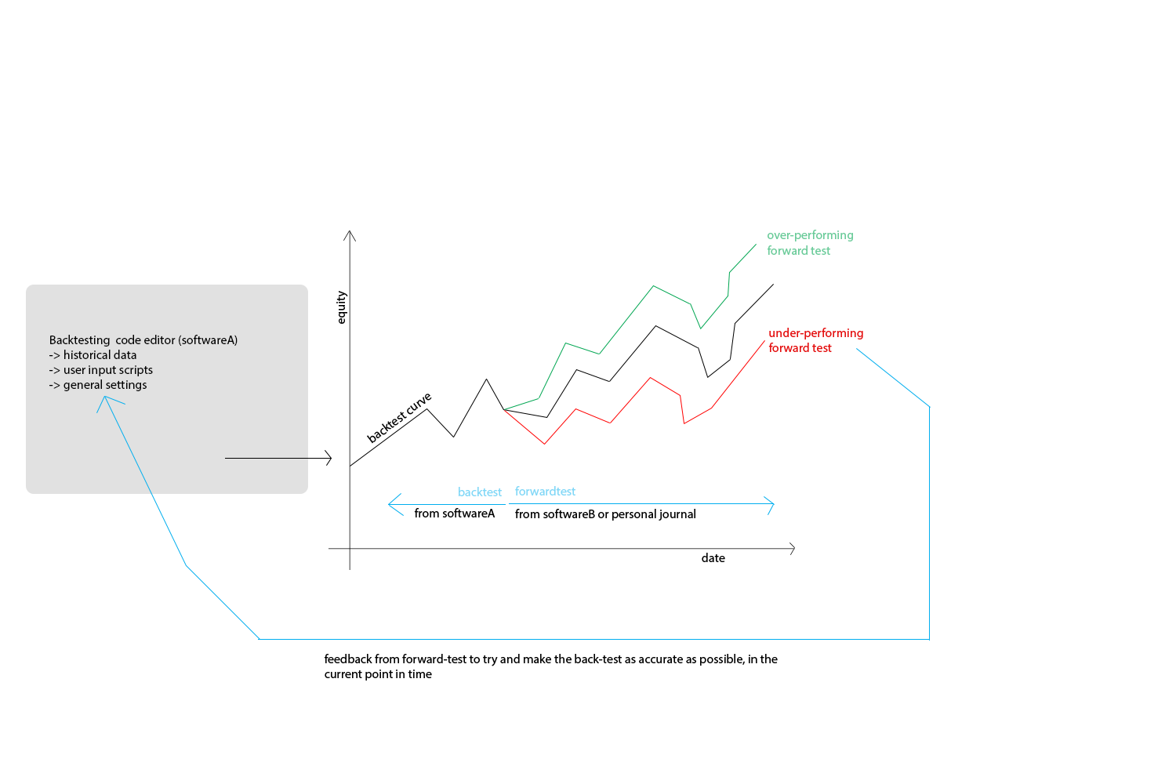
The idea (visualized)..

Slide 11
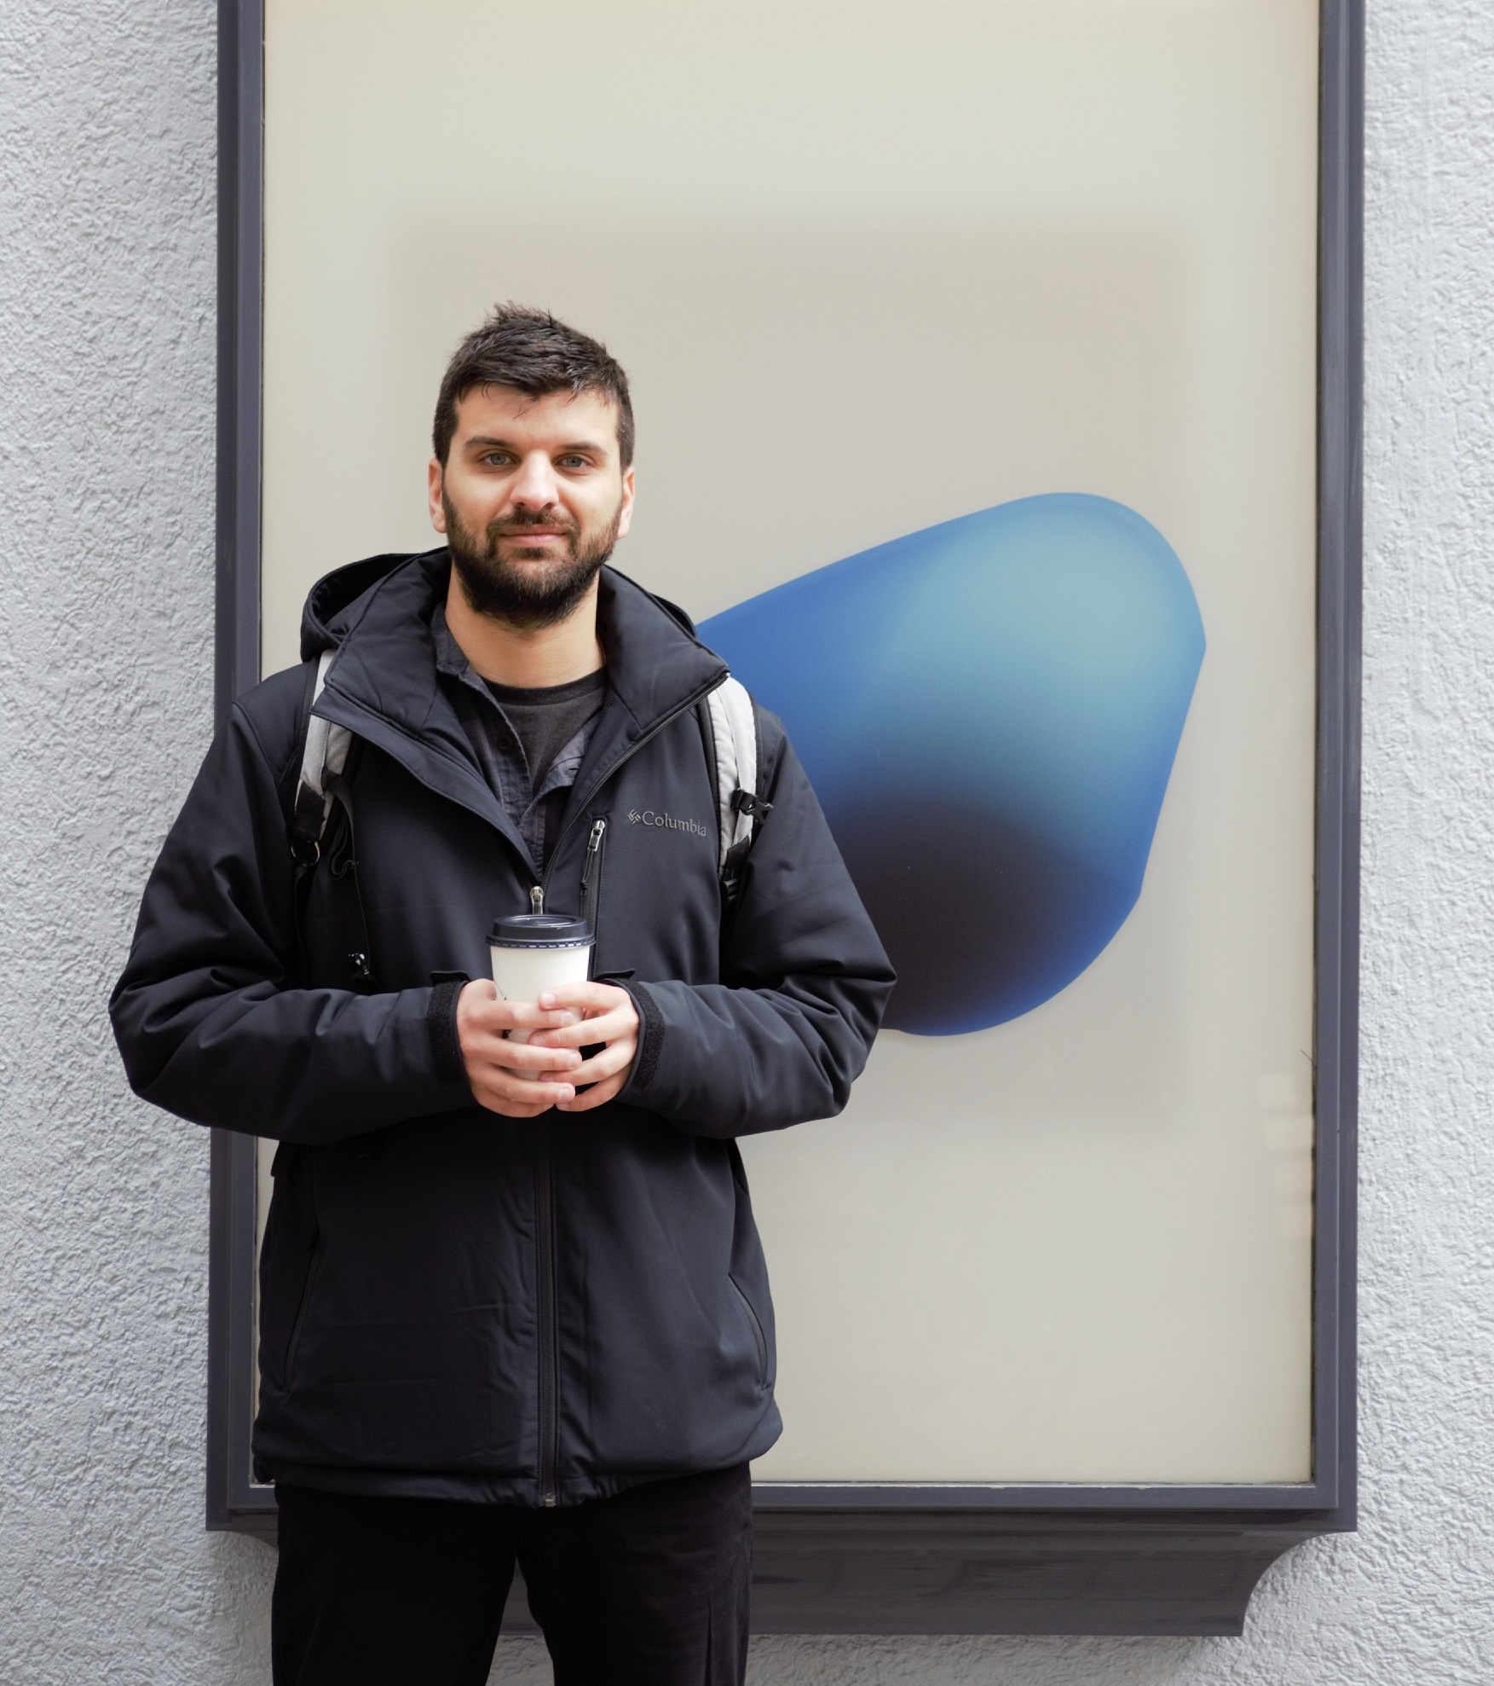
About me..
My name is Christos Kipouros. I am a software engineer with front-end and back-end experience (4-year BSc diploma in Computer Science, Athens University of Economics & Business)
I started my career as a quantitative developer Based on quantitative analysis and historical data, I developed, tested and executed auto-trading algorithms for currency pairs and futures, for the purpose of making low risk returns.
Currently I am working for Saeki Robotics AG – A start-up company based in Zürich in the field of robotic digital manufacturing.
https://www.christoskipouros.com

