Slide 1
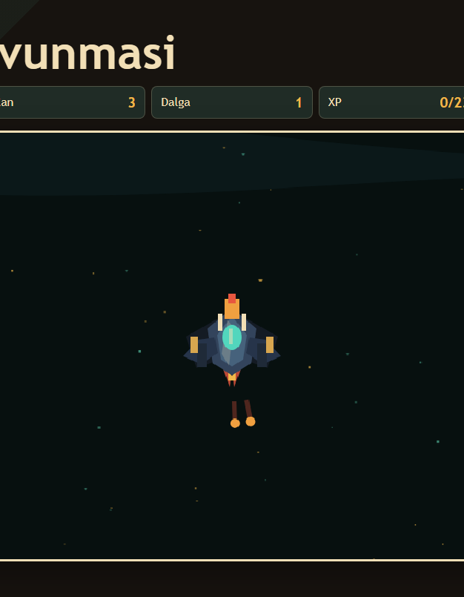
GAME PRESENTATION
Browser-Based Space Survival Game
A 2D space prototype that boots at arcade speed, auto-fires, and generates a unique build in every run with XP and upgrade choices.
Free-Roam
3 Choices
Boss
2D Movement & Camera
Level-Up Upgrade Structure
Relic Reward Layer
Presentation Goal
To clearly demonstrate the gameplay vision, systems, and next development steps of the prototype.
Source: local game prototype screenshot
01

Slide 2
CORE GAMEPLAY
The basic loop starts simple and deepens with choices.
Auto-Fire
XP Collection
The player focuses on positioning rather than aiming.
Staying in risky zones yields faster progression.
Free Movement
3 Upgrades
The ship is followed by the camera in a wide sector.
The level-up moment creates a short and meaningful choice.
CORE LOOP
Survive,
build a setup,
defeat the boss.
Run
different path every time
Boss + Relic
Build Synergy
Challenging thresholds unlock special rewards and new paths.
Combinations modify the weapon and the visual equipment.
Instant
start in browser
Source: local game prototype and tasks/todo.md verification notes
02

Slide 3
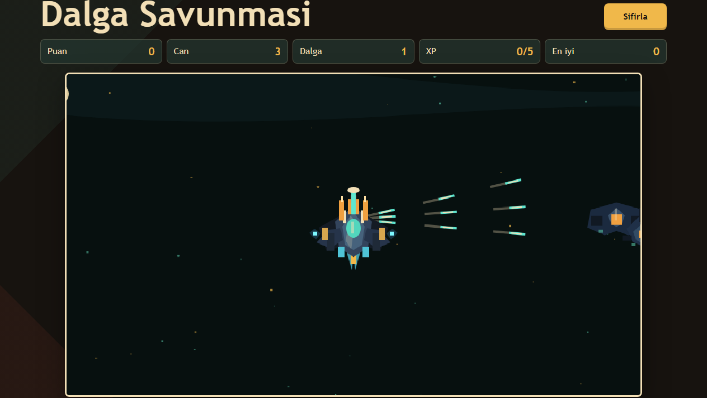
PLAYER FEEL
The player ship now carries its progression visually.
Heavy Fighter Ship
An angular hull and energy core with a unique design, approaching a Dark Orbit feel.
Weapon Modules
Damage, split, rapid, engine, and relic choices appear as visual equipment on the ship.
Overdrive
When ready, pressing E deploys Nova, Phase, Void, or Surge effects onto the battlefield.
Visual progression lets the player read the impact of their choices on screen; the ship feels powerful even without looking at the stat panel.
Source: ship-visual, weapon-evolution, overdrive-system, and local screenshot
03

Slide 4
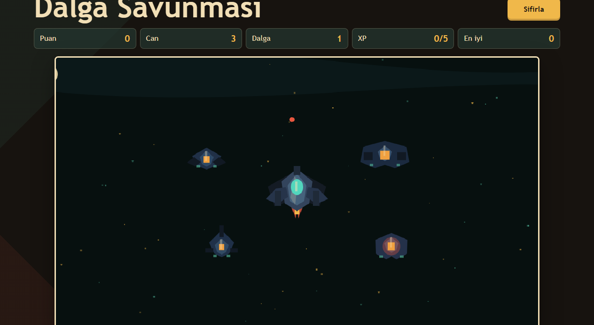
ENEMY ECOSYSTEM
Enemies are not just a crowd, but roles that make different tactical decisions.
Sniper
Keeps distance and exerts ranged pressure.
Scout
Fast pursuit; forces the player to move.
Captain
Boss
Speeds up nearby allies.
Features archetypes, telegraphs, and special rewards.
Formation Pressure
Tank
Scout swarms push the player, tanks hold areas, snipers demand distance, and bombers create explosion hazards. The Captain's aura speeds up nearby enemies.
Slow but durable; requires focused fire.
Bomber
Leaves an area explosion upon death.
Result: The player manages not just firepower, but positioning and target priority.
Source: enemy-system, enemy-formation, enemy-visual, and local screenshot
04

Slide 5
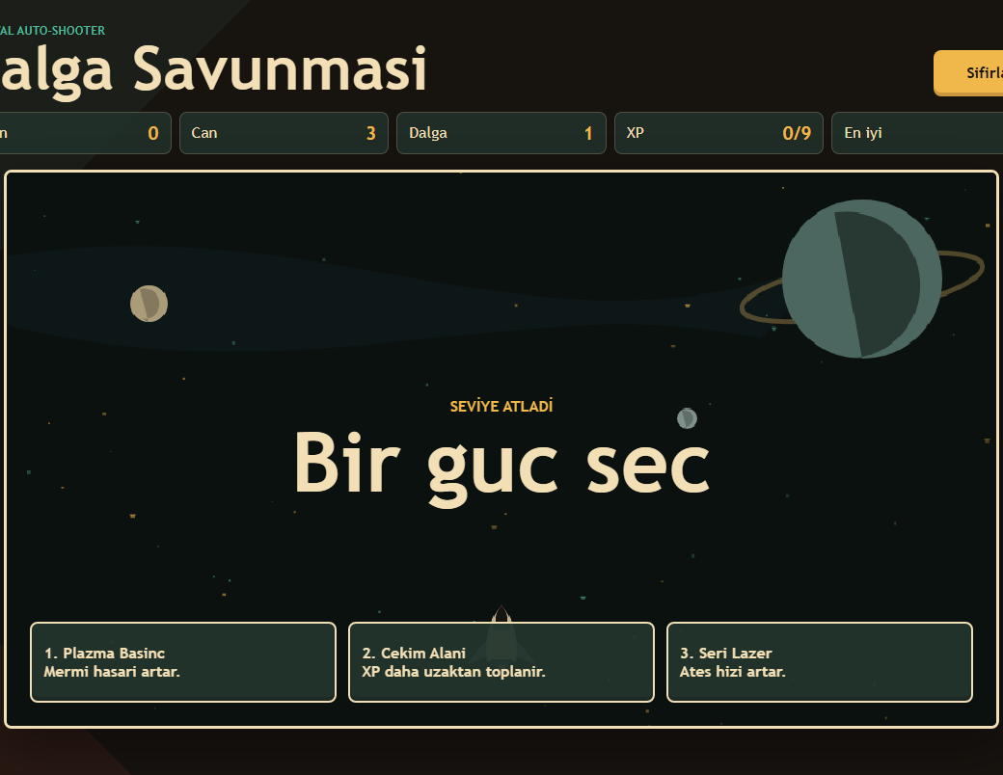
SYNERGY SYSTEM
Upgrade selections turn into build paths.
Combination
Weapon/Mod
Visual Result
Player Value
Damage + Split
Twin Plasma
Wing Turrets
Crowd Clearing
Damage + Rapid
Piercing Laser
Thin energy beam
Single-target melting
Engine + Rapid
Drone Support
Support lasers
Safe kiting path
Nova core
Nova Lance
Center core flare
Area explosion
Cards no longer just show stats, but also explain which weapon path they power up.
Phase / Void
Burst / Field
Purple phase rings
Control and defense
Source: upgrade-codex, weapon-evolution, relic-synergy, and overdrive-system
05

Slide 6
MAP AND OBJECTIVES
The wide sector invites the player not just to run, but to pursue objectives.
Signal Station
Progresses when staying close; grants XP and overdrive charge.
Supply
Signal
Supply Pod
camera view
Creates core/loot rewards via a risky route.
player
Anomaly Zone
Increases pressure, then rewards overdrive.
radar blip
Anomaly
1760x1040
Radar
expanded world
objective guidance
Source: camera, tactical-objective-system, radar-system, and sector-ui
06

Slide 7
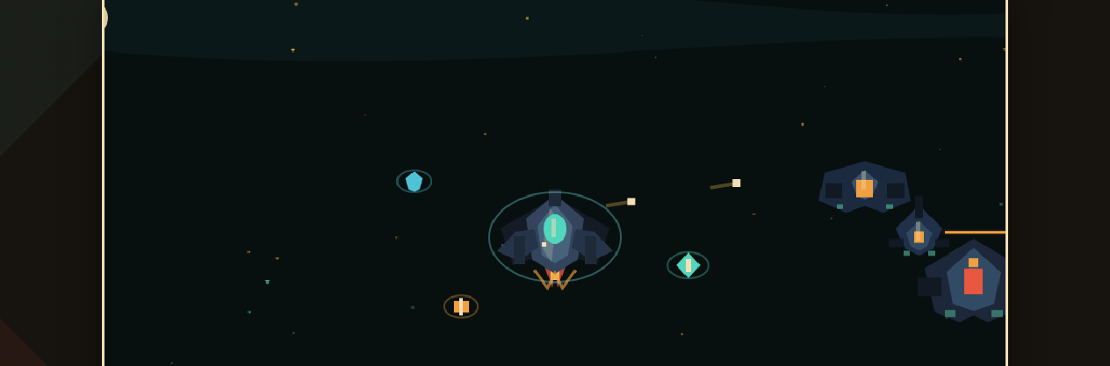
BOSS AND RELICS
The boss encounter now sets the stage with warnings, identity, and special rewards.
Telegraph
Archetype Attack
Relic Reveal
3 Reward Choices
Readable ring/line warning before attacks.
Bulwark pressure, Phase shard, Core mine ring.
A short wreckage signal scene after boss death.
Special boss relic choices tied to the build path.
Why is the Boss Reward Important?
Normal level-ups power up the player; boss relics change the identity of the run. Therefore, the boss is not just a high-HP enemy, but a threshold that defines build direction.
Source: boss-system, boss-ui, relic-reveal, relic-system, and relic-synergy
07

Slide 8
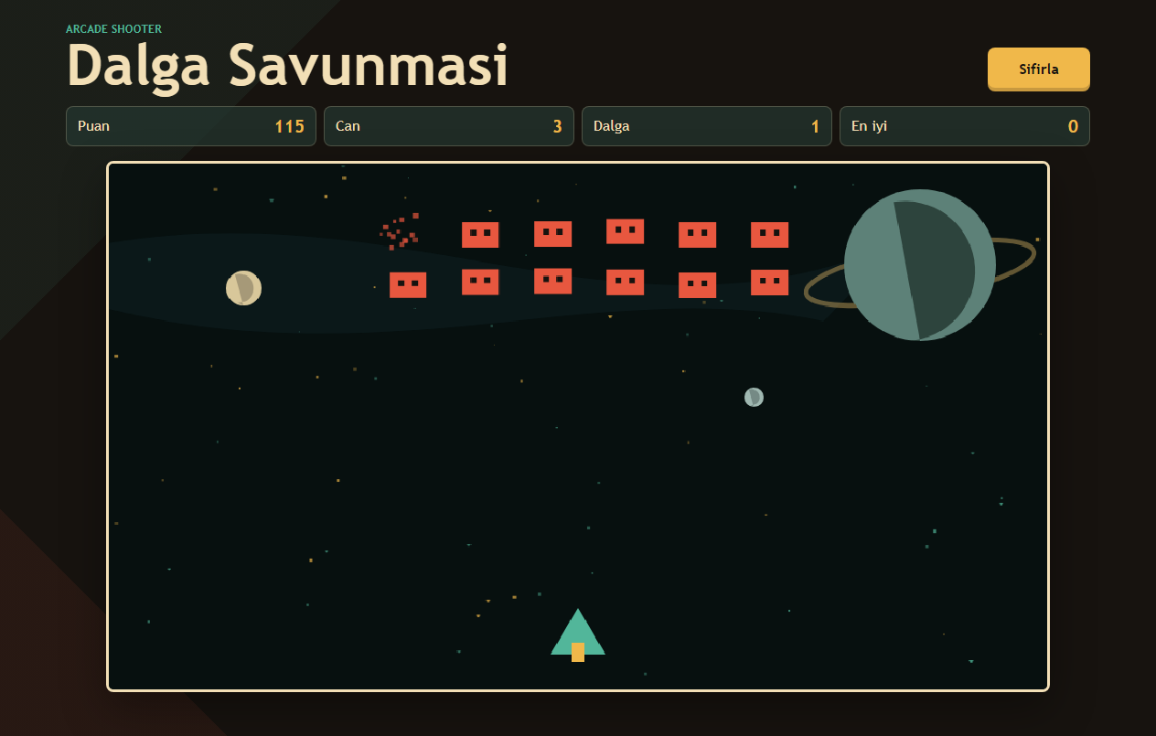
COMBAT UX
The interface displays subsequent action without obscuring the combat.
E
NOVA READY
Key command appears on screen when Overdrive is ready.
Signal objective →
Does not get lost, thanks to the off-screen objective edge indicator.
+4 XP / Overdrive +18
Brief reward notifications make progression visible.
Stat Panel
Mobile OD
Can be toggled; keeps the battlefield cleaner.
Overdrive button ready for touch players.
Source: combat-ux, controls, stat-system, and ui
08

Slide 9
PROOF OF DEVELOPMENT
The prototype grew fast, but every step was wrapped up with validation.
This rhythm is also crucial for the presentation: the described mechanics are not just ideas, but systems running and tested in the repository.
Arcade Core
Survival Transformation
Ship + Map
Enemy System
Boss Layer
UX Clarity
canvas, movement, fire, waves
XP, level-up, auto-fire
heavy fighter, wide world, camera
roles, formation, captain aura
telegraph, HUD, reveal, relic
overdrive prompt, objective pointer
92/92
node --check
security
diff check
pure Node tests passed
JS syntax clean
unsafe DOM/API scan
only CRLF warning
Source: tasks/todo.md last verification records
09

Slide 10
ROADMAP
The next most powerful move: making the game clearer, more balanced, and more memorable.
1
Balance Pass
Enemy HP, spawn density, boss timings, and XP economy are adjusted together.
PRIORITY
2
Audio & Juice
An audio layer is added to weapons, explosions, relic reveal, overdrive, and boss warnings.
First balance + audio
then meta + content
3
Meta Progression
Persistent post-run hangar, ship parts, and unlock objectives are expanded.
4
Content Depth & Scope
New enemy archetypes, relic pool, objective variants, and sector themes are added.
5
Release Package
Start screen, settings, performance QA, mobile tests, and shareable build are prepared.
With this sequence, the game feels better first, and then lasts longer.
Source: current prototype state and recommended development order
10

