Slide 1



PerfConst: BATCH_SIZE
From: 10, To: 20
Running the workloads
User space
XKernel
Lookup
Modify
Reset
Attach
Enact
Detach
Mode-Flex
func_name,
offset
Overwrite
Reset
Mode-Perf
Kernel Image
Kernel space

Slide 2

Kernel source code
ConstID | Val | expression | CS | SS
Offline Porcessing
Kernel Binary
Scope Table
$ xk_gen ConstID
Synthesize Indirections
User space
XK Skeleton
XK Tuning Program
+Policy
Kernel space
Instructions (Policy & SetVal)
Attach & Transition
CS
XK Runtime
Kernel Binary
Kprobe
redirection

Slide 3
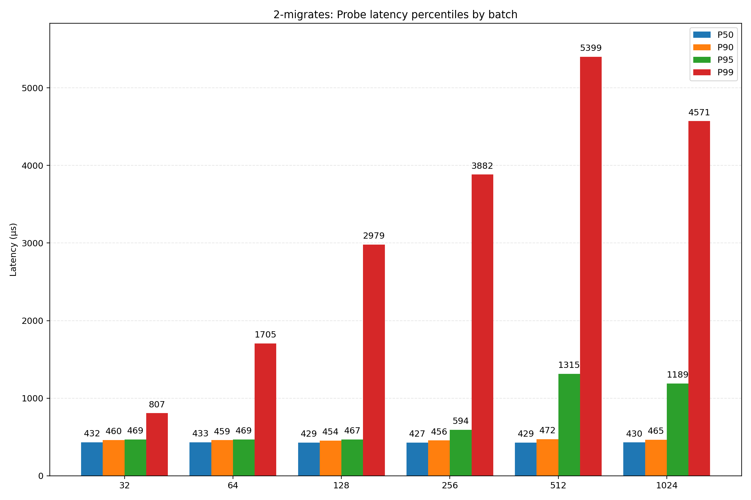
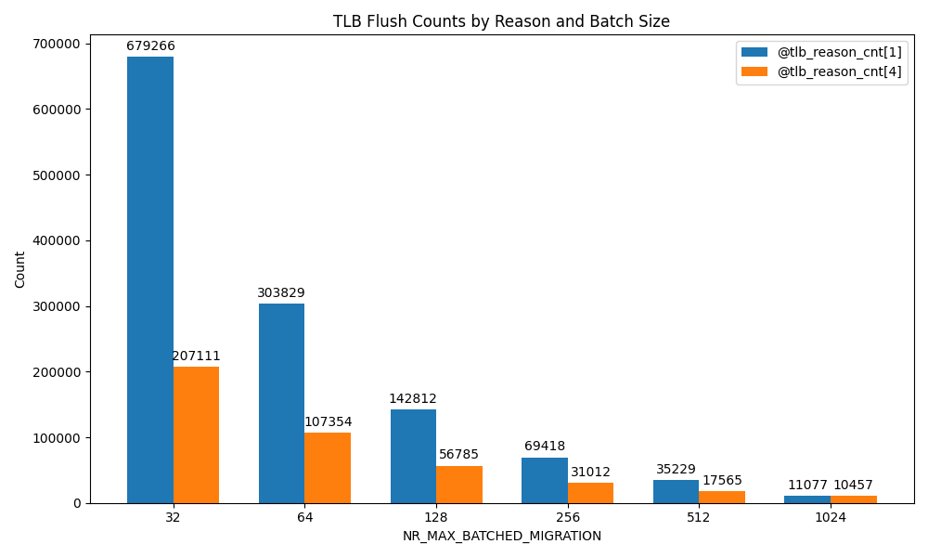

Slide 4

CS is not enough, motivation of SS
(+0x0) xor %ebx,%ebx
......
(+0x33) add $0x1,%ebx
(+0x36) call XXXXXXXXX
(+0x3B) cmp $0x6,%ebx
(+0x3E) jne XXXXXXXXX
......
(+0x50) cmp $0x6,%ebx
Safe Span
Loop
Critical Span
Jump if Not Equal
Critical Span
unsigned int nr_reads = 0;
bool exhaust_budget = false;
while (condition) {
foo();
nr_reads++;
if (nr_reads >= 6)
break;
}
if (nr_reads == 6)
exhaust_budget = true;
Data
Dependency
Wrong Time 1
if (nr_reads >= 2)
nr_reads = 4
Wrong Time 2
if (nr_reads == 2)
nr_reads = 6

Slide 5

Critical Span
Pre handler of Kprobe
Option1
tmp = rax
eax = V – 0x40
edx = V
and $0xffffffe0, %eax
add $0x40, %eax;
cmp %ax, %r14w
mov $0x80, %edx;
cmp %edx, %eax;
shl $0xa,%rax;
cmp %rax, %rcx;
rax = rax << V
Option2
eax = V
Option1
tmp = edx
eax = eax^(V^0xd)
eflags = cmp(V, %eax)
xor $0xd,%eax mov %eax,%esi
cmp $0x7, %eax;
jg XXXXXX
and $0xf,%edx
jne XXXXXX
Option2
edx = V & tmp
eax = V

Slide 6
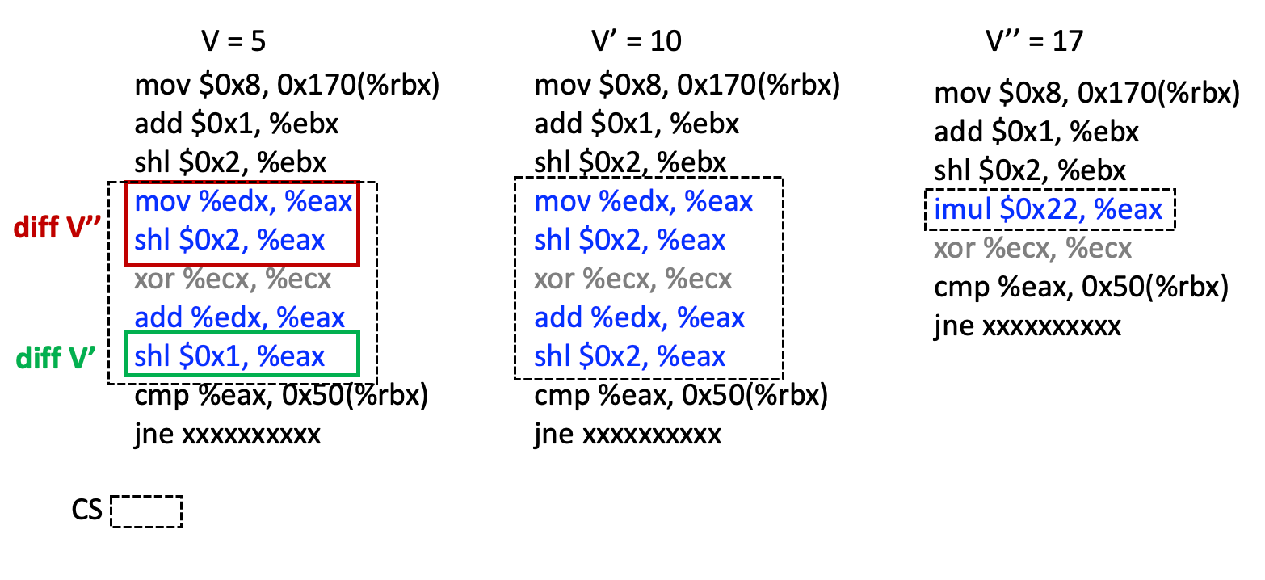



Symbolic states
Eax <- 10 * $α$
Eax <- 20 * $α$
Eax <- 34 * $α$
Back to registers
Eax = 10 * edx
Eax = 20 * edx
Eax = 34 * eax
To find where is IV, Eax = IV * edx in the original copy (V = 5),
compares 10 and 20 to get the IV position (symbolic states is robust), so we know eax = IV * edx
This solve the issue of eax = 10 * edx + 3 (which one??)

Slide 7
eax=δ
eax=4δ
(No change to eax)
eax=4δ+δ=5δ
,eax=5δ×4=20δ
eax=δ
eax=4δ
(No change to eax)
eax=4δ+δ=5δ
eax=5δ×2=10δ

Slide 8
#define V 5
... y = 2*V*x; ...
Source

Slide 9
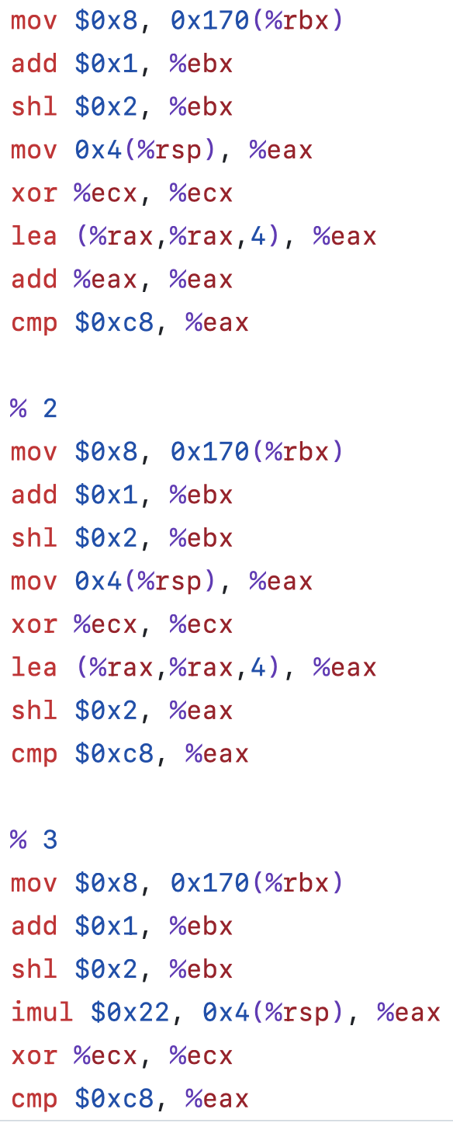
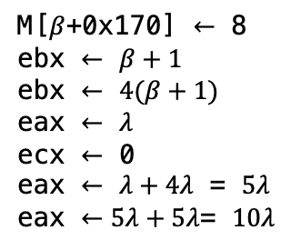
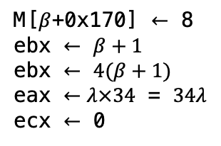
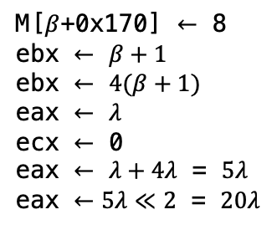
(1) V = 5
(2) V’ = 10
(3) V’’ = 17
M[$β$+0x170] $←$ 8
ebx $←$ $β+1$
ebx $←$ $4(β+1)$
eax $←$ $λ$
ecx $←$ 0
eax $←$ $λ+4λ$ = $5λ$
eax $←5λ+5λ$= $10λ$
M[$β$+0x170] $←$ 8
ebx $←$ $β+1$
ebx $←$ $4(β+1)$
eax $←$ $λ$
ecx $←$ 0
eax $←$ $λ+4λ$ = $5λ$
eax $←5λ≪2$ = $20λ$
M[$β$+0x170] $←$ 8
ebx $←$ $β+1$
ebx $←$ $4(β+1)$
eax $←λ×34$ = $34λ$
ecx $←$ 0
Source: y = 2*V*x; ...
seed
symbolic expression
CS

Slide 10
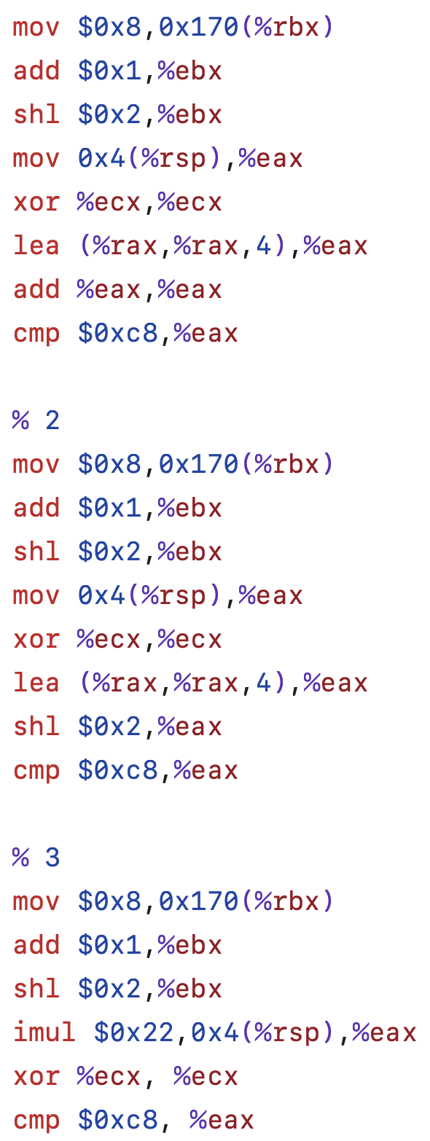
(a) V = 5
(b) V’ = 10
(c) V’’ = 17
M[$β$+0x170] $←$ 8
ebx $←$ $β+1$
ebx $←$ $4(β+1)$
eax $←$ $λ$
ecx $←$ 0
eax $←$ $λ+4λ$ = $5λ$
eax $←5λ+5λ$= $10λ$
M[$β$+0x170] $←$ 8
ebx $←$ $β+1$
ebx $←$ $4(β+1)$
eax $←$ $λ$
ecx $←$ 0
eax $←$ $λ+4λ$ = $5λ$
eax $←5λ≪2$ = $20λ$
M[$β$+0x170] $←$ 8
ebx $←$ $β+1$
ebx $←$ $4(β+1)$
eax $←λ×34$ = $34λ$
ecx $←$ 0
Source: y = 2*V*x; ...
seed
symbolic expression
CS

Slide 11
+1
Guard Kprobe
-1
Unguard Kprobe
Safe Span
corge( )
bar( )
Entry
foo( )
Entry
+1
......
......
Entry
+1
……
……
-1
bar( )
……
if (A) return baz()
quiescence
Exit
-1
current pc
corge()
Exit
if (B) return qux()
Exit
-1
bar
foo
CallStack

Slide 12
stop_machine()
AUX Kprobes on
IR Kprobes on
Xkernel
Attach AUX Kprobes
Detach AUX Kprobes
-1(1)
+1(2)
-1(0)
Kernel Task1
V
V
V’
+1(2)
-1(1)
+1(0)
-1(0)
Kernel Task2
V
V’
Transition

Slide 13
1.// Source Code: HYSTART_DELAY_THRESH(ca->delay_min >> 3)
2.// ctx->name: "cubictcp_acked"
3.// ctx->offset: 0x1f2
4.XK_PROBE(ctx, struct sock *sk) {
5. if (!ctx->transition_done())
6. return 0;
7. 8. struct bictcp *ca = inet_csk_ca(sk);
9. u32 delay_min;
10. if (bpf_probe_read_kernel(&delay_min, sizeof(delay_min), &ca->delay_min))
11. return 0;
12. if (delay_min > 60000) // RTT > 60ms
13. ctx->set(3);
14. else
15. ctx->set(4);
16. return 0;
17.}

Slide 14
basic block (SESO)
* 10
mov $0x8, 0x170(%rbx)
add $0x1, %ebx
shl $0x2, %ebx
mov %edx, %eax
shl $0x2, %eax
add %edx, %eax
shl $0x1, %eax
cmp %eax, 0x50(%rbx)
jne xxxxxxxxxx
1st symbolic execution
Final seed instructions
Final Symbolic Execution States
R2 = (((R1 * 4) + R1) * 2)
→ R2 = 10 * R1

Slide 15
mov $0x8, 0x170(%rbx)
add $0x1, %ebx
shl $0x2, %ebx
mov %edx, %eax
shl $0x2, %eax
add %edx, %eax
shl $0x1, %eax
cmp %eax, 0x50(%rbx)
jne xxxxxxxxxx
Shrink the upper bound
Final Symbolic Execution States
R2 = (((R1 * 4) + R1) * 2)
→ R2 = 10 * R1

Slide 16
mov $0x8, 0x170(%rbx)
add $0x1, %ebx
shl $0x2, %ebx
mov %edx, %eax
shl $0x2, %eax
add %edx, %eax
shl $0x1, %eax
cmp %eax, 0x50(%rbx)
jne xxxxxxxxxx
Extend the lower bound
xkernel bpf
to support ctx->set(x);
C1: const folding (1+V)*5=20,
C2: strength reduction imul 10
source:a*V+b
instruciton: IV
x, IX
(v,IV) (v’,IV’) (v’’,IV’’)
(x< 8) -→ cmp 0x7,
(x<9) → cmp 0x8,
(x<10) → cmp 0x9,
Final Symbolic Execution States
R2 = (((R1 * 4) + R1) * 2)
R2 = 10 * R1
R2 = x* R1
void set(int source_v) {
R2 = linear_transform(source_v) * R1;
}

Slide 17
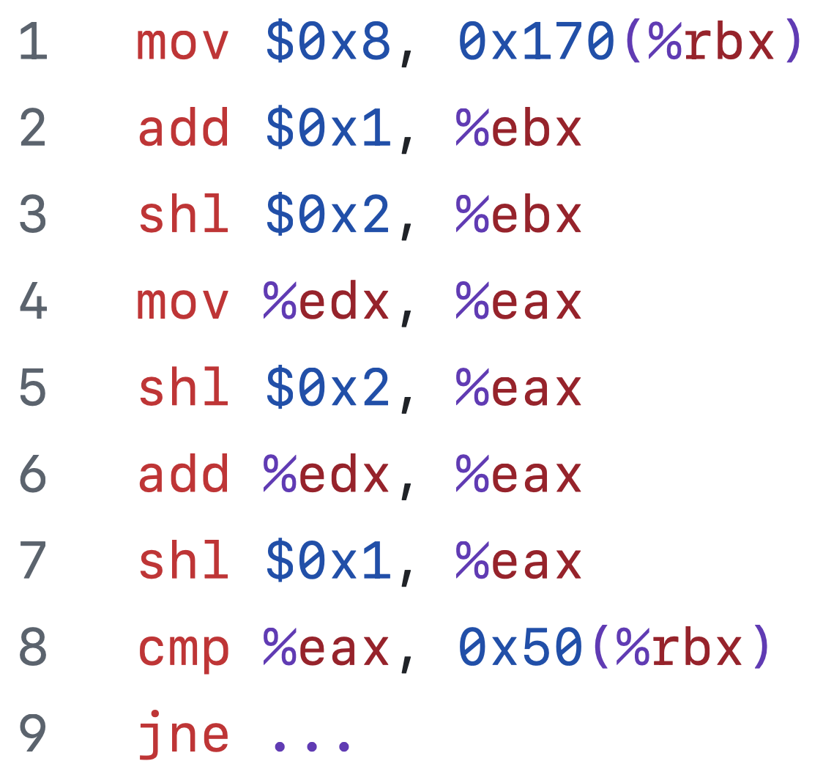
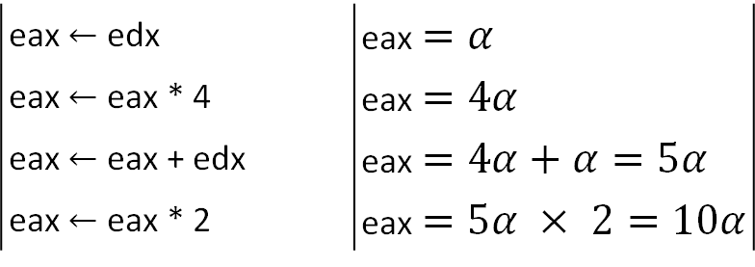


Source
Binary
Symbolic State
#define V 5
... y = 2*V*x; ...
Symbolic State Update
Resulting Expression
eax $←$ edx | eax $=α$
eax $←$ eax * 4 | eax $=4α$
eax $←$ eax + edx | eax $=4α+α=5α$
eax $←$ eax * 2 | eax $=5α × 2=10α$
Seed
Instruction
CS
eax $=10$ * edx
[V=5]
IV =
$$V∗2+0$$
return
execute
eax = (V’ * 2 + 0) * edx
Synthesize SIE indirection

Slide 18
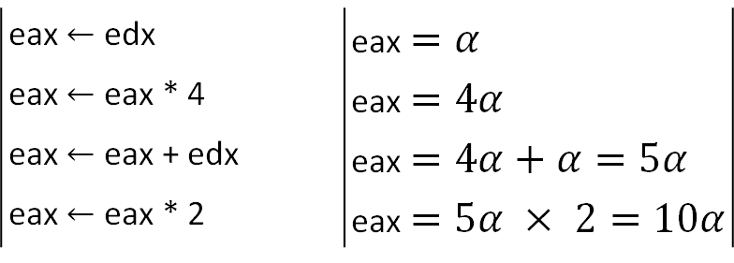
#define V 5
... y = 2*V*x; ...
Symbolic State Update
Resulting Expression
eax $←$ edx | eax $=α$
eax $←$ eax * 4 | eax $=4α$
eax $←$ eax + edx | eax $=4α+α=5α$
eax $←$ eax * 2 | eax $=5α × 2=10α$
eax $=10$ * edx
[V=5]
IV =
$$V∗2+0$$
Source
Binary
Symbolic State
return
execute
eax = (V’ * 2 + 0) * edx
generate

Slide 19
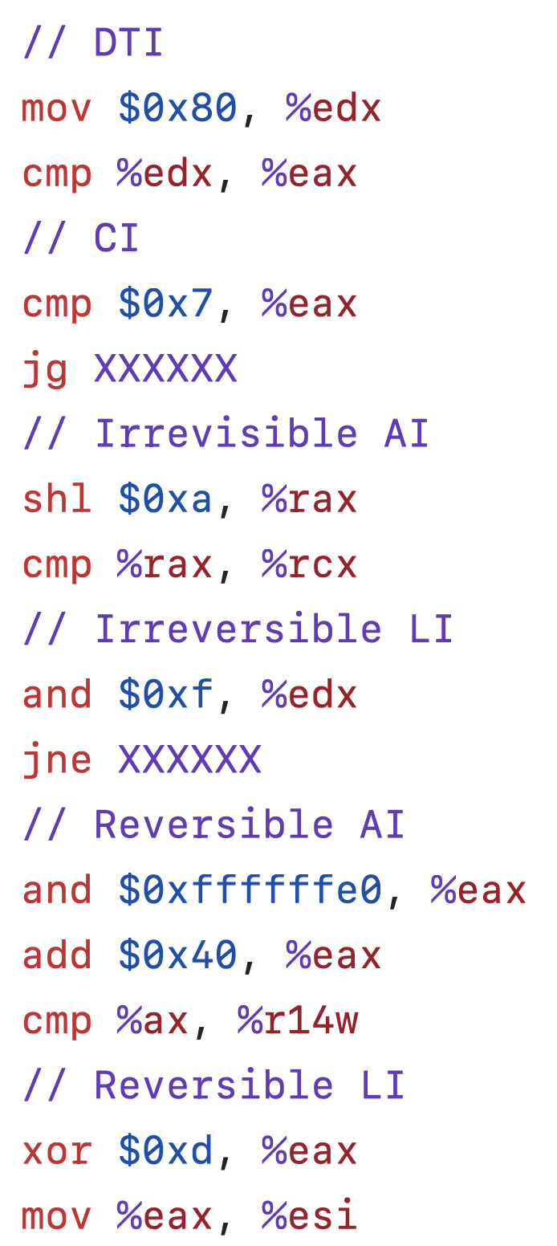
(1)
edx = V’
(2)
eflags = cmp(V’,%eax)
(3)
eax = (eax – V) + V’
(4)
eax = (eax ^ V) ^ V’
tmp = rax
(5)
rax = tmp << V’
tmp = edx
(6)
edx = tmp & V’

Slide 20
(1)
edx = V’
(2)
eflags = cmp(V’,%eax)
(3)
eax = (eax – V) + V’
(4)
eax = (eax ^ V) ^ V’
tmp = rax
(5)
rax = tmp << V’
tmp = edx
(6)
edx = tmp & V’

Slide 21
(1)
edx = V’
(2)
eflags = cmp(V’- %eax)
(3)
eax = (eax – V) + V’
(4)
eax = (eax ^ V) ^ V’
tmp = rax
(5)
rax = tmp << V’
tmp = edx
(6)
edx = tmp & V’

Slide 22



eflags $←$ cmp(V - %eax)
(1)
eflags = cmp(V’- %eax)
(2)
eax $←$ eax ^ V)
eax = (eax ^ V) ^ V’
tmp = rax
(3)
rax $←$ rax << V
rax = tmp << V’
recovered expression
CS
SIE Indirection

Slide 23
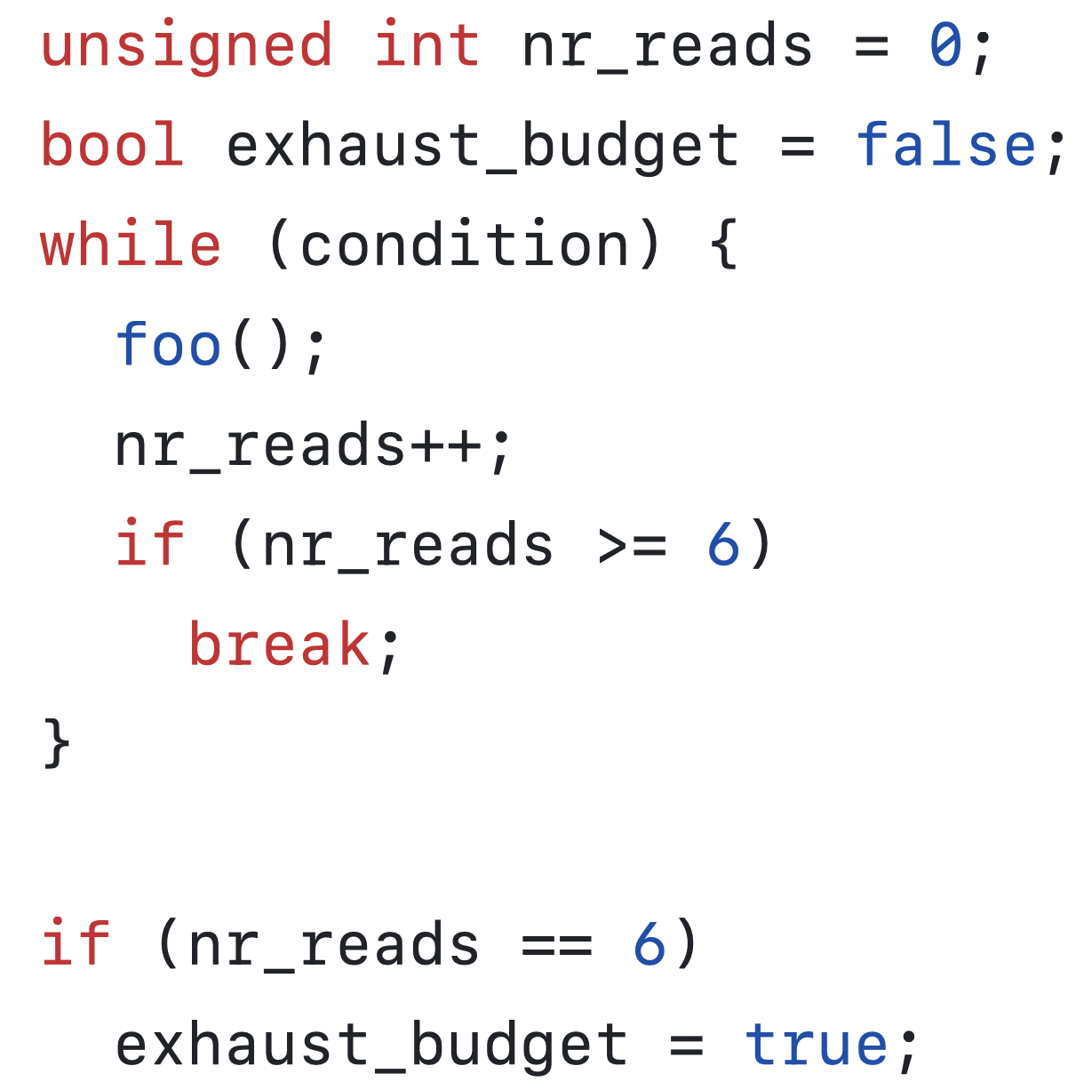

Slide 24
Transition Unit Size
Max (Full Sys)
A transition unit
can callout, so
stack inspection
is needed
Transition Time Increase
SS
CS
0
Stronger Guarantees
Version Atomicity
Version Atomicity &
Side Effect Safety

Slide 25
Single-Entry, Multiple-Exit
foo() {
int x = 0;
x++;
baz(); → exit
bar(&x); → exit
lifetime of x ends
return; → exit
}
bar(int *x) {
x -= CONST;
}

Slide 26






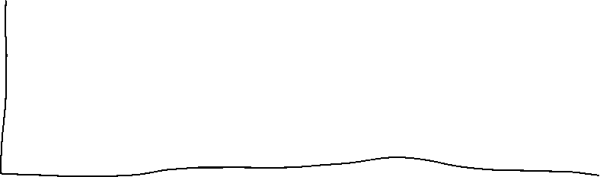




Slide 27
















return
Start, end, end, end
return

Slide 28
Const → math expression (!)
V,
IV
Expression(IV); find IV
IV → V
IV -- >
Seed instructions,
3 binary (V, V1, V2)
Seed, expression.
Compare expressions, → IV position, IV number
------------------------------------------------------------
V, V1, V2
IV, IV1,IV2
Linear
Expression(V);

Slide 29
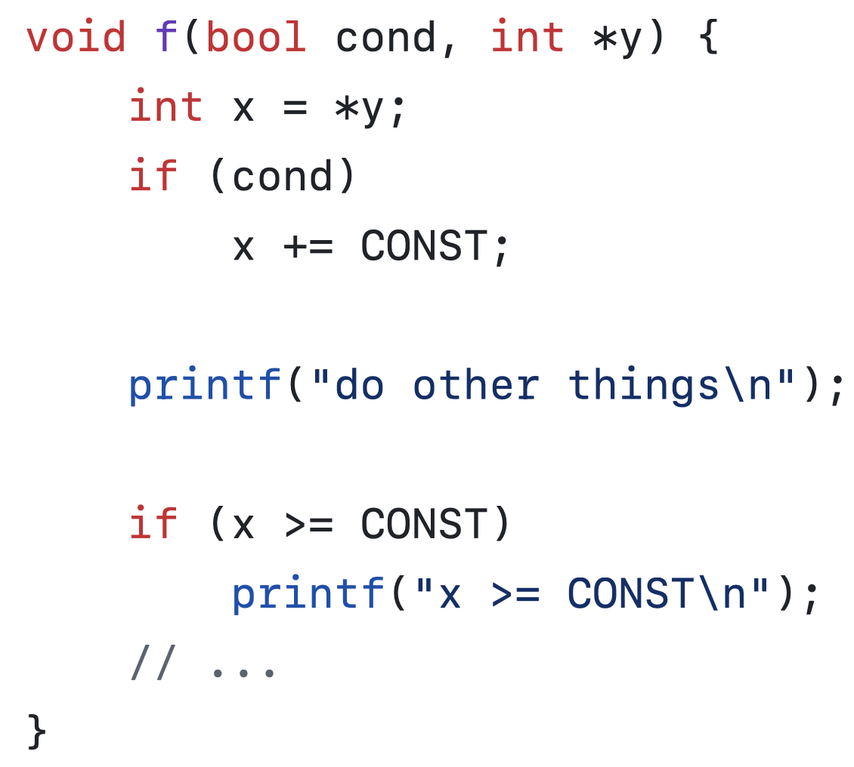

Slide 30
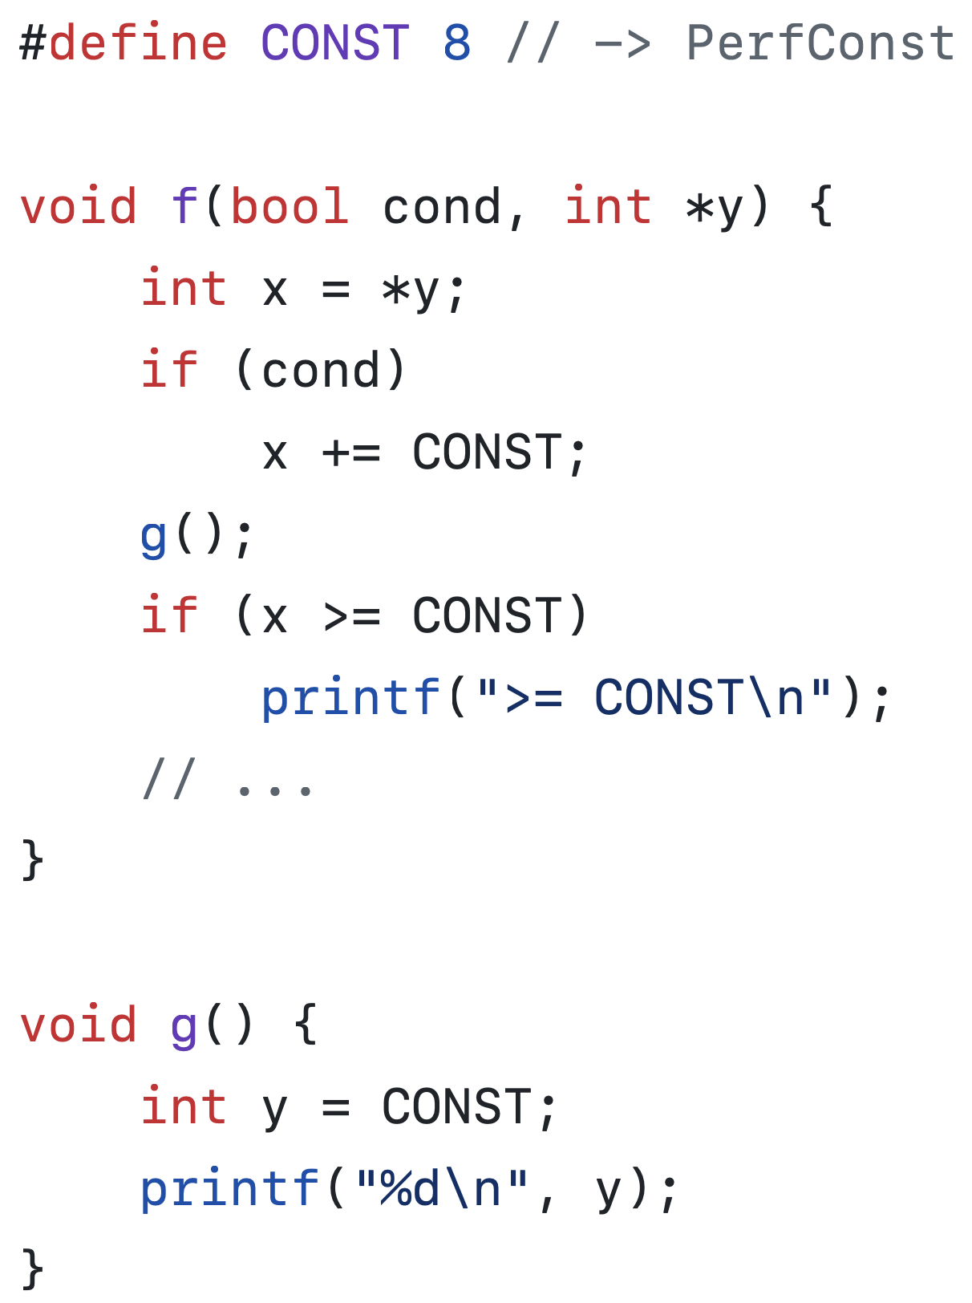

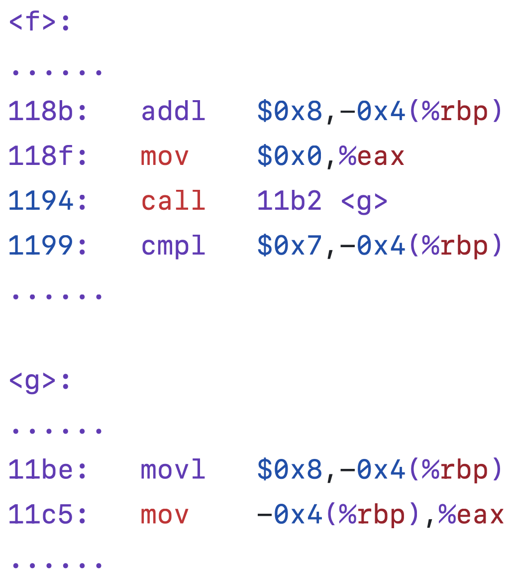

CS1 uses old value
CS2 uses new value
CS1
SS1
Depends
on
CS2
CS3
SS2
CS1 uses old value
CS2 uses new value

Slide 31









Slide 32
<line, token>
Kernel Source Code
ConstID | Val | Expression | CS | SS
Offline Porcessing
Kernel Binary
$ xk-gen ConstID xk-stub.c
Scope Table
Synthesize Indirections
User space
XK-stub
XK-tune
+Policy
$ xk-load xk-tune.o
Kernel space
Instructions
(Policy & SetVal)
Attach & Transition
CS
XK-runtime
Kernel Binary
Kprobe
redirection

Slide 33
<line, token>
Kernel Source Code
ConstID | Val | Expression | CS | SS | Status
Offline Processing
Kernel Binary
$ xk-gen ConstID Xk-stub.c
Scope Table
Synthesize Indirections
User space
Xk-stub
Xk-tune
+Policy
$ xk-load Xk-tune.o
Kernel space
Instructions
(Policy & SetVal)
Attach & Transition
CS
XK-runtime
Kernel Binary
Kprobe
redirection

Slide 34
<line, token>
Kernel Source Code
ConstID | Val | Expression | CS | SS | Status
Offline Processing
Kernel Binary
$ x-gen ConstID X-stub.c
Scope Table
Synthesize Indirections
User space
X-stub
X-tune
+Policy
$ x-load X-tune.c
Kernel space
Instructions
(Policy & SetVal)
Attach & Transition
CS
X-runtime
Kernel Binary
Kprobe
redirection
Notes:
arxiv

Slide 35
mov $0x8,0x170(%rbx)
add $0x1,%ebx
shl $0x2,%ebx
mov 0x4(%rsp),%eax
xor %ecx,%ecx
lea (%rax,%rax,4),%eax
add %eax,%eax
cmp $0xc8,%eax
mov $0x8,0x170(%rbx)
add $0x1,%ebx
shl $0x2,%ebx
mov 0x4(%rsp),%eax
xor %ecx,%ecx
lea (%rax,%rax,4),%eax
shl $0x2,%eax
cmp $0xc8,%eax
mov $0x8,0x170(%rbx)
add $0x1,%ebx
shl $0x2,%ebx
imul $0x22,0x4(%rsp), %eax
xor %ecx,%ecx
cmp $0xc8,%eax

Slide 36
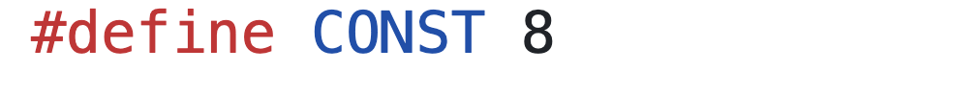
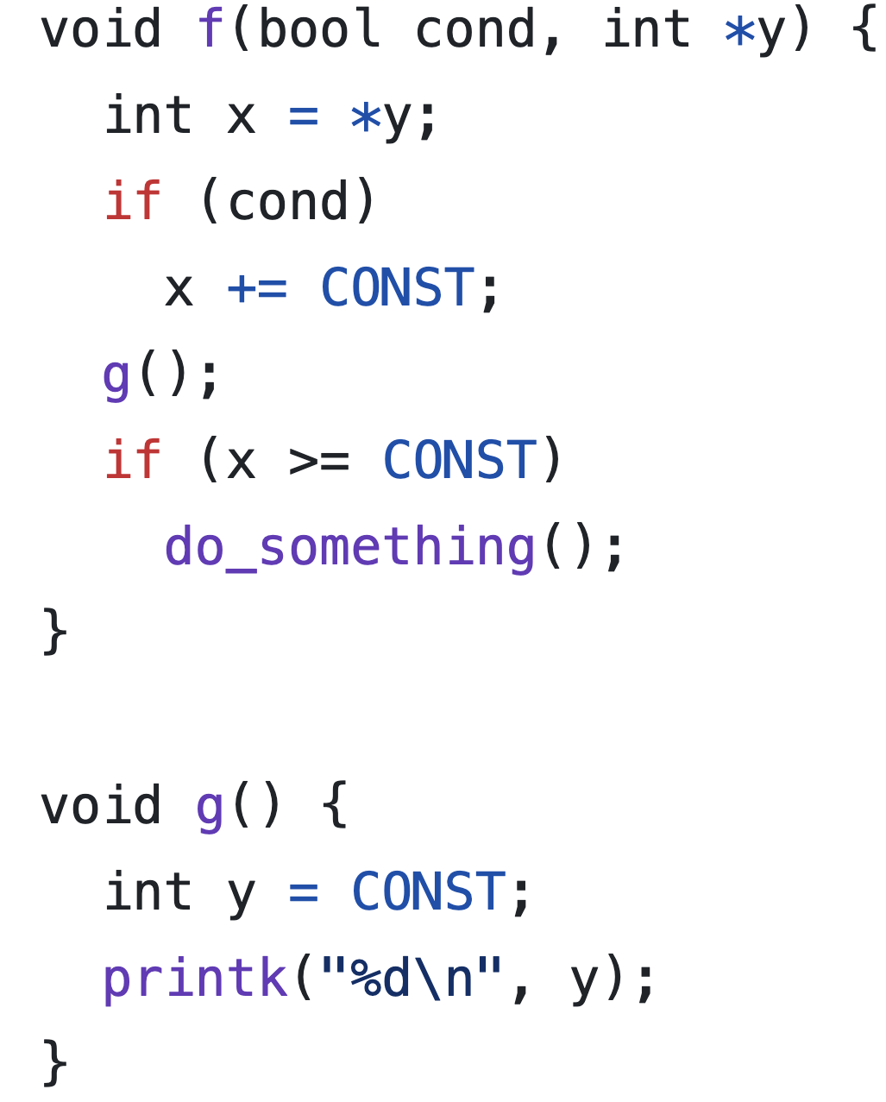
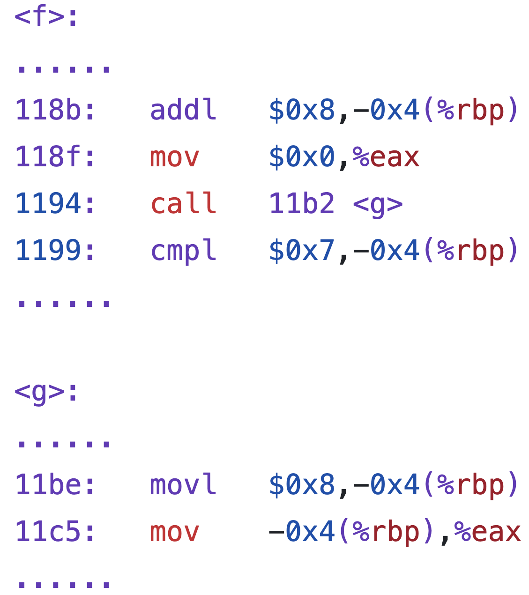
CS1 uses old value
CS2 uses new value
CS1
SS1
CS2
Depends
on
CS3
SS2
……
CS1 uses old value
CS2 uses new value

Slide 37
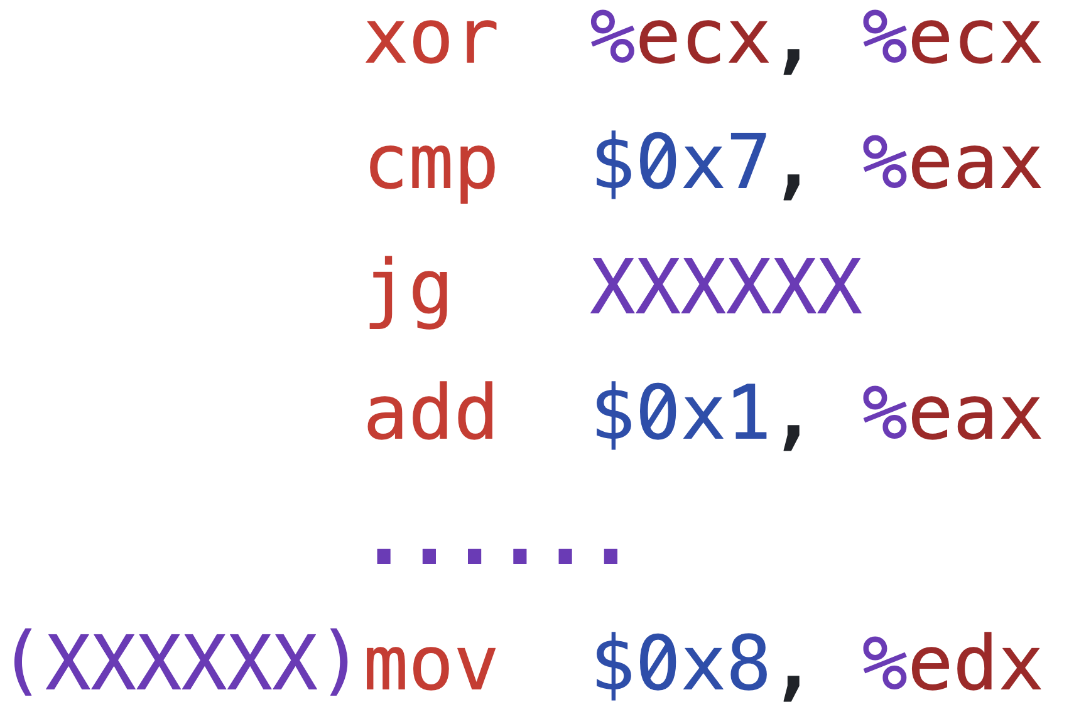
CS
SIE Indirection
Unoptimized
INT3
eflags = cmp(V’- %eax)
Optimized
JMP
push(eax)
eax = eax + 0x7 – V’
set_flag
JMP
if (flag)
eax = pop()
clear_flag
JMP
if (flag)
eax = pop()
clear_flag

